Slide 1



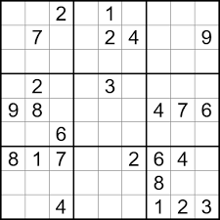

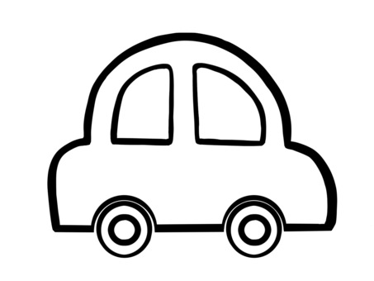
While we start, use the Annotate tool… have fun

Slide 2
Mindful Change Leadership Development Program
Week 8 (of 8)
June 10, 2024
Notes:
Leanne:
Good morning good afternoon everyone, First, I invite you to reflect on the land you are connecting from, and I would like to acknowledge that I am transmitting to you from the traditional Territory of the Anishnaabe Algonquin People; in Gatineau QC.
Please note that this session is being recorded. By remaining as a participant, we will interpret that as your consent to being recorded and we thank you for staying with us.
// Cette session est enregistrée. Nous interprétons le fait que vous demeurez en tant que participant comme votre consentement à faire partie de l’enregistrement. Nous vous remercions de votre collaboration
As today’s session is delivered in English, feel free to express yourself in the official language of your choice
// La session d'aujourd'hui étant dispensée en anglais, n'hésitez pas à vous exprimer dans la langue officielle de votre choix.
Please note there is French offering usually deliver during the Fall // Veuillez noter qu'il existe une offre française habituellement livrée à l'automne
Welcome to the last session of our program / Bienvenue tout le monde à la dernière session de notre programme

Slide 3

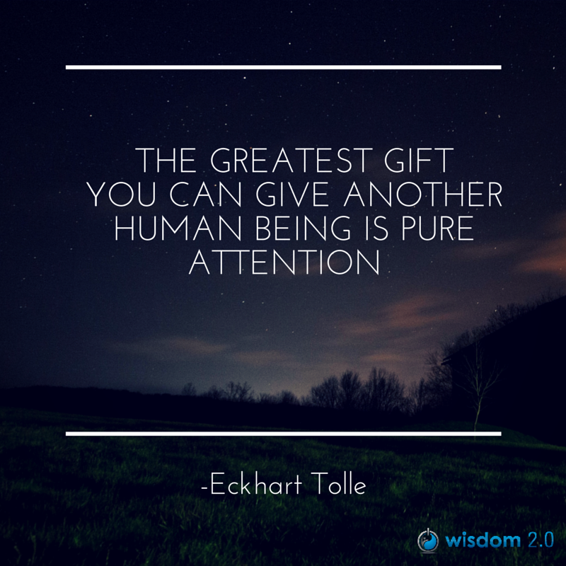
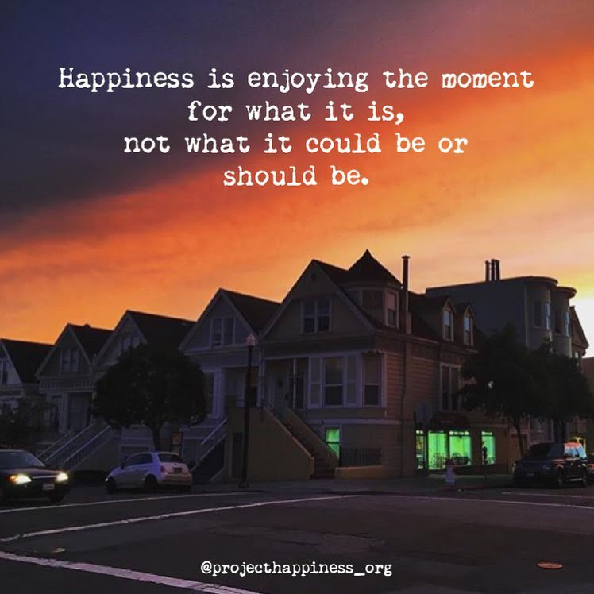
Welcome
Notes:
Leanne:
Prep French CC and font size
InBrief: The Science of Resilience https://www.youtube.com/watch?v=1r8hj72bfGo
Brains: Journey to Resilience - https://www.youtube.com/watch?v=HJvDrT6N-mw
Guided Mindfulness Meditation Connecting with Values - https://www.youtube.com/watch?v=V-LsavLI20w
Kevin Hart’s LoL video: https://www.youtube.com/watch?v=egjWRWOUME4
Open/Prep:
Convergence - https://wiki.gccollab.ca/Convergence
Clappling images - https://giphy.com/embed/7Xmgrc6ty9XlZU6h2M
what ya readin'? : Gccollab - https://gccollab.ca/discussion/view/20815944/what-ya-readin
Forms – need to be created
Also a copy of the self-assessment to create the “post-”

Slide 4


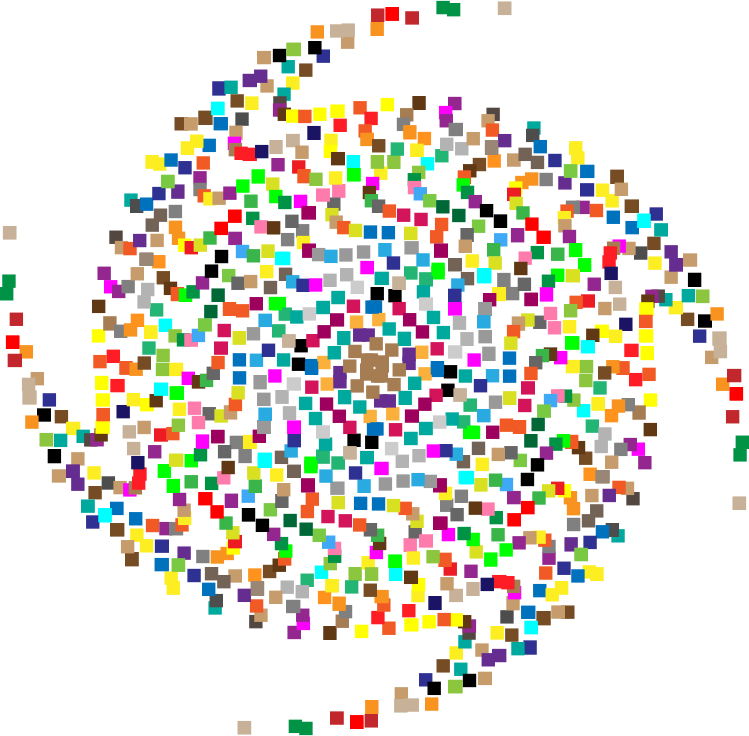
Mindful Self-Love Exercise – Centering
Notes:
Leanne:
For today’s centering exercise, we’ll use a slight variation…. Similar to previous ones, the idea is to shift from “doing” to “being”
Let’s start by doing the following...
Sit in a comfortable attentive position
It helps if you close or semi-close your eyes
Focus on your breathing…
and repeat any of the following phrases aloud or in your mind as they may feel right to you, in this moment…
(read them allowing space in between)
I am a kind person (Je suis amiable)
I love myself (Je m’aime)
I do my best (Je fais de mon mieux)
I am enough (je suis assez moi-même)
(Repeat once a minute over three to five minutes, then ask participants to…)
take a couple of deep breaths, slowly open their eyes, and return to the group session.

Slide 5






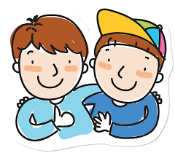
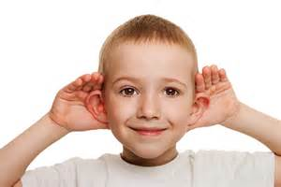





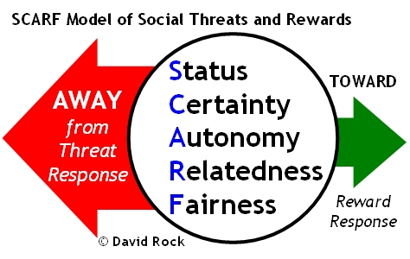

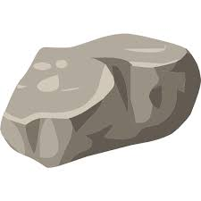

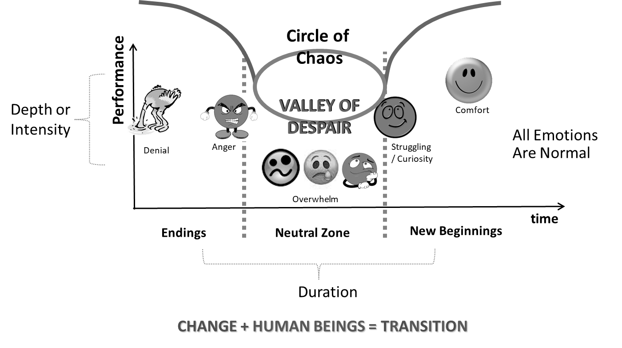
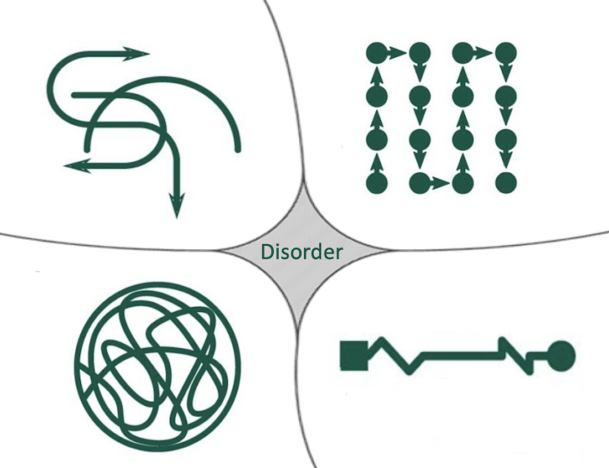





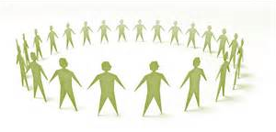

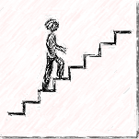
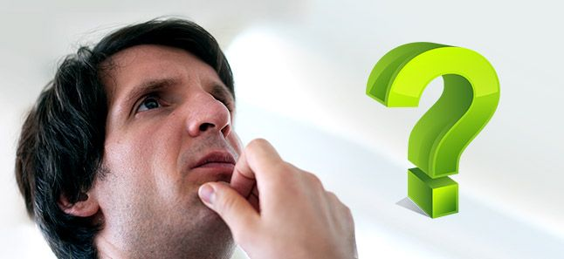

Questions/Insights from last week (7)
SBN-RR
Notes:
Leanne:
Plenary: Open mic to share your comments, challenges, surprises… particularly would like to hear from those who haven’t shared yet
the gratitude journaling
Your practice
Mindful Walking
Leadership Journal
Better Decision-making
Loving Kindness
Raise your hand to speak, type in the chat… be mindful about the time, let’s take as many as we can in about 10 mins.

Slide 6
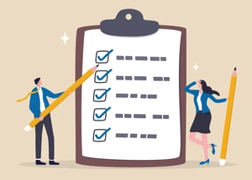
Agenda – week 8
Centering exercise
Questions/Insights from last week (7)
Today’s intentions: Focus, Compassion, Clarity, Creativity
Closing Remarks from IRCC Sponsor: Heather DeSantis
Resilience, Well-being & Mindfulness
Values & Mindfulness
Mindfulness on the spot
Some books, apps & other references
Self-Assessment Questionnaires – pre, post, final
Farewell & Reflections
Celebrate!
Notes:
Leanne:
((read the side))
((stop sharing the screen))
And now, I’ll pass the microphone to Heather DeSantis, Director General International Affairs, and co-champion Wellness and Mental Health at IRCC, and also sponsor of our program.
Heather, over to you
((restart sharing the screen))

Slide 7

Resilience, Well-being & Mindfulness
In Brief: The Science of Resilience
  Experience Positivity and Gratefulness
  Manage Stress
  Solve Problems
  Regulate Behaviour
  Plan Ahead
  https://www.youtube.com/watch?v=1r8hj72bfGo
Researchers found “individuals with higher mindfulness have greater resilience, thereby increasing their life satisfaction.” They note that resilience “can be seen as an important source of subjective well-being,” and point out many ways mindfulness can promote this state of mind.
https://greatergood.berkeley.edu/article/item/evidence_mounts_that_mindfulness_breeds_resilience
Notes:
Casey-Marie:
There is a link between Resilience Well-being & Mindfulness
(read the slide)
We’ll see a couple of videos on resiliency
Keep in mind, there will be a debrief in plenary and in small groups, if you feel like
(play both videos)
Resources in English…
In Brief: The Science of Resilience https://www.youtube.com/watch?v=1r8hj72bfGo
Brains: Journey to Resilience - https://www.youtube.com/watch?v=HJvDrT6N-mw
The 12 Inner Strengths for Lasting Well-being and Resilience - https://www.rickhanson.net/online-courses/the-foundations-of-well-being/inner-strengths-for-well-being/

Slide 8

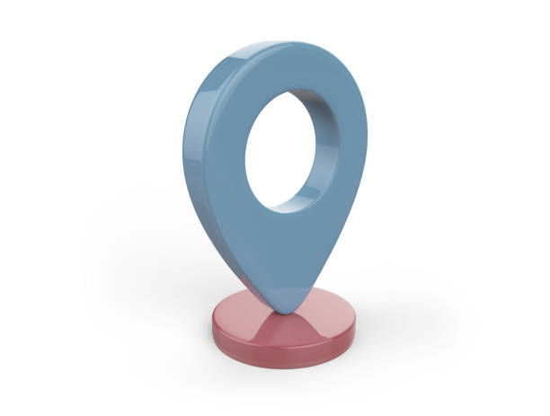
Mindfulness On The Spot… While:
Breathing, with or without sighing
Walking or running in the present
Saying “hi!”, “good morning!”, “how was your weekend?”
Joining an e-meeting
Showering
Washing dishes
Petting your pet
Making the bed
Cooking
Eating
Colouring
Any other th-ing?
https://www.centerforresilience.org/5-ways-to-practice-mindfulness-right-now
https://positivepsychology.com/meditation-exercises-activities/
https://www.thepathway2success.com/10-mindfulness-activities-you-can-try-today/
Notes:
Casey-Marie:
Similar to “Mindfulness on demand”
(Allow participants to use the marking tool)
Using the marking tool, indicate your preference for doing mindfulness on the spot
(mention an example of how I’m more present)
Being present, not because you need to be or you must be, but because you want to be ☺
Let’s now watch this video… 3.30mins Kevin Hart’s LoL video: https://www.youtube.com/watch?v=egjWRWOUME4
Resources in English…
https://www.centerforresilience.org/5-ways-to-practice-mindfulness-right-now
https://positivepsychology.com/meditation-exercises-activities/
https://www.thepathway2success.com/10-mindfulness-activities-you-can-try-today/

Slide 9

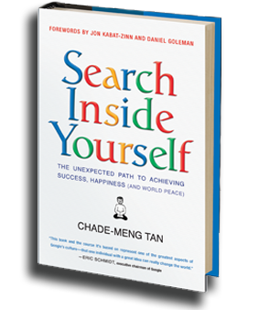

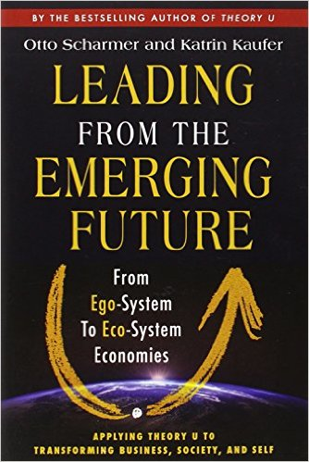
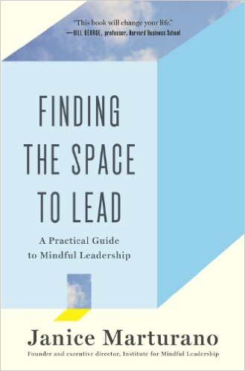



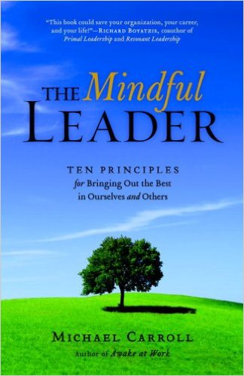
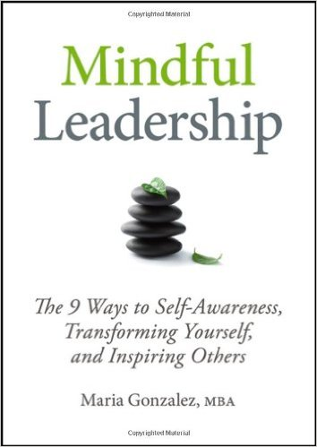



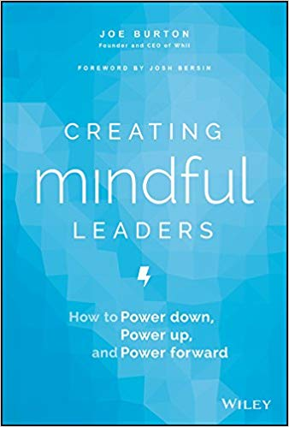
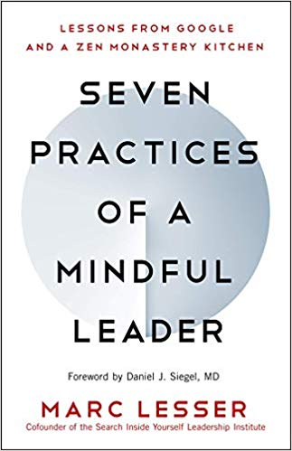
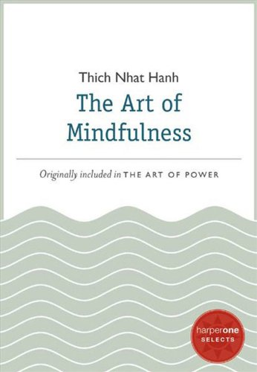
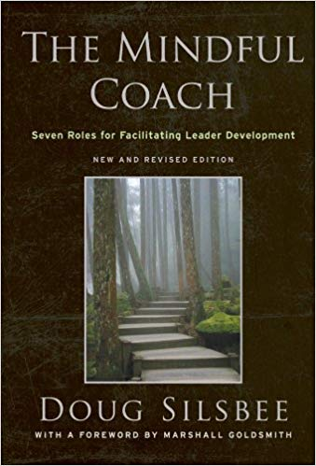
Some Book references
Notes:
Casey-Marie:
Please refer to the Cohort page, where carmen started a thread on « whatcha readin? »
Grateful that some of you have shared titles of books that work for you
(put on the chat the link and share the screen)
what ya readin'? : Gccollab - https://gccollab.ca/discussion/view/20815944/what-ya-readin
First row
https://www.amazon.ca/Search-Inside-Yourself-Productivity-Creativity/dp/0062116924
https://www.amazon.ca/Presence-Human-Purpose-Field-Future/dp/0385516304/
https://www.amazon.ca/Leading-Emerging-Future-Ego-System-Eco-System/dp/1605099260/
https://www.amazon.ca/Finding-Space-Lead-Practical-Leadership/dp/1620402475/
https://www.amazon.ca/Mindful-Leadership-Self-Awareness-Transforming-Inspiring/dp/1118127110/
https://www.amazon.ca/Joy-Demand-Discovering-Happiness-Within/dp/0062378872
Second row
https://www.amazon.ca/Self-Compassion-Proven-Power-Being-Yourself/dp/0061733520
https://www.amazon.ca/Mindful-Leader-Management-Mindfulness-Meditation/dp/1590306201/
https://www.amazon.ca/Mindfulness-Merloyd-Lawrence-Langer-Reprinted/dp/B00C6OOLR6/
https://www.amazon.ca/Eleven-Rings-Success-Phil-Jackson/dp/1594205116/
https://www.amazon.ca/Dare-Lead-Brave-Conversations-Hearts/dp/0399592520
Third row
https://www.amazon.ca/Mindful-Leader-Embodying-Christian-wisdom-ebook/dp/B07KJGHXDW/
https://www.amazon.ca/Creating-Mindful-Leaders-Power-Forward/dp/1119484782/
https://www.amazon.ca/Seven-Practices-Mindful-Leader-Monastery/dp/1608685195/
https://www.amazon.ca/Art-Mindfulness-HarperOne-Select-Selects-ebook/dp/B005HG4H24/
https://www.amazon.ca/Mindful-Coach-Facilitating-Leader-Development-ebook/dp/B00362XL64/

Slide 10
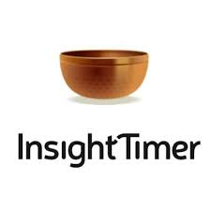







Some App references
Notes:
Casey-Marie:
Now a days, there are plenty of apps, you may have some in your smartphone
A hint of caution when using them, don’t lose yourself in trying this, and trying that… pick one, stick to it for a week and decide if you like it enough. At that point make a conscious decision and try another one for a week.
References to some apps:
https://calm.com/
https://www.headspace.com/
https://happify.com/
https://www.balanceapp.com/
https://insighttimer.com/en-ca - https://insighttimer.com/fr-ca
(veteran affairs, USA) https://mobile.va.gov/app/mindfulness-coach
https://www.thetappingsolution.com/

Slide 11

Values & Mindfulness
Love
Respect
Courage
Honesty
Wisdom
Humility
Truth
Reverence For Life
True Happiness
True Love
Loving Speech and Deep Listening
Nourishment and Healing
Respect for Democracy
Respect for People
Integrity
Stewardship
Excellence
https://www.southernnetwork.org/site/seven-teachings
https://plumvillage.org/mindfulness/the-5-mindfulness-trainings/
https://www.tbs-sct.canada.ca/pol/doc-eng.aspx?id=25049
Notes:
Casey-Marie:
Mindfulness is science based, and as with science it can be used for bad things and for good things. So when mindfulness is combined with your own values the outcomes are positive and enhanced
The three columns are examples of values, from indigenous traditions, from secular traditions, and from the PS
Let’s do this mindfulness exercise, it lasts about 8 mins: Guided Mindfulness Meditation Connecting with Values - https://www.youtube.com/watch?v=V-LsavLI20w
A hint… when in doubt, I usually ask myself “What would someone who loved themselves do?”
Resources in English…
Indigenous traditions: The Seven Teachings - https://www.southernnetwork.org/site/seven-teachings
http://www.turtlelodge.org/the-seven-sacred-laws-animated-web-series-anishinaabe/
Buddhism The Five Mindfulness Trainings - https://plumvillage.org/mindfulness/the-5-mindfulness-trainings/
Values and Ethics Code for the Public Sector of Canada - https://www.tbs-sct.canada.ca/pol/doc-eng.aspx?id=25049

Slide 12

Convergence
A page dedicated to leverage the various sessions offered by, and to, Government employees
Sessions offered:
Mindfulness Meditation – ISC/CIRNAC, BC
Mindfulness, Workplace Well-being – PSPC, NCR
Adaptive Inquiry session – IOCN, BC & NCR
https://wiki.gccollab.ca/Convergence
Notes:
Dani:
Mindfulness Meditation – ISC/CIRNAC, BC
Is a 30 minutes weekly session on Thursdays, @ noon PT
Mindfulness, Workplace Well-being – PSPC, NCR
Is delivered twice a day, 8am ET and 12:50pm ET, quick 7 minutes long sessions each
Adaptive Inquiry session – IOCN, BC & NCR
After a long pause, they’re about to start again. You may have seen a couple of recent invitations via the cohort
these sessions are an hour long, and they are like having a sounding board for someone facing a challenge, helping them open up their perspective to the issue or problem.
If you know of a session similar to these ones, please let Alejandro know and we’ll see if they want to be listed in this page.
Resources:
Convergence - https://wiki.gccollab.ca/Convergence

Slide 13
And other references…
Settle Down, Pay Attention, Say Thank You
- https://my.happify.com/hd/3-ways-to-live-mindfully -
What Is Mindfulness? “Presence of Heart” – A Definition – https://greatergood.berkeley.edu/topic/mindfulness/definition
Why Mindfulness Is a Superpower – An Animation https://www.youtube.com/watch?v=w6T02g5hnT4
The 12 Inner Strengths for Lasting Well-being and Resilience - https://www.rickhanson.net/online-courses/the-foundations-of-well-being/inner-strengths-for-well-being/
Meditate With Kevin Hart| LoL Network - https://www.youtube.com/watch?v=egjWRWOUME4
Notes:
Dani:

Slide 14
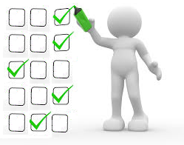
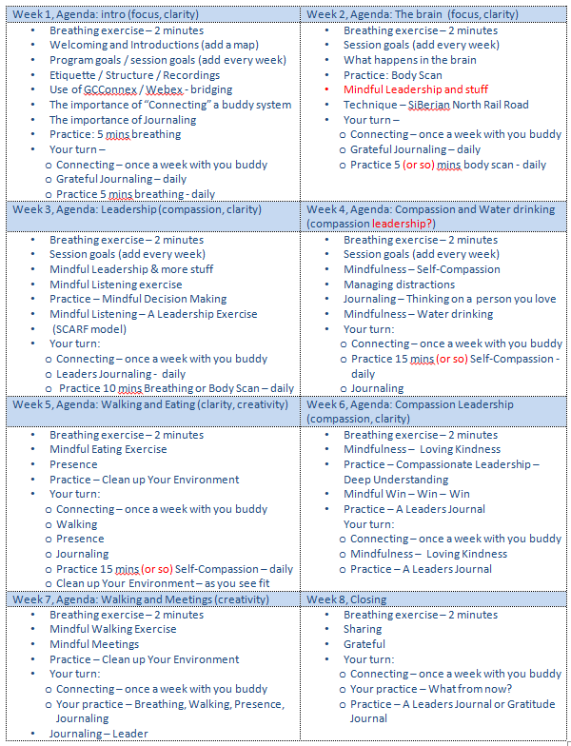
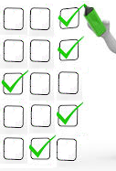

Self Assessment Questionnaires
– pre, post, final
Your self-assessments are very important,
they help report on the results of the program
You’ll receive the post-assessment today
And 3 months after today, you’ll receive the
Final Assessment
pre
post
final
★
3 months after
time
Activity
retention
How much is applied
(Behaviours changed)
Benchmark
Notes:
Dani:
(Click on each bullet)
The pre self-assessment you filled out to register for the program, it helps by establishing a benchmark
We are now completing the 8 weeks; the start shows where we are
The post self-assessment is used to identify the knowledge based on the activity retention
The final self-assessment is used to know how much of the learning is actually applied, as in applying the skills and/or behaviours changed
(Read slide)
Now, as we start closing the program, Let’s take a couple of minutes for you to answer the poll (open the poll)

Slide 15
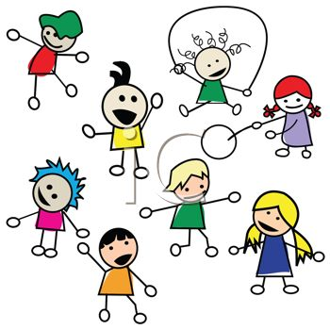


Prepping your Farewell
Think what you’d like to share, maybe
a quick thought or a phrase
Saying good bye in small groups
Notes:
Dani:
In prepping for the farewells, we’ll have time to say good bye in plenary –maybe 2 or 3 participants, and all of us in small breakout rooms
An idea: You may want to share a quick thought or a phrase you feel like sharing
Before, some had asked, but in breakout rooms I may find someone I haven’t met during the whole program… and that’s exactly it, we all have come together for 8 weeks during this program.
What about the Buddy System? You may meet with your buddies to do a celebration on your own ☺

Slide 16

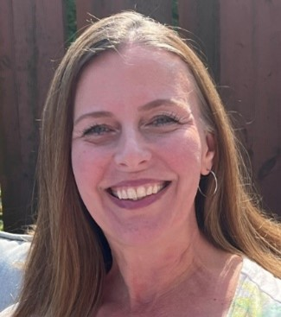
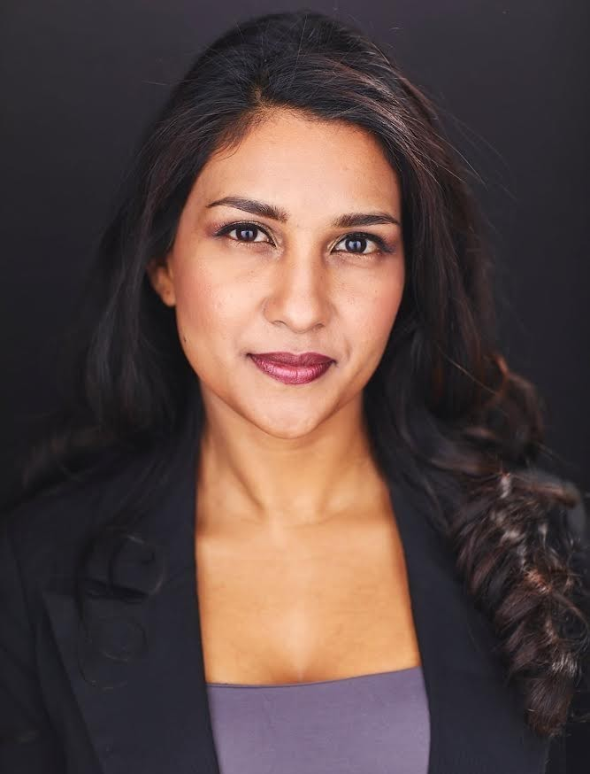
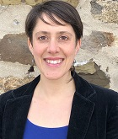
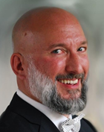
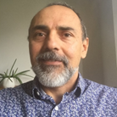
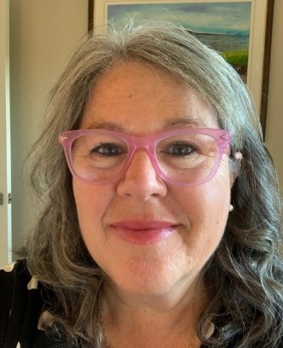
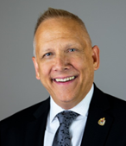
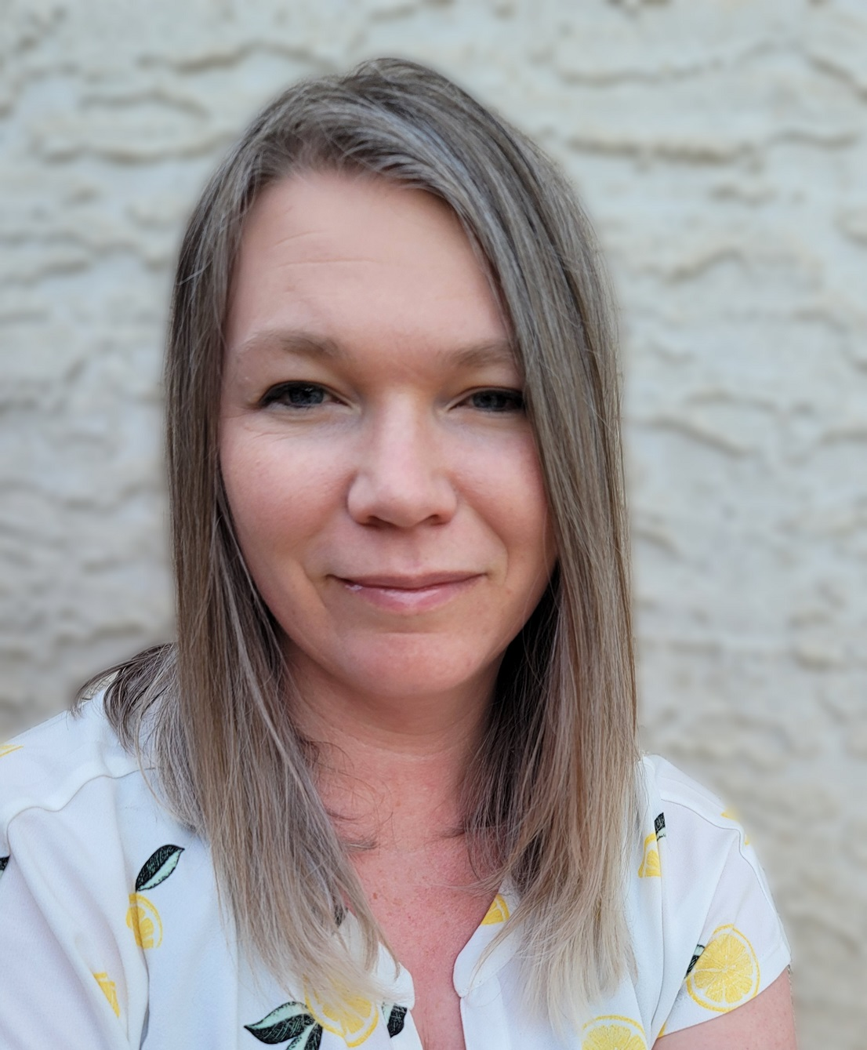
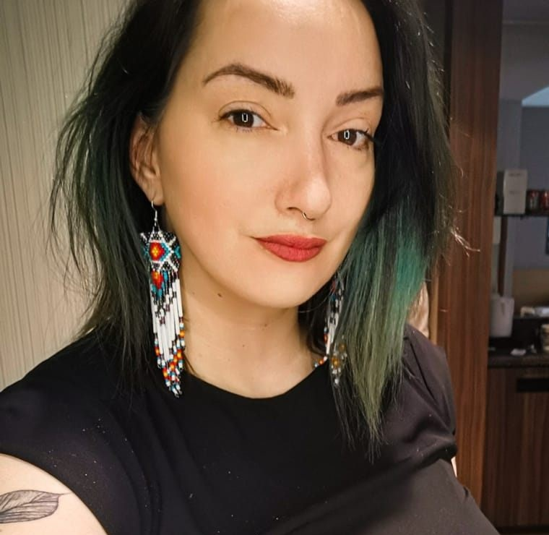
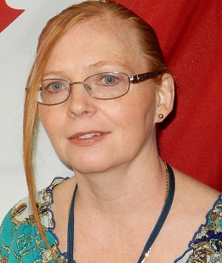
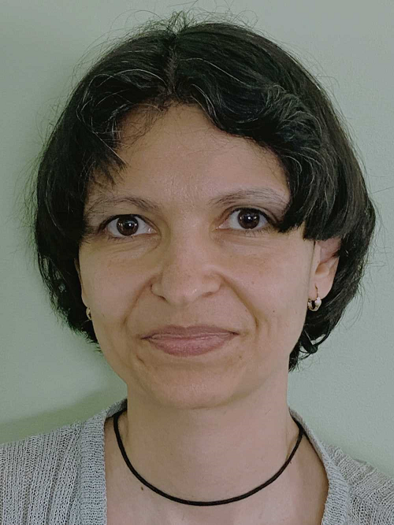

to the team of volunteering facilitators
Ginette
Casey-Marie
Annie-Claude
Carmen
Alejandro
Marie-Lyne
Robert
Michelle
Dani
Leanne
Galina
… and others…
Notes:
Dani:
Understanding some of the facilitators couldn’t make it to today’s session, I’ll invite the facilitators from this and previous co-horts, to come to the microphone and share a thought about the program and particularly how the experience of co-deilvering the program has been?
Who would like to go?
((look for facilitators and give them the microphone))
((as a reference… no need to mention this list
Here a partial list of facilitators from various government Departments/Agencies, including:
Service Canada
Office of the Secretary to the Governor General
Indigenous Services Canada
Public Services and Procurement Canada
Financial Transactions and Reports Analysis Centre of Canada
Canada Border Services Agency
Treasury Board of Canada Secretariat
Canada Revenue Agency
Immigration, Refugees and Citizenship Canada
))

Slide 17

Reflect about today’s exercises
Notes:
Alejandro:
As usual, you’ll have time to debrief in small groups (of 4-6), here are some prompts for your sharing in small groups:
Resiliency
Value-based Mindfulness
Mindfulness on the spot
Resources
Farewells
(depending on time, open the mic for plenary sharing for 2 or 3 participants):

Slide 18

Mindful Change Leadership Development (MCLD)
Our Goal:
…to increase self-awareness by developing key skills:
Focus,
Clarity,
Creativity, and
Compassion in the service of others…
with a positive impact on well-being and resiliency.
Notes:
Alejandro:
Remembering the goal of this program is to (read slide)
((Share the MSForms evaluation link))

Slide 19





Success
Do you think we succeded?
Notes:
Alejandro:
Clapping images - https://giphy.com/embed/7Xmgrc6ty9XlZU6h2M
((Share the MSForms evaluation link))

Slide 20
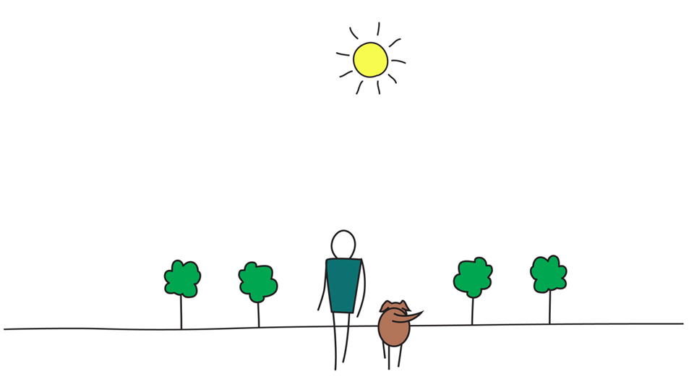

Be Mindful, Be Happy
Notes:
Alejandro:
Thanks everyone for participating in this program… we wish you happiness ☺

