Slide 1



Brought to you by the Diversity and Inclusion Office, Materiel Group, National Defence
Notes:
We are thrilled to be with you today to introduce you to the Lifting as you Lead Mentoring Circles program - commonly referred to as LLMC.
LLMC is a one-of-a-kind program created by the Diversity and Inclusion Office within the Materiel Group, National Defence with the intent to make a difference in the Federal Public Service. It is the largest group mentoring program for members of the Federal Public Service, Defence Team, and Crown Corporations helping participants pursue both personal and professional growth.
Over 1,000 people from 60 organizations graduated from last year’s program and we hope to continue the momentum of elevating our leadership for the program’s 5th cohort.
Registration is open now until May 31st.

Slide 2

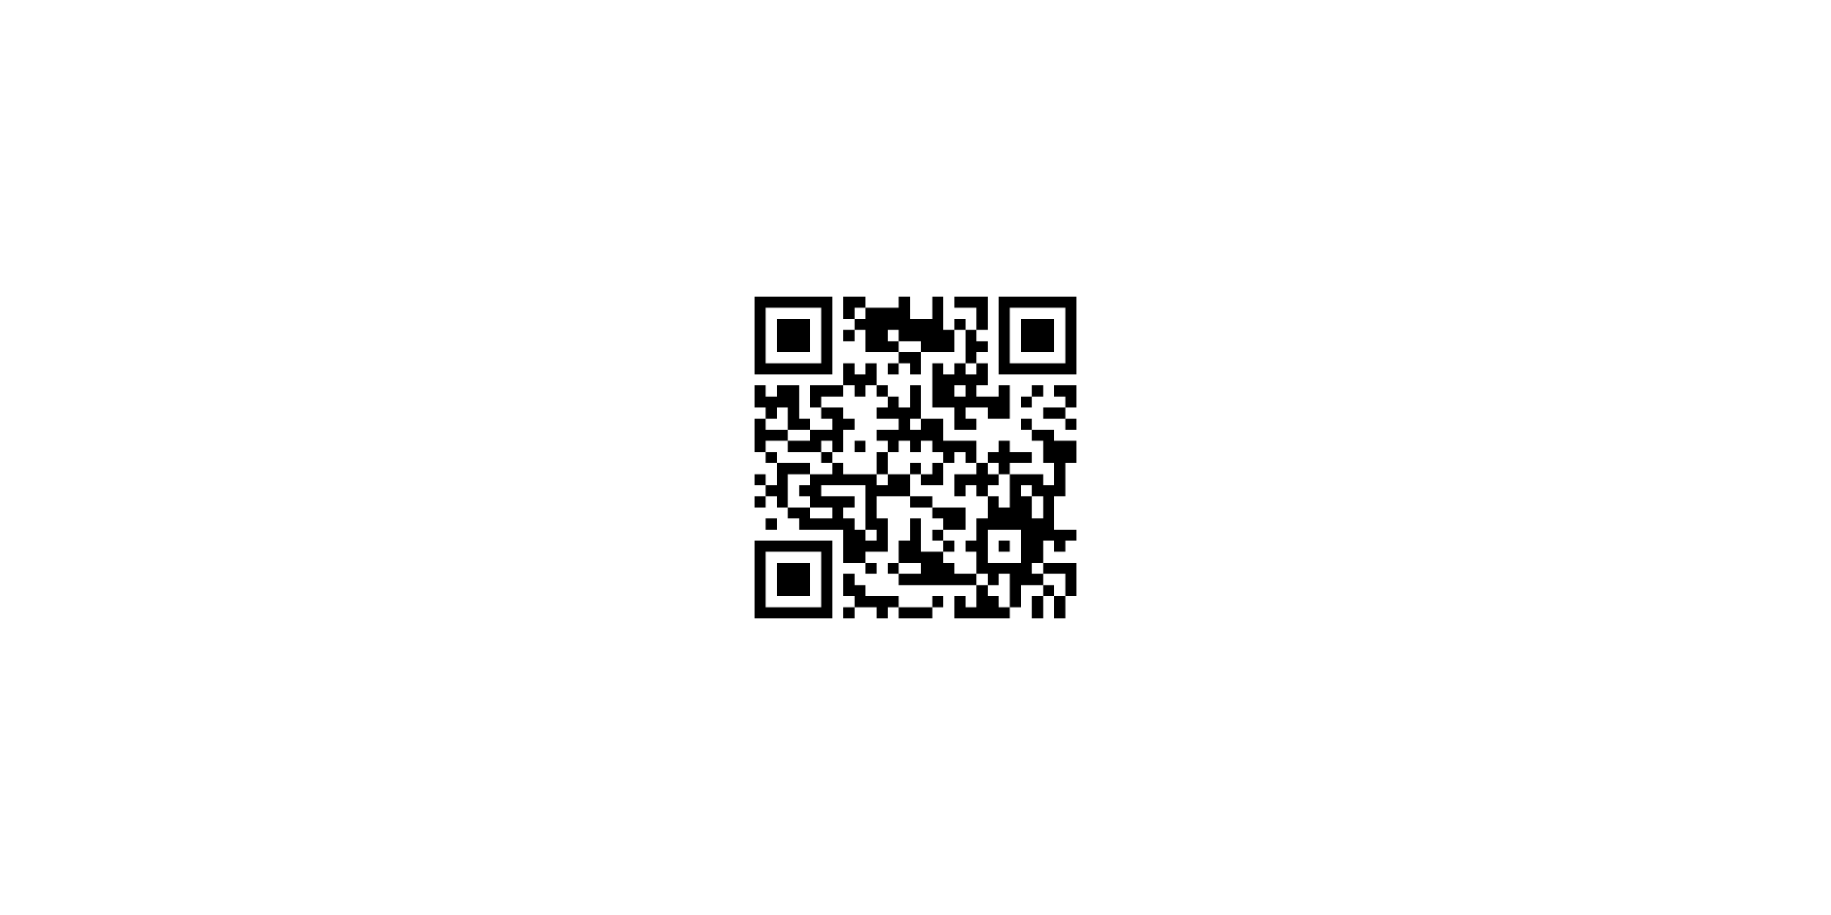

Your Health Comes First
Your Health Comes First
Your HEalth Comes First
Hope for Wellness Helpline
1-855-242-3310
Employee Assistance Program (EAP)
Toll-free: 1-800-268-7708
For persons with hearing impairments:
1-800-567-5803
For more resources visit our Support Resources wiki page:
Notes:
Before we begin today’s meeting, let's do a check-in. The intent of LLMC is to have safe conversations about important subjects that will help transform the Federal Public Service by creating diverse and inclusive, psychologically safer workplaces.
The subjects may be difficult for some people to discuss. If at any point during this event you feel that you need to step away, you may leave to protect your mental health.
Your health comes first.
If you need to talk to someone, whether before, during, or after the event, there is support available to you 24/7.
Please note the contact information on this slide and in the chat.
Now let’s allow some time to reflect during our land acknowledgement.

Slide 3


Land Acknowledgment
We acknowledge that our offices are located in Ottawa, are on the unceded, unsurrendered Territory of the Anishinaabe Algonquin Nation whose presence here reaches back to time immemorial.
The Algonquins are the customary keepers and defenders of the Ottawa River Watershed and its tributaries. We honour their long history of welcoming many Nations to this beautiful territory and uphold and uplift the voices and values of our Host Nation.
We respect and affirm the inherent and Treaty Rights of all Indigenous Peoples across this land.
We recognize the historical oppression of original lands, cultures and peoples in what we now know as Canada and strongly believe that the arts contribute to the journey of healing and decolonization that we all share together.
This acknowledgment only becomes meaningful when combined with accountable relationships and informed actions. This acts only as a first step in honouring the unsurrendered land we operate on.
We continue to honour the people, elders, and Indigenous ancestors of this land.
Notes:
[The provided land acknowledgement was developed by members of the Algonquin community for use in Ottawa. Please feel free to add your own if you’d like.]
We acknowledge that our offices are located in Ottawa, are on the unceded, unsurrendered Territory of the Anishinaabe Algonquin Nation whose presence here reaches back to time immemorial.
The Algonquins are the customary keepers and defenders of the Ottawa River Watershed and its tributaries. We honour their long history of welcoming many Nations to this beautiful territory and uphold and uplift the voices and values of our Host Nation.
We respect and affirm the inherent and Treaty Rights of all Indigenous Peoples across this land.
We recognize the historical oppression of original lands, cultures and peoples in what we now know as Canada and strongly believe that the arts contribute to the journey of healing and decolonization that we all share together.
This acknowledgment only becomes meaningful when combined with accountable relationships and informed actions. This acts only as a first step in honouring the unsurrendered land we operate on.
We continue to honour the people, elders, and Indigenous ancestors of this land.
Please take a moment to identify and reflect on the territories on which you reside and work. If you are unsure, please visit native-land.ca

Slide 4

Lifting as you Lead Mentoring Circles (LLMC):
An Introduction
https://youtu.be/Ns9AP3TP_6U
Notes:
Lifting as you Lead Mentoring Circles (LLMC): An Introduction
To start our event today, we will first take a few moments to meet LLMC’s Founder, Samantha Moonsammy, and some LLMC graduates to learn how this program has supported their personal and professional growth.
[Play LLMC Promotional Video]

Slide 5

Agenda
1
What makes LLMC unique
2
How LLMC works
3
How you can become apart of this groundbreaking initiative
Notes:
During our time together today, we are going to explore:
What makes LLMC unique
How LLMC works
How you can become a part of this groundbreaking initiative

Slide 6
Brought to you by the Diversity and Inclusion Office, Materiel Group, National Defence
Notes:
[Self-introduction. Feel free to include anything you would like to share, why you decided to talk about the LLMC today, your links with the programme or your experience of the programme]

Slide 7
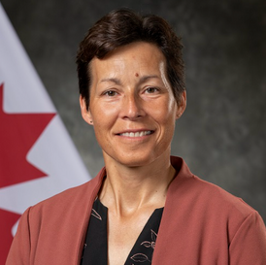

Lifting as you Lead is brought to you by
The Diversity and Inclusion Office
Materiel Group, National Defence
Samantha Moonsammy created the Lifting as you Lead Mentoring Circles program (LLMC) in 2021 in response to conversations with the people at National Defence’s Materiel Group that highlighted their desire to build connections with their colleagues, contribute more, and find career opportunities.
However, to make truly meaningful change, she knew that LLMC needed to be a collective effort. By expanding the program to include the Defence Team, other government departments, and crown corporations, LLMC is breaking down silos and fostering collaboration across the public sector. With the unwavering support of Materiel Group’s Assistant Deputy Minister, Nancy Tremblay, this strategic approach strengthens our leadership ecosystem, brings fresh perspectives into decision-making, and drives innovation at all levels.
Nancy Tremblay
Assistant Deputy Minister, Materiel, National Defence
Samantha Moonsammy
Diversity and Inclusion,
Materiel, National Defence
Notes:
LLMC is an interdepartmental program that is brought to you by the Materiel Group at National Defence.
Samantha Moonsammy created the Lifting as you Lead Mentoring Circles program (LLMC) in 2021 in response to conversations with the people at National Defence’s Materiel Group that highlighted their desire to build connections with their colleagues, contribute more, and find career opportunities.
However, to make truly meaningful change, she knew that LLMC needed to be a collective effort. By expanding the program to include the Defence Team, other government departments, and crown corporations, LLMC is breaking down silos and fostering collaboration across the public sector. With the unwavering support of Materiel Group’s Assistant Deputy Minister, Nancy Tremblay, this strategic approach strengthens our leadership ecosystem, brings fresh perspectives into decision-making, and drives innovation at all levels.

Slide 8

Lifting as you Lead
Mentoring Circles (LLMC)
Approximately 75% of leaders say mentoring played a key role in their success. (Gallup, March 2022 Study)
LLMC is a free group mentorship program that is breaking down barriers across our organizations to provide opportunities for all Canada Public Service and Defence Team members, from students to executives, to advance their careers.
Since its debut in 2021, LLMC has elevated the careers of over 2,500 participants, playing a vital role in creating inclusive leaders who create innovative workplaces, advocate for change, and take care of the people-side of business.
Notes:
Did you know that according to a study done by Gallup in 2022 that 75% of leaders say mentoring played a key role in their success?
LLMC is a free group mentorship program that is breaking down barriers across our organizations to provide opportunities for all Canada Public Service and Defence Team members, from students to executives, to advance their careers.
Since its debut in 2021, LLMC has elevated the careers of over 2,500 participants, playing a vital role in creating inclusive leaders who create innovative workplaces, advocate for change, and take care of the people-side of business.

Slide 9

Program Overview
Starting in September 2025, LLMC is a free 10-week inclusive leadership development program that focuses on immersive learning in a group mentoring setting.
We offer:
Small group mentoring circles for an immersive learning experience;
Masterclass sessions to get you real-time leadership skills you can directly implement in your organization; and
Ongoing opportunities to build your network of supportive mentors.
Notes:
Starting in September 2025, LLMC is a free 10-week inclusive leadership development program that focuses on immersive learning in a group mentoring setting.
LLMC offers:
Small group mentoring circles for an immersive learning experience;
Masterclass sessions to get you real-time leadership skills you can directly implement
in your organization; and
Ongoing opportunities to build your network of supportive mentors.

Slide 10

Why Group Mentoring?
Unique to LLMC is our collaborative group approach, making it the perfect complement to your existing one-on-one mentorship program.
At LLMC everyone is a mentor; including YOU.
Traditional mentoring:
one-on-one;
one-way; and
unstructured.
Mentoring Circle:
an entire team of trustworthy mentors;
reciprocal exchange;
discussion guidance; and
efficient expansion of your network.
Notes:
Unique to LLMC is our collaborative group approach, making it the perfect complement to your existing one-on-one mentorship program.
At LLMC everyone is a mentor; including YOU.
Traditional mentoring is typically one-on-one, one-way, and unstructured.
Whereas in a Mentoring Circle, you get an entire team of trustworthy mentors, reciprocal exchange, discussion guidance, and efficiently expand your network.

Slide 11

A Win-Win for Your Organization
Beyond its value as a leadership development initiative, LLMC is also a strategic investment that directly contributes to organizational success.
The far-reaching benefits include:
Strengthening our leadership pipeline by developing future-ready leaders;
Enhancing values-based leadership and creating a
respectful workplace;
Improving talent retention and engagement through a supportive learning culture that increases job satisfaction and reduces turnover;
Scalable and cost-effective career development that maximizes impact with minimal resources; and
Transfer of institutional knowledge that prevents the loss of expertise.
Notes:
Beyond its value as a leadership development initiative, LLMC is also a
strategic investment that directly contributes to organizational success.
The far-reaching benefits include:
-Strengthening our leadership pipeline by developing future-ready leaders;
-Enhancing values-based leadership and creating a respectful workplace;
-Improving talent retention and engagement through a supportive learning culture that increases job satisfaction and reduces turnover;
-Scalable and cost-effective career development that maximizes impact with minimal resources; and
-Transfer of institutional knowledge that prevents the loss of expertise.

Slide 12

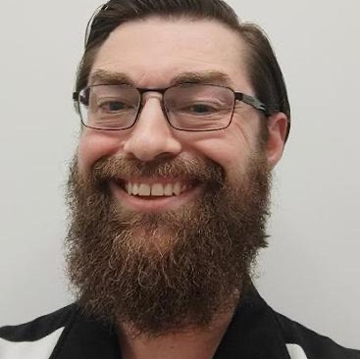

What Graduates Are Saying
Elevate
Connect
“The program was . . . an experience that every public servant should have the chance to partake in. I think it really opens eyes - and often - doors.”
“LLMC has been very helpful to me in developing the skills and confidence to make strides in my career and think more strategically. It has already paid off for me in many ways.”
Inspire
“It's been empowering, I now know how to navigate through my career progression and use tools available to speed up the process.”
Notes:
The pillars of LLMC are Connect, Elevate, and Inspire.
Connect: LLMC strives to build connection through our networks to create a level of psychological safety and belonging.
Elevate: This program elevates participants by facilitating personal and professional growth through insightful discussions.
Inspire: LLMC inspires people by fostering a strong sense of belonging. We bring people together with others who have experienced similar struggles and with those who can lift them higher. It creates brave spaces, nurturing a profound sense of belonging for all participants, and advocates for the advantages of a diverse, equitable, and inclusive workplace.
Here we have a few quotes from LLMC graduates on how this program connected, elevated, and inspired them.
Connect: “The program was . . . an experience that every public servant should have the chance to partake in. I think it really opens eyes - and often - doors.”
Elevate: “LLMC has been very helpful to me in developing the skills and confidence to make strides in my career and think more strategically. It has already paid off for me in many ways.”
Inspire: “It's been empowering, I now know how to navigate through my career progression and use tools available to speed up the process.”

Slide 13
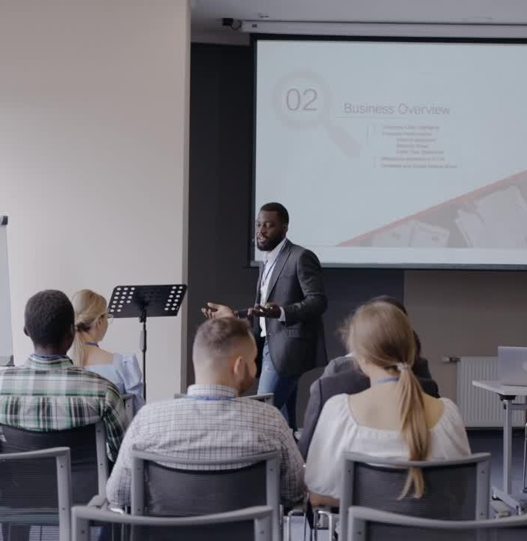
Masterclasses
Every other week, LLMC participants will attend masterclasses led by subject matter experts specializing in critical leadership skills. All sessions are 90 minutes long, recorded, and are accompanied by a Learning Library to guide self-learning and reflection.
Masterclass topics:
Inclusive Leadership
Mastering the Art of Negotiation
Sponsorship and Career Building
Diversity, Equity, Inclusion, and Accessibility:
A Non-Performative Approach
Confidence: The Science of Conquering Self-Doubt
Notes:
Now let’s break down the three main components of LLMC’s program, starting with the Masterclasses.
Every other week, LLMC participants will attend masterclasses led by subject matter experts specializing in critical leadership skills. All sessions are 90 minutes long, recorded, and are accompanied by a Learning Library to guide self-learning and reflection.
Masterclass topics:
-Inclusive Leadership
-Mastering the Art of
-Negotiation
-Sponsorship and Career Building
-Diversity, Equity, Inclusion, and Accessibility: A Non-Performative Approach
-Confidence: The Science of Conquering Self-Doubt

Slide 14
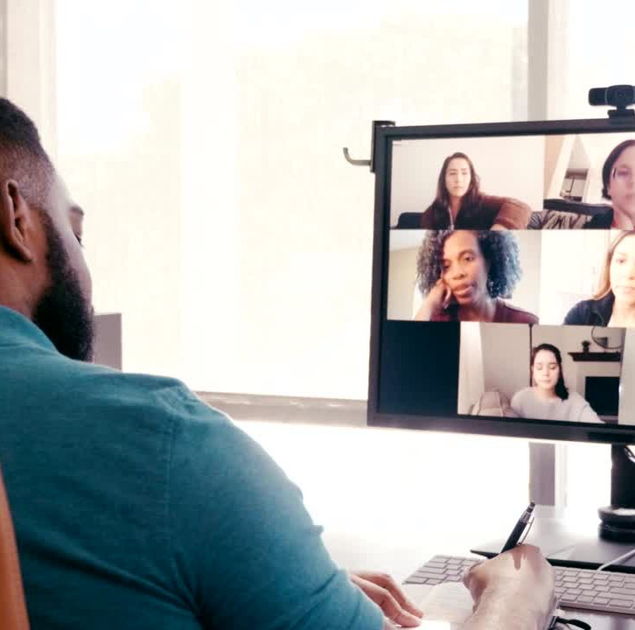
Mentoring Circles
On alternate weeks from masterclasses, LLMC participants meet with their circle for 90 minutes.
The circle format offers a confidential and supportive environment for members to learn from one another's experiences and perspectives with the support of discussion guides. The guides are designed to complement and enhance the masterclasses, providing hands-on tools to support participants in overcoming barriers.
Participating in your circle will give you more time to explore the leadership topics studied in the masterclasses, further expanding your knowledge and practical skills.
Notes:
Following the masterclasses are what makes LLMC truly unique, the small group Mentoring Circles.
On alternate weeks from masterclasses, LLMC participants meet with their circle for 90 minutes.
The circle format offers a confidential and supportive environment for members to learn from one another's experiences and perspectives with the support of discussion guides. The guides are designed to complement and enhance the masterclasses, providing hands-on tools to support participants in overcoming barriers.
Participating in your circle will give you more time to explore the leadership topics studied in the masterclasses, further expanding your knowledge and practical skills.

Slide 15

Lounges
In addition to LLMC’s core programming, we offer a weekly, one-hour LLMC Lounge as an optional opportunity to expand your network of supportive mentors beyond your circle.
Open to all participants, LLMC Lounges:
Follow an open-ended format;
Facilitate reflection on small group experiences; and
Provide an additional opportunity to connect with masterclass teachers.
Notes:
In addition to these two main components of LLMC are the Lounges.
In addition to LLMC’s core programming, we offer a weekly, one-hour LLMC Lounge as an optional opportunity to expand your network of supportive mentors beyond your circle.
Open to all participants, LLMC Lounges:
-Follow an open-ended format;
-Facilitate reflection on small group experiences; and
-Provide an additional opportunity to connect with masterclass teachers.

Slide 16

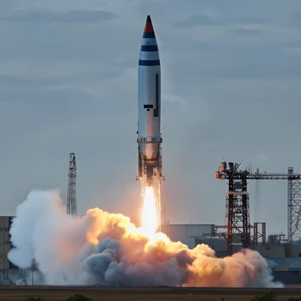
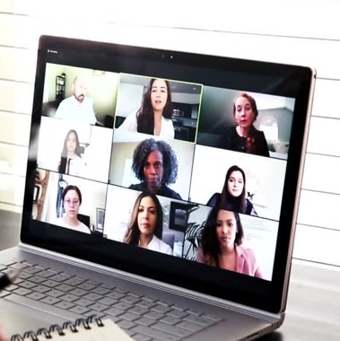

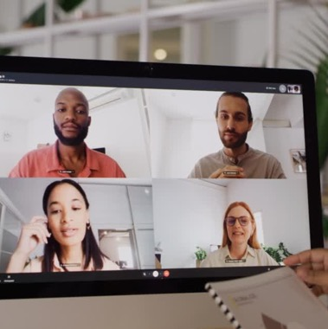



2025 Program Schedule
Information Sessions
LLMC Launch
Pre-Circle Meets
Bi-weekly Masterclasses
September 3 - 5
September 9
September 16 & 17
Starting September 22
Bi-weekly Circles
Weekly LLMC Lounge
In-Person Regional Meetups
LLMC Graduation
Starting September 30
March 17, 2026
Starting September 25
October 2025
French only Lounges available
Notes:
So, now that we understand LLMC and its unique offerings, I want to take this opportunity to review the 2025 LLMC Program Schedule with you so you have a better idea of how this can fit into your schedule.
-LLMC 2025 takes place over 10 weeks from September to December.
-Every participant is matched into a small group known as a “Mentoring Circle” with 6-10 other members.
-Your participation will include weekly alternating virtual circle sessions with your group and Masterclasses on critical leadership skills.
-There are also great networking opportunities happening outside your circle. This includes optional virtual Weekly Lounges and in-person regional events.
-Graduation from LLMC will take place March 17, 2026
-Participation in LLMC only requires 1.5 hours of your time per week with the option invest up to 2.5 hours per week by participating in the Lounges. No other program can offer you so much for so little of your time.

Slide 17

Frequently Asked Questions
Is there a fee to participate in the LLMC program?
The program is free and open to all members of the Federal Public Service, the Defence Team, and Crown Corporations.
How will my circle date and time be determined?
We will assign each member to a Circle based upon the preference indicated on the application.
I want to join a circle. Will I get a mentor?
In your Circle, there will be opportunities to network and seek mentorship. However, LLMC does not contain a formal mentoring process.
Do I need my managers approval to participate?
Yes, full engagement leads to the best outcomes for everyone and that is why we expect your full participation during Circle sessions and that your manager approves. If this is a barrier, please contact us.
Will french-only circles be available?
Circles will be available in both official languages. In the application process, we ask you to select if you’d like your Circle to be in English or French.
What is the time commitment required to participate in LLMC?
The minimum time commitment required to participate in LLMC is 1.5 hours per week. If you decide to attend the optional LLMC Lounges this increases your participation to 2.5 hours per week.
Notes:
Is there a fee to participate in the LLMC program?
The program is free and open to all members of the Federal Public Service,
the Defence Team, and Crown Corporations.
How will my circle date and time be determined?
We will assign each member to a Circle based upon the preference indicated on the application.
I want to join a circle. Will I get a mentor?
In your Circle, there will be opportunities to network and seek mentorship. However, LLMC does not contain a formal mentoring process.
Do I need my managers approval to participate?
Yes, full engagement leads to the best outcomes for everyone and that is why
we expect your full participation during Circle sessions and that your
manager approves. If this is a barrier, please contact us.
Will french-only circles be available?
Circles will be available in both official languages. In the application process, we ask you to select if you’d like your Circle to be in English or French.
What is the time commitment required to participate in LLMC?
The minimum time commitment required to participate in LLMC is 1.5 hours per week. If you decide to attend the optional LLMC Lounges this increases
your participation to 2.5 hours per week.

Slide 18
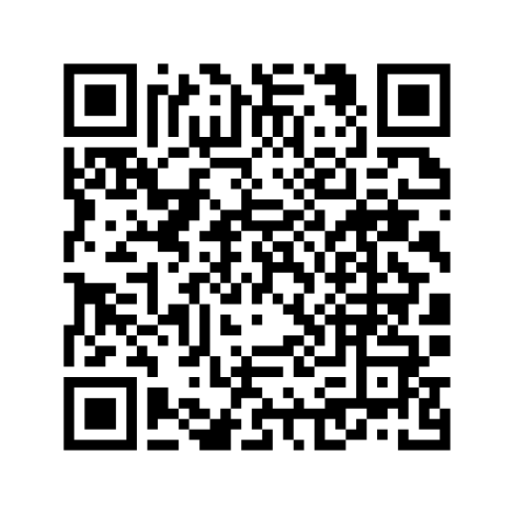

The Doors are Open!
Don't miss out on this one-of-a-kind opportunity,
Lifting as you Lead Mentoring Circles registration is now open until May 31, 2025!
LLMC Cohort 5 Registration form
Notes:
Join us in LLMC - The Doors Are Open!
The QR code on this screen will lead you to the LLMC 2025 registration form.
Leadership is not just about words, it’s about actions. Register now for LLMC and join the over 2,500 graduates who are taking meaningful steps in the right direction to create a stronger, more united public service.
This program is open to all Federal Public Servants, Defence Team members, and Crown Corporations. Registration is open until May 31, 2025.
Challenge: Help us bring LLMC to every leadership table in your organisation.
Make a list of your Top 10 current or emerging leaders and invite them to register and make a difference in our workplaces.
Let’s continue to lift each other higher, to share our knowledge, and to pay forward this exciting opportunity.

Slide 19
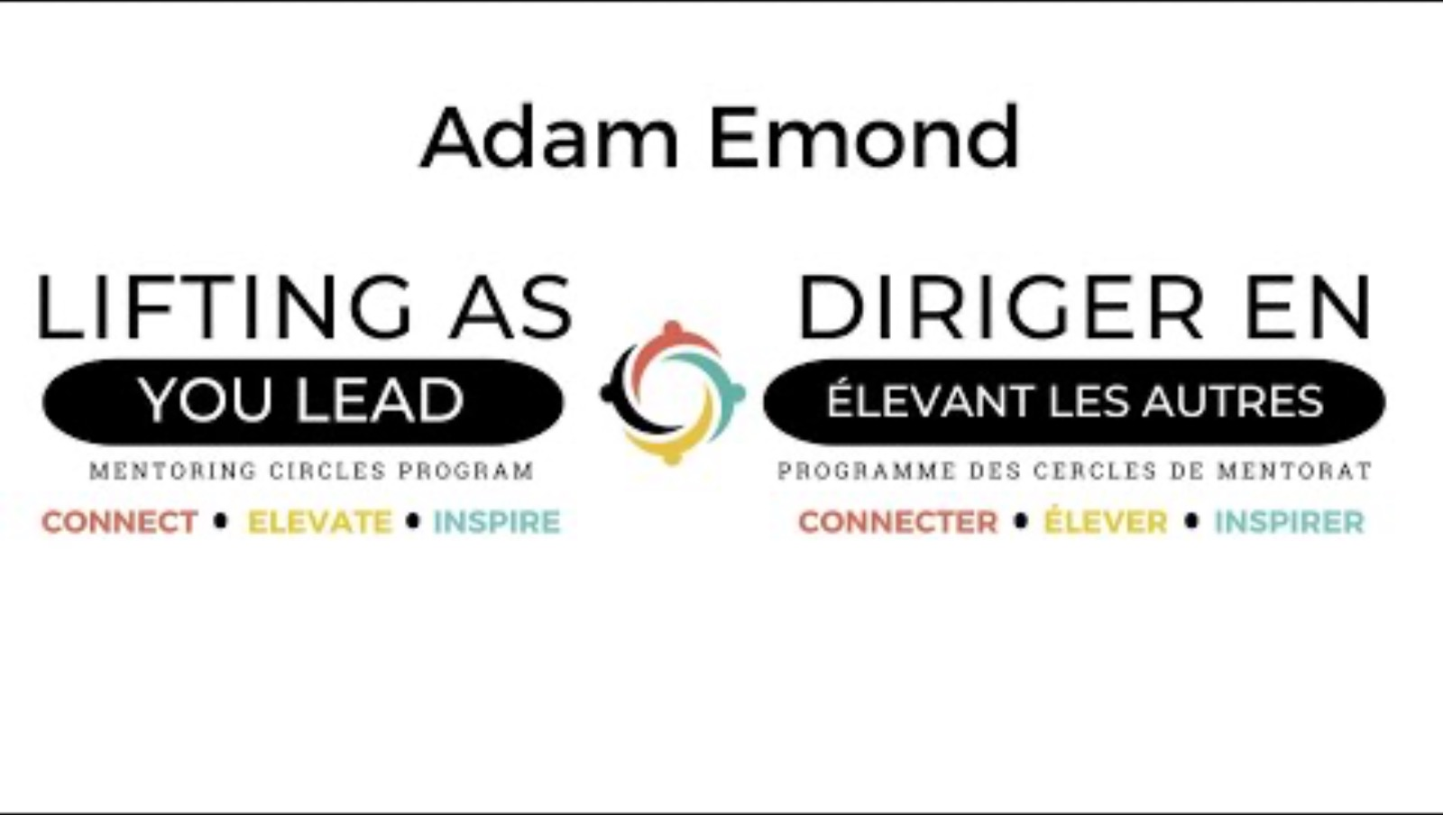
LLMC Success Story
https://youtu.be/qBrfuNqcVeI
Notes:
Before we part today, I would like to share another one of our LLMC Success Stories.
Adam Emond is a Military Officer at National Defence who just graduated from cohort 4 of LLMC and has taken to time to share his experiences with the program.
[Play Testimonial Video]

Slide 20
Contact Us
Who we are
Diversity and Inclusion Office,
Materiel Group, National Defence
Email Address
liftingasyoulead-dirigerenelevantlesautres@forces.gc.ca
Wiki Page
https://wiki.gccollab.ca/ Diversity_and_Inclusion_
Office
LLMC Founder
Samantha Moonsammy
Notes:
The Lifting as you Lead Mentoring Circles program is operated by the Diversity and Inclusion Office at National Defence. Here is their contact information if you would like to reach out to them with any questions.

Slide 21
The Doors are Open!
Don't miss out on this one-of-a-kind opportunity,
Lifting as you Lead Mentoring Circles registration is now open until May 31, 2025!
LLMC Cohort 5 Registration form
Notes:
As we close our meeting today, I will leave up the registration QR code for a few more minutes. I will also share a direct link in the chat, along with the LLMC wiki page where you can learn even more about the Lifting as you Lead Mentoring Circles program.
Don’t miss out on this one-of-kind opportunity.
By joining LLMC, you will have the opportunity to:
-Build meaningful relationships with a diverse group, across departments, from coast to coast to coast;
-Accelerate your career development by expanding your network beyond your current team or organization; and
-Get the resources you need to become a more confident, inclusive leader.
[Feel free to add your own closing comment here.]
Thank you for your time today, and I look forward to seeing you in LLMC 2025!

