Slide 1
Equity, Anti-Racism and Mental Health in the Federal Public Service
Équité, antiracisme et santé mentale dans la fonction publique fédérale
0.1
Federal Youth Network Webinar - Employment Equity, Diversity and Inclusion, Anti-Racism Series!
Webinaire du réseau fédéral des jeunes - Série sur l'équité en matière d'emploi, la diversité et l'inclusion, l'antiracisme !
October 6, 2022 - 1:30 pm to 3:30pm EST
6 octobre 2022 – 13h30 à 15h30 HSE
Dr. Martin Nicholas and/et Elisabeth (Liz) Martin

Slide 2
0.2
Disclaimer: “The facts and opinions expressed in this presentation and on the following slides are solely those of the presenters. This webinar is intended to be a collective learning experience and a template or platform for advancing the work related Racial Equity, Anti-Racism, Mental Health and Psychological Safety. We are here in a spirit of service to and solidarity with the marginalized.”
Clause de non-responsabilité : "Les faits et les opinions exprimés dans cette présentation et sur les diapositives suivantes sont uniquement ceux des présentateurs. Ce webinaire est destiné à être une expérience d'apprentissage collectif et un modèle ou une plateforme pour faire avancer le travail lié à l'équité raciale, l'antiracisme, la santé mentale et la sécurité psychologique. Nous sommes ici dans un esprit de service et de solidarité avec les personnes marginalisées."

Slide 3
Dedication of this Webinar
0.3
To: The Senator - Mr. Ian Shugart, the Retired Clerk of the Privy Council who issued the Clerk’s Call to Action on Anti-Racism, Equity and Inclusion
  We congratulate him for being appointed by the Prime Minister as an Independent Senator
  His Call to Action is supported by s.15 of the Canadian Charters of Rights and Freedom
TODAY we will be analyzing operational data as supporting evidence for undertaking the following Call to Action. We will refer to the other actions during the Webinar.
Measuring progress and driving improvements in the employee workplace experience by monitoring disaggregated survey results and related operational data (for example, promotion and mobility rates, tenure) and acting on what the results are telling us.

Slide 4
Slogans for Equity and Anti-Racism
0.4
Moral Imperative
Governance Obligation
Legal Responsibility

Slide 5
0.5
Outline of Presentation and Discussion
Equity in the Federal Public Service is Substantive Equality as protected by the Charter
Research and Analysis of Representation Data of Black Employees and the Employment Equity Designated Groups in the Public Service
New Key Leadership Competency for Executives on Racial Equity and Anti-Racism
Addressing the Cost of Racism on the Mental Health of Public Servants
What we can do about it.
Notes:
Liz will translate

Slide 6
1.1
Unit 1
Section 15 of the Canadian Charter of Rights and Freedoms
La Charte canadienne des droits et libertés
Equality is not treating all equally
Equity is a means to Substantive Equality
(d’égalité réelle)
Equality in Access
Equality in Opportunity
Have we addressed the racially disadvantaged?
Equality in Outcome
Are we monitoring outcomes for subgroups such as Black employees?
How are we doing in 2022?

Slide 7
1.2
What are the Main Takeaways?
In Canada we do not have formal equality. We have substantive equality. So equality is not treating people the same. Equality is to use Equity to address and redress inequalities which include Racial Inequalities.
Disaggregated data in the Federal Public Service (since 2017) gives irrevocable evidence that Black Employees are the most stagnated and face the largest barriers to career advancement and entry into the EX cadre.
  ACTION – Implement the Clerk’s Call to Action for Black Employees.
We require leaders competent in Racial Equity and Anti-Racism.
  ACTION – Add a Key Leadership Competency on Racial Equity and Anti-Racism for Executives.
Racism causes adverse effects on the Mental Health and Psychological Safety of Racialized Groups at a cost of Billions of Dollars.
  ACTION – Add Anti-Racism to the National Standard for the Psychological Health and Safety for Canadian Workplaces.
Notes:
Focus - What is Substantive Equality? - Addressing and Redressing Racial Inequalities in the Federal Public Service (FPS)
What is Substantive Equality?
Brief introduction to Section 15 of the Canadian Charter of Rights and Freedoms
Equality in the federal public service is not treating everyone the same
Equity is part of Equality and a means and a path towards Substantive Equality
Racial Equality
Racial Equality and the Charter
Racial Equality and Federal legislation
Addressing and Redressing Racial inequalities
The EE Act
The Purpose of the Act includes addressing inequality in outcomes
The Black EE Subgroup
Effects of Intersectionality on Racialized Groups
Disaggregated Data for EE Groups
Salary Range Representation for EE groups and Subgroups from 2017 to 2021
Grouping of Salary Range Representation Data for enabling analysis
Deep-dive analysis of disparities in outcomes using a Disproportionality Index (DI)
Irrevocable evidence from the Analysis of Salary Range Representation
Black employees face the highest level of Stagnation in the FPS
Black employees have worst outcomes for career progress in the FPS
Black employee have the highest barriers to entry into the Executive Cadre in the FPS
Effects of Racism on the Psychological Health and Safety (PHS) and Mental Health (MH) in the FPS
Racism causes adverse effects on the PHS and MH of Racialized groups (especially Black employees) and costly outcomes for all levels of Governments (i.e., federal, provincial, territorial and municipal)
Racism is a risk factor for PHS and MH and should be addressed and perpetrators held accountable upfront through prevention.
The viable solution for addressing and redressing Racism is to add Anti-Racism as a Factor to the National Standard for Psychological Health and Safety for Canadian Workplaces.
What could members of FYN, ARAN and the FPS do?
Recognize and Promote Racial Equity and Racial Equality as a fundamental human right
Speak through your networks to get all departments implement the Clerk’s Call to Action related to Appointment, Promotion, and Support for Advancement of Racialized Groups – especially Black employees
Propose to your department/ agency to add and implement Anti-Racism as a Factor to their Standard for Psychological Health and Safety

Slide 8
Unit 1: Substantive Equality is NOT treating all the same
1.3
This is a violation of the Duty to Accommodate consistent with the Canadian Human Rights Act
How do you establish a bona fide occupational requirement?
Comment établir une exigence professionnelle justifiée?
The Supreme Court of Canada established a three-step process (Meiorin and Grismer cases, both in 1999) / La Cour suprême du Canada (arrêts Meiorin et Grismer, 1999) a établi un processus comprenant les trois étapes :
It is connected to the performance of the job;
It is necessary to fulfill the work-related purpose; and
It is reasonably necessary to do the work.
Notes:
challenging unconstitutional state neglect and advancing systemic racial justice

Slide 9
Equity is a means to substantive Equality/
L'équité est un moyen d'atteindre une égalité réelle
1.4
Remove Barriers
e.g., EQUITY
Program
Address Barriers
e.g., EQUITY
Special Measures
Retirer les barrières
p. ex.
Programme
d’équité
S'attaquer aux obstacles
p. ex., ÉQUITÉ
Mesures spéciales

Slide 10
Purpose of the Employment Equity Act/ Objet de la Loi sur l’équité en matière d’emploi
1.5
2 The purpose of this Act is to achieve equality in the workplace so that no person shall be denied employment opportunities or benefits for reasons unrelated to ability and, in the fulfilment of that goal, to correct the conditions of disadvantage in employment experienced by women, Aboriginal peoples, persons with disabilities and members of visible minorities by giving effect to the principle that employment equity means more than treating persons in the same way but also requires special measures and the accommodation of differences.
2 La présente loi a pour objet de réaliser l’égalité en milieu de travail de façon que nul ne se voie refuser d’avantages ou de chances en matière d’emploi pour des motifs étrangers à sa compétence et, à cette fin, de corriger les désavantages subis, dans le domaine de l’emploi, par les femmes, les autochtones, les personnes handicapées et les personnes qui font partie des minorités visibles, conformément au principe selon lequel l’équité en matière d’emploi requiert, outre un traitement identique des personnes, des mesures spéciales et des aménagements adaptés aux différences.

Slide 11
Data that affects Public Servants differently depending on their Race
1.6
Racial Discrimination in the Federal Public Service
- Public Service Employee Survey 2020
Question 64a. Please indicate the type of discrimination you experienced. Race
Black Employees 80%
Response rates of those who said YES
Visible Minority
62%
Non-Visible Minority
12%
Notes:
Please let Liz translate

Slide 12
Unit 2: Barriers to enter EX Cadre and Stagnation in the Federal Public Service – A Comparison of Black Employees with EE Groups
2.1
What does the data on representation tell us about equality in outcomes?

Slide 13
2.2
Use of a Disproportionality Index to identify deviation from a uniform distribution – focus on the EX Cadre
Consider the Representation percentage of Demographic Groups in the EX Cadre from 2017 to 2021.
Table 1: Representation percentage of Demographic Groups in the EX Cadre from 2017 to 2021.
Demographic Group | 2017 | 2018 | 2019 | 2020 | 2021
BLACK Employees | 1.4% | 1.4% | 1.6% | 1.6% | 1.9%
Visible Minorities | 10.2% | 10.1% | 11.1% | 11.5% | 12.4%
Indigenous Peoples | 3.9% | 3.7% | 4.1% | 4.1% | 4.4%
Persons With Disabilities | 5.2% | 4.8% | 4.6% | 4.7% | 5.6%
Women | 48.0% | 49.1% | 50.2% | 51.1% | 52.3%
From the data in the table above alone we cannot do the following
Cannot determine if there is under-representation or over-representation;
Cannot evaluate the change in representation from 2017 to 2021
Cannor compare Data for the demographic groups

Slide 14
2.3
Representation of Employees in Department X as of March 31, 2021
Group | Number | Percentage of Total In Department X | % of members of Group A and B in the Canadian Population - From the 2021 Census
Group A | 20 | 4% | 4%
Group B | 20 | 4% | 4%
All Employees | 500 | 100% | Not applicable
The Representation of Group A and Group B match the % in the Canadian population.
However, examination of Salary Level Representation reveals issues with stagnation and barriers to progress.
The Next slide discusses this using illustrative data.

Slide 15




Disproportionality Index to compare groups – What is different between Groups A and B
2.4
Department X has 500 employees. Representation of Group A = 4%; and Group B = 4%
$$\text{DI} \text{Group} \text{X}\text{; }\text{Salary} \text{range} \text{i}$$
$$=$$
$$\frac{\% Group X;Salary range i}{\% All Employees;Salary range i}$$
Group A with Good Career Progress
Percentage Distribution for ALL
Group B with Stagnation and Barriers
Disproportionality INDEX
Salary
Range i
A
B
Very High
High
Middle
Low
Very Low
20%
20%
5%
1.00
0.25
20%
20%
15%
1.00
0.75
25%
20%
1.25
1.00
20%
20%
1.00
1.50
20%
30%
20%
30%
0.75
1.50
15%

Slide 16
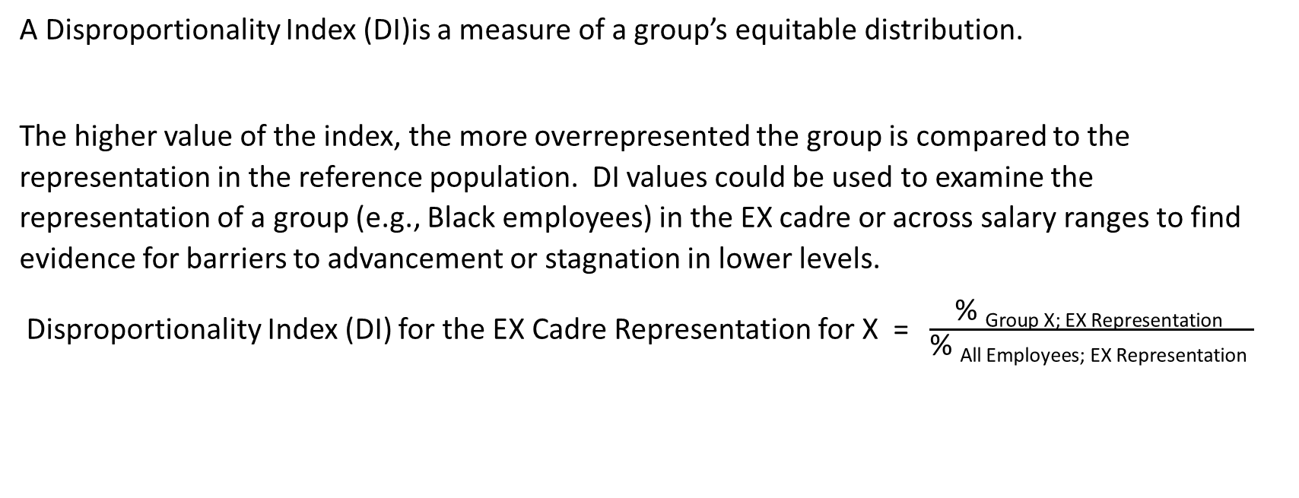
2.5
A Disproportionality Index (DI)
A Disproportionality Index (DI)is a measure of a group’s equitable distribution.
The higher value of the index, the more overrepresented the group is compared to the representation in the reference population. DI values could be used to examine the representation of a group (e.g., Black employees) in the EX cadre or across salary ranges to find evidence for barriers to advancement or stagnation in lower levels.
Disproportionality Index (DI) for the EX Cadre Representation for X = $\frac{\text{\% }\text{Group} \text{X}\text{; }\text{EX} \text{Representation} }{\text{\% }\text{All} \text{Employees}\text{; }\text{EX} \text{Representation} }$

Slide 17
2.6
Table 2. Disproportionality INDEX (DI) for EX Cadre Representation for Black Employees in comparison to the DI values for EE Groups pursuant to the EE Act as of March 31st of the following Calendar Years
Equity Group | 2017 | 2018 | 2019 | 2020 | 2021
BLACK | 0.50 | 0.48 | 0.50 | 0.46 | 0.50
Visible Minorities | 0.68 | 0.64 | 0.66 | 0.65 | 0.66
Indigenous Peoples | 0.75 | 0.73 | 0.80 | 0.80 | 0.85
Persons With Disabilities | 0.95 | 0.91 | 0.88 | 0.90 | 1.00
Women | 0.88 | 0.90 | 0.92 | 0.93 | 0.94
The Table 2 data shows the following:
Under-representation: DI < 1
Change from 2017-2021: a) Blacks and VMs do not show improvement; b) Women show a steady improvement; and c) Indigenous Peoples also show improvement but remain under-represented
Overall observation: The data is consistent with the premise that Blacks have been consistently the most under-represented in the EX Cadre.
.

Slide 18
2.7
What should be done to address the Data from Table 2:
Use EE Act Special Measures to address this issue. Disaggregated data for EX cadre representation for Blacks has been available since 2017.
Implement, the Call to Action on Anti-Racism, Equity and Inclusion by the Clerk of the Privy Council Office, which has called for special measures for the Black EE Subgroup.
  Appoint employees to and within the Executive Group through career development and talent management
  Sponsor high-potential employees to prepare them for leadership roles
  Support the participation of employees in leadership development programs (for example, the Executive Leadership Development Program) and career development services (for example, official language training)

Slide 19
Unit 3: Use of Disproportionality Indexes for Salary Range Representation to examine Stagnation and Barriers to Career Advancement
3.1
for employees in the Federal Public Service in Canada as of March 31, 2021

Slide 20
Comparison of Representation of Black Employees with All Employees
3.2
To get information whether stagnation and barriers to advancement exists the salary ranges were divided into FIVE approximately equal parts. From the very low range to the very high range.
Overrepresentation at the very low range would indicate stagnation. Underrepresentation in the very high range would suggest barriers to carriers advancement.
Salary range ($) | All employees (20% ± 3%) |  | Black Employees
 | Number | % of All employees | Number | % of All Blacks
Less than $60,000 (Very Low) | 38,139 | 16.7 | 2077 | 23.5
$60,000 to $69,999 (Low) | 40086 | 17.6 | 2089 | 23.9
$70,000 to $84,999 (Medium) | 52843 | 23.1 | 1833 | 20.9
$85,000 to $99,999 (High) | 44075 | 19.3 | 1376 | 15.7
Over $100,000K (Very High) | 53202 | 23.3 | 1379 | 15.8
All ranges | 228,345 | 100 | 8754 | 100

Slide 21

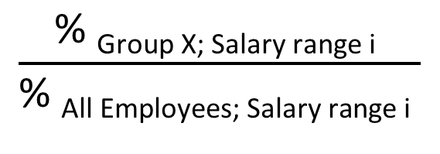
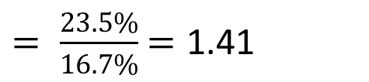
Disproportionality Index for Comparative Representation at different Salary Ranges from Very Low to Very High
3.3
$$\frac{\text{\% }\text{Group} \text{X}\text{; }\text{Salary} \text{range} \text{i} }{\text{\% }\text{All} \text{Employees}\text{; }\text{Salary} \text{range} \text{i} }$$
$$= \text{DI} \text{Group} \text{X}\text{; }\text{Salary} \text{range} \text{i}$$
𝐷𝐼 _{Black employees; < 60K}
$= \frac{23.5\%}{16.7\%}$ $=\text{1.41}$

Slide 22
3.4
Calculation of the Disproportionality Index for Salary Ranges of public service of Canada employees for Black, Visible Minority Group, Indigenous Peoples and Persons with Disabilities (as of March 31, 2021)
The Disproportionality Index (DI) for a given range R for group DG = (% Representation of DG in Range R)/ (% Representation of DG for All Ranges)
Salary range R ($) | Percentage of All employees | Disproportionality INDEX (DI) for Demographic Groups (DG)
 |  | Black Employees | Members of a visible minority group | Indigenous Peoples | Persons with Disabilities | Non-VM
Less than 60K | 17% | 1.41 | 1.07 | 1.08 | 1.13 | 0.98
60 to 70K | 18% | 1.37 | 1.12 | 1.08 | 1.11 | 0.97
70 to 85K | 23% | 0.92 | 0.95 | 1.06 | 0.91 | 1.01
85 to 100K | 19% | 0.82 | 0.97 | 1.15 | 1.00 | 1.01
Over 100 K | 23% | 0.68 | 0.93 | 0.73 | 0.95 | 1.02
Over 150K | 2% | 0.58 | 0.71 | 0.67 | 1.02 | 1.07
Executive Cadre ONLY | 3% | 0.50 | 0.66 | 0.85 | 1.00 | 1.08
All ranges | 100% | 1.0 by definition | 1.0 by definition | 1.0 by definition | 1.0 by definition | 1.0 by definition

Slide 23
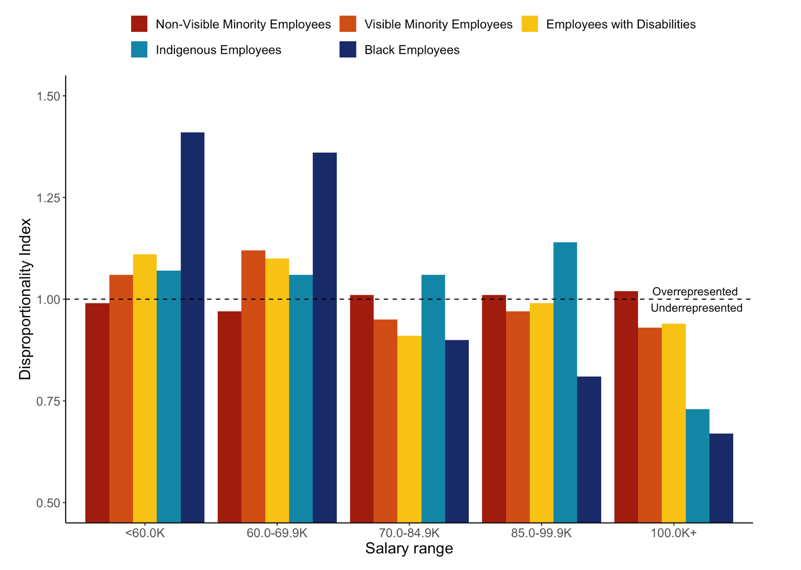
The Disproportionality Index for Salary Ranges of public service of Canada employees for Black, Visible Minority Group, Indigenous Peoples and Persons with Disabilities (as of March 31, 2021)
3.5
Evidence for Stagnation
Evidence for Systemic Barriers to Progress

Slide 24
3.6
Comparison of the Disproportionality Index for Salary Ranges of public service of Canada employees for Black, Visible Minority (VM) Group, Non-VM (as of March 31, 2021)
The Disproportionality Index (DI) for a given range R for group DG = (% Representation of DG in Range R)/ (% Representation of DG for All Ranges)
Salary range – R ($) | Disproportionality INDEX (DI) for Demographic Groups (DG)
 | Black Employees | Members of a visible minority group | Non-VM
Less than 60K | 1.42 | 1.07 | 0.98
60 to 70K | 1.37 | 1.12 | 0.97
70 to 85K | 0.92 | 0.95 | 1.01
85 to 100K | 0.82 | 0.97 | 1.01
Over 100 K | 0.68 | 0.93 | 1.02
Over 150K | 0.58 | 0.71 | 1.07
Executive Cadre ONLY | 0.50 | 0.66 | 1.08
All ranges | 1.0 by definition | 1.0 by definition | 1.0 by definition

Slide 25
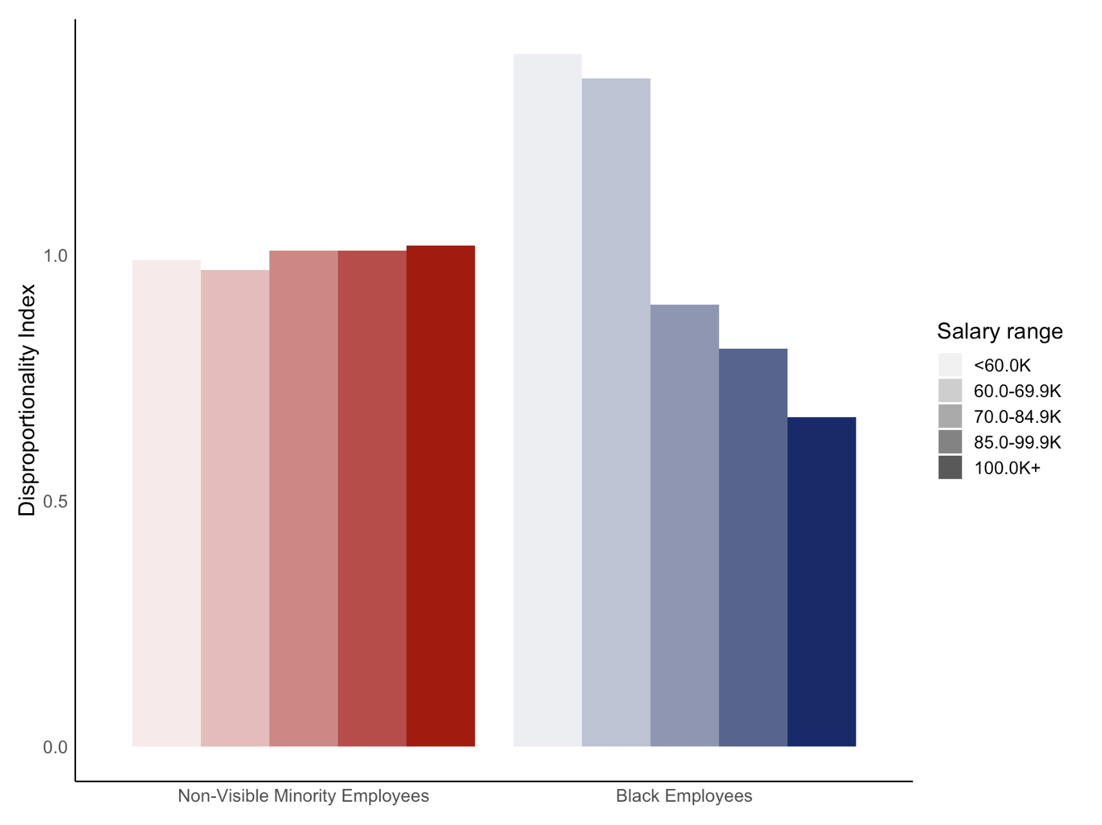
A Comparison of the Disproportionality Index for Salary Ranges of public service of Canada employees for Black and Non-Visible Minority Group, (as of March 31, 2021)
3.7
Evidence for Stagnation
Evidence for Systemic Barriers to Progress

Slide 26
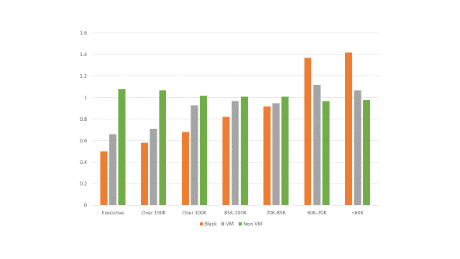
3.8
Disproportionality Indexes for Salary Level Representation of Blacks, Visible Minorities (VM) & Non-Visible Minorities (non-VM)
Disproportionality Index (DI) Values per Group
0 0.2 0.4 0.6 0.8 1.0 1.2 1.4 1.6
Executive Cadre Representation
Evidence for Systemic Barriers to entering the EX Cadre
DI =1.0 is the average
DI << 1 for the EX Cadre &
At Higher Salary Levels is evidence for Systemic Barriers to advancement
DI >> 1 at Lower Salary Levels Indicate Stagnation without career progression
150,000 and above
SALARY
RANGE
100,000 and above
85,000 to 99,999
70,000 to 84,999
60,000 to 69,999
below 60,000
Evidence for Stagnation
Black Employees
Visible Minority
Employees
All Non- Visible Minority
Employees

Slide 27
RRDP Gear Connect
3.9
RECRUITEMENT – RETENTION – DEVELOPMENT – PROMOTION
RECRUITEMENT
RETENTION
Targeted recruitment of Black, Indigenous Peoples, VMs and PWDs .
All employees, especially the racialized people need to feel that they are included and hence would want to stay .
R
R
PROMOTION
DEVELOPMENT
P
D
Racialized employees stagnated should be developed, sponsored and promoted to the Executive Cadre as well..
Targeted development programs with mentorship and sponsorship is required.
https://www.canada.ca/en/privy-council/corporate/clerk/call-to-action-anti-racism-equity-inclusion-federal-public-service.html
https://www.canada.ca/fr/conseil-prive/organisation/greffier/appel-action-faveur-lutte-contre-racisme-equite-inclusion-fonction-publique-federale.html

Slide 28
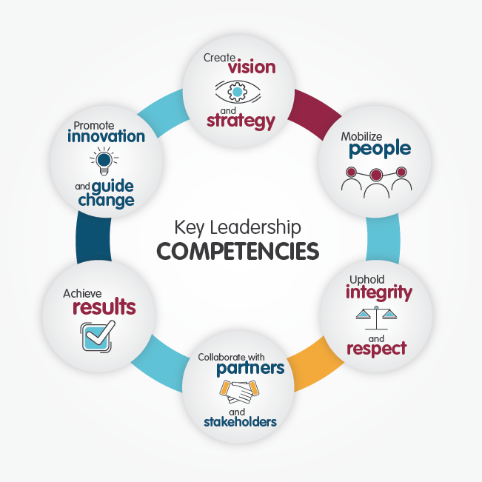
Unit 4 - Enriching the Key Leadership Competencies (KLCs) for Executives by adding a new KLC for Racial Equity, Anti-Racism & Reconciliation
4.1
Shepherd
Racial equity & Anti-Racism
Facilitate Reconciliation

Slide 29
5.1
Unit 5 - Cost of Racism on the Mental Health and Psychological Safety of Canadians

Slide 30
5.2
Spheres of Systemic Racialization
Sphères de racialisation systémique
Intériorisée
(Croyances des individus y compris la menace stéréotypée)
Internalized
(Beliefs within individuals including stereotypic threat)
Structurelle
(Génératrice de préjugés, durable & cumulatif)
Structural
( Bias-generating, Durable & Cumulative)
Institutionnelle
(Préjugés dans les politiques et les pratiques)
Institutional
(Bias in policies & practices)
Interpersonnelle
(Péjugés implicites envers des personnes spécifiques)
Interpersonal
( Implicit bias towards specific people)

Slide 31
Estimating the mental health costs of racial discrimination
5.3
Racial discrimination costs the Australian economy 235,452 in disability adjusted life years lost, equivalent to:
$37.9 billion per annum
i.e., roughly 3.02% of annual gross domestic product (GDP) over 2001–11, indicating a sizeable loss for the economy.
https://bmcpublichealth.biomedcentral.com/articles/10.1186/s12889-016-3868-1
Amanuel Elias & Yin Paradies, BMC Public Health v 16, 1205 (2016)

Slide 32
5.4
What are psychosocial factors?
https://canadianlabour.ca/uncategorized/national-standard-canada-psychological-health-and-safety-workplace/
The workplace factors in the Psychological Health & Safety Standard in the Federal Public Service
1. Psychological support; | 6. Growth and development; | 11. Balance;
2. Organizational culture; | 7. Recognition and reward | 12. Psychological protection;
3. Clear leadership and expectations; | 8. Involvement and influence | 13. Protection of physical safety;
4. Civility and respect | 9. Workload management | 14. Any other chronic stressor that may be identified by workers
5. Psychological demands | 10. Engagement
Notes:
The Canadian Labour Congress clearly recognized that the 13 factors were not addressing the mental health effects in the workplace and asked that the 14th factor is important to be used.
For the FPS anti-racism a leading chronic stressor.

Slide 33
5.5
Programs Developed using Human-Centred Design without the consideration of the Marginalised
RACISM
Cost to
MENTAL
HEALTH
Program Design Focusing on Factors Affecting the mental health of the Majority
Anti-Racism
Lens
- The Marginalised -
Percentage of Federal Public Service employees adversely affected

Slide 34
Addressing and Redressing Adverse Effects of Racism on Mental Health and Psychological Safety
5.6
Vulnerability to Adverse Health & Safety Effects (including psychological and physical injuries) increases with cumulative incidences of Racial Trauma
Career Path in the Federal Public Service
The GOOD!
CURRENT FOCUS ON:
TREATING OUTCOMES
TRAUMA INFORMED APPROACH
TRAINED COUNSELLORS & THERAPISTS
Makes
Workplace
Toxic!
Racial Acts
(Macro/Micro)
Systemic Effects
Beginning
Middle
End
The UGLY!
Above Focus is NECESSARY but NOT SUFFICIENT
for Prevention, Monitoring & Accountability
Equity-Informed Actions Required to protect Racialized employees
PREVENT
MONITOR
REDRESS
Result of Adding
New Factor
REDUCE ECONOMIC COSTS
The Current Standard is a Barrier to use a Racial Trauma Informed Approach to Mental Health and Psychological Safety
The BAD!
Civility & Respect in the Mental Health Standard, Victimizes the Victims of Racism, by asking them to be CIVIL and show RESPECT to the Perpetrators of Racist Acts
Notes:
THE GOOD
The current focus on Improving treatment of mental health outcomes
The adoption of a Trauma-informed approach
Having counsellors and therapists trained to treat racialized people
THE BAD
The current National Standard on Psychological Health and Safety in the Workplace does NOT recognize Racism as a risk factor to mental health and psychological safety
An Equity-informed approach was not used when identifying psychosocial risk factors for the Standard and so it missed including Anti-Racism, despite the estimates of the annual cost of racism on mental health and psychological safety is reported to be over $ 35 Billion in Australia.
In the Federal Public Service Mental Health Strategy, the Implementation of the Mental Health Standard by Departments and Agencies, the current approach to Civility & Respect in the Mental Health Standard, Victimizes the Victims of Racism, by asking them to be CIVIL and show RESPECT to the Perpetrators of Racist Acts
THE UGLY
Racial micro-aggressions and other acts of harmful Behaviour perpetrated against are systemic effects on racialized people AND cause adverse effects on their mental health and psychological safety.
The current National Standard does not include (or does not require) the need for prevention and monitoring of racially induced mental trauma. This is an important Gap that we, including the ANTI-RACISM AMBASSADORS NETWORK, are seeking to fix.
Vulnerability to Adverse Health & Safety Effects Increases With incidences of Racial Trauma
Equity-based approaches to design Performance Indicators is what’s needs to address Prevention, Monitoring and Accountability.

Slide 35
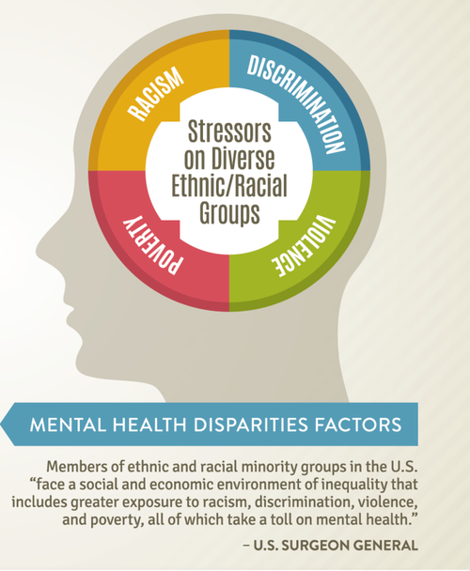
Adding a new factor to the Psychological Health & Safety Standard
5.7
identifying and eliminating racial discrimination
https://www.blackpast.org/african-american-history/mental-illness-in-black-community-1700-2019-a-short-history/
Notes:
This presentation is about the need to add a 14th factor to the Psychological Health and Safety Standard for the FPS as part of efforts to identify and eliminate systemic racism and racial discrimination

Slide 36
Identifying and Eliminating racial discrimination from the Federal Public Service (FPS) is a Government Priority
5.8
Prime Minister of Canada Justin Trudeau officially recognized the International Decade for People of African Decent (2015 to 2024) on January 30th, 2018. Through this recognition, Canada committed itself to improving the future for Black Canadians. One of the commitments is focusing on their mental health challenges
Opportunity to Reduce Costs due to Racism: The FPS has the opportunity to take the leadership for mental health by adding “Racial discrimination , bias and harassment” as a Factor of our own Psychological Health and Safety Standard and an integral part of our Mental Health Strategy

Slide 37
The National Psychological Health and Safety Standard – a source of systemic discrimination?
5.9
The implementation of the 13 factors does not give due consideration to the devastating effects of racism causing mental trauma.
The absence of an Anti-Racism factor has precluded the allocation or development of targeted Mental Health resources to prevent and/or address mental trauma due to racism.
The presence of negative impacts on racialized groups described above due to the Standard, even if indirect or unintended, can be considered as an example of systemic racial discrimination in Canada

Slide 38
5.10
Let’s use our collective and individual voices and agency to advocate the addition of ANTI-RACISM as a new factor for the following:
    National Psychological Health & Safety Standard in Canadian Workplaces

Slide 39
Unit 6 - What could members of FYN, ARAN & the FPS do?
6.1
  Recognize and Promote Racial Equity, Ant-Racism and Racial Equality as a fundamental human right
  Speak through your networks to get all departments implement the Clerk’s Call to Action related to Appointment, Promotion, and Support for Advancement of Racialized Groups – especially Black employees
  Propose to your department/ agency to add and implement Anti-Racism as a Factor to their Standard for Psychological Health and Safety

Slide 40
Poll Questions
1. Is there a Black employee network in your department/program where you work?
2. Is there a Black community/ caucus/ social structure that offers kingship/ability to connect with other Black employees at your work site?
3. If you are a member of any of these structures of support, do you find them beneficial?

Slide 41
Invitation to join the discussion
Invitation à participer à la discussion
Please provide your comments, questions, suggestions and advice.
Veuillez nous faire part de vos commentaires, questions, suggestions et conseils.
Thank you and Merci.

