Slide 1
FYN Virtual Learning Series,
May 7, 2020
Joy Moskovic,
Digital Enablement Division, TBS

Slide 2
The Government of Canada
Access to Collaboration Tools
External Tools
Powered by GCAccount – includes access to GCWiki and GCMessage
GCTools
GC-Wide
Departmental Tools
2

Slide 3
GCTools - Overview
Leveraging the Tools
EXTERNAL COLLABORATION
INTERNAL #GC NETWORK COLLABORATION
GCaccount
GCconnex
GCintranet
External facing
Includes access to:
GCcollab, GCwiki
GCmessage
Internal only
Internal only
Authoritative, central communications channel to reach all public servants.
GCdirectory - GEDS
GCpedia
GCdirectory - GEDS
External facing
Directory of federal public servants. – Partial access.
Internal only
Internal only
Directory of federal public servants. – Full access.
7
Notes:
Overview of the GCTools

Slide 4
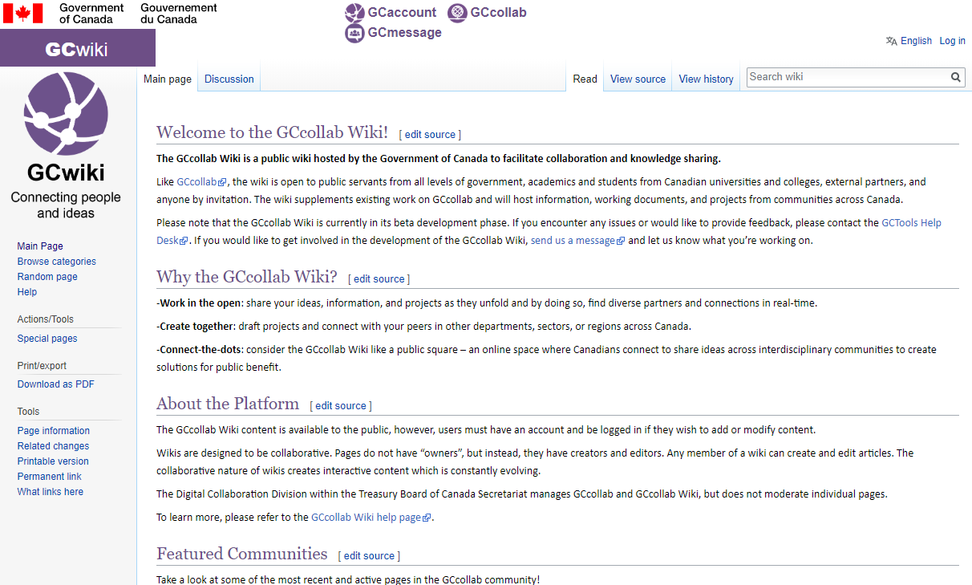
What is GCwiki? (aka GCcollab wiki)
A public square: an online space to connect and share information across interdisciplinary communities to create solutions
Pages are visible on the internet.
Pages are only editable by users with a valid GCaccount.
You will be automatically subscribed to updates when a page you create is edited.
Great for announcements and updates, or for sharing your ideas and projects as they unfold.
Designed to be collaborative. Any logged-in user can edit. However, this is rare and you can watch your content for changes.
Uses Media Wiki (same as GCpedia and Wikipedia) HTML and CSS coding are restricted.
Notes:
Given that any registered user can edit any article, it is, of course, possible for biased, out-of-date, or incorrect information to be posted. However, because there are so many other people accessing the content and monitoring contributions using the recent changes page, incorrect information is usually corrected quickly. Thus, the overall accuracy of information on the GCwiki is improving all the time. You are encouraged to help by correcting information, validating content, and providing useful references. It is the responsibility of each individual who creates a page to maintain its accuracy. There is no way of enforcing accuracy. Each individual must be trusted to be effective in sharing information. It should be noted however that any user can and should correct that which they know is wrong. As a reader you need to use your judgment about the credibility, timeliness, reliability, and accuracy of what you read on the GCwiki. Looking at when the page was created (via the history tab), and examining how many people have edited the page will help you judge what you read. Individual users' edit histories can also be scrutinized to see the kind and quality of information they are providing to the GCwiki community. As a GCwiki user, feel free to contribute to the accuracy of its content -- that's the beauty of collaboration via a wiki!

Slide 5
Why use GCwiki?
Share content and information across the GC and with external stakeholders
Informal web content

Slide 6
Growth in usage since COVID pandemic

Slide 7
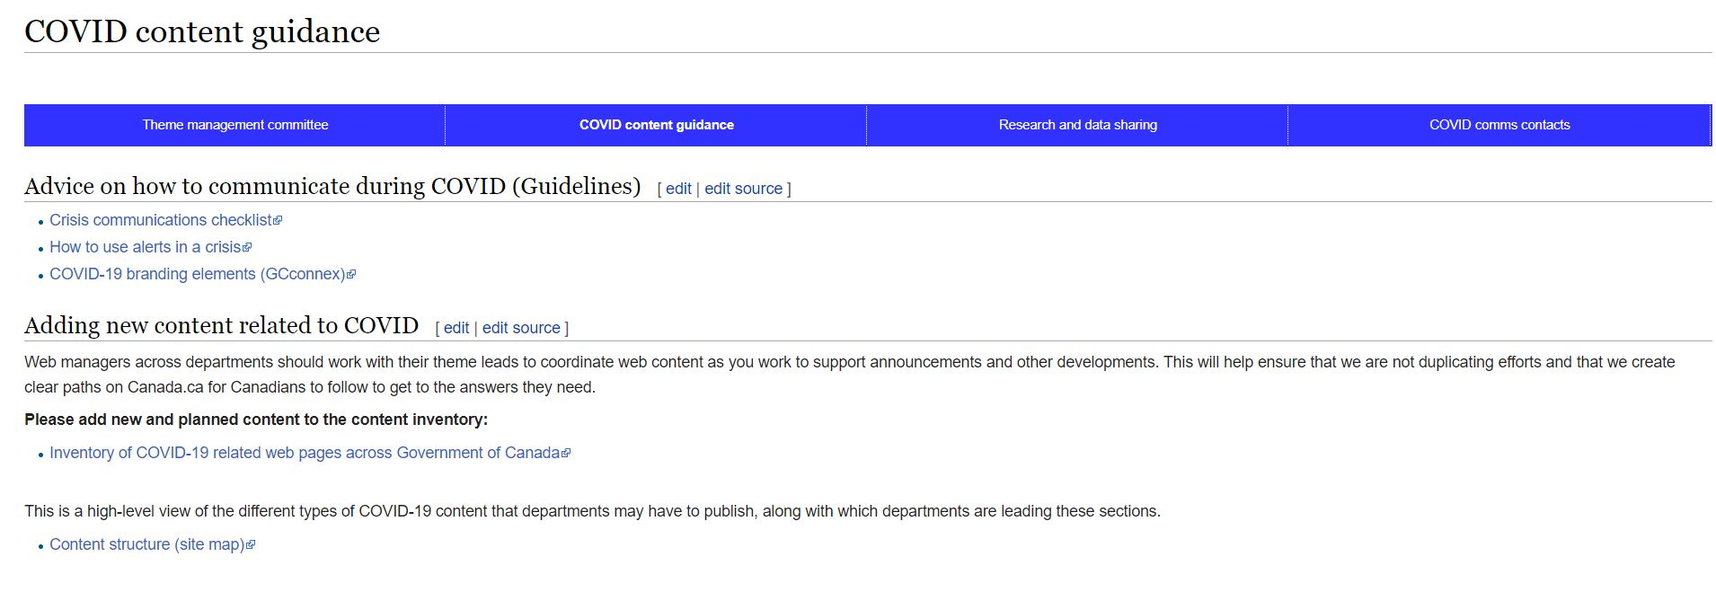
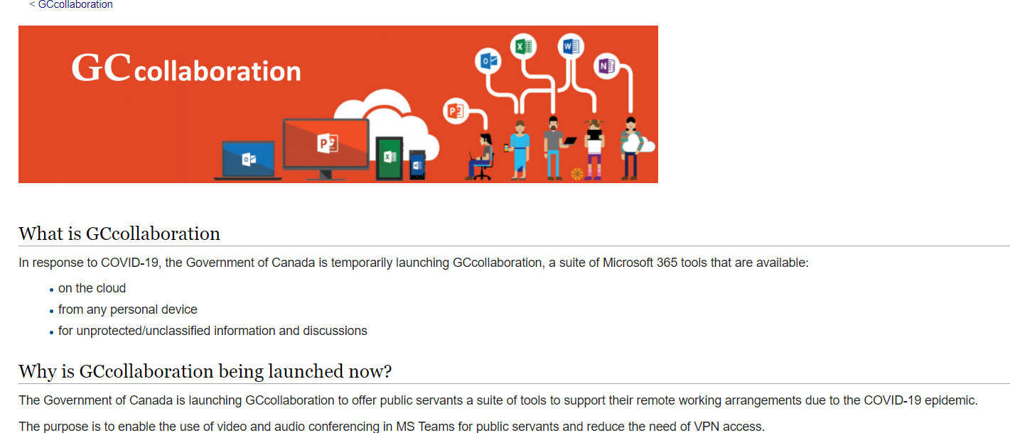
GCwiki – Sharing information during COVID-19

Slide 8
How to create a page
Through the search bar.
Through the address (URL) bar.
3. Using wiki code.
Create internal links on existing pages by using the wiki code [[Example]]
This produces a red link, click the red link.
The link will bring you to the page link, and you will be prompted to create the page

Slide 9
How to add or modify content on the GCwiki
You must be logged in.
Click Edit at the top of the page.
Basic text editing functions. Simply click on the content in the page that you wish to edit and start!
Or code the document yourself using Media Wiki (resources on GCpedia, MediaWiki.org or Wikipedia)
Show preview
Click on the show preview button at the bottom to view what you have edited before saving. Just remember to then save the page!
Saving after Editing
Once satisfied with the content, you can:
Go to the Edit Summary and note what has been done to the document in the Summary window
If you don’t want a notification to be sent, check the This is a minor edit box and then
Press Save Page

Slide 10
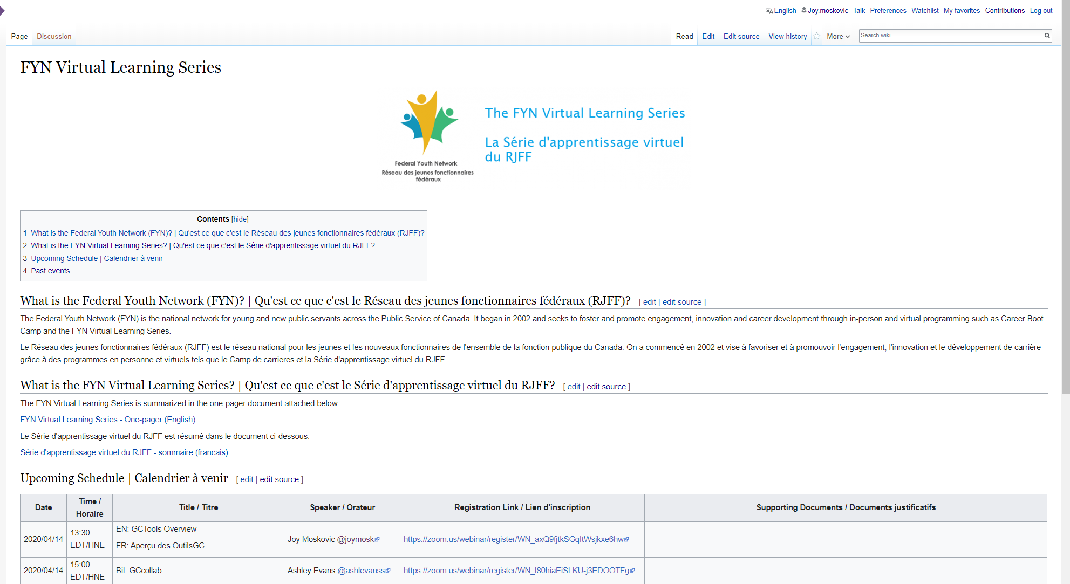

Slide 11
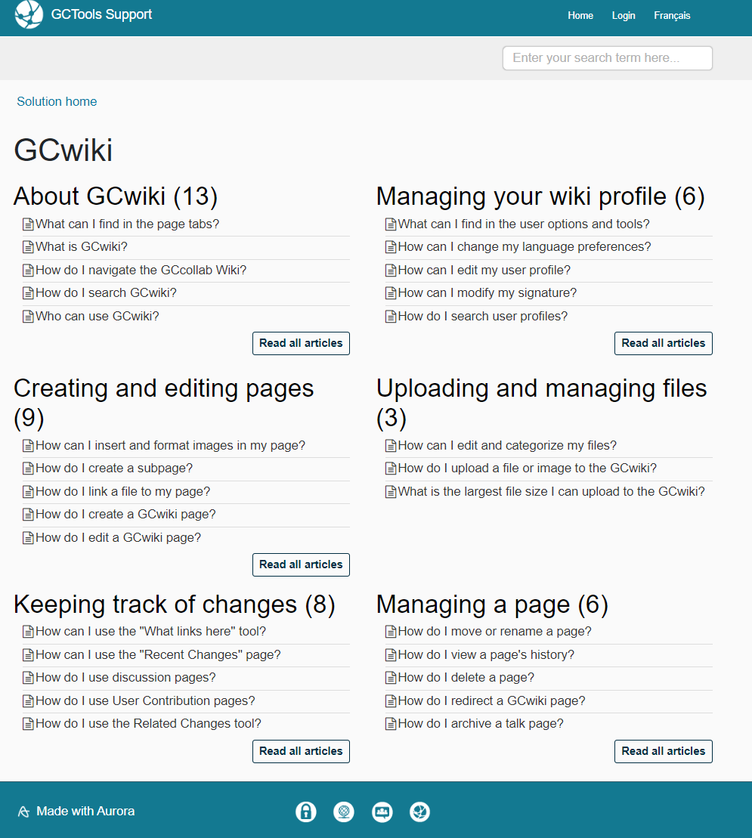
GCwiki Help
22

Slide 12
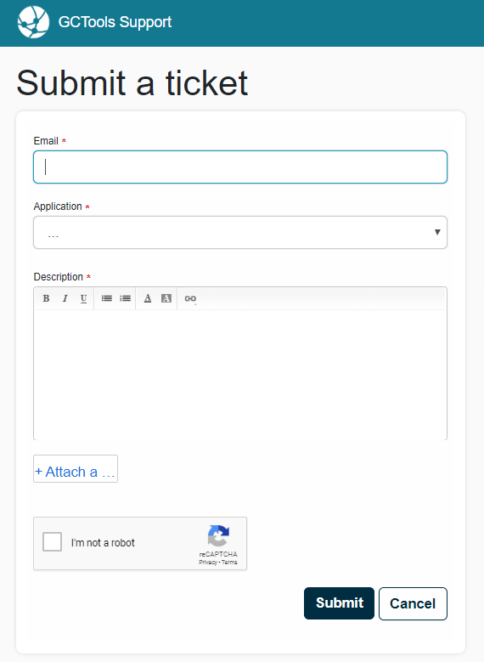
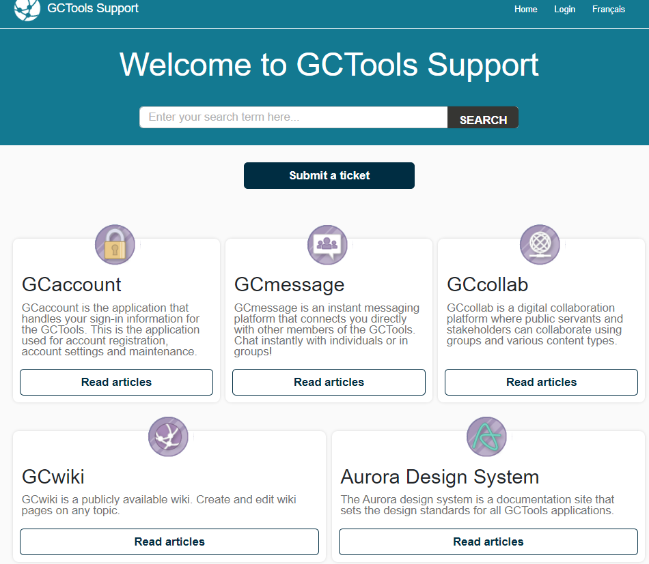
Completely stumped… contact the GCTools Help Desk

Slide 13
Joy Moskovic
Manager, Outreach and Engagement, Digital Enablement
Office of the Chief Information Officer
Treasury Board of Canada Secretariat
Joy.moskovic@tbs-sct.gc.ca
@joymosk
http://ca.linkedin.com/in/joymoskovic
613-406-5801
Add me as a colleague on GCconnex or GCcollab!
Follow us on Twitter @DigiEnablement, @GCcollab, @GCconnex, @GCpedia
4

