Slide 1
Microsoft Teams Instructor Led Training
Today’s training will begin shortly!
Housekeeping:
This session will be recorded and available for playback
To mute/unmute your line
To ask a question
If you would prefer to dial-in to the
meeting, please mute your computer
and follow these steps to get the call
in information:
2.
1.

Slide 2
Microsoft Teams Training Module 1
ACCESSING MICROSOFT TEAMS

Slide 3
In this module you will learn:
How to install Microsoft Teams
How to launch Microsoft Teams

Slide 4
Installing Microsoft Teams
Step 1
Open the Software Center
Step 2
Search for Microsoft Teams

Slide 5
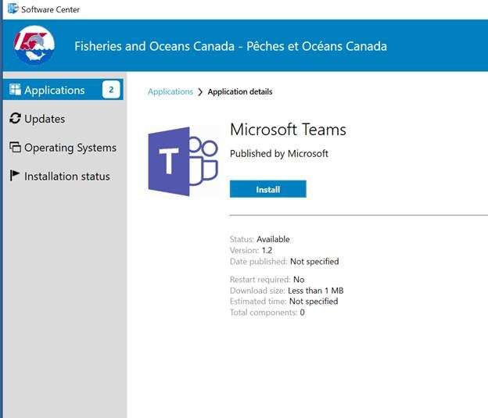
Step 3
Install Microsoft Teams

Slide 6
To Launch Microsoft Teams
Step 1
Open the Microsoft Teams application

Slide 7
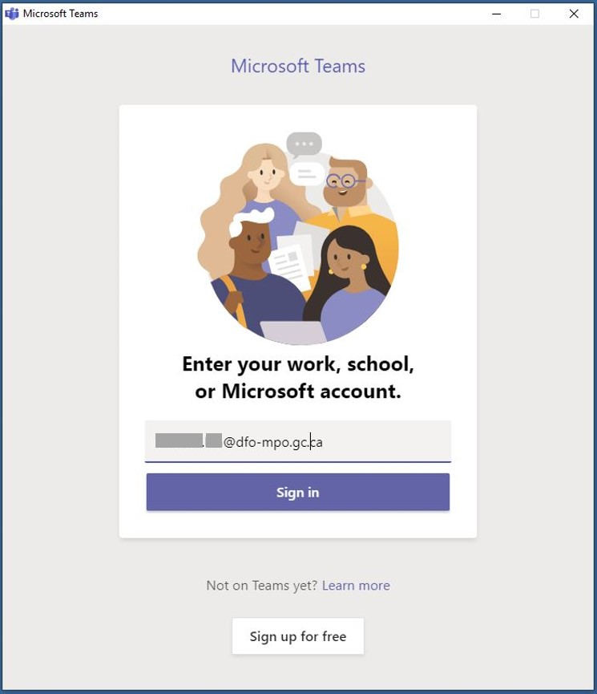
Step 2
You will be prompted to sign in to your account with an automatically populated email address - THIS MUST BE EDITED
Step 3
Enter your email address in the format firstname.lastname@dfo-mpo.gc.ca and Sign in

Slide 8
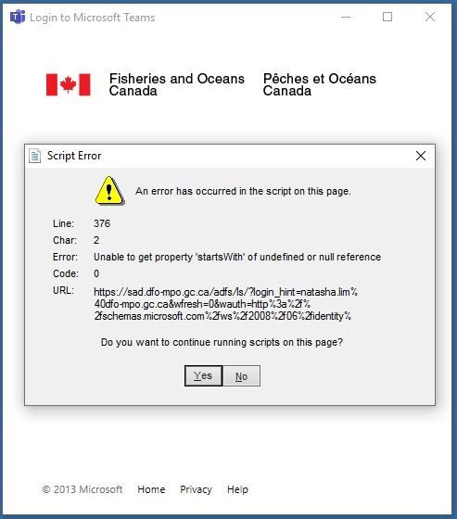
Step 4
You will then receive the following Script Error warning. Click Yes to continue running scripts on this page.

Slide 9
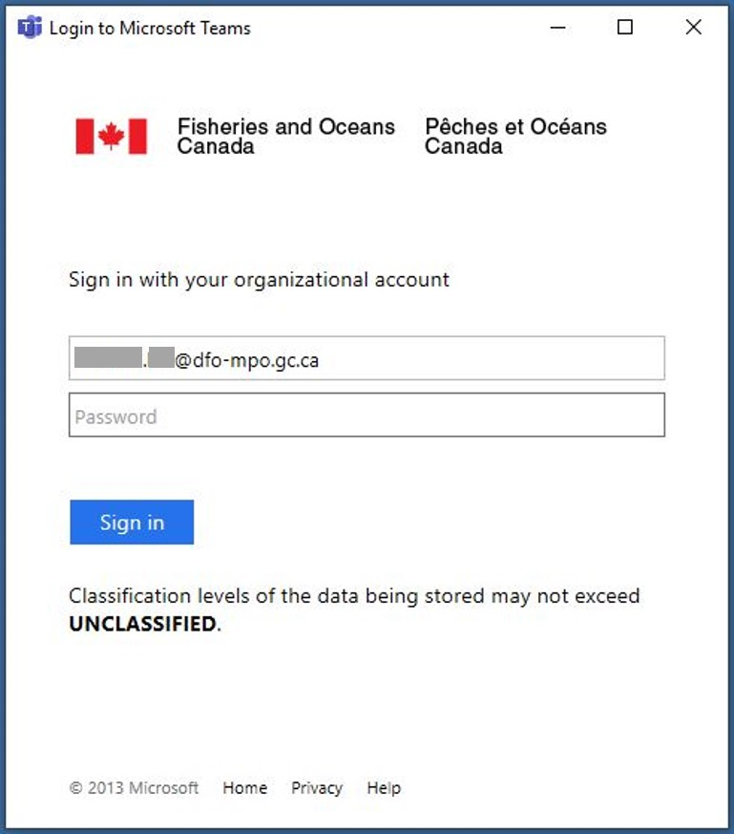
Step 5
Re-enter your credentials to Sign in to your DFO account

Slide 10
Step 6
Select a method to receive your Sign in code
Via Text to your mobile
Via email

Slide 11
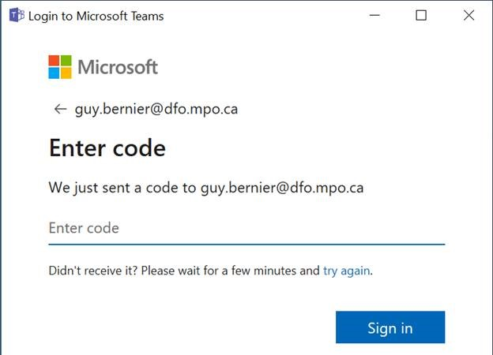
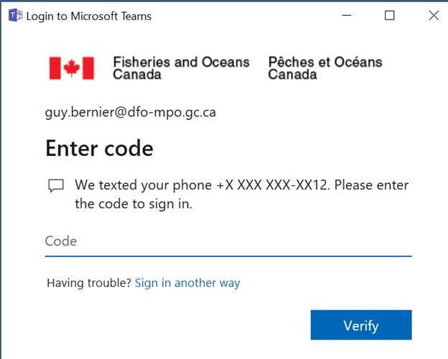
Step 7
Enter your Sign in code to verify your account and Sign in

Slide 12
Congratulations!
You should now have access to Microsoft Teams.
Start exploring!
Join us in the next learning module Navigating Teams
For questions or feedback please contact DFO.IMTS.DWS-SEN.GIST.MPO@dfo-mpo.gc.ca

Slide 13
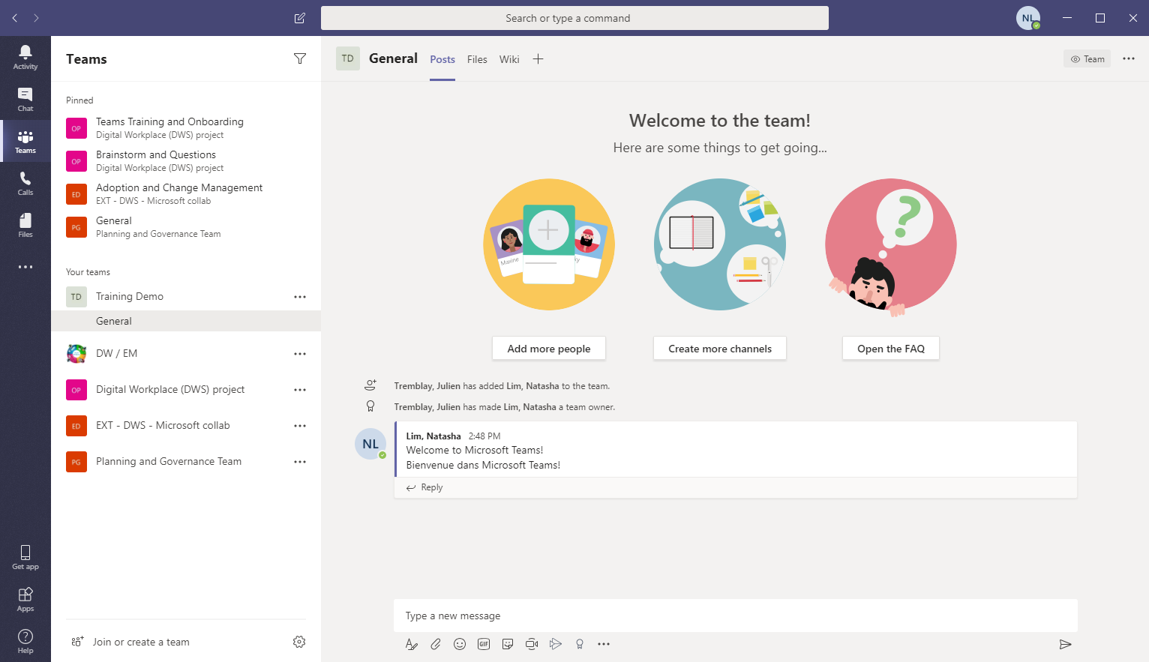
Introducing Microsoft Teams
Microsoft Teams is the hub for teamwork in Microsoft 365
Chat & Collaboration
Meetings & Calling
Applications
Notes:
This is an exciting time to be at the intersection of government and technology. For the first time, there are five generations in the workplace – all with different backgrounds and expectations about collaboration tools.
So where does Microsoft Teams come in?
Microsoft Teams is a hub for teamwork, which brings together everything a team needs: chat and threaded conversations, meetings with screen and file sharing, content collaboration with the power of Office 365 applications, and the ability to integrate and manage the applications that our operations rely on.

Slide 14
Capabilities in Microsoft Teams
Transform workplace collaboration
Streamline departmental processes
Connect everyone on
a single platform
Provide enterprise grade security, compliance & control
Notes:
Teams can help you…
Transform workplace collaboration
Teams brings everything together into a shared workspace where you can chat, meet, create, and make decisions as a team. All your content is organized by team or project, so you are able to stay organized and in the flow of your work, and your files are backed to the Cloud by OneDrive and SharePoint. Teams also allows you to read and edit Office documents right within the context of the project or conversation at hand.
Streamline departmental processes
Simplify your workflows by plugging apps and services you already use, INTO Teams. With Teams you can add your favorite applications or websites as channel tabs for fast access and easy referencing. Assign tasks and track deadlines using the integrated Planner app which helps you organize and track your work visually.
Connect everyone on a single platform
Teams is just as important and effective a tool for a Chief Information Officer or Director, as it is for an Administrative Assistant, or anyone in between. Teams allows us to connect everyone -within the department, across Government of Canada departments, and extended external collaborators, on a single platform backed by the Active Directory.
Provide enterprise grade security & compliance
As a part of Microsoft 365, Teams provides us with the security, compliance, and control we need to operate effectively and in alignment with our governance policies surrounding Information Management.

Slide 15
Teams Demo

Slide 16
Questions?

Slide 17
Thank you!
Join in on the Digital Workplace discussion in Teams using the Team Code: ldmpxvl
For questions or feedback please contact DFO.IMTS.DWS-SEN.GIST.MPO@dfo-mpo.gc.ca

