Slide 1
CRA’s Web presence: critical self-serve infrastructure Service transformation in CRA
For presentation to the GC Web Priorities Working Group
January 27, 2021

Slide 2
Purpose
Share CRA’s Web Optimization Strategy as it relates to the Agency’s digital transformation agenda (a people-first approach)

Slide 3
CRA’s people-first philosophy
CRA has adopted a People First philosophy that aims to transform the Agency into a trusted, helpful, fair and people-centric organization. This includes:
new vision of being trusted, fair, and helpful by putting people first
a set of core guiding principles that speak to how we will work to achieve our new vision
revised wording for our values to make them more meaningful and tangible for employees
a new service identity that describes how service should be translated in our daily activities

Slide 4
Problem statement
10% of pages account for 97% of all traffic
Responsibility for authoring content is 100% decentralized to teams across the CRA
Usability testing with Canadians indicated that on average, only 50% of public participants were able to complete their tasks on the CRA’s web presence
For the 68% of visitors who are individuals coming with questions about their taxes:
Content organized based on CRA’s organizational structure
Uses CRA terminology rather than common words
Written as if users are reading a paper copy rather than online
Focused on CRA programs rather than on user tasks
65% of pages are occasionally viewed (accounts for 3% of all traffic)
25% of pages were not viewed at all

Slide 5
How we secured buy-in at CRA
If we get self-service right:
More efficient operations, better service outcomes, greater levels of trust in the Agency, and increased client satisfaction
Fewer low-complexity calls to the call centre:
Currently, about 2.6M annual calls are low-complexity, costing CRA $10.50 per call
this volume could be reduced significantly, resulting cost avoidance in the range of $15-20M annually
In real terms, this would allow call centres to pick up more higher complexity calls

Slide 6
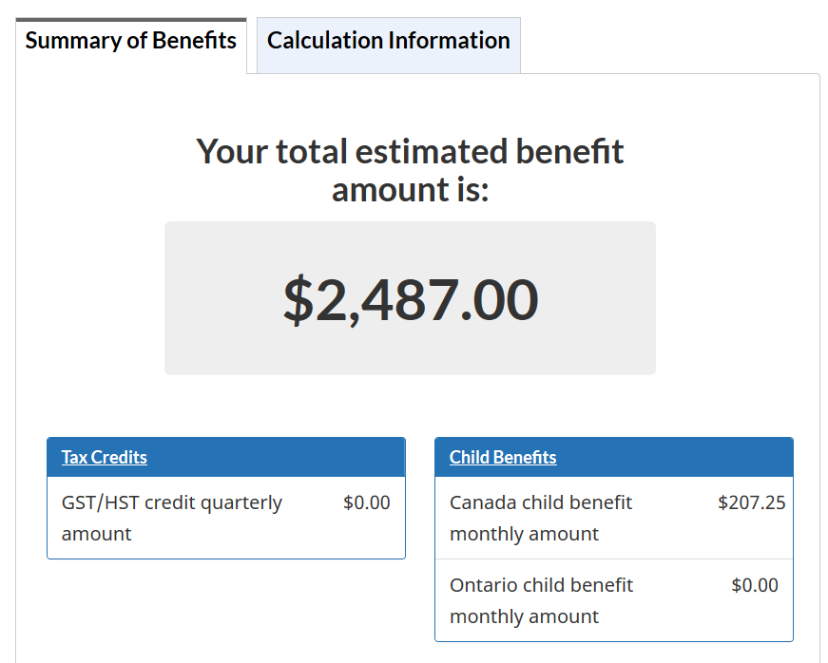
Web optimization reduces calls to the Agency
The Canada Child Benefit (CCB) optimization project made it easier to find answers to common questions people have about this benefit
A key question Canadians had was how much their CCB amounts would be for the next year
Improvements resulted in an improved ability for Canadians to determine the amount using an online calculator
Calls related to CCB benefit amounts dropped by about 50% Q1 of 2020 compared to previous years
June-Oct 2019
Notes:
Calls dropped even with a significant increase in Web traffic. Web improvements were a key contributing factor to this decrease.

Slide 7
Web Optimization Strategy (2019-2023): roadmap to overhaul our Web operations
The Web Optimization Strategy (WOS) is focused on content improvement, enabled by improved skills, better governance and modern technology:
15 content optimization projects (COPs) in partnership with program authors to improve top task content
6 product/feature releases to make content easier to find and understand, including customized content (e.g. decision trees, calculators)
Complete channel-wide improvements to overall navigation, search, and rationalize content on the CRA’s web presence
Establish and enable a Content Design Community by providing training and new toolsets to CRA authors to improve content quality

Slide 8
Introducing new design capabilities: a multi-disciplinary team model
Product manager
Content designers
UX designer
UX researcher
Web developer
Data analyst
Program SMEs
Senior leader champion

Slide 9
COVID-19 measures drive traffic to the Web
Visits to COVID-19 pages (primarily CERB) + June 1st deadline for individuals
visits
March-April: Filing deadline for individuals approaches
Pages migrated to Canada.ca
109% increase March-October 2019 vs 2020
2018
2019
2020

Slide 10
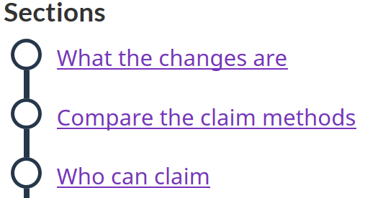
Case study: Research and design process – Home office expenses
4 usability tests to measure design improvements and explanations of policy changes
1 task scenario workshop
4 iterative unmoderated usability tests on TryMyUI
Regular co-design sessions
Built on knowledge gained from testing the COVID benefits
Subway design
Checklists
Calculator
Examples

Slide 11
continued… Example of tasks tested
Task | Baseline User Test | Validation User Test | Percentage (pts) of Improvement
1 – What is my workspace? | 3 out of 8 – (38%) | 7 out of 8 – (88%) | 132%
2 – What expenses can I claim? (Home Internet) | 4 out of 8 – (50%) | 7 out of 8 – (88%) | 76%
3 – What expenses can I claim? (Utilities, Office Supplies, Furniture) | 2 out of 8 – (25%) | 8 out of 8 – (100%) | 300%
5 – Expense limitations | 1 out of 8 – (13%) | 5 out of 8 – (62%) | 377%
Task 1 example – What is my work space?
Perceived ease of use
Jamie and his wife have been working from home since COVID-19 started. Jamie works from home at his dining room table while his wife works in the home office. She will be claiming the office as her work space on her taxes. Can Jamie claim anything?
Very difficult
Neutral
Very easy

Slide 12
Tell the usability story often
The value of UX is mentioned during every executive meeting
It highlights a fundamental gap on how we manage GC digital services today (end users must be part of the design process)
The days of pushing information as an output is not enough – Canadians expect a modern service experience, and they deserve it!
Case study – Home work expenses: https://drive.google.com/file/d/17D3TlWxxdYAWcWXiGoZcpEH4VLvhxg2w/view?usp=sharing

Slide 13
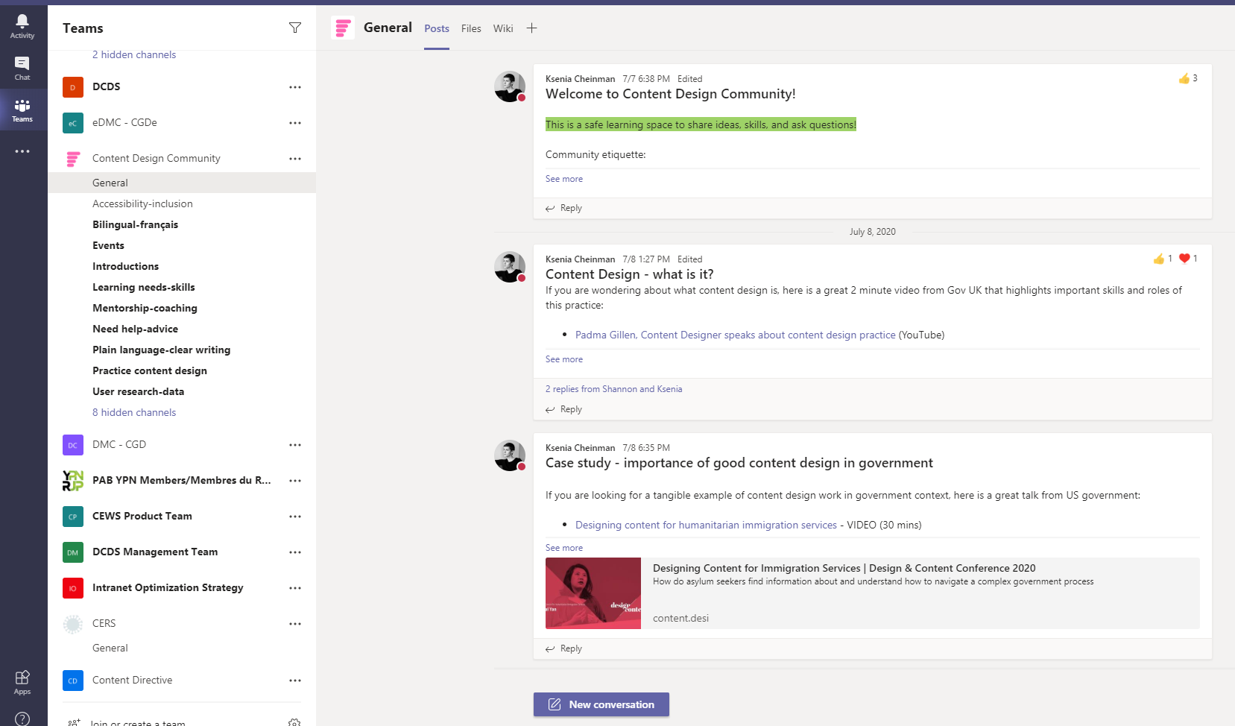
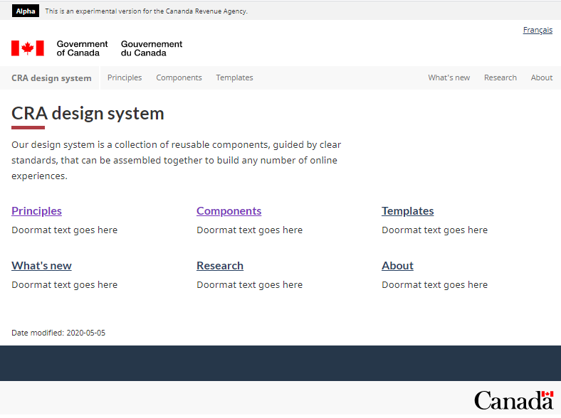
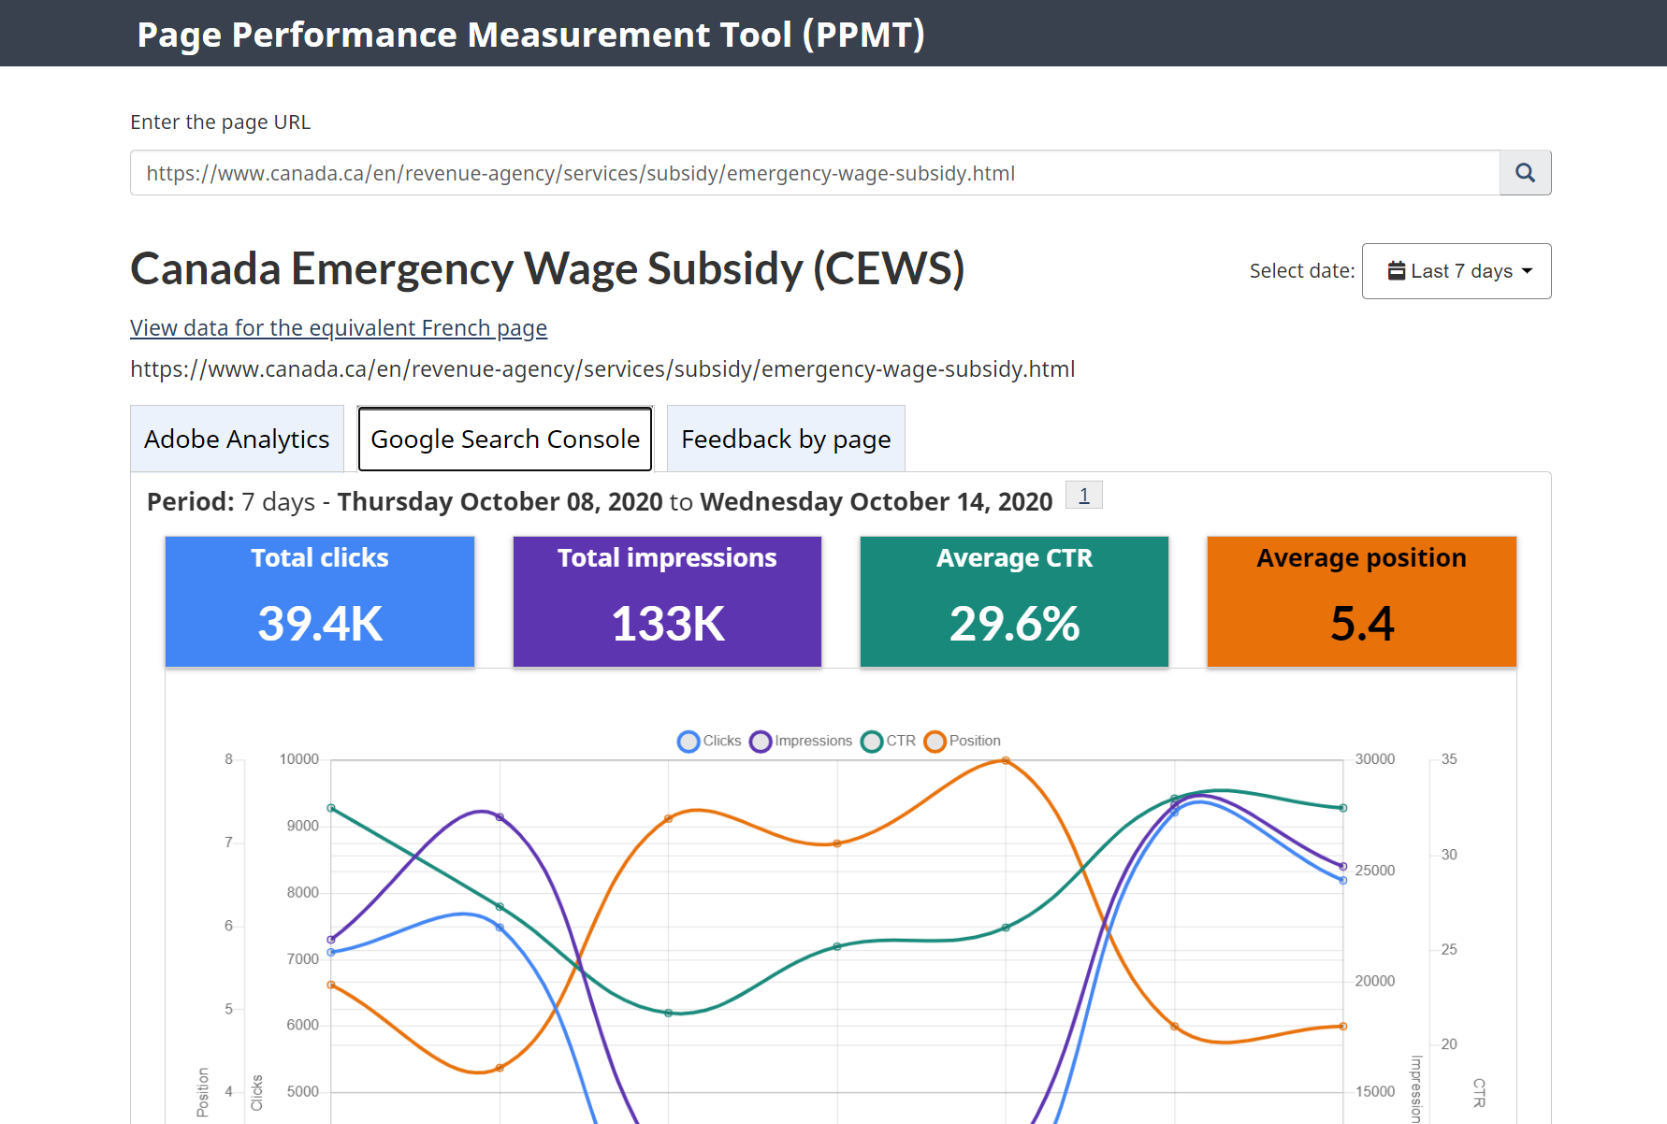
What’s next for the CRA Web presence?
WOS is about modern service management. As we continue to support COVID-19 measures, we are also enabling the community with the skills and tools they need to help manage other services lines effectively.
People
Process
Technology
Community enablement (160 members strong and growing)
Increased capacity to correlate web improvements to call-drivers
CRA Design System
Performance usability analytics (service management)
Content Design Directive
Reputational risk framework
Page Performance Management Tool
VisibleThread
Simplifier (pilot)

Slide 14
What’s your organization carrot?
CRA is an operational organization by default
We don’t administer legislation, we administer the delivery of it
A culture that strives on investing in process improvements
Web optimization has created momentum as a result of our ability to demonstrate tangible return on investment for the organization.
Optimizing the Web will result in fewer calls to the Agency and provide Canadians an effective self-served channel. A tangible outcome to the Agency’s people-first agenda.

Slide 15
Questions
Louis Michaud, Director, Digital Content Design Services
Louis.Michaud@cra-arc.gc.ca
613-406-0872

