Slide 1
WORKSHOP: Black Leadership Excellence: Truth and Resilience
Federal Youth Network
GERARD ETIENNE
GERARD-HUBERT ETIENNE

Slide 2
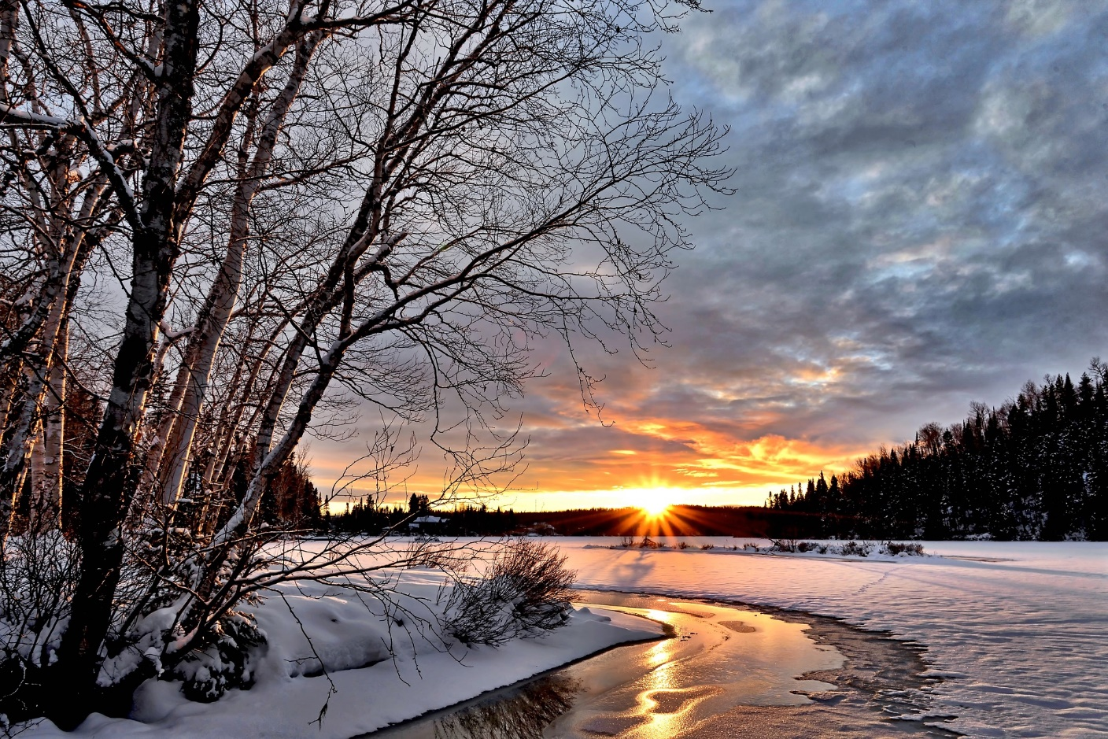
Acknowledging the Land and its People
Let us begin by acknowledging that we are meeting on Indigenous land that has been inhabited by Indigenous peoples from the beginning. As settlers, we are grateful for the opportunity to meet here, and we thank all the generations of people who have taken care of this land - for thousands of years.
Image by Alain Audet from Pixabay

Slide 3
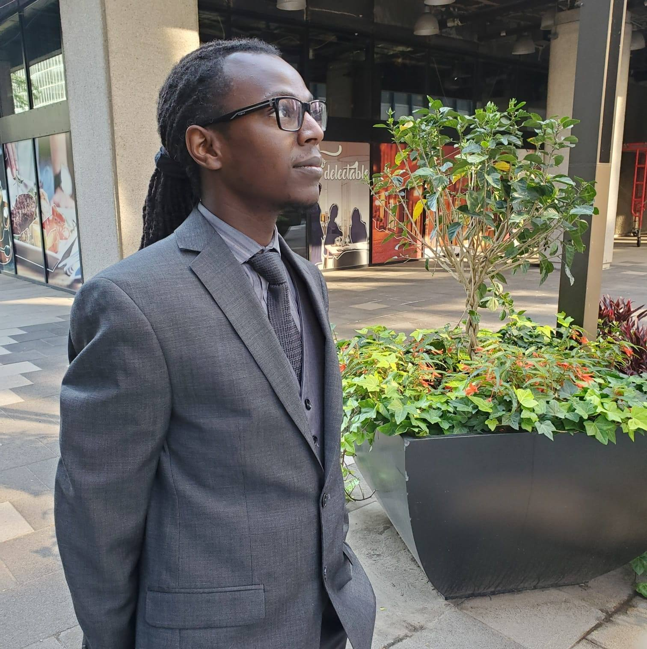
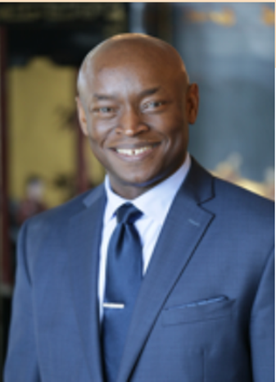
YOUR FACILITATORS
Gérard-Hubert Étienne
Gérard Étienne
Notes:
Welcome from Hamlin and Gerard

Slide 4
CREATING A BRAVE SPACE Adapted from Aware-LA
Welcome multiple viewpoints
Own your intentions and your impacts
Work to recognize your privileges
Lean into discomforts: Take risks
Step back and share space
Listen, listen and then respond
Challenge with care
Soft on self and others, hard on barriers to understanding
Confidentially
Other?

Slide 5
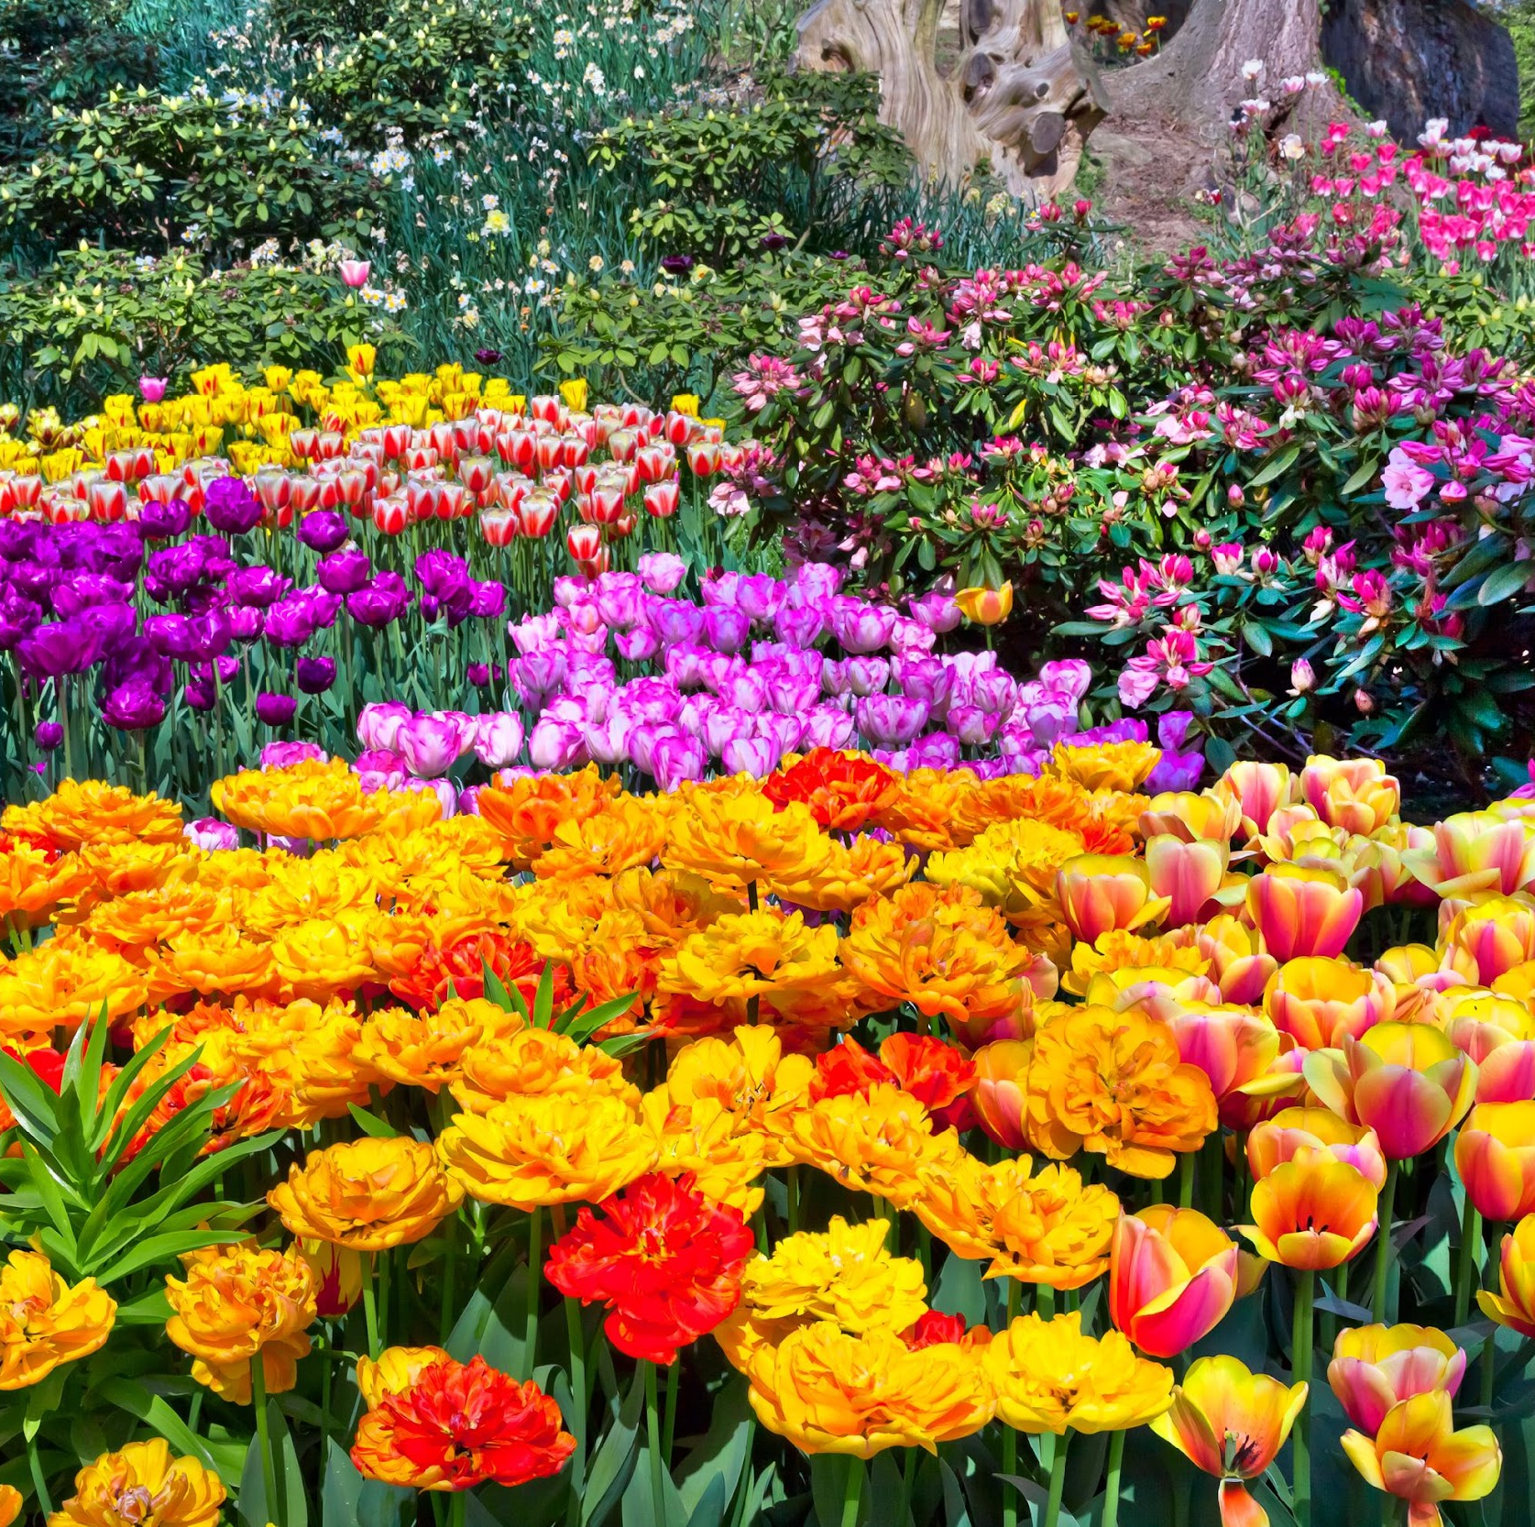
YOU ARE A GARDENER
What emotions does this scene bring to you? How does it make you feel? What words describe it?

Slide 6
YOU ARE ALLERGIC TO FLOWERS
What emotions does this scene bring to you? How does it make you feel? What words describe it?

Slide 7
Food for thought ...
Don’t be afraid of the conversations you’re having. Be afraid of those you’re not having.

Slide 8
OBJECTIVES
Provide the following:
A historical perspective on the notion of racism and anti-Black racism
The Canadian legal and institutional responses
The Big Lie : the myth of racial progress - the fallacy of "visible minorities"
An understanding of what the levers of change will be in 2023 and beyond

Slide 9
A historical perspective on the notion of racism - anti-Black racism and anti-Indigenous racism

Slide 10
Reflect
What does this open and public advertisement tell us about how the author(s) viewed Canadian identity?
How does this compare with how Canadian identity is portrayed in the media and by politicians today?
If we value inclusiveness as a goal, have we reached that goal yet? Do you think that goal is attainable?

Slide 11
Intercultural incompetence or RACISM
What happened with Blackface
Québec’s secularism law
Quebec's secularism law is a national disgrace — and yet barely an election issue: Robyn Urback for CBC News Opinion · Posted: Aug 28, 2019
When state-sponsored discrimination is the law anywhere in Canada, it is everyone's business : As of June, public servants in the province who work in so-called positions of authority — teachers, judges, police officers and so on — are prohibited from wearing religious symbols. Those who flout the ban are effectively shackled to their spots thanks to a grandfather clause that says they can't be promoted or moved. Those who wear kippahs, turbans, crosses or hijabs need not apply.

Slide 12
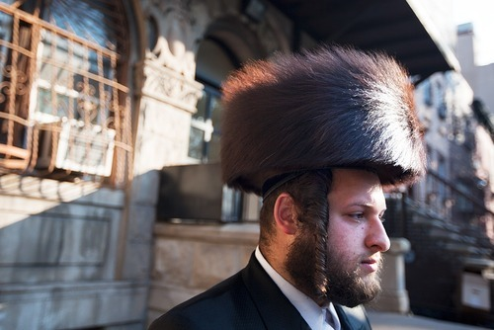
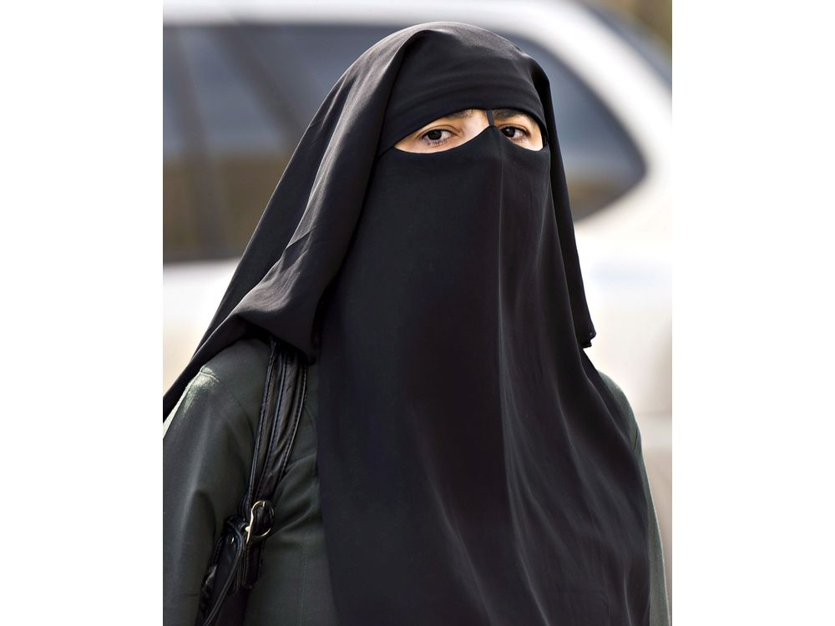
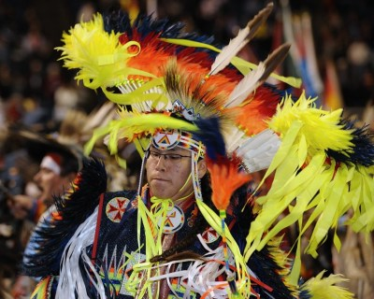
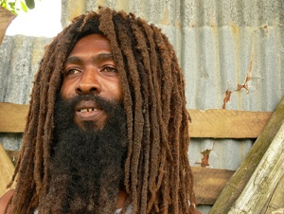
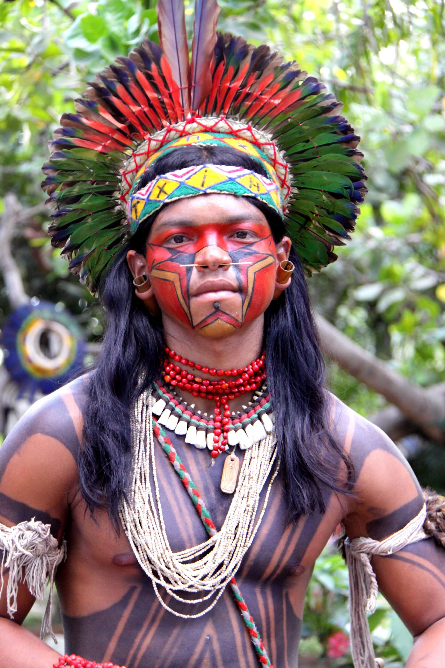
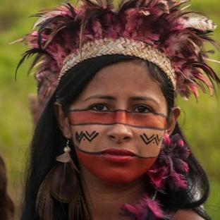
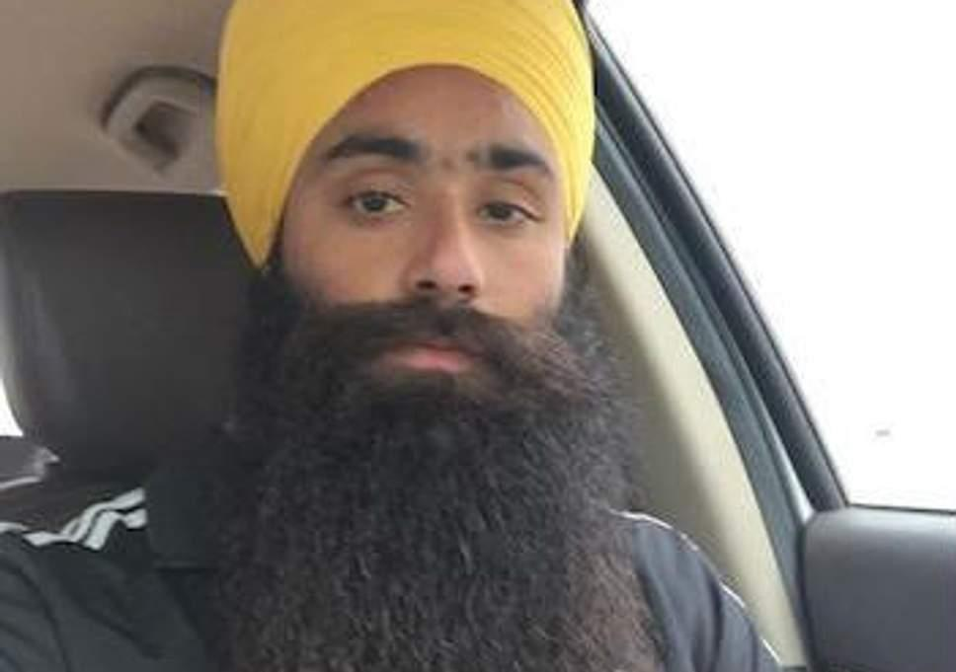
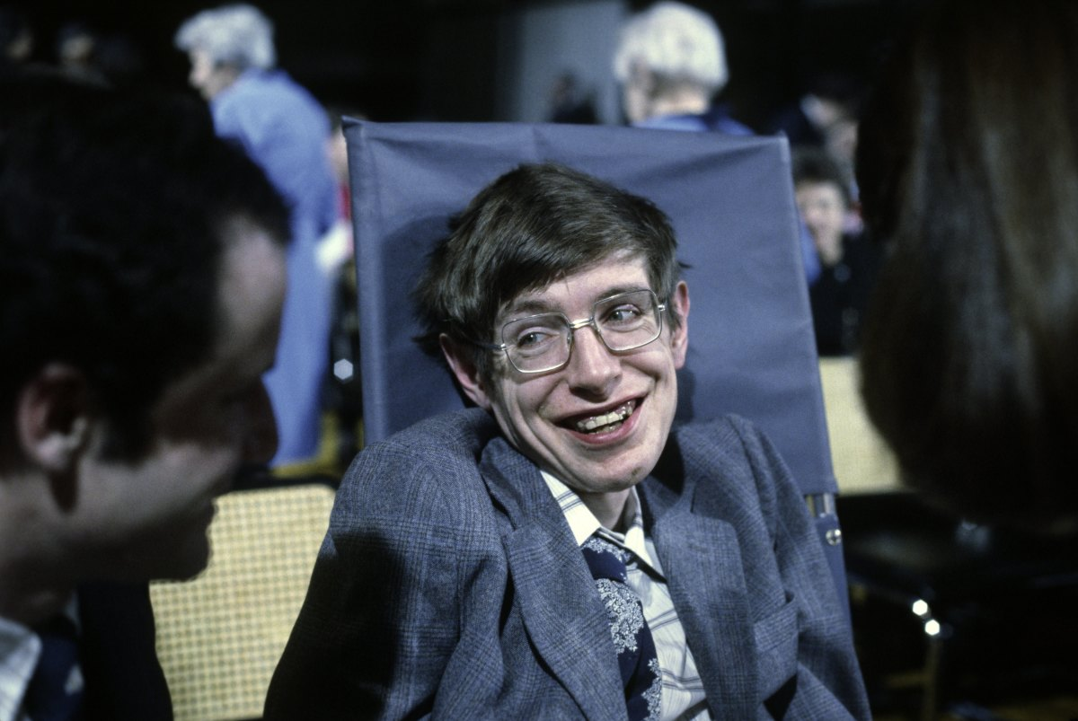
The next Clerk?
Notes:
QUESTION: am I a leader?
TASK: Make a list of great leaders you know:
Which ones are authority figures?
Identify who you would listen to
DISCUSSION: difference between leadership and authority?
Formal authority – granted
Informal authority – conferred
Most think informal authority = leadership.

Slide 13
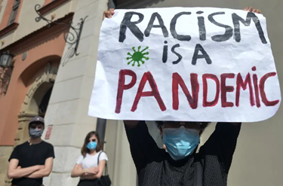
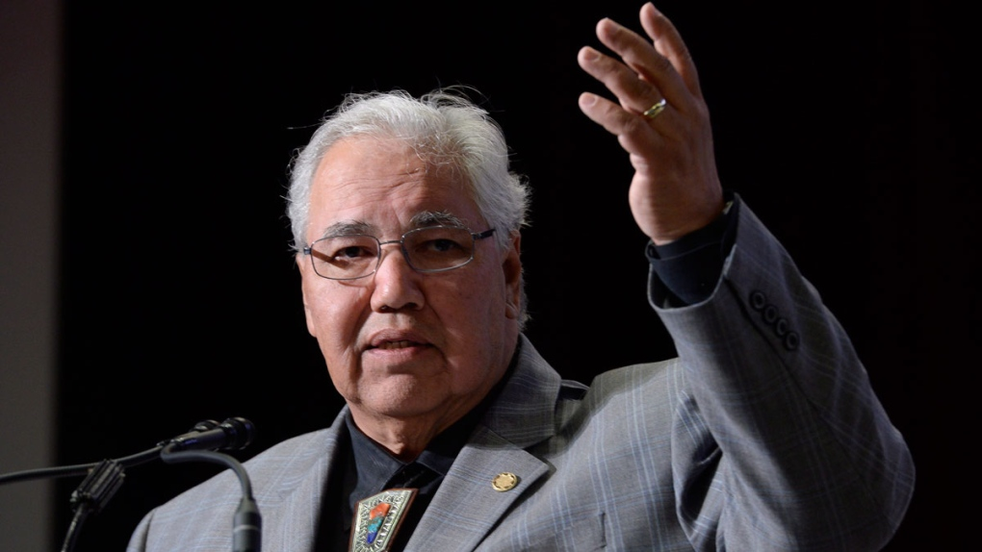
Understanding “ISMS” as Systemic Problem
Sexism
Racism
Cis-genderism
Ableism
Ethnocentrism
Image credit: The Canadian Press, 2015
Former Senator Murray Sinclair and head of the Truth and Reconciliation Commission framed it in this way:
“Systemic racism is when the system itself is based upon and founded upon racist beliefs and philosophies and thinking and has put in place policies and practices that literally force even the non-racists to act in a racist way.”

Slide 14
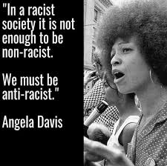
Anti-Racism
A framework and set of policies and practices that actively oppose racism and promote racial equity
"Anti-racism is the active process of identifying and eliminating racism by changing systems, organizational structures, policies and practices and attitudes, so that power is redistributed and shared equitably." Quote source: NAC International Perspectives: Women and Global Solidarity
Notes:
IG/AB
NAC = National Action Committee

Slide 15
ANTI-BLACK RACISM
Blacks make the highest proportion of visible minorities @ 19%. And yet…
Anti-Black racism is manifest in the current social, economic, and political marginalization of African Canadians, which includes unequal opportunities, lower socio-economic status, higher unemployment, significant poverty rates and overrepresentation in the criminal justice system. Ontario Anti-Racism Directorate

Slide 16
CONTEXT: ANTI-INDIGENOUS RACISM
It’s the genocidal violence practiced by the French and British via the violent colonization processes throughout the Americas, which included waging war against Indigenous societies, paying bounties for the scalps of Indigenous People, using poisoned food and blankets contaminated with smallpox,...starvation, coercion, trickery and deception (Henry & Tator, 2010).
The Indian residential school system is a striking example of a deadly colonialism steeped in discourses of white supremacy

Slide 17
The Canadian legal and institutional responses

Slide 18
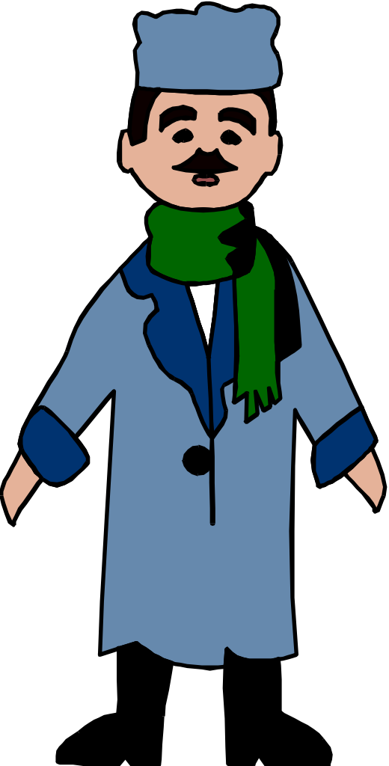
Legislative Requirements for inclusion (freedom from discrimination and harassment)
Race
Place of origin
Ethnic origin
Creed (religion)
Ancestry
Colour
Citizenship
Language
Sex (gender)
Sexual orientation
Mental disability
Physical disability
Age
Marital Status
Record of offences (pardoned)

Slide 19
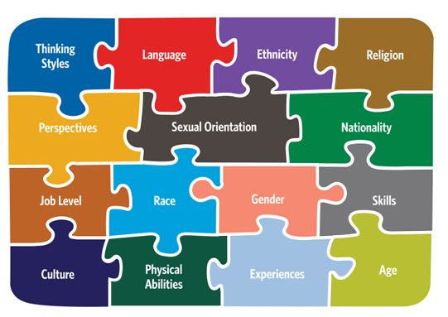
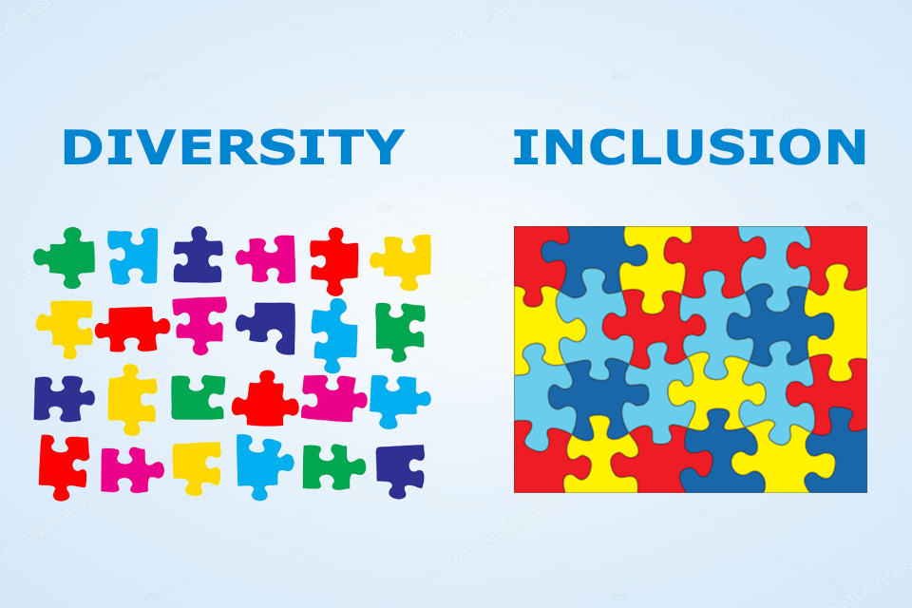
From… EQUITY To DIVERSITY To INCLUSION

Slide 20
The Three Revivals of the INCLUSION Paradigm

Slide 21
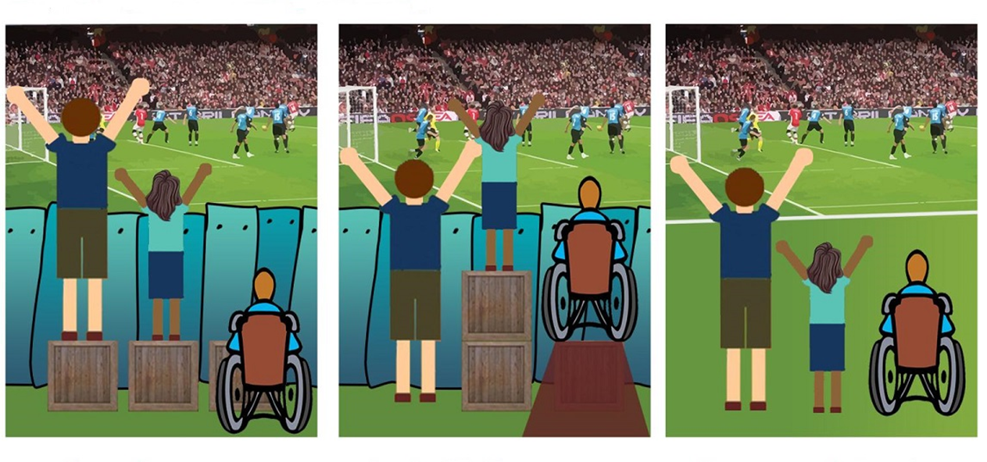
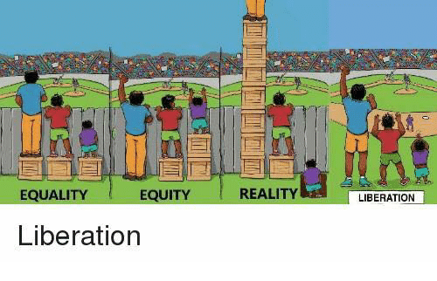
“THE OUTCOME COUNTS”
EQUITY:
A condition or state of fair, inclusive and respective treatment of all people. Equity is different from equality; it does not mean treating people the same without regard for individual differences.
It focuses instead on achieving the sameness of result, recognizing that everyone has unique needs and social locations.
www.canadianequality.ca

Slide 22
Equity: Systemic Fairness
Equity involves identifying and eliminating structural and attitudinal barriers that prevent people and groups in society from participating fully and achieving equal outcomes.
Equity recognizes the historical factors that have created the social conditions of disadvantage for specific group while creating the conditions of advantage for other groups.
Source: Equity Literacy Institute
Photo by Elena Mozhvilo on Unsplash

Slide 23
Understanding Equity…
The University of Michigan Story

Slide 24
Equality means sameness Equity means fairness
When we treat people EQUALLY, we ignore differences
When we treat people EQUITABLY, we recognize differences

Slide 25
The Big Lie : the myth of racial progress - the fallacy of "visible minorities"

Slide 27
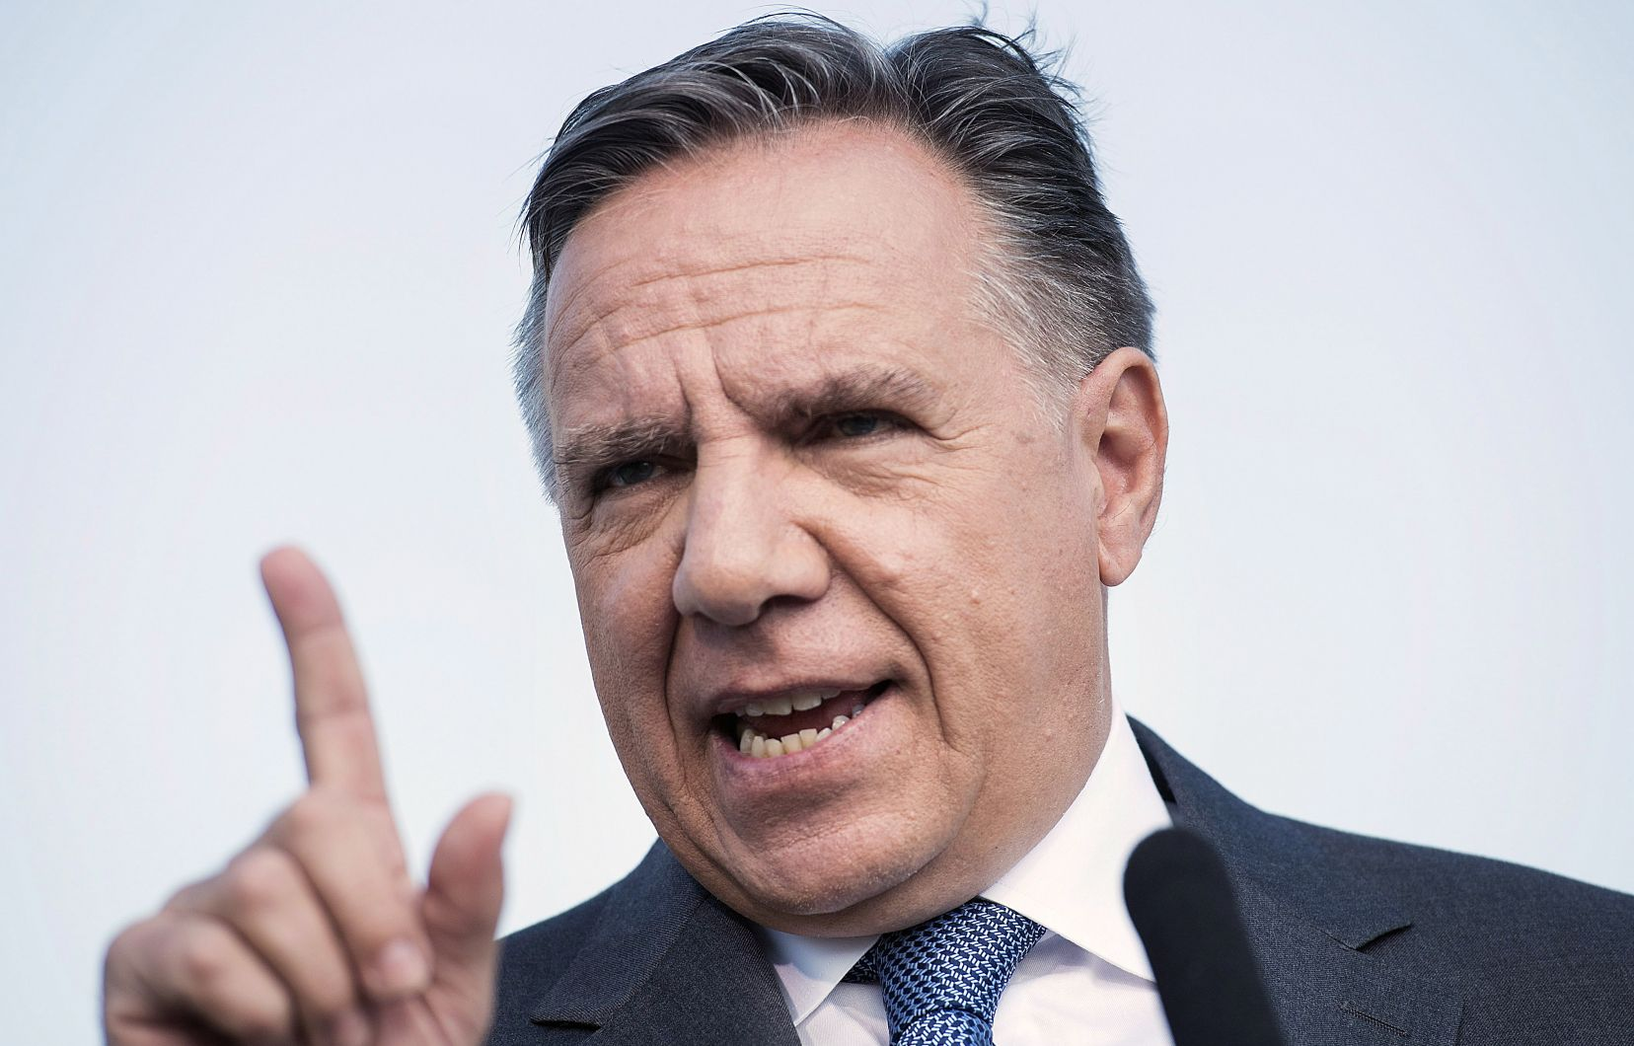
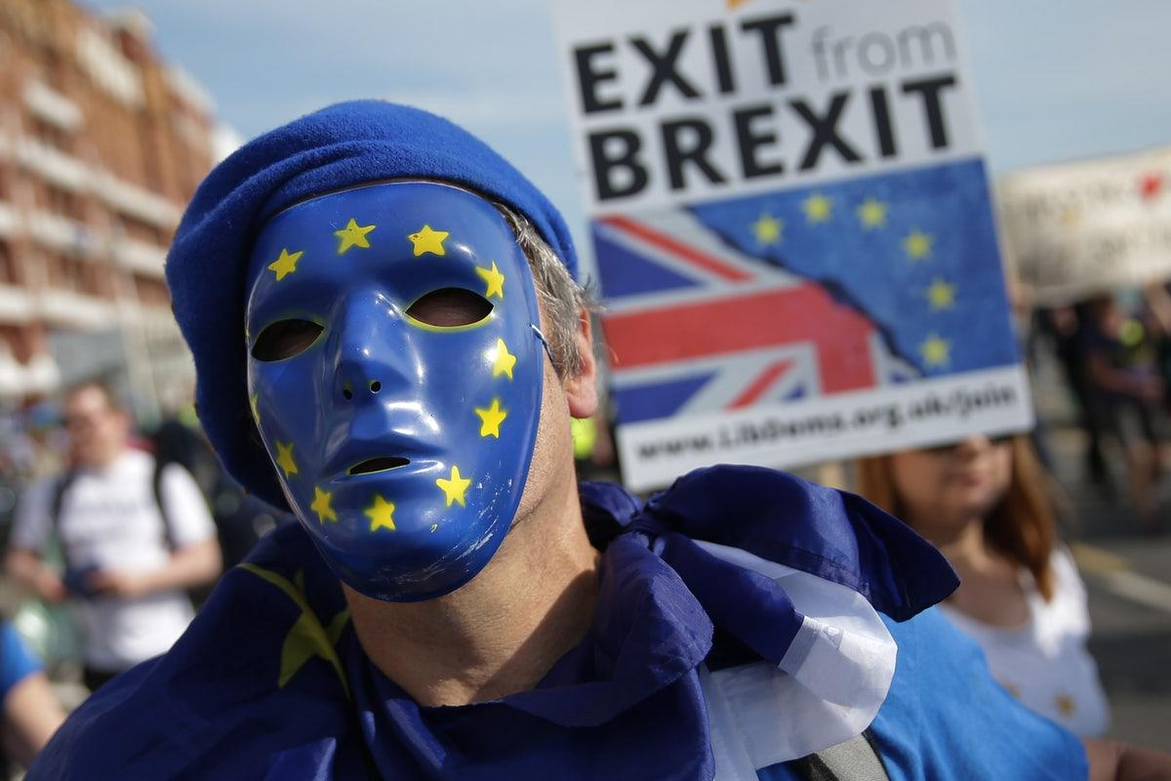
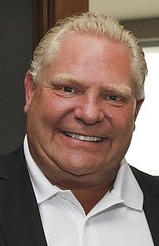
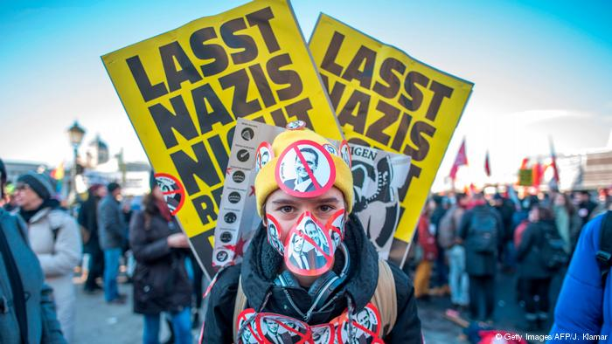
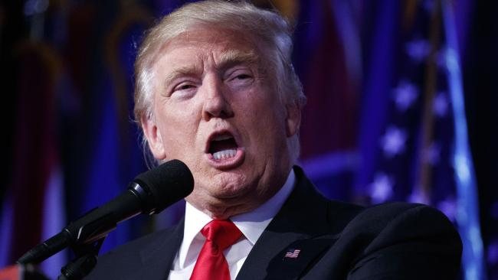
Faces of Populism

Slide 28
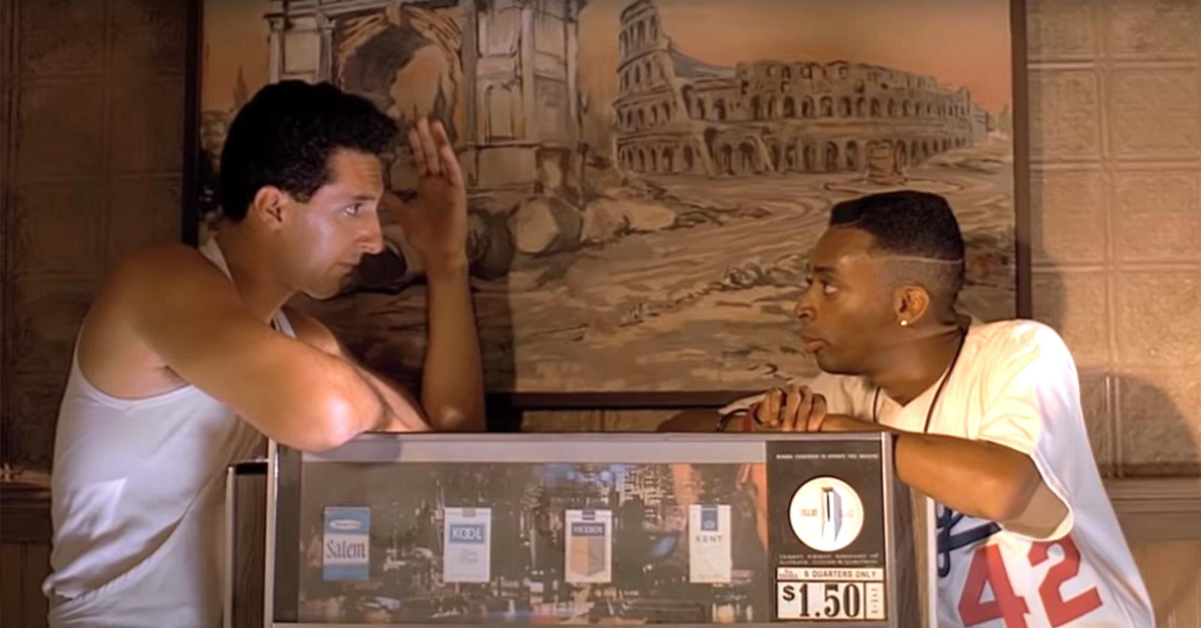
https://www.youtube.com/watch?time_continue=1&v=gLYTObRhcSY&feature=emb_logo

Slide 29
An understanding of what the levers of change will be in 2023 and beyond

Slide 30
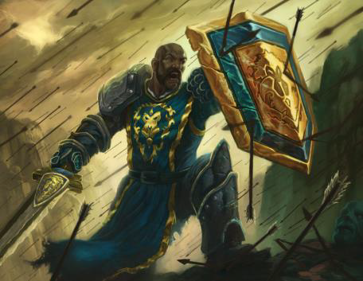
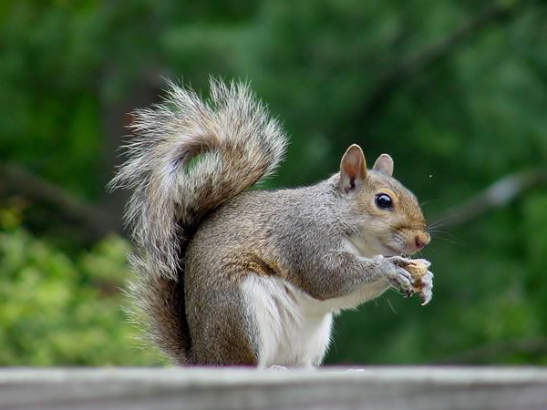
A THEORY OF CHANGE

Slide 31
Change Style Continuum
Conserver
Pragmatist
Originator
⏐
⏐
⏐
⏐
⏐
⏐
⏐
⏐
⏐
⏐
⏐
⏐
⏐
66
56
42
28
14
7
0
7
14
28
42
56
66
25 % 50 % 25 %

Slide 32
Change Style Preference
CONSERVERS
Accept the structure
Prefer change that is incremental
PRAGMATISTS
Explore the structure
Prefer change that is
functional
ORIGINATORS
Challenge the structure
Prefer change that is expansive

Slide 33
Intercultural Development Continuum and Social Justice
“I can see all systems are essentially designed to get the results they are getting. I want to dismantle racism.”
“I want to better understand how racism impacts people and our work. I get it, but I don’t know what to do.”
“All lives matter.
I don’t see colour.”
INTERCULTURAL
MINDSET
“Defense: They are a threat to our way of life.
Reversal: I am so ashamed by my culture.”
ADAPTATION
Bridges across difference
“What racial problem? I don’t get it. This has nothing to do with me. Indifference.”
ACCEPTANCE
Deeply comprehends difference
MINIMIZATION
De-emphasizes difference
POLARIZATION
Bridging
Judges difference
Universalism
DENIAL
Misses difference
MONOCULTURAL MINDSET
Assimilation

Slide 34
Reflections and Committments

Slide 35
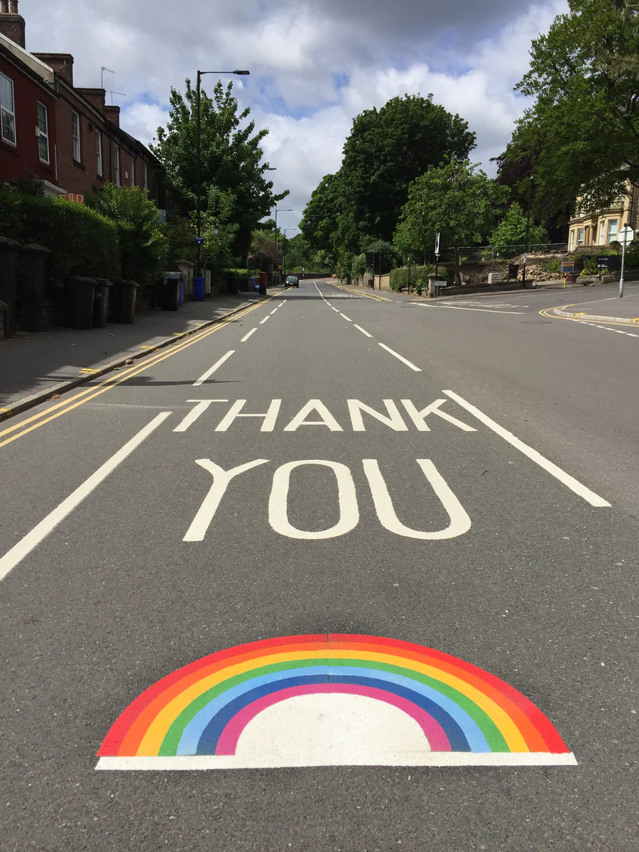
Photo by Caleb Chen on Unsplash

