Slide 1
Q1 TSS results
Digital Transformation Office • #CanadaDotCa • August 2023
Notes:
Opening slide

Slide 2
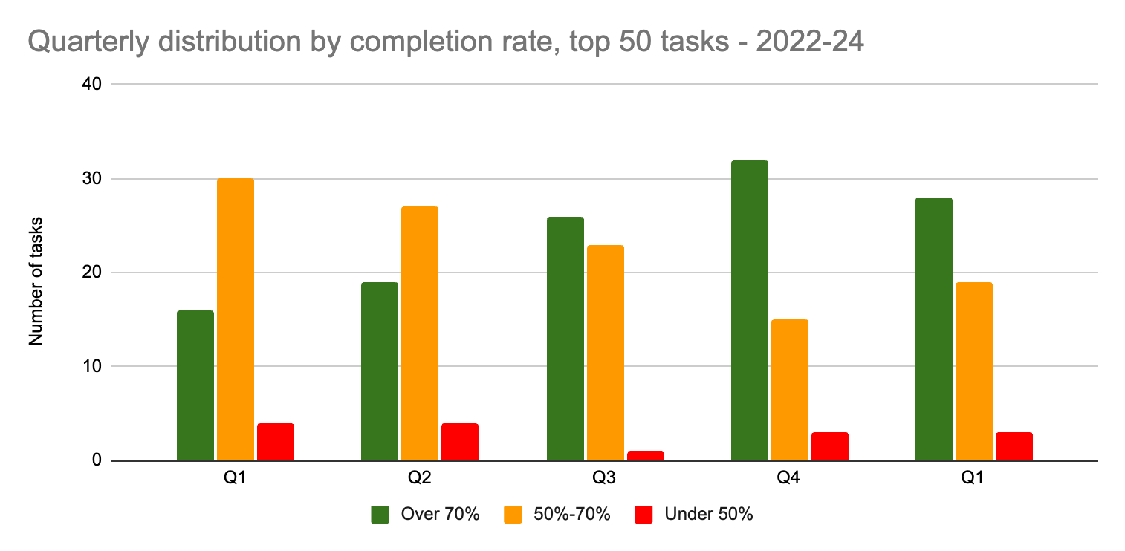
Quarterly comparison
Top 50 tasks: Small drop in green tasks last quarter
Very little change to top 50 success rates compared to Q4. Only 4 tasks had an increase that was statically significant. 3 tasks with the largest decrease were tax-related - not surprising since Q1 is the peak of tax season (but the change was not statistically significant)
Notes:
Apply for a work permit
0
0.73
3.20%
Check your application status
0
0.7
4.30%
Employment Insurance (EI) - Submit an Employment Insurance Report
0.02309
0.87
2.70%
My Service Canada Account (MSCA) - Check your Employment Insurance (EI) claim status and correspondence
0.0092
0.67
4.90%

Slide 3
Top 50 tasks
Q4 (22-23) : Q1 (23-24)
 | Q4 | Q1
Top 50 task completion average | 72.1% | 69.2%
Top 50 tasks in the green (over 70%) | 32 | 28
Top 50 tasks in the orange (50%-70%) | 15 | 19
Top 50 tasks in the red (below 50%) | 3 | 3

Slide 4
Top performers
Employment Insurance (EI) - Submit an Employment Insurance Report | 90.10%
Calculate payroll deductions | 85.10%
Travel advice and advisories | 82.40%
Check processing times | 81.80%
My Service Canada Account (MSCA) - View payment information | 81.50%
Jobs in the federal public service | 80.30%
Find out how much my benefit payment will be | 79.90%
Visit a national park or historic site | 79.90%
Check online mail | 78.90%
Get current and forecasted weather for your location | 78.80%
Jobs in the private sector | 78.80%
Top tasks in Q1 with the highest completion percentage
10 tasks are the same as Q4. New entries in yellow.

Slide 5
Biggest improvements
My Service Canada Account (MSCA) - Check your Employment Insurance (EI) claim status and correspondence | +4.9%
Check your application status (IRCC) | +4.3%
IRCC secure account - register, sign in, help * not statistically significant | +3.9%
Apply for a work permit | +3.2%
My Service Canada Account (MSCA) - Register for an account * not statistically significant | +3.1%
My Service Canada Account (MSCA) - Sign in * not statistically significant | +3.0%
Employment Insurance (EI) - Submit an Employment Insurance Report | +2.7%
Top 50 tasks in Q1 (23-24) with the greatest improvement in completion percentage compared to Q4 (22-23)

Slide 6
Thank you for your time
Lana Stewart
Design Researcher Digital Transformation Office Treasury Board of Canada Secretariat
Lana.Stewart@tbs-sct.gc.ca
Nicolas Pjontek
Manager, Analytics Services
Principal Publisher Service Canada
Nicolas.Pjontek@servicecanada.gc.ca
GC Task Success Survey on GCpedia

