Slide 1
Departmental Showcase / Ministère sous les projecteurs Statistics Canada / Statistique Canada August 02, 2022

Slide 2
Agenda:
Meet the moderator and co-producers
Statistics Canada at a glance
Meet our speakers – individual presentations
Job opportunities at Statistics Canada
Q&A
Contact us
Rencontrez la modératrice et les coproductrices
Statistique Canada en un coup d'œil
Rencontrez nos conférenciers - présentations individuelles
Possibilités d'emploi à Statistique Canada
Q&A
Contactez nous
Notes:
From the IAD of Field 5 - Economics Statistics
Studys at Laval university and plays piano

Slide 3
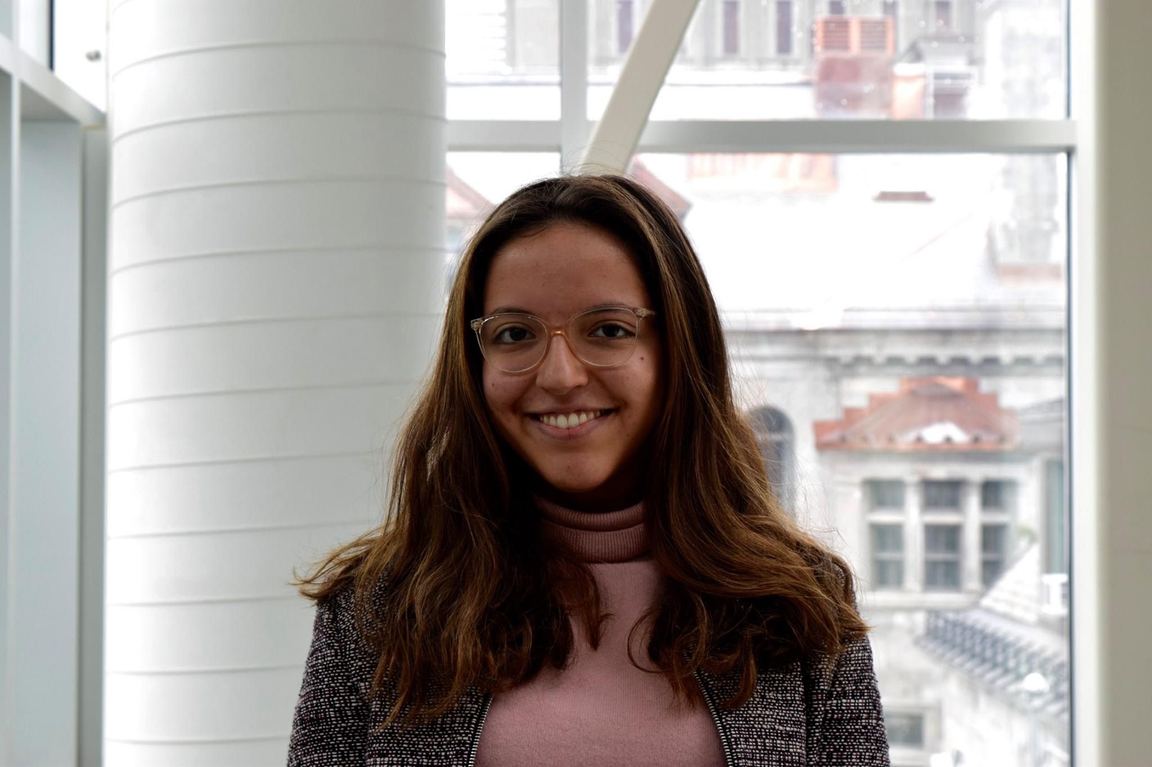
Moderator & Co-producers / La modératrice et les coproductrices
Ruting Guo
First position: Analyst, Monthly Wholesale Trade Survey
Current position: Analyst, Quality of Life team in the Centre for Income and Socioeconomic Well-being Statistics
Statistics Canada’s Student Representative
Member of Statistics Canada Professional Network Student Subcommittee
Mahrukh Shah
Recruit Analyst
First rotation:
Dissemination and Production Unit in the Centre for Labour Market Information
Second rotation:
Mortality and Quality of End of Life, in the Centre for Population Health Data
Member of Statistics Canada Professional Network Student Subcommittee
Sara Pineros
Recruit Analyst
Premier rotation: Division des Comptes des Industries
Deuxième rotation: Division du commerce et des comptes internationaux (DCCI/IATD)
Member of Statistics Canada Professional Network Student Subcommittee

Slide 4
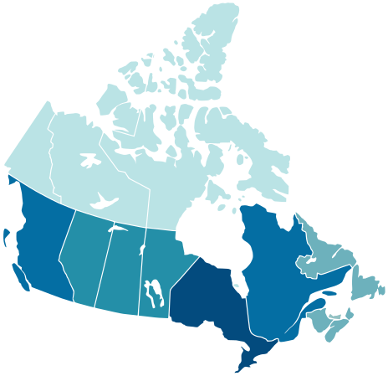
Statistics Canada at a glance / Statistique Canada en un coup d'œil
Mandate / Mandat
Organizational structure / La structure
Statistics Canada produces data that help Canadians better understand their country - its population, resources, economy, environment, society and culture.
Chief Statistician of Canada Anil Arora
Fields:
Economic Statistics
Social, Health and Labour Statistics
Census, Regional Services and Operations
Analytical Studies, Methodology and Statistical Infrastructure
Corporate Strategy and Management
Digital Solutions
Strategic Engagement
Mission / Mission
Statistics Canada's mission is to provide trusted data, statistical services and insights required to support decision-making.
Main roles / Rôles principaux
Fournir des renseignements et des analyses statistiques sur la structure économique et sociale du Canada
Promouvoir l'utilisation de pratiques et de normes statistiques reconnues
Regional Offices /
Bureaux régionaux

Slide 5
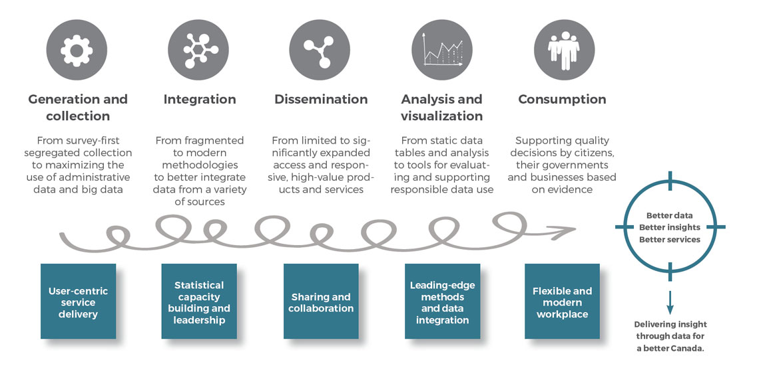
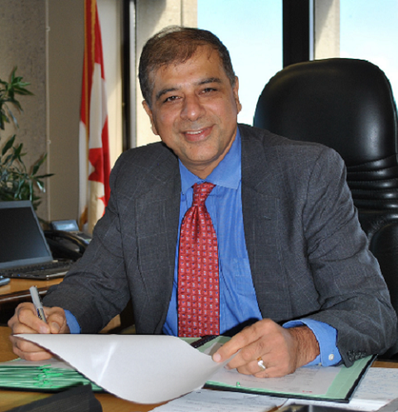
Modernization initiative / L'initiative de modernisation
Modernizing to serve Canadians / En modernisation pour servir le Canada
Statistics Canada: 100 Years and Counting / Statistique Canada : Cent ans bien comptés
-AnilArora

Slide 6
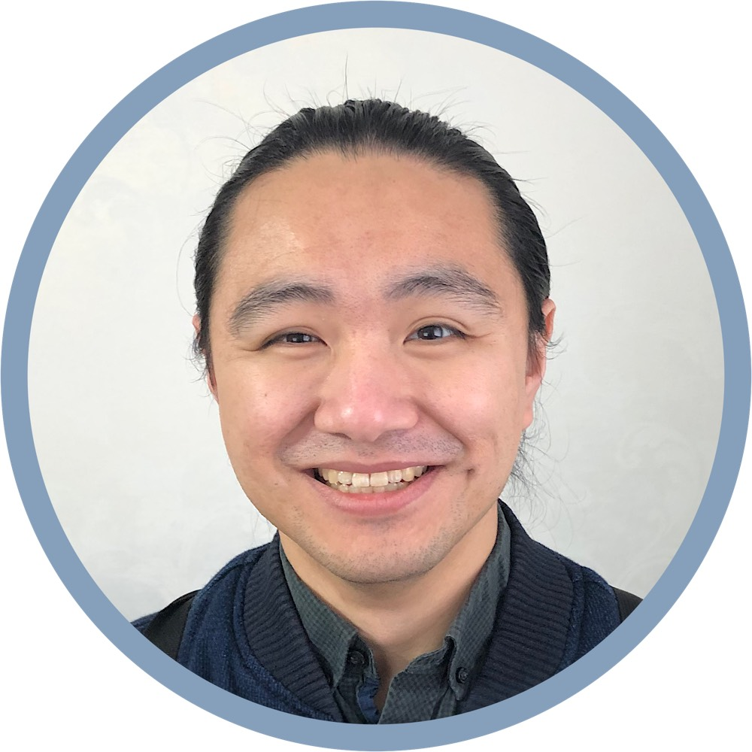
Zheren Hu Unit Head, Canadian Housing Survey
Steps of the data journey (click to learn more)
Education background | Career journey | Functions
B.Sc. Biomedical Sciences M.A. Applied Economics | Co-op student with ESDC StatCan's EC-RDP graduate | Data development (via linkages) Data analysis and dissemination
Other engagements | Enjoying StatCan | Lessons learned
Functional groups, CoPs, etc. Mentorship program | Like-minded colleagues Expert subject matter guides | Be adaptable and embrace change Bring value and build relationships
Notes:
CISWS: Centre for Income and Socioeconomic Well-being Statistics
SHLSF: Social, Health and Labour Statistics Field

Slide 7
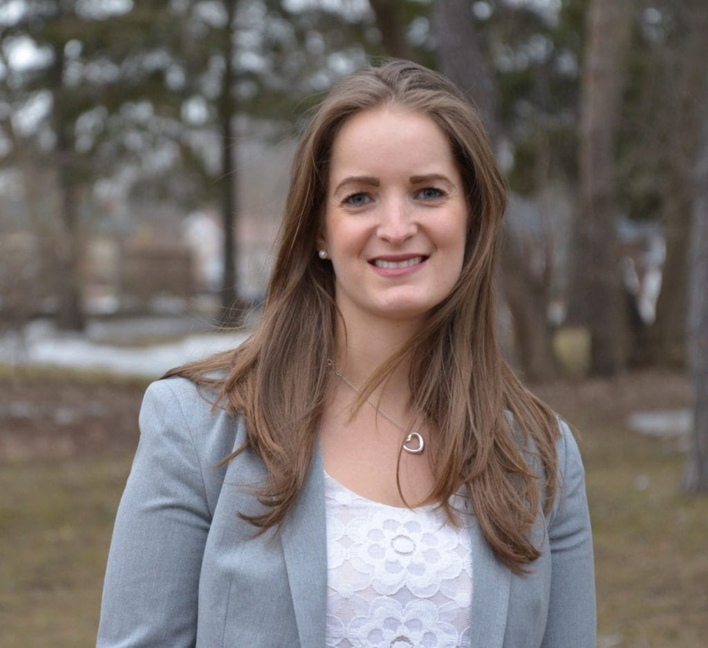
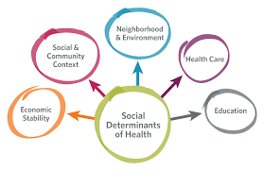
Danielle Bader, Ph.D. Junior Research Analyst, Health Analysis Division, Analytical Studies and Modeling Branch
Educational background
Criminology (B.A.), York University
Criminology and Criminal Justice Policy (M.A.), University of Guelph
Sociology (Ph.D.), University of Guelph
Career development
Statistical Assistant, Branch Research Data Centre, University of Guelph
Research Assistant and Teaching Assistant positions
Graduate research projects and publications
Lessons learned
Expand your network
Diversify your skills
Enjoying StatCan
Positive workplace culture
Professional development
Working on research projects to contribute to a better Canada
Health Reports - June 2022 (statcan.gc.ca)

Slide 8
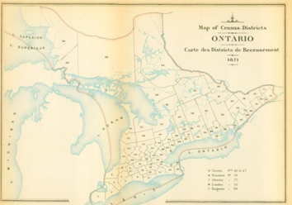
Elizabeth Nash – Librarian, Strategic Data Management Branch
Éducation | Développement de carrière | Bénévolat
Langue et littérature anglaises, L’Université Western Ontario (B.A.) Sciences de l'information, L’Université McGill (MISt) | Spécialiste de l'information, Innovation, Sciences et Développement économique Canada Bibliothécaire, Statistique Canada | Secrétaire, Réseau stratégique des bibliothèques fédérales canadiennes
Sample projects | Enjoying StatCan | Lessons learned
Literature searches Journal integrity guide Historic map guide | Working with the public on issues that matter to local communities Never the same day twice | Never stop learning! Ask for help

Slide 9
Johan Fernandes – Data Scientist, Data Science Division
Education Background | Career Background | Fields I'm interested in
MCS in Applied A.I. (University of Ottawa) BCS in Applied Computing (University of Windsor) | Research and Teaching Assistant (University of Ottawa) SAP UI5 Full stack developer at Bristlecone Ltd. | Artificial Intelligence Computer Vision Document Analysis
Sample Projects | Lessons Learned | Enjoying at StatCan
Information Extraction from electronic documents Identifying outliers in images | There's always more to learn Positive or negative feedback is always helpful | Learning more than I could have ever imagined Seeing the positive impact of our work on Canadian lives
Data Science Projects (statcan.gc.ca)

Slide 10
Frances Zsurka – Technical Advisor, Cloud and Workload Migration Division
Education background
Pure and Applied Science, Vanier College (DEC)
Computer Science, Concordia University (B.Sc.)
Career development
Lessons learned
Graduated into the Cloud Native Solutions team
Enjoying StatCan
CSRDP (Data Analytics as a Service, Cloud Native)
Seek out alternate solutions and learning opportunities
Be vocal about what you are interested in
Open-source modernization (CNCF, k8s, DevSecOps)
Support for continuous learning
Learn more about the Cloud Native Platform: EN | FR

Slide 11
Job opportunities at Statistics Canada / Offres d'emploi à Statistique Canada
Alternance travail-études ou stage
(Co-op / Internship)
Expérience de quatre mois.
Consultez les tableaux d’affichage du centre de carrière de votre campus ou du centre de placement par alternance travail-études ou stage. Les offres ne se trouvent pas sur le site Internet de la Commission de la fonction publique (CFP). StatCan s’adresse directement aux établissements d’enseignement.
GC Emplois
(GC Jobs)
Banque de données des emplois disponibles dans la fonction publique
Programme de recrutement et de perfectionnement des EC – Volet analyse
(EC Recruitment and Development – Analysis Stream)
Le programme combine une formation structurée obligatoire avec une expérience de travail pratique, qui consiste habituellement en deux périodes de douze mois d'affectations par rotation. Vous recevrez l'aide d'un mentor et vous travaillerez en étroite collaboration avec un gestionnaire de programme de ressources humaines.
Programme fédéral d’expérience de travail étudiant
(Federal Student Work Experience Program)
Géré par la Commission de la fonction publique (CFP). Si vous fréquentez à temps plein une école secondaire, un cégep, un collège, un institut de technologie ou une université, remplissez la demande en ligne du PFETE. Il n’y a pas de date limite pour s’inscrire au PFETE. Les étudiants à temps plein peuvent le faire à tout moment de l’année.
Résautage
(Networking)
For futher information, you may refer to the Muslim Federal Employees Network Career Resource Handout following this link: https://gcconnex.gc.ca/file/view/105784533/mfen-career-resource-handout-document-dinformation-sur-les-carrieres-du-refm
Notes:
Co-op
FSWEP
GC Jobs
Programme de recruitement
Résautage

Slide 13
Contact us / Nous contacter
Ruting Guo: ruting.guo@statcan.gc.ca
Mahrukh Shah: mahrukh.shah@statcan.gc.ca
Sara Pineros: sara.pineros@statcan.gc.ca
Zheren Hu: zheren.hu@statcan.gc.ca
Danielle Bader: danielle.bader@statcan.gc.ca
Elizabeth Nash: elizabeth.nash@statcan.gc.ca
Johan Fernandes: johan.fernandes@statcan.gc.ca
Frances Zsurka: frances.zsurka@statcan.gc.ca

