Slide 1
The Lending Library Service Pilot Project
Quick access to adaptive technology, accommodation, services, and tools for public service employees with short term needs
2021-12

Slide 2
Agenda
Overview of AAACT
Definitions: Accessibility, Equity, and Inclusion
What is the Lending Library Service Pilot (LLSP)?
Why is the LLSP needed?
Who are the LLSP’s clients?
Client Centric Delivery Model
The LLSP Mobile Office
How does the LLSP process work?
Overview of adaptive technologies
How do I contact AAACT?
Notes:
We’re going to begin today with an overview of Triple A C T, and then explain what the Lending Library Service Pilot is and why it’s needed. We’ll then introduce our new experiment, the LLSP Mobile Office. We’ll tell you how the process works to become a Lending Library client, and explain how to hire a short-term employee with a disability. Finally, I will give an overview of some of the adaptive technologies we can provide, and let you know how to contact us.

Slide 3
Accessibility, Accommodation & Adaptive Computer Technology (AAACT) Program
A leader in the fields of accessible technology and digital accessibility for over 30 years.
Mandate: To provide GC employees with disabilities and managers across Canada with expert advice, training, support services, and adaptive technologies to facilitate access to workplace accommodation.
Client Services
Individual, personalized support for persons with disabilities
Training
adaptive technology
digital accessibility
accessible documents
disability awareness
Research and Testing
new products
enterprise software accessibility
accessible procurement
Notes:
Triple-A-C-T was a natural home to pilot a solution for these disadvantaged employees.
Triple-A-C-T has been a leader in the field of accessible technology and digital accessibility for over thirty years.
The Program has three lines of services–
First, client services, where we help individual employees with disabilities to find adaptive technology solutions that reduce workplace barriers;
Second, training in adaptive technology use and IT support, accessible documents and disability awareness,
And third, research and testing for new products, enterprise software, and procurement.
Triple-A-C-T’s mandate is to provide GC employees with disabilities and managers across Canada with expert advice, training, support services, and adaptive technologies to facilitate access to workplace accommodation.

Slide 4
Accessibility, Equity, and Inclusion
A barrier is anything that does not allow people with disabilities to be included and take part in all areas of life, work, and society
Accessibility means that everyone can get to and use information and spaces and places. We need to identify and eliminate barriers every time we buy, build, or deliver any system or service
Assistive Technology is all products, equipment, and systems that enhance learning, working, and daily living for persons with disabilities
Notes:
Let’s talk quickly about accessibility, equity, and inclusion.
We have an image on the screen that demonstrates the difference between equality and equity. On the left is a demonstration of "equality"-- an image of three people (tall, medium, and short) watching a baseball game over a fence. They are standing on three boxes of the same height. As a result, the tall person can see clearly and the short person cannot see over the fence. The right image depicts "equity," and the three people (tall, medium, and short) are on different heights of boxes which allow them to all see over the fence at the same height. This demonstrates that giving the same resources to everyone is different than giving everyone the resource they need to participate fairly.
We talk in terms of “barriers,” anything that does not allow people with disabilities to be included and take part in all areas of life, work, and society. In response to barriers, we have Accessibility, which means that everyone can get to and use information and spaces and places. We need to identify and eliminate barriers every time we buy, build or deliver any system or service.
Triple-A-C-T helps the government of Canada by providing Assistive Technology: all products, equipment, and systems that enhance learning, working, and daily living for persons with disabilities.

Slide 5
What is the Lending Library Service Pilot?
Part of the AAACT Program, a new Lending Library Service Pilot uses a Fast-Tracked Accommodation process to:
provide expert advice to address barriers in the workplace
recommend the right tools and services based on needs and environment
Provide at no cost:
Hardware and software loans
Access to specialized services
The Lending Library Service pilot is funded by SSC, in partnership with the Centralized Enabling Workplace Fund, a program of The Treasury Board of Canada's Office of Public Service Accessibility.
Notes:
The Accessibility, Accommodation, and Adaptive Computer Technology Program has a new Lending Library Service Pilot that uses a Fast Tracked Accommodation process to provide the right tools and services for the work environments of government employees who have a disability, injury or require workplace adjustments. The Lending Library provides short term support for temporary employees, disabilities or injuries, and situations in much less time than through traditional processes.
The Project also addresses barriers that delay access to the tools needed by employees with disabilities or injuries, allowing them to focus on their job and training, gain valuable work experiences during their terms and deliver services to Canadians.
There is no cost associated with borrowing equipment, resources, and software from the Lending Library.
The Lending Library Service pilot has been funded by SSC, in partnership with the Centralized Enabling Workplace Fund , which is administered by The Treasury Board of Canada's Office of Public Service Accessibility.

Slide 6
Why is the LLSP Needed?
Recent Public Service Employee Survey results and the TBS 2019 Benchmarking Study on Workplace Accommodations identify:
Significant delays in obtaining the tools and measures employees need to succeed at work
Additional challenges for temporary or short-term employees
The LLSP was officially launched in 2021 and now offers its clients:
Expedited assessments of employee needs
Faster turnaround for recommendations
Loans of equipment and software, thus avoiding procurement delays
Notes:
Key findings in the Public Service Accessibility Strategy as well as
the Office of Public Service Accessibility’s surveys on Workplace Accommodation, highlighted that the traditional assessment and procurement processes which are used to identify and remove barriers to employment for persons with a disability who wish to work in the Government of Canada can be lengthy. This delays the ability of employees with disabilities or injuries to gain access to the tools required to work comfortably and effectively.
The Lending Library first considered this procurement problem from the perspective of a short-term employee. This delay could prevent persons with a disability from being able to work for a large portion of their short-term employment. Think about a summer student, for example, if it takes 3 months or longer to get accommodations in place, the employee would only have one month of employment during which they were able to reach their full potential.
Similarly, consider an employee who has broken their wrist and needs to wear a cast for six weeks. It’s difficult and unwieldy to do their job while they have their cast on, but they know that eventually they will be able to return to using both hands equally. They need a temporary solution to help them as they recover from their injury.
Situations like these put short-term employees with a disability and anyone with a temporary accommodation need at a significant disadvantage.
This is certainly less than ideal for the student who is trying to gain work experience, the employee struggling with their vision during a MS flare-up, or for the manager who had work that needed to get done.
In April 2020, the Lending Library Service Pilot began on a small scale,
serving short-term employees who have a disability or injury.
Since its official launch on January twenty second of this year, we have been providing the service more widely.

Slide 7
Who are the LLSP’s Clients
Determinate employees with disabilities, injuries, or episodic conditions (including students, interns, casual and term employees)
All public service employees who are experiencing the short-term or occasional effects of a disability, injury, or episodic condition (e.g. broken limbs, Multiple Sclerosis, Post Concussion Syndrome)
Support for employees with disabilities in Hybrid workplaces, or who are away from their primary work location for work-related training or travel, or who work at multiple locations (hybrid workers and participants in GC workplaces)
We serve GC clients no matter where they work
Notes:
Generally, we can support employees who might be unfairly disadvantaged by delays in receiving assessments and acquiring accommodation. This includes:
-all determinate employees- students, interns, casuals, and term employees. Procurement delays mean that they could lose a good chunk of their employment time waiting for the tools they need to work effectively.
-employees with short term or occasional disabilities and injuries– if you break your arm, you need equipment right away and you don’t need it forever. We can loan equipment to cover this period.
-employees who are temporarily away from their primary work location for travel or work training, and to help employees adapt to Hybrid work.
We serve clients from all Government Departments regardless of geographic locations and leverage technology to do so.

Slide 8
Client-Centric Service Delivery
Client is the expert on their needs and the work they do
Manager and Duty to Accommodate/ Workplace Wellness/ Health & Safety Case Worker reaches out to AAACT to schedule a meeting, provides IT, HR, and Facilities contacts and brings these teams in to support the client
IT works with AAACT technician to ensure that the tools are working in the client department IT environment
AAACT recommends and loans equipment, hardware and software, then helps the client identify and test potential solutions. We can also make recommendations about other accommodation services (Occupational Therapists, hearing or vision testing, captioning) as appropriate, but cannot liaise on behalf of the client or their department
Notes:
We have a client centric service delivery model, which means that the client is at the center of the accommodation, and we have everyone playing their roles.
Client is the expert on their needs and their work, and tests solutions to see if they can reduce or eliminate the barriers they experience on the job
Manager meets their “Duty to Accommodate” and is active in the accommodation process. This includes approving equipment loans and contacting their department’s Duty to Accommodate team. The manager may also fill the role of the Duty to Accommodate advisor when there is not one within the department
Duty to Accommodate/Workplace Wellness/Health & Safety Case Worker manages the client file, reaches out to AAACT to schedule a meeting, provides IT, HR, and Facilities contacts and brings these teams in to support the client as appropriate, and ensures that the accommodation process continues to move forward
IT works with AAACT technician to ensure that the tools are working in the client department IT environment. This include hardware and software installation.
AAACT provides expertise on Assistive Technology and Accommodation solutions. We recommend and loan equipment, hardware and software, then help the client identify and test potential solutions. AAACT can also make recommendations about other accommodation services (Occupational Therapists, hearing or vision testing, captioning) as appropriate, but cannot liaise on behalf of the client or their department.
This leaves the client to do the job that they were hired to do and does not make them have to become a specialist in all of these different areas.

Slide 9
The LLSP Mobile Office
Individually tailored for each client’s needs and work environment
Assembled in consultation with Occupational Therapists to ensure a secure and safe commute
Small, lightweight versions of adaptive equipment
Includes everything needed to start working quickly and easily like adapters, USB hubs, laptop risers, headsets, and more
Switches and other small items can be mounted to provide a consistent user experience no matter where they are set up
Just unpack and go!
Notes:
Adaptive technology can be large and heavy, or require a lot of setup. In the past, this meant that employees with accommodations were tied to their desks and at a disadvantage without their technology in other workspaces like conference rooms. However, work in the Government is increasingly mobile and flexible. Employee surveys indicate that eighty percent of the public service is interested in working in a hybrid form when we return to the office. Additionally, the GC is moving away from the traditional office setup of assigned desks and meeting rooms. The new GCWorkplace prioritizes flexibility and collaboration by structuring offices into dynamic, activity-based workspaces intended for employees to move through depending on their tasks during a workday.
The Lending Library’s mobile offices are individually tailored to fit their needs and work environment.
Each mobile office is assembled in consultation with Occupational Therapists to ensure a secure and safe commute. The Lending Library has a selection of rolling suitcases, briefcases and bags to make it as easy as possible to grab your mobile office and go.
The offices are packed with small, lightweight versions of the adaptive equipment clients use in their daily lives, and also include everything needed to start working quickly and easily like adapters, USB hubs, laptop risers, headsets, and more.
We’ve also considered how to make it as easy as possible to start working when you arrive! As well as minimizing the need to search for plugs and untangle wires, the Lending Library can work with the client to establish an easy to unpack work setup. For example, switches and other small items can be mounted to provide a consistent user experience no matter where they are set up .
Just unpack and go!

Slide 10
AAACT’s Accommodation Process
Step 1: Post-Infosession
AAACT will send all participants of the Infosession a summary document outlining the tools we discussed during this Infosession within the next 3 days
AAACT will assign a lead technician who is a subject matter expert in Adaptive Computer Technology to work one-on-one with the client. The lead technician will contact the client to set up an exploratory session and discuss potential solutions
Step 2: Finding the Right Solution with the LLSP
Manager/Management Support completes the Client Contact form so that the employee can be added to our system. Please note: we can begin providing services in advance of receiving this document back
Client identifies the solutions that might work, tries out different tools, and identifies the ones best suited to their needs and their work
Manager/Management Support approves loans of equipment and software to the client department
Client reaches out to their lead technician if the equipment is not working, their condition changes, or they want to explore other solutions
Step 3: Concluding LLSP Service
Determinate employees keep equipment for length of their term
Indeterminate employees can borrow equipment for at least six months, with check-ins about if their condition is improving or stabilizing
If client wishes to keep their equipment permanently, AAACT will provide resources to help the client department procure replacement stock for the Lending Library, which avoids work interruptions and the need to reconfigure tools
Notes:
Step 1: Post-Infosession
AAACT will send all participants of the Infosession a summary document outlining the tools we discussed during this Infosession within the next 3 days. We will assign a lead technician who is a subject matter expert in Adaptive Computer Technology to work one-on-one with the client. The lead technician will contact the client to set up an exploratory session and discuss potential solutions.
Step 2: Finding the Right Solution with the LLSP –
The Infosession summary will include a Client Contact form for the manager or management support to complete so that the client can be added to our system. We can begin providing services in advance of receiving this document back.
The client identifies the solutions that might work, tries out different tools and identifies the ones best suited to their needs and their work. The equipment is approved for loan by the manager or management support, and delivered to the client at their place of work.
You can contact us at any point in this process for more assistance. Please reach out to the lead technician if the equipment is not working, your condition changes, or you want to explore other solutions. All shipping and equipment at this stage is covered by the Lending Library– there is no cost to you or your department for returning equipment or receiving new products.
Step 3: Concluding LLSP Service.
If you’re a determinate employee, you can keep using your equipment until your term ends or until you become an employee. If you have a temporary or episodic condition, you can borrow the equipment for at least six months before working with your technician to decide if you want to use the equipment permanently.
Eventually, if the client wishes to keep their equipment permanently, the client department procures replacement stock for the Lending Library, which avoids work interruptions and the need to reconfigure tools. AAACT provides resources, information, and links to support the employee’s department in procuring replacement equipment.

Slide 11
Categories Of Technology & Adaptations
The LLSP has purchased the most common assistive technology tools to have on-hand for employees with short term accommodation needs:
20+ types of software
500+ types of hardware and ergonomic equipment
Notes:
AAACT supports over 130 software and 4,000+ hardware adaptations. The LLSP has purchased the most common tools from this list to have them on-hand for short term accommodation needs.
In the following slides I will explain several types of adaptive tech that can be helpful for people with different disabilities
Categories of Disabilities:
Vision Enhancement or Replacement Technology
Audio Enhancement or Replacement Technology
Mobility and Dexterity Enhancement and Replacement Technology
Cognitive and Learning Style Enhancement Technology
3D printed devices

Slide 12
Example: Vision Enhancement and Replacement Technology
Notes:
Disabilities which affect vision, including non-sighted users, users with low-vision, users with obstructed vision or visual distortion, users with changes in field of vision, or even simply requirements due to aging.
Examples include Myopia, Colour blindness, Glaucoma, and Albinism
Example 1: Optelec Traveller HD 13" portable video magnifier

Slide 13
Example: Vision Enhancement and Replacement Technology
Notes:
screenshot of Supernova Magnifier and Screen Reader

Slide 14
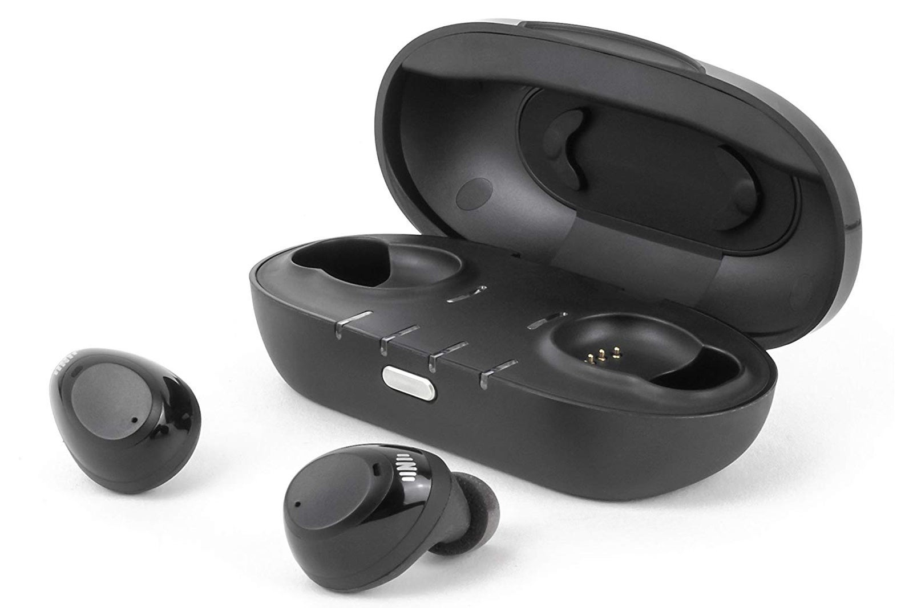
Example: Audio Enhancement and Replacement Technology
Notes:
Disabilities which affect a person’s ability to hear, including deaf or deafened users, users who are hard of hearing, or even simply requirements due to aging.
Examples include Tinnitus, Presbycusis, Acoustic trauma, Auditory processing disorder, Otosclerosis
Example 1: Jabra Evolve2 85 with boom mic and noise cancellation; Nuheara IQbuds with directional, active hearing

Slide 15
Example: Audio Enhancement and Replacement Technology
Notes:
Communication Access Realtime Translation (CART) is a professional service that can be delivered on location or remotely where the audio that is spoken on a teleconference, videoconference or during a meeting is converted in real time to text that can be displayed on a screen or on a PC/laptop's screen. Remote CART services are in use in a number of departments for people who are hard of hearing, deaf or have difficulties understanding spoken audio.

Slide 16
Example: Mobility & Dexterity Enhancement Technology
Notes:
Mobility issues affect the user’s ability to move their body, including the required use of a wheelchair or a cane, or other issues impacting their mobility. Flexibility and Dexterity issues affect the user’s ability to move joints or perform motor tasks, especially with their hands.
Examples include RSI, Cerebral palsy, Parkinson's, Muscular dystrophy.
Chronic Health Conditions or Pain affect the ability to function on a regular or episodic basis due to migraines, Crohn’s disease, colitis, and other disabilities or health conditions.
Example: Kinesis freestyle split keyboard, Atech light switches, big red button switch, touchpad on flex arm, pressure switches

Slide 17
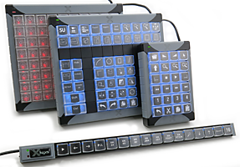
X-Keys
Notes:
XKeys

Slide 18
Cognitive and Learning Style Enhancement Technology
Notes:
Cognitive disabilities affect the process of carrying out tasks involving executive functioning, such as planning and organization, learning information, communication and memory. Examples include autism or Asperger’s syndrome, attention deficit disorder, learning disabilities and speech impediments.
Mental health conditions affect psychology or behaviour, such as anxiety, depression or social / compulsive disorder or phobia or psychiatric illness.
Example: multimodal reading

Slide 19
Cognitive and Learning Style Enhancement Technology
Notes:
WordQ

Slide 20
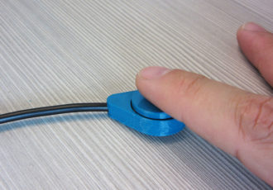
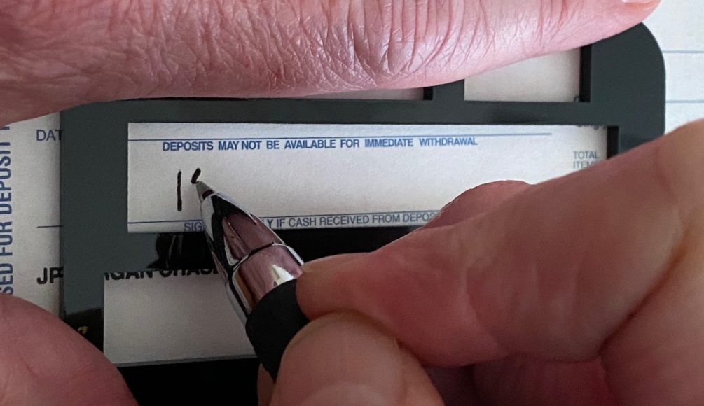
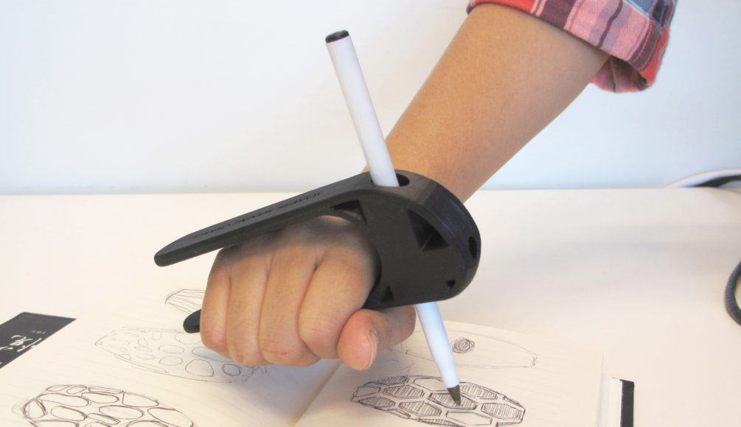
3D Printed Devices
Notes:
Talk about:
- we can print switches with different sizes, shapes, levels of force, methods of activation
- mounting mechanisms can be created for ideal setup, angle and even to mount a device to a wheelchair
- we also 3d print other devices

Slide 21
How Can I Contact AAACT
Reach out to AAACT to:
Set up an InfoSession to:
Identify employee accommodation needs
Test out available equipment
Borrow the right equipment
Contact AAACT / AATIA (SSC/SPC):
Email: aaact-aatia@ssc-spc.gc.ca
Toll Free: 1-866-442-2228
Visit AAACT’s website (https://www.canada.ca/en/shared-services/corporate/aaact-program/how-aaact-help-you.html) for more information
Notes:
Contact AAACT by telephone or email to
Set up an InfoSession for your short term employee and their manager
To Identify their ICT accommodation needs
Test out and borrow the right equipment
Our contact information will also be posted in the chat.

