Slide 1

Microsoft Teams Training
Module 3A
CUSTOMIZING TEAMS FOR MEMBERS

Slide 2
In this module you will learn how to:
Join a team
Add a channel
Add channel tabs
  GCdocs folder
Customize your interface
  Pin channels
  Hide/show teams and channels
Customize your settings
  Status
  Notifications

Slide 3
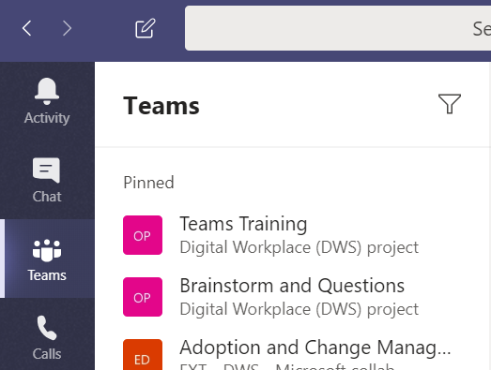

Join a team
Request to Join
To join a specific team:
Click Teams
At the bottom of the Teams panel, select Join or create a team

Slide 4
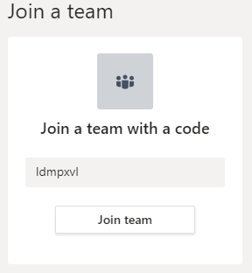
Join a team
Request to Join
To join a team with the team code:
  Enter the team code
  Click join

Slide 5
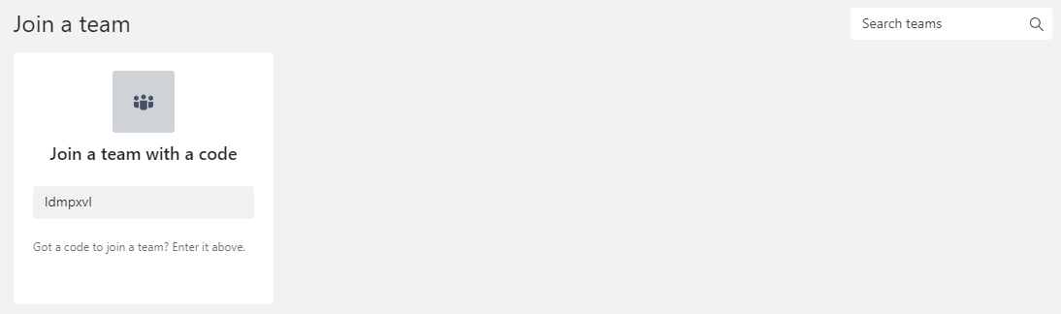
Join a team
Request to Join
To join a team without the team code:
  Search for the team name in the Search teams box
  Select the team you want to join and click Join team

Slide 6
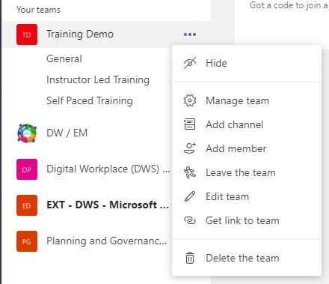
Add a Member
Request to Add a Member
To request someone be added to a team you’re a member of:
Click Teams
Click the three dots beside the team name for More Options
Select Add member

Slide 7
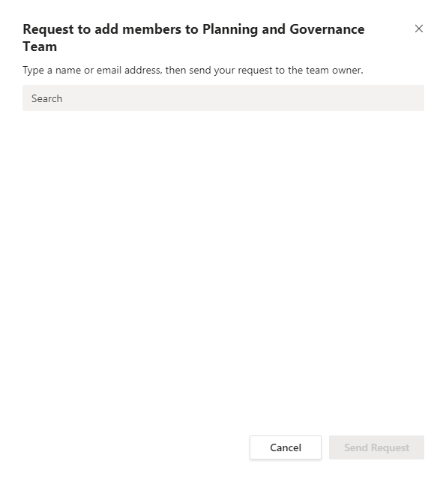
Add a Member
Request to Add a Member
Type the name or email address of the person you’d like to add in the search box
Click Send Request
The team owner(s) will receive an alert that they have a pending request

Slide 8
Add a Channel
Recall that Teams are made up of channels, which are dedicated to specific topics, departments, or projects
To Create a Standard Channel
Click Teams
Click the three dots beside the team name for More options
Click Add channel

Slide 9
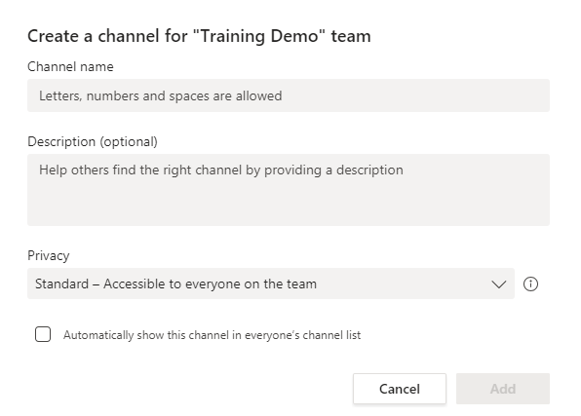
Add a Channel
Enter a Channel name
Enter a Description for the channel
Leave the Privacy as Standard
Select whether or not you want the channel to automatically show the channel in everyone’s list
  NOTE: if you do not select this option, the channel will appear as a hidden channel in the team list and users will have to “Unhide” the channel to view it
Click Add to create the channel

Slide 10
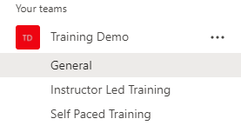
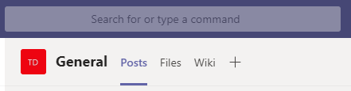
Add a Channel Tab
For every new channel, three tabs are automatically generated: Posts, Files and Wiki
To Create a New Channel Tab
Click on the channel you want to add the tab to
Click on the + at the top of the channel beside the other tabs

Slide 11
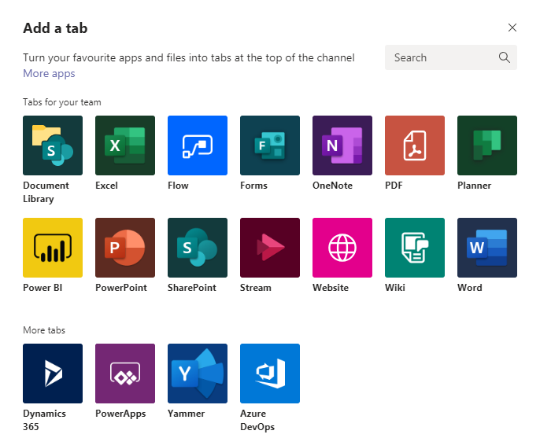
Add a Channel Tab
From here, you can select what type of tab you would like to add:
  An Excel spreadsheet
  A OneNote notebook
  A Planner project plan
  A PowerPoint presentation
  A website
  A Word document
We highly recommend adding the relevant Gcdocs folder to your channel tabs
Click Website

Slide 12
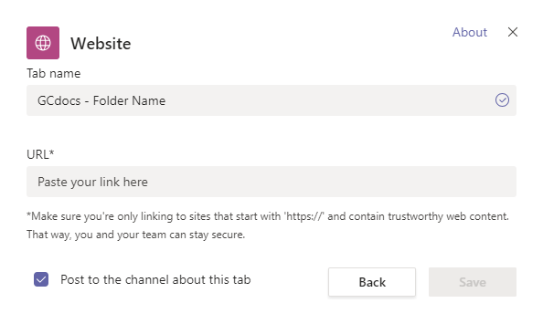
Add a Channel Tab
Go to the relevant GCdocs folder in your web browser and copy the URL
Enter the Tab Name using the naming convention GCdocs – Folder Name
  Ex. GCdocs – Teams Training Documents
Paste the URL in the URL box
Select whether or not you want to Post to the channel about the tab
Click Save

Slide 13

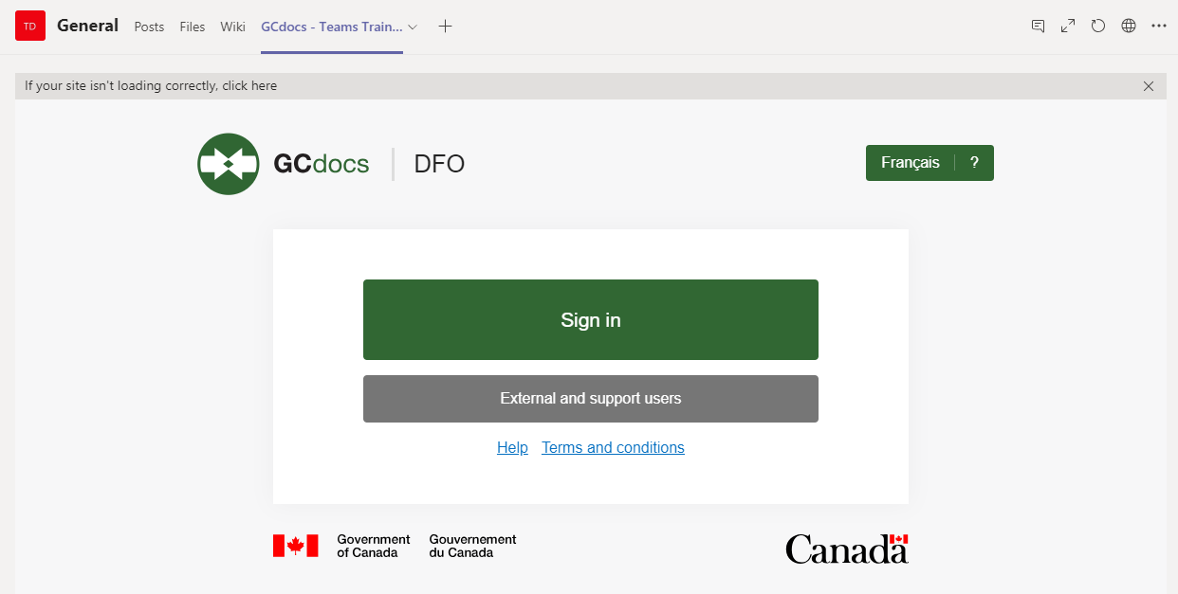
Add a Channel Tab
The tab should now be added at the top of the channel
Click on the tab to access it
You will be prompted to Sign In as usual

Slide 14
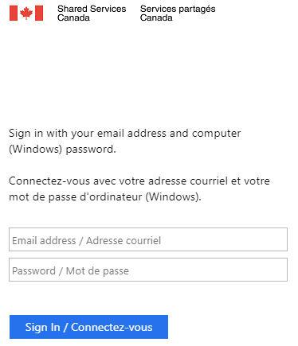
Add a Channel Tab
Sign in with your credentials

Slide 15
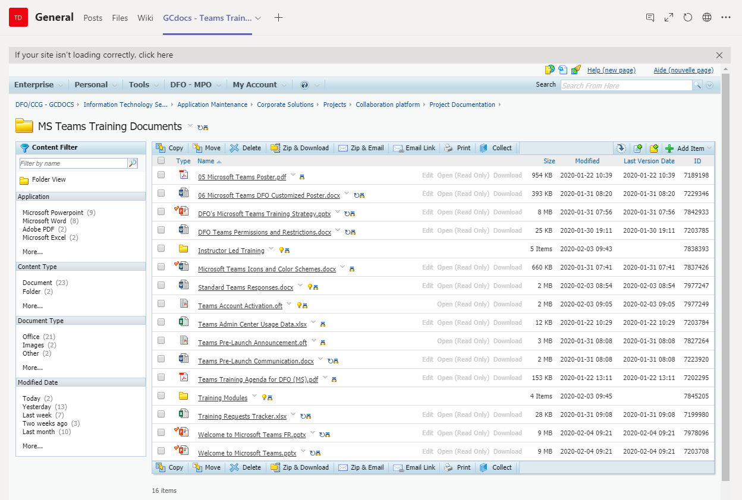
Add a Channel Tab
The GCdocs folder will then open in Teams
You can still drag/drop to add/update files in the folder and should have the full functionalities that the website offers

Slide 16
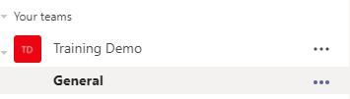
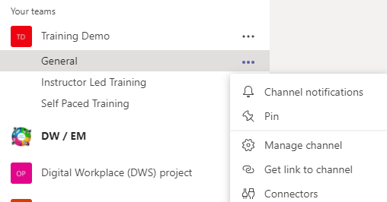
Customize your Interface
Pin your Favorite Channels
Click on the three dots for More Options beside the channel you want to pin
Select Pin to pin the channel to the top of your teams list

Slide 17
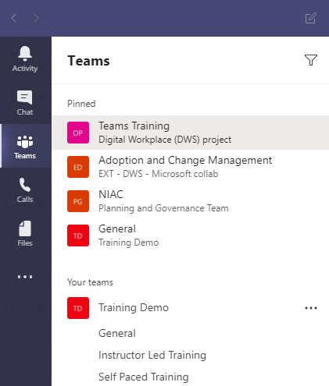
Customize your Interface
The channel will now appear in the Pinned section at the top of your Teams panel

Slide 18
Customize your Interface
Hide a Team or Channel
Click Teams to access your teams panel
Click the three dots beside the team or channel name for More options
Click Hide

Slide 19
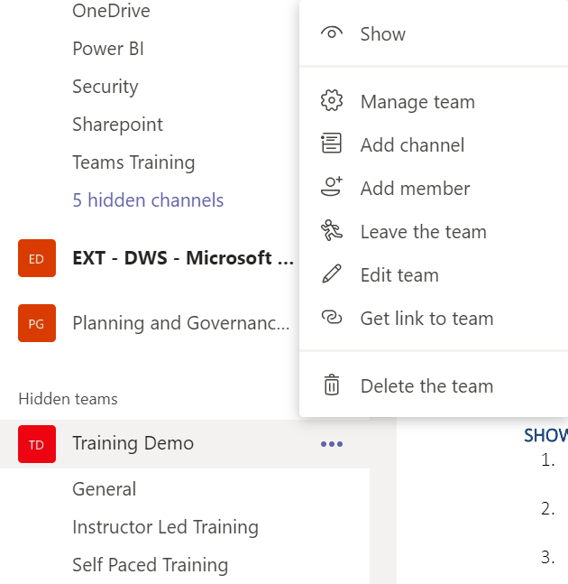
Customize your Interface
Show a Team
Click Teams to access your teams panel list
Select Hidden Team(s) at the bottom of the teams panel list
Click the three dots beside the team or channel name for More options
Click Show

Slide 20
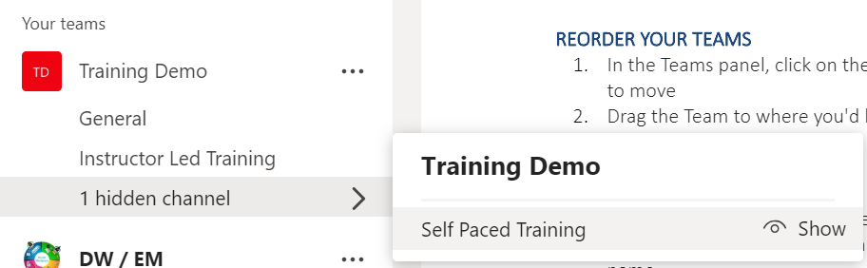
Customize your Interface
Show a Channel
Drop-down the channels list of the team
Select Hidden Channel(s) at the bottom of the team and click Show beside the channel you want to show

Slide 21
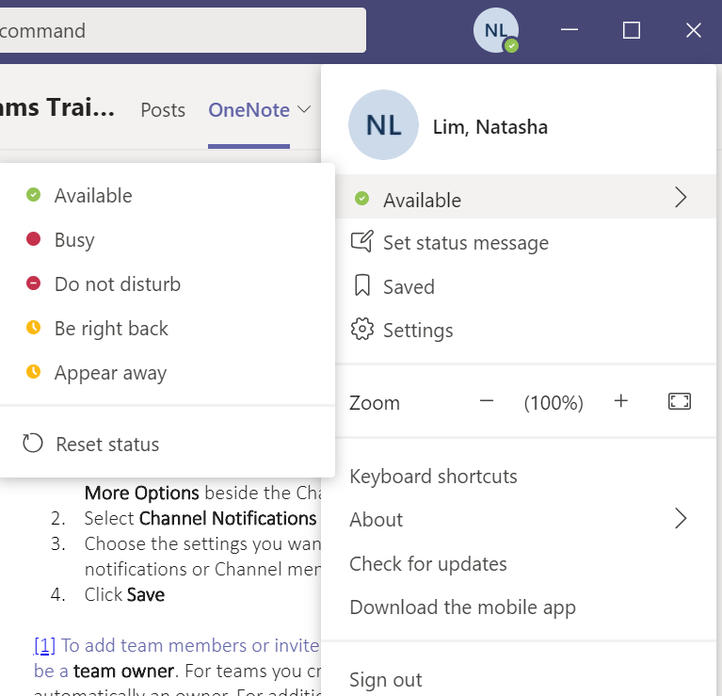
Customize your Settings
Customize your Status
Click on your profile
Hover over your status
Select your desired status
  Available
  Busy
  Do not disturb
  Be right back
  Appear away
  Reset status

Slide 22
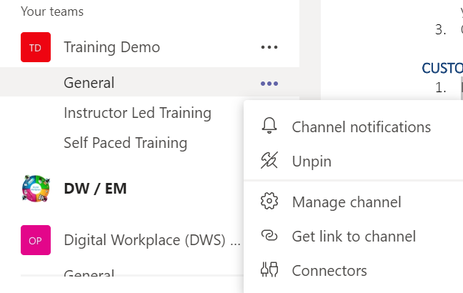
Customize your Settings
Customize your Channel Notifications
In the Teams panel, click on the three dots for More Options beside the Channel name
Select Channel Notifications
Choose the settings you want for post notifications or Channel mentions
Click Save

Slide 23
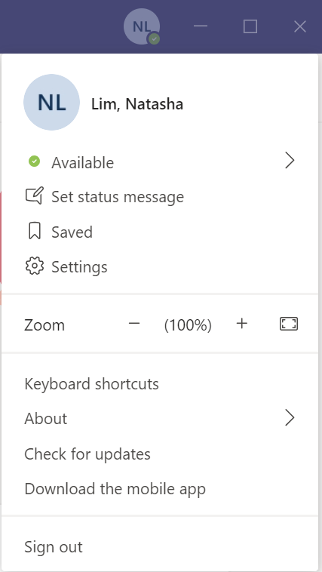
Customize your Settings
Customize All your Notifications
Click on your Profile
Select Settings

Slide 24
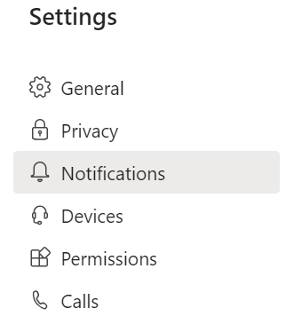
Customize your Settings
Customize All your Notifications
Click on Notifications
Choose the settings you want for:
  @mentions
  Messages
  Meetings
  Other
Exit the settings window and your selections will be saved automatically

Slide 25
Congratulations!
You should now have a be able to customize your Teams experience.
Start customizing!
Join us in the next learning module Collaborating in Teams & Channels
For questions or feedback please contact DFO.IMTS.DWS-SEN.GIST.MPO@dfo-mpo.gc.ca

