Slide 1
Health Canada Policy on the Implementation of Part VII of the Official Languages Act
Presentation - Symposium on Official Languages
Official Language Community Development Bureau
Health Canada
November 18, 2025

Slide 2

Health Canada Policy on the Implementation of Part VII of the Official Languages Act
Context
Modernized Official Languages Act (OLA) – 2023
Reinforced Part VII with government-wide commitments to:
Enhance the vitality of official language minority communities (OLMCs);
Foster the full recognition and use of English and French;
Protect and promote the French language (including in Quebec); and
Advance lifelong learning opportunities for OLMCs in their own language.
Obligations for federal institutions:
Conduct impact analyses for all initiatives
Based on dialogue/consultation activities, research and data;
Take positive measures to enact Part VII commitments;
Promote the inclusion of official language clauses in agreements with provinces and territories;
Consider the possibilities for avoiding, or at least mitigating, the direct negative impacts that the federal institution’s structuring decisions may have on Part VII commitments; and
Document these processes / monitor progress / report on achievements.
Notes:
Impact analyses for new AND existing initiatives.
Examples of positive measures: setting aside funding for OLMCs in grants and contribution programs, adapting communication strategies and policies to the needs and priorities of OLMCs.
Language clauses: cannot be imposed on PTs, but we must be able to demonstrate that we encouraged them to include such clauses.
Examples of structuring decisions: creation/termination of a program or policy; substantial modifications to a program; reduction or reallocation of funding; decisions requiring approval as part of a Memorandum to Cabinet or a Treasury Board submission

Slide 3

Health Canada Policy on the Implementation of Part VII of the Official Languages Act
Policy – Objective
Aims to facilitate Health Canada’s compliance with Part VII of the OLA
Applies Part VII to Health Canada’s context
Translates legal jargon into plain language
Inludes a glossary of important terms and concepts
Defines roles and responsibilities
Introduces useful/mandatory tools, i.e.:
Part VII Impact Analysis Tool
Official Languages Engagement Checklist
Monitoring and Self-Assessment Tool for Positive Measures under Part VII
Provides resources
Health Canada’s Official Language Community Development Bureau (OLCDB)
Legal Services
Notes:
The Policy was developed in collaboration with Justice Canada, with input from the Treasury Board Secretariat and Canadian Heritage.

Slide 4

Health Canada Policy on the Implementation of Part VII of the Official Languages Act
Policy – Expected Results
The Policy converts legal obligations into measurable expected results. E.g.:
All initiatives led or supported by Health Canada include, to the extent possible, positive measures to promote the vitality of OLMCs.
For all of Health Canada’s structuring decisions, direct negative impacts on Part VII commitments are avoided or at least taken into account and include appropriate mitigation measures.
Necessary measures are taken to promote the inclusion of official language clauses in the negotiation of all agreements between Health Canada and PT governments.
Notes:
« SMART » objectives
Note: « to the extent possible » does not mean that these measures are optional. In case of litigation, the Department would have to demonstrate that these measures were not possible to implement.
Full list of expected results:
6.2.1 Based on analysis, consideration must be given to whether initiatives led or supported by Health Canada could foster the government of Canada’s commitments respecting official languages set out in subsections 41(1) to (3) of the OLA.
These considerations and analyses must be documented for all initiatives.
6.2.2 All initiatives led or supported by Health Canada include, to the extent possible, positive measures to promote the vitality of OLMCs (OLA s. 41 (1)(a)).
6.2.3 All initiatives led or supported by Health Canada that allow learning in a formal, non-formal or informal context include, to the extent possible, positive measures to enable members of OLMCs to access quality learning in their own language (OLA s. 41(3)).
6.2.4 All initiatives led or supported by Health Canada include, to the extent possible, positive measures to promote linguistic duality (fostering the full recognition and use of both English and French (OLA s. 41 (1)(b)) and to promote and protect the French language (OLA s. 41 (2)).
6.2.5 For all of Health Canada’s structuring decisions, direct negative impacts on OLMC vitality, on the advancement of learning opportunities for OLMCs, on the full recognition of English and French, or on the promotion and protection of the French language are avoided or at least taken into account and include appropriate mitigation measures (OLA s. 41(7)(b)).
6.2.6 Necessary measures are taken to promote the inclusion of appropriately tailored official language clauses in the negotiation of all agreements between Health Canada and a provincial or territorial government, in accordance with regulations stemming from the OLA (OLA s. 41(7)(a.1)).
These measures must be taken in addition to the other positive measures listed above, as appropriate.
6.2.7 All Health Canada strategies for the disposal of surplus real property or immovables take into account the needs and priorities of English or French linguistic minorities in the province or territory in which the immovable or real property is located (OLA s. 41.1(1)).

Slide 5

Health Canada Policy on the Implementation of Part VII of the Official Languages Act
Policy – Process
The Policy details how to implement Part VII obligations throughout the lifecycle of Health Canada's initiatives:
Strategic planning;
Policy and program development;
Implementation;
Monitoring/evaluation; and
Reporting.
The process must be documented.
The documentation could be used for:
Reporting (e.g. TBS, PCH, Parliament);
Supporting changes to initiatives; and
Providing evidence in case of an investigation by the Commissioner of Official Languages or litigation.

Slide 6

Health Canada Policy on the Implementation of Part VII of the Official Languages Act
Risks
The OLA imposes obligations and is legally binding; the policy translates the requirements of the OLA into the departmental context.
Non-compliance with the requirements of the OLA could result in legal and operational risks for the Department, such as:
Complaints to the Commissioner of Official Languages;
Litigation to enforce requirements; and
Parliamentary reviews and audits / evaluations from TBS.
Notes:
A 2022 decision by the Federal Court of Appeal in Canada ordered that an agreement between ESDC and British Columbia on employment services be terminated unless it could be renegotiated in compliance with Part VII.

Slide 7

Health Canada Policy on the Implementation of Part VII of the Official Languages Act
Policy - Tools and Support
Tools:
Impact Analysis Tool for Part VII of the Official Languages Act
Official Languages Engagement Checklist
Health Canada Monitoring and Self-Assessment Tool of Positive Measures under Part VII of the OLA
Support:
OLCDB
Training on Part VII of the OLA
Secretariat for the Health Portfolio Consultative Committee for OLMCs
Research and data on OLMC needs and priorities
Attestations for Cabinet and Treasury Board documents
Advice on Part VII requirements
Official Languages Health Program
Legal Services
Provide advice on Part VII requirements and compliance

Slide 8

Health Canada Policy on the Implementation of Part VII of the Official Languages Act
Next Steps/Dissemination
Official launch of the Policy by the Deputy Minister and OL Champion.
Information sessions by the OLCDB to Branch Executive Committees and staff.
Links to Policy and tools shared in Health Canada’s Broadcast News and available in the Health Canada Hub on the Implementation of Part VII of the OLA.
Policy and tools will be referenced in the OLCDB’s training sessions on Part VII of the OLA (offered three times a year).

Slide 9
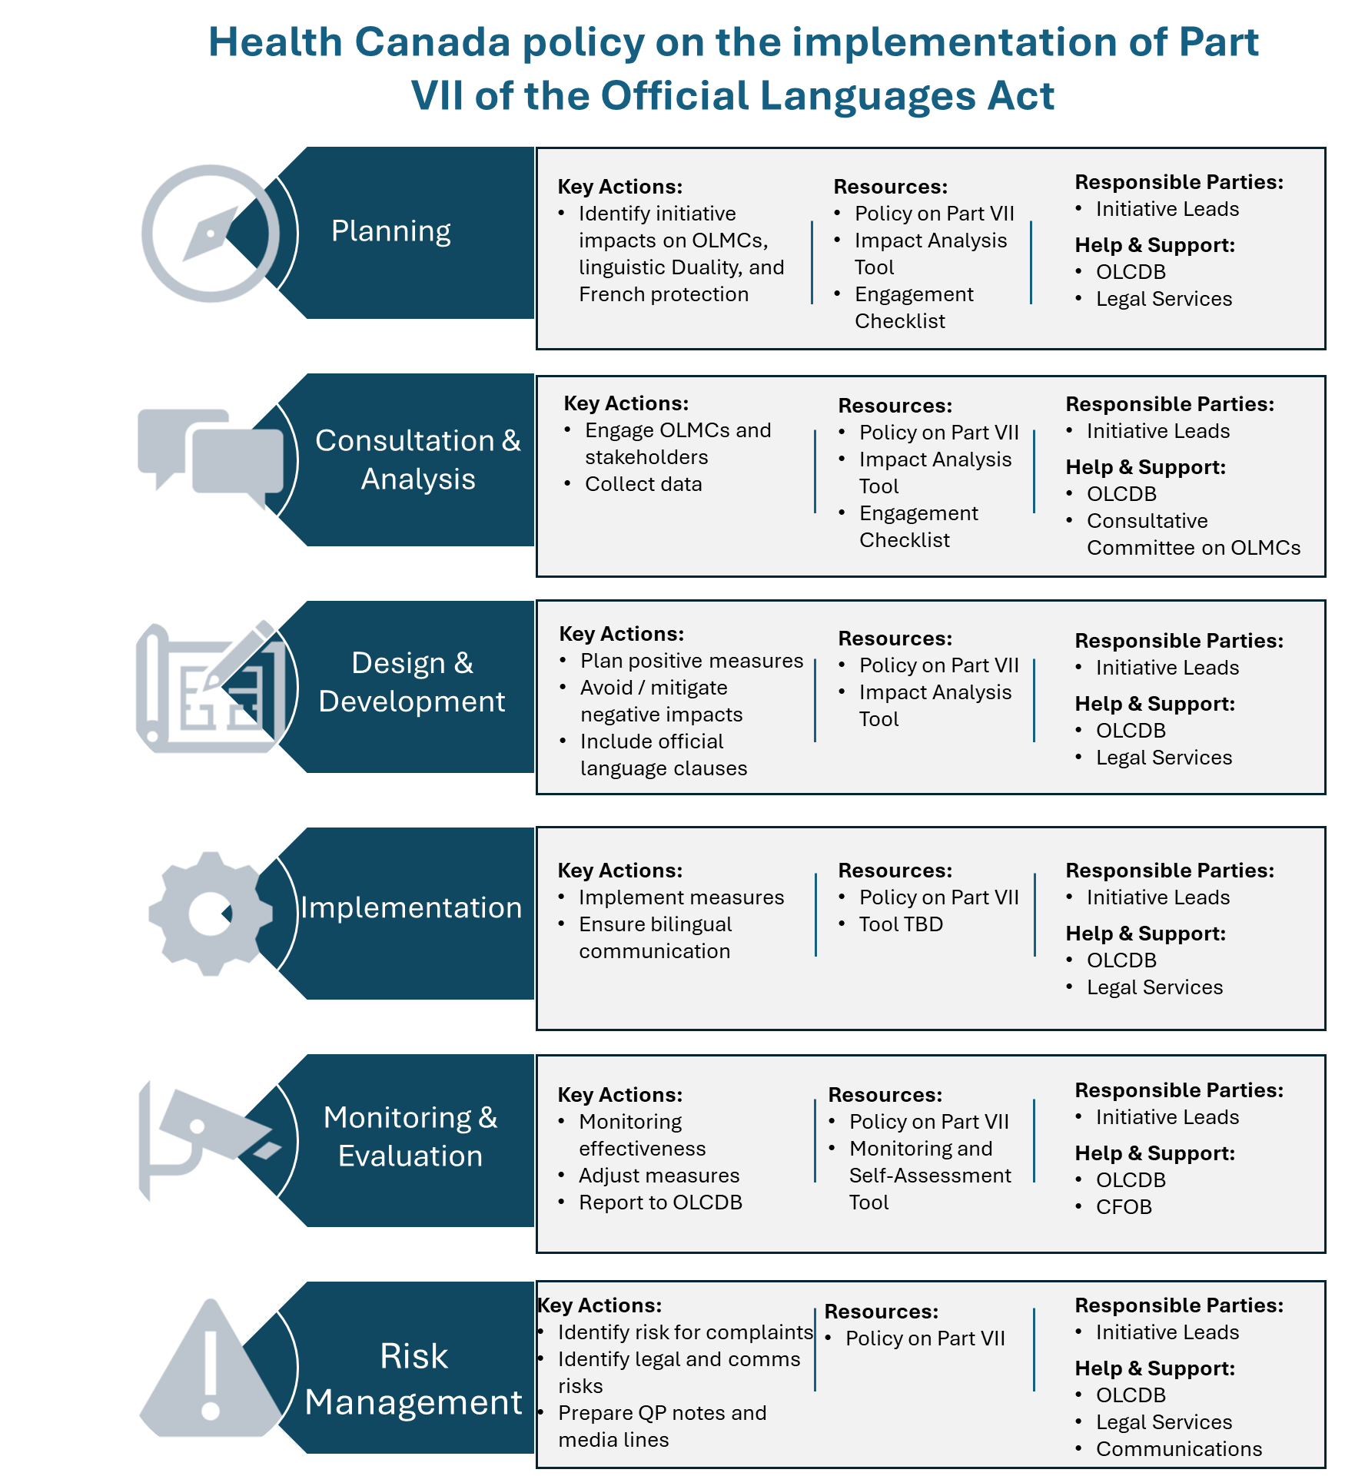
Health Canada Policy on the Implementation of Part VII of the Official Languages Act
Quick reference
Detailing key actions to undertake at each step of the cycle
Referencing existing resources available to guide employees
Providing information about internal groups that can provide support and/or advice, as required

Slide 10

Health Canada Policy on the Implementation of Part VII of the Official Languages Act
Questions?

