Slide 1

Microsoft Teams Training
Module 2
NAVIGATING MICROSOFT TEAMS

Slide 2
In this module you will learn:
How to navigate the interface
  Left rail tabs
    Activity
    Chat
    Teams
    Calls
    Files
    Help
  Start a new chat
  Search/command
  Profile and settings

Slide 3

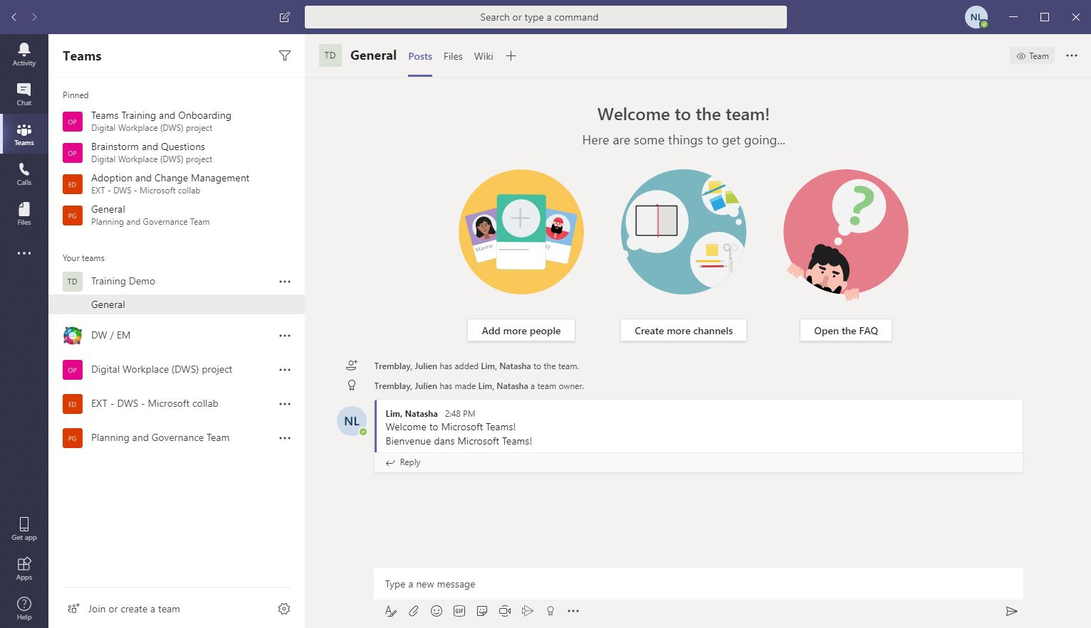
Microsoft Teams Interface
Start a new chat with an individual or group
Search/Command allows you to search for specific files or people, make quick actions or launch apps
Profile manages your profile and application settings and your saved items
Back/Forward navigation
Activity shows your notifications and activity history
Add Channel tabs to highlight apps, websites, and files at the top of a channel
Teams contains all your teams and channels
Chat and share files with an individual/group
Calls allows you to make calls, view your history and your contacts
More options to manage your teams, add channels, or get the link to the team
Files shows your files that have been shared on Teams or uploaded to your OneDrive cloud
Left Rail contains your main tabs
Compose a message to post to a channel with attachments, @mentions, emojis and GIFs
Join a team using the team code or searching for your team
Help contains Teams help topics, training videos and news updates

Slide 4
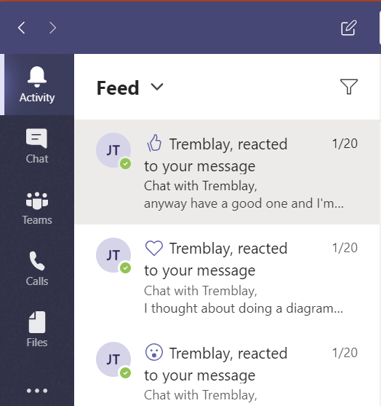
Activity
View your Notifications & Manage Your Activity Feed
When someone @mentions you, likes your post, or replies to your thread, you will receive a notification in your Activity feed
Click Activity
Your Feed shows you a summary of everything that’s happened in the channels you follow

Slide 5
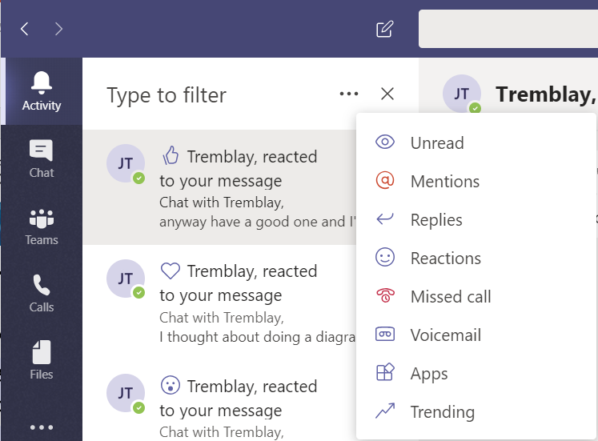
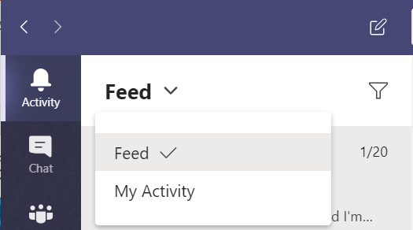
Activity
Click Filter and then select More Options to show only certain types of notifications
Select Feed then My Activity from the dropdown menu to see a list of your activity

Slide 6
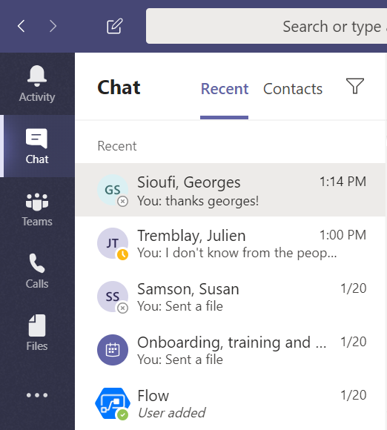

Chat
View your Recent Chats & Contacts
All your chats and contacts can be accessed from the Chat tab
Click Chat
Chats are continuous so you can continue a previous chat with a group/individual or a chat from a meeting
Select a chat conversation
Type your message in the message box and click Send

Slide 7
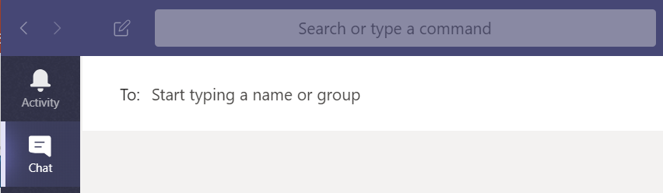
Chat
Start a New Chat with a Person or Group
Click New Chat at the top of the screen on the left side of the search bar
Type the name of the person/people you want to chat with in the To field
Type your message in the message box and click Send

Slide 8
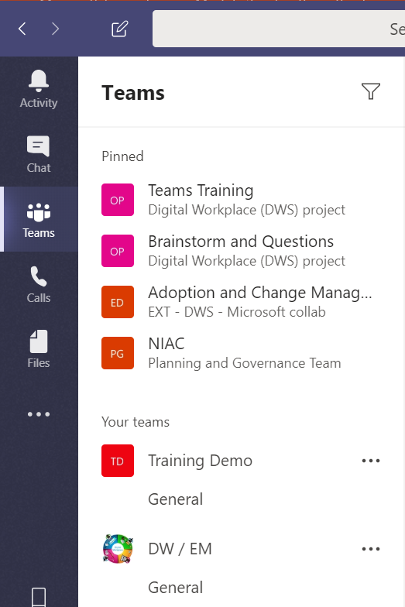
Teams and Channels
A team is a collection of people, conversations, files and tools. Teams can be for specific departments, projects, events or social activities. Teams are made up of channels. (Training Demo)
A channel is a discussion WITHIN a team, dedicated to a particular department, project, or topic. Channels are where conversations happen, where files are shared, and where apps are added. (General)

Slide 9
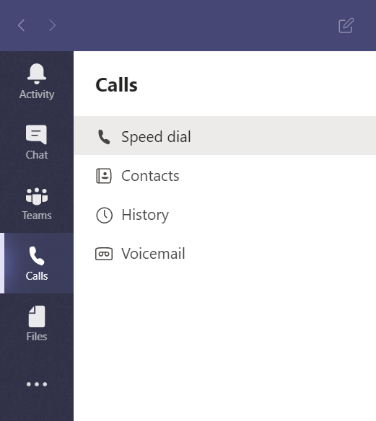
Calls
Click Calls
Make calls from your speed dial
Manage or call your contacts
View your call history
Access your voicemail

Slide 10
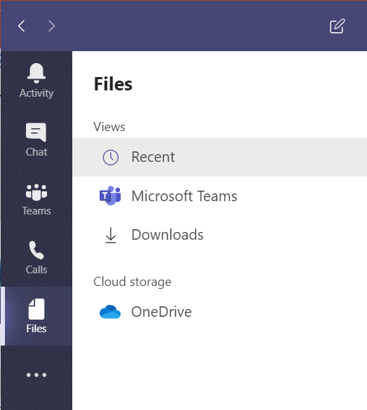
Files
Click Files
View your
  Recent files
  Microsoft Teams files
  Downloads
Access and manage your OneDrive cloud files and folders

Slide 11
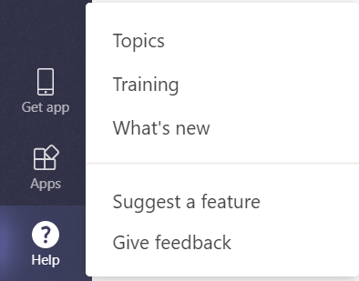
?
Help
Click Help
Get help directly in Teams
  Find help based on topic
  Watch Microsoft’s Teams training videos
  Check out new features
Suggest a feature
Give feedback

Slide 12

Search & Command
Searches in Teams cover all of the teams and channels you are a part of within the organization
Type what/who you’re looking for in the search bar at the top of the page and press Enter
Select the Messages, People, or Files tab to narrow your results
  You can also click Filter to further refine your results

Slide 13
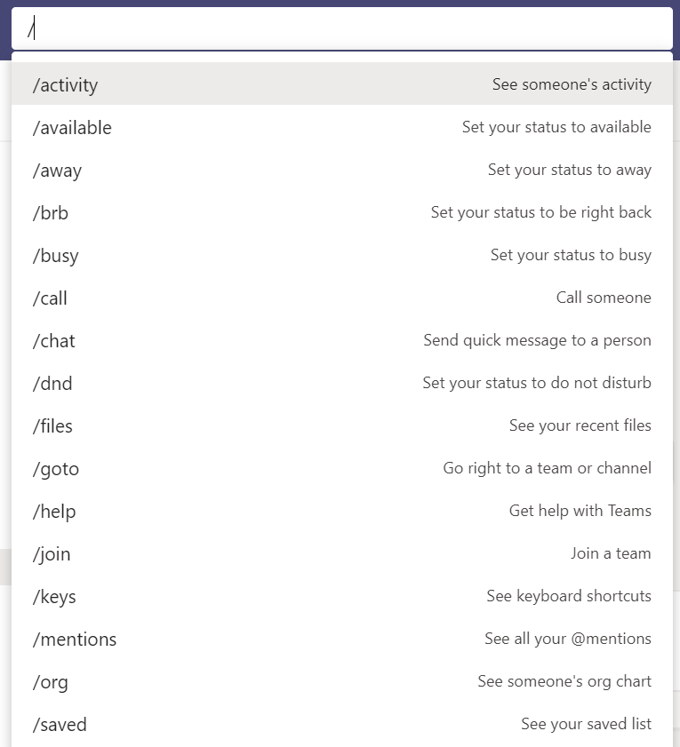
Search & Command
This box can also be used to command quick action
Type / in the command box for a list of quick actions to perform
Type @ in the command box to send a message directly to a contact without having to leave your window

Slide 14
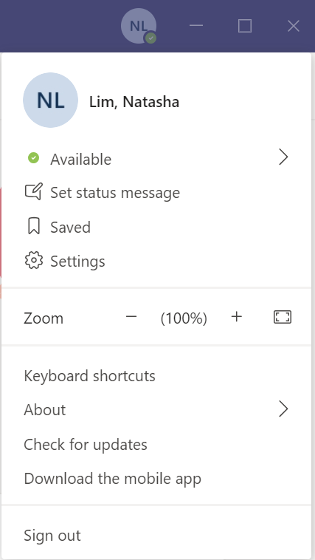
Profile & Settings
Click on your profile
Select your status
Set your status message
View your saved items
Manage your settings and notifications
Sign out of Teams

Slide 15
Congratulations!
You should now have a basic understanding of the Microsoft Teams layout.
Start exploring!
Join us in the next learning module Customizing Teams
For questions or feedback please contact DFO.IMTS.DWS-SEN.GIST.MPO@dfo-mpo.gc.ca

