Slide 1
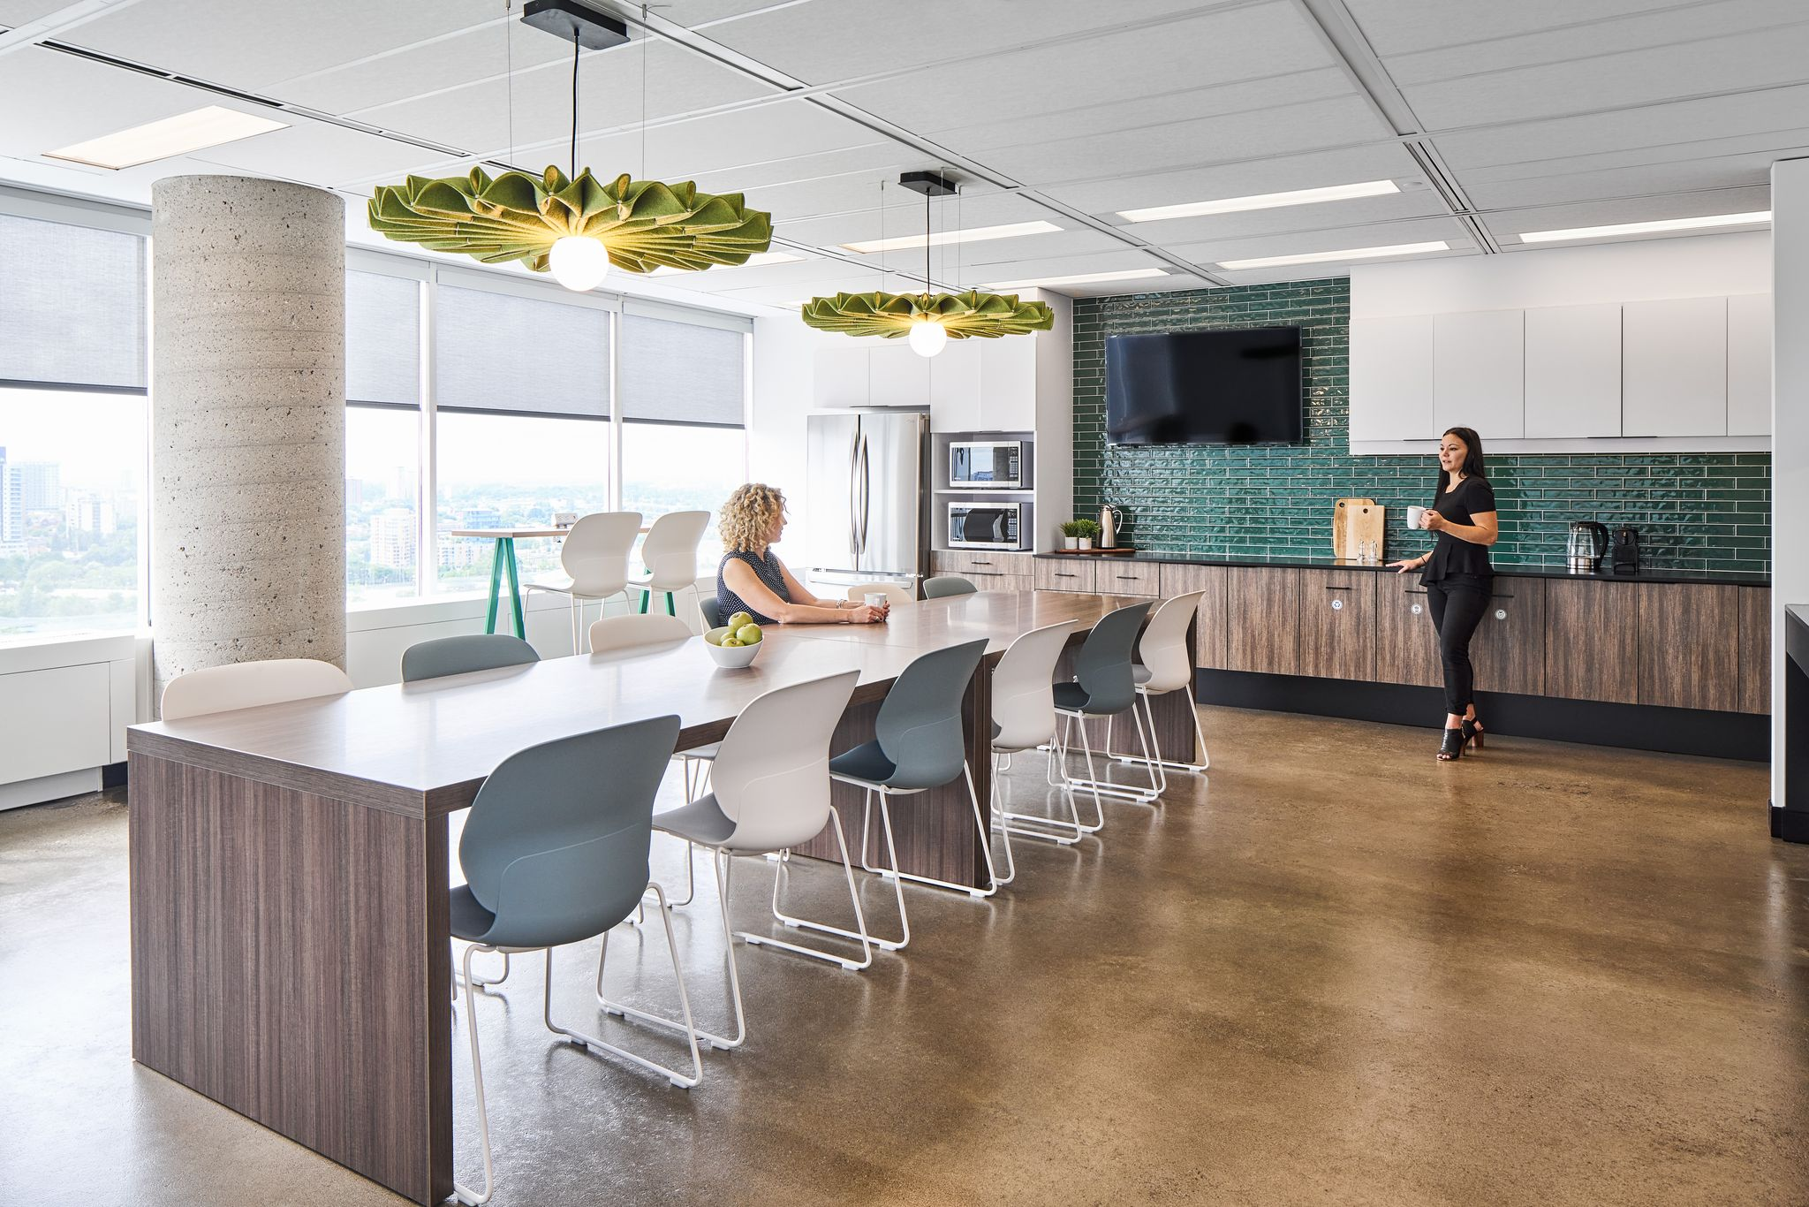
SPACE BOOKING CONSIDERATIONS For a Hybrid Return to Office
Presented by: SWAG (Strategic Workplace Advisory Group)
February 2023
Notes:
2 weeks ago we had a great presentation from Jonathan Carrier on Archibus for space booking
With the RTO and the common hybrid model we thought we would continue the conversation of space booking to hopefully help support the differeent RTO strategies understanding that we’re all in different boats with our workplaces and possible accommodation options
These are not the be all end all solutions but rather considerations that we would be happy get your feedback on

Slide 2
Hybrid Work Models & Workplace Utilization
In the context of a hybrid work model, to ensure efficient use of office space or to accommodate recent growth, many departments are looking to adopt an unassigned workplace utilization for the return to office.
X
X
HYBRID WORK
UNASSIGNED
WORKPLACE
UTILIZATION
=
X
X
X
X
X
X

Slide 3
The Return to Office Looks Different for Everyone
However, with only about 4% of general purpose office space having been modernized to GCworkplace in the last few years, the reality is that most employees will be going back to more traditional workplaces.
Workplace 2.0
Traditional Workplaces

Slide 4
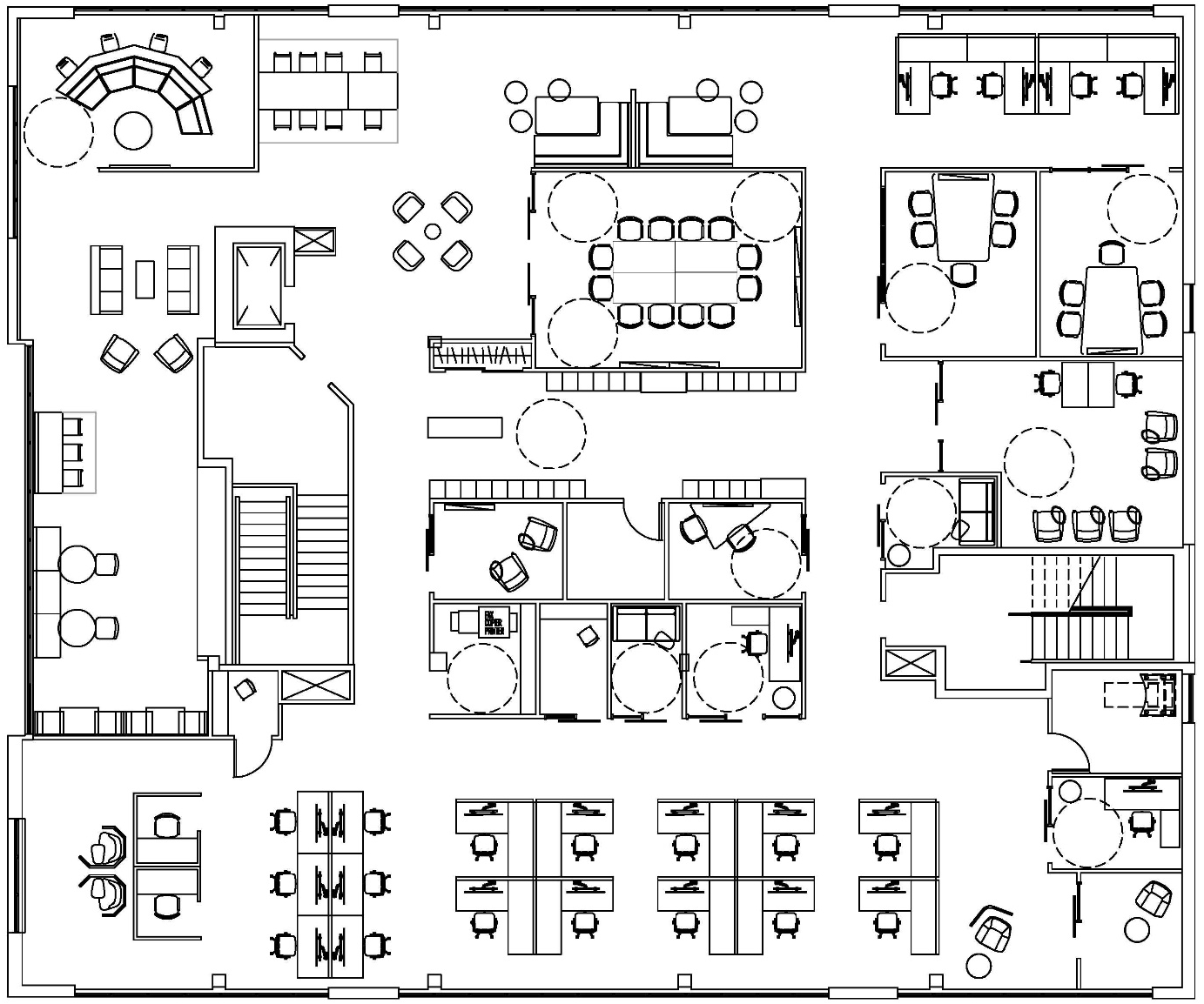
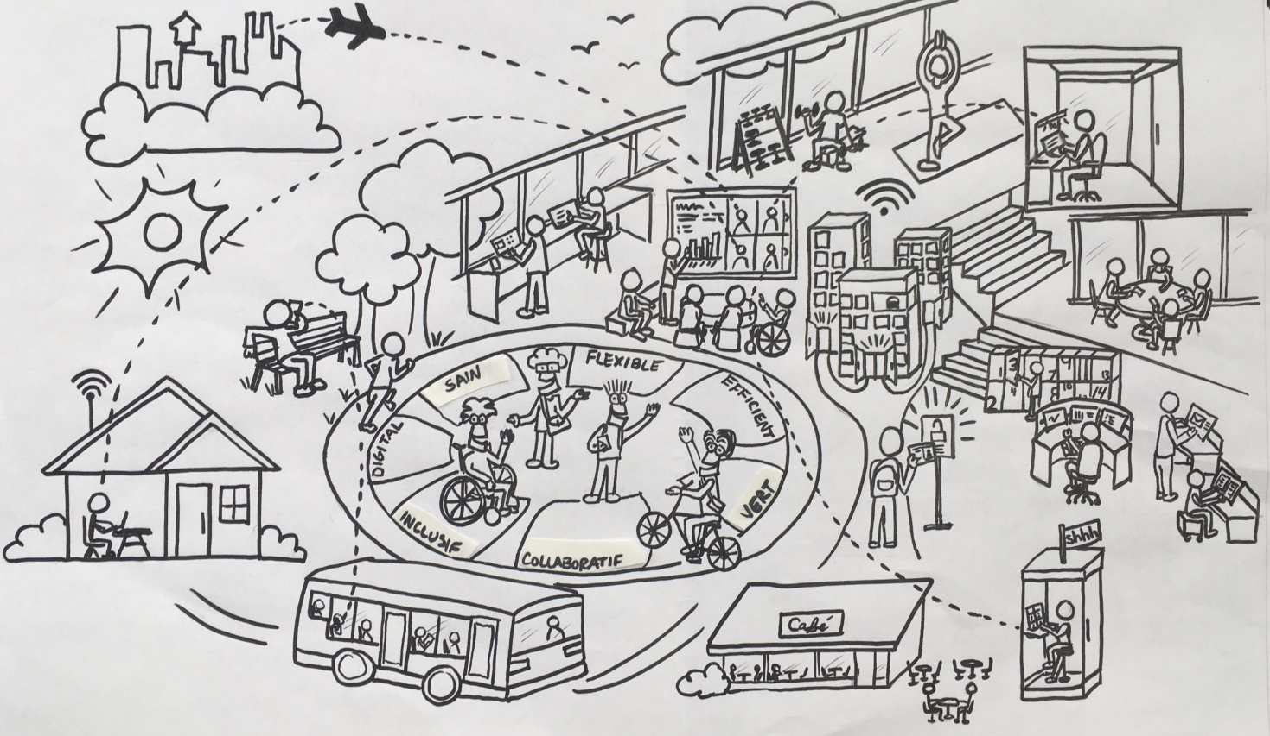
Accommodating More with Less
While adopting an unassigned workplace utilization for a hybrid work model is a flexible and efficient strategy to serve a larger population than its target onsite occupancy can accommodate, there are two important factors to consider: the employee experience and managing occupancy levels.
OCCUPANT
POPULATION

Slide 5
Managing Occupancy & the Employee Experience
A major enabler to both the employee experience and occupancy management is the use of a space booking tool. However, in order for a space booking tool to be a successful enabler, it must align to the type of workplace and its utilization intention.
FULL

Slide 6
Differences in Workplace Types
Depending on the type of workplace as well as its intended utilization, different booking strategies should be considered.
Lots of variety in workpoint types
Centralized personal storage
Purposely designed to be unassinged
Workplace 2.0
More open w/lower workstation panels
A few quiet rooms & open collab areas
Personal storage is within workstations
Traditional Workplaces
High workstation panels
Little variety in workpoints
Personal storage is within workstations

Slide 7
GCworkplace & Activity Based Working
GCworkplace is specifically designed to enable Activity-Based Working, which recognizes that with mobile technology, “work” isn’t somewhere you go, but rather something you do.
Activity
Based
Working
(ABW)

Slide 8
A Space Designed to be Unassigned
With a wide variety of workpoints found in three distinct acoustical zones, employees can untether from one specific spot and gain the freedom to access an entire ecosystem of work settings.
Interactive Zone
Transitional Zone
Phone Calls
Routine Tasks
Quick Chat
Focus Work
Quiet Zone

Slide 9
GCworkplace is Inclusive
A shared, activity-based workplace is an inclusive workplace where everyone, regardless of job title, is empowered to self-select the work settings that best suit their various activities, needs and personal preferences throughout the day, at any time, on any day.

Slide 10
Shift in Mindset from “Me Space” to “We Space”
With an equal access, unassigned use of space, as well as a ‘one-workpoint-at-a-time’ etiquette, GCworkplace provides an almost 2:1 ratio of total workpoints (from all categories) to target onsite occupancy; meaning there will always be ample variety of available workpoints to be used by its onsite occupants.
WORKSTATION
WORKPOINT

Slide 11
Space Booking Considerations for GCworkplace
Aside from meeting rooms, a “general admission” booking prior to using a GCworkplace will ensure occupancy levels are managed while allowing occupants to freely use the entire workplace based on their own individual needs and preferences. Requiring employees to book specific workpoints ahead of time goes against the flexible intended use of GCworkplace.
Tue, Mar. 7
General Admission to 5th Floor is Booked
- 47 of 150 remaining -

Slide 12
Space Booking Considerations for GCworkplace
Examples of a GOOD
user experience for General Admission booking in GCworkplace:
X
Reassurance that there will be room for you when you get there by booking a general admission to the floor
Moving to another, better suited workpoint at any time by simply seeing that it is vacant
Using informal collaboration spaces, like a lounge or chat point, for impromptu exchanges with colleagues
X
X
X
X
X
X
X

Slide 13
Space Booking Considerations for GCworkplace
Examples of a BAD user experience with a workstation booking strategy in GCworkplace:
X
Showing up to someone sitting in your booked station
Not making use of the variety of available workpoints because booking and unbooking every time is a deterrent
Wanting to move to a workpoint that looks vacant but is booked in the system
X
X
X
X
X
X
X

Slide 14
Space Booking Considerations for GCworkplace
Booking strategy best practices for GCworkplace:
X
General Admission
‘Use what you see’
Manage occupancy
X
X
Bookable by the Hour
Meeting Spaces
Need to plan ahead
X
X
Alternative Options
Adaptation reassurance
Can add or remove w/time
X
X
X

Slide 15
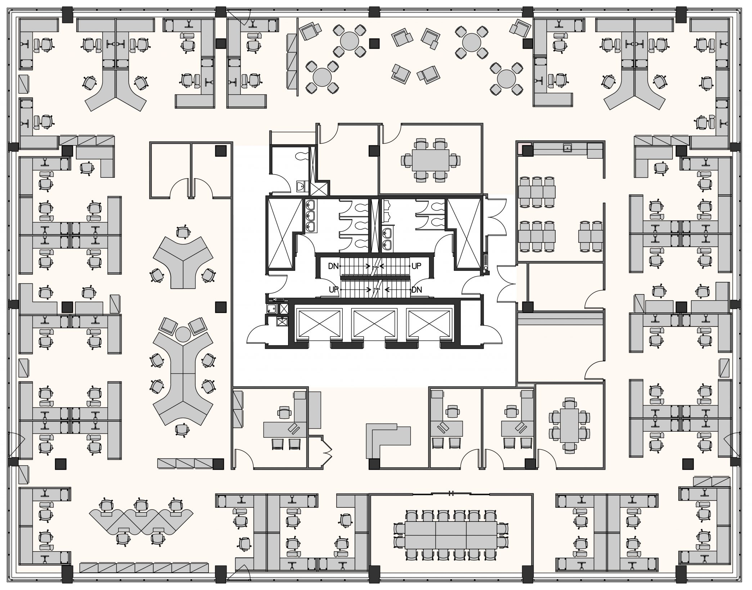
Utilization Opportunities for Workplace 2.0 Spaces
An office space designed to Workplace 2.0 presents some opportunities to improve an unassigned user experience, such as dividing the existing space into acoustical zones.
Interactive Zone
IF POSSIBLE…
- remove & centralize personal storage from workstations/offices
- relocating any existing collab furniture to the newly identified interactive zone
Quiet Zone
Transitional Zone

Slide 16
Space Booking Considerations for Workplace 2.0
Because Workplace 2.0 space does not offer as much workpoint variety compared to GCworkplace, different space booking solutions can enhance the user experience by providing its users with options:
General Admission
‘Use what you see’
Manage occupancy
Bookable by the Hour
Meeting Spaces
Need to plan ahead
Alternative Options
Some quiet worksations
Team cluster booking

Slide 17
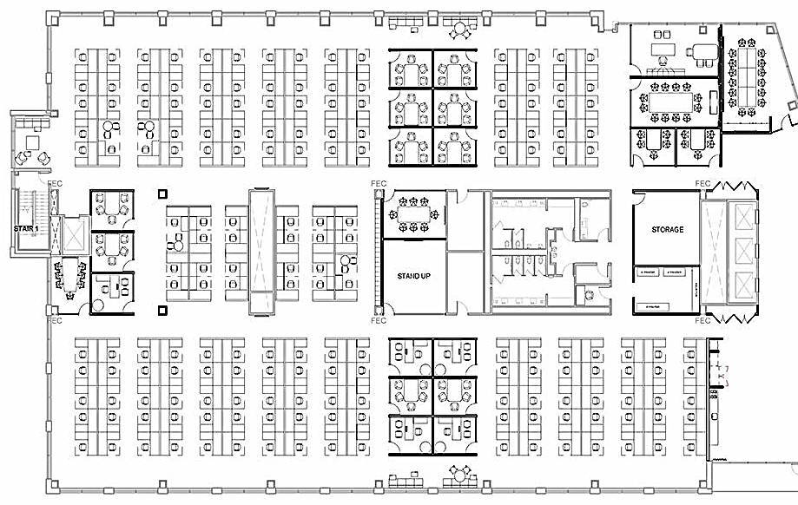
Space Booking Considerations for Traditional Workplaces
In the case of traditional workplaces (pre-WP2.0), it is generally best to keep a simple ‘book-a-workstation for-the-day’ strategy. With high workstation panels, the environment is not conducive collaboration outside of meeting rooms and it is very difficult to see what is occupied or vancant.
Workstation Booking
Can be coordinated with other team members
Bookable by the Hour
Meeting Spaces
Need to plan ahead
No Booking Req’d
For ad-hoc use

Slide 18
Summary
Going unassigned in a hybrid work model is a great way to ensure office space is being used efficiently, BUT to ensure occupancy levels are managed as well as the employee’s workplace experience, booking strategies must align to each workplace type.
Mostly General Admission booking
Meeting rooms bookable
Some specific use workpoints bookable
Workplace 2.0
Mix of General Admission and bookable workstations
Meeting rooms and specific use bookable
Traditional Workplaces
Book a workstation for the day
Meeting rooms and specific use bookable

Slide 19
Q & A
Strategic Workplace Advisory Group (SWAG)
Accommodation Management & Workplace Solutions
Public Services and Procurement Canada

