Slide 1



Unpacking AI in Official Languages: Insights from Federal Institutions
Enhancing Bilingualism in the Public Service
Notes:
Bil
In an era of rapid technological advancement, the Treasury Board of Canada Secretariat’s Official Languages Centre of Excellence (TBS’s OLCE) is exploring innovative ways to support Canada’s official languages through artificial intelligence (AI). To this end, the OLCE is developing a strategic framework that leverages AI to enhance bilingualism across the federal public service and improve service delivery to Canadians in both English and French.
This emerging strategy focuses on three key areas:
Language training and assessments
Translation and interpretation
Discoverability of Francophone content
To ensure the strategy is responsive to the realities and needs of federal institutions, the OLCE conducted a targeted survey. The questionnaire was distributed to individuals responsible for official languages, those administering Part VII of the Official Languages Act, and those overseeing language training programs. Their insights will help shape a forward-looking approach to integrating AI in support of Canada’s linguistic duality. This report therefore presents the results of the questionnaire completed by 136 respondents.

Slide 2
About the initiative
Why this matters
Our Goal
The Official Languages Centre of Excellence (OLCE) is developing an OL-AI strategy to protect and promote bilingualism.
Support federal institutions to use AI responsibly to enhance bilingualism in the public service.
Who Shared Their Perspectives?
136
Respondents
Persons Responsible for Official Languages
Persons Responsible for Part VII of the OLA
Persons Responsible for Language Training

Slide 3
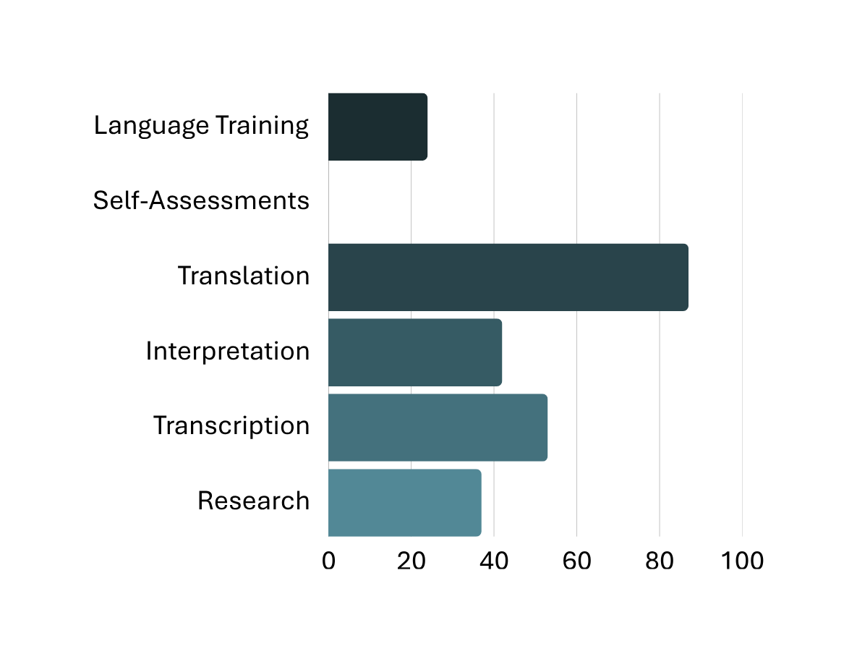
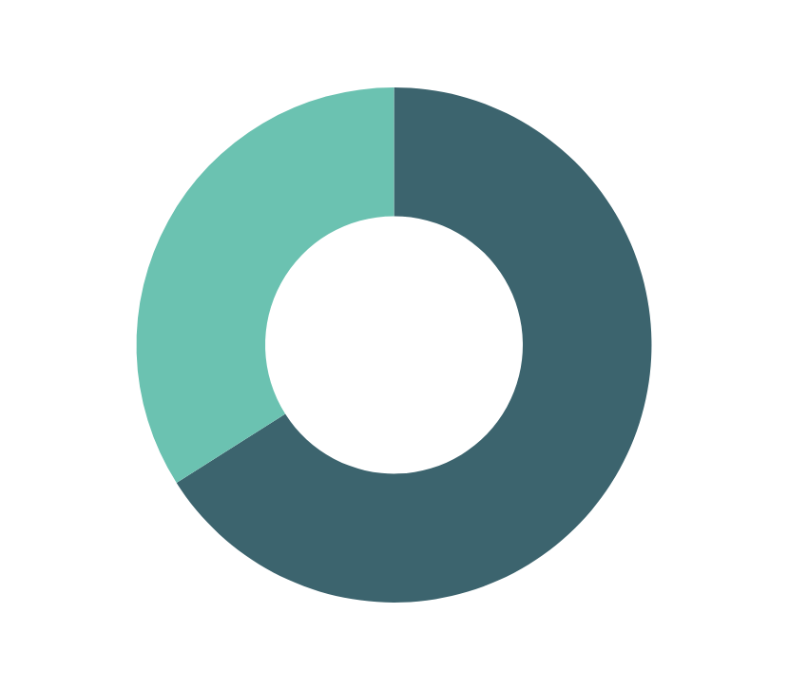
Overall use of AI
66% of respondents stated that their institution uses AI in areas related to OL.
Among those using AI:
24%
0%
87%
66%
42%
53%
37%

Slide 4
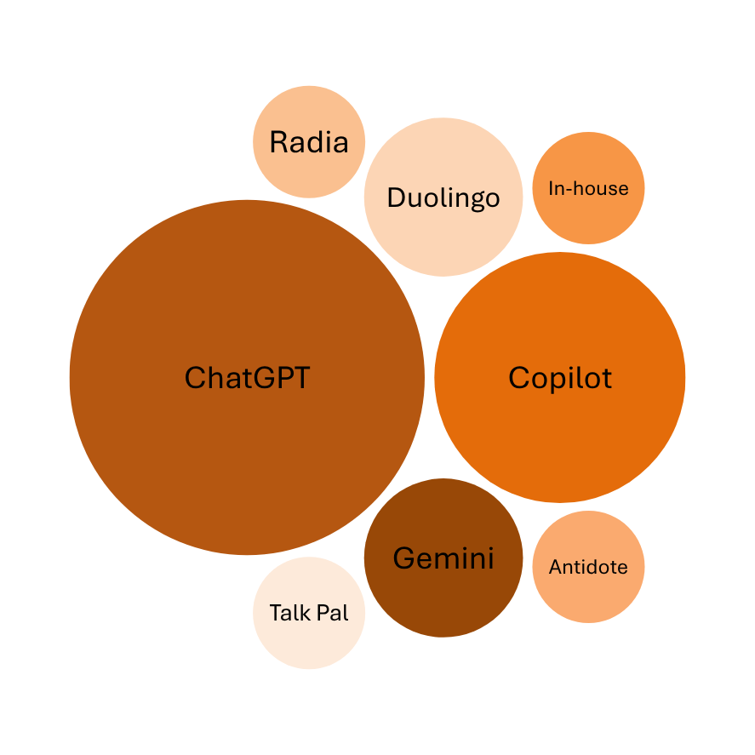
AI Tools in Use
Language Training

Slide 5
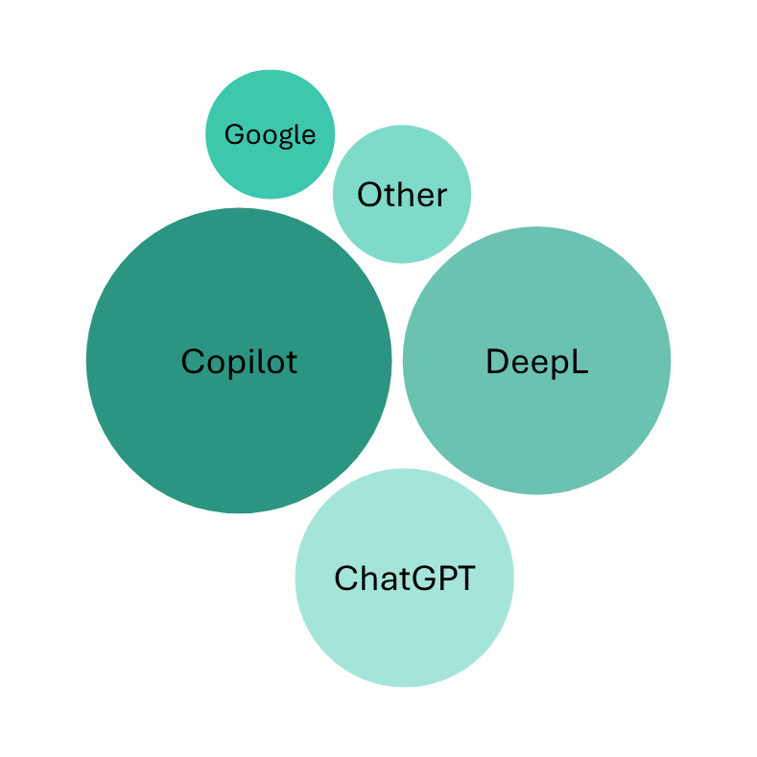
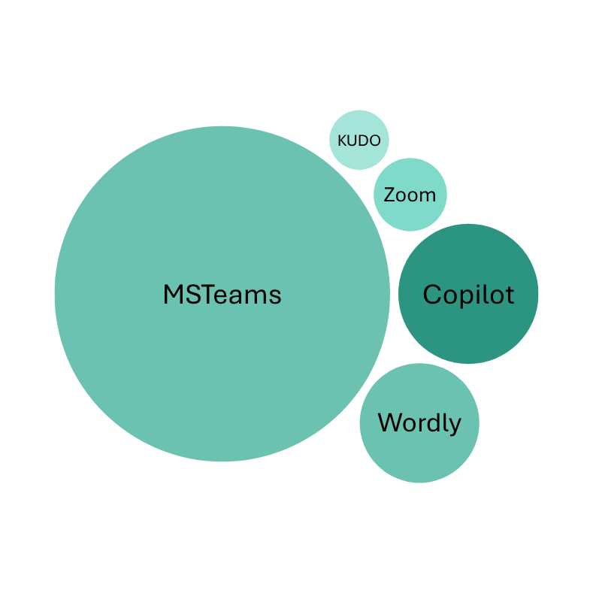
AI Tools in Use
Transcription and Interpretation
Translation
Other includes: JUSTranslate, GCTranslate, Trados, Gemini, etc.

Slide 6
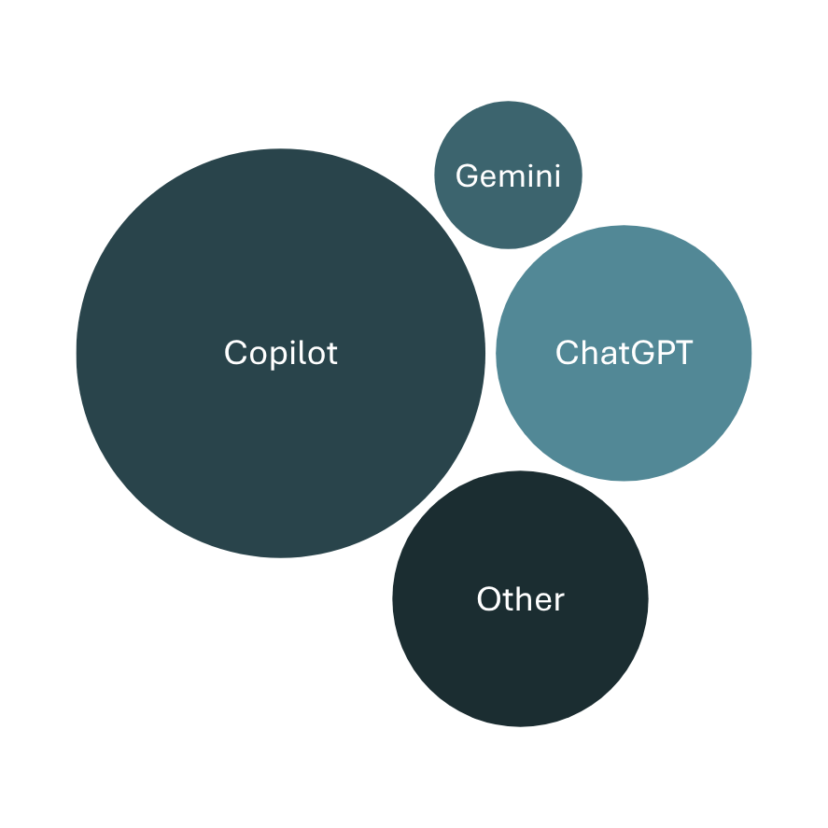
AI Tools in Use
Research
Other includes: CANChat, Radia, Sphere, etc.

Slide 7
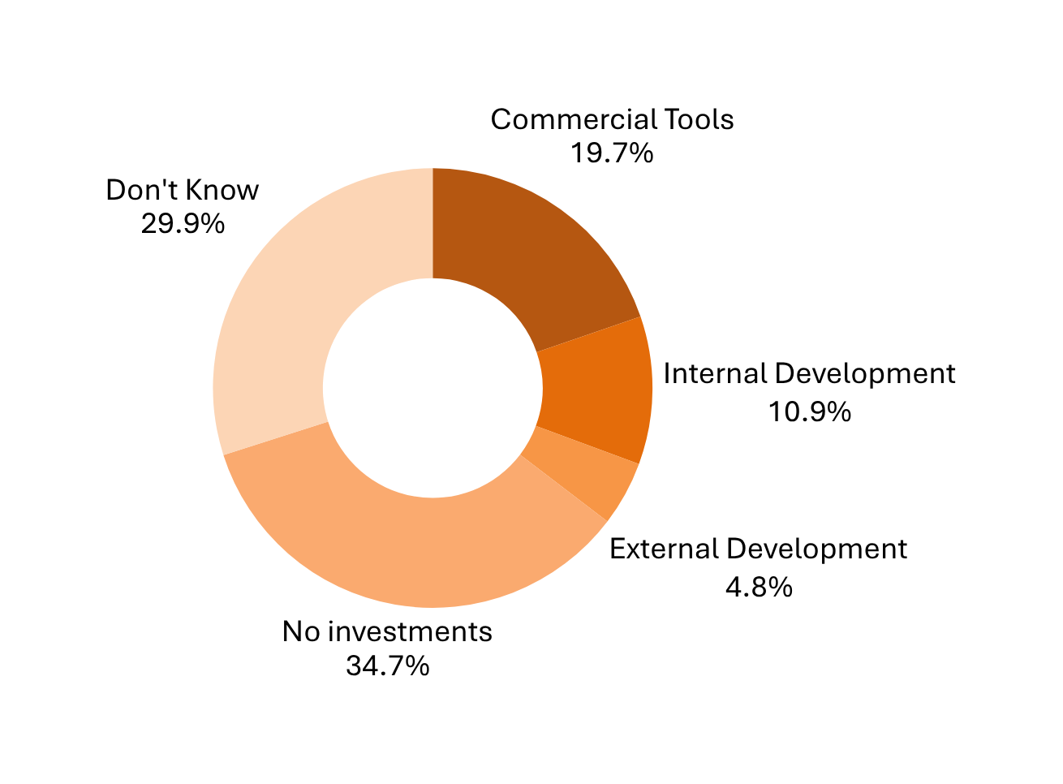
Current investments

Slide 8
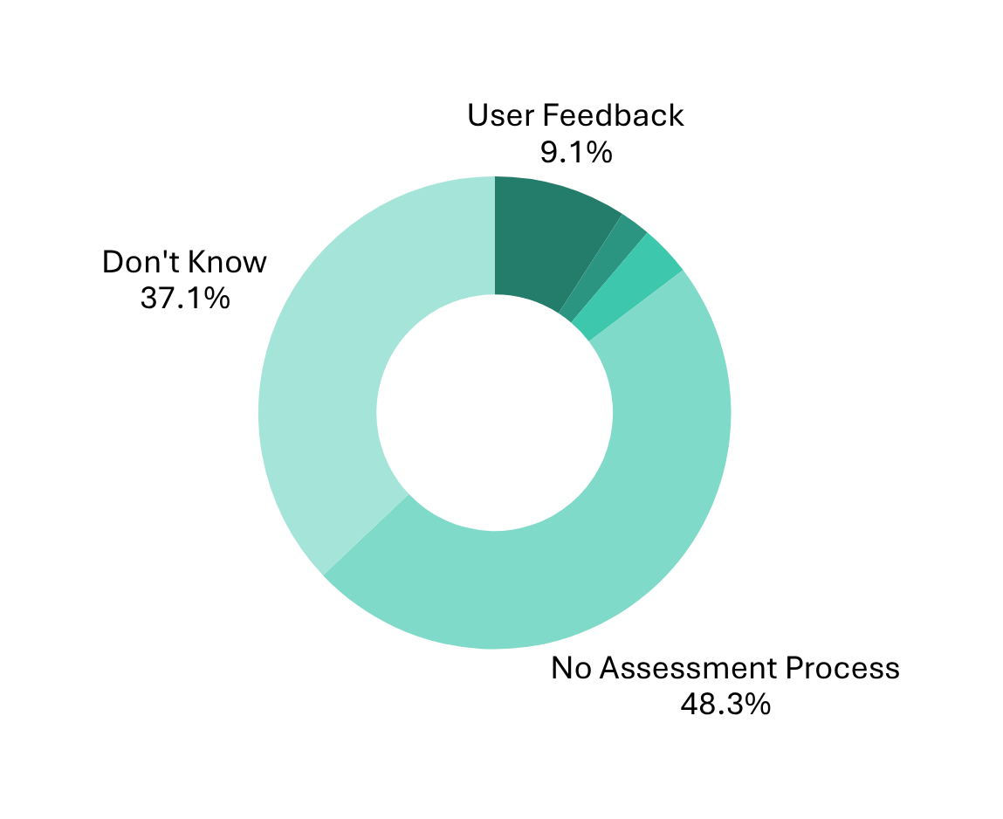
Quality Assessment
Automated Performance Metrics
2.1%
Formal Evaluations or Audits
3.5%

Slide 9
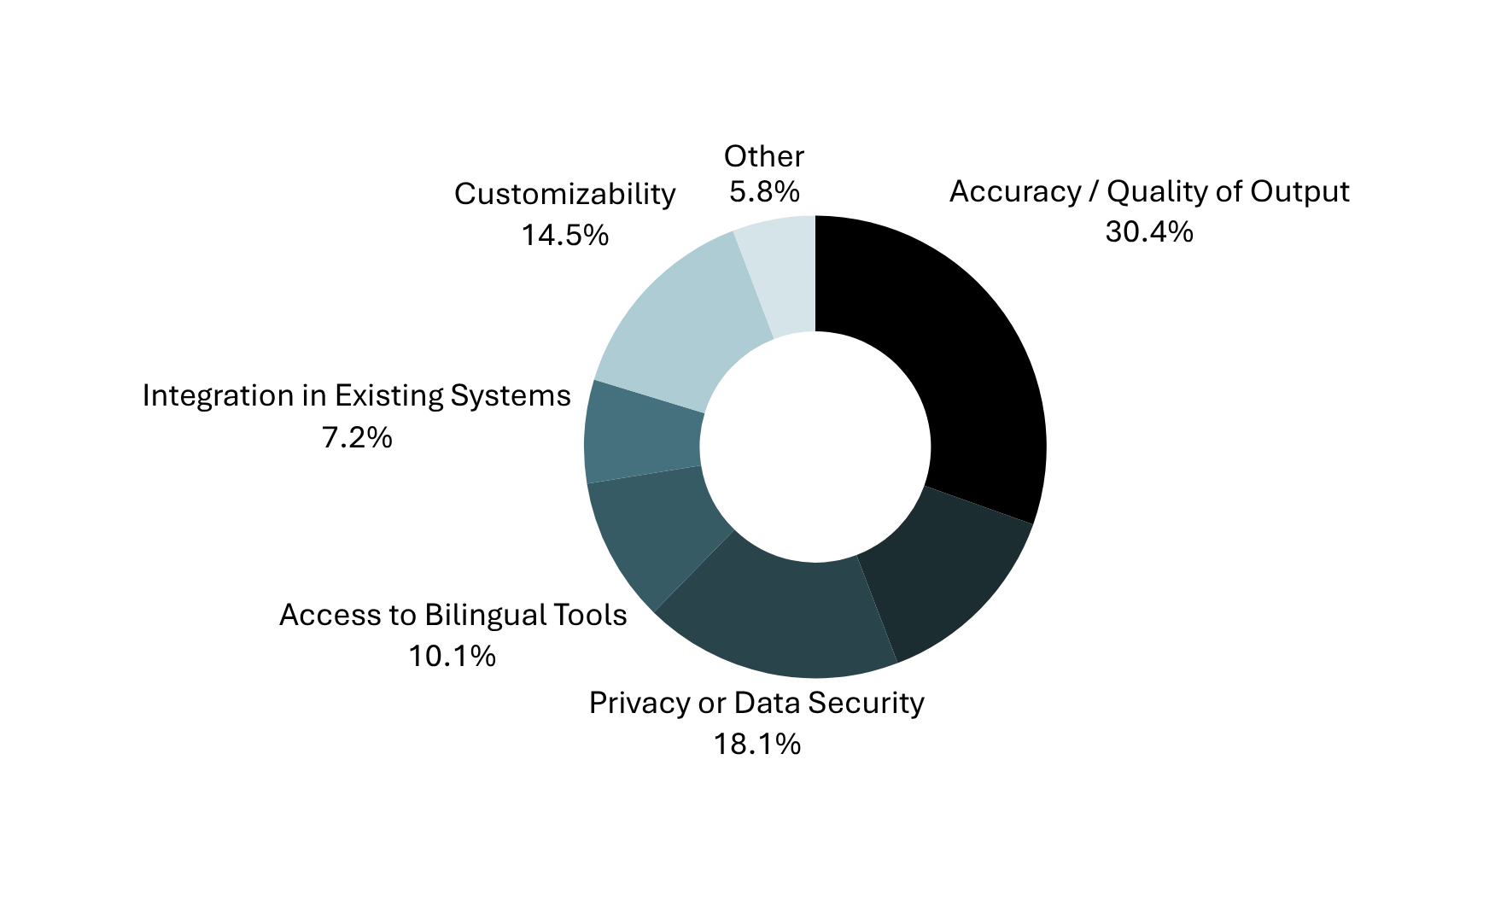
Challenges or Limitations
Bias in Language Models
13.8%

Slide 10


Main Concerns
01
Quality and Accuracy of Information
06
Canadian Context and Regional Nuances
02
Language Equality and Equity
07
Awareness and Responsible Use
03
Security and Integrity
08
Governance
04
AI Replacing Bilingualism
09
Potential Impact on Bilingual Public Servants
05
Potential Biases
10
Financial and Environmental Impacts

Slide 11
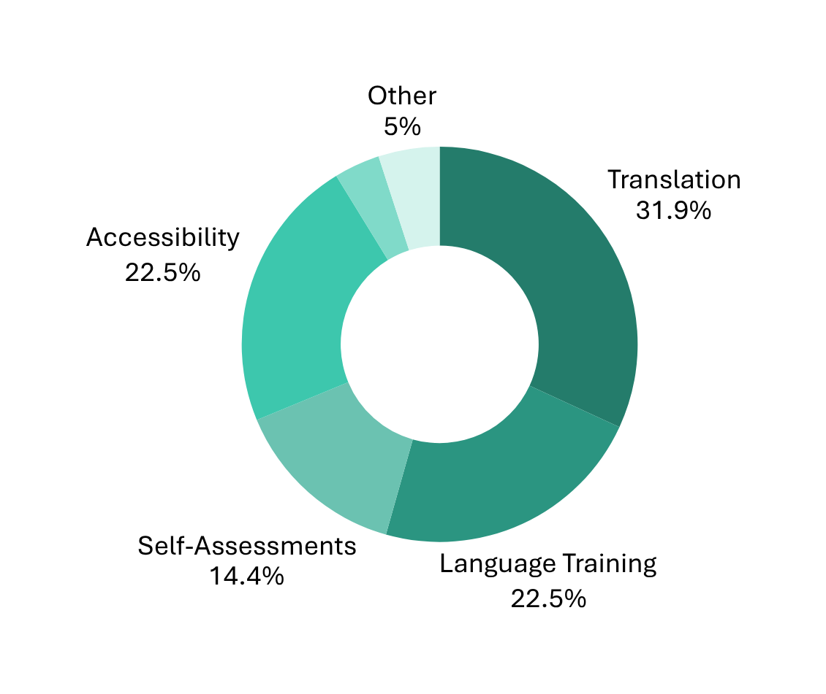
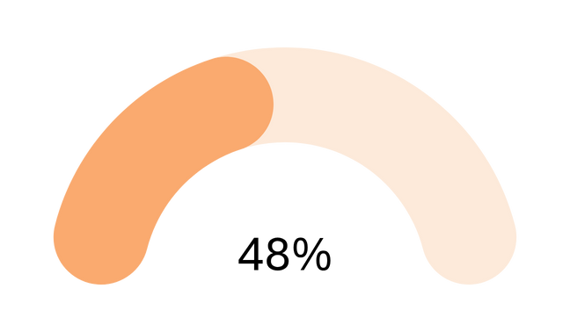
Future Use
48% of respondents stated that their institution plans to further explore AI in areas related to OL.
Don’t Know
3.8%

Slide 12





Unlocking Opportunities
Communication Enabler
Inclusive Workplace
AI can act as a communication enabler by enabling everyone to work in their preferred official language.
AI can break down language barriers, automate translations, and provide real-time accessibility tools that make information understandable and inclusive for diverse audiences.
Language Learning Support
Efficient Services
AI-driven tools, such as interactive chatbots, could make second-language education more personalized and accessible
AI can create administrative efficiencies, including cost savings and faster service delivery

Slide 13
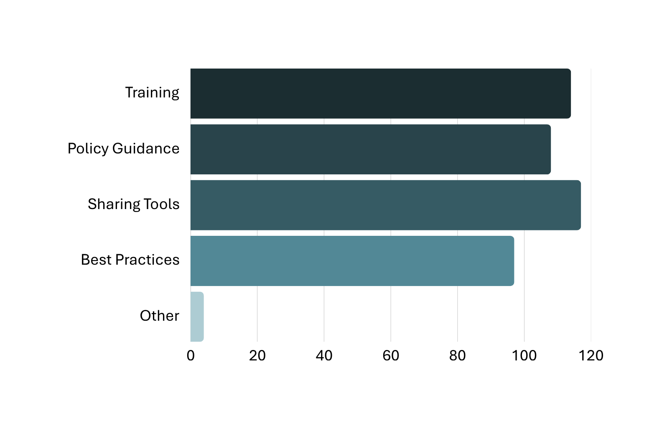
Support Requested

Slide 14







Final Thoughts
Responsible Use
Human Oversight
Linguistic Equality
Security

Slide 15
Questions?
Second Official Language Learning Support Team
Official Languages Centre of Excellence / Office of the Chief Human Resources Officer
Treasury Board of Canada Secretariat / Government of Canada
OLCE-2OL-Learning_CELO-Apprentissage-2LO@tbs-sct.gc.ca

