Slide 1
Government of Canada
Enterprise Architecture Review Board (GC EARB)
Treasury Board of Canada Secretariat
GC Cloud Enablement: Cloud Connection Patterns
(December 19, 2019)
Presentation for:
EARB Appearance:
Contact Information:
X Endorsement
Information
Exemption
X Initial
Follow-up
Final Architecture
Presenter(s):
Po Tea-Duncan (TBS) / po.tea-duncan@tbs-sct.gc.ca / 613-404-2924
Last Updated June 7, 2019
GC Docs #31758070

Slide 2
Purpose of GC EARB Session
The purpose of this presentation is to seek GC EARB endorsement on the cloud connection patterns and prioritization of departments seeking services from the Secure Cloud Enablement and Defence (SCED) initiative.
The presentation will focus on:
  Cloud connection patterns
  Cloud guardrails and usage profiles

Slide 3
Request – Background
  As workloads are migrated to the cloud, and the GC perimeter shifts outside of the on-premise environment, the GC must rethink how it monitors and protects these cloud-based environments.
  Establishing a risk-based adaptive service will help the government protect its cloud-based information systems and maintain continuous awareness of the cyber threat landscape.
  Further, the establishment of dedicated, private connections to Cloud Service Providers (CSP) will enable a hybrid IT environment with the extension of the GC network and data centers to GC-approved CSPs, and ensure that the GC can continue to have access to GC information systems and solutions hosted in the cloud.

Slide 4



What is SCED?
Internet
Cloud Service Provider
Background
Secure Cloud Enablement and Defence (SCED) is an initiative funded as part of Budget 2018.
#2 – Security Services
Objectives
#1 Establish new private, dedicated connections to public cloud environments to minimize the proliferation of non-enterprise, ad-hoc links.
#2 Enable full visibility and monitoring of GC cloud environments to respond to cyber threats.
#1 – Network Services
GC Network
Notes:
Since Dec 2017, public cloud services are available for consumption by GC departments for unclassified data. The GC Cloud Vehicle is in progress and will enable access to cloud services for up to Protected B.
Departments are actively seeking interim solutions today, that will enable dedicated connectivity to their workloads that are hosted in the public cloud services environment.
The Secure Cloud Enablement and Defence (SCED) initiative was approved in Budget 2018 and will address the requirement for secure cloud connectivity and protection of GC’s cloud-based workload.
While the SCED project will apply an iterative approach, full operating capability is targeted for completion in 2023.
As not all target state security services will be available until 2023, a risk-based approach is recommended to ensure that departments can access cloud services while ensuring that they implement appropriate safeguards to protect GC information and assets hosted within the cloud environments.
ADMs in the ProB Cloud Meeting have requested that a risk assessment be performed on the various cloud connectivity scenarios.
The risk assessment was performed with a focus on connectivity with IaaS/PaaS environments. Cloud Access Security Broker (CASB) is a separate solution targeted to address SaaS solutions and is out-of-scope for this presentation.

Slide 5

Network Connection Types
Ref. | Type | Description
1 | Enterprise Internet Service / Internet Information Services (EIS/IIS) | Connection provided to Public Internet. Standard user Internet surfing via EIS. Uses existing security stack (e.g. SSC managed gateways). Can be used as failover/backup connection where applicable
2 | Internet Exchange Provider (IXP) | Public peering at the Internet layer Available for GC approved enterprise-wide SaaS offerings Social media redirected to IXP connection
3 | Cloud Exchange Provider (CXP) | Provides Direct Peering with CSP Segregation of cloud connections from GC corporate internet connections
4 | External Cloud Service Provider Connection | Cloud-native network and security services provided by CSP
SCED Objective #1
Establish new private, dedicated connections to public cloud environments

Slide 6
Network Security Services & Cyber Defense
Network Security Services
Routing
Boundary protection
Logging and auditing
Intrusion detection and prevention
Denial of service protection
Malware protection
Access Control
Proxy Service
Secure VPN Service
TLS traffic inspection (based on risk profile)
Threat monitoring
As per the SPIN 2017-01, Departments are expected to ensure that the cloud tenant environments are configured with appropriate network security services.
Where available, centralized services should be utilized, to support a standardized, cost-effective, enterprise approach.
For IaaS/PaaS, SCED is PILOTING centralized services to be delivered by SSC:
    GC Trusted Interconnection Points (GC-TIP) – physical hardware stack in CXP environment
    GC Cloud Access Points (GC-CAP) – virtual stack in GC-approved CSP environments
This is supplemented by threat monitoring performed via the Canadian Centre for Cyber Security (CCCS) Cyber Defense Services:
    Cloud-based Sensor (CBS)
    Host-based Sensor (HBS)
    (Virtual) Network-based Sensor (NBS)
These services help to address GC Cloud Guardrails #9 for Network Security Services and #10 Cyber Defense Services.
  SCED Objective #2 - Enable full visibility and monitoring of GC cloud environments to respond to cyber threats
*As outlined in the GC TIP Concept Paper

Slide 7
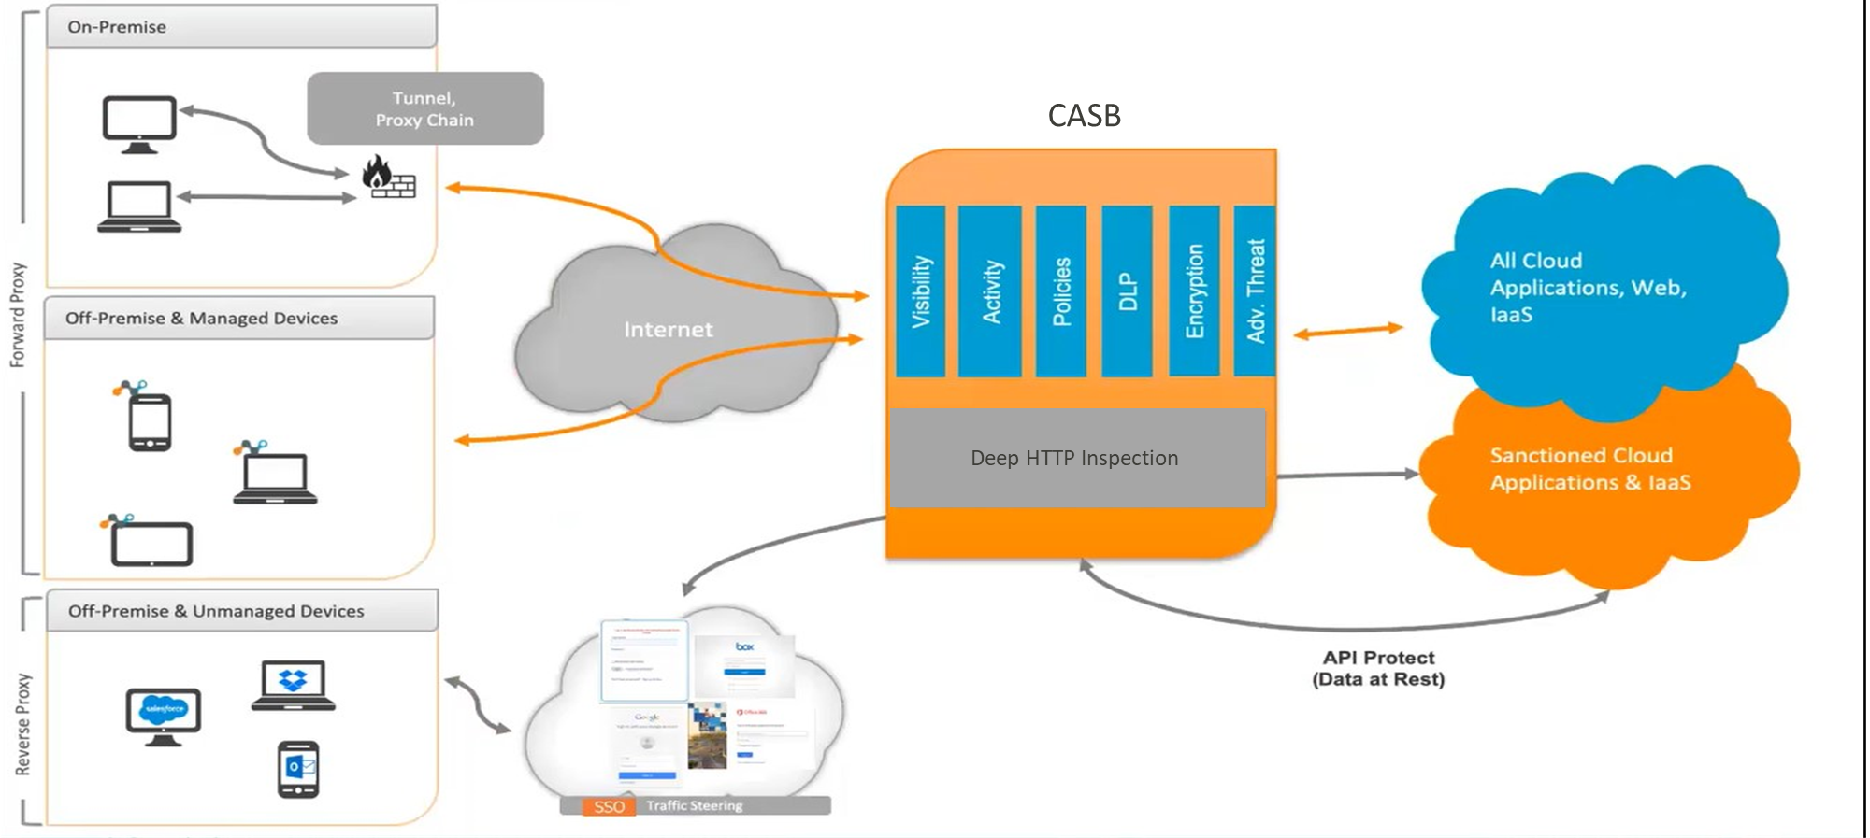




SCED Initiative - Cloud Access Security Broker
CASB Functions
Visibility
Data Security
Threat Protection/Ransomware
Compliance
Auditing
Enforcement
Coach Users
Enterprise Integration
Central management console
SCED will deliver a common approach for Cloud Access Security Broker (CASB) capabilities for SaaS
Excerpt from SSC SCED Executive CASB Overview (CASB) – Sept 2019 Presentation
Notes:
Simplifies security by unifying, detecting, managing and enforcing security policies to secure the use of apps, files and data (ie. Office 365, Service Now, Salesforce, etc.)
Protect the GC data hosted in SaaS based applications based on GC data security standards
Securely broker the user access to government sanctioned SaaS cloud applications
Provides visibility into the use of cloud applications, both sanctioned and unsanctioned
Block risky cloud applications, reducing threats to the GC
Monitor SaaS applications’ service usage and compliance.

Slide 8
Cloud Access Scenarios
Ref | Scenario | Description
A | GC user access to cloud-based service from GC network | A GC worker accessing a cloud-based GC service on the GC network.
B | GC user access to cloud-based service from Internet | A GC worker accessing a cloud-based GC service from outside the GC network over the public Internet.
C | External user access to cloud-based service | A non-GC external user accessing a cloud-based GC service from outside the GC network.
D | Service/Application Interoperability | Service and application communications with cloud-based GC services.
E | Cloud Administration and Management Traffic | Management of cloud-based components and support for Network Operations Center (NOC) and Security Operations Center (SOC) activities.

Slide 9
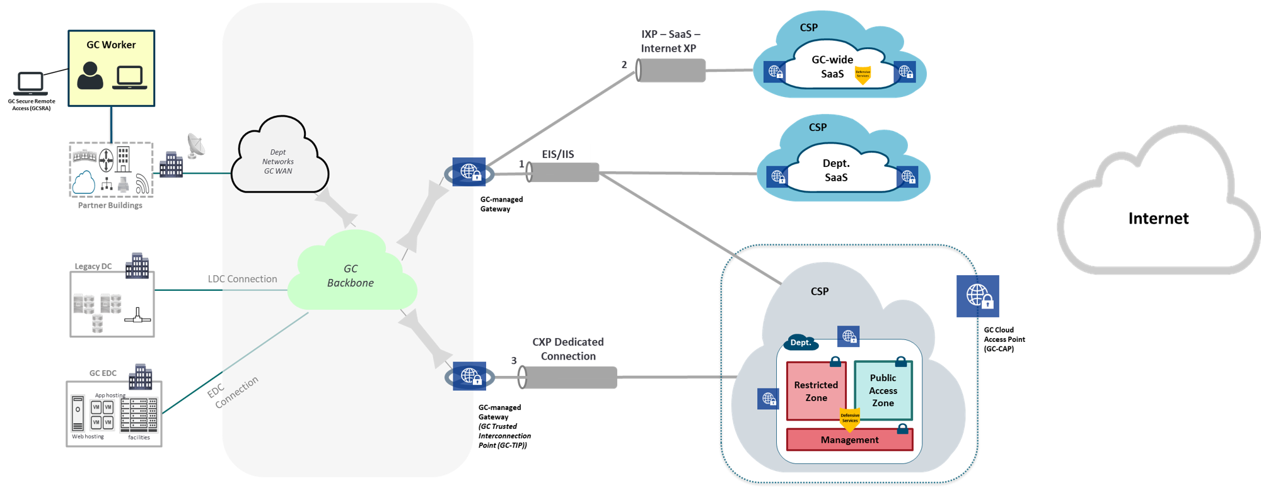

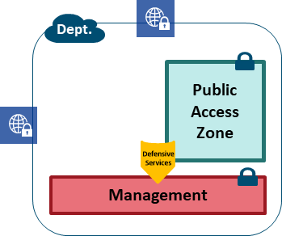
Scenario A – GC user access to cloud-based service from GC Network
A3
Security Services (GC-wide SaaS)
Access Control
Logging and monitoring
Auditing
Cyber defense services (CCCS CBS)
Security Services (SaaS)
Access Control
Logging and monitoring
Auditing
SaaS procured via PSPC RFSA or Dept.
A2
A5
A1
Ref. | Use Case
A1 | GC user access to cloud-based GC service hosted in GC-approved Hyper-Scale CSP (no Interconnection)
A2 | GC user access to cloud-based Dept. SaaS Application
A3 | GC user access to cloud-based GC-wide SaaS Application
A4 | GC user access to cloud-based GC service hosted in GC-approved Hyper-Scale IaaS/PaaS (with Interconnection and no external access)
A5 | GC user access to cloud-based GC service hosted in GC-approved Hyper-Scale IaaS/PaaS (with Interconnection and outbound Internet access enabled)
A4
Security Services (IaaS/PaaS)
Access Control
Boundary Protection
Intrusion detection and prevention
Logging and monitoring
Auditing
Cyber defense services (CCCS CBS/HBS)
Security Services (IaaS/PaaS)
A4 - For GC only Hybrid IT environment, access restricted to GC users only – no External user access to cloud-based GC service.
A5 - Only approved outbound Internet connections are permitted with security services enabled based on risk profile.
Notes:
Scenario A

Slide 10
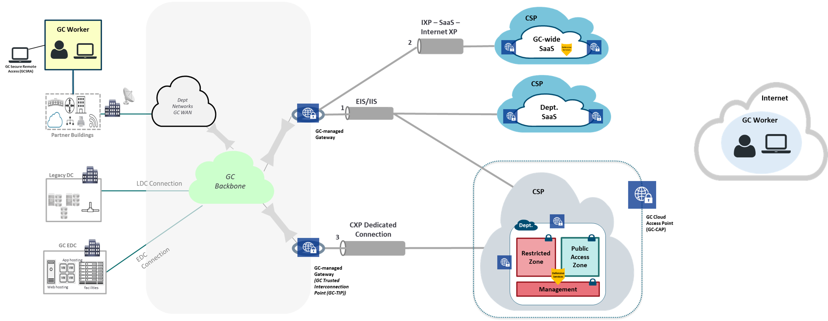
Scenario B – GC user access to cloud-based service from Internet
Security Services (GC-wide SaaS)
Access Control
Logging and monitoring
Auditing
Cyber defense services (CCCS CBS)
B3
Security Services (SaaS)
Access Control
Logging and monitoring
Auditing
Threat monitoring
SaaS procured via PSPC RFSA or Dept.
B2
TARGET STATE – ZERO TRUST SECURITY - UNDER DISCUSSION
B1
B4
Ref. | Use Case
B1 | GC user access to cloud-based GC service from outside GC network (via the Internet) to approved Hyper-Scale IaaS/PaaS (without Interconnection)
B2 | GC user direct access to cloud-based GC service (via the Internet) to Dept. SaaS Application
B3 | GC user direct access to cloud-based GC service (via the Internet) to GC-wide SaaS Application
B4 | GC user access to cloud-based GC service from outside GC network (via the Internet) to approved Hyper-Scale IaaS/PaaS (with Interconnection)
GC-TIP Services
Access control
Boundary Protection
Intrusion detection and prevention
Logging and monitoring
Auditing
Cyber defense services (NBS)
Security Services (IaaS/PaaS)
Access control
Boundary Protection
Intrusion detection and prevention
Logging and monitoring
Auditing
Denial of service protection
Malware protection
TLS Inspection – Ingress (depending on risk profile)
Cyber defense services (CCCS CBS/HBS)
GC-CAP Security Services
Access control
Boundary Protection
Intrusion detection and prevention
Logging and monitoring
Auditing
Denial of service protection
Malware protection
TLS Inspection – Ingress (depending on risk profile)
Cyber defense services (CCCS Virtual NBS)
Notes:
Scenario B
FUTURE STATE – Zero Trust Security
Trusted Identity (e.g. ICAM, 2FA)
Trusted Device
Context-specific policies

Slide 11
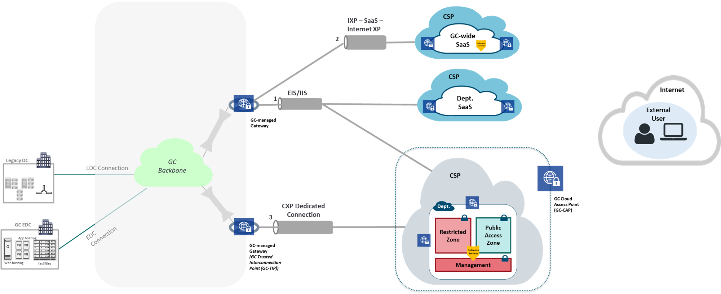
Scenario C – External user access to cloud-based GC service
Security Services (GC-wide SaaS)
Access Control
Logging and monitoring
Auditing
Cyber defense services (CCCS CBS)
C3
Security Services (SaaS)
Access Control
Logging and monitoring
Auditing
Threat monitoring
SaaS procured via PSPC RFSA or Dept.
C2
C1
C4
Ref. | Use Case
C1 | Non-GC user access to cloud-based GC service hosted in GC-approved Hyper-Scale IaaS/PaaS (without Interconnection)
C2 | Non-GC user access to cloud-based GC service hosted in Dept. SaaS Application
C3 | Non-GC user access to cloud-based GC service hosted in GC-wide SaaS Application
C4 | Non-GC user access to cloud-based GC service hosted in GC-approved Hyper-Scale IaaS/PaaS (with Interconnection) Application
Limit interactions with GC Data Centres and IT services.
Use secure Application Programming Interfaces (API) to expose GC data and services.
GC-TIP Services
Access control
Boundary Protection
Intrusion detection and prevention
Logging and monitoring
Auditing
Cyber defense services (NBS)
Additional features enabled based on risk profile:
Malware protection
TLS Inspection – Ingress
Security Services (IaaS/PaaS)
Access control
Boundary Protection
Intrusion detection and prevention
Logging and monitoring
Auditing
Denial of service protection
Malware protection
TLS Inspection – Ingress (depending on risk profile)
Cyber defense services (CCCS CBS/HBS)
GC-CAP Security Services
Access control
Boundary Protection
Intrusion detection and prevention
Logging and monitoring
Auditing
Denial of service protection
Malware protection
TLS Inspection – Ingress (depending on risk profile)
Cyber defense services (CCCS Virtual NBS)
Notes:
Scenario C

Slide 12

Scenario D – Service/Application Interoperability
Security Services (SaaS)
Access Control
Logging and monitoring
Auditing
Security Services (IaaS/PaaS)
Access control
Logging and Monitoring
Auditing
Cyber defense services (CCCS CBS/HBS)
Additional services may be required based on risk profile (e.g. if Internet flows are enabled)
Security Services (GC-wide SaaS)
Access Control
Logging and monitoring
Auditing
Cyber defense services (CCCS CBS)
D5
Security Services (SaaS)
Access Control
Logging and monitoring
Auditing
Threat monitoring
SaaS procured via PSPC RFSA or Dept.
D4
D2
D1
D3
D6
Ref. | Use Case
D1 | Cloud-based GC service to cloud-based GC service, same CSP
D2 | Cloud-based GC service to cloud-based GC service, different CSPs
D3 | Non-GC service to cloud-based GC service for IaaS/PaaS (no interconnections)
D4 | Non-GC service to cloud-based GC service for Dept. SaaS Application
D5 | Non-GC service to cloud-based GC service for GC-wide SaaS Application
D6 | Non-GC service to cloud-based GC service (with interconnection)
Limit interactions with GC Data Centres and IT services.
Use secure Application Programming Interfaces (API) to expose GC data and services.
GC-TIP Services
Access control
Boundary Protection
Intrusion detection and prevention
Logging and monitoring
Auditing
Cyber defense services (NBS)
Additional features enabled based on risk profile:
Malware protection
TLS Inspection – Ingress
Security Services (IaaS/PaaS)
Access control
Boundary Protection
Intrusion detection and prevention
Logging and monitoring
Auditing
Denial of service protection
Malware protection
TLS Inspection – Ingress (depending on risk profile)
Cyber defense services (CCCS CBS/HBS)
GC-CAP Security Services
Access control
Boundary Protection
Intrusion detection and prevention
Logging and monitoring
Auditing
Denial of service protection
Malware protection
TLS Inspection – Ingress (depending on risk profile)
Cyber defense services (CCCS Virtual NBS)
Notes:
Scenario D

Slide 13
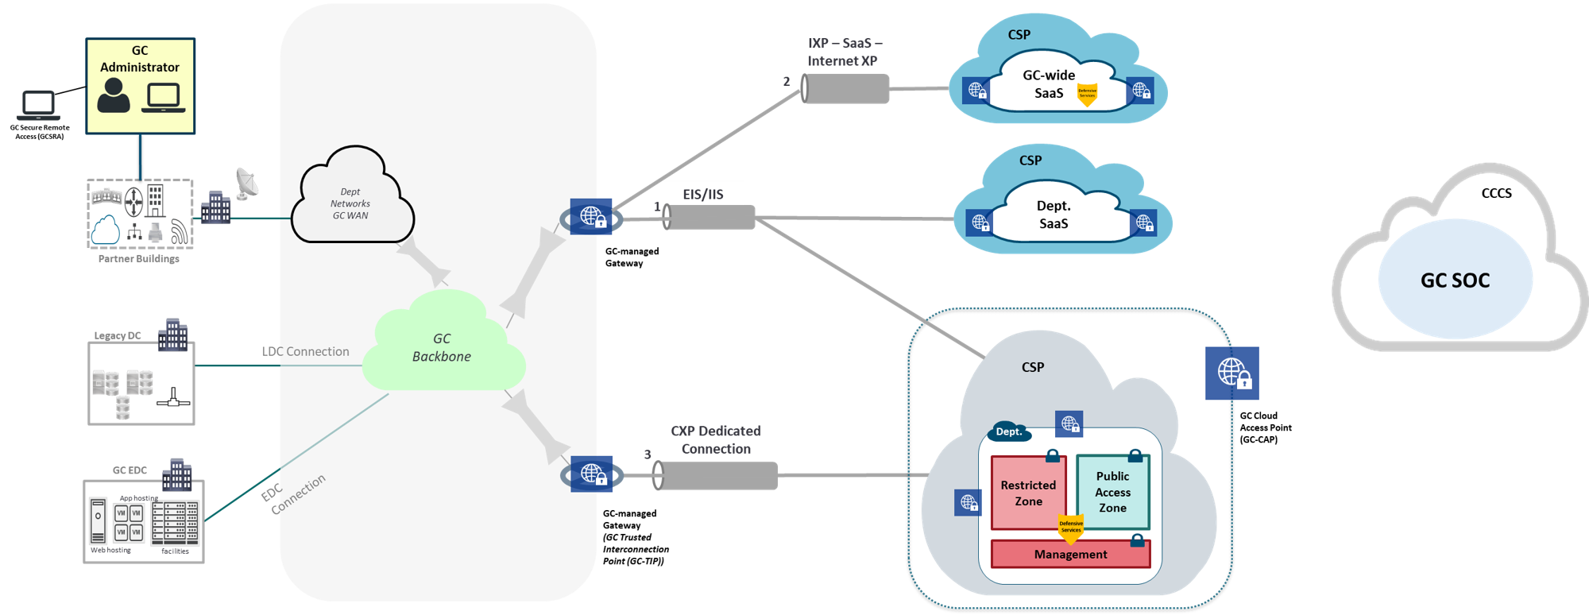
Scenario E – Cloud Administration and Management Traffic
Security Services (SaaS)
Access Control
Logging and monitoring
Auditing
SaaS procured via PSPC RFSA or Dept.
Security Services (GC-wide SaaS)
Access Control
Logging and monitoring
Auditing
Cyber defense services (CCCS CBS)
E3
E6
E5
E2
E1
E4
Ref. | Use Case
E1 | GC administrator to cloud-based GC service administrative interface for IaaS/PaaS
E2 | GC administrator to cloud-based GC service administrative interface for Dept. SaaS Application
E3 | GC administrator to cloud-based GC service administrative interface for GC-wide SaaS Application
E4 | NOC and SOC integration (IaaS/PaaS)
E5 | NOC and SOC integration (Dept. SaaS Application)
E6 | NOC and SOC integration (GC-wide SaaS Application)
Security Services (IaaS/PaaS)
Access Control
Boundary Protection
Intrusion detection and prevention
Logging and monitoring
Auditing
Cyber defense services (CCCS CBS/HBS)
Notes:
Scenario E

Slide 14
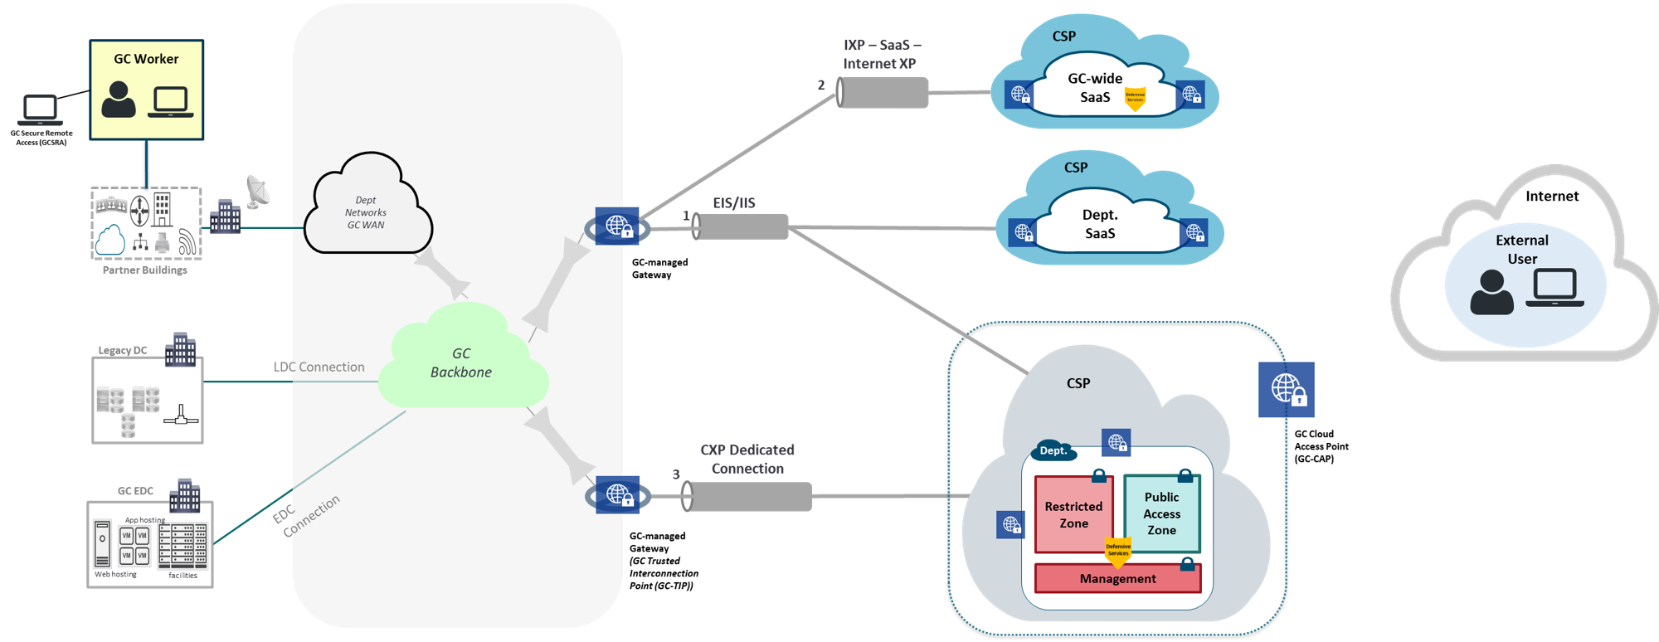
Where does SCED fit in?
GC-CAP Security Services
Access control
Boundary Protection
Intrusion detection and prevention
Logging and monitoring
Auditing
Denial of service protection
Malware protection
TLS Inspection – Ingress (depending on risk profile)
Cyber defense services (CCCS Virtual NBS)
GC-TIP Services
Access control
Boundary Protection
Intrusion detection and prevention
Logging and monitoring
Auditing
Cyber defense services (NBS)
Additional features enabled based on risk profile:
Malware protection
TLS Inspection – Ingress
Network Services
Type 3 – Cloud Exchange Provider

Slide 15
Guardrails

Slide 16
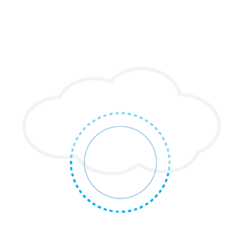

RECAP: Operationalization Framework
No
Removal of access
Yes
Reassign environment
Request access to PB Contract through GC Cloud Broker
Reassign existing environment(s) to PB Contract?
Apply guardrails (see next slide)
Conduct compliance
validation
Validation passed
Refer to GC Cloud Risk Management Approach and Procedures
Provide Root/GA to Dept.
Perform solution engineering and design
Department Security Risk Management Activities
(e.g. SA&A)
No
Yes
GC EARB Oversight
No more than 30 calendar days
Perform dept. security assessment activities
Obtain authority to operate (ATO)
Launch Production Workloads
Operate and Maintain Cloud Environment
Outcome = Enterprise Visibility + Departmental Agility
Dept.
SSC

Slide 17
Cloud Guardrails – First 30 Days
Access Management
Protect Root / Global Admins Account
Cloud Console Access
Data Protection
Protection of data-at-rest
Protection of data-in-transit
Network Security
Segment and separate
Network security services
Operations
Cyber defense services
Configuration of Cloud Marketplaces
Data location
Logging and monitoring
Management of Administrative Privileges
Enterprise Monitoring Accounts
Emergency Break Glass Procedures Approved by CIO/CSO
Plan for Managing Privileged Accounts
Compliance Report
Compliance Report
Target Network Architecture Diagram
MOU Signed with CCCS
Compliance Report
Validation of Guardrails via SSC
Notes:
In August 2019, the Government of Canada (GC) established supply contracts for Protected B Cloud Services with AWS Canada and Microsoft Azure.
In order for the GC to consume this supply in secure and responsible fashion, the Chief Technology Officer of the GC deemed that an underlying operationalization framework was required.
Sept 19th, 2019 – GCEARB we presented the operationalization framework to establish a set of minimal security controls and architecture prior to departments consuming PB supply.
2FA for privileged accounts
Who has an account that has access to portal.azure.com today? How many of you have 2FA enabled?
Protect data at rest and in transit
Appropriate segmentation between dev/test environment and production
Enable logging – when things go wrong, making sure you have the right logging to help you understand what happened

Slide 18
Cloud Usage Profiles
Ref. | Profile | Characteristics | Applicable Service Model | Connection Type | In scope for SCED?
1 | Experimentation/Sandbox | Cloud-based services used for experimentation/sandbox No direct system to system network interconnections required with GC data centers | IaaS, PaaS, SaaS | Type 1 – EIS/IIS | No
2 | Non-sensitive cloud-based services | Cloud-based services hosting non-sensitive GC content No direct system to system network interconnections required with GC data centers | IaaS, PaaS, SaaS | Type 1 – EIS/IIS | Interim – No Future – For IaaS/PaaS, use GC-CAP with CCCS virtual NBS when available, based on risk profile.
3 | Sensitive (up to PB) cloud-based services | Cloud-based services hosting sensitive (up to Protected B) information No direct system to system network interconnections required with GC data centers | IaaS, PaaS, SaaS | Type 1 – EIS/IIS | Interim – No Future – For IaaS/PaaS, use GC-CAP with CCCS virtual NBS when available, based on risk profile. Future - For SaaS, use CASB solution, if available, based on risk profile
4 | Sensitive (up to PB) cloud-based services for GC-wide SaaS Solutions | Cloud-based services hosting sensitive (up to Protected B) information for GC-wide enterprise applications (SaaS) No direct system to system network interconnections required with GC data centers | SaaS | Type 2 – IXP | No – protection via CCCS Cyber Defense services
5 | GC to GC only (Hybrid IT - Extension of GC Data Centers) | Hybrid IT environment with an extension of GC network to cloud-based virtual private cloud (up to Protected B) information GC cloud-based systems required to interact with systems in GC data centers Restricted environment for GC users only No external user connections to/from GC cloud-based virtual private cloud and no publicly accessible services | IaaS, PaaS | Type 3 - CXP | SCED Objective #1 (Network)
6 | Cloud-based services with External user access and interconnection to GC data centers | Cloud-based services hosting sensitive (up to Protected B) information GC cloud-based systems required to interact with systems in GC data centers Environment accessible for both GC users and External users and services Solution implemented, managed and operated by a GC department/agency | IaaS, PaaS | Type 3 - CXP | SCED Objective #1 (Network) and #2 (Security via GC-CAP)
Notes:
Question 1 – Is the GC network extended to a GC-approved Cloud Service Provider (CSP) environment to establish a “virtual private cloud” restricted only to GC users?
Question 2 - Does the cloud-based GC service require system to system network interconnections with information systems located in GC data centres?
Question 3 – Is the cloud-based GC service accessible to external users from the Internet?

Slide 19
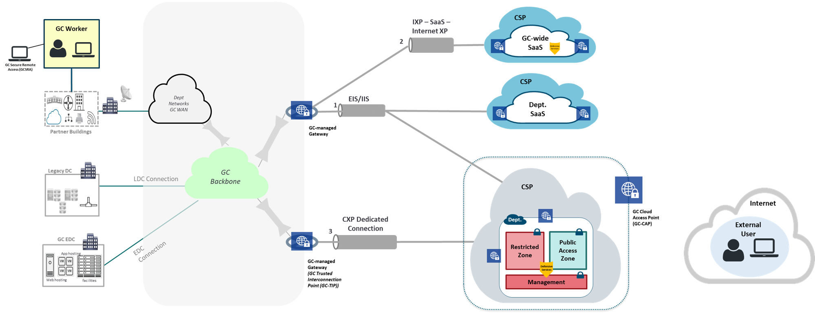
Cloud Usage Profiles
Profile 4
Profile 1,2,3
Profile 5
Profile 6
Notes:
1 Protect root / global admins account
2 Management of administrative privileges
3 Cloud console access
4 Enterprise monitoring accounts
5 Data location
6 Protection of data-at-rest
7 Protection of data-in-transit
8 Segment and separate
9 Network security services
10 Cyber defense services
11 Logging and monitoring
12 Configuration of cloud marketplaces

Slide 20
Mandatory Guardrails – Compliance Monitoring
Minimum, mandatory, guardrails a department must implement within 30 days of gaining access to their account(s). Non-adherence is violation of terms of use.
ID | Cloud Guardrails | Applicable Service Model | Profile 1 – Experimentation/ Sandbox | Profile 2 – Non-sensitive cloud-based services | Profile 3 – Sensitive (up to PB) cloud-based services | Profile 4 – Sensitive (up to PB) cloud-based services for GC-wide SaaS Solutions | Profile 5 – GC to GC only (Hybrid IT - Extension of GC Data Centers) | Profile 6 – Cloud-based Service Accessible to External users (Connections to GC Data Centers Required)
01 | Protect root / global admins account | IaaS, PaaS, SaaS | Required | Required | Required | Required | Required | Required
02 | Management of administrative privileges | IaaS, PaaS, SaaS | Required | Required | Required | Required | Required | Required
03 | Cloud console access | IaaS, PaaS, SaaS | Recommended | Required | Required | Required | Required | Required
04 | Enterprise monitoring accounts | IaaS, PaaS, SaaS | Required (for billing) | Required | Required | Required | Required | Required
05 | Data location | IaaS, PaaS, SaaS | Recommended | Recommended | Required (in Canada for GC storage of PB and above) | Required (in Canada for GC storage of PB and above) | Required (in Canada for GC storage of PB and above) | Required (in Canada for GC storage of PB and above)
06 | Protection of data-at-rest | IaaS, PaaS, SaaS | Not required | Recommended | Required | Required | Required | Required
07 | Protection of data-in-transit | IaaS, PaaS, SaaS | Recommended | Required | Required | Required | Required | Required
08 | Segment and separate | IaaS, PaaS | Required (network filtering at a minimum) | Required | Required | Required | Required | Required
09 | Network security services | IaaS, PaaS, SaaS | Recommended | Required | Required | Required (Restrict to GC only) | Required (Deny External Access policy – GC only) | Required
10 | Cyber defense services | IaaS, PaaS, SaaS | Not required | Required | Required | Required | Required | Required
11 | Logging and monitoring | IaaS, PaaS, SaaS | Recommended | Required | Required | Required | Required | Required
12 | Configuration of cloud marketplaces | IaaS, PaaS, SaaS | Required | Required | Required | Required | Required | Required

Slide 21
Next Steps
Consultation
Executive Approval
Implementation
Review artifacts and obtain endorsement for GC EARB review.
Present artifacts at GC EARB for approval.
Continue with GC Cloud Enablement activities including governance artifacts (naming/tagging standards) and tools/templates, etc.

Slide 22

Questions?
Contact us:
TBS OCIO
Cyber Security
ZZTBSCYBERS@tbs-sct.gc.ca
SSC Cloud Broker
ssc.cloud-infonuagique.spc@canada.ca

Slide 23
References
TB Policies & Standards
Policy on Management of Information Technology
Policy on Government Security
Direction for Electronic Data Residency, ITPIN No: 2017-02
Direction on the Secure Use of Commercial Cloud Services: Security Policy Implementation Notice (SPIN)
Guidance
TBS
Government of Canada Security Control Profile for Cloud-Based GC IT Services
Government of Canada Cloud Security Risk Management Approach and Procedures
Guidance on Cloud Authentication for the Government of Canada
Recommendations for Two-Factor User Authentication Within the Government of Canada Enterprise Domain
Considerations for the use of Cryptography in Commercial Cloud
GC Event Logging Guidance
Standard Operating Procedure for GC Cloud Event Management
CCCS
CCCS ITSG-22 Baseline Security Requirements for Network Security Zones in the Government of Canada
CCCS ITSG-38 Network Security Zoning - Design Considerations for Placement of Services within Zones
CCCS ITSP.30.031 V2 User Authentication Guidance for Information Technology Systems
CCCS ITSP.40.062 Guidance on Securely Configuring Network Protocols
CCCS ITSM.50.100 Cloud Service Provider Information Technology Security Assessment Process
Tools & Templates
Guardrails
GC Cloud Guardrails
https://github.com/canada-ca/cloud-guardrails
https://github.com/canada-ca/cloud-guardrails-azure
https://github.com/canada-ca/cloud-guardrails-aws
Design Patterns
GC ESA SaaS Design Patterns
Playbooks
Security Playbook for Information System Solutions
Templates
https://gccode.ssc-spc.gc.ca/GCCloudEnablement
https://github.com/canada-ca/accelerators_accelerateurs-azure
https://github.com/canada-ca/accelerators_accelerateurs-aws

