Slide 1

What the Evidence Shows:
Racial Discrimination and Health Outcomes for Racialized Public Servants
by Dr. Rose Darly Dalexis
PHAC REN
RESN
ARAN

Slide 2

Land Acknowledgement
Acknowledgments extend beyond simply recognizing the land you occupy; they encourage settlers, including recent arrivals, to reflect on the history and ongoing impact of colonialism.
For instance, you should consider:
What privileges do settlers benefit from today as a result of colonialism?
How can individuals build meaningful relationships with Indigenous Peoples whose territories they currently inhabit within the modern Canadian context?
What actions are you or your organization taking beyond territorial acknowledgments in your homes, workplaces, or events?
Are there ways in which you may be reinforcing settler colonial futures instead of exploring alternative paths for Canada’s future?
Do you have awareness of the continuing violence and trauma embedded in the colonial system?
https://native-land.ca/

Slide 3
Land Acknowledgement
For instance, you should consider:
  What privileges do settlers benefit from today as a result of colonialism?
  How can individuals build meaningful relationships with Indigenous Peoples whose territories they currently inhabit within the modern Canadian context?
  What actions are you or your organization taking beyond territorial acknowledgments in your homes, workplaces, or events?
  Are there ways in which you may be reinforcing settler colonial futures instead of exploring alternative paths for Canada’s future?
  Do you have awareness of the continuing violence and trauma embedded in the colonial system?
Acknowledgments extend beyond simply recognizing the land you occupy; they encourage settlers, including recent arrivals, to reflect on the history and ongoing impact of colonialism.

Slide 4
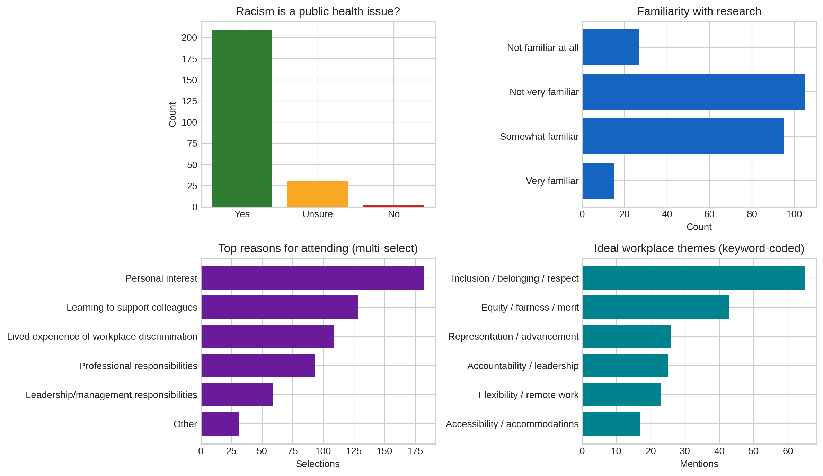
Participant Insights from Registration Data (I–M)

Slide 5
Participant Insights from Registration Data (I–M)
Racism is overwhelmingly viewed as a public health issue by employees (86.4% “Yes”).
Significant proportions report health impacts tied to racism at work:
• 36.0% “Yes” and 32.6% “Maybe,” indicating two‑thirds experience or suspect harm.
Familiarity with research is low: Only 6.2% are “Very familiar,” and 43.4% are “Not very familiar.” Mean familiarity score is 1.40/3.
Motivations for attending center on personal learning (75.2%), supporting colleagues (52.9%), and lived experience (45.0%).
Every respondent provided an “ideal workplace” description, signalling strong engagement and a wealth of qualitative insight.
TOP Workplace Themes Identified by Participants
Accountability & fairness (transparency, equity): 21.5%
Respect, kindness, empathy: 16.5%
Flexible / remote work: 9.1%
Anti‑racism / anti‑microaggression commitments: 8.7%
Representation in leadership: 6.6%
Learning & career growth: 6.6%
Psychological safety: 6.2%
Accommodations & accessibility: 5.8%
9 in 10 consider racism a public health issue.

Slide 6

What the Evidence Shows:
Racial Discrimination and Health Outcomes for Racialized Public Servants
Examining the profound health consequences of systemic discrimination in Canada's public sector workplace
by Rose Darly Dalexis

Slide 7


PRESENTATION ROADMAP
Overview
Racial Discrimination in the Workplace Among Racialized Employees
Racial Discrimination in the Public Sector Workplace
The Experience of Black Workers in Canada
Narratives: Black Public Servants
Health Consequences of Workplace (WP) Racism
  Mental health effects
  Physical health effects
  Physiological health effects
  Explanation of stress pathways
  (link between discrimination chronic illness)
  Call to Action and Closing Comments
Discussion / Q&A

Slide 8
The Hidden Crisis
2021-Pan Canadian Survey
Workplace racial discrimination was reported by 2 out of 5 racialized employees, with prevalence rising to
1 in 2 among Black employees (Zhou et al, 2022)
2021-2022
Workplace racial discrimination affected
3 out of 5 racialized Canadian Workers (Forste, 2023)
2021-2022
47% of Black respondents reported discrimination in hiring, promotion, and pay, compared to 23% of Indigenous and 24% of Asian respondents (Foster et al, 2024)

Slide 9
Alarming Statistics
FOR DECADES
Black, Filipino, and Indigenous individuals reported the highest rates of Workplace Racial Discrimination, evident in hiring biases, wage gaps, and limited career advancement
2021 to 2024 Social Survey
2024
28% of non-white and 48% of Black participants have reported experienced unfair treatment in hiring, pay or promotion because of their race (Foster et al, 2024)
41% of the racialized individuals and 48% of Black declared having experienced discrimination when applying for jobs or promotions (Statistics Canada, 2024).

Slide 10
Workplace Racial Discrimination Among Racialized Workers
69.53% of Racialized workers have experience at least on type of Workplace Racial Discrimination (WP-RD).
Slower promotion and Pay raise and not getting hired are the most prevalent type of WP-RD.

Slide 11
Workplace Racial Discrimination in Canadian Public Service Workplaces
More than half of the racialized workers have experienced at least one type of WP-RD.
All types of Workplace Racial Discrimination (WP-RD) are more prevalent among the public service in comparison to the other working sectors.

Slide 12
Work Place Racial Discrimination:
Industry and Racial Background
Across all working sectors, Black workers reported more workplace racial discrimination experiences compared to the other working sectors.
The prevalence is higher in the public working sectors

Slide 13

Domains of WP-RD Among Black Workers 1 of 2
01
02
03
Work Organization
Promotion Denial/Slower Access to Promotion
Inadequate Performance Evaluation
04
05
06
Slower Access to Employment Security
Hiring
Firing, Laid Off or Forced to Resign

Slide 14
Domains of WP-RD Among Black Workers 2 of 2
01
02
Racial Harassment
Personal Harms
Misuse of authority
Social exclusion and isolation
Incivility
Work vandalism / work impeding
Threats
03
Racial Microaggressions

Slide 15
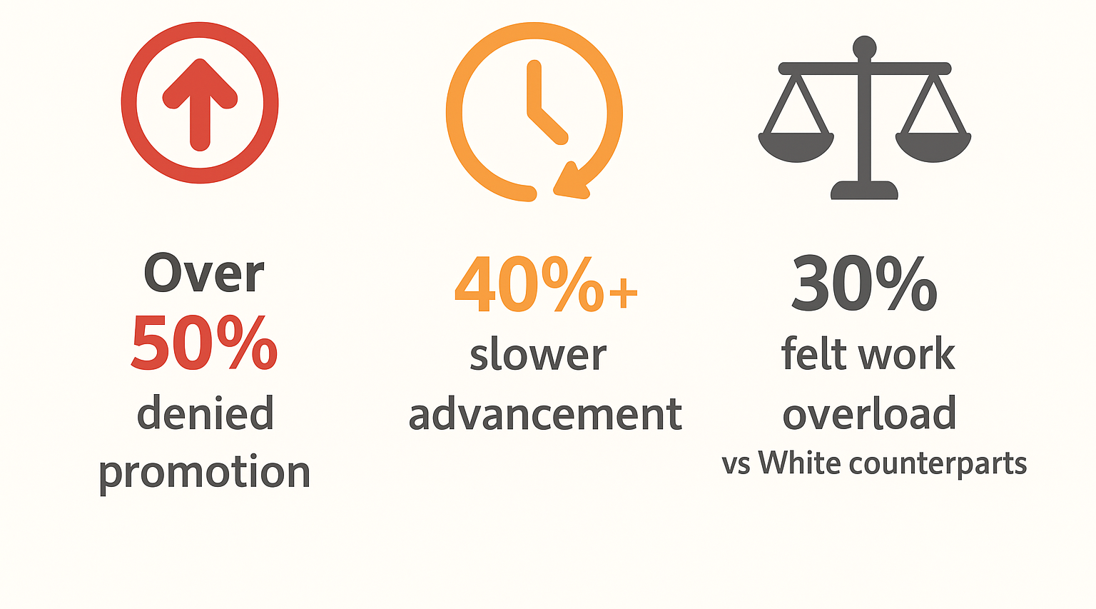



Dr. Rachel Zellers’ report: A Study on the Black Executive Community in the Federal Public Service
Black Executives Experiences
100% faced unfounded allegations
60% experienced harassment
or intimidation
Over
50% denied promotion
40% slower advancement
30%
felt work overload
vs. white counterparts
60% reported Racial
Microaggressions
A Study on the Black Executive Community in the Federal Public Service by Dr. Rachel Zellars, MA, JD, PHD

Slide 16

Real Voices: Experiences from Black Public Servants (1 of 3)
Exclusion from meaningful position
Undesirable Tasks Assignment
“In the process of investigating false accusations against me, of which I was found not guilty, they took away my team, they took away my budget. Despite the end of the process, I didn't return to my initial position”
“She would remove these quote unquote sexy files and give me the not so much. That's right. So, I get to be in the background. You, see?”
Work Overload
Promotion Barriers
“Actually, other employees same level as me have maybe one or two portfolios. Yeah. Yeah… And mine were always over four and five”
“I've been requesting French classes for years, and it was never approved while White colleagues got the French classes they needed”,
“For no reason my supervisor countersigned my scholarship approval, which had already been planned and approved by the other departments”

Slide 17
Real Voices: Experiences from Black Public Servants (2 of 3)
Career advancement barriers
Early Career Exit
My career is blocked. I've been in the same job for 7 years. No one would sponsor my application for higher position since I denounce the racist perpetuators by any means necessary. I'm stuck withing the organization”
On top of all, this last experience made me feel treated lesser than in public push me to retire two years after. It was not the only reason but was definitely one of them.
Promotion Denials
Performance injustice
I have trained many White employees with less experiences than I that became my boss few months later. The higher vacant positions are always offered to them, even if I apply for it too. “I feel like I did not have it not because I am incompetent, but because I am Black” I'd apply for things, whatever it is, a promotion, acting position and not get them, right? The white colleagues would.
I went to one of my White woman bosses, and I said: “hey, I'm just wondering why you gave this acting position to this junior colleague who's only been here for three months, without even offering it to me, who's been here for 10 years”. And she looked me in the face and said: “oh! that's because your work doesn't meet expectations”. However, nothing like this never comes up on my multiple performance reviews.

Slide 18
Real Voices: Experiences from Black Public Servants (3 of 3)
Racial Harassment
“A colleague once came into my office with a red-lipped fluffy monkey. I usually wear red lipstick. She began pretending to babysit the monkey, then she asked me if she could borrow some big markers. She started drawing the monkey on my notepad and eventually made it clear that the drawing was supposed to represent me, implying that I looked like the monkey and that I should be cleaning the toilets. I still have the drawing, in fact. “
Isolation/Exclusion
Incivility
“I was under investigation for false accusations made by a White colleague, of which I was found not guilty. Therefore, everyone was warned not to invite me to any work or social meetings to protect white women. Because she's a victim. They put me in a corner and made fun of me in top of all”
During a meeting where I defended a Black race director against false allegations, someone asked me, “are you sleeping with him?” A similar comment resurfaced when I was granted paid study during a financially difficult time, and people insinuated I might be sleeping with the upper-levels managers

Slide 19
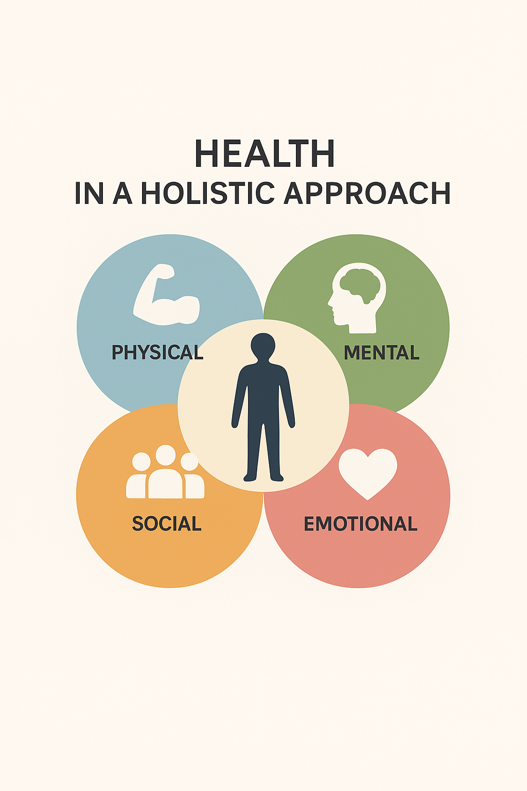
Workplace Racial Discrimination
and
Health

Slide 20

Mental Health Toll:
Mental health problems cost the Canadian economy billions of dollars yearly
WORK RELATED STRESS
Absenteeism
WORKPLACE RACIAL DISCRIMINATION
Anxiety
2X
Moderately stressful
Depression
2X
Burnout
3X
Extremely stressful
Work-related Stress
3X
PTSD
Psychological Distress

Slide 21
Organizational Toll: Economic Burden
Presenteeism
Life Stress
1.4X
Illness, Injury or
Assault as a results
of being at the
workplace or performing
Workplace duties
WORKPLACE RACIAL DISCRIMINATION
2X
Health impacts increase absenteeism, drive up healthcare costs, and substantially reduce overall workforce productivity

Slide 22
Increased Likelihood of Chronic Diseases associated with Racial Discrimination in the Workplace
Go to the accessible version of this slide
TYPE 2 DIABETES
CHOLESTEROL
7X
3X
4X
3X
Promotion
Denial
4X
Slower
promotion
and pay
raises
5X
10X
Firing
3X
Hiring
STROKE
EFFECT
Other
types
BACK
PAIN
2X
3X

Slide 23
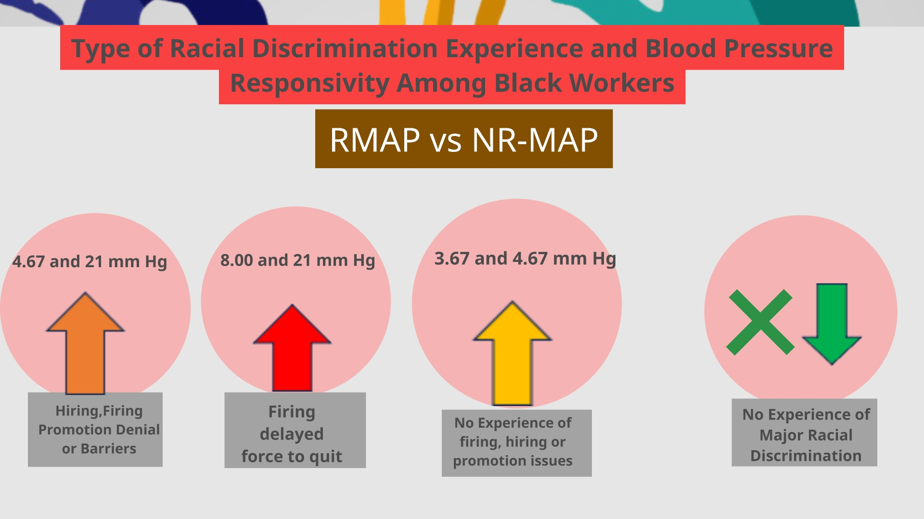
Type of Racial Discrimination Experience and Blood Pressure Responsivity Among Black Workers

Slide 24
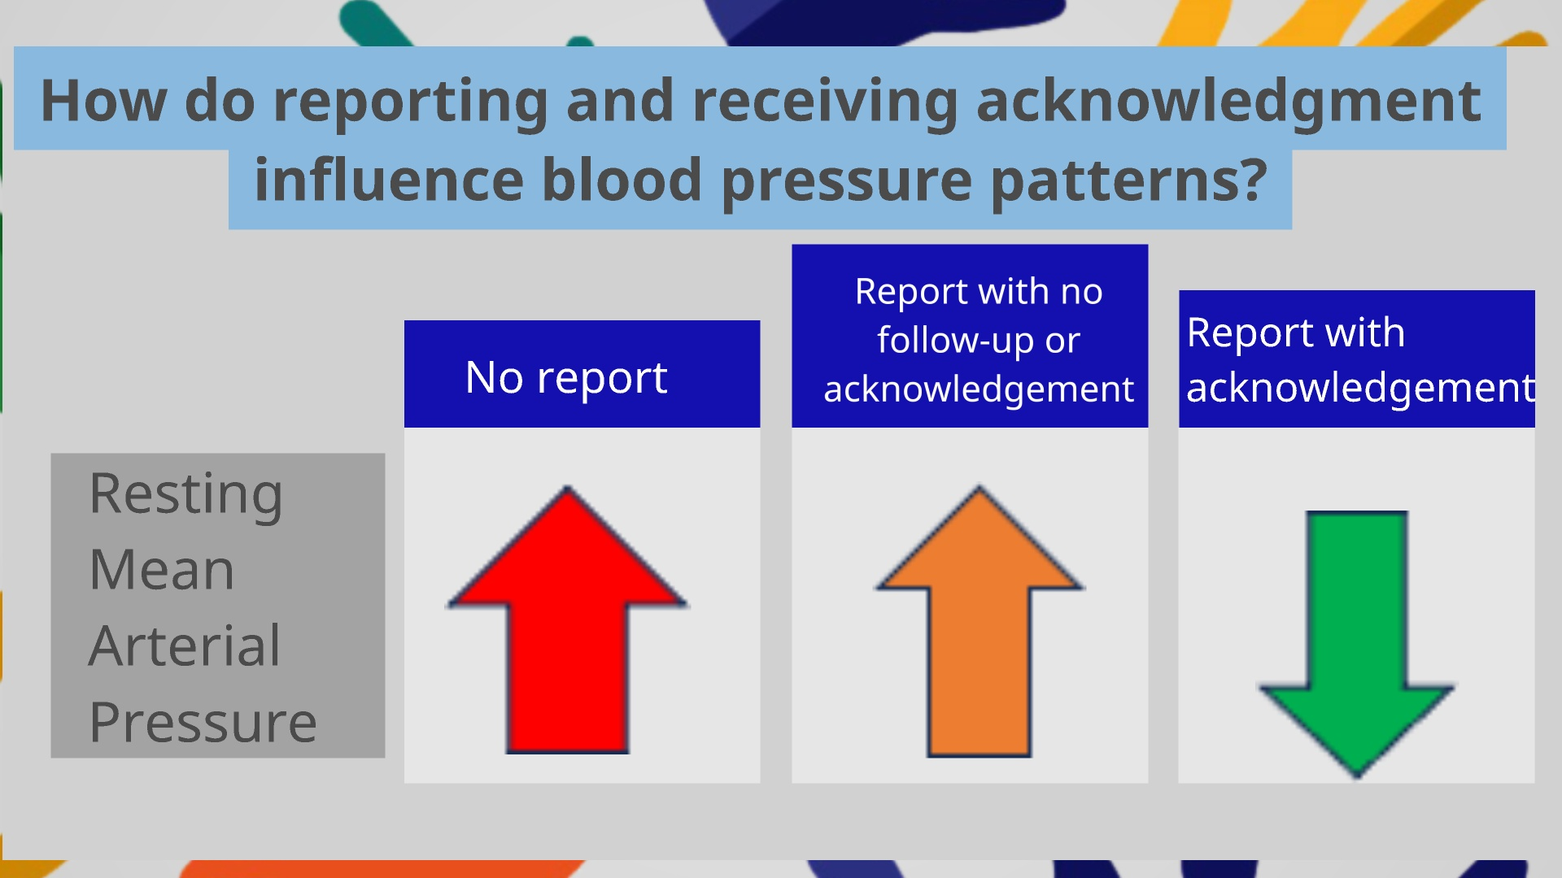
How do reporting and receiving acknowledgement influence blood pressure patterns?

Slide 25
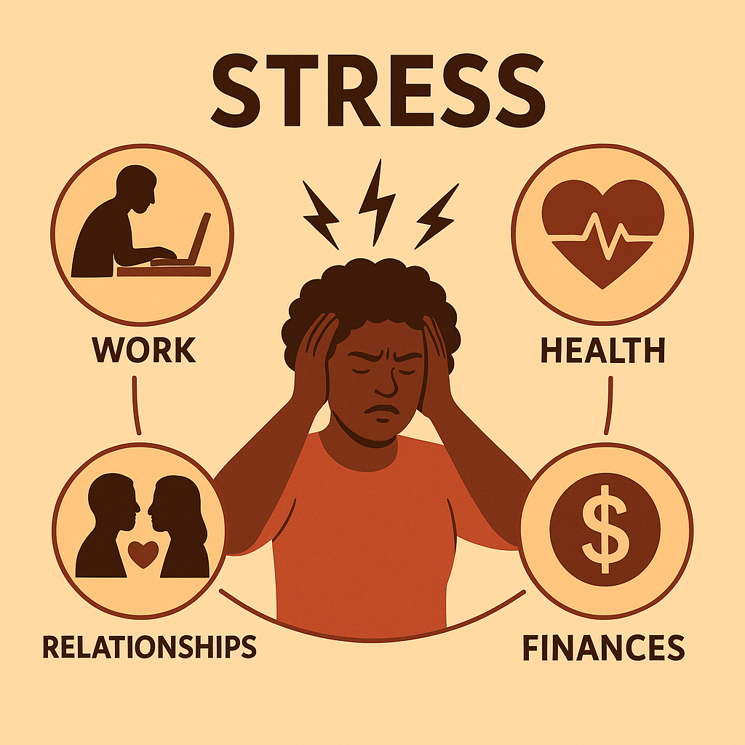
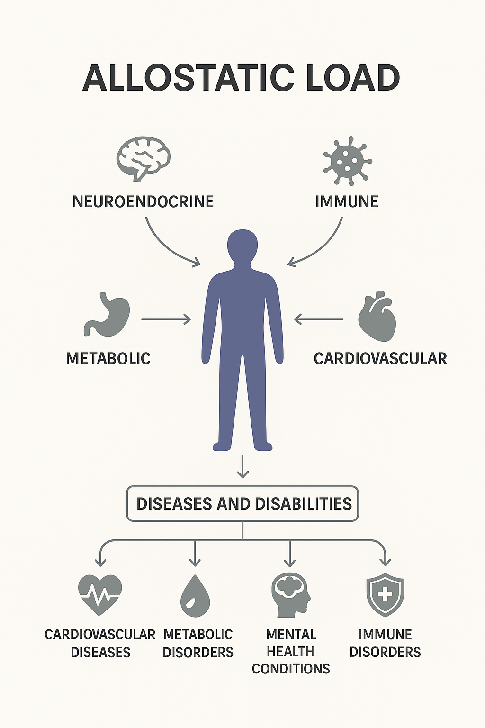
Health Toll: Stress Pathway
WORK-RELATED STRESS
WORKPLACE RACIAL DISCRIMINATION
CHRONIC DISEASES
Prediabetes
Type 2 Diabetes
Blood Pressure
Heart Disease
Cholesterol
Back Pain
Stroke Effect
Workplace racial discrimination
influences health though the
work-related
stress pathway

Slide 26
Quote
“Racism is a visceral experience...It dislodges brains, blocks airways, rips muscle, extracts organs, cracks bones, breaks teeth... You must never look away from this."
Ta-Nehisi Coates

Slide 27
What the evidence shows
Various forms
Increase work-related stress perception
Associated with mental health and chronic diseases outcomes
Reporting is not a culture
Reporting and receiving acknowledgment might be protective factors
Often ignored

Slide 28
TAKE AWAY
Community and culturally-based prevention
Employer
support
Proactive
anti-discrimination policies
Commitment
Recognition

Slide 29


Implications For Us

Slide 30
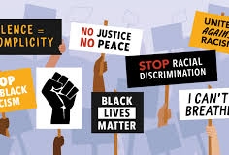
Embedding Racism into Hazard Prevention Programs
What This Means In Practice
If Racism Is Recognized As A Hazard, Departments MUST:
Map Where Racism Can Occur In Structures, Processes, And Culture
Take Proactive Steps To Eliminate Or Control Those Risks
Report On Actions And Progress Every Year
Recognize employee networks as essential partners in preventing workplace harm.
The Role Of Employee Networks
Why employee networks must be at the key tables:
Employee networks offer lived expertise on workplace risks that leadership may not see.
Networks should have structured representation in:
Occupational Health and Safety (OHS) committees
People committees / HR governance committees
Policy review and risk‑assessment processes
Including employee networks ensures harmful policies, processes, and cultural practices are identified early — before they cause harm.

Slide 31
Embedding Racism into Hazard Prevention Programs
Formally classify racism, discrimination, microaggressions, exclusion, and inaccessibility as psychosocial hazards under the Hazard Prevention Program (HPP).
Integrate equity‑related hazards into every step of the Hazard Prevention Program: hazard identification, risk assessment, prevention measures, training, and program evaluation.
Add employee network representatives as voting members of Workplace Health & Safety Committees and the Policy Health & Safety Committee.
Establish trauma‑informed, culturally safe reporting mechanisms co-designed with employee networks.
Embed anti-racism, inclusion, culturally safe supervision, and psychosocial hazard prevention into mandatory manager training and PMAs.

Slide 32
Why This Matters — The Impact on Employees
The Reality
The public service does not currently track the long‑term health impacts of workplace racism — but research shows the risks are significant and measurable.
• Ignoring this harm contributes to:
– burnout
– long‑term and short‑term disability
– attrition of racialized employees
– chronic stress‑related health conditions
• Recognizing racism as a health and safety issue means the PS can no longer treat it as optional or secondary work.

Slide 33
Closing Reflections:
The harms of systemic racism and discrimination have leveraged legal, regulatory, and policy compliance requirements tied to equity, human rights.
These harms have been highlighted also as organizational risks, linking inequitable workplaces with productivity loss, payouts related to grievances and harassment claims, disability leave, attrition, presenteeism, and absenteeism.
With Dr. Dalexis’ research, we now must contend with the real physical and mental health harm caused by inequitable workplaces.

Slide 34
THANK YOU in several African and Caribbean languages
Niitsíniiyi’taki
MERCI
Wela’lin
MÈSI
TANK YUH
THANKS NAH
ASANTE
THANK YOU
NA GODE
ENKOSI
O SE
IMELA
JËRËJËF
NIA:WEN
NGIYABONGA
AMESEGINALEHU
SHUKRAN
MAITA BASA
DANKI

Slide 35

Questions and Answers

Slide 36
Accessiblity Slides

Slide 37
Increased Likelihood of Chronic Diseases associated with Racial Discrimination in the Workplace (accessible version)
Hiring was associated with
  2X back pain
Slower promotion and pay raises were associated with
  7X Type 2 Diabetes
  3X cholesterol
  3X back pain
Promotion denial was associated with
  4x Type 2 diabetes
  3X cholesterol
  10X stroke effect
Firing was associated with
  4x Type 2 Diabetes
Other types were associated with
  5X Type 2 Diabetes
  3X Back pain
Return to slide 20

