Slide 1

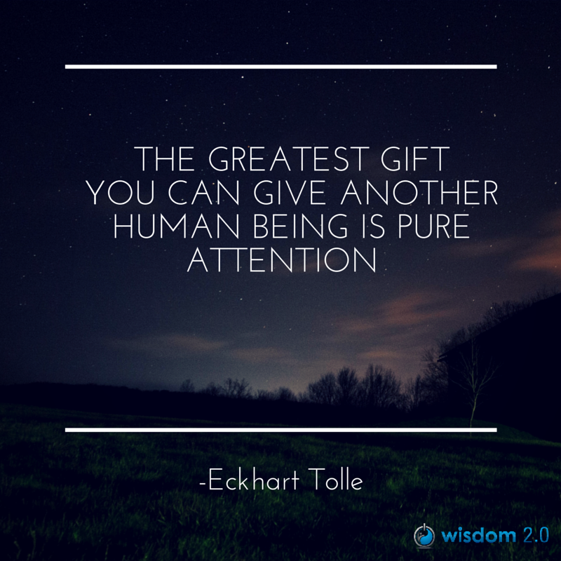
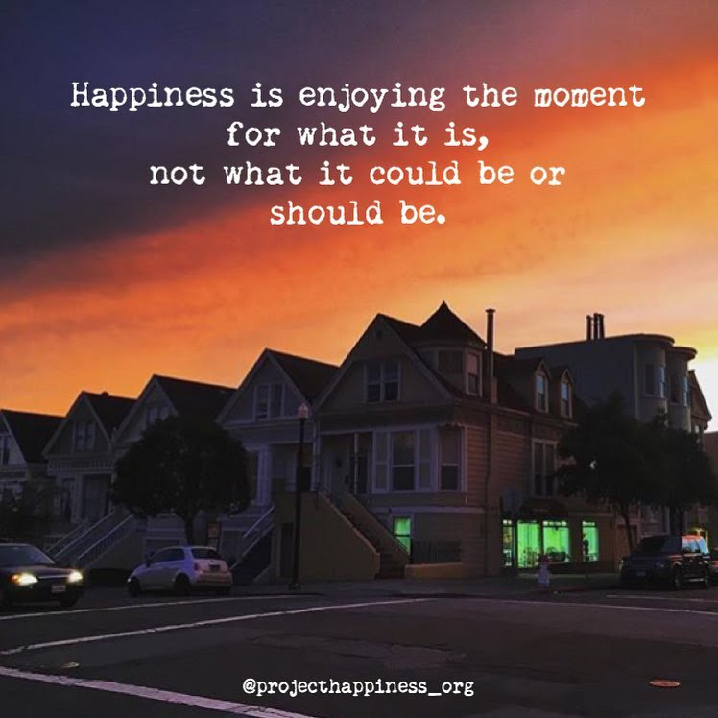
Welcome
Notes:
Carmen 1-5
Alejandro… for conversation in private with Elder Saulis (to get the idea):
Option 1 (preferred): if the Elder is OK in sharing his closing prayers first, and then we go into the breakout rooms. This allows us to chat with the Elder while people are debriefing (need to set up a room for the Elder and us)
Before we go into the small groups, Elder Saulis will close the program with his prayers
And if you would like to, after you debrief in small groups, come back and share and insight you got or what you liked the most of this program, or anything you’d like to share
Option 2: if the Elder prefers we close with his prayers
And before closing with the Elder’s prayer, I invite you to spend some time in small groups to say good bye to your colleagues… although you may end up meeting new people in the last day, remember we all partcipated in this program during the last 8 weeks.
You’ll have until 2:00pm EST for the small groups
This will give opportunity to those who would like to share in plenary something
Prep French CC and font size
InBrief: The Science of Resilience https://www.youtube.com/watch?v=1r8hj72bfGo
Brains: Journey to Resilience - https://www.youtube.com/watch?v=HJvDrT6N-mw
1f time allows… Guided Mindfulness Meditation Connecting with Values - https://www.youtube.com/watch?v=V-LsavLI20w
Open/Prep:
Whatcha readin – https://gccollab.ca/blog/view/13204265/whatcha-readin
Convergence - https://wiki.gccollab.ca/Convergence
Clappling images - https://giphy.com/embed/7Xmgrc6ty9XlZU6h2M
Slido - https://app.sli.do/event/4cdJ6BEhYuyfrRJ7tqWt8J
Polls – Session 8

Slide 2
Mindful Change Leadership Development Program
Week 8 (of 8)
13 Jun 2022
Notes:
Carmen
Welcome to the last session of our program / Bienvenue à tous à la dernière session de notre programme

Slide 3



Mindful Self-Love Exercise – Centering
Notes:
Carmen
For today’s centering exercise, we’ll use a slight variation…. Similar to previous ones, the trick is to shift from “doing” to “being”
Let’s start by doing the following...
Sit in a comfortable attentive position
It helps if you close or semi-close your eyes
Focus on your breathing…
If at any time your mind wanders away, being gently with yourself, acknowledge that though, let it be, and bring back your attention to the here and now
Continue focusing in your breathing
and repeat in your mind the following sentences that feel right to you, in this moment…
Repeat twice or three times the following phrases, aloud, whispering or in your mind, what feels good for you (with enough pause in between each sentence):
I am a kind person (Je suis aimable)
I love myself (Je m’aime)
I do my best (Je fais de mon mieux)
I am enough (je suis assez moi-même)

Slide 4


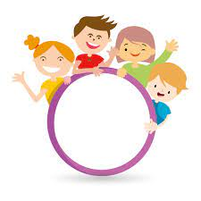










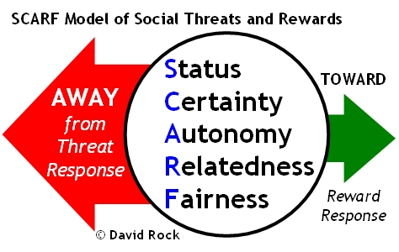


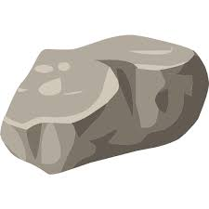




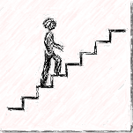
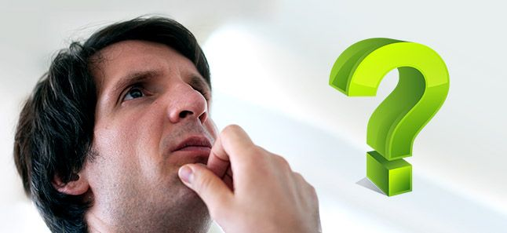


Questions/Insights from last week (7)
Notes:
Carmen
Plenary: Open mic to have your comments, challenges, surprises… particularly would like to hear from someone who hasn’t spoke
Mindful Walk
Leadership Journal
Better Decision Making
Loving Kindness
Raise your hand to speak, type in the chat… be mindful about the time, let’s take as many as we can in about 10 mins.

Slide 5

Agenda – week 8
Centering exercise
Questions/Insights from last week (7)
Today’s intentions
Focus, Compassion, Clarity, Creativity
Resilience, Well-being & Mindfulness
Values & Mindfulness
Mindful on the spot
Some book, apps & other references
Self-Assessments Questionnaires – pre, post, final
MCLD Goal
Your practice – What now?
Farewell
Notes:
Carmen

Slide 6

Resilience, Well-being & Mindfulness
InBrief: The Science of Resilience
  Experience Positivity and Gratefulness
  Manage Stress
  Solve Problems
  Regulate Behaviour
  Plan Ahead
  https://www.youtube.com/watch?v=1r8hj72bfGo
Researchers found “individuals with higher mindfulness have greater resilience, thereby increasing their life satisfaction.” They note that resilience “can be seen as an important source of subjective well-being,” and point out many ways mindfulness can promote this state of mind.
https://greatergood.berkeley.edu/article/item/evidence_mounts_that_mindfulness_breeds_resilience
Notes:
Alejandro
InBrief: The Science of Resilience https://www.youtube.com/watch?v=1r8hj72bfGo
Brains: Journey to Resilience - https://www.youtube.com/watch?v=HJvDrT6N-mw
The 12 Inner Strengths for Lasting Well-Being and Resilience - https://www.rickhanson.net/online-courses/the-foundations-of-well-being/inner-strengths-for-well-being/

Slide 7

Values & Mindfulness
Love
Respect
Courage
Honesty
Wisdom
Humility
Truth
Reverence For Life
True Happiness
True Love
Loving Speech and Deep Listening
Nourishment and Healing
Values and Ethics Code for the Public Sector of Canada:
Respect for Democracy
Respect for People
Integrity
Stewardship
Excellence
https://www.southernnetwork.org/site/seven-teachings
https://plumvillage.org/mindfulness/the-5-mindfulness-trainings/
https://www.tbs-sct.canada.ca/pol/doc-eng.aspx?id=25049
Notes:
Alejandro
1f time allows… 8 mins: Guided Mindfulness Meditation Connecting with Values - https://www.youtube.com/watch?v=V-LsavLI20w
The Seven Teachings - https://www.southernnetwork.org/site/seven-teachings
The Five Mindfulness Trainings - https://plumvillage.org/mindfulness/the-5-mindfulness-trainings/
Values and Ethics Code for the Public Sector of Canada - https://www.tbs-sct.canada.ca/pol/doc-eng.aspx?id=25049
When in doubt, I usually ask myself « What would someone who loved themselves do? »

Slide 8
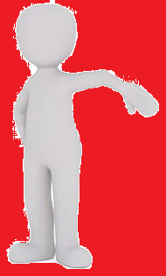
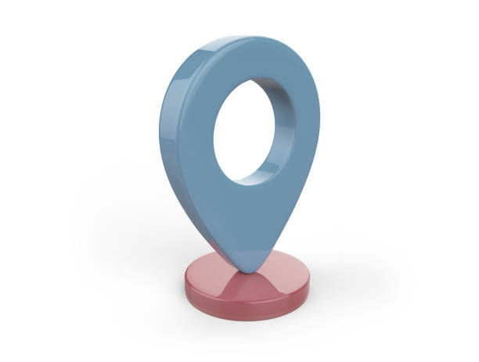
Mindful On The Spot… While:
Breathing, with or without sighing
Joining an e-meeting
Saying “hi!”, “good morning!”, “how was your weekend?”
Coloring
Walking in the present
Being aware of my thinking style
Showering
Washing dishes
Making the bed
Cooking
Eating
Petting my pet
Any other th-ing?
https://www.centerforresilience.org/5-ways-to-practice-mindfulness-right-now
https://positivepsychology.com/meditation-exercises-activities/
https://www.thepathway2success.com/10-mindfulness-activities-you-can-try-today/
Notes:
Both
https://www.centerforresilience.org/5-ways-to-practice-mindfulness-right-now
https://positivepsychology.com/meditation-exercises-activities/
https://www.thepathway2success.com/10-mindfulness-activities-you-can-try-today/
Similar to “Mindfulness on demand”
Being present, not because you need to or you have to but, because you want to ☺

Slide 9



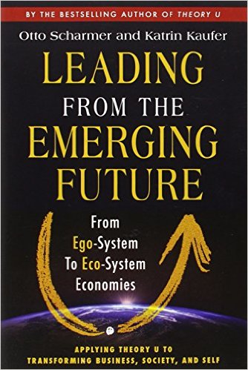
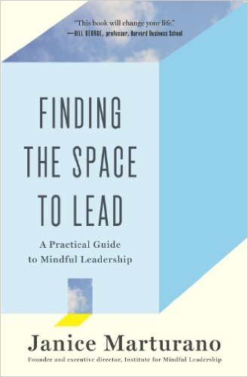



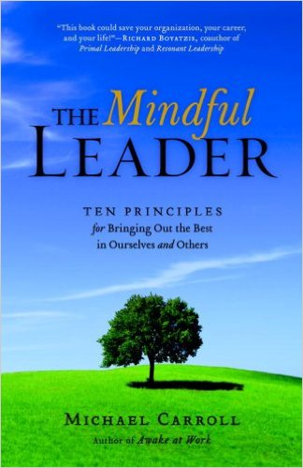





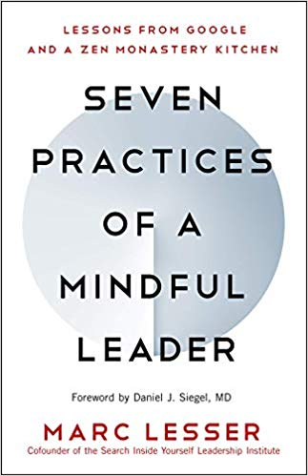

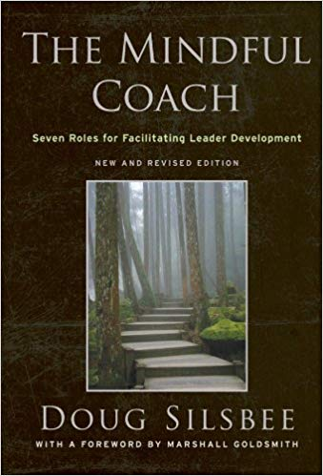
Some Book references
Notes:
Both
References to the books:
First row
https://www.amazon.ca/Search-Inside-Yourself-Productivity-Creativity/dp/0062116924
https://www.amazon.ca/Presence-Human-Purpose-Field-Future/dp/0385516304/
https://www.amazon.ca/Leading-Emerging-Future-Ego-System-Eco-System/dp/1605099260/
https://www.amazon.ca/Finding-Space-Lead-Practical-Leadership/dp/1620402475/
https://www.amazon.ca/Mindful-Leadership-Self-Awareness-Transforming-Inspiring/dp/1118127110/
https://www.amazon.ca/Joy-Demand-Discovering-Happiness-Within/dp/0062378872
Second row
https://www.amazon.ca/Self-Compassion-Proven-Power-Being-Yourself/dp/0061733520
https://www.amazon.ca/Mindful-Leader-Management-Mindfulness-Meditation/dp/1590306201/
https://www.amazon.ca/Mindfulness-Merloyd-Lawrence-Langer-Reprinted/dp/B00C6OOLR6/
https://www.amazon.ca/Eleven-Rings-Success-Phil-Jackson/dp/1594205116/
https://www.amazon.ca/Dare-Lead-Brave-Conversations-Hearts/dp/0399592520
Third row
https://www.amazon.ca/Mindful-Leader-Embodying-Christian-wisdom-ebook/dp/B07KJGHXDW/
https://www.amazon.ca/Creating-Mindful-Leaders-Power-Forward/dp/1119484782/
https://www.amazon.ca/Seven-Practices-Mindful-Leader-Monastery/dp/1608685195/
https://www.amazon.ca/Art-Mindfulness-HarperOne-Select-Selects-ebook/dp/B005HG4H24/
https://www.amazon.ca/Mindful-Coach-Facilitating-Leader-Development-ebook/dp/B00362XL64/
Please refer to the Cohort page; some of you have shared titles of books that work for them
https://gccollab.ca/blog/view/13204265/whatcha-readin

Slide 10







Some App references
Notes:
Carmen
References to some apps:
https://calm.com/
https://www.headspace.com/
https://happify.com/
https://insighttimer.com/en-ca - https://insighttimer.com/fr-ca
(veteran affairs, USA) https://mobile.va.gov/app/mindfulness-coach
Remember, if you feel like trying, don’t lose yourself in the trying this, and trying that… just pick one, stick to it for a week and decide if you like it enough or you try another one for a week.

Slide 11

Convergence
page dedicated to leverage the various sessions offered by, and to, the Federal Government of Canada employees
Current sessions:
Mindfulness Meditation – ISC/CIRNAC, BC
Mindfulness, Workplace Well-being – PSPC, NHQ
Well-being – PSPC, NHQ (recordings)
Well-being – ISC, MB
Adaptive Inquiry session – IOCN, Varies
https://wiki.gccollab.ca/Convergence
Notes:
Alejandro
Convergence - https://wiki.gccollab.ca/Convergence

Slide 12
And other references…
Settle Down, Pay Attention, Say Thank You
- https://my.happify.com/hd/3-ways-to-live-mindfully -
What Is Mindfulness? “Presence of Heart” – A Definition – https://greatergood.berkeley.edu/topic/mindfulness/definition
Why Mindfulness Is a Superpower – An Animation https://www.youtube.com/watch?v=w6T02g5hnT4
The 12 Inner Strengths for Lasting Well-Being and Resilience - https://www.rickhanson.net/online-courses/the-foundations-of-well-being/inner-strengths-for-well-being/
Meditate With Kevin Hart| LoL Network - https://www.youtube.com/watch?v=egjWRWOUME4
Notes:
Carmen
And many more…
If want to… 3.30mins Kevin Hart’s LoL video: https://www.youtube.com/watch?v=egjWRWOUME4

Slide 13
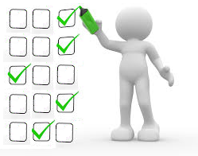
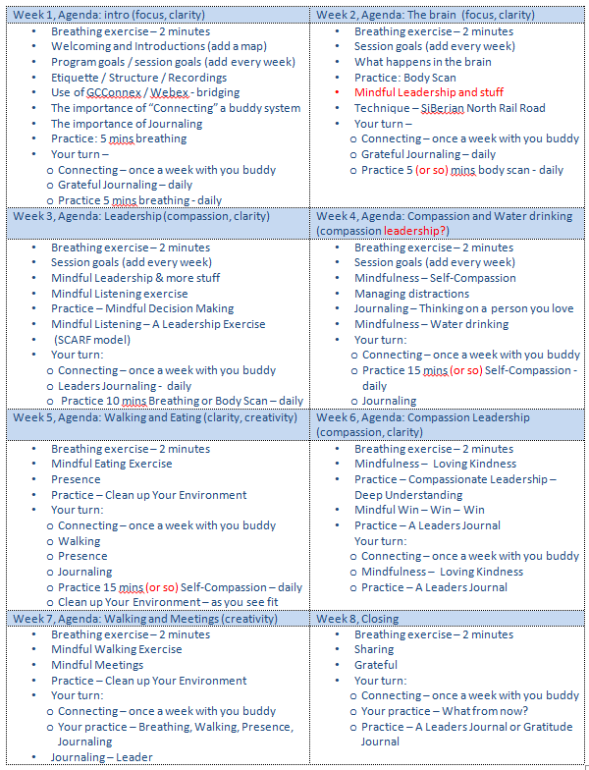
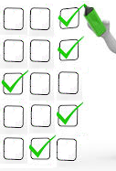

Self Assessment Questionnaires
– pre, post, final
Your self-assessments are very important,
they help report on the results of the program
You will receive a follow up email in 3 months, asking you to complete the assessment again
pre
post
final
★
3 months after
time
Activity
retention
How much is applied
(Behaviours changed)
Benchmark
Notes:
Alejandro
Click on each bullet:
The pre self-assessment you filled for registering to the program, it helps stablishing a benchmark
The post self-assessment is used to identify the knowledge based on the activity retention
The final self-assessment is used to know how much of the learning is actually applied, as in applying the skills and/or behaviours changed
(Read slide)
(Read slide) + we decided only ask you to respond to the final self-assessment
Keep an eye/Look for a call, we likely will need your help to get resources in French, as we just started working on the Fall offering in French, we may need your input
Now, as we start closing the program, Let’s take a couple of mins for you to answer the poll (open the poll)

Slide 14


Mindful Change Leadership Development (MCLD) Program Goal
The goal of the MCLD development program is to increase self-awareness by developing key skills: Focus, Clarity, Creativity, and Compassion in the service of others… with a positive impact on well-being and resiliency.
“Individuals with higher mindfulness have greater resilience, thereby increasing their life satisfaction.” - sciencedirect
Notes:
Carmen
Remembering the goal of this program (read from the slide)

Slide 15





Success
Do you think we succeded?
Notes:
Alejandro
Clappling images - https://giphy.com/embed/7Xmgrc6ty9XlZU6h2M

Slide 16

MCLD Goal
In one word, What's the skill you improved the most during the MCLD Program?
sli.do with code: #MCLD
https://app.sli.do/event/4cdJ6BEhYuyfrRJ7tqWt8J
Notes:
Carmen
https://app.sli.do/event/4cdJ6BEhYuyfrRJ7tqWt8J
With the goal in mind, answer the sli.do

Slide 17

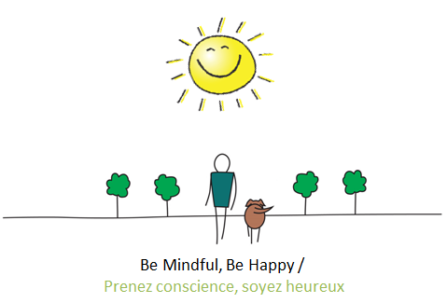
Your practice – What now?
What is the one thing, or two, that
you’ll bring with you from this program?
Notes:
Alejandro
For reflection in small groups, and optional to comment on the chat
What is the one thing (or two) that you’ll bring with you from this program?

Slide 18
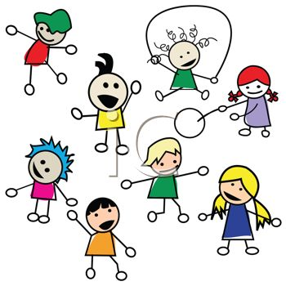


Farewells
Hint: Share a quick thought or a phrase
Saying good bye in small groups
Notes:
Carmen
You’ll have time to say good bye to your colleagues
As a Hint: Share a quick thought or a phrase you feel like sharing

Slide 19

Reflection for today…
Notes:
Alejandro
Here the prompts for your sharing in small groups:
Resiliency
Values Based Mindfulness
Mindful on the spot
Resources
Goal of the MCLD
An intention to brng with you
Farewells
As usual, you’ll have time to debrief in small groups (of 4-6), and for this week, we have a special request for closing the program
Option 1 (preferred): if the Elder is OK in sharing his closing prayers first, and then we go into the breakout rooms. This allows us to chat with the Elder while people are debriefing (need to set up a room for the Elder and us)
Before we go into the small groups, Elder Saulis will close the program with his prayers
And if you would like to, after you debrief in small groups, come back and share and insight you got or what you liked the most of this program, or anything you’d like to share
Option 2: if the Elder prefers we close with his prayers
And before closing with the Elder’s prayer, I invite you to spend some time in small groups to say good bye to your colleagues… although you may end up meeting new people in the last day, remember we all partcipated in this program during the last 8 weeks.
You’ll have until 2:00pm EST for the small groups
This will give opportunity to those who would like to share in plenary something

Slide 20

Be Mindful, Be Happy /
Prenez conscience, soyez heureux
Notes:
(observing Elder Saulis closing prayers)
Both: we may need to say something about our experience?
Thanks everyone for participated in this program… I wish you happiness ☺

