Slide 1
Usability Performance Dashboard
Overview
GC Web Priorities January 8, 2025

Slide 2
Agenda
What is the UPD and who is it for?
Business Value
Adoption
Data Sources
Task Management
UPD Demo
Case Studies
Future of UPD
5763

Slide 3
"Data will talk to you if you’re willing to listen." – Jim Bergeson

Slide 4
What is the UPD?
The Usability Performance Dashboard (UPD) is a data-driven service that allows CRA employees to save time through quick access to data, so more time can be spent improving services for individuals and businesses.
Who is the UPD for?
UX and content practitioners: To quickly measure performance, make content and design decisions and enhance user experience.
Content authors: To assess the performance of their content and inform design choices.
CRA teams and executives: To see how products and services are performing at a glance.

Slide 5
Business Value
Key Metrics
Easy Access to Data and Analytics: Provides quick access to data and analytics in one place.
Connected Data Sources: Integrates insights across data points and channels, creating a comprehensive view of user behaviors.
Informed Decision Making: Enables evidence-based decisions leading to real improvements.
Continuous Monitoring: Helps stay proactive by monitoring trends.
Enhanced Prioritization and Efficiency: Provides a structured approach to organizing, prioritizing, and tracking task performance.
580+
User Tasks tracked
55,000+
Canada.ca Pages tracked
500K+
Page feedback comments
Call volume
4.5m+ calls
71
Completed UX Projects tracked
500+
Participants trained to use UPD at CRA

Slide 6
Adoption
The UPD is now integrated into our daily processes including the User-Centred Design (UCD) process.
Using data in the discovery phase provides us with insights that shape decision-making early on, enabling evidence-based, user-centred design.
By monitoring feedback after changes, we can continually refine and improve user experiences.
Initiate phase
Discover phase
Design phase
Deliver phase
Monitor & refine phase

Slide 7
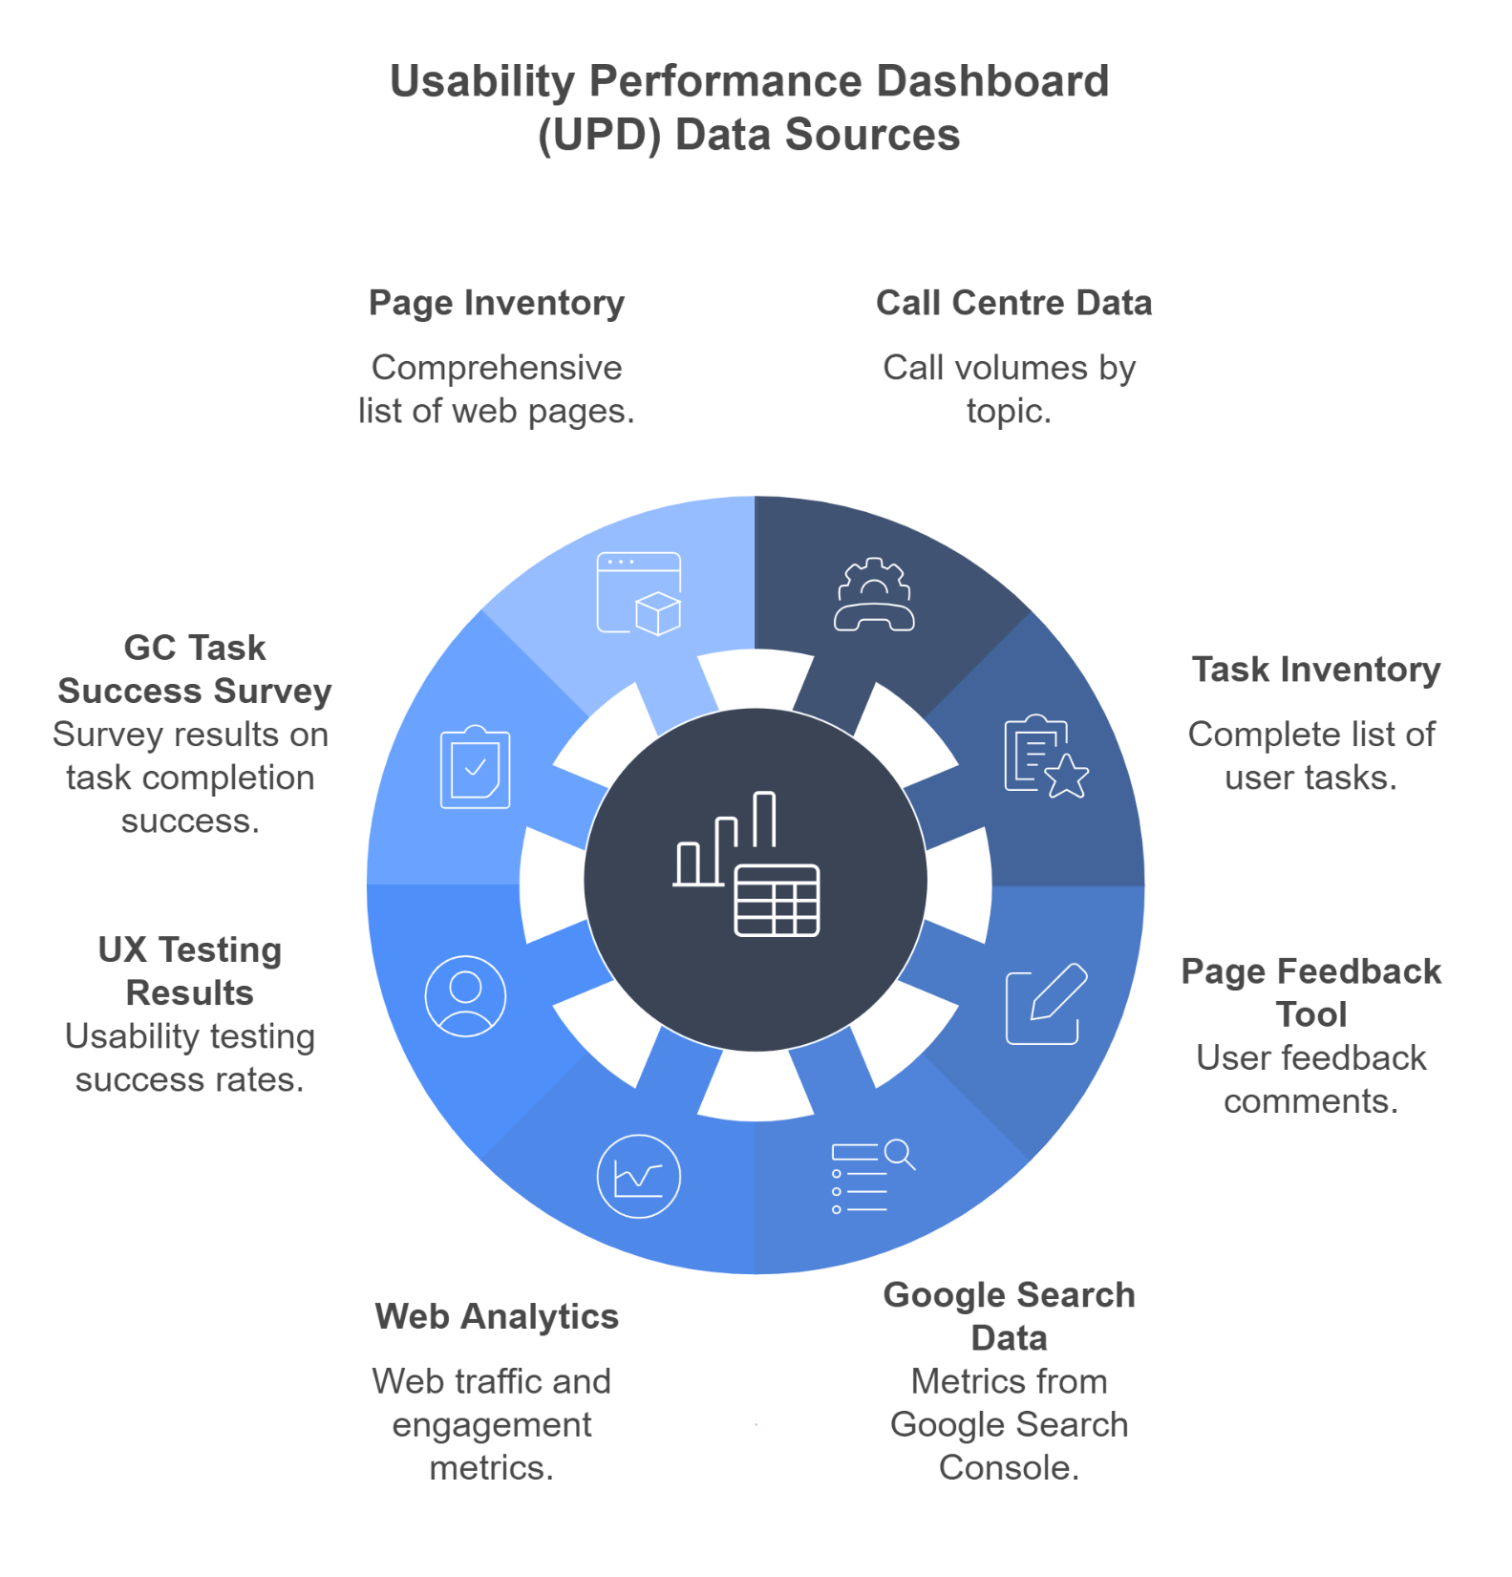
Data Sources
8 Data Sources:
Page Inventory
Call Centre Data
Task Inventory
Page Feedback Tool
Google Search Data
Web Analytics
UX Testing Results
GC Task Success Survey

Slide 8
Task Management
We manage user tasks through a structured process that enables us to:
Maintain a record of tasks visitors come to the CRA website to complete.
Categorize tasks and connect them with relevant data points for better organization and analysis.
Measure task performance over time, allowing us to make actionable improvements.
This process supports iterative improvements, moving beyond data collection and reporting to support continuous improvement.

Slide 9
UPD Demo

Slide 10
Case Study #1 – Content Authors
How they use UPD?
Content Optimization: Identify and address trends in negative feedback.
Search Optimization: Align page metadata and content with user language.
Prioritization: Focus on improving high-impact pages based on user feedback.
Reporting: Create monthly report targeted to their group summarizing trends and recommendations.
Collaboration: Share insights to support decisions.
Group of content creators responsible for maintaining a portion of the website.
Focus Area: Individual pages or sets of pages within their assigned section of the site.
Goal: To ensure their content aligns with user needs and supports usability standards within their scope of responsibility.
Key Data Sources
Page Feedback Tool
Web Analytics
Google Search Data
…more

Slide 11
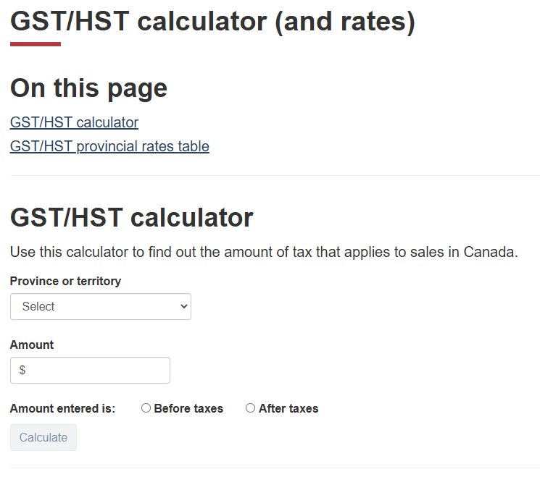
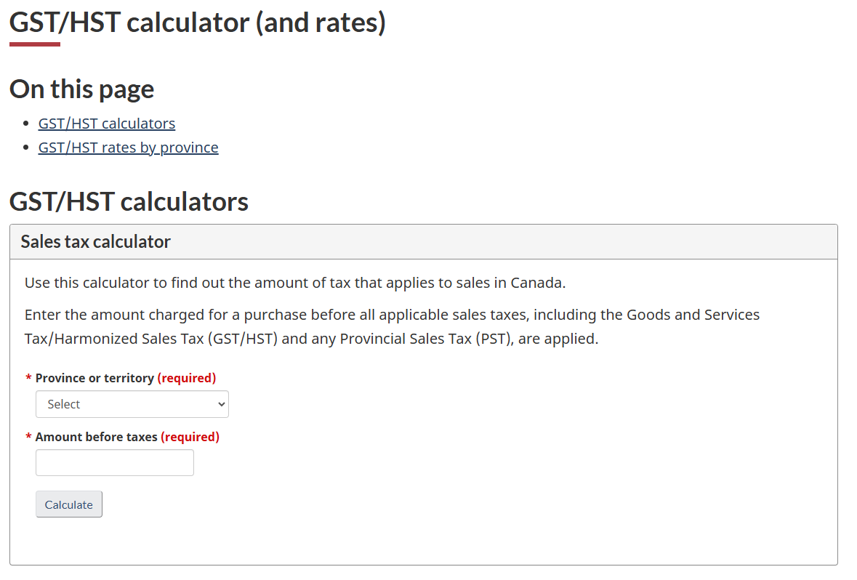
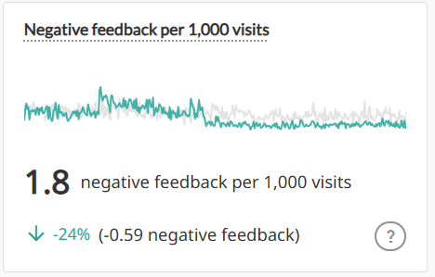
Case Study #1 – Content Authors
Solution: The user interface was changed substantially to make it easier to use.
Data from Page Feedback Tool Users frequently indicated they “Didn’t find what they were looking for” and mentioned difficulties and confusion in using the calculator Problem
GST/HST Calculator page saw the number of comments from visitors increasing relative to visits in early 2024
Results
Key Data Sources
Page Feedback Tool
Web Analytics
Google Search Data
…more

Slide 12
Case Study #2 Content Optimization Project – My Account
How they use UPD?
Content Optimization: Identify and address trends in negative feedback and call volumes
Prioritization: Focus on identifying and improving high-impact pages based on user feedback.
Reporting: Create monthly reports summarizing trends and recommendations.
Collaboration: Share insights to support localized decisions.
Multidisciplinary teams include content designers, strategists, usability designers researchers, program stakeholders and data analysts.
Focus Area: Sets of pages for selected group of tasks.
Goal: To improve task success, improve findability and reduce related phone calls and negative feedback.
Key Data Sources
Page Feedback Tool
Web Analytics
Google Search Data
Call Centre Data

Slide 13
Case Study #2 Content Optimization Project – My Account
Solution: The redesigned registration page has clear buttons to start the registration process.
Data from Page Feedback Summary Users frequently mentioned difficulties in finding a clear and direct link or button to start the registration process. They expressed frustration about not being able to locate the actual registration form.
Problem The registration instructions described in detail the registration process, but didn’t have a link or button to start the registration process.
Result: Negative feedback for this task decreased by 51% and calls per 100 visits decreased by 42%.
Key Data Sources
Page Feedback Tool
Web Analytics
Google Search Data
Call Centre Data

Slide 14
Future of UPD
Enhanced AI Capabilities: Introduce qualitative data analysis of user feedback to identify trends, improve content, and streamline processes.
Data Source Integration: Expand data sources to include chatbot interactions and establish tighter integrations with call center data for a more holistic view of user behavior.
Streamlined Task Management: Improve task management functionality to support ongoing monitoring of top tasks and collaboration with partners for better decision making.
"Data will talk to you if you’re willing to listen." – Jim Bergeson
Tools for Data Listening: Prioritize evolving tools like the UPD to effectively capture and interpret feedback. Evolving Infrastructure: Invest in scalable systems to integrate new data sources and adapt to user needs. Commitment to Success: Continuously upgrading tools and infrastructure and ensuring data analysis is embedded in all processes will help to stay aligned with goals.

Slide 15
Thank You Questions?

