Slide 1

OUR PROJECT STORY
[PROJECT LOCATION]
DATE

Slide 2
How to use this document
Instructions – Remove this page before using
OBJECTIVE and FOR WHO: This template is designed by the change managers and project team to narrate the project's story from the perspective of employee experiences. It is intended to be shared with employees to commemorate our collective journey.
WHEN: After opening week to celebrate the success of your workplace. Some of you may want to use it during the opening ceremony, and that is fine! Just make sure to adjust the slides, as templates for slides 13 to 15 currently include pictures of the opening week and possibly pictures of people collaborating in the space after opening week.
HOW: By email and on the intranet
NOTES: There are many placeholders for quotes from employees throughout the document. Make sure to include quotes from various point of views, such as employees from many equity groups, levels, and more.
* The French version of this document is available here: FR version

Slide 3


Our vision
This may include your project’s scope (Fit-up, WTP, move, etc.) and a couple of the project’s key dates in the project (When it started, opening date, etc.)
Project context
Project vision
Find your project’s vision in the PRET
QUOTE FROM PROJECT SPONSOR

Slide 4
Our project team
The project team coordinated the implementation of the work environment: from IM to IT, security, communication and change management, they made sure that our project reflected our values and needs!
PLACEHOLDER FOR A GROUP PICTURE
Names and titles

Slide 5
Our change agent network
This project would not have been possible without our amazing change agents! They championed for you every step of the way, ensuring your needs were met and your voices heard. Thanks to their dedication, we've navigated this transition smoothly together!
PLACEHOLDER FOR A GROUP PICTURE
Names

Slide 6











Our timeline
This timeline captures our progress from the initial stages of change to now. Each marker represents pivotal moments in our collective efforts towards our new normal. Let's reflect on our achievements and embrace the exciting path ahead as we navigate through this journey together.
ADJUST THIS TIMELINE TO MATCH THE ACTIVITIES YOU CONDUCTED THROUGHOUT THE PROJECT
Project announcement
Start of cleaning up activities
Floor plan announcement
Community norms/Team charters
Tours of the new workspace
WE ARE HERE!
Our new normal
Townhall activity
Creation of a change agent network
Meeting room naming
Pre-opening Q&A
Opening week

Slide 7
Our starting point
PLACEHOLDER
REPLACE WITH PICTURES OF YOUR WORKPLACE BEFORE THE PROJECT

Slide 8
Let’s clean up!
PLACEHOLDER
REPLACE WITH PICTURES OF EMPLOYEES DURING THE CLEAN UP PROCESS
We all got in on the action!
# documents shredded
# documents digitalized
Insert other numbers or fun facts from the clean up process

Slide 9
Our temporary home
PLACEHOLDER
REPLACE WITH PICTURES OF YOUR SWING SPACE
Pictures may include people collaborating in the space, using different workpoints, using the kitchen, etc.

Slide 10
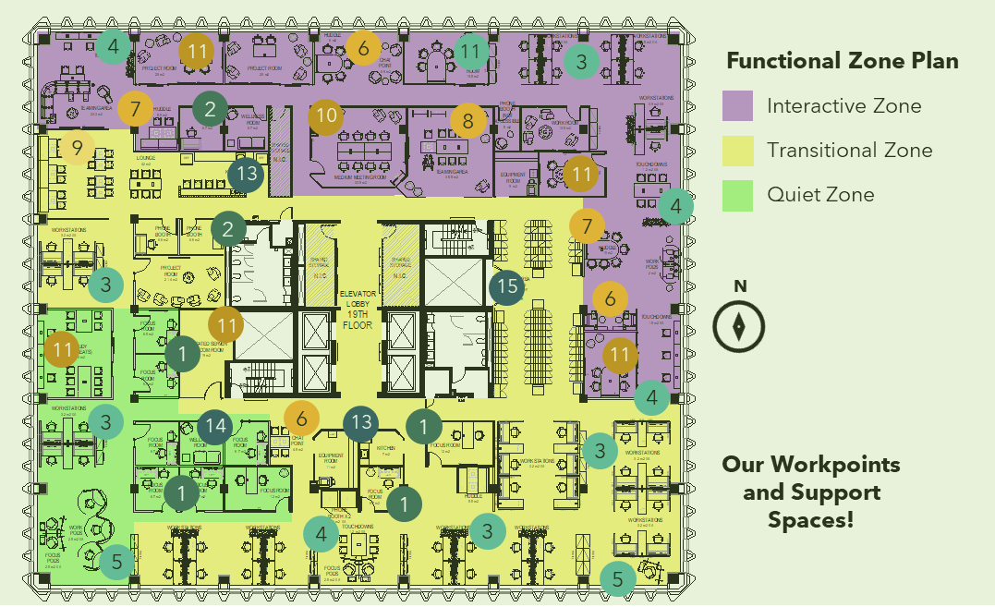

A glimpse into the future
We now are used to our new workplace, but here is a glimpse of what the very first time you saw the floor plan looked like!
PLACEHOLDER IMAGE
REPLACE WITH A PICTURE OF YOUR FLOOR PLAN
QUOTE FROM AN EMPLOYEE IN REACTION TO FLOOR PLAN
PLACEHOLDER FOR A PICTURE OF THE PROJECT SPONSOR ANNOUNCING THE FLOOR PLAN
QUOTE FROM AN EMPLOYEE IN REACTION TO FLOOR PLAN
QUOTE FROM AN EMPLOYEE IN REACTION TO FLOOR PLAN

Slide 11
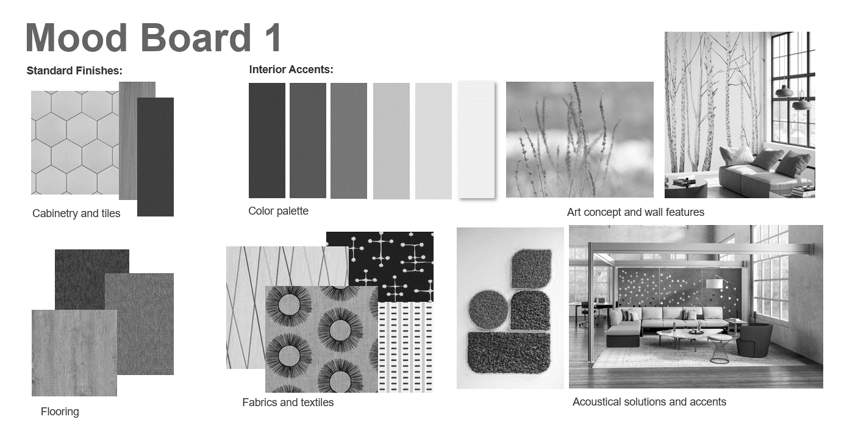
What you voted for
Mood board
Feature wall
PLACEHOLDER FOR A PICTURE OF CHOSEN FEATURE WALL
PLACEHOLDER IMAGE
REPLACE WITH A PICTURE OF CHOSEN MOOD BOARD
% of employees who voted chose this mood board
% of employees who voted chose this feature wall

Slide 12
Our journey
A day in-a-life presentation
Pre-opening Q&A session
Tours of the workplace
PLACEHOLDER
REPLACE WITH PICTURES OF YOUR DAY IN-A-LIFE PRESENTATION
PLACEHOLDER
REPLACE WITH PICTURES OF YOUR PRE-OPENING Q&A SESSION
PLACEHOLDER
REPLACE WITH PICTURES OF TOURS OF THE WORKPLACE

Slide 13
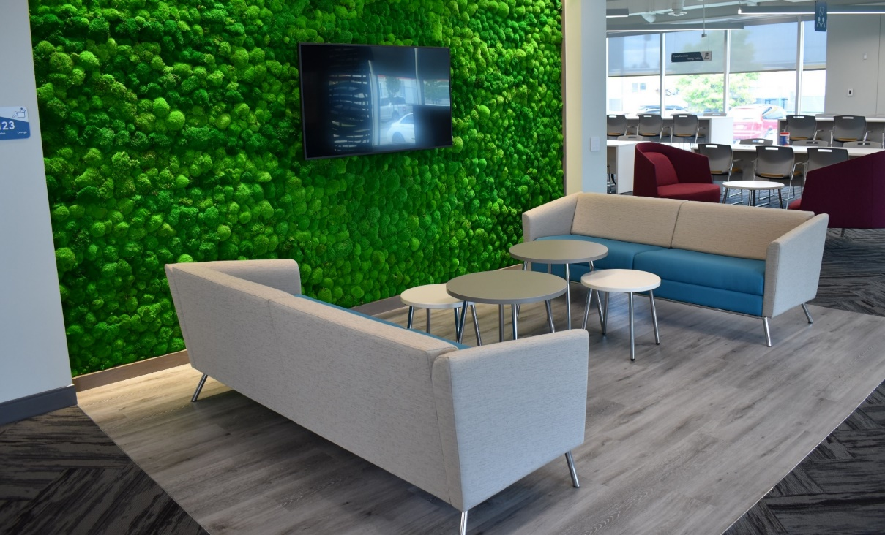
Opening week
PLACEHOLDER IMAGES
REPLACE WITH PICTURES OF YOUR OPENING WEEK
Pictures may include the welcoming team, kiosks, the ribbon cutting ceremony, etc.
Week of DATE to DATE
Insert stats or fun facts from the opening week
QUOTE
QUOTE

Slide 14
This is our new normal!
PLACEHOLDER IMAGES
REPLACE WITH PICTURES OF YOUR NEW WORKPLACE
Pictures may include people collaborating in the space, having a potluck, attending a meeting in a large meeting room, using different workpoints, using the kitchen, etc. It can also include new spaces such as the equipment room, the IT helpdesk, and more.

Slide 15

Gathering your feedback
QUOTE FROM EMPLOYEE FEEDBACK
We're committed to enhancing your experience in our workplace. To achieve this, we're constantly seeking your feedback on your experienceson how you’ve been experiencing it all.
Here is some of the feedback we’ve received so far:
QUOTE FROM EMPLOYEE FEEDBACK
QUOTE FROM EMPLOYEE FEEDBACK
To send us your feedback or any comments regarding our workplace, contact us at GENERIC EMAIL.

Slide 16
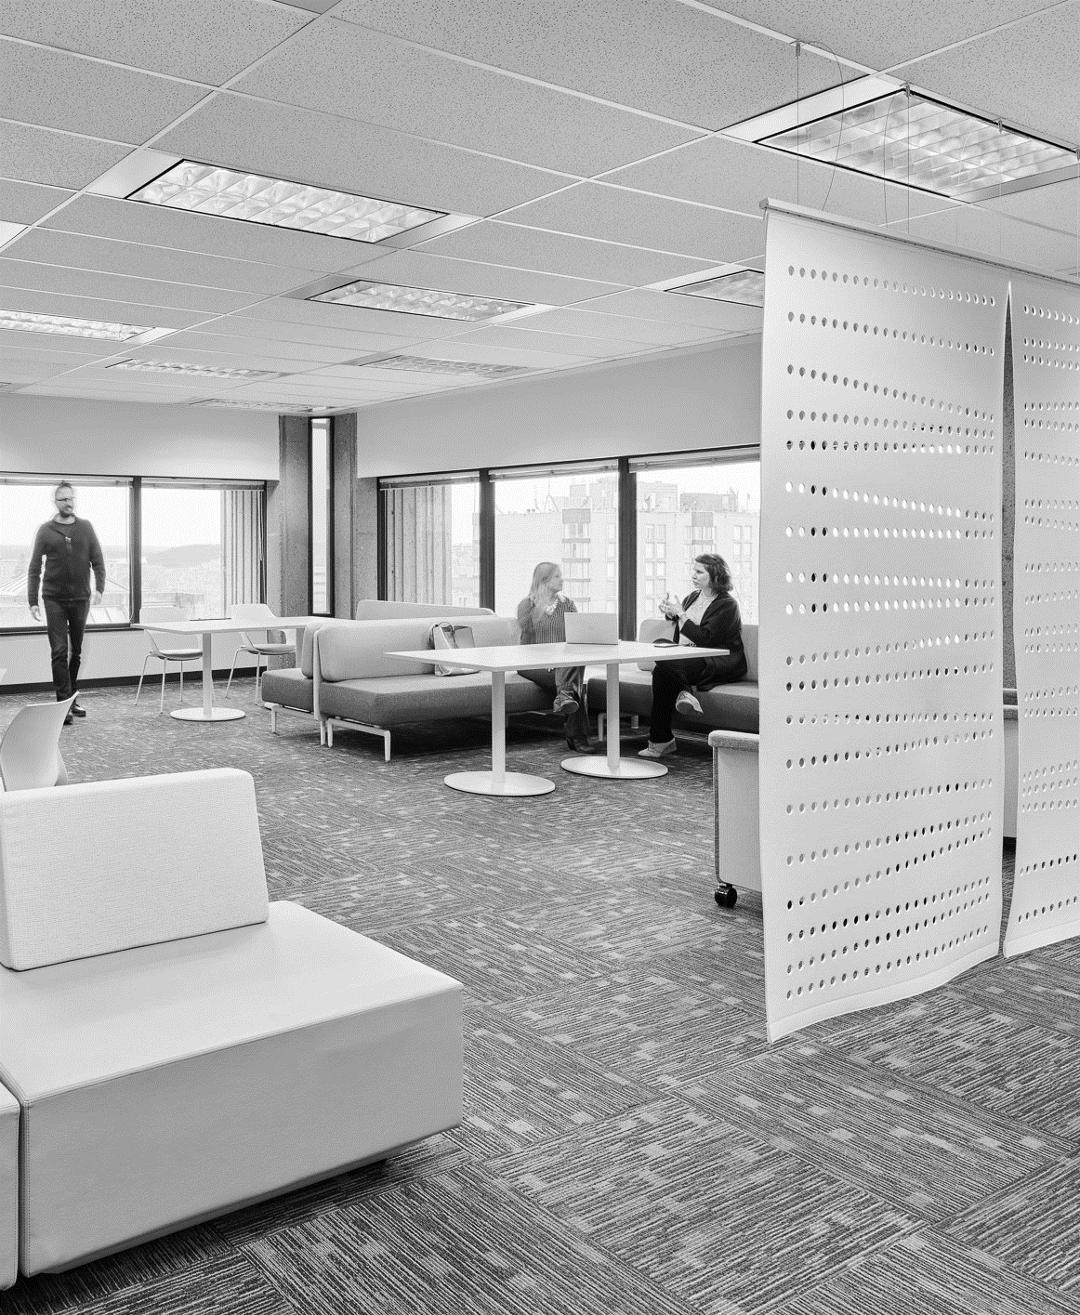
Thank you!
We hope you enjoyed this telling of our story. Let’s keep on writing it together.
PLACEHOLDER IMAGE
REPLACE WITH A PHOTO OF YOUR WORKPLACE
You can find additional information here:
[INSERT LINK TO INTRANET]
For questions or comments,
please write to:
[CONTACT]

Slide 17
Before and after pictures
BEFORE
PLACE HOLDER
Insert before and after pictures taken from the same point of view here. If you don’t have pictures taken from the same point of view, you can delete this page.
AFTER

