Slide 1
The psychology of creativity in the workplace

Slide 2
Presentation outline
Today I will ask you to
Free write
Use your senses and intuition instead of rational thinking
Step slightly outside of your comfort zone
Understand that creativity is a process accessible to everyone
Have fun, above all else! And maybe learn something new

Slide 3
Free writing activity 1
Free writing
1 minute
What does ‘creativity’ mean to you?

Slide 4
Creativity 1 of 2
Creativity
◉ Generation of meaningful ideas
◉ In some cases, implementation of these ideas
into the real world (innovation)
◉ People-focused

Slide 5
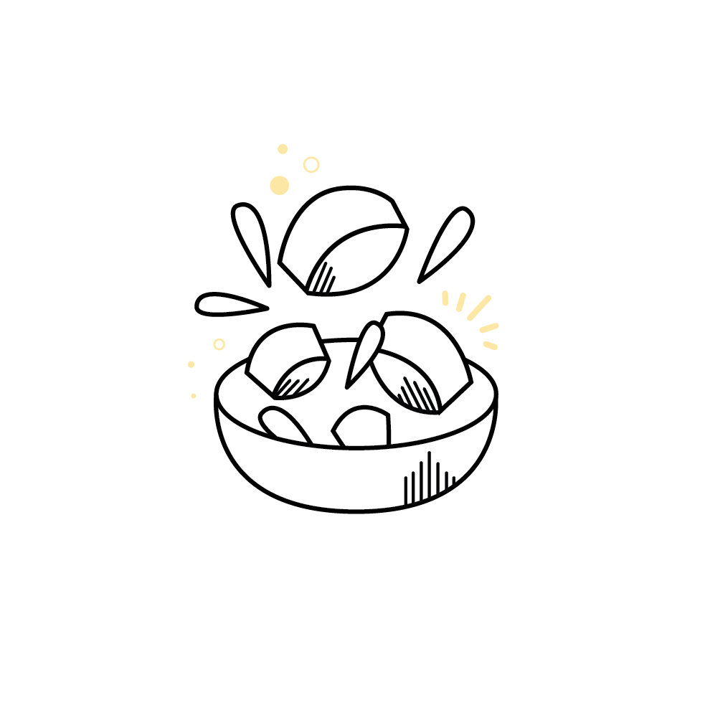
Creativity 2 of 2
Problem identification
Preparation
Idea generation
Idea revision/ implementation

Slide 6
Problem identification
New or non-existant ideas
Vague or non-existant goal
Vague or non-existant audience

Slide 7
Preparation
Gather information from as many sources as possible
Learn
+
explore
Understand problem from multiple perspectives

Slide 8
Idea generation
Produce as many ideas as possible
Associate mental elements that do not usually go together
Failing + working alone

Slide 9
Idea revision/implementation
Determine if novelty of ideas meet goal set in problem identification
Determine if ideas are meaningful to audience
Determine if ideas can be implemented

Slide 10
Free writing activity 2
Free writing
1 minute
What does ‘play’ mean to you? What are some of your barriers to being playful?

Slide 11
The playspace
Allows for multiple perspectives
Helps be comfortable with uncertainty
Understand problems in intuitive manner
Experienced as pleasurable and rewarding in and of itself
Does not have to be productive to be impactful
Intuitive

Slide 12
Play and creativity
Allows to adapt to change and complexity
Provides opportunity for safety to explore diverse perspectives, create imaginary and alternate worlds, and adopt different identities
Play is pleasurable, which can increase motivation to persevere through difficult themes
Because of its link with emotion, play can also help develop empathy for self and others
Can foster a deeper sense of of personal presence

Slide 13
The Psychology of Flow 1 of 3
Psychological barriers to play
Self-consciousness
Outcome focus (instead of process focus)
Attachment to roles/hierarchy

Slide 14
The Psychology of Flow 2 of 3
The Psychology of Flow
◉ State of consciousness with no sense of time or self
◉ Attention is like a beam of light that determines the contents of your consciousness
◉ Where and how long you direct your attention will determine whether you get into flow

Slide 15
The Psychology of Flow 3 of 3
The Psychology of Flow
◉ Flow is called optimal experience because it adds order to consciousness
◉ Also called ‘optimal experience’ because attention is focused on goals that are important to the person
◉ Disorder in consciousness happens when attention is focused on things that contradict goals, or that stop someone from carrying them out, like pain, fear, rage, anxiety, and boredom

Slide 16
Creative benefits of Flow
◉ Allows to grow skills
◉ Builds self-confidence
◉ Makes the present moment more enjoyable
◉ Clears the mind of self and time, which makes rooms for other important elements (emotions, insights, thoughts) to emerge into consciousness

Slide 17
How to get into Flow on ‘purpose’
◉ Have a clear and simple goal
◉ Have a good perceived skill to challenge match
◉ Get immediate feedback (are you achieving your goal?)
◉ Remove all distractions
◉ Enjoy the activity

Slide 18
Embodied cognition and Flow
◉ Focusing on bodily sensations help focus the
mind
◉ Fairly simple and enjoyable goal
◉ Helps reduce distractions

Slide 19
Activity: Flow meditation
Notes:
Let us begin! 5 minutes
Begin by finding a comfortable position
Close your eyes or focus them on one spot in the room
Take a deep breath in………………….. And a deep breath out
Relax your jaw and your shoulders. Take another deep breath in……… and another deep breath out.
Keep your breathing slow and relaxed
Now imagine looking at a flower. What colour is it? See the petals, the leaves, the stem. Imagine looking at the flower from very close up. See the fine details of the flower including any texture in the petals, drops of water, grains of pollen.
Let's move on now to one of the other senses – hearing.
Imagine the sound of waves washing to shore. What does it sound like?
Now imagine the sound of rain on a roof. What does each drop sound like as it lands?
Let’s move on to our sense of smell.
You are now walking through a forest, surrounded by fragrant pine trees. Take a deep breath in. What do the trees smells like? What about the earth beneath your feet?
Now, let’s focus on our sense of taste.
Imagine that your favorite food has just appeared in front of you. Take a bite out of it (or a sip from it). What does it taste like? Take a moment to really enjoy the taste.
Let’s move on to our sense of touch.
Imagine a tub of warm water. Imagine placing your bare feet into the tub of water. The water is pleasantly hot. Feel the warm water on your feet, all the way up to your ankles. Now put the rest of your body in the water. What does the hot water feel like against your skin?
Finally, lets explore our sense of movement.
Imagine lying in a hammock that is gently swaying. Feel the slight movement from left.... to right.... left.... to right..... calming and repetitive movement. How does your body feel as it sways slowly above the ground?
Take a deep breath in…… and a deep breath out. Now, gently open your eyes and re-familiarize yourself with the room and people around you.

Slide 20
Group discussion

Slide 21
The importance of community 1 of 3
The importance of community
◉ Creativity requires learning from many different sources
◉ Since learning is a social process, communities offer the opportunity for the co-construction of knowledge
◉ Communities favor risk-taking, facilitate engagement in challenging tasks, and help to delve deep into problems
◉ The right community will provide safety, which helps people follow their curiosity and immerse themselves in what interests them

Slide 22
The importance of community 2 of 3
The importance of community
◉ Important to build a learning mindset by working with diverse people with different backgrounds
◉ Sometimes, working in groups can bring fear of judgement and social loafing
◉ A safe space and a diverse group of people can provide a wide range of perspectives
◉ But too much diversity can bring barriers in communication

Slide 23
The importance of community 3 of 3
The importance of community
◉ Disagreement and respectful conflict can aid creative
thinking
◉ Especially task-based conflict about the work being done
◉ Interpersonal conflict is no good for creativity OR wellbeing!

Slide 24
Free writing Activity 3
Free writing
1 minute
What kind of collaboration do you do at work? What would you like to improve or change about it?

Slide 25
Motivation 1 of 2
Motivation
◉ One of the most important components of creativity
◉ Intrinsic motivation (interest, satisfaction, and appreciation of the work’s challenges)
◉ Extrinsically motivated person will take the shortest and most obvious road to reward
◉ Intrinsically motivated person will take alternative routes, which can
lead to novel solutions

Slide 26
Motivation 2 of 2
Motivation
◉ Intrinsic motivation is most important for creativity
◉ Synergistic extrinsic motivators can be good for
persistence (example, getting feedback and
encouragement)
◉ Passion is very helpful to cultivate intrinsic
motivation

Slide 27
Openness to experience
◉ Ability to see many different perspectives
◉ Curiosity to internal and external worlds
◉ Tendency to explore
◉ Can be used as a ‘free’ trait - practiced with play

Slide 28
Activity: Curiosity
Your mission is to use curiosity to neutralize, modify, or otherwise transform something you don’t care for.
Choose something you don’t like doing. This can be a chore, a task, an activity. Maybe consuming some type of cultural product you don’t like (listening to a kind of music you’re not a fan of, for example). Whatever it is, make sure it’s something you authentically and innately do not enjoy.
Now, please reflect on this thing you don’t like doing. (Or do it if it is accessible for you at this time).
Notice at least 3 things about the experience you may not have consciously paid attention to before. Write them down.
Write down at least three questions about or related to this experience/activity that you don’t already know the answers to. Take steps to answer at least one of these questions.
If the process of taking these steps leads to more questions or things you notice, write those down, too.

Slide 29
Group discussion

