Slide 1
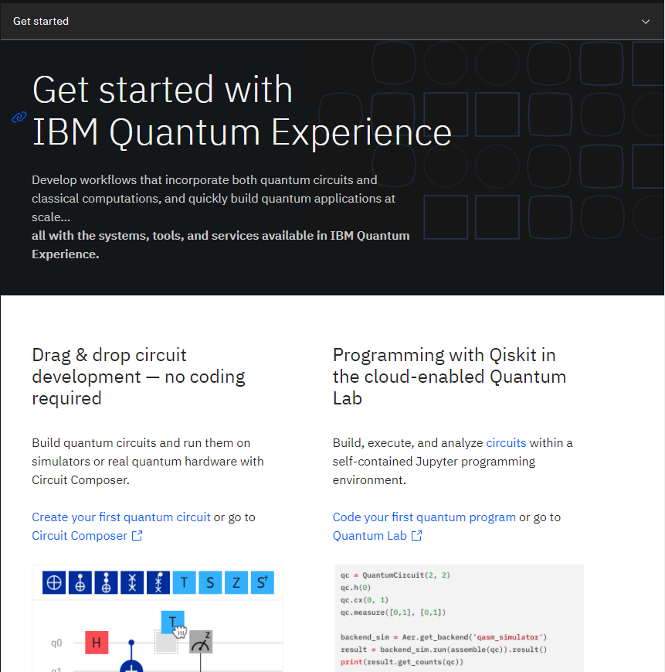
Real quantum computers you can play with for free
https://quantum-computing.ibm.com
Real quantum computers you can play with for free
https://quantum-computing.ibm.com

Slide 2
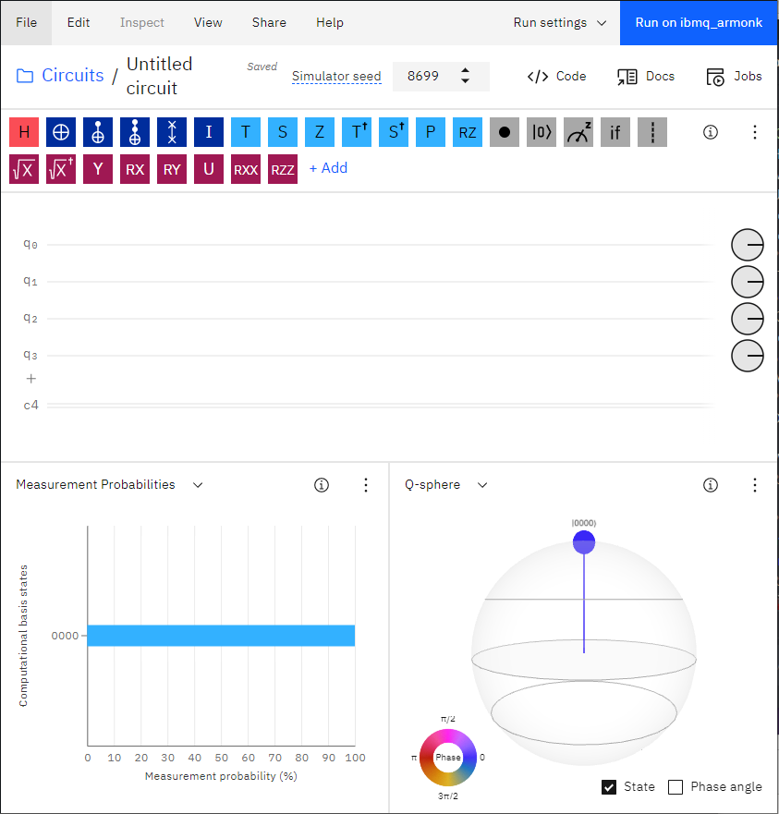
Build and run quantum circuits with no coding necessary
Build and run quantum circuits with no coding necessary

