Slide 1
MATERIEL GROUP’S DIVERSITY & INCLUSION OFFICE
OPEN TO ALL GOVERNMENT OF CANADA EMPLOYEES

Slide 2
What is the LLMC program?
Today's Agenda
What makes the LLMC program different?
The benefits of the LLMC program
Schedule and registration

Slide 3
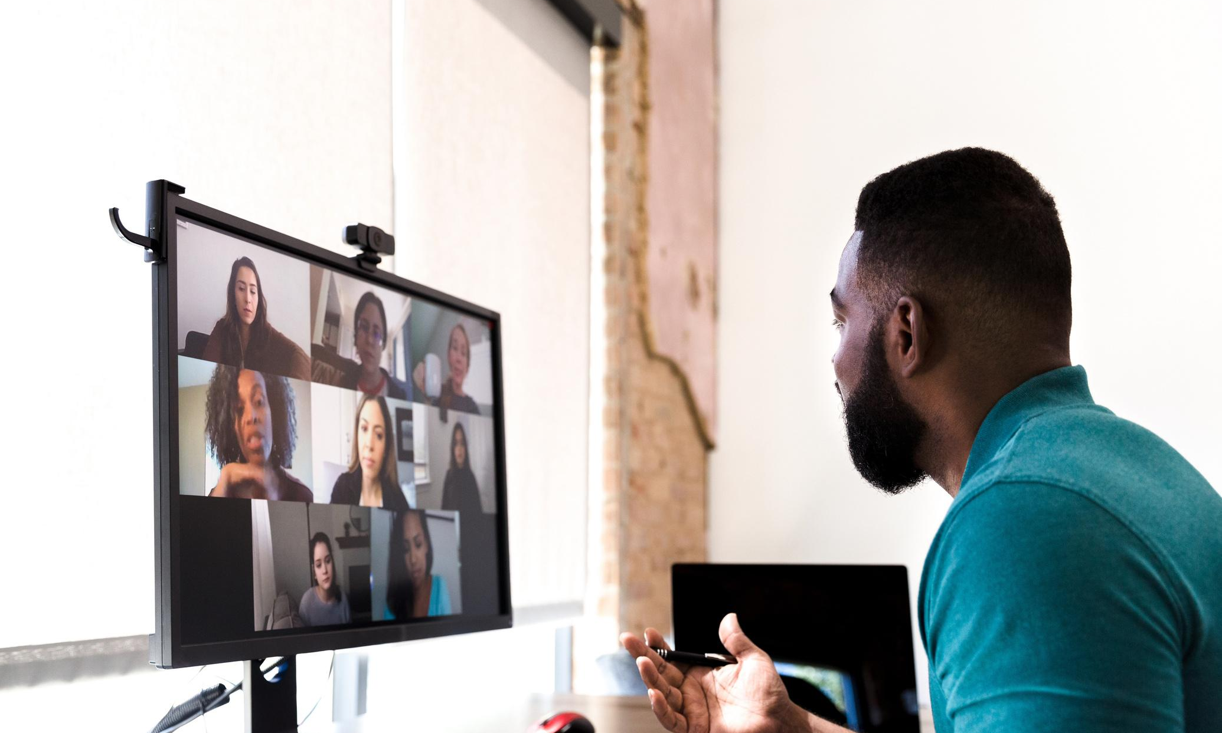
There’s power in people coming together
Lifting as you Lead
Mentoring Circles (LLMC) program
Are you looking for a way to grow? Join a mentorship circle today to prepare for the future.

Slide 4
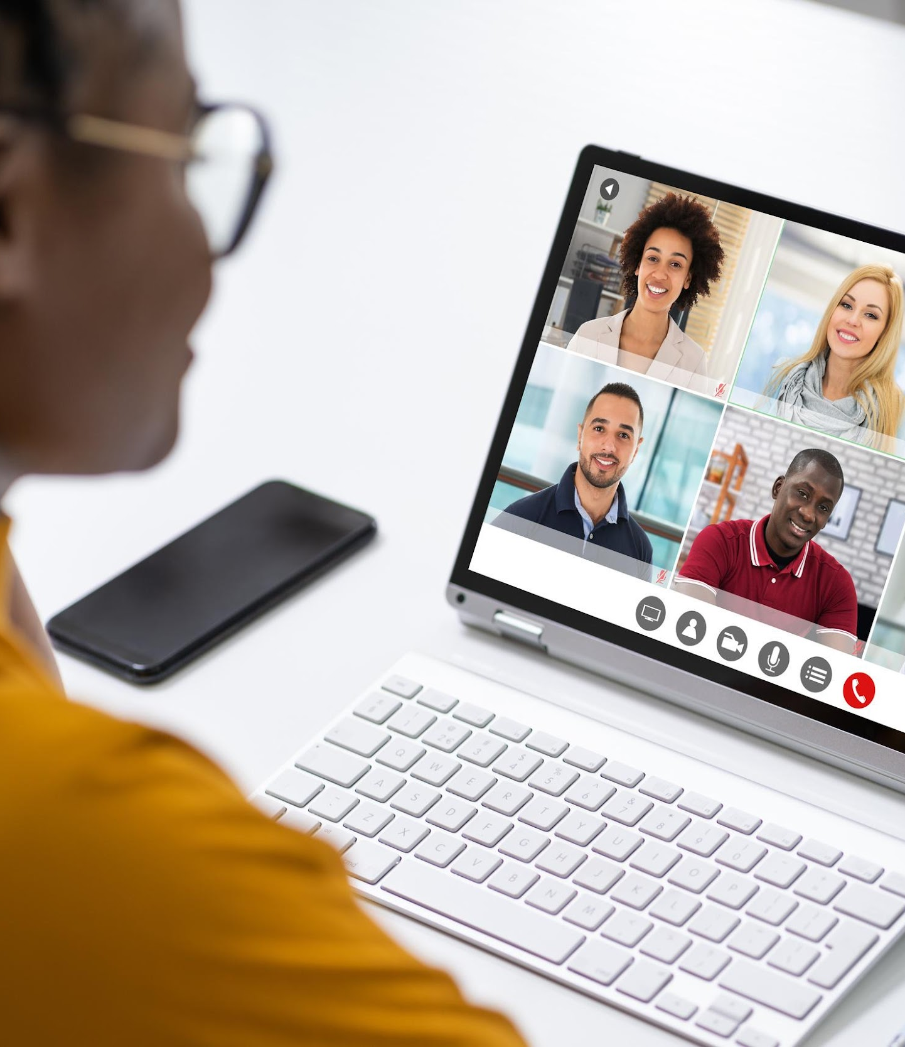
What is the LLMC program?
Leaders across the Government of Canada from all levels
Colleagues who share common interests and learning objectives
6-10 participants per group
Five Circle discussions and five optional enrichment sessions
Discussions led by a circle leader

Slide 5
What makes the LLMC program different?
People come first
Grounded in the 2020/2021 Deputy Minister Commitments on Diversity and Inclusion
Builds on the Clerk’s Call to Action to address anti-racism, equity, and inclusion in the federal public service

Slide 6
CONNECT
ELEVATE
INSPIRE
Engage with colleagues and senior management across the federal public service
Develop relationships with diverse participants
Help create a stimulating environment that fosters a desire for growth and success
Personal and professional growth through thought provoking discussion topics
Learn about mentorship and sponsorship
Share knowledge of the benefits of an inclusive workplace
Improve and develop communication/public speaking skills
Broaden your federal public service network
Share and participate in mentorship and sponsorship opportunities
Improved access to career enhancing resources
Develop leadership skills

Slide 7
Schedule & Registration
2022 Schedule
DATES
5 Circle Sessions during the weeks of September 26th, October 10th, October 24th, November 7th and November 21st.
5 Optional Enrichment Sessions during the weeks of October 3rd, October 17th, October 31st, November 14th and November 28th.
Registration is now open!
Deadline: Wednesday, August 31, 2022
QUESTIONS? CONTACT US
Diversity and inclusion - diversité et inclusion @forces.gc.ca

Slide 8
Surround yourself with people who lift you higher
Thank you to all of our collaborators who helped to develop this initiative in 2022:
Bernadeth Betchi
Kelly Brewer-Balch
Terri Graham
Liliya Ishkaeva
Wanda Lewis
Samantha Moonsammy
Lyrique Richards
Lamare Robinson
Christina Tularam
And thank you to all the members of the Defence Team, particularly the Materiel Group L1 Diversity & Inclusion Working Group, HR-Civilian Defence Team Mentoring Group, the Anti-Racism Secretariat, and all contributors who helped inform program design.

Slide 9
MATERIEL GROUP’S DIVERSITY & INCLUSION OFFICE
OPEN TO ALL GOVERNMENT OF CANADA EMPLOYEES

