Slide 1
ATIPOnline & RPSS
ATIP Digital Services, March 2026
MS PowerPoint accessibility checked completed - date 2026-03-11

Slide 2
Agenda
Digital ATIP Ecosystem (quick introduction between ATIPOnline & RPSS)
Lifecycle of a request & Best Practices in ATIP Online
External Request Intake Tool & Inter-institutional Consultations in ATIPOnline
Integration between RPSS and ATIPOnline
ATI Summaries on the OG Portal

Slide 3
ATIP Ecosystem
(quick introduction between ATIPOnline & RPSS)

Slide 4
ATIP Ecosystem
ATIP Online
Request Processing Software Solutions (RPSS)
ATIPOnline is the GoC's enterprise digital service delivery that allows citizens, organizations and others to submit Access to Information Act and Privacy Act requests to federal institutions. ATIPOnline consists of 3 web applications:
ATIP Online Request Service (AORS): public-facing portal for Canadians and others to submit formal ATIP requests, communicate with institutions and receive responses.
ATIP Online Management Tool (AOMT): public-facing portal for federal institutions to manage institutional users, edit institutional profile, produce reports, receive requests, communicate with requesters and issue responses.
ATIP Online Administrative Services (AOAS): internal portal for product team to manage the overall platform.
RPSS are suits of features that offer case management, document redaction, ATIP reporting, fees management and more. TBS initiated a procurement process to replace the legacy software (Access Pro), and in May 2022 awarded three contracts. The selected products are Amanda (from Granicus) and ATIPXpress Tier 1 & Tier 2 (from iPSS and Casepoint).
Although these platforms are not prescribed, they are the preferred software to replace the older technology solution.
Notes:
Slide taken from Dom L’s ATIP 101 deck.

Slide 5
Request Lifecycle & Best Practices
in ATIPOnline

Slide 6
ATIP Online Functionality
1. Make Request
Digital request intake solution
Online payment
AI help to find institutions and summaries of previously released ATIs
Multiple requests
AI-Help continuous improvements
PI requests under the ATI Act
Informal request process flow
Quick access to previously released packages
Request for ATI fee waiver
3.b. Request Updates
High-level request status
Correspondence tracking
More detailed request status
4. Receive records
Receive completed requests online
Online status updates through a dashboard
Multi-factor authentication
Get previously released ATI requests online
7. Accountability
Referral to OIC/OPC for complaints
Interaction with oversight bodies for complaints (Office of the Information Commissioner, Office of the Privacy Commissioner)
Citizens
2. Receipt of Request
Request data captured at source and electronically delivered to institution, process-ready
Online payment and refund process managed by TBS
Digital clarification process
Proof of ID submission
Automated request intake with institutional ATIP RPSS
ATI fee waiver request
3. Process Request
E-delivery of completed requests
Secure, electronic, inter-institutional consultations
Institutions adding requests (splitting)
Online transfer of misdirected requests
Continued integration with RPSS
Identity Validation up front
6. Post on Open.Canada.ca
Simplify and integrate publication of ATI summaries on AORS
ATIP Online open data sets
5. Reporting
Basic statics for institutions onboarded
Capture of reporting data at time of delivery
Robust statistical reporting
Institutions
Versions 1 & 2 (2018-2020)
Version 3.1 (July 2022)
Version 4 (July 2023)
Version 5.1 (Winter 2024)
Version 8 (Spring 2026)
Other desired functionality
Notes:
.

Slide 7
Online Request Lifecycle
AORS: ATIP Online Request Service
AOMT: ATIP Online Management Tool
AOAS: ATIP Online Administrative Service
Requester
ATIP Online
Processing Institution
AORS
Request
AOMT
Manual process
Secure account
ATIP Office
records
Responses
Secure connection
Request processing software
Correspondence
API
ATIP Server
Change Management and Client Support
AOAS
Automated process
Local network
Local server

Slide 8
Best Practices
Regular user management
Authorizing Representatives have a responsibility to manage their institution’s user access
Document labels
Adding helpful text with document descriptions can make things clear to your requesters
Requester support
TBS provides technical support to all requesters as it relates to ATIP Online
File Consolidation
Including all your response attachments in a compressed ZIP folder can help you add more information to a message in AOMT
Notes:
User management:
Authorizing Representatives are responsible for managing who has access to their institution’s AOMT dashboard. It is recommended that ARs perform regular audits several times a year of their users to ensure only the correct people have access.
Document labels:
When attaching documents to a message in AOMT, institutions may want to consider using the “Description” field as a way to indicate to requesters the total number of documents. For example, including a description of the file, and then indicating the document is doc 1/3.
Requester Support:
When engaging with requesters it’s important to remember that your institution is not responsible for technical support. Should a requester require support related to ATIP Online you should direct them to our Client Support team, or to our contact us page (links provided).
File Consolidation:
AOMT offers institutions the ability to upload 5 documents per message. If a response package contains numerous smaller files, institutions may want to consider combining these all into one compressed zip folder. This helps institutions save some file size and include more than just 5 documents per message.

Slide 9
External Request Intake Tool &
Inter-institutional Consultations
(New with Version 8)

Slide 10
External Request Intake Tool
Requests external to ATIP Online can now be added to the system
Enables institutions to utilize consultation features for requests from other channels
Sets a foundation for future functionalities being developed
Can be used as a low-quality request splitting function in the interim
ATIP Office
All requests in one place
External requests (mail, email, paper)
Request processing software
External requests
Data Entry
Manual process
Automated process
ATIP Online requests
AOMT
Online requests
10
AORS

Slide 11
Inter-institutional Consultations
Transmit consultation requests through AOMT
Works just like requests except its between two institutions
Send consultation:
Attachments
Due date
Notifications
Messaging:
Reply, Decline, Withdraw
Requester
Consultation reply
ATIP Office
AOMT
ATIP Request
ATIP Online Protected B Environment
AOMT
ATIP Office
Process consultation
ATIP Request
Institution process
ATIP Online
Consultation
Institution receiving request
Consultation Request
Institution receiving consultation

Slide 12
ATIP RPSS Applications

Slide 13
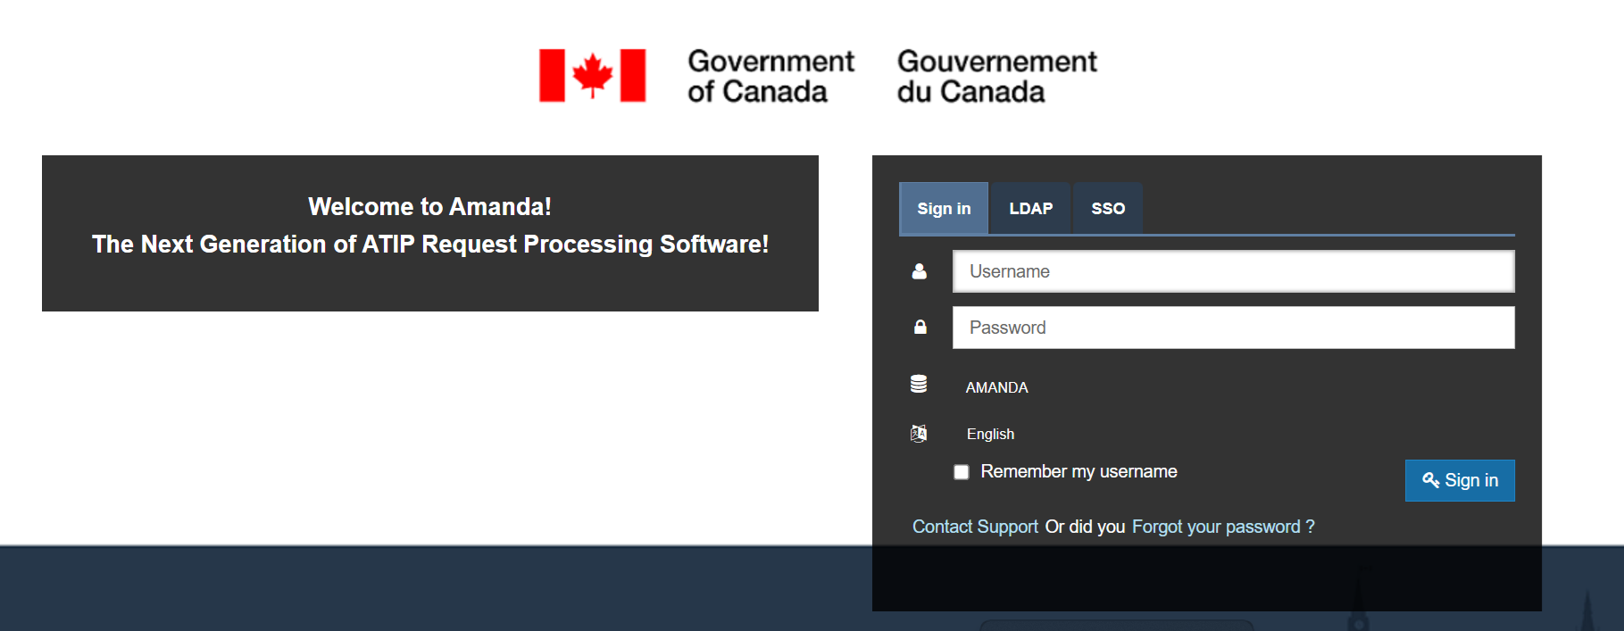
AMANDA Login Screen

Slide 14
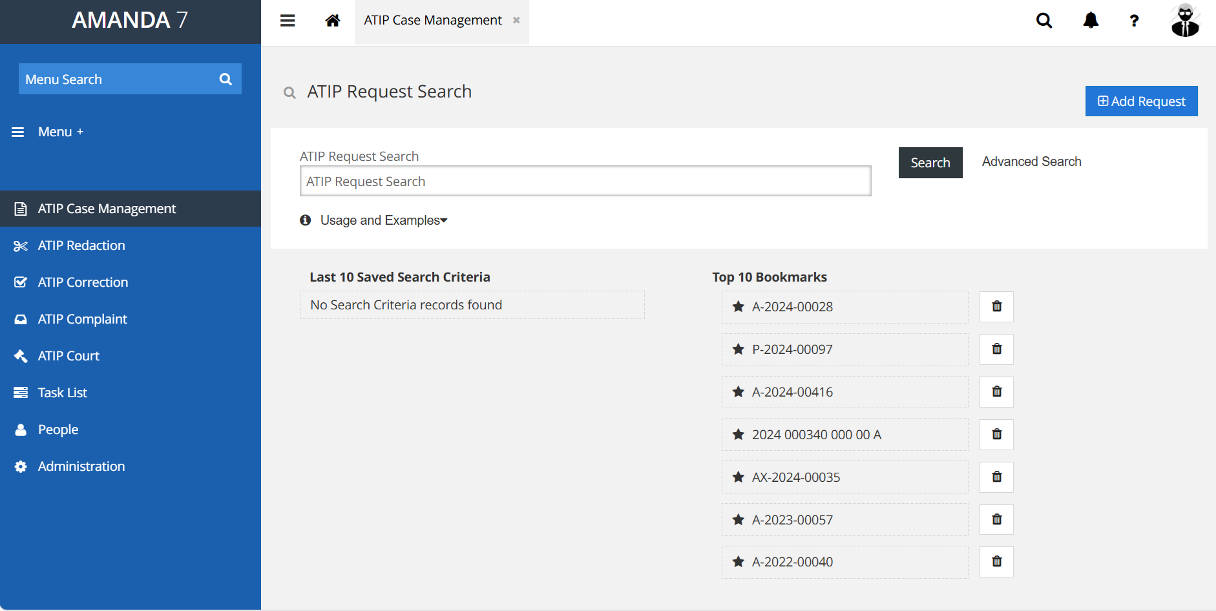
AMANDA – Case Management Screen

Slide 15
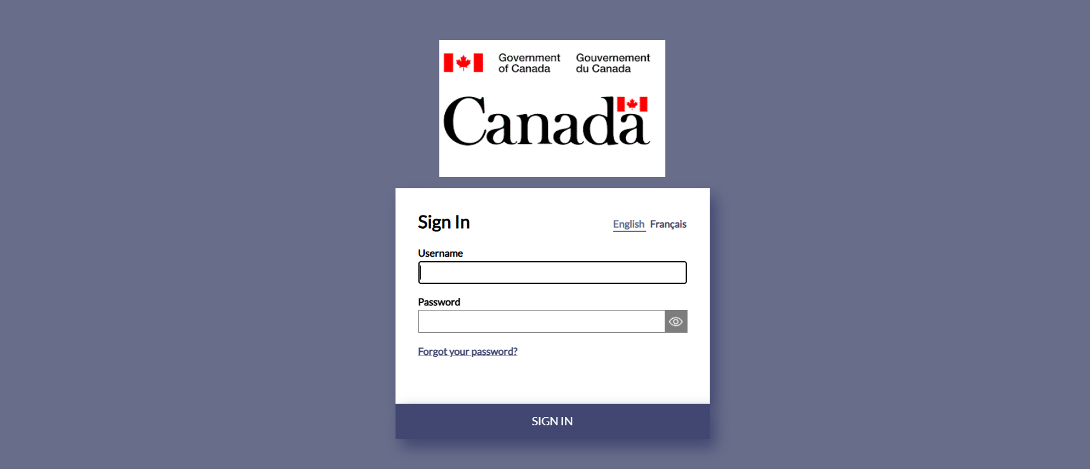
ATIPXpress Login Screen

Slide 16
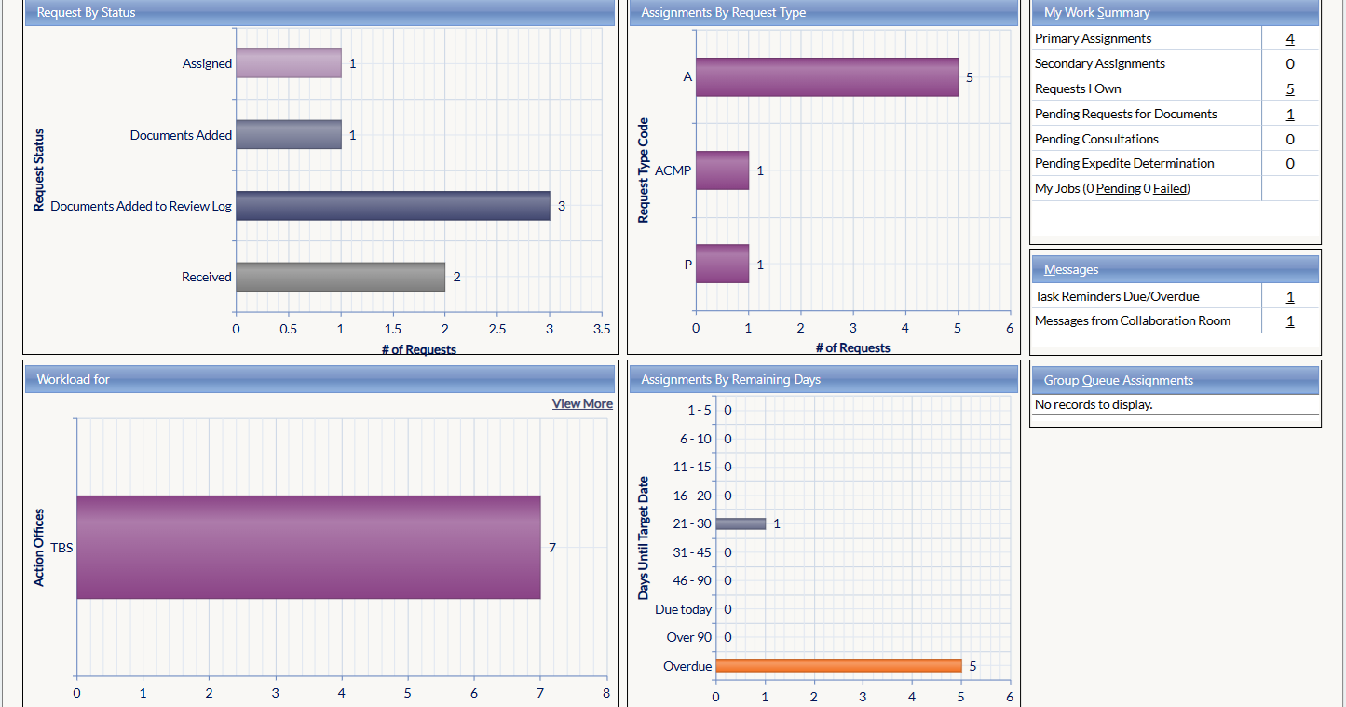
ATIPXpress Home Screen

Slide 17
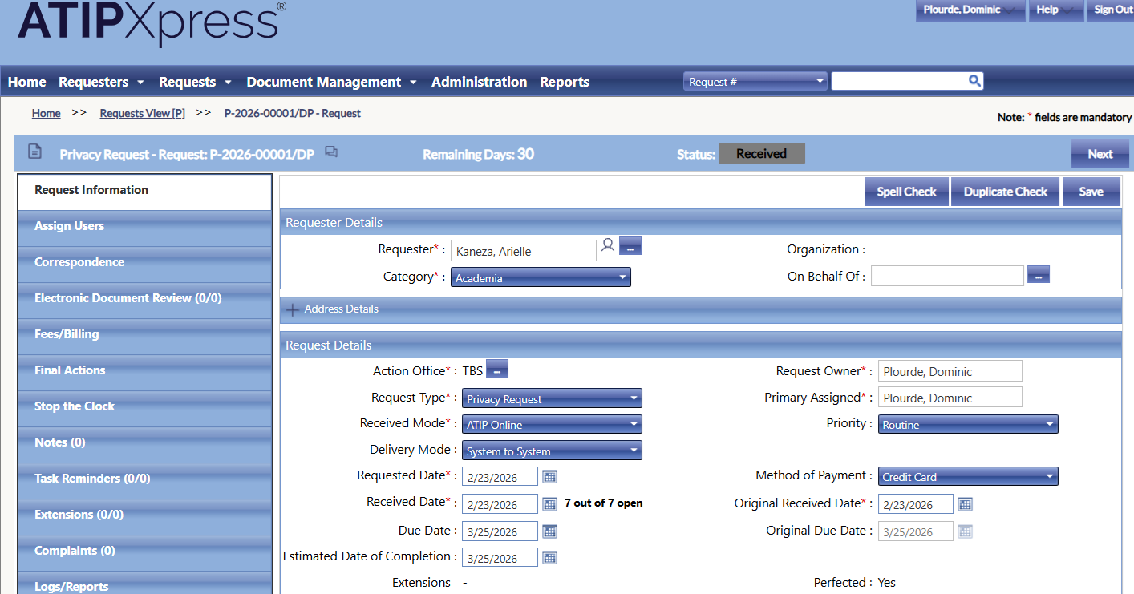
ATIPXpress Request Screen

Slide 18
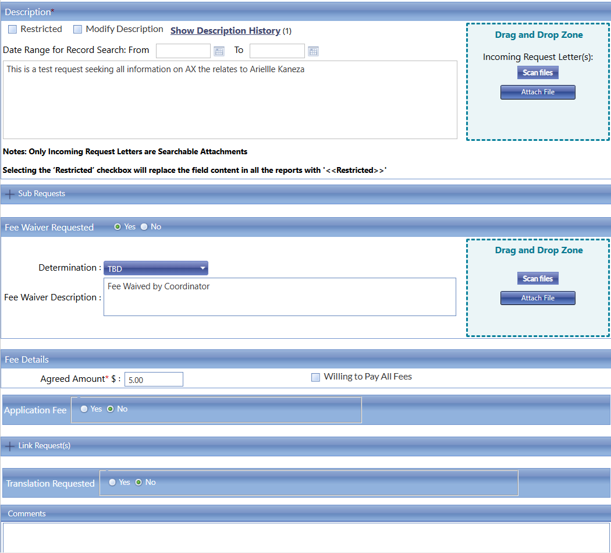
ATIPXpress Request Screen (cont.)

Slide 19
Integration between RPSS & ATIPOnline

Slide 20
ATIP Online and RPSS Integration
External API endpoints
Allows automated intake of new requests
Automated internal tracking number updates
Initial integration efforts underway with RPSS vendors
RPSS vendors will have a solution available to institutions who use their software
API documentation and specifications available to non RPSS users
External API is available for any onboarded institution to use, regardless of their participation with RPSS
First wave of institutions fully integrated expected soon
Initial institutions are beginning testing now

Slide 21
ATI Summaries on the OG Portal

Slide 22
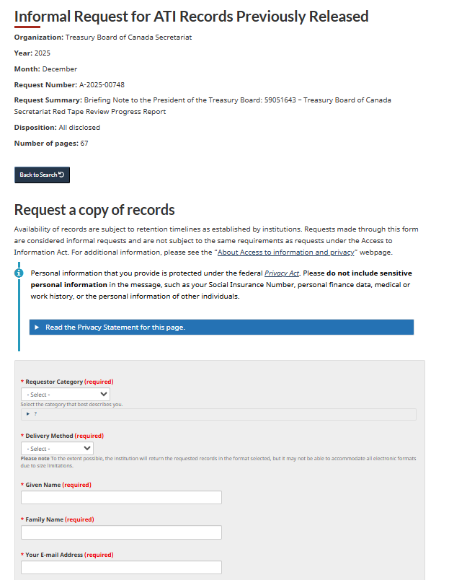
How ATI Summaries are Published and Accessed
3 Ways to Publish
🖥 Web UI
Submit individual records through the web interface.
📊 Excel
Upload multiple records using a structured spreadsheet
🔌 API
Programmatically publish and update data.
3 Ways to Consume
🔎 Search Interface
Browse and search ATI records.
📂 Dataset Download
Export data in spreadsheet format.
⚙ API Access
Retrieve data programmatically.
Request Previously Released Records
📄After a summary is published, users can submit an informal ATI request to obtain previously released records from the search.

Slide 23
Thank You !

