Slide 1
How do we know if the NHS is achieving its objectives?
Do existing sources provided necessary data for detailed analysis and assessment?
Housing need and response
Steve Pomeroy
steve@focus-consult.com
pomeros@mcmaster.ca

Slide 2


The promise

Slide 3
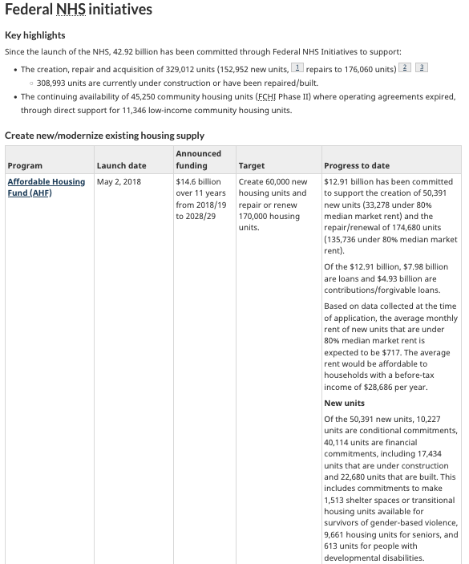
Extract from June 2025 quarterly “progress on the NHS”
Very high-level summary data, conflating commitments, approvals, and actual completions devoid of geographic details

Slide 4
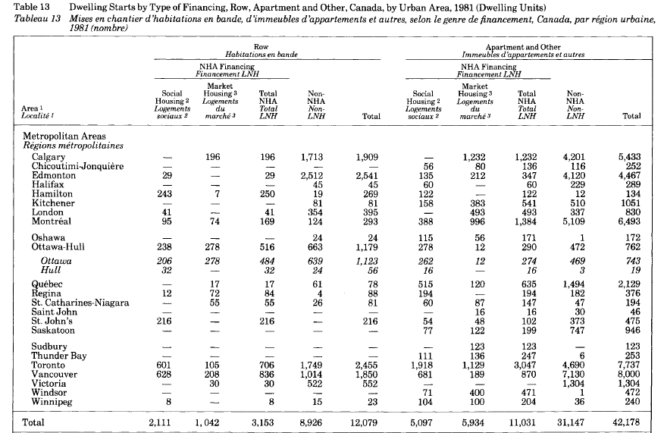
Extract from Canadian Housing Statistics (1991)

Slide 5

About the McMaster Canadian Housing Evidence Collaborative (CHEC)
CHEC is the lead central coordinating hub of a joint initiative between CMHC and the Social Sciences and Humanities Research Council or SSHRC - the Collaborative Housing Research Network (CHRN)
The Collaborative Housing Research Network is an independent, Canada-wide collaboration of academics and community partners. It’s focused on holistic research of housing conditions, needs and outcomes in support of the priority areas of the National Housing Strategy.
The Collaborative Housing Research Network provides objective, recognized, and high-quality research that can support housing policy decision-making and inform future program development.
CHEC’s mission is to accelerate evidence-based solutions that advance Canada’s National Housing Strategy to ensure every Canadian has “housing that meets their needs and that they can afford”.

