Slide 1
Canada.ca 2030 Brainstorm
Facilitated by
Digital Transformation Office at CDS
March 12, 2025

Slide 2
Objective
Today’s exercise is a brainstorm to collect ideas from Canada.ca teams
We want to explore a collective vision for the Canada.ca product in 5 years’ time. Let’s take a wide view and look at all dimensions of the Canada.ca ecosystem, from user experience design, to content management, to platform security and functionality, to analytics, data and performance, to processes and procedures.
Why are we doing this now?
The environment is changing rapidly (as always!)
It’s been a few years since we’ve done a similar exercise

Slide 3
Outcomes
The results of today’s exercise will feed into strategy and work planning.
What will we do with the information collected?
Analyze for trends, patterns and anomalies
Share results
Feed it into work planning for 2025-26 and beyond
Next steps
Internal brainstorm with Principal Publisher/CDS
Share results with GCWP and Web Executive Board
Feed into DTO and PP work planning exercises

Slide 4
Canada.ca = Government of Canada’s core web presence
Any public-facing web property, including information, services, pages, microsites, non-authenticated and authenticated applications, etc.
Canada.ca requirements apply to institutions subject to the Directive on the Management of Communications

Slide 5
What is Canada.ca trying to solve today?
Find 1,000+ information and services from 100+ GC institutions
Use top GC information and services easily and quickly
Provide a trusted GC brand experience
Operate a reliable and secure primary platform

Slide 6
What can DTO and PP do to help you?
Design - patterns, brand, UX/UI improvements
Advise - guidance, standards, support, recommendations
Advocate - feedback, analytics, data, research
Enable - features and functionalities, new products

Slide 7
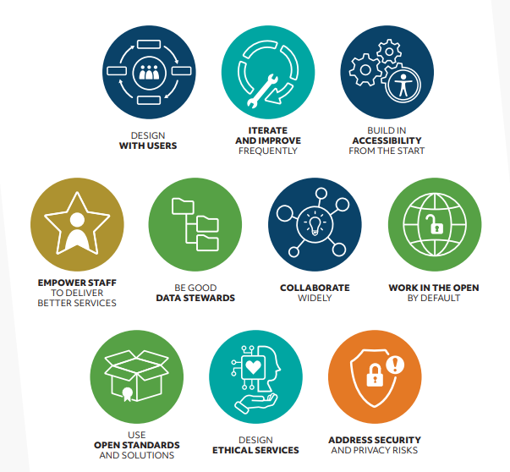
Government of Canada Digital Standards
GC Digital Standards Playbook

Slide 8
Public service statement of values
Respect for democracy
Respect for people
Integrity
Stewardship
Excellence

Slide 9
Brainstorm
Think 5 years in the future
Dream big and focus on success
Infuse it with passion and make it inspiring
Align it with the Digital Standards and the Values and Ethics Code for the Public Sector
Use the present tense
Use clear, concise, jargon-free language
Image credit: Photo by Brands&People on Unsplash

Slide 10
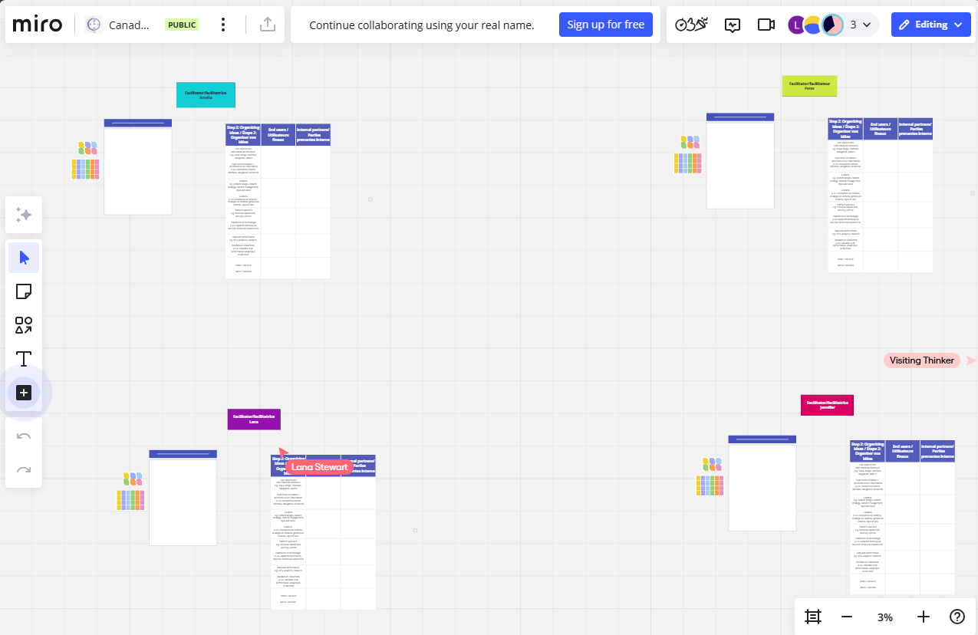
Virtual brainstorm
We’ll set up breakout rooms in MS Teams to create groups of 20-25 people
Within each breakout room, we’ll be using Miro
https://miro.com/app/board/uXjVISc7LVg=/?share_link_id=667234619592

Slide 11
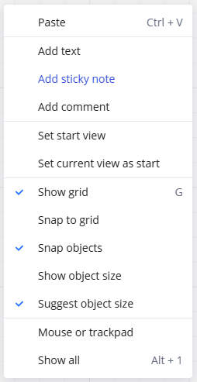
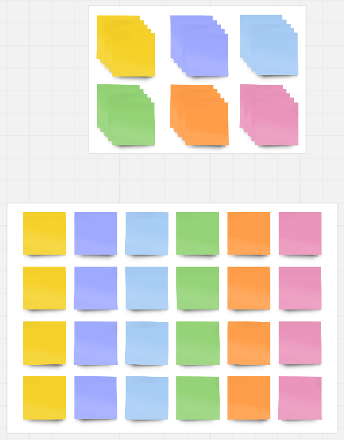
Step 1: Generating our ideas
Or you can right click to create a new one
Each board will have sticky notes to copy

Slide 12
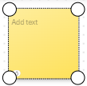
Step 2: Organizing our ideas
Each whiteboard has a preset grid which you can drag the stickies into
 | End users |  | Internal stakeholders
UX/UI
Content
Tech/platform
Data/performance
Other

Slide 13
Facilitators
Each of us will be in a breakout room to lead the brainstorming session
Jennifer Mealing
Amelia Parkhurst-Batel
Peter Smith
Lana Stewart
Interaction Designer, DTO/CDS
Policy Advisor, CDS
Chief, Product Design, DTO/CDS
Supervisor, Data and Performance,
DTO/CDS

Slide 14
What do you want to see from Canada.ca in 2030?

