Slide 1
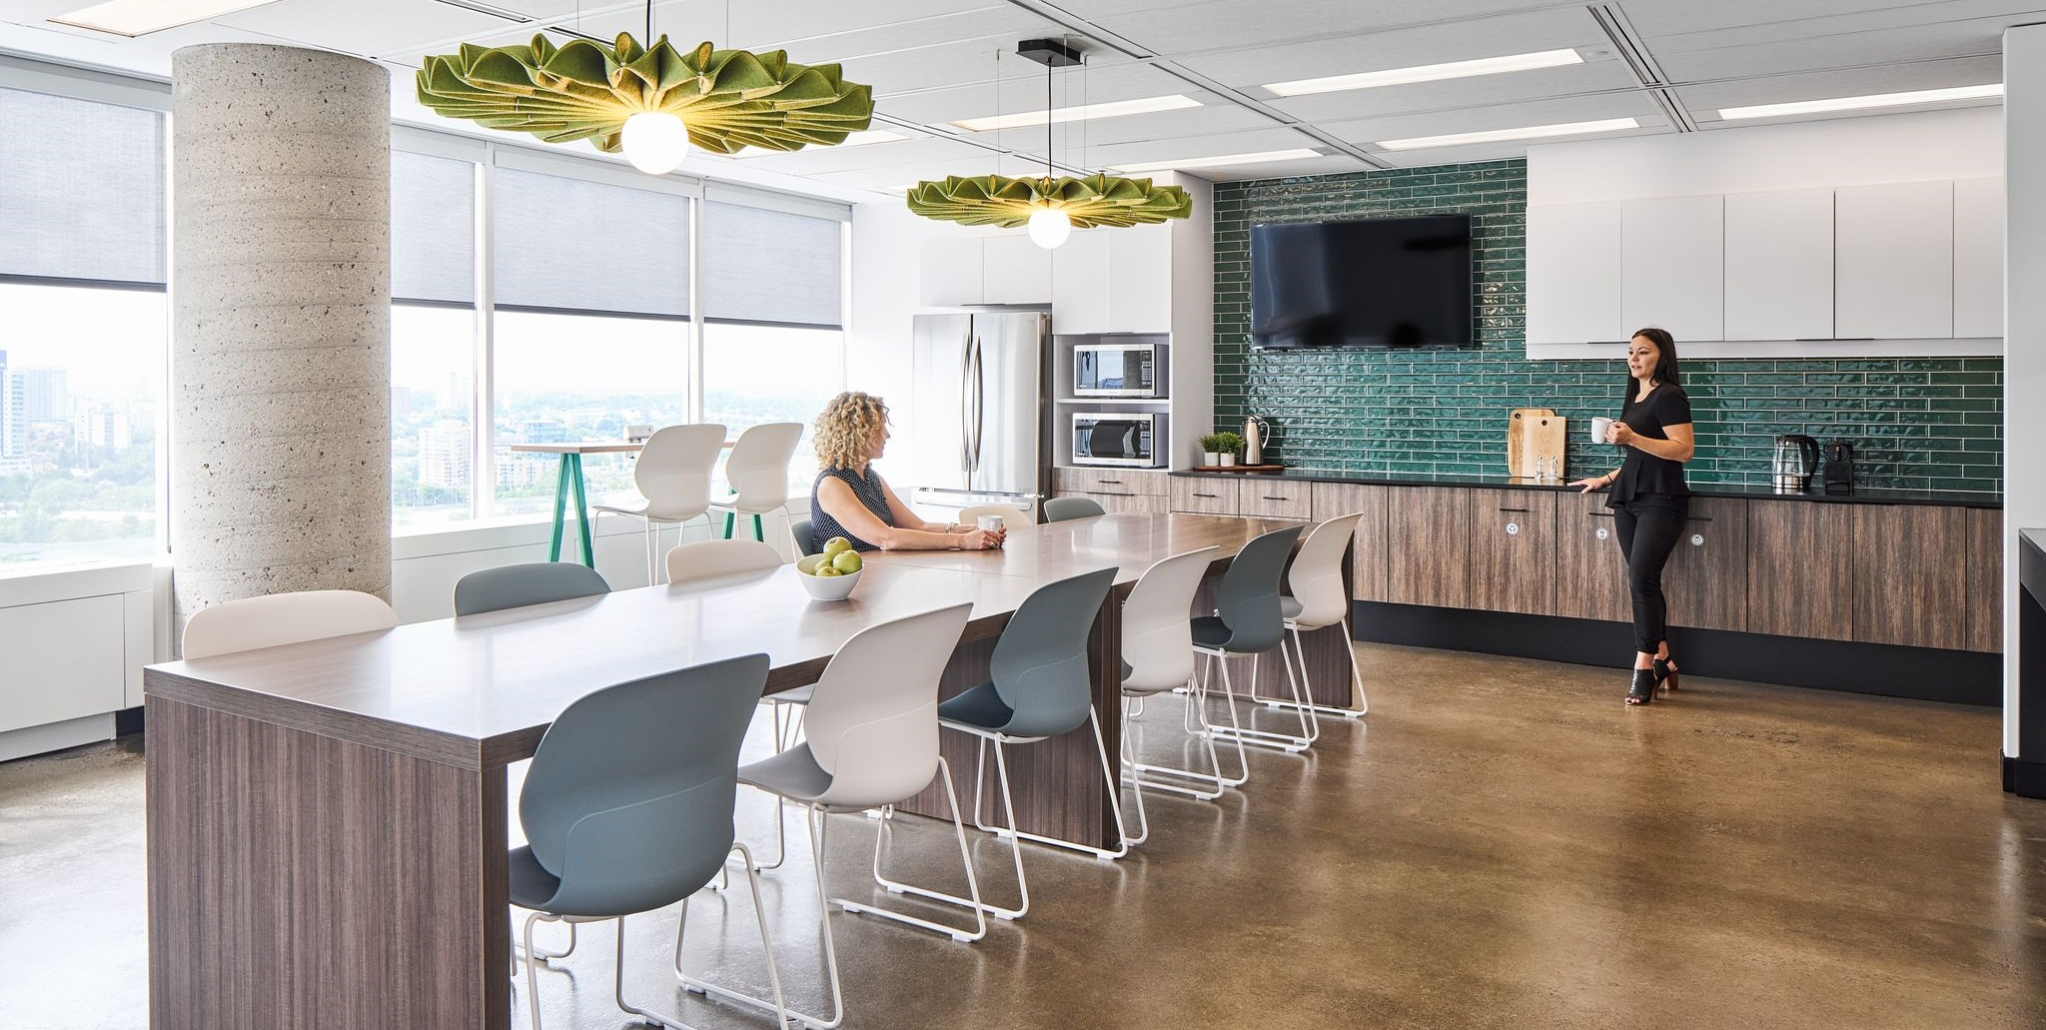
RETURN TO THE WORKPLACE EMPLOYEE EXPERIENCE
Accommodation Management and Workplace Solutions
March 2022

Slide 2
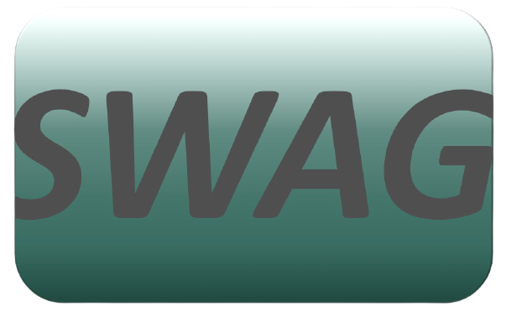
This is us
Strategic Workplace Advisory Group
Workplace Change Management National Centre of Expertise
TARGET AUDIENCE:
Client leadership & Accommodations Teams
To help demystify and advance workplace modernization.
Provides holistic, strategic and expert guidance to client departments in support of their workplace modernization programs for the future of work
Enables clients to understand the critical elements that need to be established early to ensure a successful workplace modernization and its adoption
Act as the single & initial point of access to all workplace modernization strategy information and services
TARGET AUDIENCE:
Client based Change Managers in support of their employees
Provide change management advice and guidance to client organizations in the establishment of a change management program and its implementation throughout a workplace modernization project or initiative
Provide a change management approach and tools specially developed to guide client organizations in the development of their change management program
Via our Community of Practice, provide a forum for change managers involved in workplace modernization projects across the Government of Canada, to learn and exchange on workplace change management best practices and experiences

Slide 3
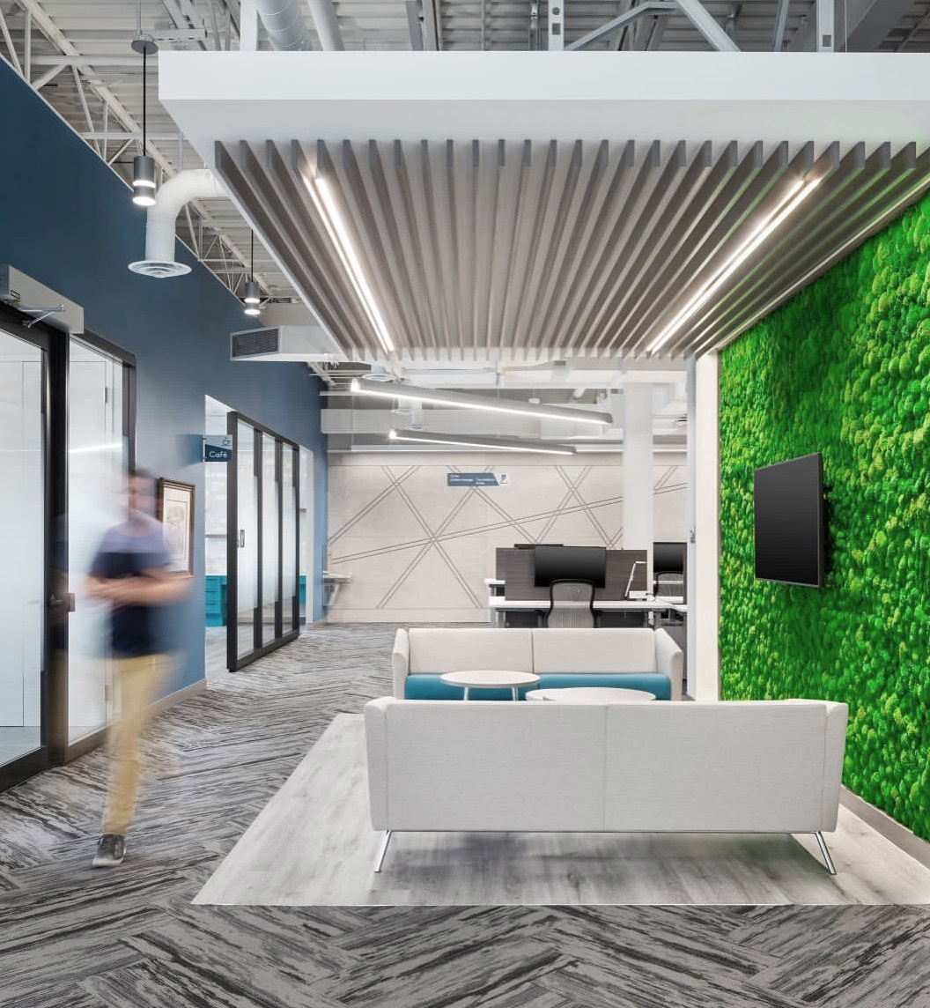
Defining Your Return to the Workplace Strategy
What do our employees want?
What will be supported in terms of flexibility going forward?
How does the return strategy support the long-term vision for our workplace?
How can we best support employees NOW in with what we CURRENTLY have?

Slide 4
Return to the Workplace Scenarios
MODERN, UNASSIGNED
HERE IS OPPORTUNITY
THE FUTURE IS FLEXIBLE!
TELEWORK NOT SUPPORTED
FULL FLEXIBILITY & HYBRID WORK*
HOW IT’S ALWAYS BEEN
HERE IS OPPORTUNITY
TRADITIONAL, ASSIGNED OFFICE SPACE
*HYBRID WORK is a flexible work model that empowers people to choose where they work, typically a balance between home and the office, or any other location such as a GCcoworking site. Hybrid working is a spectrum which allows each individual to determine the right balance of days at the office vs days working remotely that best suits their needs, circumstances and personal preferences.
Notes:
THE FUTURE IS FLEXIBLE
Benefits
Supports what the vast majority of employees want
Optimizes space utilization
Aligned to many other major organizations’ FoW strategies (remains competitive in attracting and retaining talent)
Risks
A lot of changes from pre-pandemic
Changes must be properly managed to ensure successful transition and adoption
HOW IT’S ALWAYS BEEN
Benefits
No change to what it was, familiar, comfortable
Risks
Employees may feel like they are losing the positives they found from working from home for 2 years
Recalling ppl back full-time with no justification of “why” after 2 years working remotely may cause some to seek new employment
Be among the “last ones” to modernize their space AND the way they work (difficult to attract and retain talent)
OPPORTUNITY – HYBRID IN TRADITIONAL SPACE
Benefits
Can adopt some modern workplace ways (unassigned, etc)
Opportunity to get used to new ways of working
Will be ready when the physical workplace gets modernized
Risks
Workplace experience may be sub-par compared to orgs with modern space
OPPORTUNITY - MODERN SPACE WITH NO FLEX
Benefits
Potential to adopt new behaviours in the right, modernized, supportive work setting
Can gradually come to understand the added benefits of a modern workplace for flexibility in utilization (even more so with hybrid work)
Risks
Employees may feel like they are losing the positives they found from working from home for 2 years
Recalling ppl back full-time with no justification of “why” after 2 years working remotely may cause some to seek new employment
Be among the “last ones” to modernize the way they work (difficult to attract and retain talent)

Slide 5
Integration is key for a positive employee experience
SPACE
A RTW Strategy that focuses on the delivery and implementation [WHO, WHAT, WHEN & WHERE] while taking into consideration the employee experience by adding in the reasons and ways to execute it [WHY & HOW]
TECH
CULTURE
POSITIVE EMPLOYEE EXPERIENCE
Notes:
The next few slides we will be focused on creating a positive employee experience, not matter what the RTW strategy that has been chosen by your organization. Here you can see that the integration of Space, Tech and Culture is key for a positive employee experience. And it’s also important to communicate the WHY and HOW of your RTW strategy.

Slide 6
An employee-centric approach at home or at the office
Prioritizes mental and physical wellbeing
Change Management toolkit to plan the RTW developed by the Workplace Change Management National Centre of Expertise
Considers safety first
Agile
Offers flexibility
Focused
on changing mindsets and behaviors
Ensures
access to proper tools and training
Notes:
An employee-centric approach is one that:
Prioritizes mental and physical wellbeing
Is Agile
Is Focused on changing mindsets and behaviors
Ensures access to proper tools and training
Offers flexibility
Considers safety first
The Workplace Change Management National Centre of Expertise has created a Change Management toolkit to plan the RTW with more on this specific topic.

Slide 7
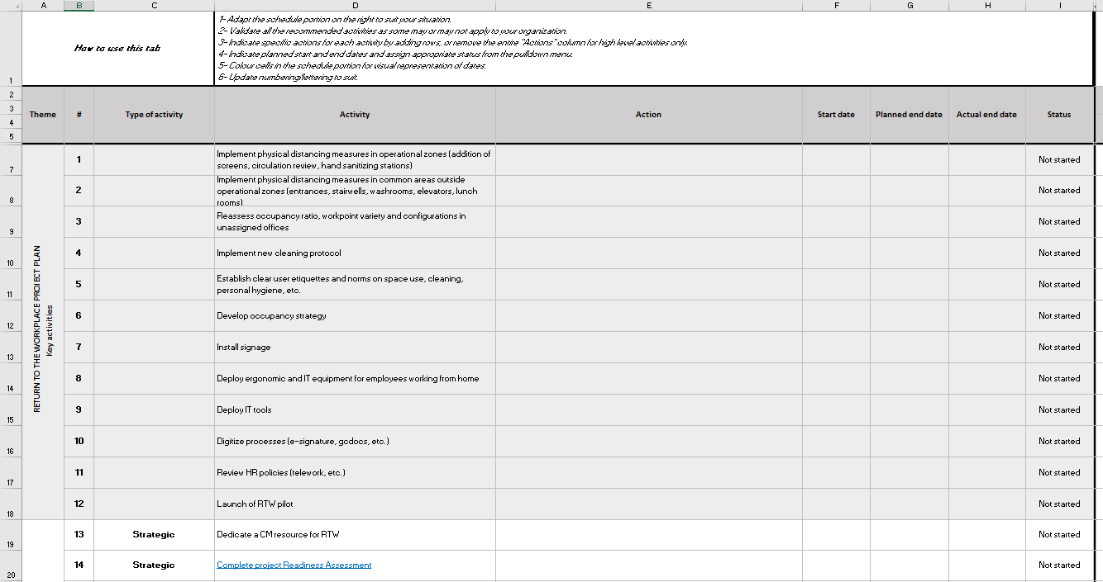
Consider ▪ Consult ▪ Communicate (1 of 3)
What has changed?
Work with your colleagues in IT and HR to identify what has changed. Tools like the RTW PM-CM Integrated plan‒Change inventory and impact assessment and the Collection of changes and lessons learned can help
What do employees need to be successful?
Think about training on new measures, tools, protocols, procedures, ways of working, etc. and ensure managers are equipped to support employees through the transition
How will employees respond to these changes?
In the last 2 years, experiences have been as diverse as the number of employees in your organization. It’s important to consider their unique perspectives – personas, like the ones proposed by BGIS, can be a great start
Notes:
There is a model for employee experience considerations that we really like that was developed by BGIS Tenant Facilities Management Services. They propose the Consider, Consult, Communicate approach.
Under consider, it’s important to consider what has changed, what employees needs to be successful and how employees will respond to these changes. The use of personas, such as the ones developed by BGIS, can be a good start to imagine each employee’s unique perspective.

Slide 8
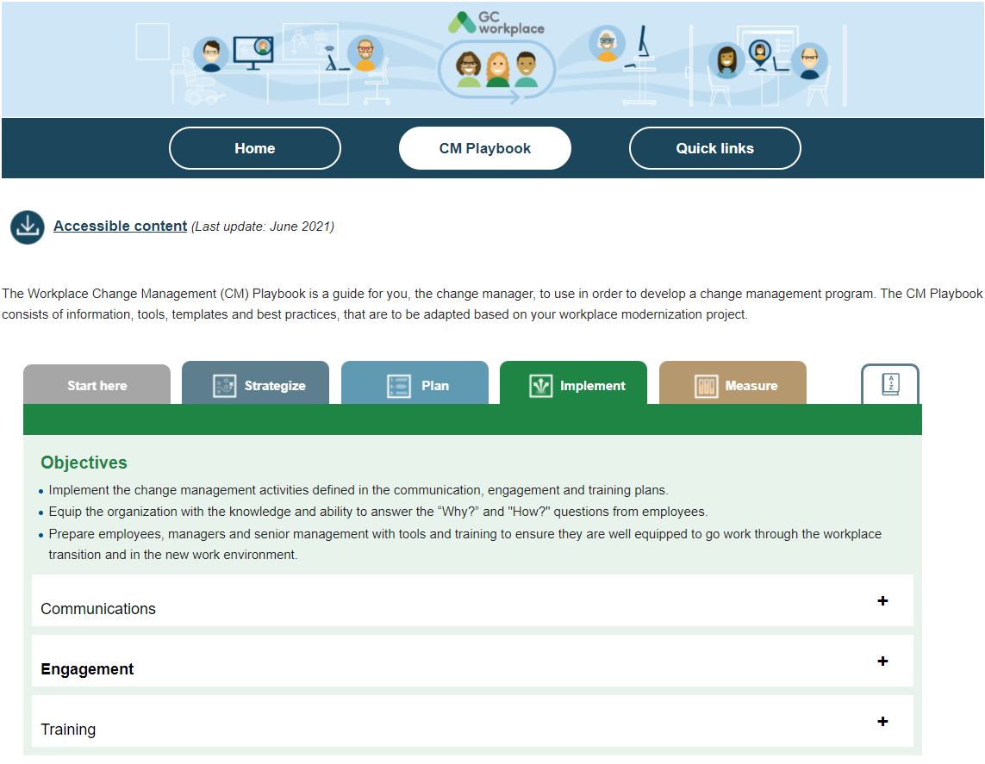
Consider ▪ Consult ▪ Communicate (2 of 3)
Survey your employees
Make sure to be very clear about the context in which you are asking the questions. What is the organization’s plan for the future? Will their input directly affect the organisations decisions?
Consider multiple sources
Consult both on a broad level to identify trends and on the individual level to find solutions for unique or special circumstances
Keep the pulse
Employees’ needs and preferences change over time. Make sure to have relevant data for your decision making. Keep up the employee engagement and ask questions even once you’ve reopened your offices
Find ideas and resources on how to consult and engage employees in the PSPC Change Management Playbook (in the section Implement -> Engagement)
Notes:
In consult, it’s important to survey employees to understand their needs, both on a broad level to identify trends and on the individual level to find solutions for unique or special circumstances. Employees’ needs and preferences change over time. Make sure to have relevant data for your decision making. Keep up the employee engagement and ask questions even once you’ve reopened your offices.
You can find ideas on consultation and engagement in the PSPC Change Management Playbook.

Slide 9
Consider ▪ Consult ▪ Communicate (3 of 3)
Start now!
Even if your organization has not figured out all the details, it’s important to communicate what you do know, and that you are working on what you don’t know. Absence of communication can cause anxiety in employees
Include the WHY and the HOW
Employees will want to understand why specific decisions are been made – if you can, make links with the organization’s vision for the Future of Work
Use multiple channels
Depending on the objectives of the communication, consider who is the best sender and which communication vehicle should be used. This Communication Model (in Annex) can serve as a starting point
NEW tool coming soon!
Notes:
Finally for communicate, it’s important to have clear, transparent and frequent communications on the return to the workplace. If your organization has yet to communicate on this matter, it should start as soon as possible! To help organizations with this, we’re finalizing a new tool that will have important information you should have that are necessary to communicating on the RTW, Helpful tips, and examples of communications to employees on the RTW that can be used for inspiration. We expect to have this tool ready in the next week or so and will share it with the community as soon as it is.

Slide 10
Use the ADKAR model to ensure employees are ready
I understand why…
I decide to…
I know how…
I am able to…
I will continue to…
Awareness
Desire
Knowledge
Ability
Reinforcement
Notes:
The last tool I want to mention quickly is the ADKAR model by PROSCI. You don’t need to be an expert in change management to use it. It’s easy to use the ADKAR model to see if your return to the workplace strategy has considered all the elements required for a positive employee experience. Ultimately, you want your employees to understand why the change is needed, decide to participate in the change, know how to change, become able to change and continue with the new way of work.
There are slides in Annex where we look at each of these elements in more detail.

Slide 11
Questions?
If you have questions on designing your Return to the Workplace Strategy:
Véronique Boton
Veronique.boton@tpsgc-pwsgc.gc.ca
613-698-2704
If you have questions on designing your Employee Experience:
Chantal Bemeur
Chantal.bemeur@tpsgc-pwsgc.gc.ca
613-286-7326

Slide 12
Annex

Slide 13
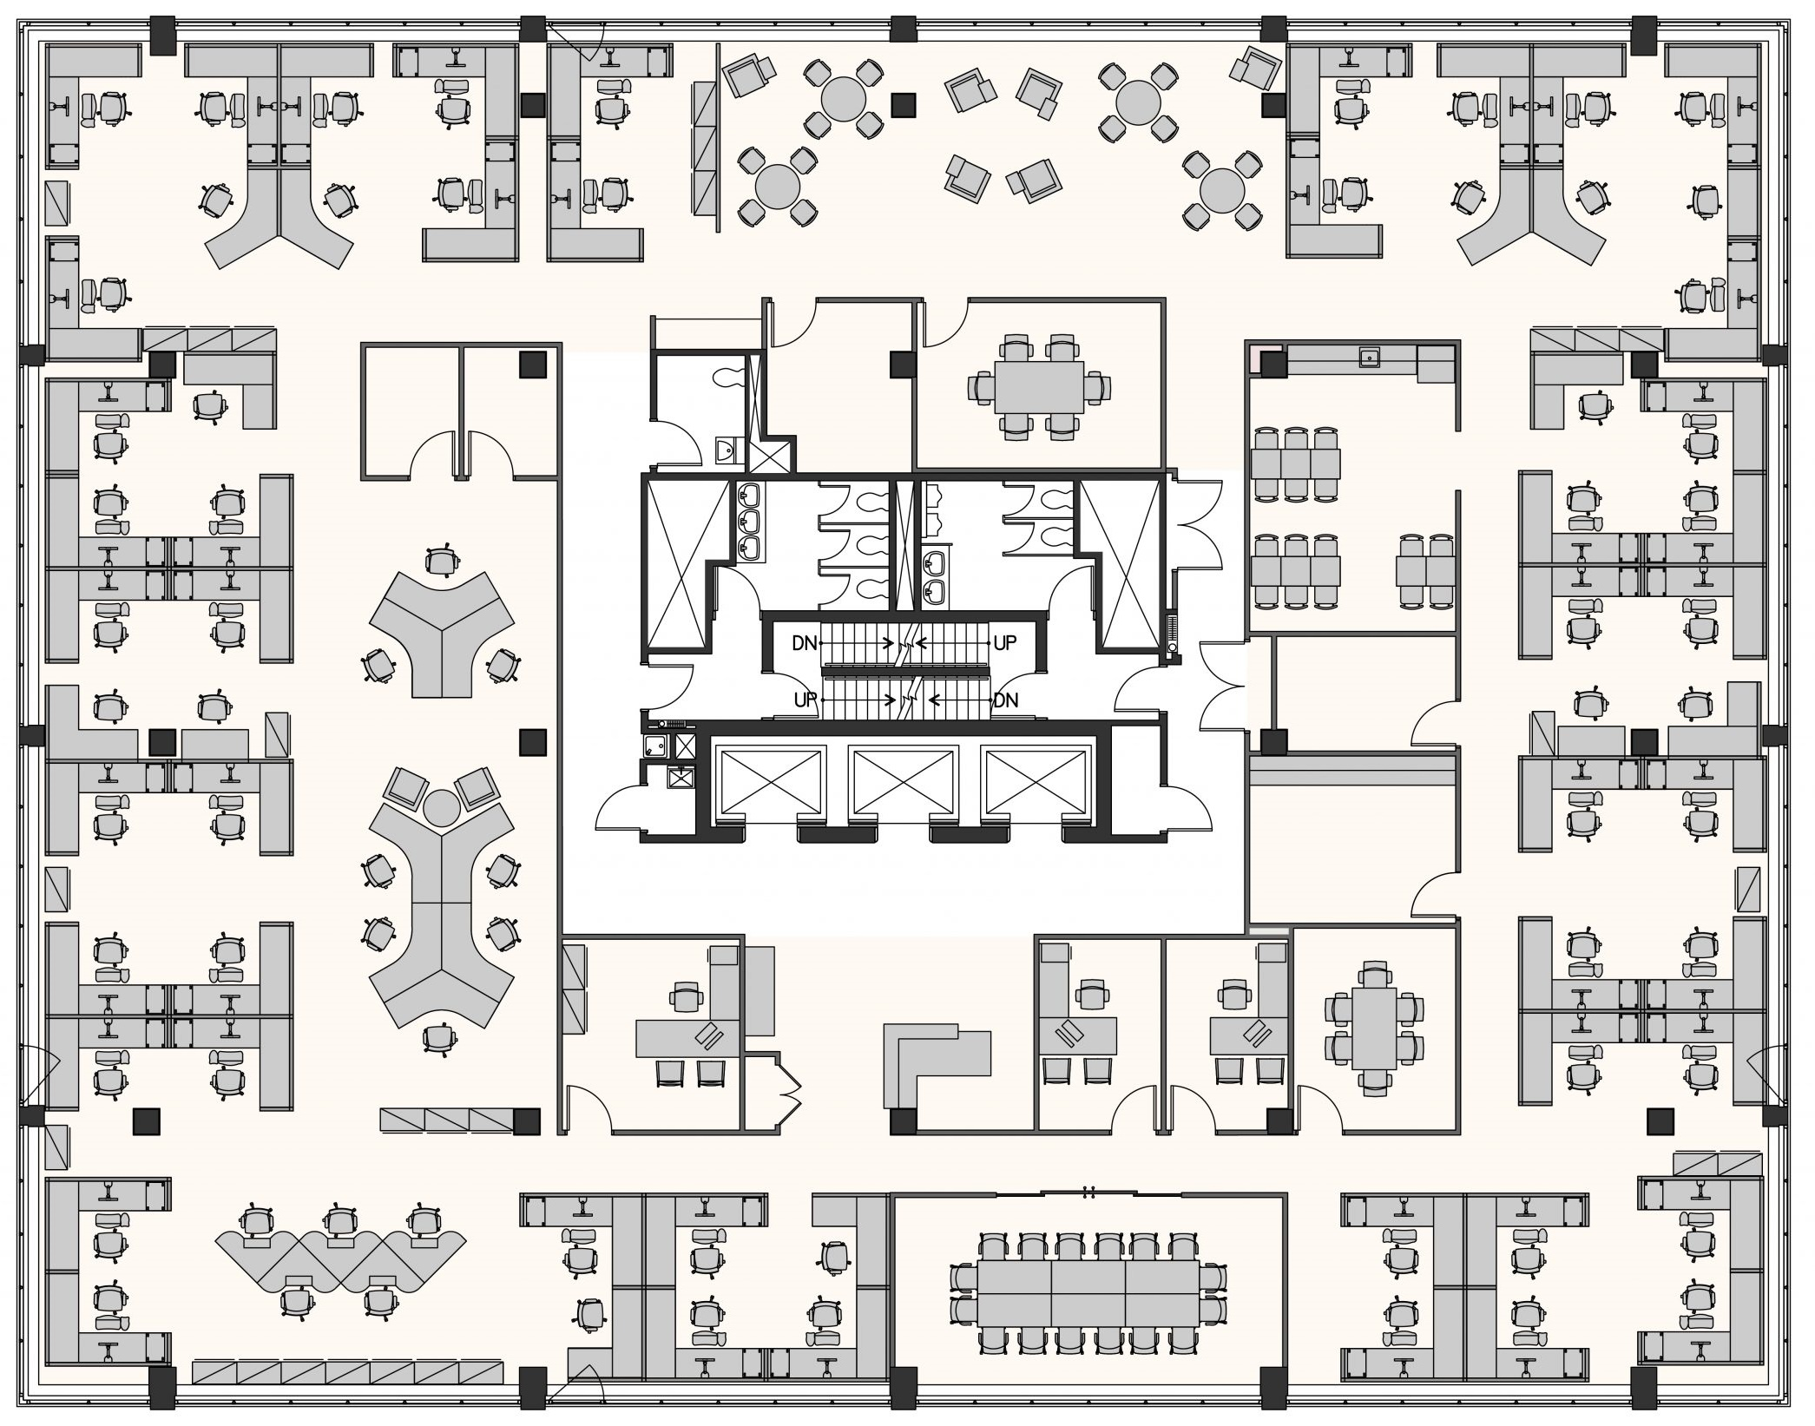
Health & Safety in the Workplace
Shared space
in traditional, assigned workplaces:
Risk in providing a false sense of security to occupants
Notes:
Even in traditional, assigned workplaces, most spaces are shared, which can provide a false sense of security.

Slide 14
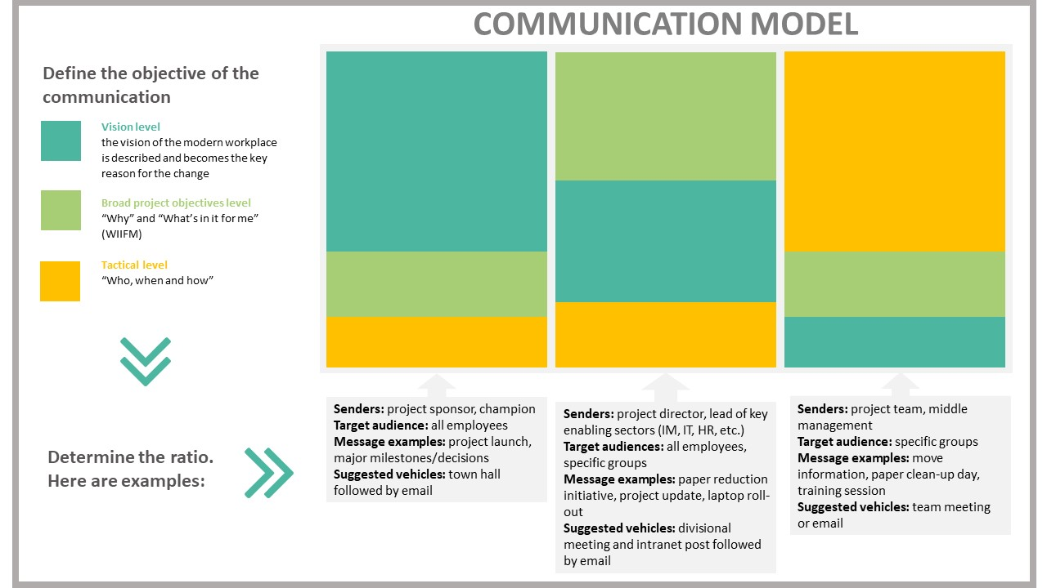
Communication model
This model is from the Change Management Playbook in the context of a workplace modernization project. The same principles can be applied in the context of RTW strategy.

Slide 15
How to create ADKAR in employees (Awareness)
Awareness
Communications
Understanding the need for change and the nature of the change
Transparency and accuracy in communications is critical to credibility and trust
Use plain language and empathy to respect emotional responses
Clear communication about what has changed (physical and protocols) and what remains the same will help reduce anxiety
Communication channels: consider that people need to hear information in multiple ways
Consider that messages will need to be communicated multiple times: before, during and after they return to the workplace
Work with all implicated stakeholders to ensure alignment on key messages and protocols to avoid confusion
In the absence of
AWARENESS
you may see:
resistance from employees
delays in implementation

Slide 16
How to create ADKAR in employees (Desire)
Desire
Showing benefits, what’s in it for me?
Willingness to support the change, to participate and engage
Consider engaging employees in giving feedback, sharing their concerns and their needs
Consider putting in place a mechanism to gather employees' feedback on processes, available tools, shared information and support they need to perform their work at home and at the office
Be prepared to listen and act on employees’ concerns
Managers should engage often with their team and employees
In the absence of
DESIRE
you may see:
higher turnover
lower productivity

Slide 17
How to create ADKAR in employees (Knowledge)
Knowledge
Training, skills development
Having access to resources on how to change, new skills and behaviours
Ensure that employees receive training on new measures, new tools, protocols, procedures, ways of working, etc.
Ensure managers are equipped to support employees through the transition. Managers play a key role in employees’ return to the workplace experience; therefore, is it critical they themselves be adequately equipped.
In the absence of
KNOWLEDGE
you may see:
lower utilization or incorrect usage of new processes and tools

Slide 18
How to create ADKAR in employees (Ability)
Ability
Guidance/How-to, pilots
Getting involved and believing in the change, using new knowledge on how to change, new skills and behaviours
Provide toolkits for managers and leadership
If there is an opportunity for employees to visit the office prior to the actual return, think about offering in-person tours. Employees can get familiar with a new floor layout, new building, new health protocols, parking, etc. before their first day back at the office.
In the absence of
ABILITY
you may see:
sustained reduction in productivity

Slide 19
How to create ADKAR in employees (Reinforcement)
Reinforcement
Reward/recognition
Adopting the new way, living with and sustaining the change
Continue to send out communications from senior leaders on new ways of working and celebrating successes of the RTW
Ensure managers are equipped to continue the discussions about the RTW at their team meetings
Recognize and reward employees adopting new ways of working (both at home or in the office)
In the absence of
REINFORCEMENT
you may see:
employees revert to the old ways
organization creates a history of poorly managed change

Slide 20
References
PSPC Workplace Change Management Playbook (gcpedia.gc.ca)
PSPC Return to the workplace change management toolkit (ZIP)
Change management toolkit to plan the return to the workplace (PowerPoint)
RTW PM-CM Integrated plan‒Change inventory and impact assessment (Excel)
PSPC Guidance and Practices for the Safe Return to Workplaces in Light of the Easing of Restrictions
PSPC Building Management Direction for Coronavirus Disease 2019 (COVID-19)
Information for Government of Canada employees: Coronavirus disease (COVID-19)
Orientation Package to Support the Easing Of Restrictions at Federal Worksites
https://www.csps-efpc.gc.ca/tools/jobaids/orientation-package-eng.aspx
https://www.csps-efpc.gc.ca/tools/jobaids/pdfs/orientation-package-eng.pdf

Slide 21
References (continued)
Summary of the Workplace Change Management Community of Practice session Adapting to change held on June 9th, 2020. The objective of the session was to create a collection of workplace changes and lessons learned from the current pandemic situation.
BGIS Return to the Workplace Employee Experience Considerations (gcconnex.gc.ca)
COVID-19 & GCWORKPLACE Design

