Slide 1
NextGen HR and Pay Project – Employee Engagement Workshop
Government of Canada | September 20th, 2018

Slide 2
Government of Canada Introductions
1

Slide 3
EY Introductions
2

Slide 4
EY’s Team
Kirsten Tisdale
Engagement Partner
Paul Tucker
HR Technology Payroll Process SMA
Warren Tomlin
User Experience Digital SMA
Atir Syed
HR Technology Payroll Process SMA
Tracey De Angelis
HR Technology Payroll Process SMA
Australia
Julie Barac
Senior Consultant
Brittany Smith
Senior Consultant

Slide 5
Project Polaris HR and Pay Workshop Session
Government of Canada
Agenda
Arrival and Refreshments
8:30-9:00
1
Introduction / Session Objectives
9:00-9:15 | Kirsten Tisdale
2
Replay of GC Statement & Guiding Principles
9:15-9:45 | Warren Tomlin + Paul Tucker
3
Human Resources Management Process / Technology Overview
9:45-10:00 | Paul Tucker
Break (15 minutes): Refreshments to be provided
4
HR and Pay Pain Processes
10:15-10:45 | Paul Tucker + Atir Syed + Tracey De Angelis
5
Activity #1: Key Pay Pain Processes and Opportunities
10:45-11:45 | Paul Tucker + Atir Syed + Tracey De Angelis
Lunch (60 minutes): Lunch to be provided
6
Activity #2: Key Pain Processes and Opportunities
12:45-1:45 | Paul Tucker + Atir Syed + Tracey De Angelis
7
Conclusion
1:45-2:00 | Paul Tucker

Slide 6
Today’s Objectives
Discover and understand world-class digital employee experiences
DEFINING HR/PAY REQUIREMENTS THROUGH A SHARED UNDERSTANDING OF PERSONAS, HR/PAY JOURNEYS, PAIN POINTS, MOMENTS THAT MATTER, AND TECH ENABLERS.
Validate GC statement and guiding principles
Validate key HR/Pay stakeholders (personas)

Slide 11
Vision
3

Slide 12
Importance of Design Thinking
5% increase in employee engagement
94% of the worlds most admired organizations said that engaged employees is a source of competitive advantage
BETTER PERFORMANCE
MORE INNOVATIVE
correlates to 0.7% increase in operating margin
The benefits of investing in employee experience are well documented
87% less likely to leave if you’re engaged
4x less
Sick days a year taken by an engaged person compared to the disengaged
3x more
The likelihood of employees staying in a purpose driven organisation.
They are also 1.4x more engaged
87% less likely to leave if you’re engaged
ADVOCATES
67% of
74% of Generation Z
WANT TO STAY
Engaged employees advocate their organization compared to those who are disengaged
agree that business has a responsibility
to create a better world

Slide 13
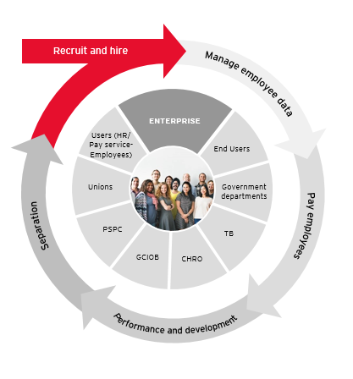
Consequences of a Negative Experience
No joy in working life; disengages employees
With better tech at home; organization feels frugal
Lower productivity
Candidate navigates an opaque process
Creates a poor first impression
Higher drop out rates
Poor “Day 1” sets out a negative tone
Perceived lack of fairness in compensation adjustments
Higher turnover rates
Lasting negative impression of organization; likely to tell others
Sense “too little, too late”
PUBLIC SERVICE COMMISSION
Public Service Comission
Performance management feels subjective; impacts trust
Reward mechanisms poorly targeted
Interventions lack relevance; disengages employee

Slide 14
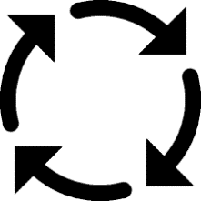
Guiding Principles
User-centric
Statement:
An adaptive, future-ready people solution(s), that puts the user at the centre and enables the delivery of an efficient end user experience to candidates, current employees, and former public servants. The solution will foster the attraction, development and retention of talent that enables the Government of Canada people strategy while further enhancing the delivery of exceptional service to Canadians.
Integrated solution that enables seamless operations
Single source of record
Accessible to all end users regardless of language or location
Simple, self-service that provides 24/7 access
Enables standardized business processes
Supports our future way of working
Meets digital and architecture standards

Slide 15
Lessons Learned

Slide 16
Break
(15 minutes)

Slide 17
Human Resources Management: Process & Technology Overview
4

Slide 18
Value of a Modern Human Resources Management Solution
The right strategy can result in a variety of benefits
Reduced manual effort
Process standardization
Informed decision making
Reduced training effort
Strategic enablement
Data integrity
Improved compliance
Reduced operational risk
Employee engagement
Focus on higher-value tasks
Real-time reporting capabilities
Technology management

Slide 19
“Customers will never love a company until its employees love it first.”
Simon Sinek

Slide 20
Enabling an Exceptional Employee Experience
A superior Employee Experience (Ex) seamlessly connects employees and organizational strategy, ultimately improving citizen experience.
“
Creating the environment for a diverse workforce to engage and thrive requires insights.
As analytics and digital capabilities mature, organizations can personalize experiences to help their people deliver more value, faster.
Purpose and values
Needs
Sentiment and behaviors
Leadership and development
Roles and responsibilities
Ways of working
Interaction and engagement
Inclusion and recognition
Experience is not what happens to you; it's what you do with what happens to you.
Aldous Huxley
Distinct to the employee, Ex comprises three primary dimensions
Individual
Relational
Environment
Location and space
Systems and tools
Compensation and incentives
Perks and benefits

Slide 21
Employee Lifecycle Management
Recruit and hire
RECRUIT AND HIRE
Manage recruitment
Manage hire, on boarding, and integration
PERFORMANCE AND DEVELOPMENT
Manage employee development and training
Manage performance
Manage competency
Manage career and succession planning
Manage employee and org. data
EMPLOYEE AND ORGANIZATIONAL DATA
Perform employee data administration
Manage organization and positions
Manage workforce planning
Compensation and rewards
Classification
Separation
PUBLIC SERVICE COMMISSION
SEPARATION
Manage employee separation
Workforce adjustments
Compensate employees
Performance and development
COMPENSATE EMPLOYEES
Manage compensation
Manage payroll
Manage time

Slide 22
Experience Map
Recruit and Hire
Manage Employee and Organizational Data
Pay Employees
Manage Performance
and Development
Separation
1.
Manage
Recruitment
6.
Manage benefits
and pension
8.
Manage time
12.
Manage
competency
4.
Manage organization
and positions
11.
Manage
performance
13.
Manage career
and succession planning
2.
Manage hire, on boarding,
and integration
10.
Manage employee
development and
training
14.
Manage
employee
separation
5.
Manage workforce planning
7.
Manage compensation
9.
Manage payroll
3.
Perform employee data administration

Slide 23
HR and Pay Pain Processes
5

Slide 24
Leading Practices:
Recruit and Hire
Streamlined process and technology to enable the experience
Onboarding to drive new hire retention
New hires and internal movements
Forging connections early
First impressions count
Use of onboarding portals

Slide 25
Process Map: Recruit and Hire
Recruit
Establish recruitment / sourcing strategy
Develop selection criteria
Analyze / create job requisition
Post job / position
Manage talent pool
Screen and select candidates
Prepare job offer
Perform employee due diligence
Onboard
Legend
Map to HR business reference model
EY recommendation to include
Assign company property
Perform employee orientation
Manage onboarding/ new hire activities
Document employee data

Slide 26
Process Map: Recruit and Hire Examples
Screen and Select Candidates
If candidate is not suitable, review for another requisition
If applicable, assign candidate to new pipeline
If not suitable, candidate receives rejection
Perform initial candidate screen
Determine candidate suitability
Rank candidates
Add to short list
Candidate receives notification
Mange Onboarding/ New Hire Activities
Coordinate with hiring manager to update onboarding programs
Evaluate onboarding / orientation needs
Maintain letters and forms
Administer and maintain new hire surveys
Evaluate onboarding effectiveness
Execute onboarding program

Slide 27
Leading Practices:
Manage Employee and Organizational Data
Integrate platforms and systems which need to feed from the HRIS
Have a single source of truth for employee data
Allow employees to have some control over personal data
Perform rigorous audits

Slide 28
Process Map: Manage Employee Data
Core Record
Process employee personal data change
Manage leave of absence
Monitor leave of absence
Manage return from leave of absence
Initiate job change request
Manage employee file
Data stewardship
Workforce Management
Establish and define headcount outside of budgetary cycle
Determine and monitor open positions
Establish and maintain organization structure
Establish and define positions during annual budget cycle
Create position
Identify jobs and job descriptions
Manage mass organizational changes
Edit position

Slide 29
Process Map: Manage Employee Data Continued
Workforce Planning
Legend
Map to HR business reference model
EY recommendation to include
Manage start of year planning
Perform year-end evaluations
Maintain ongoing demand
Benefit Data
Administer flexible spending accounts
Administer disability claims
Process benefits terminations
Perform benefits reporting
Maintain eligibility
Exchange data with providers
Manage provider payments
Manage employee life events
Manage benefit enrollment

Slide 30
Process Map: Manage Employee Data Example
Legend
Map to HR business reference model
EY recommendation to include
Manage Benefit Enrollment
Vendor receives employee enrollment and eligibility status
Communication is administered back to employee regarding benefit details
Employee fills out enrollment details
Vendor confirms enrollment details
Determine whether active or passive enrollment
Update benefits platform provider
Send reminders to employees (ongoing during annual enrollment)
Monitor enrollment process (ongoing during annual enrollment)
Manage employee inquiries
Generate reports, as needed

Slide 31
Leading Practices:
Pay Employees
Payroll service delivery
Reduced complexity
A consolidated view of the workforce
Data analytics and benchmarking
Greater compliance
Mobile apps

Slide 32
Process Map: Pay Employees
Compensation
Legend
Map to HR business reference model
EY recommendation to include
Manage merit increase process
Manage employee annual incentive plans
Manage long term incentive plans
Conduct annual market pricing
Payroll
Payroll compliance: Operations and configurations maintenance
Coordinate with third party institutions
Post to general ledger
Generate year end payment summary
Treasury funding
Process wage attachments
Payroll adjustments
Process separation payment
Maintain employee payroll data
Unclaimed disturbances
Process reversals
Data exchange inbound
Data exchange outbound
Process / distribute on / off cycle
Assign costing allocation

Slide 33
Process Map: Pay Employees Continued
Time and Attendance
Create work schedule
Allocate work schedule
Process leave request
Collect daily time and attendance
Audit time and leave data
Edit time and attendance data
Send the time data to 3rd party vendor
Employee time data maintenance
Legend
Map to HR business reference model
EY recommendation to include

Slide 34
Process Map: Pay Employees Examples
Post to General Ledger
Load general ledger file and send report of payments by cost center
Approve and post general ledger
Create and upload final payroll upload reports
Download and review General Ledger file
Determine initial view is correct
Reconcile General Ledger
Determine if all items reconcile
Follow up on any incorrect items
Open case
Manage Merit Increases
Create eligibility rules and guidelines in system
Advise on merit allocation for key talent
Managers meet with direct reports to discuss increase
Design / evaluate salary surveys
Determine recommended compensation budget
Receive merit approval documentation
Create merit budget in system
Allocate merit increase to employees
Submit for approval

Slide 35
Lunch
(60 minutes)

Slide 36
Leading Practices:
Performance and Development
Reward success
Offer frequent, actionable feedback
Document everything
Provide training and learning opportunities

Slide 37
Process Map: Performance and Development
Development / Planning
Assess new training needs
Assess existing training courses / curriculum
Develop and amend course type
Communicate training information
Manage self-enrolment for all courses
Manage employee pre-book request
Manage group enrollment course
Manage employee initiated waitlist
Manage course cancellation request
Deliver training
Appraise courses
Reimburse education
Track external employee training
Create individual learning plan
Legend
Map to HR business reference model
EY recommendation to include

Slide 38
Process Map: Performance and Development Continued
Performance Tracking / Feedback
Conduct performance appraisal
Administer 360 feedback
Administer performance improvement plans
Manage goals
Calibrate ratings
Performance Evaluation
Legend
Map to HR business reference model
EY recommendation to include
Maintain qualification log
Evaluate employee profiles
Update employee profiles
Succession Planning
Prepare for succession planning
Perform consensus assessment on talent
Conduct talent audit and identify succession gaps
Create and execute succession management
Identify high potentials
Tracking and evaluation

Slide 39
Process Map: Performance and Development Example
Monitor and Execute Succession Management
Match high potential employees to critical positions and determine development gaps
Assess skills and competencies required for unmatched critical position
Capture / maintain final outcomes (reports, system, etc.)
Action plans created for high potential candidates
Review high potential employees and critical roles
Validate employee’s skills, readiness and experience
Create report of unmatched / unready high potentials
Final outcomes updated in system
Legend
Map to HR business reference model
EY recommendation to include

Slide 40
Leading Practices:
Separation
Not leaving it all for the exit survey
Engaging former employees
The transient workforce
Increasing people analytics

Slide 41
Process Map: Separation
Separation
Conduct performance appraisal
Administer 360 feedback
Administer performance improvement plans
Manage goals
Calibrate ratings
Legend
Map to HR business reference model
EY recommendation to include

Slide 42
Activity
6

Slide 43
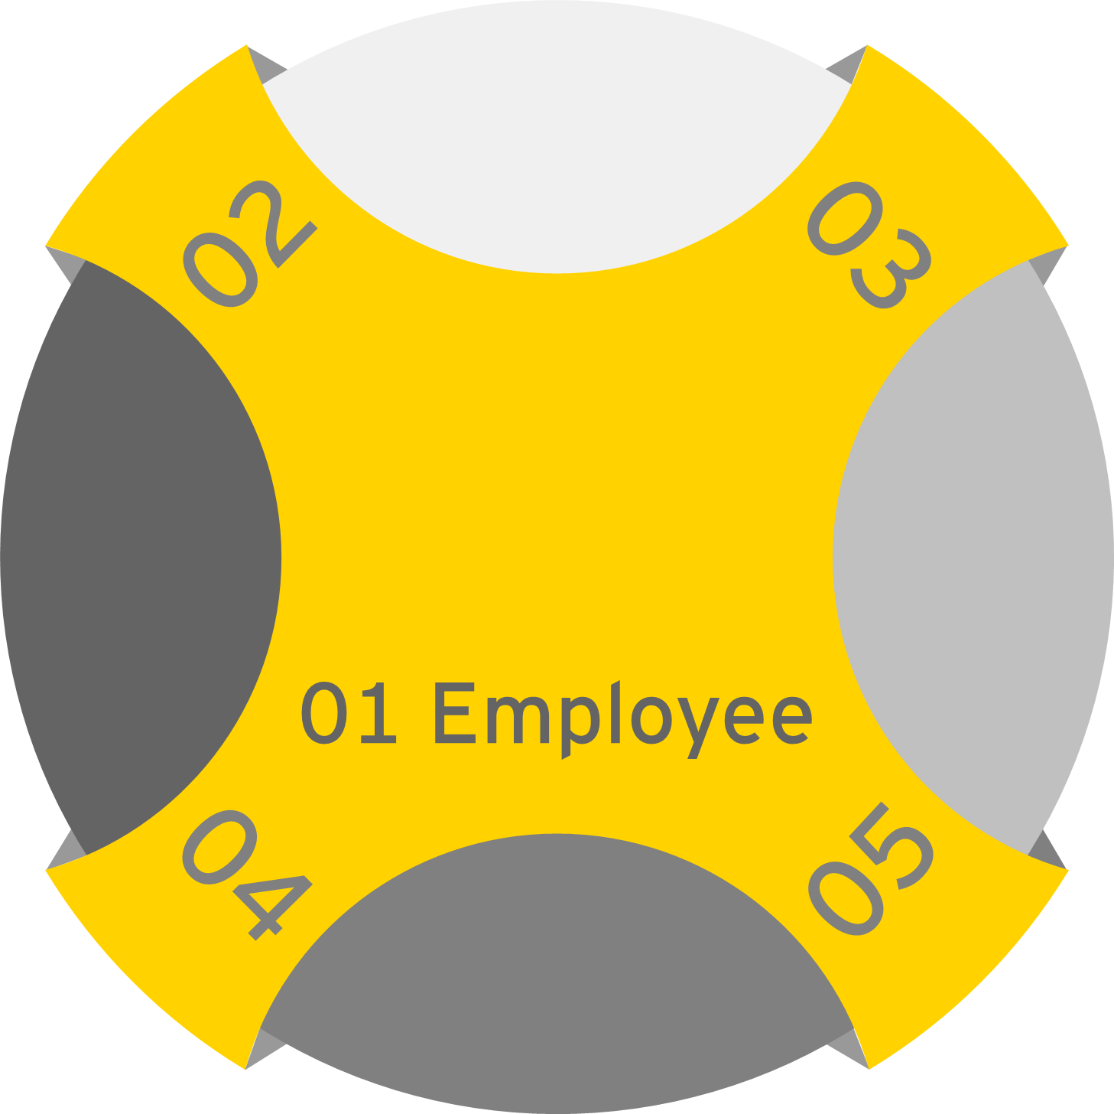
Personas: Getting to Know our Users
Personas are characters which represent different groups of people, specifically employees, workforce segments, or user groups.
Personas are especially valuable as they can assist us in recognizing that different people have different needs and expectations. They help us to understand these wants, experiences, behaviours and goals. When creating personas, we identify unique needs and pain points.
Priority Personas
People Manager
Decentralized Admin
A unique need: articulates service delivery considerations that differentiate a segment group
A unique pain point: identifies opportunities for solution and enablement that should be factored into design for a segment
Payroll and Compensation Advisor
HR Specialist

Slide 44
Chris – Community Health Nurse
Chris is a Community Health Nurse for Indigenous Services Canada (ISC) where he works with partners to improve access to high quality services for First Nations, Inuit and Métis. ISC’s vision is to support and empower Indigenous peoples to independently deliver services and address the socio-economic conditions in their communities.
Chris has been in his role for three years, he often works autonomously delivering care out in the communities.
He has 2 children and is the primary caregiver for his elderly father.
Planning work and my life…
My weeks are never the same and I have a lot of changes to my schedule. It is important my manager receives preferences and planned changes early so she can schedule future resourcing more accurately. This also helps me to plan my family commitments in advance.
I have my second round of paternity leave coming up in October and this time I would like to stay more connected, especially if I need to change my timeframes while away, or any of my personal or profile information.
My career development…
My role has me disconnected to the broader organisation and I find it hard to see career/advancement opportunities beyond my Manager’s position. I like working for GC so I don’t want to look externally but it is hard to see my next steps as I don’t get any information on what development pathways I should take to make any change. Feedback and achievements are given often verbally or on paper and is hard to bring together for my reviews and career plans. Finding and accessing training is difficult and I don’t get the luxury of taking whole days off, when clients need me.
My hiring experience and first 90 days…
I have formal qualifications, but my experience is important. You need to know the quality of my skills and I found the process hard to show I am a high performer compared to my competition through a very paper-based process. Where does my information go – do you match me to other roles or do I need to know all of these and apply separately? I found out about this role through word of mouth and the process was unclear. In today’s job market we need more certainty, earlier in the process, or at least an understanding of how long things will take.
My first 90 days were a blur, learning the communities, my client load and the organisation. Because I work out of the central office, I needed to orient myself out of hours, however the mechanisms were not available and people were hard to access to answer my questions..
My day and getting paid...
I want to be paid accurately and I don’t have time for administrative processes. We have a lot of adhoc shift changes based on what the community clients need at the time, so I need my time changes and any allowances for entitlements captured close to real time. I also need to see that these have happened so I have confidence in tracking my pay.
There needs to be better ways to record unplanned changes/leave, update my time, schedule and notify relevant approvers and relevant parties ie. meetings in a single step.
Importantly, I need any changes in my schedule or position ie. acting to seamlessly result in correct and timely payment.
Making a change...
When I leave I am not just changing positions I am leaving a team with work and clients who depend on me. If you are counting on me to manage handover before I go. you need to make my exit simple and purposeful. I am happy to give feedback through the right mechanisms, but as long as you do something with it.

Slide 45
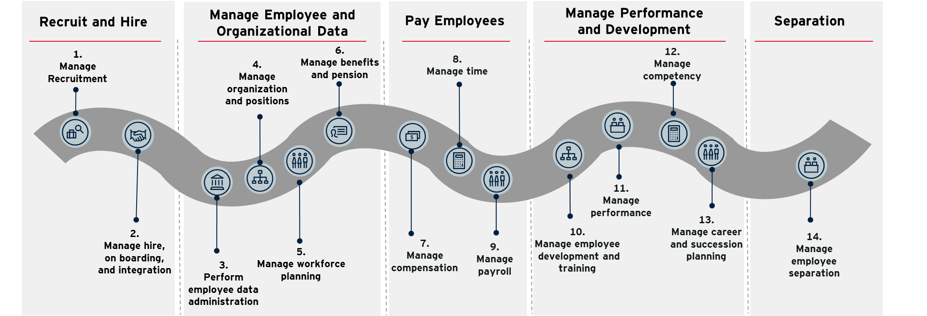
Activity #1
Objective: Identify key areas of opportunity, moments-that-matter, and technology enablers across the recruit and hire process area, specific to the assigned persona.
Instructions: Congregate into groups of 3 around the persona posters around the boardroom. Leveraging Chris’s story and focusing on your assigned persona , capture the main areas of opportunity, moments-that-matter, and technology enablers for the recruit and hire process area . Use the sticky notes provided to record your answers on the posters.
People Manager
Decentralized
Admin
HR Specialist
Payroll and Compensation Advisor

Slide 46
HR Specialist: Recruit & Hire
Candidates are not always streamed to the correct hiring committee
It is difficult to compare candidate data in an at-a-glance format
Human resource specialists are the link between employer and employee. The exact duties of the human resource specialist can vary; some have specific titles (recruitment specialist, labour relations, union steward). However, human resource specialists perform a variety of job duties.
Areas of Opportunity
“
“My short-list of candidates possesses the key skills and qualifications needed for the role”
Moments That Matter
Questionnaires are integrated into the application process to facilitate the pre-screening of candidates
Accurate job descriptions are available to applicants
Hiring managers can easily identify relevant candidate competencies
Candidates who were previously flagged as future job prospects are included in the pre-screening process
Enablers

Slide 47
Activity #2
Objective: Identify key areas of opportunity, moments-that-matter, and technology enablers across the manage employee and organizational data area, specific to the assigned persona.
Instructions: Congregate into groups of 3 around the persona posters around the boardroom. Leveraging Chris’s story and focusing on your assigned persona , capture the main areas of opportunity, moments-that-matter, and technology enablers for the recruit and hire process area . Use the sticky notes provided to record your answers on the posters.
People Manager
Decentralized
Admin
HR Specialist
Payroll and Compensation Advisor

Slide 48
Decentralized Admin: Manage Employee and Organizational Data
Communication between departments and central HR is not timely
Historical data is lost when transferring an individual from one unit to another
Decentralized Admins focus more on the administrative functions associated with managing personnel to support a business group. In a decentralized structure, the HR professionals report to different managers, and they may not interact with each other or provide the same services. Their relationship with the managers they support tends to be closer.
Areas of Opportunity
“
“Accessible organizational data allows me to explain the ideal department-to-employee ratio to the department heads”
Moments That Matter
Organizational data is clearly displayed in a dashboard
Administrators can quickly pull reports on organizational data to provide leaders with strategic workforce insights
Leaders have visibility into their own workforce data, and ask less related questions to HR administrators
A single source of data and a consistently applied governance model ensures all workforce data is accurate
Enablers

Slide 49
Activity #3
Objective: Identify key areas of opportunity, moments-that-matter, and technology enablers across the accurate payment of employees area, specific to the assigned persona.
Instructions: Congregate into groups of 3 around the persona posters around the boardroom. Leveraging Chris’s story and focusing on your assigned persona , capture the main areas of opportunity, moments-that-matter, and technology enablers for the recruit and hire process area . Use the sticky notes provided to record your answers on the posters.
People Manager
Decentralized
Admin
HR Specialist
Payroll and Compensation Advisor

Slide 50
Payroll and Compensation Advisor: Pay Employees
Employees complain about internal equity and pay rules.
New hires are demanding higher salaries than longer term employees.
The workflow process for approvals causes off-cycle payments
Time entry and approval is not captured electronically
Payroll and Compensation Advisors focus on performing payroll and administrative duties to support the payroll function. On the compensation side, they review salary and benefits against internal and external market trends, support the annual salary review process, bonus planning, design, review and administration.
Areas of Opportunity
“
“
“I have the ability to communicate with confidence that we’re paying fairly and have the analytics to back me up”
“I am easily able to run pay cycles (on / off cycles) as all tasks are automated”
Moments That Matter
Calibration process in a system ensures the performance management process is much smoother/ effective
Data captured online enables the analysis of trends
Clear procedures and automation of tasks allows for more time to be spent on data mining, reporting, and exception reviews
Logical workflow allows for clear audit trails within the system
Enablers

Slide 51
Activity #4
Objective: Identify key areas of opportunity, moments-that-matter, and technology enablers across the manage performance and development area, specific to the assigned persona.
Instructions: Congregate into groups of 3 around the persona posters around the boardroom. Leveraging Chris’s story and focusing on your assigned persona , capture the main areas of opportunity, moments-that-matter, and technology enablers for the recruit and hire process area . Use the sticky notes provided to record your answers on the posters.
People Manager
Decentralized
Admin
HR Specialist
Payroll and Compensation Advisor

Slide 52
Employee: Manage Performance and Development
There is no qualification catalog for people to identify skills required for positions they are interested in
There is no feedback cycle on expectations on job role between manager and employees
Employees capture all types of role types, including the most complex aspects. This also encompasses full-time, part-time, permanent, and temporary workers.
Areas of Opportunity
“
“I am able to easily identify learning and development opportunities based on my talent profile”
Moments That Matter
The talent solution is integrated with the learning system to suggest relevant training and learning opportunities related to an individuals goals and skillsets
Employees are able to connect completed learning hours back to performance goals
Enablers

Slide 53
Activity #5
Objective: Identify key areas of opportunity, moments-that-matter, and technology enablers across the separation area, specific to the assigned persona.
Instructions: Congregate into groups of 3 around the persona posters around the boardroom. Leveraging Chris’s story and focusing on your assigned persona , capture the main areas of opportunity, moments-that-matter, and technology enablers for the recruit and hire process area . Use the sticky notes provided to record your answers on the posters.
People Manager
Decentralized
Admin
HR Specialist
Payroll and Compensation Advisor

Slide 54
People Manager: Separation
Exit surveys are not used consistently
The termination process is paper-based and doesn’t capture an end-to-end process
People Managers are those who responsible for certain tasks or a certain subset of the organization. They are also typically involved in hiring, motivating their teams, and performance managing the employees who report to them.
Areas of Opportunity
“
“With some recent changes in my workforce, I am ready and able to assess hiring needs and track movements”
Moments That Matter
The people leader is able to run tailored reports on their workforce, including movements, terminations, and promotions
The people leader has visibility into their workforce’s key data (movements, job events, productivity, engagement) relative to the rest of University
Analytics provide people leaders visibility into the diversity makeup of their unit
Enablers

Slide 55
Thank you

