Slide 1
TABLE OF CONTENTS
GCworkplace TECHNICAL REFERENCE
MANUAL
INTRODUCTION
PREAMBLE
GENERAL SPECIFICATIONS AND OPEN OFFICE AREAS
ACCESSIBILITY OVERVIEW
TECHNOLOGY OVERVIEW
WORKSTATION
WORK POD
FOCUS ROOM
STUDY
FOCUS POD
TOUCHDOWN
PHONE ROOMS/BOOTH
CHAT POINT
HUDDLE TEAMING AREA
LOUNGE
WORK ROOM
PROJECT ROOM
MEDIUM MEETING ROOM
LARGE MEETING ROOM
KITCHENETTE
WELLNESS ROOM
EQUIPMENT AREA PERSONAL STORAGE AREA
SHARED STORAGE
WASTE & RECYCLING
RESOURCES
PRIMARY INDIVIDUAL OPEN
PRIMARY INDIVIDUAL CLOSED
SECONDARY INDIVIDUAL
COLLABORATIVE OPEN
COLLABORATIVE CLOSED
SUPPORT SPACE
RESOURCES

Slide 2
INTRODUCTION
PREAMBLE
The GCworkplace Technical Reference Manual is a document outlining the various workpoints included in the GCworkplace Design Guide. This document should be referred to for any Fit-up or modernization project in conjunction with both the GCworkplace Design Guide and the Government of Canada Workplace Fit-up Standards. The information provided includes best practices regarding workpoint dimensions, planning tips, accessibility tips, technical data and its application along with visual representations.
GCworkplace is a workplace strategy developed to best support a high-performing public service that embraces innovation, transformation and continuous renewal. Spaces are intended to promote choice, encourage collaboration, leverage technology and foster a culture of autonomy and wellbeing. Furniture solutions with integrated power and technology are to be incorporated throughout the whole work environment.
This manual is intended to be a technical reference to direct the design requirements of a new GCworkplace. This baseline of technical requirements should be applied in conjunction with client requirements as well as all relevant standards, policies; including but not limited to National, Provincial and Municipal building codes, electrical codes, and accessibility standards (CAN/CSA B651-23 and B652 -23). It should be read along with the Government of Canada Workplace Fit-up Standards, GCworkplace Design Guide, GCworkplace Best Practices Checklist, GCworkplace Space Planning Workbook, GCworkplace Indigenous Design Guide and the Technical Reference for Office Building Design (TRFOBD).
It is important to note that with the implementation of a GCworkplace fit-up, occupant density may differ from original base building design estimates. The Designer must ensure the base mechanical and electrical building systems have adequate capacity to meet additional demands. This should be done taking a holistic view of the building, not just the individual project in a building.

Slide 3
INTRODUCTION
GENERAL SPECIFICATIONS AND OPEN OFFICE AREAS
Detailed specifications in this section are the basic requirement for the design of GCworkplace unless otherwise specified in the workpoint specifications.
GENERAL SPECIFICATIONS
ELECTRICAL :
Where floor monuments are required, the use of under carpet power tracks are recommended to limit the need for core drilling wherever possible;
Provide general use power outlets and switches throughout as required by the National Building Code and current version of CSA C22.2 No. 42. and CSA C22.2 No.111-2010 (15).
LIGHTING:
Base building lighting;
Provide appropriate lighting levels as required by the National Building Code. Refer also to the Technical Reference for Office Building Design section 8.12.1.1 Illuminance and Luminance Ratio and 8.12.9.2 Illumination Levels Interior Spaces;
Where feasible within workpoints, provide dimmable lighting that can be user adjusted.
MECHANICAL:
Base building heating, cooling and ventilation;
Airflow to suit occupant density;
Consider the provision of automatic controls (when possible) to reduce cooling and ventilation to a standby mode when enclosed spaces are unoccupied;
U or Z shaped acoustically lined transfer duct for full height partitions (slab to underside of ceiling with plenum barrier).
ACOUSTICS:
Consider using interior architectural solutions like wall hung panels or room dividers for space definition and sightline control. These solutions also absorb sound, helping to create different acoustic zones (quiet for focused work, interactive for collaboration). They provide visual separation, reducing distractions from high traffic areas.
INTERIOR ARCHITECTURE:
Demountable and/or drywall partitions with glazing, slab to underside of ceiling with insulation and plenum barriers (enhanced speech privacy, approx. STC 45);
Painted walls or unfinished to suit substrate. Limited use of wall coverings in high traffic areas can be used where appropriate;
If necessary, relocate/add water bottle filling stations / drinking fountains to suit planning requirements;
Notes:
-Consider interior architectural solutions for defining space and controlling sightlines and for sound absorption (i.e. wall hung, suspended panels or other room dividers) and to help separate workpoint(s) from other zones with differing acoustic recommendations (quite versus interactive) or tasks (focus versus collaborative). Visual separation can also be helpful in reducing distractions from high traffic circulation routes or areas where tasks are performed in the open such as shared equipment and filing areas;
-Provide acoustic treatment for sound absorption, such as ceiling hung or wall mounted acoustical panels, etc.
Changed to:
-Consider providing interior architectural acoustic solutions such as ceiling hung or wall mounted acoustical panels (baffles) to assist in sound absorption. This will also support in defining the space and serving as a wayfinding mechanism throughout an open floorplan;
-Consider providing interior architectural acoustic solutions to also assist in visual separation and helping to minimize distractions in high traffic circulation routes and/or areas where tasks are performed in an open plan layout.

Slide 4
OTHERS
GENERAL SPECIFICATION AND OPEN OFFICE AREAS (continued)
FLOORING:
Where required, specify raised floor systems and ramps, epoxy or other special treatments to suit client requirements;
Typically carpet (rolled goods or carpet tile) for all open office areas, studies, focus, work and project rooms as well as phone booths and meeting rooms and resilient sheet or tile, ceramic tile or “unfinished” within lounges and kitchenettes. Consider adjacent spaces and finish transitions to determine most appropriate finish;
Enhance wayfinding and durability in major circulation paths (carpet inserts) maximum 10% of floor area unless using carpet tile.
CEILINGS:
Base building standard (typically acoustic tile);
Bulkheads as required to suit mechanical design or other site constraints;
Bulkheads or other design elements may be used to define or delineate spaces, and for wayfinding purposes;
Provide felt baffles at ceilings in open areas where base building architecture is left exposed (open steel web joists for example). May also be helpful in areas with high ceilings to reduce sound transmission and improve acoustics.
DOORS:
Doors to enclosed rooms may be hinged or sliding, glazed, partially glazed or full core;
Film on fully glazed doors, walls and sidelights must be compliant with all applicable codes and standards;
Consider additional hardware as required, for durability in high traffic areas, e.g, push/pull and kick plates;
INTERIOR DESIGN NATIONAL CENTRE OF EXPERTISE | PSPC WORKPLACE SOLUTIONS

Slide 5
OTHERS
GENERAL SPECIFICATION AND OPEN OFFICE AREAS (continued)
ACCESSIBILITY:
Please note the following is not a comprehensive list. Please refer to CSA/ASC B651:23 Accessible Design for the Built Environment for minimum mandatory accessibility standards. (Note: Clauses referred to below are from CSA/ASC B651:23)
Circulation:
Turning diameters (2100mm minimum) must be provided where needed. (Clause 4.1)
Pathways must meet or exceed minimum width requirements. (Clause 5.1.1)
Clear floor space must be provided when an accessible route terminates. (Clause 5.1.2)
Doors and doorways must meet or exceed the minimum requirements, i.e. width, manoeuvring space on both sides, force to operate, accessible hardware, etc. (Clause 5.2)
Clear floor space must be provided at all controls, equipment, amenities. i.e. light switches, power door operators, whiteboards, lockers, filing cabinets, etc. (Clause 4.3.2)
General:
Ensure controls are accessible. Controls include things such as light switches, locks on lockers and filing cabinets, door and millwork handles, power door operators, etc. (Clause 4.3)
Ensure appropriate headroom clearance has been provided. (Clause 4.5.1)
Ensure protruding objects are cane detectible, or plan so they don’t protrude. i.e. wall mounted TV’s/monitors, surfaces mounted on the back of seating, wall mounted first aid kits, etc.(Clause 4.5.2)
Ensure consideration is given to address functional and cognitive barriers, environmental intolerances, and acoustics. (Clause 4.7)
Consider how lighting/space can be designed to address the needs of people with sensitivities to light. Incorporate adjustability and dimming wherever possible and consider lighting from a number of sources, such as task and pendant lighting, to provide various lighting conditions and facilitate user control.
Finishes:
Film on fully glazed doors, walls and sidelights must be compliant with codes and standards. (Clause 5.2.2.10) Note: It is acceptable to add additional decorative film provided the mandatory requirements are met.
Ensure luminance (colour) contrast has been addressed. i.e. between floors and walls, walls and door frames, doors and door frames, contrast strips on glass doors & walls, handles and background surface, furniture and surroundings, etc. (Clause 4.2)
Ensure carpets comply (Clause 4.4.3)
Consider using colour contrast and/or install different floor finishes to visually separate support spaces from adjacent accessible route.
Select finishes that prevent glare. i.e. matte finishes on things such as table surfaces, floors, signage, millwork, etc.
Avoid strong patterns on large surfaces i.e. walls, floor, large furniture, millwork, etc.
INTERIOR DESIGN NATIONAL CENTRE OF EXPERTISE | PSPC WORKPLACE SOLUTIONS

Slide 6
OTHERS
GENERAL SPECIFICATION AND OPEN OFFICE AREAS (continued)
ACCESSIBILITY CONTINUED:
Workpoints:
Many individual workpoints of each type must be accessible to wheeled mobility device (WMD) users. Minimum requirements for individual workpoints to be considered accessible to WMD users. Considerations include:
Turning diameter provided and space for WMD users to participate. (Clause 4.1)
Accessible surface height and knee & toe clearance provided if applicable. (Clause 6.7.1)
Accessible power within reach, if provided (A.2.2)
All collaboration spaces and support spaces must allow wheeled mobility device (WMD) users to participate. Minimum requirements for collaboration spaces to be considered accessible to WMD users. Considerations include:
Turning diameter provided and space for WMD users to participate. (Clause 4.1) Note: Turning diameters can be shared.
Note: The larger the room grouping, the more WMD users that should be able to participate.
Accessible surface height and knee & toe clearance provided if applicable. (Clause 6.7.1)
Accessible power within reach if provided. (A.2.2)
Clear floor space to access amenities, equipment, and controls. i.e. light switches, whiteboards, etc. (Clause 4.3.2)
Note: Path of travel within enclosed rooms must be considered. i.e. around a meeting table and to access amenities.
Furniture and planning considerations:
Offer a variety of furnishings and ways for people to participate.
Consider adjustability, ergonomics & flexibility when selecting furniture.
Knee and toe clearances must be considered when selecting table/desk base styles.
Choose electric mechanisms for height adjustable sit-stand tables which are easier to adjust.
Ensure worksurfaces and counters have rounded or blunted corners and edges
Include left-handed and right-handed options or those that provide both.
Consider how whiteboards can suit people of varying statures as well as from a seated position. i.e. positioned vertically.
Avoid planning workpoints with users backs to a main corridor.
Ensure there is space for displaced chairs (must not obstruct pathways) when a workpoint is occupied by a WMD user.
Provide opportunities to allow WMD users to “park” their devices and transfer to another seat.
Consider how sightlines can be maximized for those that benefit from lip reading.
INTERIOR DESIGN NATIONAL CENTRE OF EXPERTISE | PSPC WORKPLACE SOLUTIONS

Slide 7
INTRODUCTION
TECHNOLOGY OVERVIEW
GCworkplace and the Digital Government Vision is being amalgamated within the Digital Workplace initiative launched by Treasury Board Secretariat (TBS), in collaboration with PSPC and Shared Services Canada (SSC). The objective is to standardize and enable the Digital Government Vision within the context of GCworkplace and align technology fit-up standards towards a common shared vision. The roles of the three organizations are as follows:
Treasury Board Secretariat (TBS) will support PSPC and SSC in the implementation of the GCworkplace technologies with relevant policy instruments and standards, with the accompanying mechanisms and models for funding.
Shared Services Canada (SSC) will elicit the enterprise business requirements and develop the associated technology requirements. SSC will develop technology infrastructure solutions that meet the enterprise business requirements to enable the GCworkplace vision through a common Digital Workplace model. Technology solutions will be packaged into standardized flexible, modern, secure and reliable IT services. SSC will work with TBS to establish IT service and technology standards and help PSPC deliver the technology within GCworkplace fit-up projects.
Public Service and Procurement Canada (PSPC) will establish the vision for the GCworkplace and the associated enterprise business requirements. Design office interiors that meet the business requirements to enable the GCworkplace of the Future vision. PSPC and SSC will work together to integrate the technology solutions into the facility design in a holistic approach.
The GCworkplace Fit-up Model will satisfy the general workplace needs of GC employees working in an unassigned wireless workplace environment, requiring collaborative and responsive technology services, anytime and anywhere within the domains of their workplace (i.e. floor, multiple floors, and whole building solutions). SSC remains the Technical Authority (TA) for all technology services brought to GCworkplace Fit-ups. The technology services, and workplace standards that form the basis of the GCworkplace Fit-up model are compiled based upon business requirements under a “Protected B” security posture for space configuration, accessibility and design. Subsequent security postures will be developed in close consultation and collaboration with partners and stakeholders. All fit-up requirements that are not covered within the GCworkplace Fit-up Model will require to be approved through TBS GCEARB governance for funding.

Slide 8
INTRODUCTION
TECHNOLOGY OVERVIEW (continued)
GCworkplace Technology Requirements, Considerations and Assumptions form the basis of the GCworkplace Fit-up Model. These conditions should be available at all fit-up locations unless otherwise stated or desired by PSPC and/or the client department. All business requirements for the fit-up should be indicated within the business requirements (BR) document. These assumptions will be reviewed and updated on a regular basis. *Note: Mandatory Codes and Technical Specifications for Technology can be found in the reference section of this manual.
General:
PSPC and SSC will require to complete a site survey for every fit-up to evaluate technology service considerations and assumptions
Standard ceiling height of 10 feet
Standard wall and building construction materials (i.e. metal, concrete and drywall)
GCworkplace designed principally for office workspace (does not account for special purpose space)
Cabling:
Vertical and horizontal cabling (excluding GC Wi-Fi) will be completed by PSPC.
Single LAN drop will be leveraged for multiple services when possible
A maximum of 20% LAN drops will be deployed as required for a GCworkplace Fit-Up (for all workpoints combined excluding touchdowns, phonebooths and chat points)
Minimal to no cabling restrictions in a building (i.e. coring, adding conduit)
Network (LAN / WAN):
1 port of access (POA) per access point (AP)
48 port distribution switch PoE
1 telecommunications room (TR) room per 1100 m2
Average floor is planned for 1100 m2
Hardwired LAN connection to support 1 MB/s per connected device
Wi-Fi:
100% wireless connectivity at the GCworkplace Fit-up
GC Wi-Fi (whole building approach) is the GC service recommended by SSC for network connectivity
Commercial Wi-Fi service (CWS) available (SRA / VPN gates to be assessed for department)
1 AP supports 15 concurrent device connections (compatible GC computing and mobile devices)
2 devices per end user (computing and mobile)
Minimum 3 AP’s per floor
Controller size is dependent on number of AP’s
Wi-Fi calling enabled
VoIP
Please note this section is under review by SSC to ensure alignment with the latest technological advancements.
100% availability within Enclosed Collaborative workpoints
100% availability in Phonebooth and Focus Room workpoints
Videoconferencing
Access to videoconferencing solutions will be made available to all Collaborative Enclosed workpoints
Wireless presentation technology to screencast will be made available at all workpoints with 40” or higher monitors
All-in one videoconferencing solution will be installed in Medium and Large Meeting rooms
Cellular Services
Minimum 60db signal strength available throughout the workplace
Custom Solution Configuration:
Heritage buildings
Military bases
Secret and classified infrastructure requirements
XL Enclosed Collaborative workpoint
Technical Reference Manual (TRM) will contain full technology and service details by workpoint

Slide 9
PRIMARY INDIVIDUAL OPEN
WORKSTATION
DESIGN:
Can be L-shaped or benching;
Any surface with monitor(s) to be at least 762mm (30”) deep to allow for use of monitor arm(s);
Always confirm compatibility between monitors, monitor arms and worksurface size;
Panels should not exceed 1.37m (54”) high; can be lower based on zone and activity being performed;
Include adjustable ergonomic task chair and task lighting;
Provide power modules at work surface;
Optional open storage or hooks can be included for bags or purses;
Optional ottoman can be included based on zone and activity being performed.
OCCUPANTS: 1
VISUAL PRIVACY: Low-Medium
ACOUSTIC PRIVACY: Low
AVERAGE SIZE: 3.5m²
TECHNOLOGY:
Bring-Your-Own-Device workpoint
For additional workstation technology requirements, please refer to the GCworkplace Workpoint IT Requirement.
ELECTRICAL:
Furniture Requirements:
Provide power circuits (one circuit/three workstations), receptacles, conduits and raceways to suit function and layout;
Provide power module(s) to be mounted at the front side of the work surface for accessibility with simplex outlets and a minimum of 1 double USB outlet for connectivity;
Provide one (1) power module to be undermounted at back of work surface. Power module comes with five (5) simplex outlets;
Floor monument (where possible) or LAN drop (where required);
Provide one (1) image/voice/data outlet per workstation (if required by client).
MECHANICAL:
Refer to General Specifications and Open Office Areas on pages 3 & 4.
EXAMPLE:

Slide 10
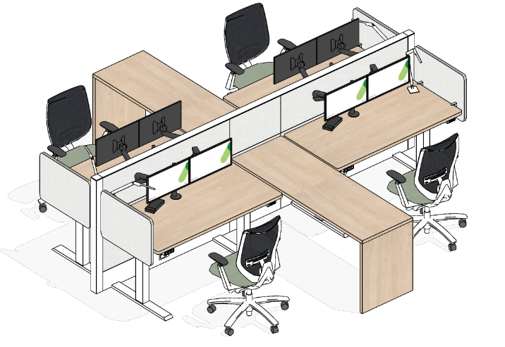
PRIMARY INDIVIDUAL OPEN
WORKSTATION (continued)
INTERIOR ARCHITECTURE:
Consider implementing architectural elements such as wall-mounted panels or room separators to delineate space and manage sightlines. These features can also serve as sound absorbers, aiding in the establishment of distinct acoustic environments.
ACCESSIBILITY:
Offer a diverse range of workstation types to provide user choice.
Ensure that some workstations are accessible to wheeled mobility device users and include a turning diameter. Turning diameters can often be shared. i.e. in a bull pen workstation grouping of 4.
Include workstations that maximize visual and acoustic privacy.
When designing L-shaped workstations, consider specifying a style with a single electric height-adjustable mechanism and a 3-legged base. This style offers several benefits such as: clearance under desk, no finger pinch space and full work surface usability.
Include more than one type of ergonomic task chair on the floor to offer choice to users.
Ensure that monitor arm adjustments require minimal effort and dexterity.
Refer to pages 5 & 6 for general accessibility information that may apply.
ALTERNATE CONFIGURATION EXAMPLES:

Slide 11
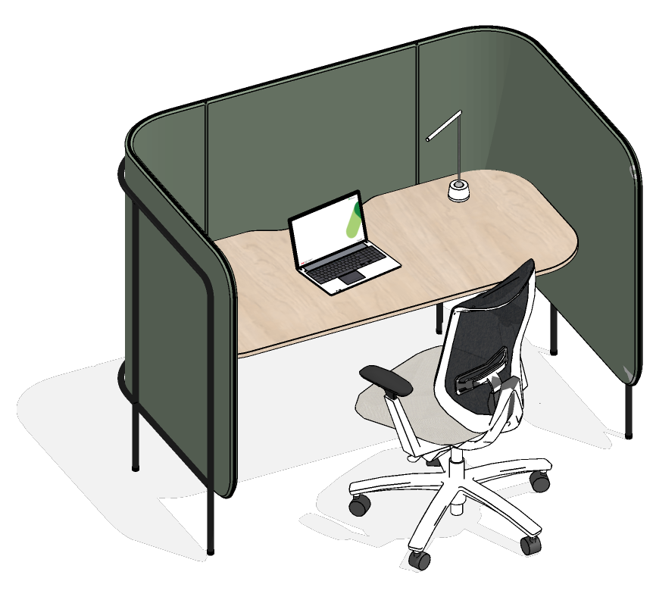
PRIMARY INDIVIDUAL OPEN
WORK POD
DESIGN:
Semi-enclosed furniture solution with work surface and privacy panels;
Include adjustable ergonomic task chair;
Optional task light;
Optional adjacent open storage or hooks can be included for bags or purses.
Provide power module at work surface
OCCUPANTS: 1
VISUAL PRIVACY: Low - Medium
ACOUSTIC PRIVACY: Low
AVERAGE SIZE: 2.5m²
TECHNOLOGY:
Bring-Your-Own-Device workpoint
For additional workstation technology requirements, please refer to the GCworkplace Workpoint IT Requirement.
ELECTRICAL:
Furniture Requirements:
Allow for one (1) circuit per five (5) Work Pods or other workspaces with similar Electrical Profile;
Equip work surface with one (1) USB double outlet for connectivity;
Optional: Provide one (1) additional duplex receptacle per Work Pod
MECHANICAL:
Refer to General Specifications and Open Office Areas on pages 3 & 4.
EXAMPLE:

Slide 12
PRIMARY INDIVIDUAL OPEN
WORK POD (continued)
INTERIOR ARCHITECTURE:
Consider implementing architectural elements such as wall-mounted panels or room separators to delineate space and manage sightlines. These features can also serve as sound absorbers, aiding in the establishment of distinct acoustic environments.
ACCESSIBILITY:
Offer a choice of work pod types to provide user choice. i.e. Ensure that some are accessible to wheeled mobility device users and include a turning diameter; others may maximize visual and acoustic privacy.
Refer to pages 5 & 6 for general accessibility information that may apply.
ALTERNATE CONFIGURATION EXAMPLES :

Slide 13
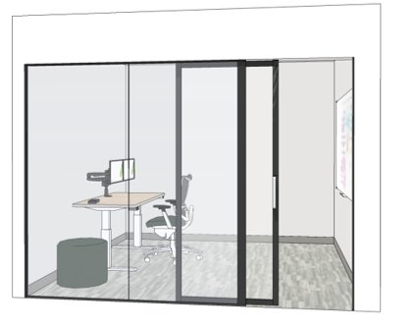
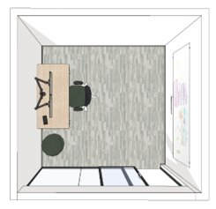
PRIMARY INDIVIDUAL ENCLOSED
FOCUS ROOM
DESIGN:
Enclosed room with demountable and/or drywall partitions;
Any surface with monitor(s) to be at least 762mm (30”) deep to allow for use of monitor arm(s);
Always confirm compatibility between monitors, monitor arms and worksurface size;
Consider sliding door to optimize space;
Glazing on at least one wall to allow light penetration (privacy film to be applied in accordance with applicable codes and standards) only if high acoustical privacy is not required;
Prioritize a work surface that can be adjusted in height and allows for both sitting and standing positions;
Include a task chair that can be adjusted ergonomically for comfort and support;
Provide secondary seating if space allows;
Include writable surface on minimum of one wall;
Provide power modules at work surface.
OCCUPANTS: 1-2
VISUAL PRIVACY: Medium-High
ACOUSTIC PRIVACY: Medium (Target: STC 45)
AVERAGE SIZE: 7.5m²
TECHNOLOGY:
Bring-Your-Own-Device workpoint;
For additional workstation technology requirements, please refer to the GCworkplace Workpoint IT Requirement.
ELECTRICAL:
Furniture Requirements:
Provide power module(s) to be mounted at the front side of the work surface for accessibility with simplex outlets and a minimum of one (1) double USB outlet for connectivity;
Provide one (1) power module to be undermounted at back of work surface. Power module comes with 5 simplex outlets.
Room Requirements:
Allow for one (1) circuit per four (4) Focus Rooms;
Equip room walls with a maximum of two (2) standard electrical duplex;
Consider removal of base building lighting and replace with dimmable accent lighting with controls for user adjustability or rewiring existing light fixture.
Provide Image/voice/data outlet per Focus Room (if required by client- to be assessed on a project by project basis);
MECHANICAL & INTERIOR ARCHITECTURE:
Refer to General Specifications and Open Office Areas on pages 3 & 4.
ACCESSIBILITY:
Refer to pages 5 & 6 for general accessibility information that may apply.
EXAMPLE:

Slide 14
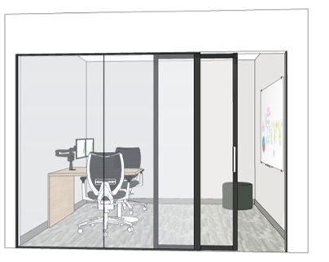
PRIMARY INDIVIDUAL ENCLOSED
FOCUS ROOM (continued)
ALTERNATE LAYOUT EXAMPLES:

Slide 15
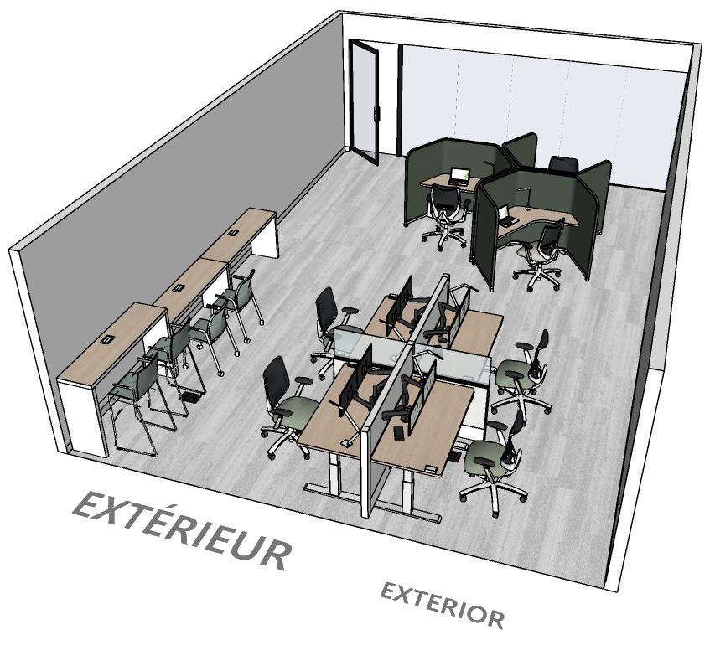
PRIMARY INDIVIDUAL ENCLOSED
STUDY
DESIGN:
Enclosed room with demountable and/or drywall partitions;
Consider sliding door to optimize space;
Glazing on at least one wall to allow light penetration (privacy film to be applied in accordance with applicable codes and standards);
Include a variety of different individual open workpoints (Workstation, Touchdown and Focus Pods);
Always confirm compatibility between monitors, monitor arms, weight and worksurface size.
OCCUPANTS: 4-6 min. recommended varies depending on size and task
VISUAL PRIVACY: Low-Medium
ACOUSTIC PRIVACY: Medium (Target: STC 45)
AVERAGE SIZE: 5m² per occupant
TECHNOLOGY:
Bring-Your-Own-Device workpoint
For additional workstation technology requirements, please refer to the GCworkplace Workpoint IT Requirement.
ELECTRICAL:
Furniture Requirements:
For soft seating furniture solutions, provide convenience outlets in nearby floor or wall as required;
When populating studies with other workpoint types, ensure to provide the required electrical infrastructure as indicated for those specific workpoints.
Room Requirements:
Allow for one (1) circuit per maximum six (6) workpoints; (if panel-based solutions)
Equip room walls with a maximum of three (3) standard electrical duplexes.
MECHANICAL & INTERIOR ARCHITECTURE:
Refer to General Specifications and Open Office Areas on pages 3 & 4.
EXAMPLE:

Slide 16
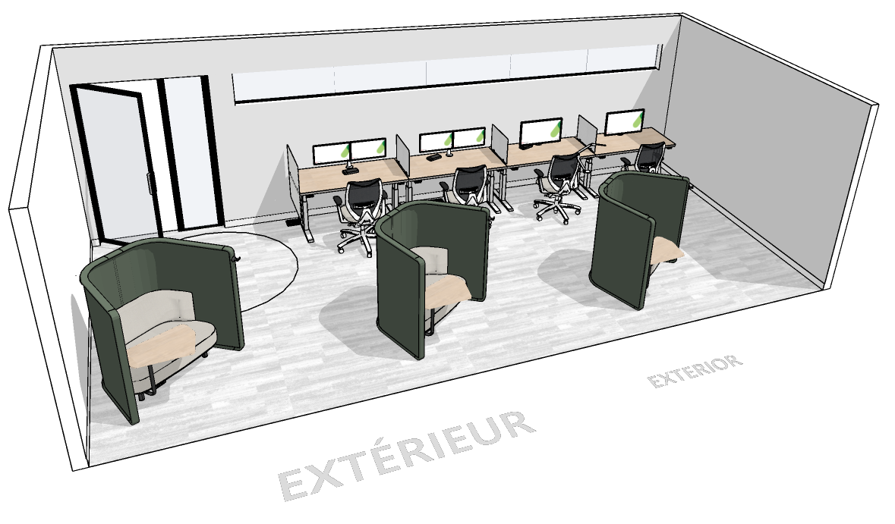
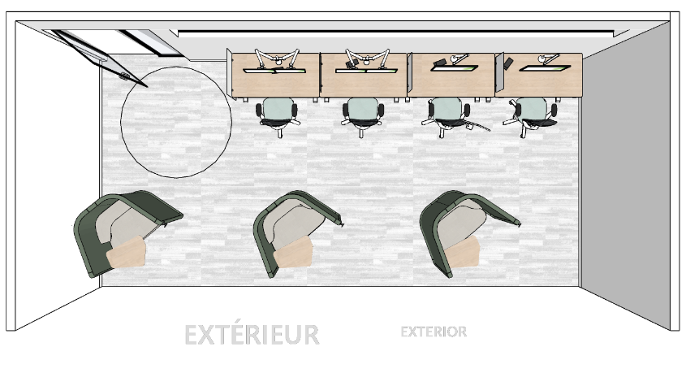
PRIMARY INDIVIDUAL ENCLOSED
STUDY (continued)
ACCESSIBILITY:
Ensure turning diameters, and circulation space allows wheeled mobility device users to access a variety of accessible workpoints within the study.
Refer to pages 5 & 6 for general accessibility information that may apply.
ALTERNATE LAYOUT EXAMPLE:

Slide 17
SECONDARY INDIVIDUAL
FOCUS POD
DESIGN:
Semi-enclosed soft seating furniture solution surrounded by privacy screens;
Optional dimmable task light and ottoman;
Optional adjacent open storage or hooks can be included for bags or purses.
OCCUPANTS: 1
VISUAL PRIVACY: Low-Medium
ACOUSTIC PRIVACY: Low (STC N/A)
AVERAGE SIZE: 4.0m²
TECHNOLOGY:
Bring-Your-Own-Device workpoint, no AV or IT technology provided as workpoint is intended for short term use.
ELECTRICAL:
Furniture Requirements:
If Focus Pod(s) are to be powered:
Allow for one (1) circuit per five (5) Focus Pods;
Equip work surface with one (1) USB double outlet and minimum of one (1) duplex receptacle per Focus Pod (where the pod doesn’t have an integrated design for outlets, the USB connection can be located at the base);
MECHANICAL:
Refer to General Specifications and Open Office Areas on pages 3 & 4.
EXAMPLE:

Slide 18
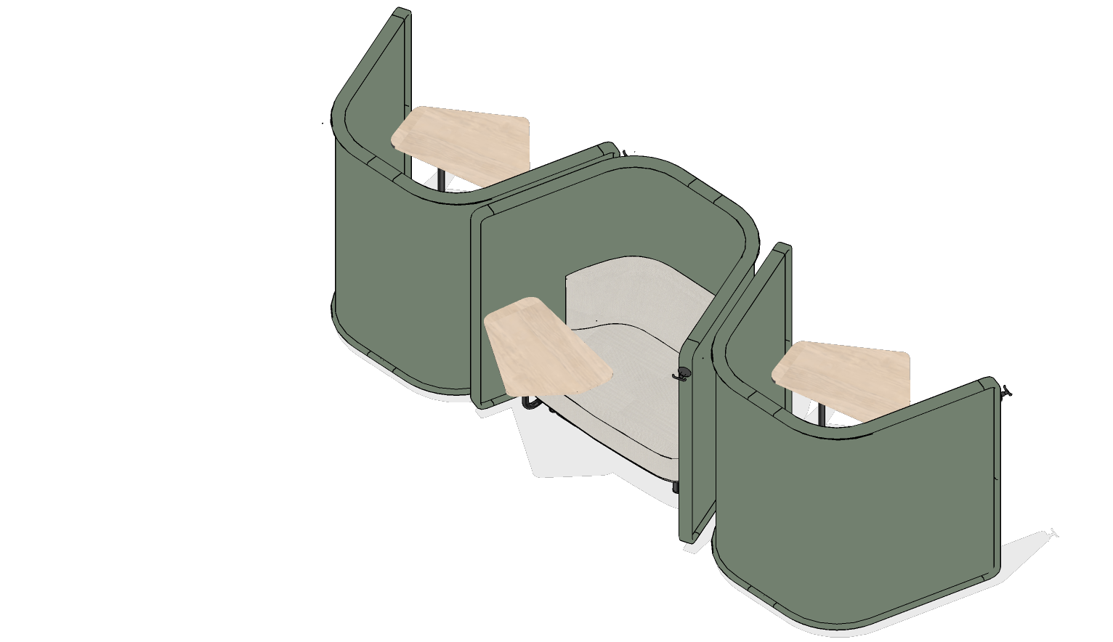
SECONDARY INDIVIDUAL
FOCUS POD (continued)
INTERIOR ARCHITECTURE:
Consider implementing architectural elements such as wall-mounted panels or room separators to delineate space and manage sightlines. These features can also serve as sound absorbers, aiding in the establishment of distinct acoustic environments.
ACCESSIBILITY:
Allocate space adjacent to some focus pods for turning diameter and placement of wheeled mobility device (must not impede on circulation space).
If many are included, try to include some variety in styles for choice if possible.
Provide left-handed and right-handed options.
Refer to pages 5 & 6 for general accessibility information that may apply.
ALTERNATE CONFIGURATION EXAMPLES:

Slide 19
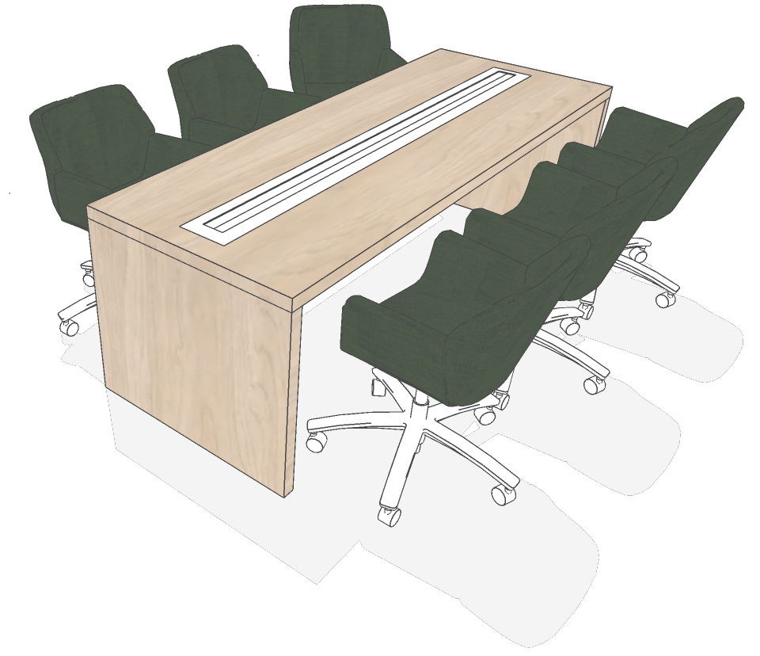
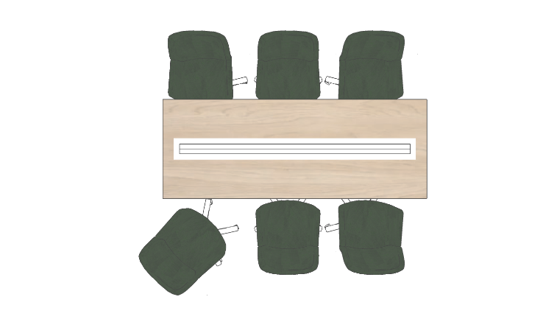
SECONDARY INDIVIDUAL
TOUCHDOWN
DESIGN:
Offer a variety of seating options;
Provide power modules at work surface;
Optional adjacent open storage or hooks can be included for bags or purses.
OCCUPANTS: 2-8
VISUAL PRIVACY: Low
ACOUSTIC PRIVACY: Low (STC N/A)
AVERAGE SIZE: 1.5m² per occupant
TECHNOLOGY:
Bring-Your-Own-Device workpoint.
ELECTRICAL:
Furniture Requirements:
Allow for 1 dedicated circuit per maximum 8 seats;
Touchdowns at collaborative tables can have surface integrated power module(s);
Equip work surface with one (1) duplex receptacle or one (1) triplex receptacle within reach of each seat;
Equip work surface with 1 double USB outlet within reach of 2 seats.
MECHANICAL:
Refer to General Specifications and Open Office Areas on pages 3 & 4.
EXAMPLES:

Slide 20
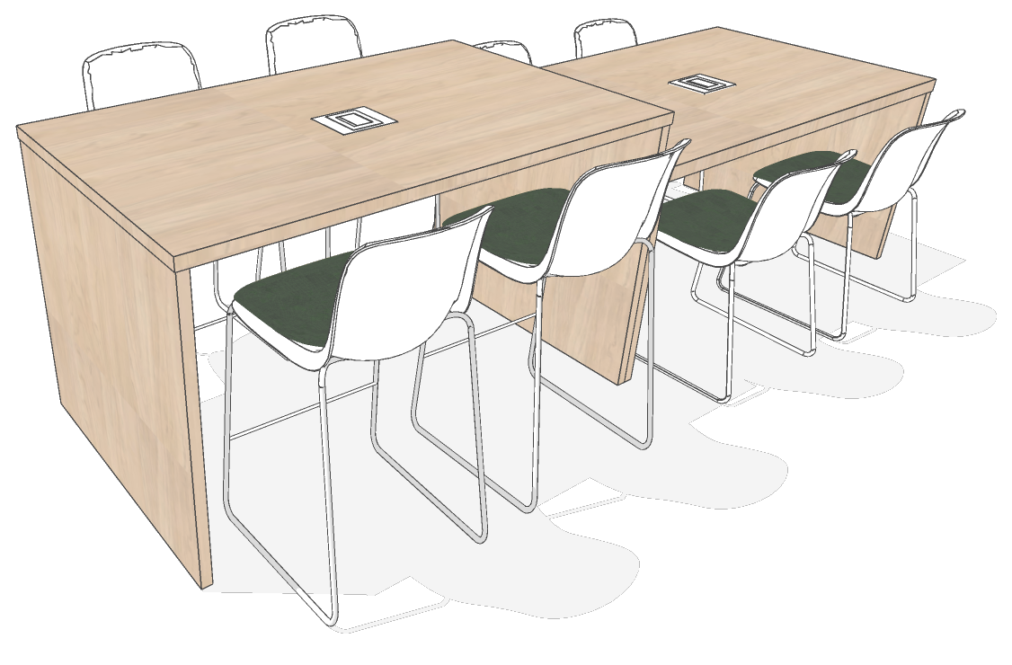
SECONDARY INDIVIDUAL
TOUCHDOWN (continued)
INTERIOR ARCHITECTURE:
Consider implementing architectural elements such as wall-mounted panels or room separators to delineate space and manage sightlines. These features can also serve as sound absorbers, aiding in the establishment of distinct acoustic environments.
ACCESSIBILITY:
Ensure some accessible options are provided. Consider: surface height, knee & toe clearance, power within reach, turning diameter at workpoint.
Note: Refer to pages 5 & 6 for general accessibility information that may apply.
ALTERNATE CONFIGURATION EXAMPLES:

Slide 21
SECONDARY INDIVIDUAL
PHONEBOOTHS AND PHONE ROOMS
DESIGN:
Can be enclosed room with sliding door, or prefabricated solution;
For enclosed rooms, glazed partition on at least one wall to allow light penetration (privacy film to be applied in accordance with applicable codes and standards);
Include writable surface on at least one wall;
Optional dimmable task lighting and ottoman.
OCCUPANTS: 1
VISUAL PRIVACY: Medium
ACOUSTIC PRIVACY: Medium-High (Target: STC 35)
AVERAGE SIZE: 6.5m² (Phone Room) or 2.5m² (Phonebooth)
TECHNOLOGY:
Bring-Your-Own-Device workpoint, no AV or IT technology provided as workpoint is intended for short term use.
ELECTRICAL:
Prefabricated Solution (ie: phonebooth):
Allow for one (1) circuit per five (5) Phone Booths;
Provide power module(s) to be mounted at the front side of the work surface for accessibility with simplex outlets and a minimum of 1 double USB outlet for connectivity;
Phone Room Option:
Allow for one (1) circuit per five (5) Phone Rooms;
Equip room walls with a maximum of two (2) standard electrical duplexes;
Provide power module(s) to be mounted at the front side of the work surface for accessibility with simplex outlets and a minimum of 1 double USB outlet for connectivity;
Provide one (1) power module to be undermounted at back of work surface. Power module comes with five (5) simplex outlets.
MECHANICAL:
Refer to General Specifications and Open Office Areas on pages 3 & 4;
For a prefabricated solution, refer to manufacture’s specifications.
INTERIOR ARCHITECTURE:
Refer to General Specifications and Open Office Areas on pages 3 & 4.
ACCESSIBILITY:
Refer to pages 5 & 6 for general accessibility information that may apply.
EXAMPLE:

Slide 22
SECONDARY INDIVIDUAL
PHONEBOOTHS AND PHONE ROOMS (continued)
ALTERNATE LAYOUT EXAMPLES:

Slide 23
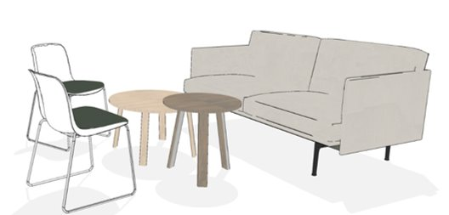
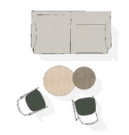
COLLABORATIVE OPEN
CHAT POINT
DESIGN:
Small, casual, standing or seated workpoint with a small surface.
OCCUPANTS: 2-4
VISUAL PRIVACY: Low
ACOUSTIC PRIVACY: Low (STC N/A)
AVERAGE SIZE: 4m²
TECHNOLOGY:
Bring-Your-Own-Device workpoint, no AV or IT technology provided as workpoint is intended for short term use.
ELECTRICAL:
Optional Requirements:
Power at tabletop if specified and conditions allow.
A dimmable floor lamp may be considered where layout and access to electrical allows. Cords to be covered accordingly to avoid tripping hazard.
MECHANICAL:
Refer to General Specifications and Open Office Areas on pages 3 & 4.
INTERIOR ARCHITECTURE:
Consider interior architectural solutions for defining space and controlling sightlines and for sound absorption (i.e. wall hung, suspended panels or other room dividers) between chat points or to separate a group of chat points from another zone or workpoint(s);
ACCESSIBILITY:
Seating on casters when appropriate.
Refer to pages 5 & 6 for general accessibility information that may apply.
EXAMPLE:

Slide 24
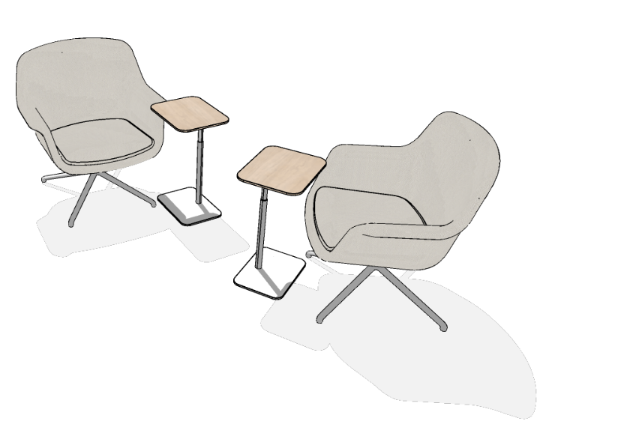
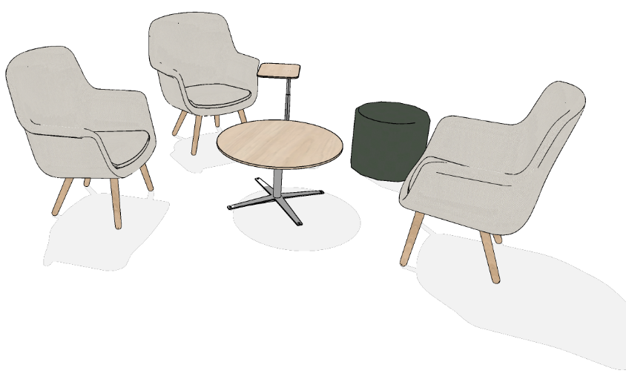
COLLABORATIVE OPEN
CHAT POINT
ALTERNATE LAYOUT EXAMPLES:

Slide 25
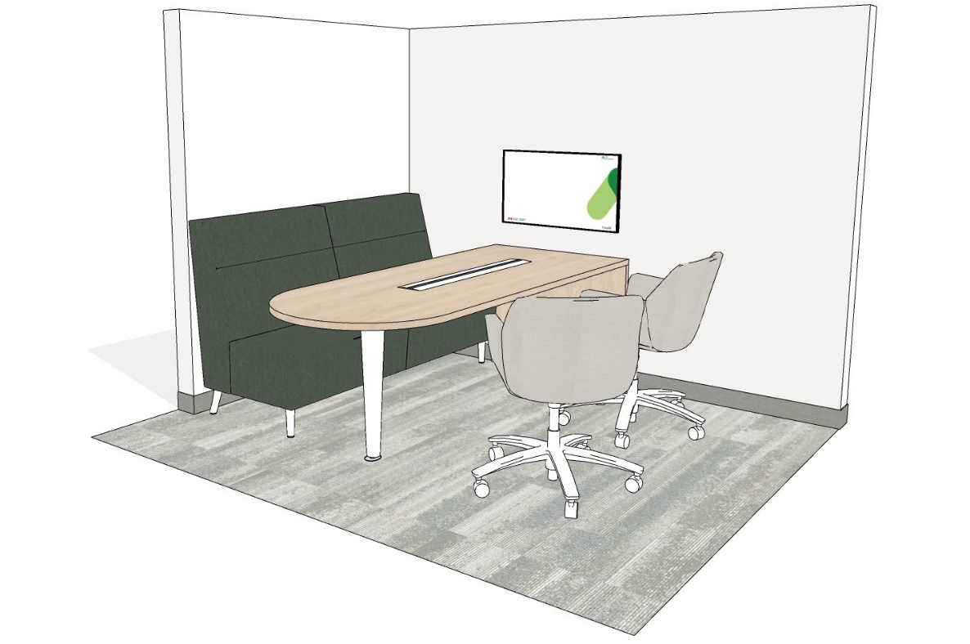
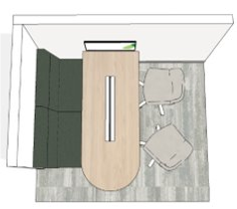
COLLABORATIVE OPEN
HUDDLE
DESIGN:
Semi-enclosed booth or furniture solutions with visual privacy;
Include a shared worksurface and soft seating.
OCCUPANTS: 4
VISUAL PRIVACY: Low-Medium
ACOUSTIC PRIVACY: Low (STC N/A)
AVERAGE SIZE: 7.0m²
TECHNOLOGY:
Bring-Your-Own-Device workpoint;
For additional workstation technology requirements, please refer to the GCworkplace Workpoint IT Requirement.
ELECTRICAL:
Furniture Requirements:
Provide power & USB charging at work surface if work surface permits.
Huddle Requirements:
Allow for one (1) circuit per two (2) huddles if monitor is required OR one (1) circuit per four (4) huddles without monitor;
Where applicable equip:
One (1) quadruplex receptacle OR two(2) standard duplex receptacle outlets dedicated to each display;
One (1) standard electrical duplex receptacles and one (1) double USB outlet in the wall at work surface level height;
Direct/indirect suspended lamp(s) to suit meeting table function on a separate dimmable switch/light control.
MECHANICAL:
Refer to General Specifications and Open Office Areas on pages 3 & 4.
EXAMPLE:

Slide 26
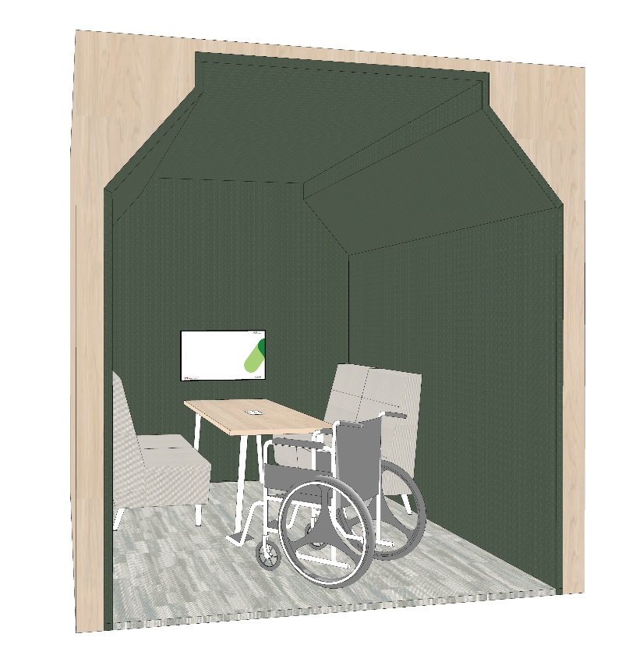
COLLABORATIVE OPEN
HUDDLE (continued)
INTERIOR ARCHITECTURE:
Consider using interior architectural solutions like wall hung panels or room dividers for space definition and sightline control. These solutions also absorb sound, helping to create different acoustic zones (quiet for focused work, interactive for collaboration). They provide visual separation, reducing distractions from high traffic areas.
ACCESSIBILITY:
Refer to pages 5 & 6 for general accessibility information that may apply.
ADDITIONAL LAYOUT EXAMPLE:

Slide 27
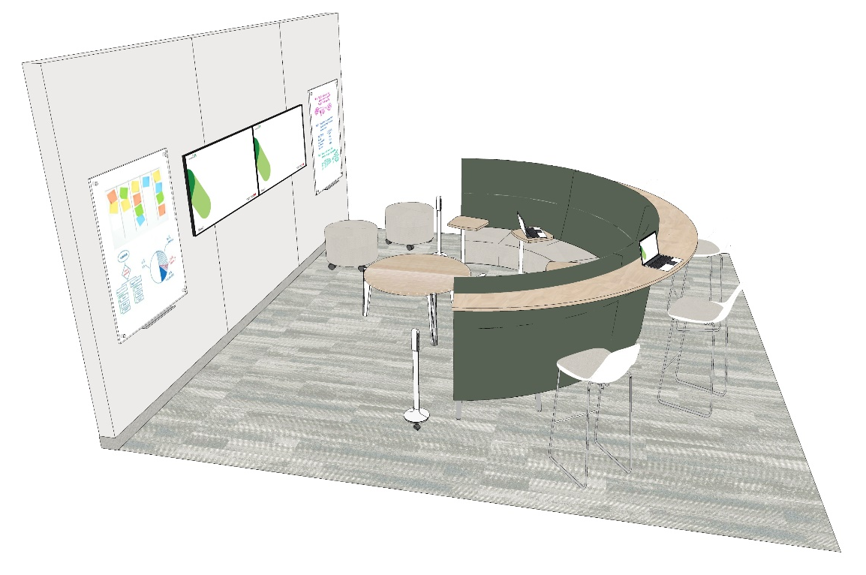
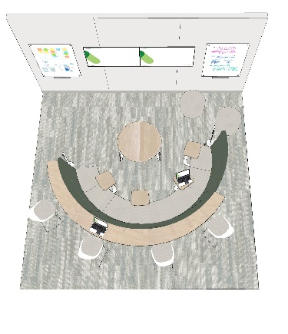
COLLABORATIVE OPEN
TEAMING AREA
DESIGN:
Various collaborative work tools incorporated in the area, such as display monitor(s), interactive touchscreen, whiteboards, etc.;
Consider a section offering arm rests and/or tablet arms or small moveable and adjustable tables;
May include various work surfaces that are fixed or moveable;
Provide credenza for storage of IT and/or audio-visual equipment as required. Always verify with furniture and IT resources to determine requirements for each project.
OCCUPANTS: 6-10
VISUAL PRIVACY: Low-Medium
ACOUSTIC PRIVACY: Low (STC N/A)
AVERAGE SIZE: 15m²
TECHNOLOGY:
For additional technology requirements, please refer to the GCworkplace Workpoint IT Requirement.
ELECTRICAL:
Furniture Requirements:
Power and USB receptacle can be incorporated in furniture solution (if applicable).
Where applicable:
Allow for two (2) circuits per Teaming Area;
Provide one (1) quadruplex receptacle OR two(2) standard duplex receptacle outlets with dedicated circuit to each display;
Provide three (3) electrical duplex receptacles with USB charging per teaming area if architecture permits.
MECHANICAL:
Refer to General Specifications and Open Office Areas on pages 3 & 4.
EXAMPLE:

Slide 28
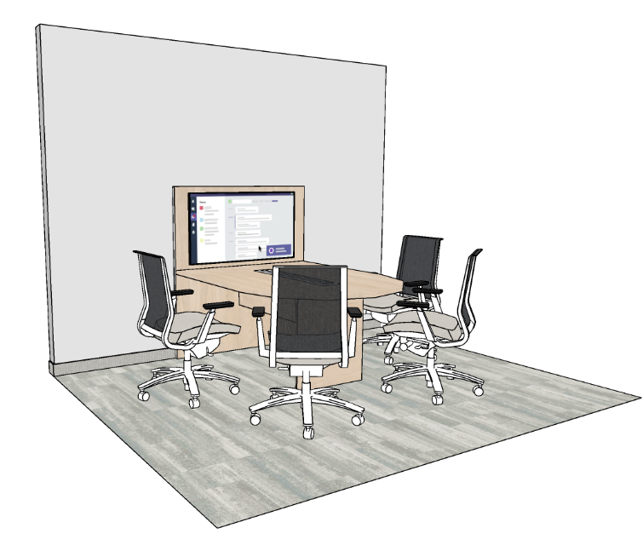
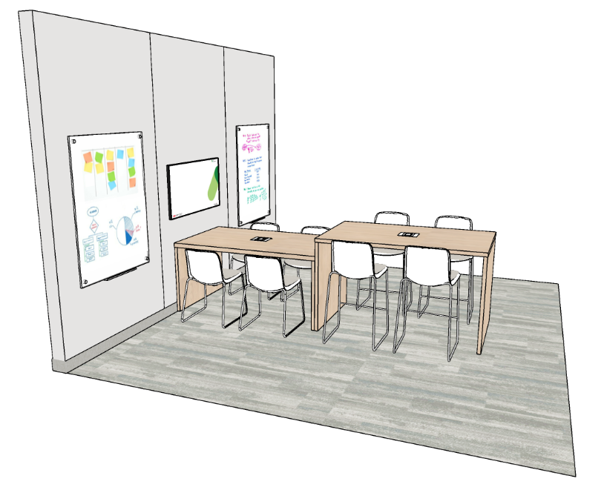
COLLABORATIVE OPEN
TEAMING AREA (continued)
INTERIOR ARCHITECTURE:
Consider using interior architectural solutions like wall hung panels or room dividers for space definition and sightline control. These solutions also absorb sound, helping to create different acoustic zones (quiet for focused work, interactive for collaboration). They provide visual separation, reducing distractions from high traffic areas.
ACCESIBILITY:
Provide mobile, height adjustable laptop tables that require minimal effort and dexterity to adjust;
When including a semi-circle seating arrangement, angling it slightly may help create a place for a wheeled mobility device user to participate.;
Refer to pages 5 & 6 for general accessibility information that may apply.
ALTERNATE LAYOUT EXAMPLES:

Slide 29
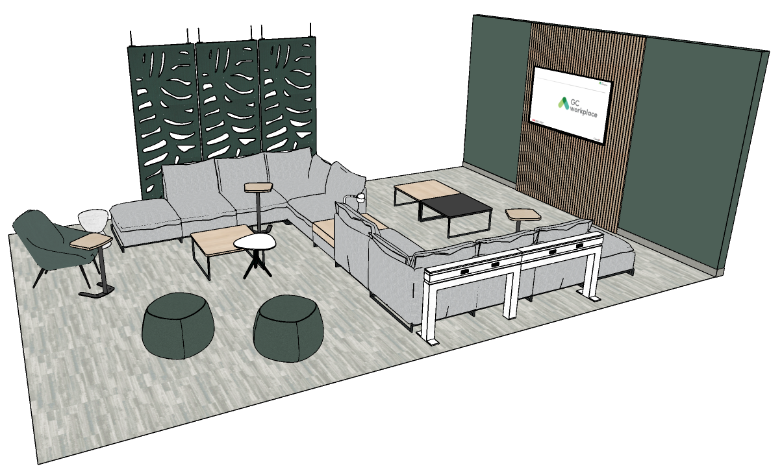
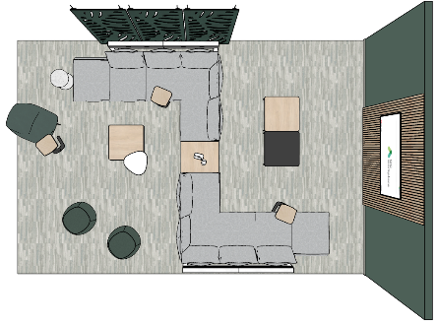
COLLABORATIVE OPEN
LOUNGE
DESIGN:
Provide a variety of dining furniture such as soft seating, small tables, and chairs with and without armrests;
Lounges can be found anywhere in both the Interactive and Transitional zone(s) however there must be one at least 10m2 with each kitchenette.
Furniture should be easy to clean.
OCCUPANTS: 10+
VISUAL PRIVACY: Low
ACOUSTIC PRIVACY: Low (STC N/A)
AVERAGE SIZE: 10m²
TECHNOLOGY:
For additional technology requirements, please refer to the GCworkplace Workpoint IT Requirement.
ELECTRICAL:
Furniture Requirements:
Power and USB receptacle to be incorporated in furniture solution (if applicable).
Room Requirements:
Allow for one (1) dedicated circuit per 15m2 of Lounge space;
Provide one (1) quadruplex receptacle OR two(2) standard duplex receptacle outlets dedicated to each display;
Provide three (3) electrical duplex receptacles with USB charging on walls if architecture permits.
MECHANICAL:
Refer to General Specifications and Open Office Areas on pages 3 & 4.
INTERIOR ARCHITECTURE:
Consider interior architectural solutions for defining space and controlling sightlines and for sound absorption (i.e. wall hung, suspended panels or other room dividers) to help separate lounges from other zones or workpoints.
EXAMPLE:

Slide 30
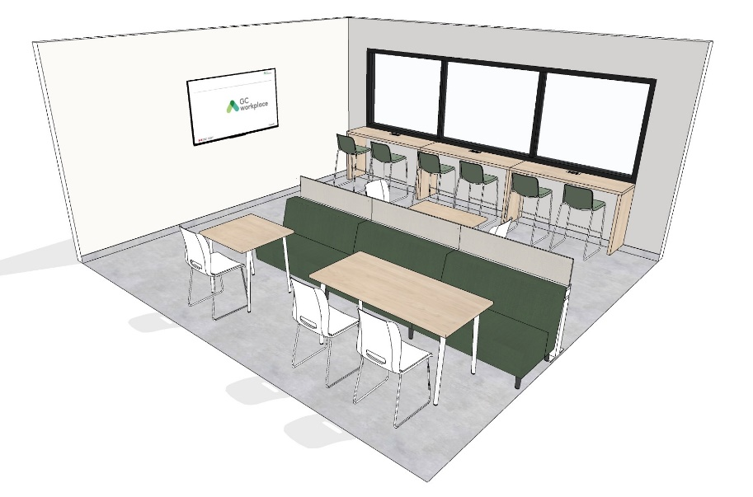
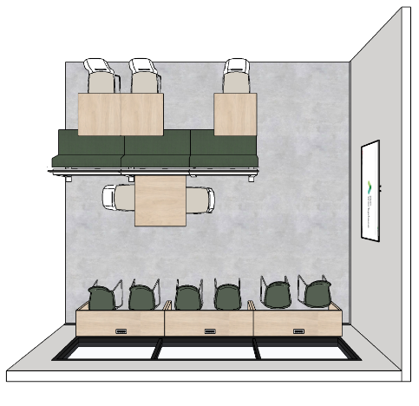
COLLABORATIVE OPEN
LOUNGE (continued)
ACCESSIBILITY:
Ensure turning diameters, and circulation space allows wheeled mobility device users to access a variety of accessible choices within the lounge;
Provide seating with and without arm rests.;
Tables in lounges adjacent to kitchenettes must be carefully considered to ensure accessible options are provided:
Avoid sharp corners and edges
Ensure base style allows for the necessary knee and toe clearance
Select finishes that do not not have strong patters and are glare free.
Refer to pages 5 & 6 for general accessibility information that may apply.
ALTERNATE LAYOUT EXAMPLE:

Slide 31
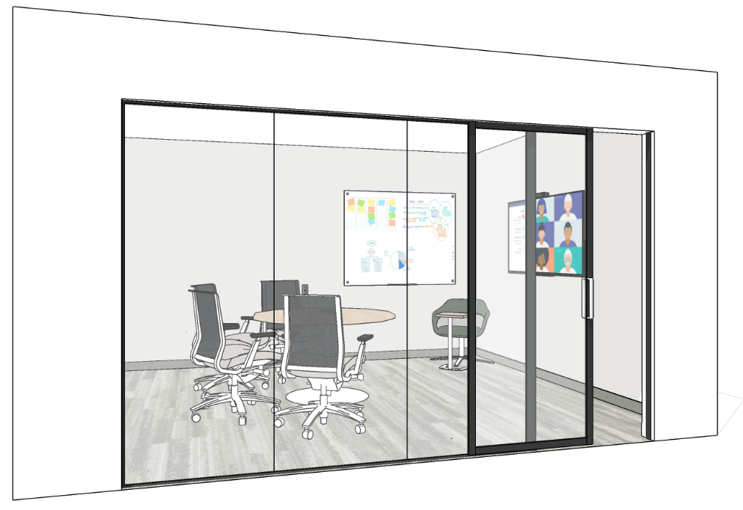
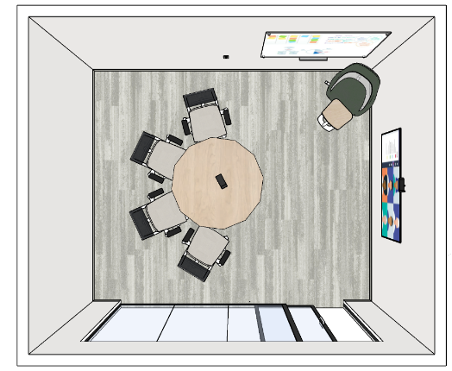
COLLABORATIVE ENCLOSED
WORK ROOM
DESIGN:
Work surface, conference chairs and a large screen display;
Consider sliding door to optimize space;
Glazed partition on at least one wall to allow light penetration (privacy film to be applied in accordance with applicable codes and standards);
Include writable surface on at least one wall;
Provide appropriate dimmable task and/or accent lighting.
OCCUPANTS: 4-6
VISUAL PRIVACY: Medium-High
ACOUSTIC PRIVACY: Medium (Target: STC 35)
AVERAGE SIZE: 16m²
TECHNOLOGY:
For additional technology requirements, please refer to the GCworkplace Workpoint IT Requirement.
ELECTRICAL:
Furniture Requirements:
Power and USB receptacles to be incorporated in furniture solution (if applicable).
Room Requirements:
Allow for one (1) circuit per Work Room;
Provide one (1) quadruplex receptacle OR two(2) standard duplex receptacle outlets with dedicated circuit to each display;
Equip room walls with a maximum of two (2) standard electrical duplex receptacles with USB charging;
Provide one (1) image/voice/data outlet per workstation (if required by client).
EXAMPLE:
INTERIOR DESIGN NATIONAL CENTRE OF EXPERTISE | PSPC WORKPLACE SOLUTIONS

Slide 32
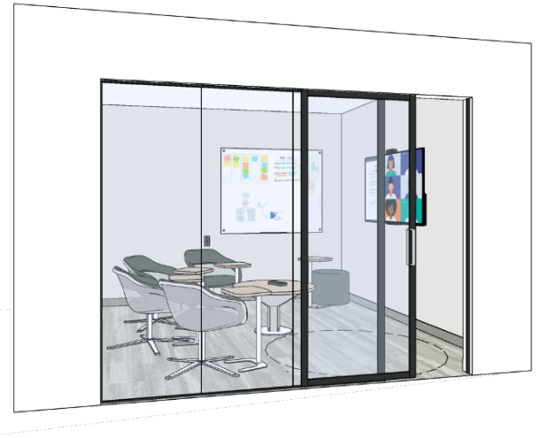
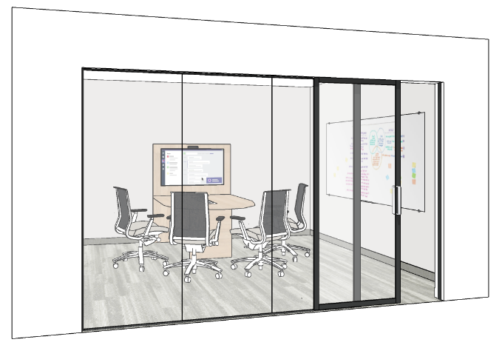
COLLABORATIVE ENCLOSED
WORK ROOM (continued)
MECHANICAL:
Refer to General Specifications and Open Office Areas on pages 3 & 4.
Note: Mechanical must be designed specifically for enclosed meeting rooms.
INTERIOR ARCHITECTURE:
Refer to General Specifications and Open Office Areas on pages 3 & 4.
ACCESSIBILITY:
When including a sliding door ensure the following:
door has a contrasting surround with handle
force to operate complies with CSA B651-23
Height adjustable tables are helpful in this environment as well. i.e. individual tables, multi-media tables, etc.
Refer to pages 5 & 6 for general accessibility information that may apply.
ALTERNATE LAYOUT EXAMPLES:

Slide 33
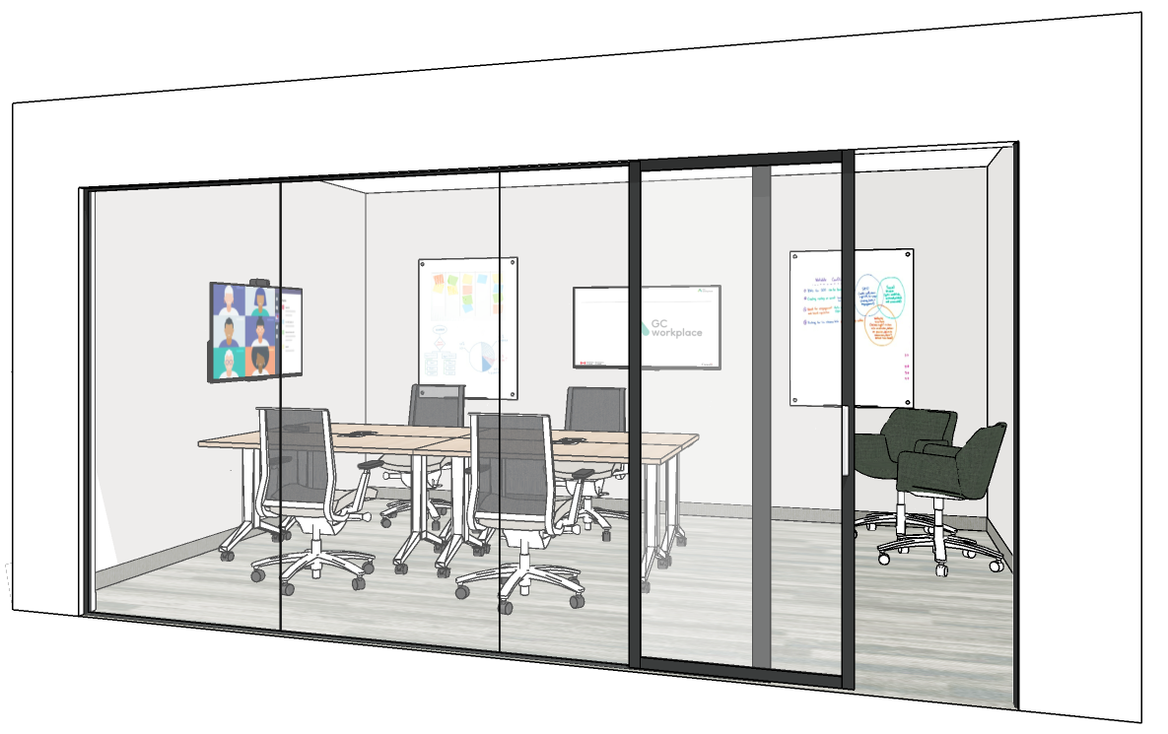
COLLABORATIVE ENCLOSED
PROJECT ROOM
DESIGN:
Enclosed room with demountable and/or drywall partitions;
Consider sliding door to optimize space;
Glazed partition on at least one wall to allow light penetration (privacy film to be applied in accordance with applicable codes and standards);
Provide writable walls or mobile whiteboards;
Provide appropriate dimmable task and/or accent lighting.
OCCUPANTS: 6-10
VISUAL PRIVACY: Medium-High
ACOUSTIC PRIVACY: Medium (Target: STC 35)
AVERAGE SIZE: 20m²
TECHNOLOGY:
For additional technology requirements, please refer to the GCworkplace Workpoint IT Requirement.
ELECTRICAL:
Furniture Requirements:
Power and USB receptacles to be incorporated in furniture solution (if applicable).
Room Requirements:
Allow for one (1) circuit per Project Room;
Provide one (1) quadruplex receptacle OR two(2) standard duplex receptacle outlets with dedicated circuit to display;
Equip room walls with a maximum of three (3) standard electrical duplex receptacles with USB charging;
Provide one (1) image/voice/data outlet per workstation (if required by client).
EXAMPLE:

Slide 34
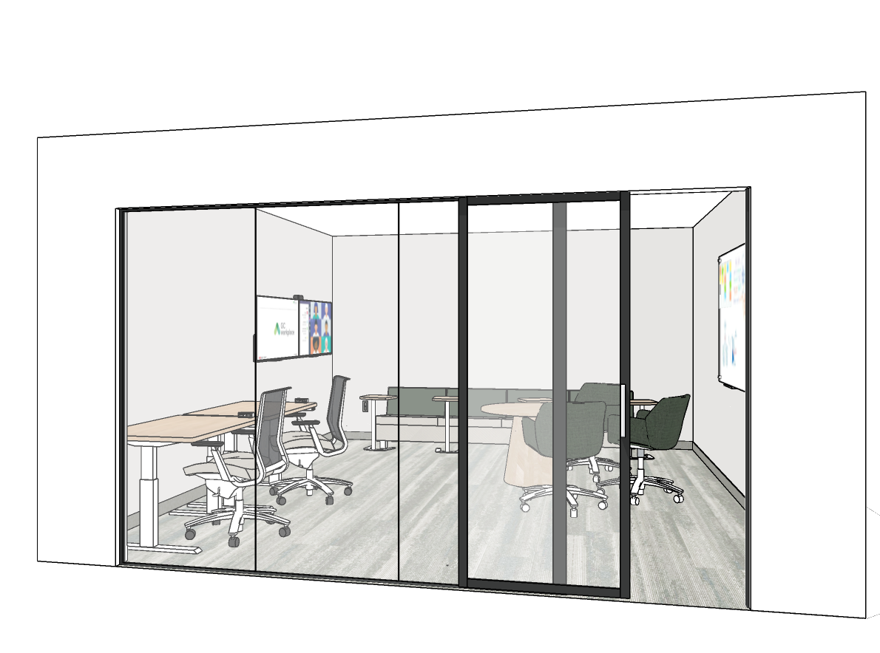
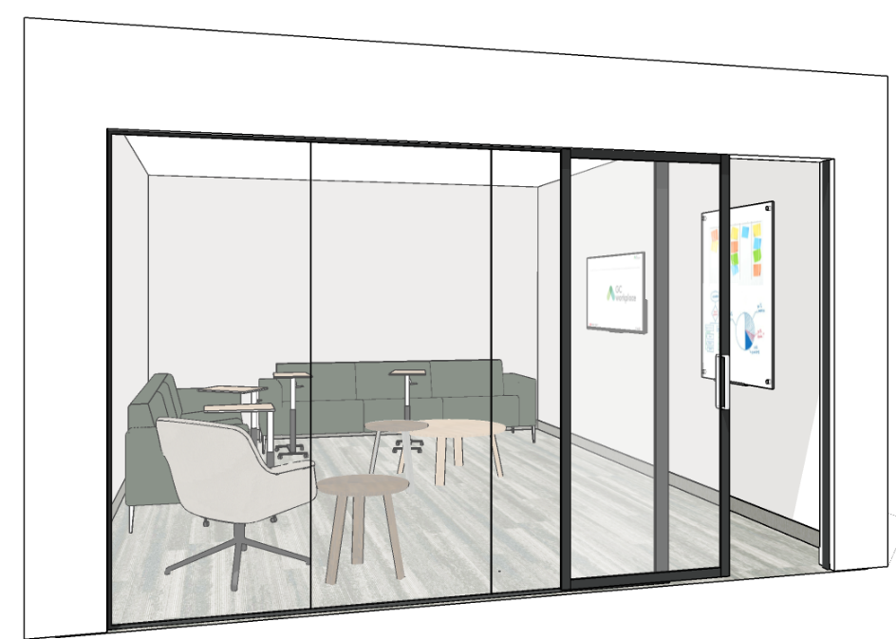
COLLABORATIVE ENCLOSED
PROJECT ROOM (continued)
MECHANICAL:
Refer to General Specifications and Open Office Areas on pages 3 & 4.
Note: Mechanical must be designed specifically for enclosed meeting rooms.
INTERIOR ARCHITECTURE:
Refer to General Specifications and Open Office Areas on pages 3 & 4.
ACCESSIBILITY:
Seating and mobile furniture on casters when appropriate;
Height adjustable tables are helpful in this environment as well. i.e. individual tables, multi-media tables, etc.
Refer to pages 5 & 6 for general accessibility information that may apply.
ALTERNATE LAYOUT EXAMPLES:

Slide 35
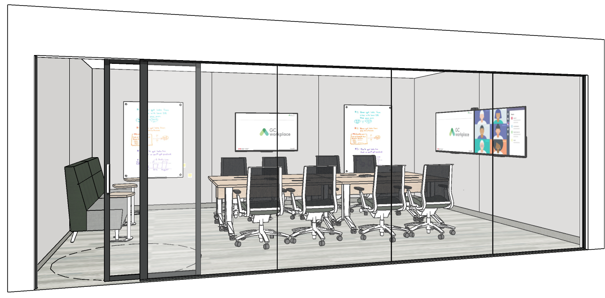
COLLABORATIVE ENCLOSED
MEDIUM MEETING ROOM
DESIGN:
Enclosed room with demountable and/or drywall partitions;
Consider sliding door to optimize space;
Height adjustable conference-type chairs on casters;
Provide mobile tables reconfigurable into various layouts (training, presentations, etc.);
Glazed partition on at least one wall to allow light penetration (privacy film to be applied in accordance with applicable codes and standards);
Provide credenza for storage of IT and/or audio-visual equipment as required. Always verify with furniture and IT resources to determine requirements for each project;
Videoconferencing layout and furniture solution to store mobile technology.
OCCUPANTS: 10-12
VISUAL PRIVACY: Medium-High
ACOUSTIC PRIVACY: Medium-High (Target: STC 45)
AVERAGE SIZE: 32m²
TECHNOLOGY:
For additional technology requirements, please refer to the GCworkplace Workpoint IT Requirement.
ELECTRICAL:
Furniture Requirements:
Power, data and USB receptacles to be incorporated in furniture solution (if applicable);
Room Requirements:
Allow for three (3) circuits per Medium Meeting Room;
Provide one (1) quadruplex receptacle OR two(2) standard duplex receptacle outlets with dedicated circuit to each display;
Equip room walls with a maximum of four (4) standard electrical duplex receptacles with USB charging;
Provide a maximum of two (2) standard floor mounted electrical duplex receptacle;
Provide Image/voice/data outlets if required by client (to be assessed on project-by-project basis).
EXAMPLE:

Slide 36
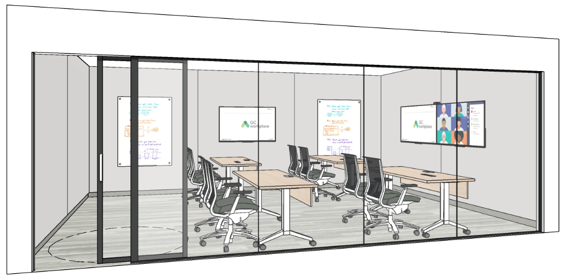
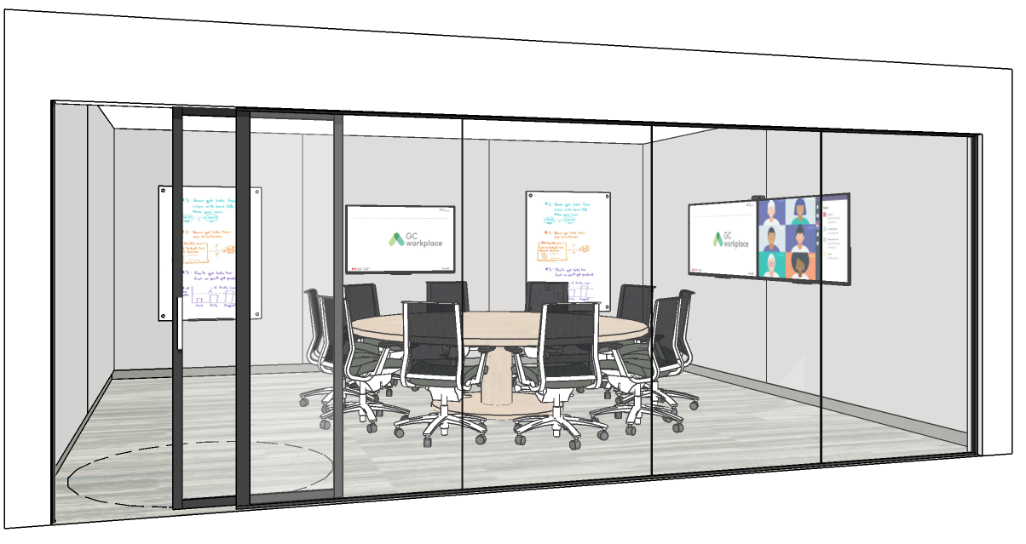
COLLABORATIVE ENCLOSED
MEDIUM MEETING ROOM (continued)
ELECTRICAL cont.:
Direct/indirect suspended luminaire(s) to suit meeting table function on a separate switch/light control and motion sensor;
Dimmable perimeter/accent lighting to support presentation function on a separate switch/light control and motion sensor.
MECHANICAL:
Refer to General Specifications and Open Office Areas on pages 3 & 4;
Note: Mechanical must be designed specifically for enclosed meeting rooms.
INTERIOR ARCHITECTURE:
Refer to General Specifications and Open Office Areas on pages 3 & 4.
ACCESSIBILITY:
Ensure turning diameters, and circulation space allows wheeled mobility device users to access accessible workpoints and amenities (ie. Whiteboard)
Ensure there is space for displaced chairs outside of the circulation space. Don’t crowd the room with too many chairs.
Power modules in meeting tables must be reachable from a seated position (at an accessible location at the table) and be usable with minimal effort and dexterity.
Consider how sightlines can be maximized for those that benefit from lip reading. i.e. round, oval or boat-shaped tables may be helpful, but remember they must also provide knee and toe clearance.
Refer to pages 5 & 6 for general accessibility information that may apply.
ALTERNATE LAYOUT EXAMPLES:

Slide 37
COLLABORATIVE ENCLOSED
LARGE MEETING ROOM
DESIGN:
Enclosed room with demountable and/or drywall partitions;
Include two doors at opposite ends of room, consider sliding door to optimize space;
Glazed partition on at least one wall to allow light penetration (privacy film to be applied in accordance with applicable codes and standards);
Include writable surface on at least one wall;
Height adjustable conference-type chairs on casters;
Include banquette or other secondary seating and mobile height-adjustable laptop tables along one wall for additional guest seating;
Provide credenza for storage of IT and/or audio-visual equipment as required. Always verify with furniture and IT resources to determine requirements for each project;
Videoconferencing layout and furniture solution to store mobile technology.
OCCUPANTS: 20+
VISUAL PRIVACY: Medium-High
ACOUSTIC PRIVACY: Medium-High (Target: STC 45)
AVERAGE SIZE: 60m²
TECHNOLOGY:
For additional technology requirements, please refer to the GCworkplace Workpoint IT Requirement.
ELECTRICAL:
Furniture Requirements:
Power, data and USB receptacles to be incorporated in furniture solution (if applicable).
Room Requirements:
Allow for four (4) circuits per Large Meeting Room;
Provide one (1) quadruplex receptacle OR two(2) standard duplex receptacle outlets with dedicated circuit to each display;
Equip room walls with a maximum of five (5) standard electrical duplex receptacles with USB charging;
Provide a maximum of three (3) standard floor mounted electrical duplex receptacle;
Provide Image/voice/data outlets if required by client (to be assessed on project-by-project basis).
EXAMPLE:

Slide 38
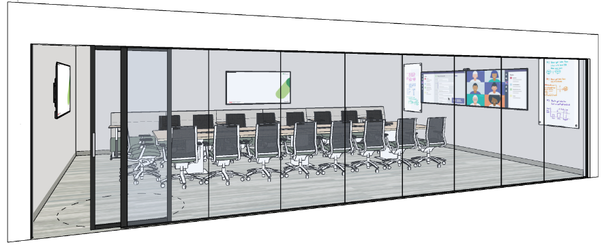
COLLABORATIVE ENCLOSED
LARGE MEETING ROOM (continued)
ELECTRICAL cont.:
Direct/indirect suspended luminaire(s) to suit meeting table function on a separate switch/light control and motion sensor (additional circuit(s) may be required);
Dimmable perimeter/accent lighting to support presentation function on a separate switch/light control and motion sensor (additional circuit(s) may be required).
MECHANICAL:
Refer to General Specifications and Open Office Areas on pages 3 & 4;
Note: Mechanical must be designed specifically for enclosed meeting rooms.
INTERIOR ARCHITECTURE:
Refer to General Specifications and Open Office Areas on pages 3 & 4.
ACCESSIBILITY:
Ensure turning diameters, and circulation space allows wheeled mobility device users to access accessible workpoints and amenities (ie. Whiteboard)
Ensure there is space for displaced chairs outside of the circulation space. Don’t crowd the room with too many chairs.
Power modules in meeting tables must be reachable from a seated position (at an accessible location at the table) and be usable with minimal effort and dexterity.
Consider how sightlines can be maximized for those that benefit from lip reading. i.e. round, oval or boat-shaped tables may be helpful, but remember they must also provide knee and toe clearance.
Consider including assistive listening system;
Consider arm rests and back support for secondary seating where space allows;
Ensure that when meeting rooms have folding partitions to allow for modification of the room size that the furniture layout is accessible in both arrangements.
Refer to pages 5 & 6 for general accessibility information that may apply.
ALTERNATE LAYOUT EXAMPLE:

Slide 39
SUPPORT SPACE
KITCHENETTE
DESIGN:
Kitchen facilities for use by employees for food storage and preparation;
Access to daylight and views when possible and/or glazed partition on at least one wall to allow light penetration;
Enclosed or semi-enclosed space with visual separation from workspaces;
Includes sink(s), space for refrigerator(s) and microwave(s), millwork and counter space;
Include Recycling centre.
OCCUPANTS: N/A
(Not included in occupancy calculation)
VISUAL PRIVACY: Medium
ACOUSTIC PRIVACY: Low - Medium
TECHNOLOGY: N/A
ELECTRICAL REQUIREMENTS:
Standard dedicated circuit duplex receptacles to suit quantity of refrigerators and microwaves;
Standard 5-20R duplex or 5-15R duplex with GFCI protection (GFCI where required by Canadian Electrical Code CSA C22.1); Duplex receptacles for other countertop appliances to suit client requirements;
MECHANICAL:
Hot water, cold water, drain and vent piping for kitchen sink (see building code requirements for kitchen plumbing requirements)
Exhaust fan when required where required.
FINISHES:
Provide acoustic treatment for sound absorption, such as ceiling hung or wall mounted acoustical panels, etc.;
Solid surface or plastic laminate counters and plastic laminate or engineered wood cabinets. Refer to Section A5.1 in the Fit-up Standards for further details.
BENCHMARKS:
1-24 occupants
One 5m²
5 lin.ft. (1.5m) millwork
One refrigerator
One microwave
Recycling centre
25-49 occupants
One 10m²
5-8 lin.ft. (1.5m-2.5m) millwork
Max. 2 refrigerators
Max. 2 microwaves
Recycling centre
50-149 occupants
One 15m²
12-16 lin.ft. (3.5m-5m) millwork
Max. 3 refrigerators
Max. 3 microwaves
Recycling centre
150-299 occupants
Two 15m², each with
12-16 lin.ft. (3.5m-5m) millwork each
Max. 2 refrigerators each
Max. 2 microwaves each
One Recycling centre each
SEE NEXT PAGE FOR ELEVATION AND DETAILS.

Slide 40
SUPPORT SPACE
KITCHENETTE (continued)
A
Counters:
Provide knee and toe space at both work area of counter and sink areas. Refer to B652:23 Clause 5.10.6.
Choose matte counter surface to minimize glare.
Counter must not have 90-degree edges and it is recommended that they be bullnose or rounded.
Backsplash:
Thickness, profile and backsplash height to be determined on a per project basis.
Sink:
Pipes must be protected to prevent contact.
Consider including touchless faucet, soap dispenser and paper towel dispenser. All to be within reach from a seated position at the sink. Refer to B652:23 Clause 4.5 for more details.
Storage:
Both open and closed storage to be provided.
Cabinets must be drawer style when located under counter surfaces.
Base cabinets must provide toe space.
Recommend D-style handle. Ensure handles contrast with the cabinet door. Refer to B652:23 Clause 4.5 for more information.
Fascia and/or side wall mounted electrical outlets and light switches to comply with Clause 4.5.
Refer to B652:23 Clause 5.10.8 for full details and helpful ideas for accessible storage solutions.
Finishes:
Floor to be luminance (colour) contrasted from the walls, millwork, and appliances.
Floor must be slip resistant, produce minimal glare, and not have strong visual patterning.
Millwork to not have strong visual patterning.
Refrigerators (N.I.C.):
Must be counter depth.
Refer to B652:23 Clause 5.10.9.1 and 5.10.9.2 for additional information.
Microwave(s) (N.I.C.):
Refer to B652:23 Clause 5.10.9.1 and 5.10.9.5 for additional information.
A pull-out shelf under the microwave, matching its width or wider, and extending at least 250mm, is an acceptable alternative to counter space on the latch side.
Recycling Center (N.I.C.)
B
A
B
C
1
G
C
H
3
F
D
2
D
A
For conceptual purposes only. Design may vary.
E
ELECTRICAL LEGEND:
Dedicated 15A GCFI duplex receptacle for microwave.
Accessible 15A GCFI duplex receptacles and task light switch. Refer to B652:23 Clause 5.10.5 and 4.5.Dedicated 15A duplex receptacle if required for secondary microwave.
Dedicated 15A duplex receptacle for fridge.
All kitchen illumination, including general and any task lighting below overhead cabinetry, shall comply with B652:23 Clause 4.8.
2100mm by 2100mm clear floor space must be provided within kitchen. Refer to B652:23 Clause 5.10.1.
Ensure that appliances are ordered with the appropriate door swing for the design.
Consider varied heights between counter and island to ensure range accommodates as many users as possible.
E
1
2
F
3
4
G
Please refer to CSA/ASC B652:23 Accessible Dwellings Clause 5.10 Kitchens for minimum standards that must be applied to kitchenettes.
H

Slide 41
SUPPORT SPACE
WELLNESS ROOM
DESIGN:
Enclosed room with demountable and/or drywall partitions and visual privacy;
Dimmable lighting in the room;
Provide adjustable (color and intensity) accent lighting, such as LED color strip, or indirect lighting sources such as table lamp or floor lamp with LED color light bulb;
Include a high-back lounge chair, ottoman and small tables to put down water bottle, phone, etc.;
Automatic occupied indicator as door should not be lockable;
Side door glazing (side light) with privacy film (can be full or ¾ privacy film for seated privacy).
OCCUPANTS: 1
VISUAL PRIVACY: Medium-High
ACOUSTIC PRIVACY: Medium (Target: STC 35)
AVERAGE SIZE: 7.5m²
TECHNOLOGY:
No technology use.
ELECTRICAL:
Equip one (1) standard electrical duplex receptacle on a wall;
Base building lighting must be on separate circuit to allow user to adjust the intensity;
Consider adding LED accent lighting with controls for user adjustability or rewiring existing light fixture;
A floor lamp may be considered where layout and access to electrical allows. Cords to be covered accordingly to avoid tripping hazard.
MECHANICAL:
Refer to General Specifications and Open Office Areas on pages 3 & 4.
INTERIOR ARCHITECTURE:
Refer to General Specifications and Open Office Areas on pages 3 & 4.
ACCESSIBILITY:
If more than one wellness room is provided, ensure they are different to offer variety.
Refer to pages 5 & 6 for general accessibility information that may apply.
EXAMPLES:
Notes:
Electrical:
Room Requirements:
One (1) standard electrical duplex receptacle on a wall; (Daphne to confirm if sufficient)
Base building lighting must be on separate circuit to allow user to adjust the intensity;
A floor lamp may be considered where layout and access to electrical allows with controls for user adjustability. Cords to be concealed accordingly to avoid tripping hazard.

Slide 42
SUPPORT SPACE
EQUIPMENT AREA
DESIGN:
Business Centre with office supplies and layout space;
Provide power for equipment; multi-function device, shredder, etc.;
Include storage furniture and layout surface.
OCCUPANTS: N/A
(Not included in occupancy calculation)
VISUAL PRIVACY: Low- Medium
ACOUSTIC PRIVACY: Medium
AVERAGE SIZE: 5m²
POSTURE: N/A
TECHNOLOGY:
LAN;
Printer and/or Multi-function device;
Shredder;
Plotter (optional).
ELECTRICAL:
4 electrical duplex receptacles to meet equipment needs;
3 image/voice/data outlets to meet equipment needs.
MECHANICAL:
Exhaust for photocopier to exterior may be required for enclosed photocopying spaces or where photocopying and printing processes rates and volumes are high, where feasible.
FINISHES:
Solid surface or plastic laminate counters and plastic laminate or engineered wood cabinets. Refer to Section A5.1 in the Fit-up Standards for further details.
BENCHMARK:
Up to one equipment area for every 100-target population;
Minimum of one equipment area that is semi-enclosed per floor, with supply storage and a collating surface: 1,800 to 2,400 linear mm (6’ to 8’) of counter and lower storage.

Slide 43
SUPPORT SPACE
EQUIPMENT AREA
Counters:
If surface will be used for collating documents, recommend including knee and toe space at a section of the counter. Refer to B652:23 Clause 5.10.6.
Counter must not have 90-degree edges and it is recommended that they be bullnose or rounded.
Choose matte counter surface to minimize glare.
Storage:
Cabinets must be drawer style when located under counter surfaces.
Base cabinets must provide toe space.
Recommend D-style handle. Ensure handles contrast with the cabinet door. Refer to B652:23 Clause 4.5.
Consider including overhead shelves so open and closed options are available.
If outlets at counter height are provided, install at least one on fascia or side wall. Refer to B652:23 Clause 4.5.
Refer to B652:23 Clause 5.10.8
Finishes:
Floor to be luminance (colour) contrasted from the walls and millwork.
Floor must be slip resistant, produce minimal glare, and not have strong visual patterning.
Avoid strong visual patterning on millwork
Circulation Space:
Include clear floor area of 2100mm x 2100mm. Refer to B652:23 Clause 5.10.1.
Please refer to CSA/ASC B652:23 Accessible Dwellings for minimum standards that should be applied to equipment areas.

Slide 44
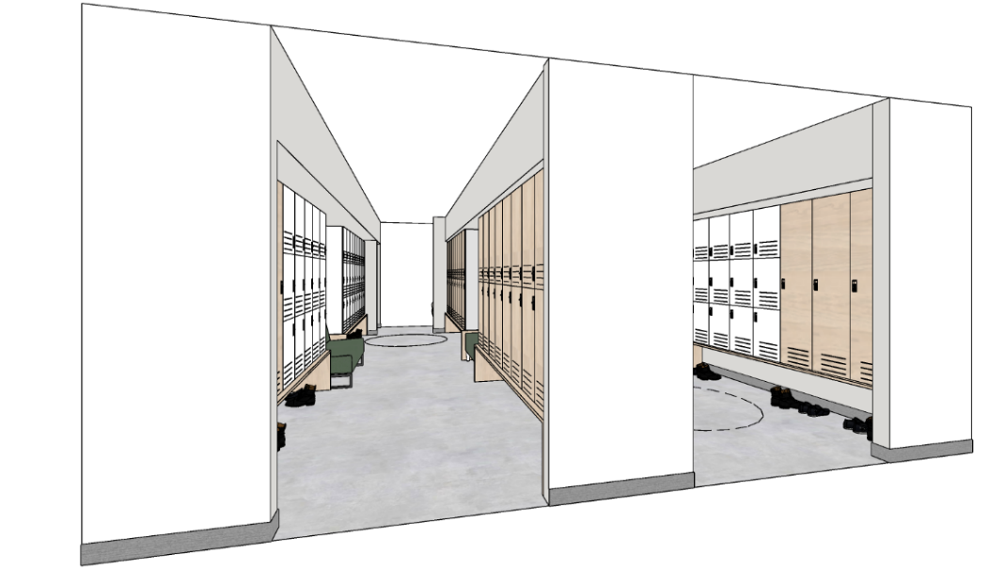
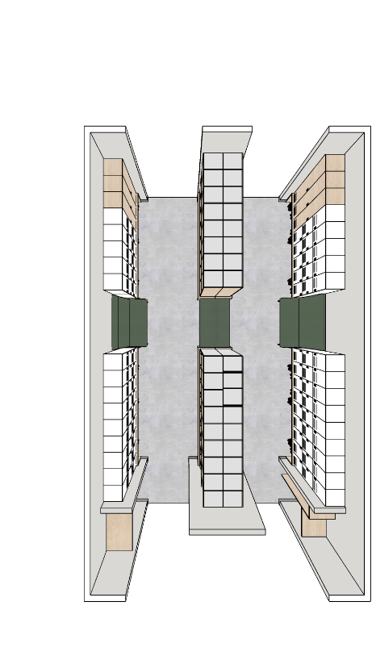
SUPPORT SPACE
PERSONAL STORAGE AREA
DESIGN:
Organisations have the flexibility to explore a locker strategy to suit their operational needs, however they must not exceed the locker area calculation AND maximum quantity of locker units, as described below:
Locker Area Calculation:
The Maximum Locker Area = 0.5 sq.m. (per target occupant) x Number of targeted occupants.
This area includes locker units, accessible benches, shared storage (like coat closets and boot storage), and clearance/circulation.
Maximum Quantity of Locker Units:
The total number of locker units must not exceed the target occupancy.
Locker Units: A singular locker unit that may be divided up as a single height (full height), double height (half height), or a multi-unit cubby (3-5 high).
Avoid over-occupying the space and comply with local building codes.
Refer to the GCworkplace Design Guide for planning strategies and best practises.
OCCUPANTS: N/A
(Not included in occupancy calculation)
VISUAL PRIVACY: Low
ACOUSTIC PRIVACY: Low
AVERAGE SIZE: 0.5m² per occupant
TECHNOLOGY: N/A
MECHANICAL:
Refer to General Specifications and Open Office Areas on pages 3 & 4.
INTERIOR ARCHITECTURE:
Refer to General Specifications and Open Office Areas on pages 3 & 4.
EXAMPLE:

Slide 45
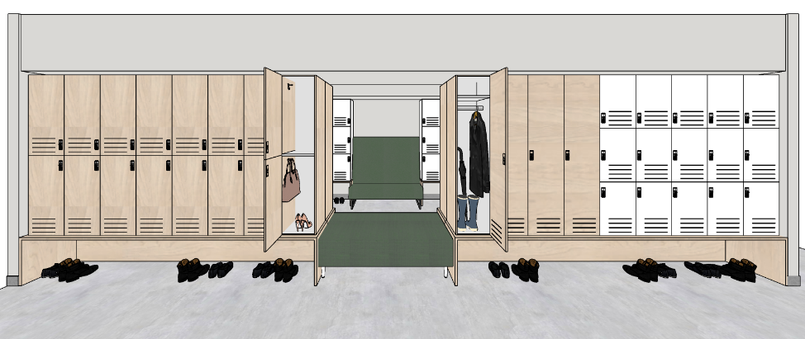
SUPPORT SPACE
PERSONAL STORAGE AREA (continued)
ACCESSIBILITY:
Lockers
Provide a variety of locker sizes at an accessible height (reach range between 400mm and 1100mm AFF)
An adjustable shelf provides flexibility in a full height locker;
Hanging rod to be max height of 1100mm AFF. Recommend including hooks at different heights on the sides of the locker for closer reach;
Consider including air grill in lockers for ventilation
Locks and handles to comply with CSA/ASC B651:23 Clause 4.3; also consider the size and contrast of the numbers and buttons on digital locks. If they are too small they can be difficult to see and use.
Number signage: consistently located, 50mm high characters which contrast with their background
Include identifying features, in addition to numbers, to aid in recognition of lockers. i.e. color codes or symbols recognition.
Other
Provide sufficient maneuvering space around the lockers for easy access;
Avoid dead end corridors;
Provide seating near lockers. At least one option should be equipped with arms and a backrest. If more, provide variety of seating options.
Ensure accessible coat closet is provided which complies with CSA/ASC B652:23 Accessible Dwellings, Clause 5.13.
Refer to pages 5 & 6 for general accessibility information that may apply.
INTERIOR ARCHITECTURE:
Consider interior architectural solutions for defining space and controlling sightlines and for sound absorption (i.e. wall hung, suspended panels or other room dividers) to help separate locker areas from other zones or workpoints.
LOCKER OPTION EXAMPLES:
(VARIES BY PRODUCT)
Coat Rod
Removable Coat Hangers
Boot Tray
Boot Storage
Shelving
Hooks
Bins
Keyless Lock
Etc…
LOCKER UNIT TYPE EXAMPLES:
Full Height
Half Height
3-High
4-High
5-High

Slide 46
SUPPORT SPACE
SHARED STORAGE
DESIGN:
Optional centralized filing to be provided only as required by group's paper storage needs (in line with an active digitization / IM modernization strategy) or for supply storage;
Filing can be grouped with a common surface to provide layout space;
Ensure common surface does not overhang over drawer openings;
Individual filing drawers available for personal lockers, if required.
OCCUPANTS: N/A
(Not included in occupancy calculation)
VISUAL PRIVACY: N/A
ACOUSTIC PRIVACY: N/A
AVERAGE SIZE: 5m²
TECHNOLOGY: N/A
MECHANICAL:
Refer to General Specifications and Open Office Areas on pages 5 & 6.
INTERIOR ARCHITECTURE:
Refer to General Specifications and Open Office Areas on pages 3 & 4.
ACCESSIBILITY:
Locks and handles to comply with CSA/ASC B651:23 Clause 4.3;
2-high cabinets are an accessible height, higher cabinets are not.
If planning an accessible layout space, ensure required clear floor space is provided for approach and use.
Consider clear floor space required to access the files/supplies once the drawer has been pulled open.
Refer to pages 5 & 6 for general accessibility information that may apply.
EXAMPLES:
INTERIOR DESIGN NATIONAL CENTRE OF EXPERTISE | PSPC WORKPLACE SOLUTIONS

Slide 47
SUPPORT SPACE
WASTE & RECYCLING
DESIGN:
Centralized communal waste and recycling units;
One unit to be adjacent to kitchenette(s)/lounge(s);
Garbage receptacles for wet garbage located in food preparation areas require a tight-fitting lid;
Consider placement near circulation/entrances for convenience of use;
Open area, approximately 1 unit per 200m²;
Allow for disposal of waste, paper recycling and plastic recycling.
OCCUPANTS: N/A
(Not included in occupancy calculation)
VISUAL PRIVACY: N/A
ACOUSTIC PRIVACY: N/A
AVERAGE SIZE: 0.5m²
TECHNOLOGY: N/A
MECHANICAL:
Refer to General Specifications and Open Office Areas on pages 3 & 4.
INTERIOR ARCHITECTURE:
Refer to General Specifications and Open Office Areas on pages 3 & 4.
ACCESSIBILITY:
Recycling Units: Signage and pictograms on the vertical surface rather than the horizontal surface provides better visibility from a seated position;
Refer to pages 5 & 6 for general accessibility information that may apply.
EXAMPLE:

Slide 48
ANNEX
RESOURCES
GCworkplace Design Guide
Government of Canada Workplace Fit-up Standards
GCworkplace Best Practices Checklist
GCworkplace Space Planning Workbook
GCworkplace Workpoint IT Requirement
Technical Reference for Office Building Design (TRFOBD)
CSA/ASC B651:23 Accessible Design for the Built Environment
CSA/ASC B652:23 Accessible Dwellings

