Slide 1
Introduction to Benefits Realization
Business Architecture Community of Practice
2023/11/20
Don Charboneau, Technical Advisor
APCP level 3 graduate

Slide 2
Today’s Purpose
Discuss SSC’s Benefits Management Program (BMP)
Define key Benefits Realization concepts
Highlight its integration into QualiWare
Explore its linkages to Business Architecture
Discuss next steps for BMP

Slide 3
Key Concepts
Key Concepts for Benefits Realization
Immediate Outcome: a short-term outcome that is directly attributable to a policy, program or initiative’s outputs.
Benefit: A benefit is a measurable improvement which contributes to departmental (including strategic) objectives.¹ A benefit measures the value of a CHANGE that has occurred.
Project produces output
Output produces business change
Business change produces outcomes
Our benefits world focuses on changes leading to outcomes, and outcomes achieving specific, measurable benefits.
Outcome (Project) examples:
Improved Perimeter Network Security
Continuous and uninterrupted access to mission critical HPC capacity
Reduced administrative overhead
Benefit examples:
Reduced number of access points
Increased processing speed and capacity
Reduced help desk staffing costs
³ TBS Policy on the Planning and Management of Investments

Slide 4
Benefits vs Performance Measurement
Performance Measurement
Used to monitor important aspects of an organization’s activities (e.g., services, systems, and processes). Performance is measured against departmental goals and objectives. The results identify how current activities are working and may inform allocation of resources.
Benefits Realization Management
Ensures that any business change achieves its expected results by translating the business objectives into measurable benefits that can be systematically tracked through to realization. The results allow the organization to more accurately report on the value added from investments in projects.
What is the Difference?
Performance measurement addresses what you are doing.
Benefits realization addresses what you are changing.
Importance?
In areas of SSC experiencing transformation, benefits realization is of critical importance.
For services that are more mature, performance measurement is the key activity.

Slide 5
Defining the Role of Benefits Realization
What is the Benefits Management Program?
Provides benefits realization guidance and supports to identify, quantify, and monitor SSC benefits.
BMP’s Objective
To ensure that business changes achieve expected results by translating objectives into measurable benefits that can be tracked through to realization.
How?
Helps stakeholders identify and focus attention on the most important benefits to SSC;
Promotes and embeds Benefits Realization Management principles across all activities at SSC; and
Increase the chances of successful changes by focusing on end results
💡 The BMP ensures that SSC is capable of achieving and reporting on the value gained from its investments

Slide 6
Defining the Role of Benefits Realization
BMP’s Raison d’etre
In 2015 the Office of the Auditor General (OAG) stated that SSC should reassess the reporting process for its transformation initiatives to ensure that methods for measuring progress are defined and aligned to key benefits established at the outset of the initiative.
OAG 2015 Fall Report – Specific Findings
No baselines or targets associated with outcomes. Information reported to assess transformation was limited. SSC failed to consistently demonstrate whether it was achieving identified outcomes.
SSC’s Response
Developed its Benefits Realization Framework (BRF) to align to the key benefits stated when SSC was created and to include methods for measuring progress.

Slide 7
Policy Guidance
Policy on the planning and Management of Investments
Directive on the Management of Projects and Programmes
Genesis for the requirements to undertake Benefits Realization for the bulk of the GoC
Policy on Digital and Service
Guidance on Enterprise Architecture - why we are all here
Policy on Results
Drives departmental accountability for performance information and evaluation
Challenge: sometimes there are inconsistencies between the policies (i.e., definition and treatment of the term ‘outcomes’)

Slide 8
Benefits Cycle
Program Initiatives
Projects
Outputs
Business Change
Expected Outcomes
Benefits
Program Expected Results

Slide 9
Support for Implementing Benefits Realization
How can the BMP help?
We are Benefits collaborators!
The BMP team works with the Business Analyst, Project Manager (PM) and service line to help create the required benefits artefacts.
Developing and reporting on benefits remains the responsibility of the PM, and, ultimately, the service line that the project will deliver into.
We provide training!
Through awareness sessions and this course, available through the SSC Academy.
We provide department-wide advice on Performance Measurement
Advice on the Results sections of Memorandum to Cabinet (MC) and Treasury Board Submissions (TB Subs) for respective projects;
Benefits advice on Service Strategy and Blueprint documents; and
Input on updates to the Performance Information Profiles (PIPs).
💡 Performance measurement at the strategic level falls under the Results and Delivery team. Their team email address is:
resultsanddelivery-resultatsetlivraison@ssc-spc.gc.ca

Slide 10
Support for Implementing Benefits Realization
Governance
Benefits Realization, including completion of artefacts and ongoing measurement, is a formal requirement of the Directive on the Management of Projects and Programmes.
Operational
The Director of the BMP is presently at the Project Management Board (PMB) and ensures that benefits are properly articulated at each gate (2-6) to secure PMB gate approval.
The Finance and Investment Management Board (FIIMB) is responsible for overseeing the allocation, control and prioritization of SSC's financial resources, including investments. It is responsible for projects (including benefits) for gates 0-1. It reviews project Benefits for lessons learned post gate-6.
The Services and Architecture Review Board (SARB) interacts with the Benefits Dependency Maps through a review of the Solution Architecture Description (SoAD) and Service Architecture Description (SeAD). It is the first engagement point at gate 0 for all new investment proposals.

Slide 11
Alignment with Project Governance Framework
BMP Implementation
To avoid duplicating governance and to leverage an existing engagement framework, benefits realization activities are fully integrated into the Project Governance Framework (PGoF).
Each Project Gate presentation has specific benefits realization requirements which must be reported (outlined on next slide).
Specific instructions regarding benefits are embedded within the PM&D Operating Guide and project artefacts, including: the business case, project charter, and gate presentations.
More information can be found on the PMCoE - PGoF and Templates GCpedia page, PMCoE Standards and Publications page, PMCoE Training and Outreach and the SSC Benefits Management Program SharePoint site.

Slide 12
Alignment with PGoF, Artefacts and TB Subs
PGoF 5.0: Benefits Artefacts and Activities
Benefits Dependency Map
Benefits Dependency Map (updated)
Benefits Register
Benefits Dependency Map (updated)
Benefits Register (updated)
Benefits Realization Plan
Benefits Dependency Map (updated)
Benefits Register (updated)
Benefits Health Assessment
Benefits Realization Plan (updated)
Benefits Dashboard
Benefits Register (updated)
Benefits Health Assessment (updated)
Benefits Realization Plan (updated)
Benefits Dashboard (updated)
Benefits Register (updated)
Benefits Health Assessment (updated)
Benefits Realization Plan (updated)
Transition Benefits Realization Plan to service line
Gate 0
Gate 1
Gate 2
Gate 3
Gate 4
Gate 5
Gate 6
Strategic Assessment
Business Justification
Delivery Strategy
Detailed Planning
Operational Readiness
Deployment
Closeout

Slide 13
Benefits Realization Artefacts
There are specific benefits artefacts and requirements that must be completed.
Dependency
Map
Benefits
Register
Benefits Realization Plan
Benefits Health Assessment
Benefits Dashboard
Links project outputs, business change, and expected benefits to strategic outcomes
The visual representation of the elements, activity and value it provides
Contains all performance indicator information for each benefit
The working doc that contains all relevant benefits and their supporting data – i.e., performance indicators
Captures all benefits work, benefits ownership, and transition plan
Signed contract that captures all bene work; ownership and transition plan
Confirms that benefits are still realistic and achievable based on project scope
The dashboard is a visualization tool to demonstrate the progress of benefits

Slide 14
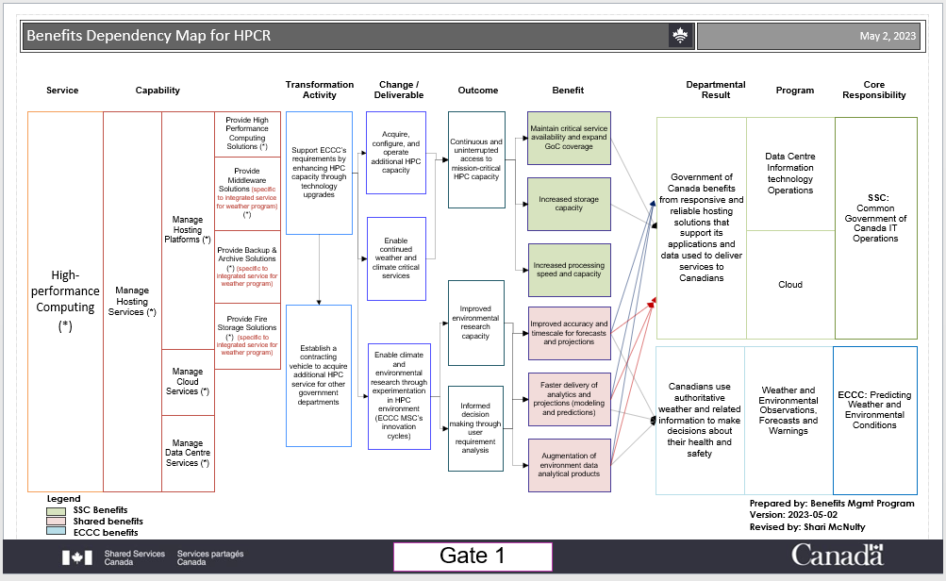
SCED Benefits Map

Slide 15
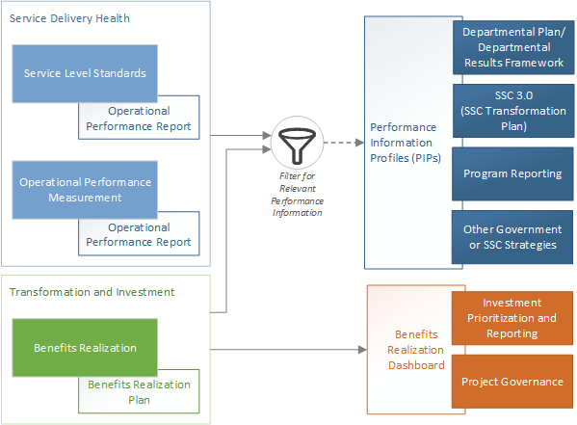
New Service Blueprint Guidance – Performance Measurement Section

Slide 16
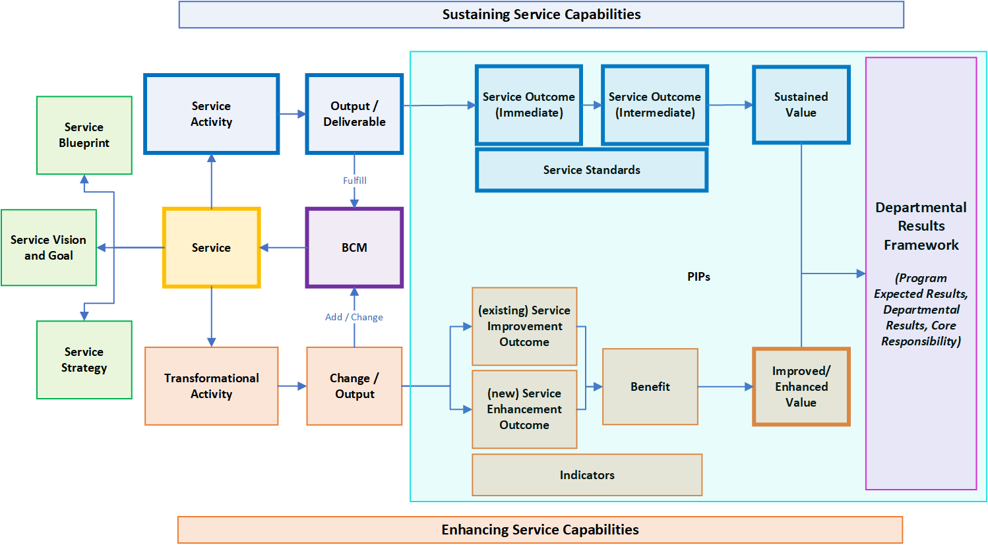
Proposed New Map and Approach
BMP and Service Lines work together to Model Service Value Motivation Map (SVMM) during Service Reviews and Authorizations
EA continues to model Service and BCM
Model SVMM during BMP benefits mapping
💡 Business Capabilities act as bridge between components

Slide 17
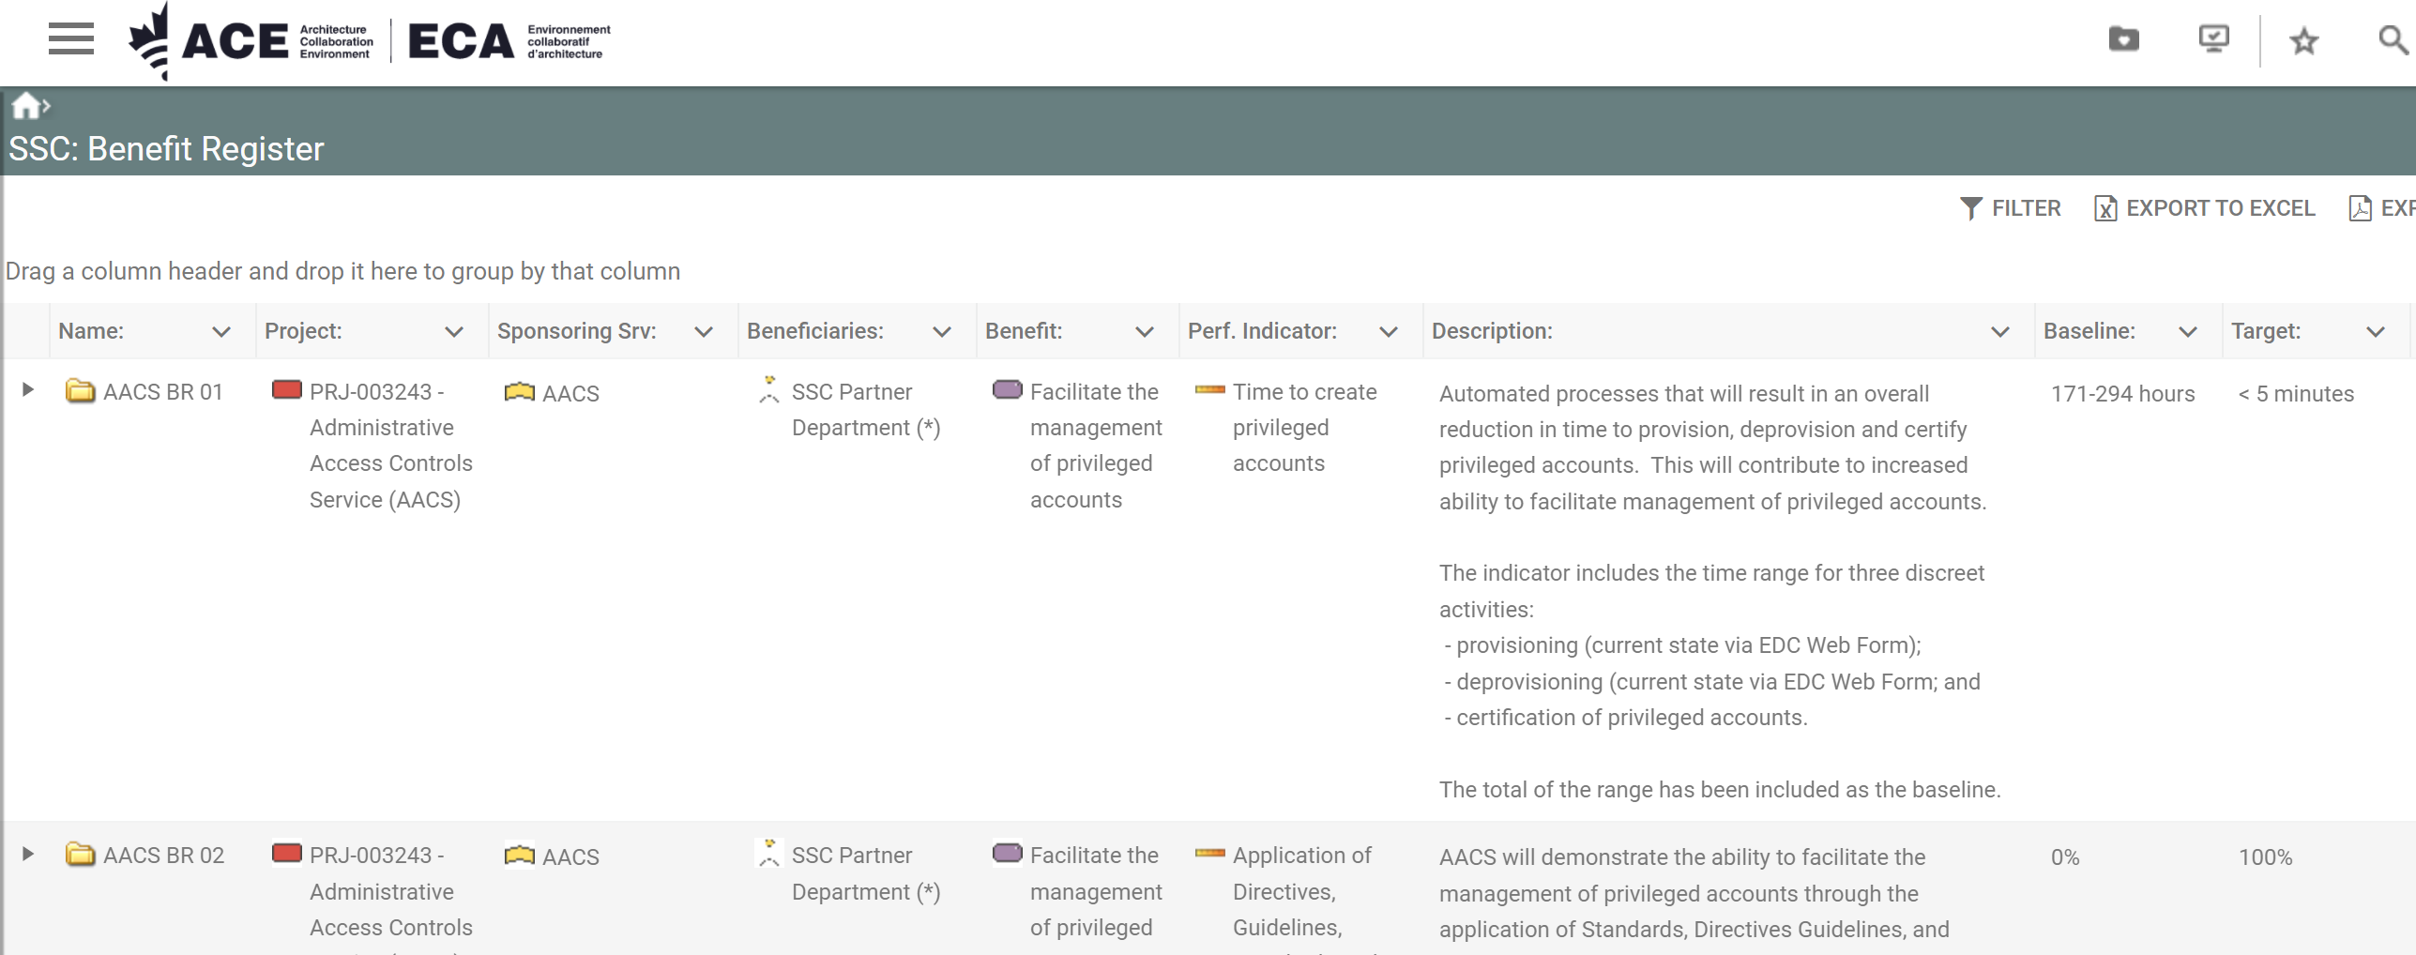
Benefits Realization and QualiWare
Architecture Collaboration Environment (ACE): QualiWare
The ACE interface provides a broader reporting mechanism across outcomes, benefits, and indicators for all projects/initiatives that have been added to the tool.
Click here!
Navigating the SSC: Benefits Register is the easiest way to view artefacts related to your project/initiative.
ACE provides us with the entire project/initiative portfolio across Shared Services Canada.

Slide 18
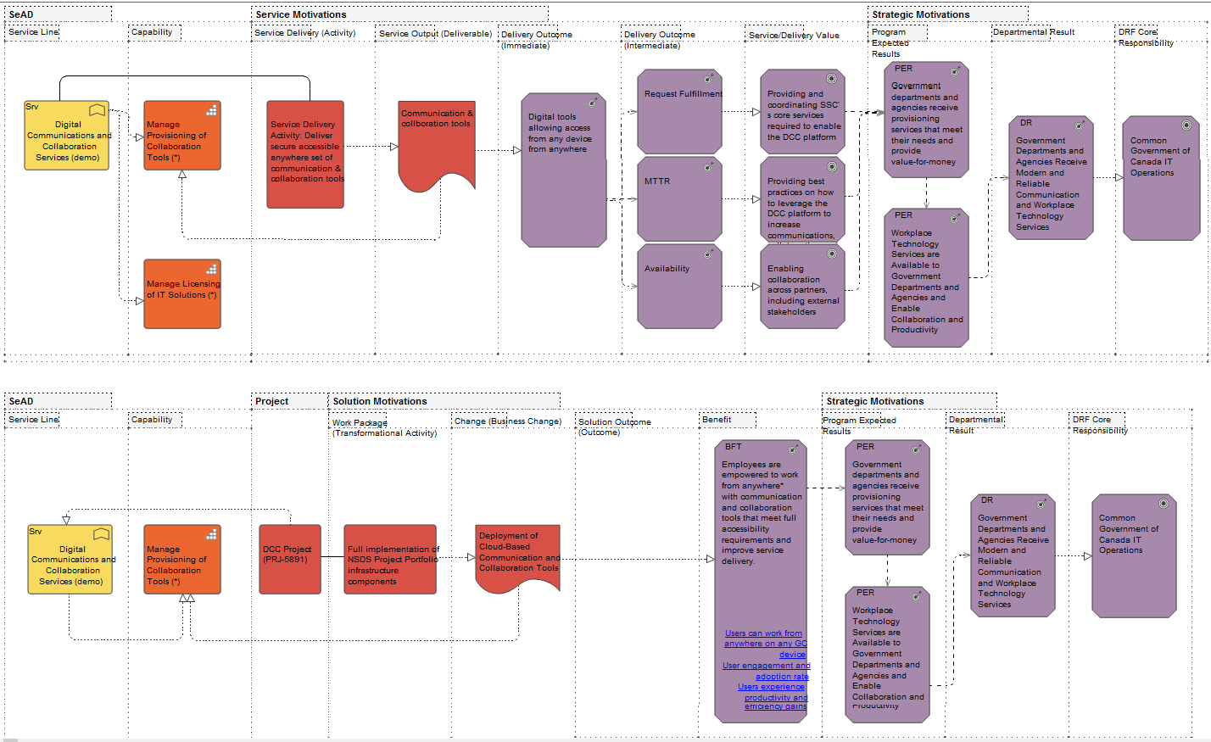
ACE/QualiWare Case Study- DCC Service
Example of ACE implementation of Service Value Motivation Map for Service Activities and Transformational Activities

Slide 19
What is next for Benefits Realization SSC?
Starting in Q4, support Strategy Branch to further refine and improve SSC Performance Information Profiles (PIPs)
Collaborate with Audit and Evaluation to coordinate Service Value Motivation Map and logic models necessary for evaluations
Once a critical mass of SVMM are complete, leverage the breadth of the strategic performance measurement in QualiWare to develop new decision support reports for senior management
Collaborating with Enterprise Architecture team to build Service Architecture Descriptions (SeAD) for the majority of services available in the service catalog

Slide 20
Questions?

