Slide 1
PMCD Seminar – 14 Oct 2022 Industry & DND [HCCS - HALIFAX Class Combat Systems] Lessons Learned
Kris Hildebrandt
Deputy MSC 5/5-1 Combat Management and Sensor Systems, Major Surface Combatant
Senior [Technical] Program / Ops Manager
CAN UNCLASSIFIED

Slide 2
Agenda
Today’s Theme / Message
The link between Lessons Learned & Knowledge Management
ISSC Lessons Learned
Start-Up / Transition / Steady-State / Timeframe(s)
Plans / Reports / Business-to-Business / Enterprise Processes / Tabletops
Validating Contractor Performance (Verification Cross Reference Matrix (VCRM) checklists do not equal verified capabilities)
Performance Management
Setting the Stage … Perspective
Clearly Articulated Contract Requirements: Why it Matters
Explicit / Implicit Contract Language & Perspective
Parting Thoughts …
Questions

Slide 3
Today’s Theme / Message
Apply lessons experienced in the past to learn and gain the knowledge meant to impart in the future

Slide 4
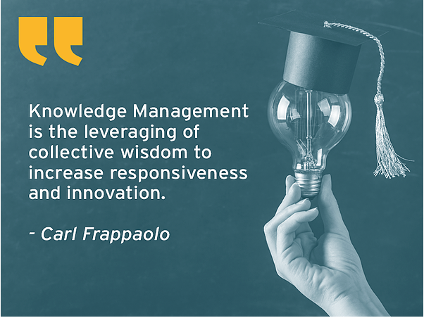
The link between Lessons Learned & Knowledge Management
These quotes illustrate the importance behind Lessons Learned and the link to - “Knowledge Management”
Sharing information and applying lessons learned, leads to better project / service delivery, cost reduction, improved processes
and stronger org performance
The primary link between lessons learned & knowledge management is transferring explicit, implicit and tacit knowledge and applying the lessons learned …

Slide 5
ISSC Lessons Learned – the WiiFM
Start-Up / Transition / Steady-State
Allow sufficient time and space to facilitate transfer knowledge / lessons learned
Aid in the growth of contractor in-service support capabilities (they don’t have the benefit of our experience or knowledge) – relational vice transactional
Plans / Reports / Enterprise Processes / Business-to-Business
Validating Contractor Performance (Verification Cross Reference Matrix (VCRM) checklists do not equal verified capabilities)
Focus on Capabilities vice Checklists - adopt a many to one, one to many approach (i.e., multiple contract requirements are needed to provide engineering support – define what those are and where there are gaps, utilize either tabletop scenarios, or allow the contractor to use prior experience that demonstrates the capability desired)
Performance Management
Applying a “One Size Fits All” will not yield positive results
Build flexibility into the Contract and Performance Work Statement to allow an update to the Performance Requirements Specification as experience is gained

Slide 6
Setting the Stage … Perspective!
Seek to understand
Than …
Be understood

Slide 7
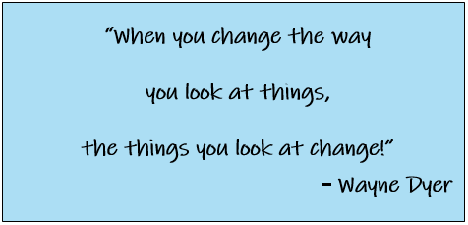
Changing the way we look at things … a different & RENEWED Perspective!

Slide 8
Clearly Articulated Contract Requirements & Perspective: Why it Matters

Slide 9
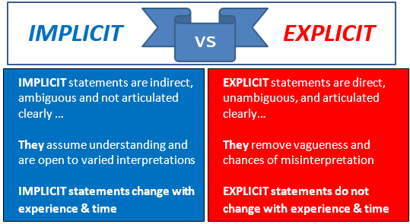
Implicit vs. Explicit Statements

Slide 10
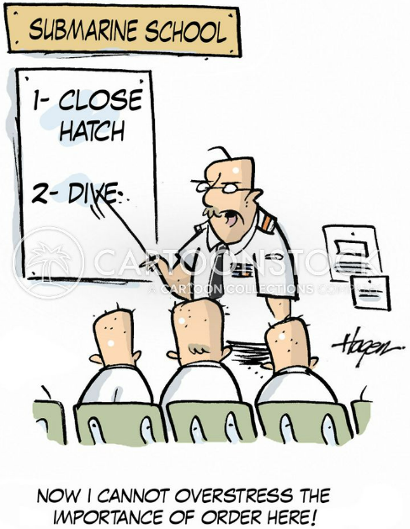
Explicit Requirements: Why it Matters

Slide 11
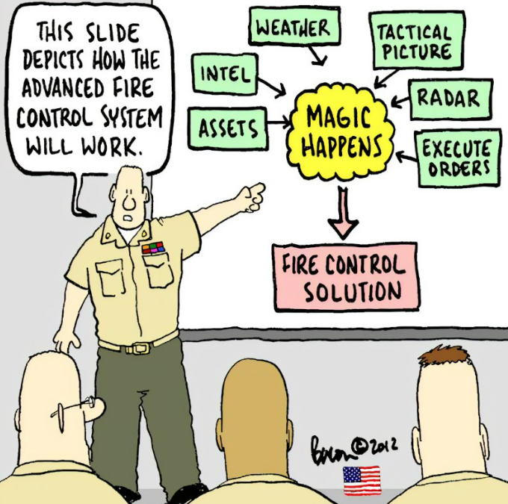
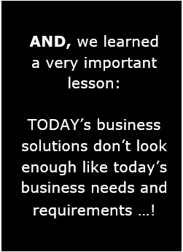
Test of Time … Time bound Solutions & Perspective

Slide 12
Parting Thoughts …
There is an urban axiom that says:
Lessons Learned: Seldom Remembered: Soon Forgotten
Review lessons learned early / often – document regularly
Avoid paying it lip service as an adjunct / ad hoc activity
Ensure key project members availability - don’t assign to a junior member
Develop explicit and clear contract requirements
avoid ambiguous, vague and implied requirements
When reviewing and providing feedback on contract documents use the opportunity to transfer knowledge
Allow enough time for your Contractor to gain knowledge through lessons experienced
When assessing performance, ensure your methodology focuses on capabilities, not lists of requirements

Slide 13
Questions!?

