Slide 1
ATSSC Overview
For new employees

Slide 2
What is the ATSSC?
The ATSSC was established with the coming into force on November 1, 2014, of the Administrative Tribunals Support Service of Canada Act.
The ATSSC is responsible for providing support services and facilities to 12 federal administrative tribunals by way of a single, integrated organization.
These support services are carried out by ATSSC employees: individuals working in the eight secretariats and in internal services.

Slide 3
ATSSC support services
Secretariats
Internal Services
Human resources
Planning and
Communications
Registry
services
Mandate
and
member
services
Financial services
Accommodation
and Security
Legal
services
Information
management
and technology

Slide 4
ATSSC’s eight secretariats
8 SECRETARIATS serving 12 TRIBUNALS:
Canada Industrial Relations Board (CIRB) Secretariat
Social Security Tribunal (SST) Secretariat
Canadian International Trade Tribunal (CITT) Secretariat
Competition Tribunal (CT) Secretariat
Public Servants Disclosure Protection Tribunal (PSDPT) Secretariat
Canadian Human Rights Tribunal (CHRT) Secretariat
Federal Public Sector Labour Relations and Employment Board (FPSLREB) Secretariat
Integrated Secretariat – serving the following tribunals: Canada Agricultural Review Tribunal (CART) Canadian Cultural Property Export Review Board (CCPERB) Environmental Protection Tribunal of Canada (EPTC) Specific Claims Tribunal (SCT) Transportation Appeal Tribunal of Canada (TATC)

Slide 5
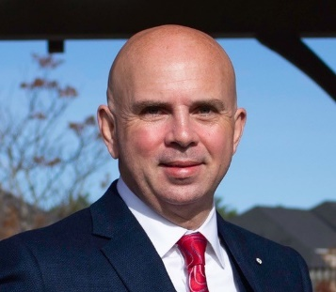
ATSSC and Tribunal heads
ATSSC’s Chief Administrator | Tribunal Chairperson
administrative tribunals to exercise its powers and perform its duties and functions in accordance with the rules that apply to its work. | The chairperson of an administrative tribunal has supervision over and direction of the work of the tribunal.
The Chief Administrator, is responsible for the provision of the support services and the facilities that are needed by each of the
Orlando Da Silva, LSM
Chief Administrator

Slide 6
ATSSC employees vs. tribunal members
ATSSC employees | Tribunal members
ATSSC employees are federal public servants working in one of the secretariats or in Internal Services. | Tribunal members are not public servants, but rather individuals who have been appointed by the Governor in Council (GIC) for a term of up to 5-years, with the possibility of re-appointment. Tribunal members (GICs) are the decision-makers for the tribunal.

Slide 7
Secretariats vs. Tribunals
Secretariat = ATSSC Tribunal ≠ ATSSC
ATSSC
Secretariat
(Serving the tribunal)
CIRB
SST
CITT
CT
PSDPT
CHRT
FPSLREB
Integrated Secretariat
Serves the following tribunals: CART, CCPERB, EPTC, SCT, TATC
Executive Director
(ATSSC Employee)
Carol McLean
(ED and Senior General Counsel)
Anab Ahmed
Greg Gallo
Gillian Burnett
Fabien Lengellé
Lucie Morneault
Independent tribunals served by the ATSSC
Tribunal
CIRB
SST
CITT
CT
PSDPT
CHRT
FPSLREB
Chairperson
(GIC / Member)
Ginette Brazeau
Paul Aterman
Frédérique Seppey
Denis Gascon
Martine St-Louis
Jennifer Khurana
(acting)
Edith Bramwell
Tribunal
CART
CCPERB
EPTC
SCT
TATC
Chairperson
(GIC / Member)
Luc Bélanger
Sharilyn Ingram
Heather Gibbs
Victoria R. Chiappetta
Patrick Vermette

