Slide 1
Task Success Survey prototype
Usability and findability study
For discussion
Digital Transformation Office • #CanadaDotCa • December, 2022

Slide 2
Outline
Background
Key findings
Next steps
Study results

Slide 3
Background

Slide 4
Background
After running a user survey on the TSS over the summer of 2022, we used the feedback and insights to prototype a solution that centralizes TSS guidance and provides access to quarterly survey results and comments.
Study goals
Does the prototype improve the user experience for the following elements:
Findability and usability of information
Landing page banded design and navigation between pages
Getting and understanding quarterly survey results
Accessing raw feedback and pre-analyzed “clustered” feedback
Making evidence-based decisions about what to improve

Slide 5
Participants
Tasks | 6 + intro and exit questions
Participants | 7 (2 Web managers, 4 Web advisors, 1 data analytics)
Devices | Desktop
Date | November 22-December 16
Prototype | https://test.canada.ca/experimental/design-system/performance/survey.html
Documents | Session log

Slide 6
Key findings

Slide 7
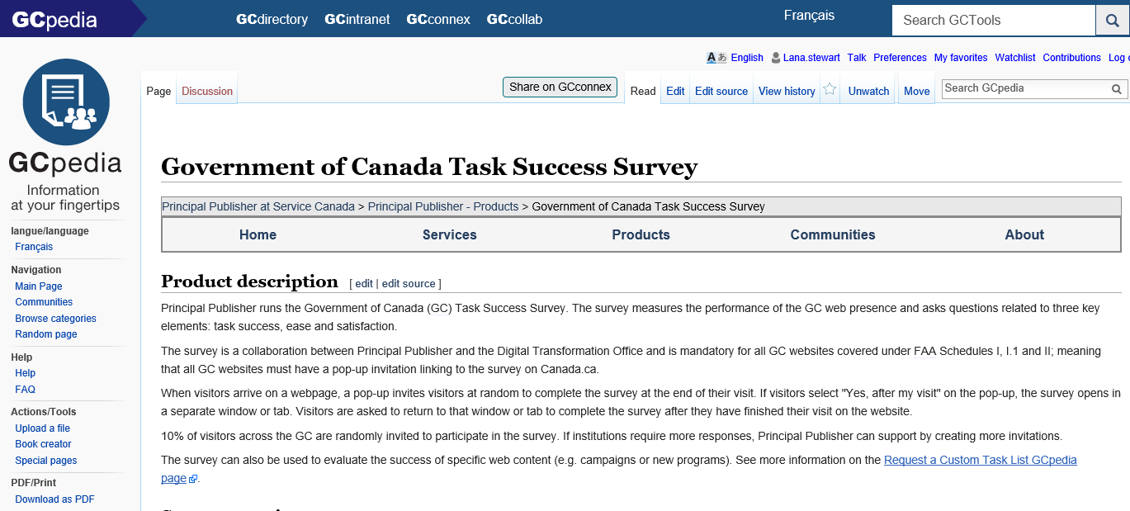
GC TSS findability of resources
Takeaways: Decentralized guidance materials makes it inefficient to find key info
Participants relied on GCPedia for guidance followed by emails
Most participants used the emailed quarterly results to get data
Most had downloaded survey comments at some point, but often a “side of desk” activity

Slide 8
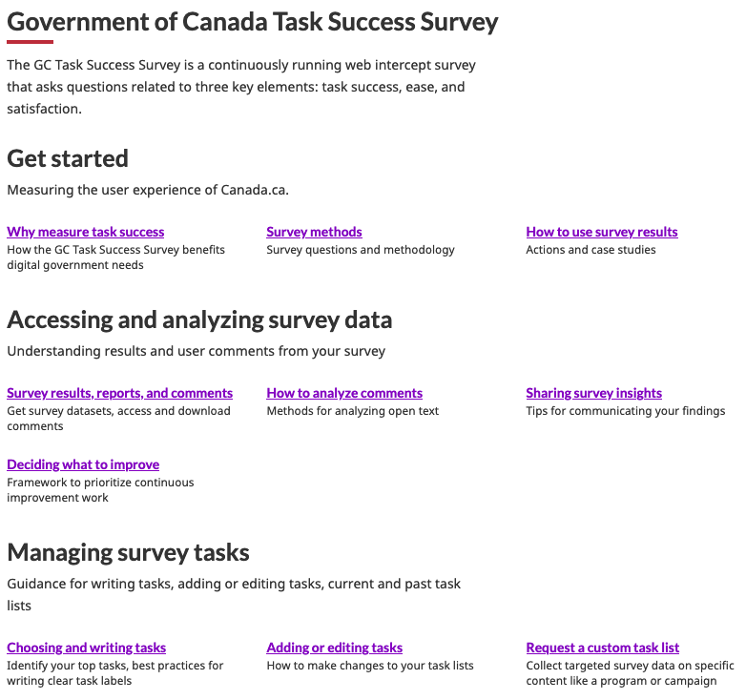
GC TSS findability of resources
Takeaways:
New landing page design, headings, doormats were effective
Easy to find answers to common questions and tasks:
Accessing data and results
Managing task lists
Taking action with data including case studies
Who to contact for help
Navigation between pages and sections was easy

Slide 9
GC TSS: Survey results viewer
Takeaways:
Common tasks like finding a department’s or task’s success score were easy to complete in the results viewer prototype

Slide 10
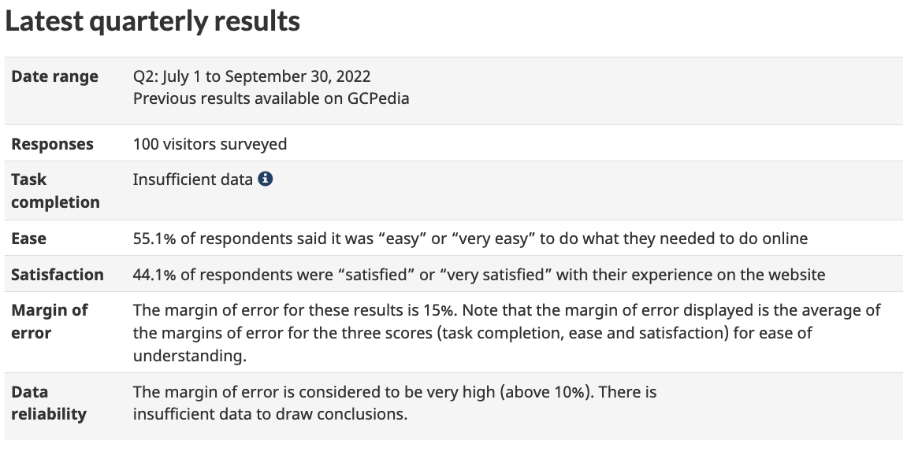
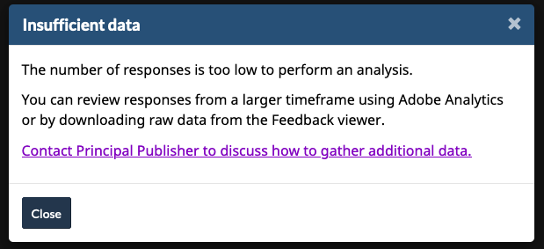
GC TSS: Survey results viewer
Takeaways:
Added guidance on how to deal with ‘insufficient data’ and data reliability for the quarter
Defining what ‘insufficient data’ means
How to share results with a larger margin of error
Including guidance for what to do next (download larger time frame of data, contact PP for help)

Slide 11
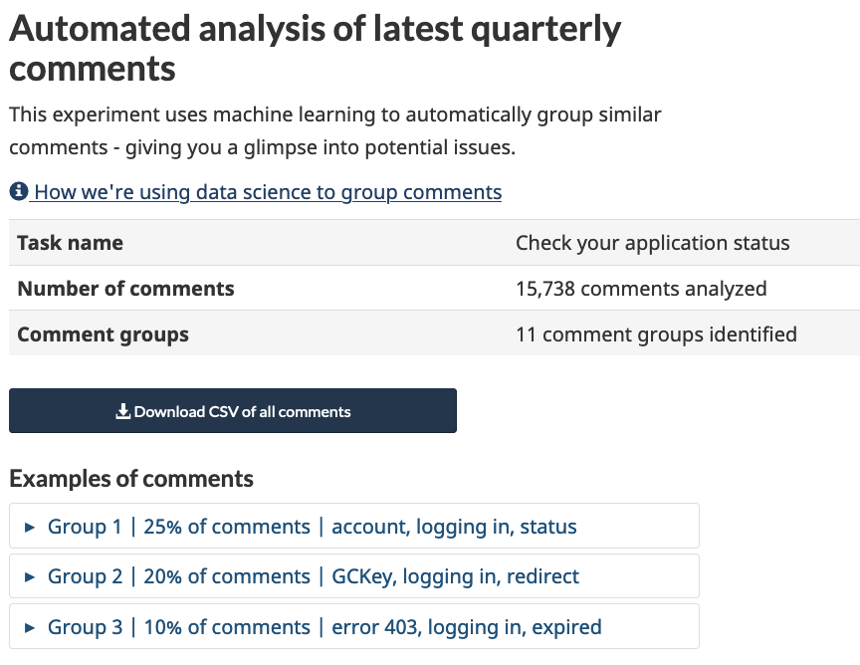
GC TSS: Survey results viewer
Takeaways:
Lots of iterations to the pre-analyzed comments section to make comments groups easier to find and understand
Avoiding data science terminology in favour of more plain language
Displaying clustering keywords and % of feedback to better understand the scale of a problem at a glance

Slide 12
GC TSS: Rating of new prototype
Overall participants were very happy with the improvements to guidance and excited to use the survey results viewer with the pre-analyzed comments.
“BIG IMPROVEMENT over the GCPedia, language is more explain like I’m 5. Nice improvement.”
(Pre-analyzed comments) “Based on limited time and resources we would rely on this.”
“It’s great that we’re living in an age when we have the data, we’re not guessing.”

Slide 13
GC TSS: Next steps
ETA:
Guidance: End of March
Results viewer: TBD
Final approvals
Translate and code materials

Slide 14
Study results

Slide 15
Prior use of GC TSS materials
Where you go now to find guidance about the TSS? | And how you get results from your survey? | Have you downloaded feedback from your survey?
P1 Emails and GCPedia P2 GCPedia P3 Bookmarked pages P4 Quarterly report P5 Emails P6 GCPedia P7 Not sure where | P1 GCpedia P2 Download portal P3 Email for quarterly results P4 Email for quarterly results P5 Email for quarterly results P6 -- P7 -- | P1 No, not sure how P2 Yes, every month P3 Yes, quarterly analysis P4 -- P5 Yes, but not regularly P6 Yes, using clustering script P7 No, not yet
4 - GCPedia / bookmarks 3 - Emails / quarterly report 1 - Not sure | 3 - Quarterly results email 1 - Feedback viewer 1 - GCPedia | 4 - Yes 2 - No
Notes:
Quotes

Slide 16
Task 1
PURPOSE & TAKING ACTION WITH THE TSS You need to explain what the GC Task Success Survey is to your program clients for one of their tasks. Find an explanation of why the survey is useful to measure online performance to share with them. Find examples and case studies of the types of changes or actions you can take using survey data.
Success: 7/7
Participants easily used “Get started” section to find answers to both parts of this task.
https://test.canada.ca/experimental/design-system/performance/about-tss.html
Recommendations
None.
Notes:
Quotes

Slide 17
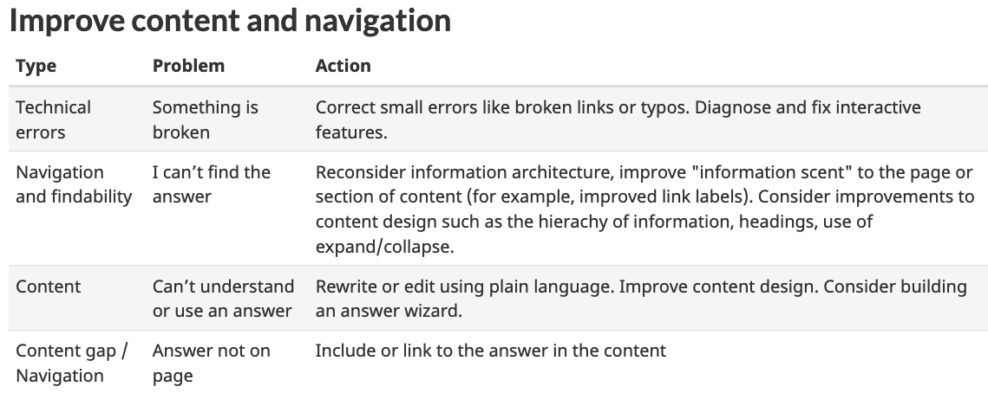
Task 1
Success: 7/7
https://test.canada.ca/experimental/design-system/performance/benefits.html
Actions related understanding and awareness were skipped over in favour of the table with “quick fixes”
“I love the table. Problems you can solve with the survey.” P1
Recommendations
Revised section of content to better highlight processes and workflows, using preferred table format
Remove “quick” - not all will be quick!

Slide 18
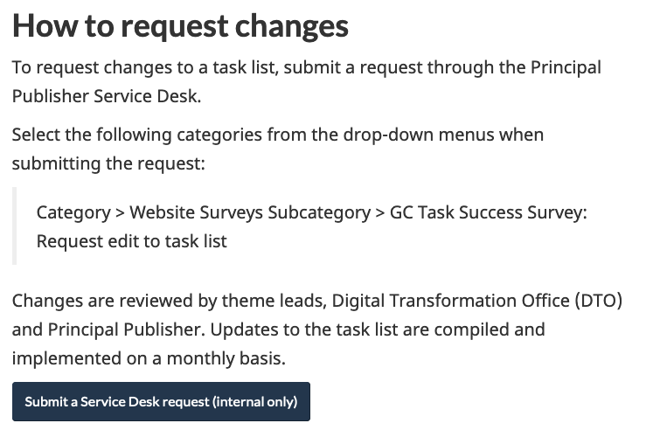
Task 2
MANAGING TASK LISTS Your department is getting set to launch a new funding program that Canadians will need to apply for. Find out how to add a task to the survey for this program. Now, find suggested wording for “applying for” tasks.
Success: 7/7
After adding the missing link to the Service Desk, participants easily completed this task
https://test.canada.ca/experimental/design-system/performance/updating-tasks.html
Recommendations
Add the keyword “managing” to landing page heading

Slide 19
Task 3
ACCESSING AND INTERPRETING SURVEY RESULTS Your Director has asked for a summary of your department’s TSS results for the last quarter. Find the overall task completion score for your department.
Find how to download your department’s task completion scores by task.
For your department’s task with the most responses, could you find a summary of the feedback for it?
Participants easily navigated from the TSS landing page to the survey results viewer
It was intuitive to navigate to a task via their Institution
“It's great. I appreciate the fact that it is laid out for us more.” P3
Recommendations
Make it clear from the landing page that it only contains the previous quarter of results

Slide 20
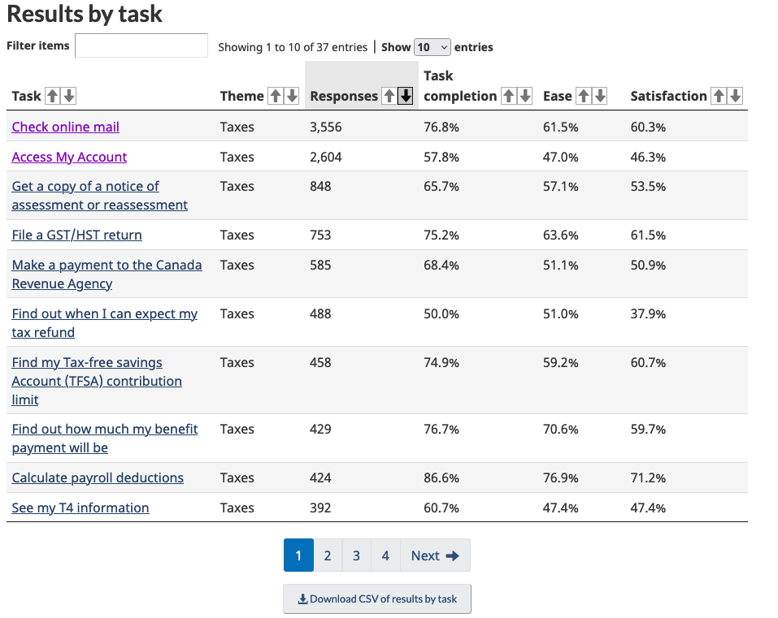
Task 3
… continued
Three participants expected the download the CSV button to be at the top of the table on the results by institution page
“...can you move that (download CSV) to the top or have a button that says full spreadsheet or full data. I think It would be easier if it was at at the top'.” P2
Recommendations
Reconsider the placement of the download button - move to top of the table

Slide 21
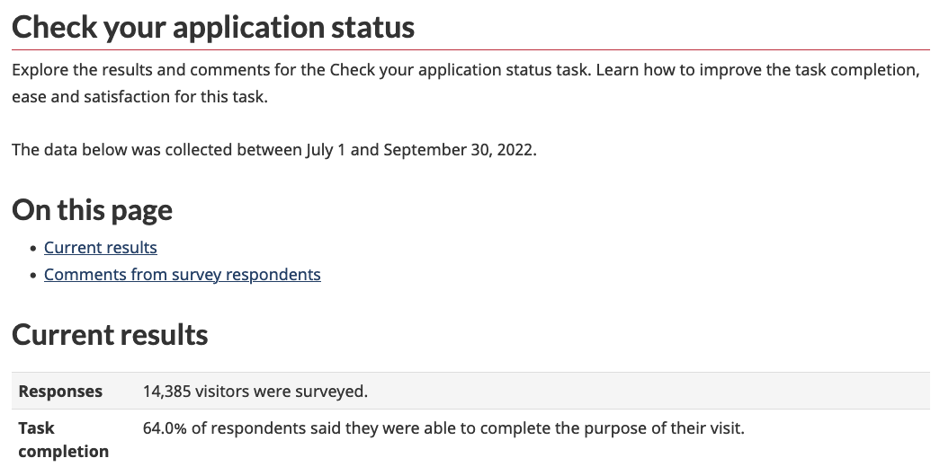
Task 3
RESULTS BY TASK INTRODUCTION
Heading “Current results” could reinforce “Latest quarterly results for this task”
Move the date range for the quarter under the heading
It was unclear what “insufficient data” meant. How little is insufficient?
Improve guidance for insufficient results
BEFORE

Slide 22
Task 3
RESULTS TREND PROBLEMS WHEN INSUFFICIENT DATA
Unsure if it was an error or what to do when there is insufficient data for a task
Understanding what “insufficient data” means
AFTER

Slide 23
Task 3
Revised wording for data reliability options to better explain HOW to use the data

Slide 24
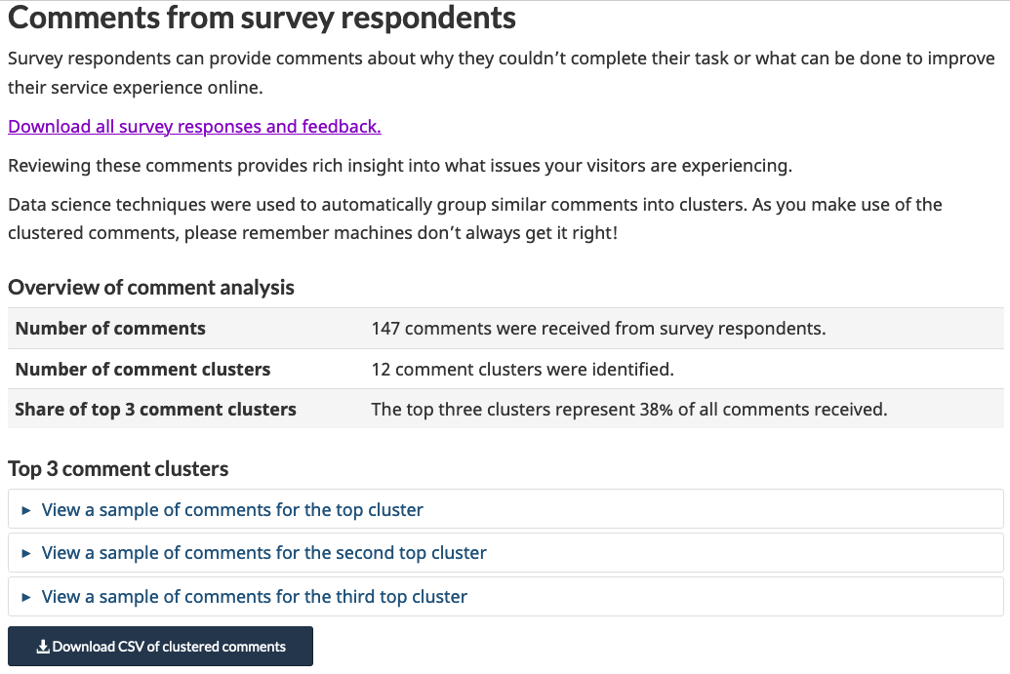
Task 3
CLUSTERING SECTION PROBLEMS
Unfamiliar term: “cluster”
Intro content skipped over
Not obvious to open accordions
Why only 3 groups?
How many comments are in each group
Are “sample” comments real?
BEFORE
“What is a cluster?” P3 “oh this is great!" I'm not sure what it means by cluster” P1

Slide 25
Task 3
CLUSTERING SECTION CHANGES
Shortened intro text
Swapped “cluster” for “group”
Added task name
Added info about how automated analysis works
Comment group examples include % of share of comments and cluster keywords
Moved download comments button above samples
AFTER

Slide 26
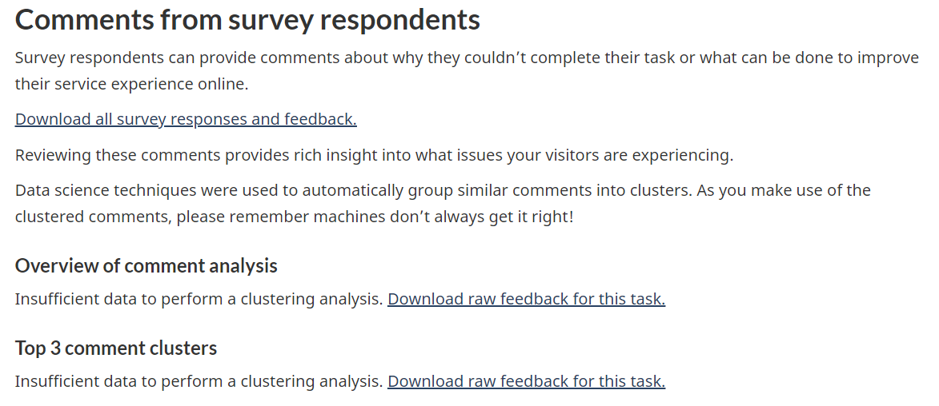
Task 3
Show what data is available when there is insufficient data
INSUFFICIENT DATA
Even if there is insufficient comments for grouping, still show ungrouped comments
BEFORE

Slide 27
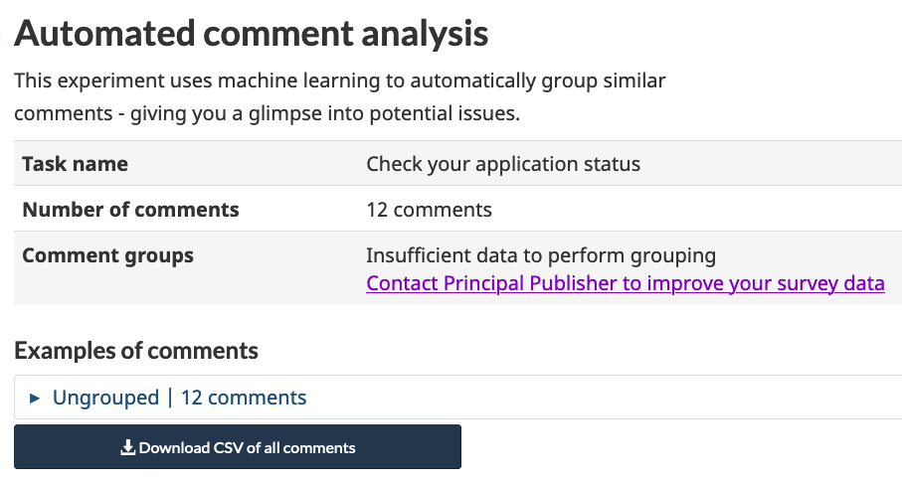
Task 3
INSUFFICIENT DATA
Even if there is insufficient comments for grouping, still show ungrouped comments
AFTER

Slide 28
Task 4
FEEDBACK VIEWER You’re decided to download a custom timeframe of your top task comments to manually analyze. Could you show the process to download the feedback for your top task for the last month?
BEFORE
Some people given this task thought downloading the grouped comments was the answer.
One person that used the feedback viewer initially missed the difference between the tabs.
AFTER
Recommendations
In the feedback viewer, make the tabs clearer between page feedback and TSS

Slide 29
Task 5
MANUAL FEEDBACK ANALYSIS You’ve downloaded 500 comments into a spreadsheet and now need to make sense of the user feedback. Find 3 best practices for analyzing feedback before you begin. Next, could you find a template that can help you group feedback and document your grouping strategy.
Due to timing not everyone was asked this task after the first 3 participants. With the machine learning grouping, this task may become less common.
Guidance on how to manually analyze feedback was easy to find.
Recommendations
The template for documenting the grouping strategy could include a couple additional examples.

Slide 30
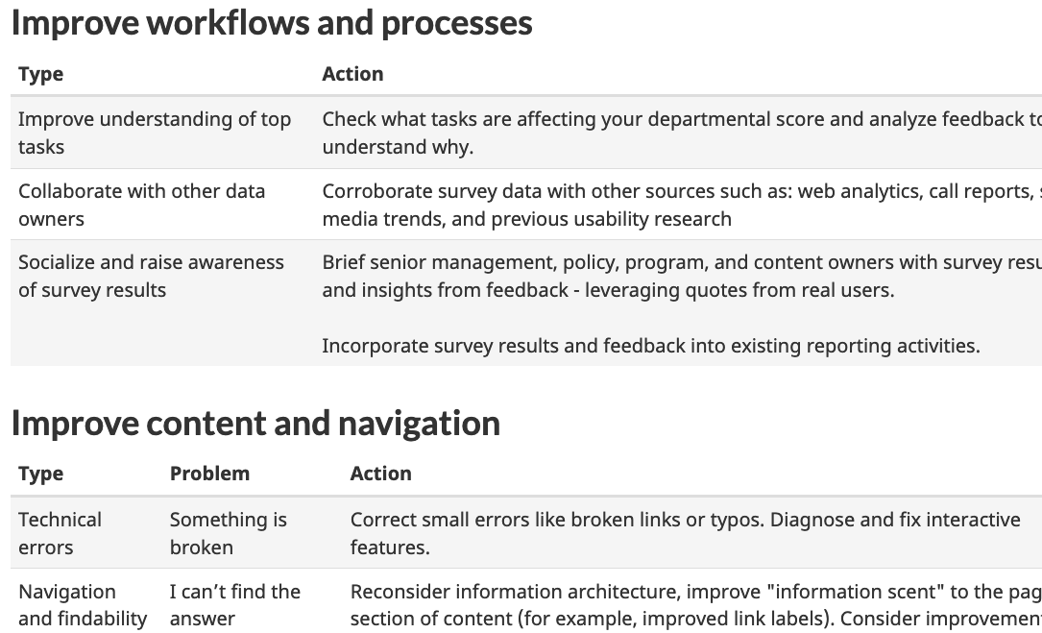
Task 6
PRIORITIZATION & TAKING ACTION Find guidance for how to decide what tasks to work on.
What are 3 considerations that may influence your decision?
Due to timing, not every participant was asked this task
Content page was easy to find
One participant said they don’t have time to be proactive, most of their actions are reactive
AFTER
Recommendations
Revise formatting to show actions in table format

Slide 31
Results by task
 | Task scenario | P1 | P2 | P3 | P4 | P5 | P6 | P7 | Total
1 | Find an explanation of why the survey is useful to measure online performance to share with them. Find examples of the types of changes or actions you can take using survey data. | C | C | C | C | C | C | C
2 | Find out how to add a task to the survey for this program. Then, find suggested wording for “applying for” tasks. | C | C | C | C | C | C | C
3 | Find the overall task completion score for your department. Then, find how to download your department’s task completion scores by task. For your department’s task with the most responses, could you find a summary of the feedback for it? | Improve | Improve | Improve | Improve | Improve | Improve | Improve
4 | Could you show the process to download the feedback for your top task for the last month? | Improve | Improve | Omitted | Improve | Improve | Omitted | Omitted
5 | Find 3 best practices for analyzing feedback before you begin. Next, could you find a template that can help you group feedback and document your grouping strategy. | Improve template | C | C | Omitted | Improve | Omitted | Omitted
6 | Find guidance for how to decide what tasks to work on. What are 3 considerations that may influence your decision? | C | C | C | Omitted | Omitted | Omitted | Omitted

