Slide 1
Mindful Change Leadership Development Program
Session 1 (of 8)
April 29, 2025
Notes:
Jena:
Then start sharing the screen, and read from the slide
Good morning good afternoon everyone, First, I invite you to reflect on the land you are connecting from, and I would like to acknowledge that I am transmitting to you from the traditional Territory of the Anishnaabe Algonquin People; in Gatineau QC.
Please note that this session is being recorded. By remaining as a participant, we will interpret that as your consent to being recorded and we thank you for staying with us.
// Cette session est enregistrée. Nous interprétons le fait que vous demeurez en tant que participant comme votre consentement à faire partie de l’enregistrement. Nous vous remercions de votre collaboration
Please note there is French offering usually deliver during the Fall, as this program is delivered in English, feel free to express yourself in the official language of your choice
// Veuillez noter qu'il existe une offre française habituellement livrée à l'automne, le programme étant dispensée en anglais, n'hésitez pas à vous exprimer dans la langue officielle de votre choix.
Having put the miscellaneous away, let’s start!!
Hi everyone and a warm welcome to our first session of the Mindful Change Leadership Development Program… my name is ________, and along with my colleagues I’m a volunteer facilitator
Keep in mind, Webcams are welcome
If you have the option to log off from your VPN, do so as to have a better experience
The Sessions are recorded:
Be assured, if ever there is something sensitive recorded, at the request of those interested, the recording will be edited before posting
The breakout rooms are not recorded, thus what is said in small groups stays there
The recording is also very helpful in case you miss a session
(Show the CC slide and stop sharing)

Slide 2
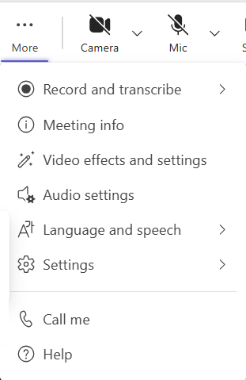
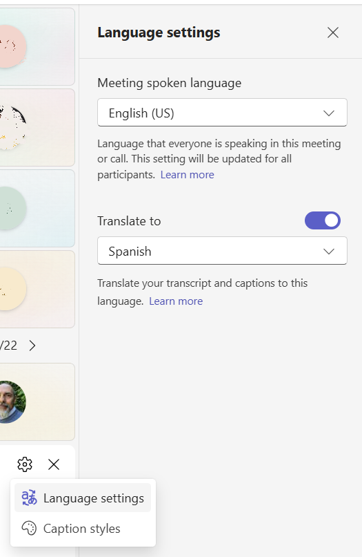
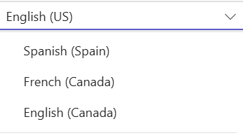

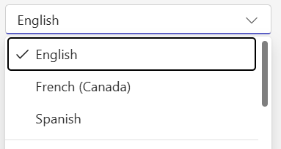

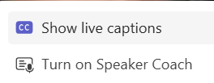
MSTeams automatic CC interpretation
This parameter changes the "Spoken Language" for everybody in this meeting, use
with caution!
1
2
4
This
parameter
changes
the "Translate to" for yourself only, enjoy ☺
3
Speaker name: The close caption
will shows at the bottom of
your screen…
Notes:
Heads up, today we will offer a bilingual session, first slides will be in English, some in French, and then back to English.
Feel free to follow in your prefered language, I beleive the decks in both language were provided, or you can use the close caption feature on MSTeams.
To turn on the “automatic CC Interpretation, follow the next steps
From the “more” option at the top of your window, select “Language and speech”
Then select “Show live captions”
It opens up a window at the bottom
Towards its right, there is an engine icon,
from there select “Language settings”.
On the right, the “Language settings” panel opens
Toggle the “Translate to” option,
and select the language to translate the CC into
5 - Be aware that if you change the “Meeting spoken language”, it does for everybody on this meeting.

Slide 3
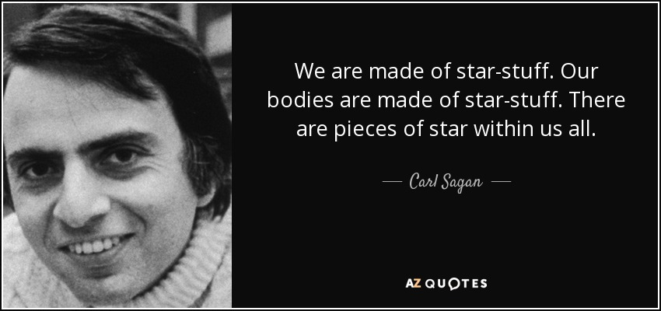
We all are STARS
Notes:
Jena:
This slide shows a quotation from the well known, and dear to many, astronomer late Carl Sagan.
Read the quote
(click)
We all are STARS
His statement sums up the fact that the carbon, nitrogen and oxygen atoms in our bodies, (as well as atoms of all other heavy elements), were created in previous generations of stars over 4.5 billion years ago. Because humans and every other animal as well as most of the matter on Earth contain these elements, we are literally made of star stuff.
What is more amazing is that the complex balance of these molecules gives way to a complex biological system that allows us to move, to feel emotions and even contemplate our existence.
This quote continues on to say, “Some part of our being knows this is where we came from. We long to return; and we can, because the cosmos is also within us. We’re made of star stuff. We are a way for the cosmos to know itself.”

Slide 4

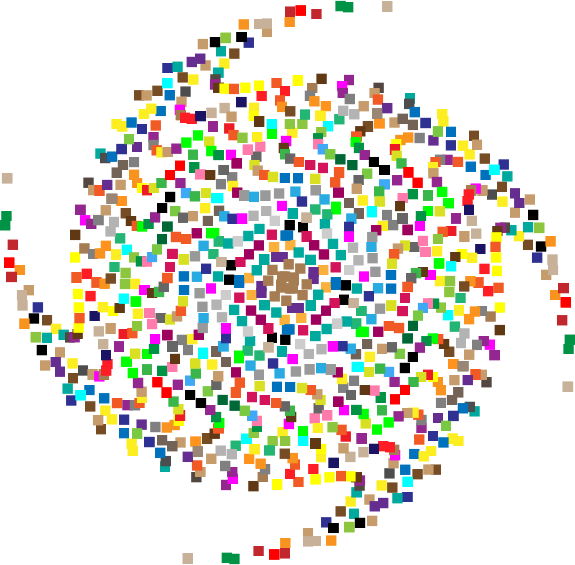
Mindful Breathing Exercise – Centering
Time required: 2 minutes
Sit comfortably, with a straight back
Close your eyes or find a soft gaze
Focus on your breath
Notes:
Jena:
With this we will come into a mindful centering exercise, one of many, we will do these at the start of all sessions as a way to bring our attention and awareness to this moment and to set the space for a beneficial session for all.
Sit as comfortable as possible in a position that allows you to be awake, attentive and comfortable at the same time
You can put your feet flat on the ground, your palms on you lap, upside or downside as it feels more comfortable
Feel free to close your eyes, or semi close them
Follow my voice as I lead you through the exercise
Gently bring attention to your breath, no need to change the way you’re breathing, just notice it
Let’s not worry about time
Just focus on
Breathing in
Breathing out
If at any time your mind wanders away, being gently with yourself, acknowledge that thought, let it be, and bring back your attention to your focus of attention, your breathing
Breathing in
Breathing out
Now, we’ll take one full minute of breathing for centering ourselves
I’ll let you know when the minute is over
Just continue focusing on your breathing

Slide 5








This is a “hands-on” program
Raise
hand
Sub-groups
Video
Connecting
& Debriefs
Buddy
System
Tasks
Notes:
Jena:
During the sessions, we may or may not use the mentioned functionality or activity
(click 6 times)
Mention each tool/activity

Slide 6





Hands on Workshop
Sub-group
Cohort, CoP, CoI
(GCCollab)
Journaling
Buddy System
Debriefs
Weekly Sessions
Centering
Excersices
Homework
Notes:
Jena:
Addition: this is a toolbox, don’t worry if you feel you’re getting overhwhelmed… just try to be present
Today’s Objective is to familiarize with the program
One thing to understand is that this program is a workshop, very hands on and there is a bit of homework to do every day, the idea is that you have the support for you to experience it in a welcoming environment, week by week, step by step, in community via this weekly sessions, your Buddy System & the Cohort.
The objective of today’s session is to familiarize with the way these sessions will be offered, to know the structure of the sessions and start your first week of your practice.
Now, here is an explanation of all the resources and activities we’ll be using throughout the program. It may take a bit of time to get used to everything, just be patient
(click on every main bullet, until the figure in the center appears)
Sessions 1 – 8: Once a week, 1.5 hours, generally on Mondays, we now use MSTeams
Debriefs (Breakout rooms) – this is to give time to reflect and share perspectives. Usually at the very last of every session, designed like that to give each breakout room as much time as needed
You’re encouraged throughout the sessions to write a few bullets so you can debrief in small groups at the end
Centering exercise, like the one we did when starting the session
The Buddy System: the same group of (4 to 6) people that you will meet at your convenience once a week to reflect and talk about the homework, and how things are going for you in the program.
The Buddy System are created randomly later today.
Be aware, the Buddy System is where the majority of the people obtain the best value for your efforts, so be sure to join and participate in yours
[file link here, and share LATER via the chat]
Gratitude journal – yes, you’ll need a notebook to write on.
The benefits of this is to reconnect with your feelings, particularly those related to gratitude
For journaling, it can be bullt form, or paragraph as you prefer, my own examples are something like:
I am grateful for food in my fridge
I am grateful for feeling the sun in my skin
The Cohort – is a GCCollab group, now morphed to include the CoP/CoI, in here you can find the recordings, slides, and homework. You can also ask questions, share resources, and more
[have the link here, and share LATER via the chat]
Homework/Mindfulness practices – there are plenty and it may be overwhelming, my preference is to share them gradually on every session, and if there is a need then you can explore and share
Sub-groups – in some sessions there will be exercises we practice in different small groups
And guess… who’s in the center of all of this?
Yourself!!
As mentioned, it may seem like a lot in one slide, keep in mind there will be the opportunity to get to know and use them gradually
And we’ll explain some of them in more detail in the next few slides

Slide 7

Agenda - Week 1 – (focus and clarity)
Centering – Breathing exercise – 2 minutes (done)
Welcoming (done)
Overview of resources/toolbox
Etiquette / Main goal of the Program / Target Audience
Snail Model
The importance of “Connecting” & Buddy System
Gratitude Journaling
Practice: 5 min body scan
Debriefs
Your takeaway assignment for week 1.
Meeting Your Buddy System
Notes:
Dani:
Be advised: Today session will be the most lengthy…
(review/read from the slide)

Slide 8

Etiquette
What would we like to see happening in our sessions and during your Buddy System get togethers?
Respect
Having fun
Confidentiality
Consider and treat this virtual
classroom as a safe space
We follow the Values and Ethics Code for the Public Sector
Notes:
Dani:
(kind request/reminder) Webcams are welcome, please avoid eating while your webcam is open
[[Values and Ethics Code for the Public Sector – https://www.tbs-sct.gc.ca/pol/doc-eng.aspx?id=25049 == https://www.tbs-sct.canada.ca/pol/doc-fra.aspx?id=25049]]

Slide 9

Sessions are Recorded
For sharing via the Cohort page:
The recording is helpful for those who miss a session or would like to revisit the material
Be assured, if there is ever something sensitive recorded, at the request of those involved, the recording will be edited before posting
The breakout rooms are not recorded
Notes:
Dani:
(read from the slide)

Slide 10
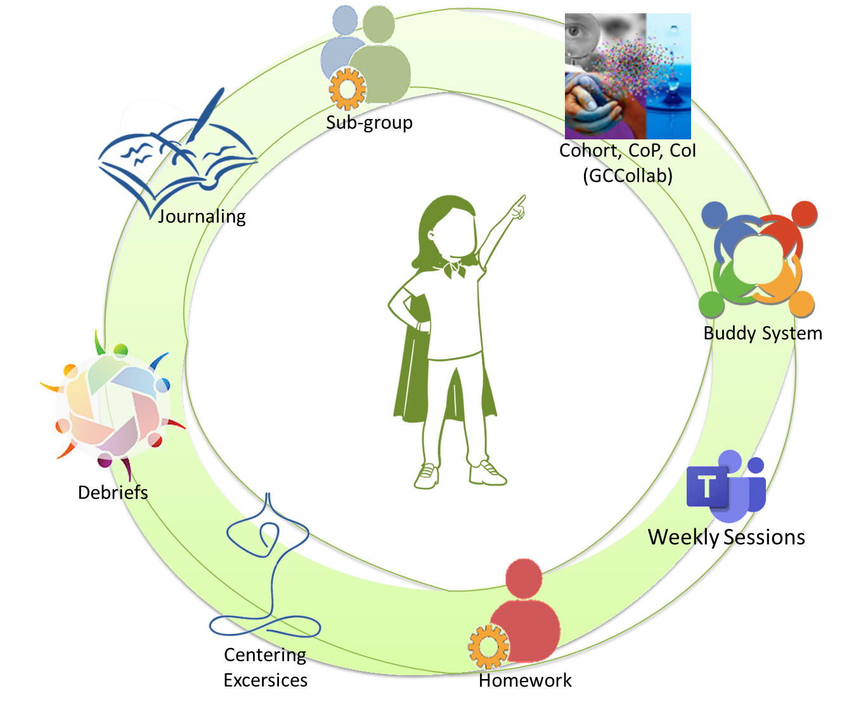

Target Audience
Notes:
Dani:
Who is the target audience for this program?
(click on every bullet)
This program is those who are willing to invest in their selves and develop their self-awareness
This program is for you! the individual, not to your team, other employees, your bosses, other communities or trainings, or any other people who you think may benefit from this program
In other words, this program is for those wishing to take it, those who got the support from their management and voluntary joined the program to become more Self-Aware

Slide 11
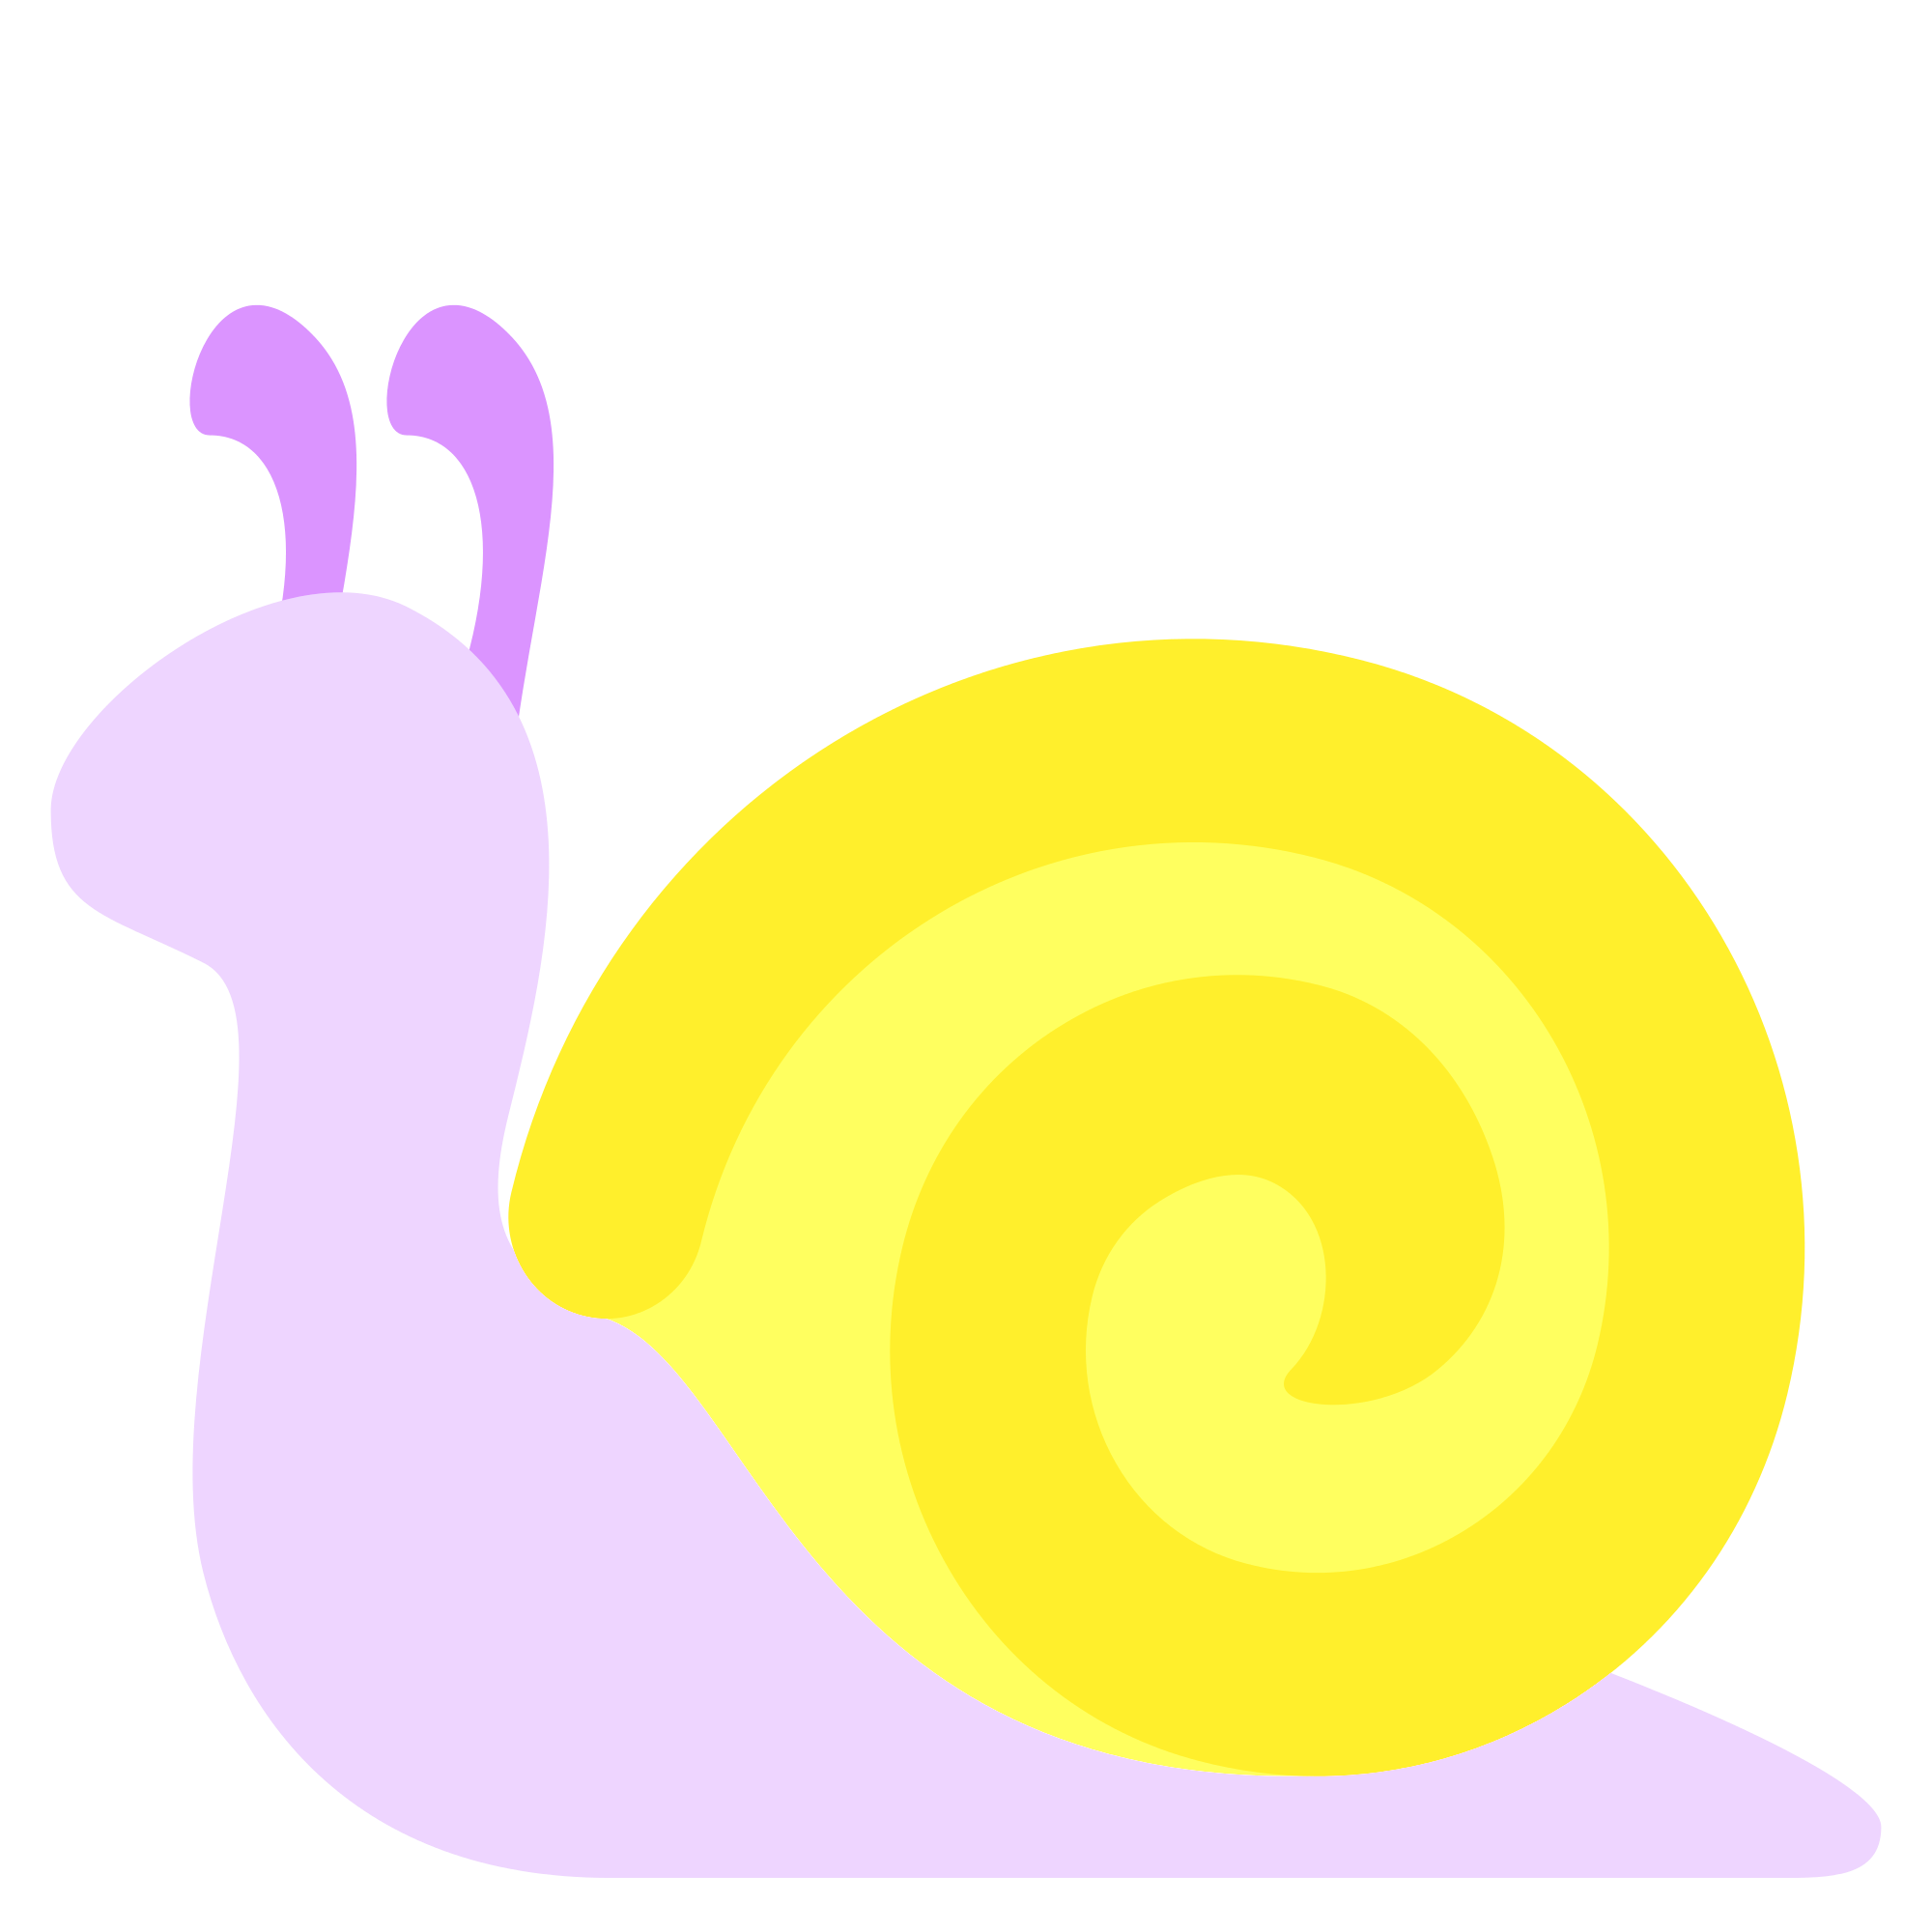
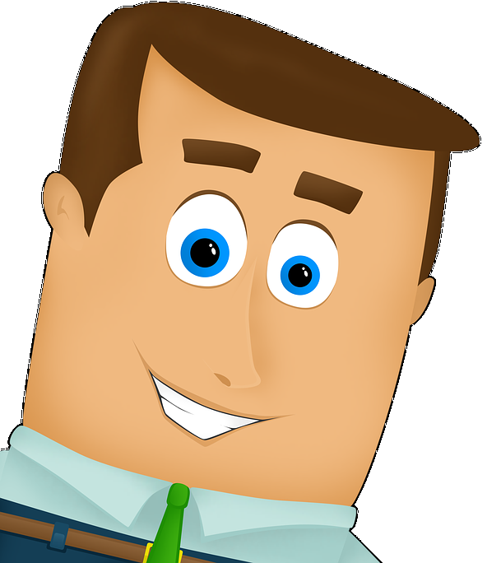

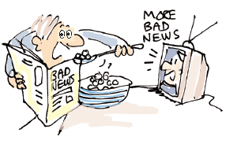
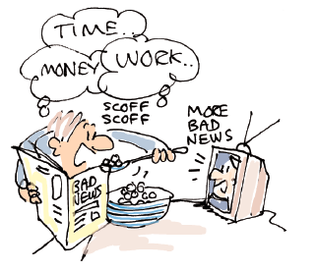
Snail model – From unaware to unaware
Desired
Aware - Desired
Unaware - Desired
Behaviours
Aware
Unaware
D i s r u p t i o n
Aware - Undesired
Unaware - Undesired
Undesired
Notes:
Dani:
Now let’s take a look at a model, I call it “the snail model”, it goes from unaware to unaware… adapted from the Four stages of competence model
(click on every main bullet)
This model is based on behaviours
We have desired and undesired behaviours,
We also have the aware and the unaware behaviours
To understand this model, let’s start at the bottom right quadrant, with the unaware-undesired behaviours
At some point we become aware of that undesired behaviour on the bottom left quadrant
And then we start to change that behaviour to a desired one while being very aware of it, on the top left
And after sometime, practice and effort we move to the top right quadrant, with the desired behaviour and unaware, because we do it automatically
Let’s review the model with a few graphics added and some examples
We start in the same sequence, bottom right, let’s say we are “multitasking”, having breakfast, reading the newspaper, while watching the news, planning the day with the partner, and encouraging the kids to go on their day
Then something happens, we become aware, see the expression on the face of the cartoon. There is something that happens that makes the person become aware
On the top left, you see the expression, the person is making a strong effort to do one thing at a time, is aware of the desired behaviour and is making an effort to focus on only reading the newspaper
Then with practice, the person does automatically and unaware the desired behaviour
The cycle typically starts with a disruption, it could be this program, or something recent because you’re already taking this program. There is something inside you that already started this cycle
And very rarely this change occurs quickly, that’s why it’s called snail model… it takes its time to arrive
[[Adapted form https://en.wikipedia.org/wiki/Four_stages_of_competence]]

Slide 12
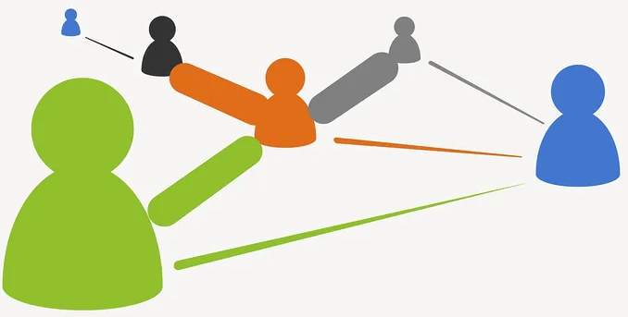
The importance of “Connecting”
We will build relationships throughout the program
By using reflection and engagement tools
By sharing your experience and what you notice
These all are elements that bring the program to life:
Notes:
Jena:
How important is building relationships? Well, it's very important!
We build relationships throughout the program by doing the following:
during the session, by doing various activities, such as exercise debriefing and exercises in subgroups;
between sessions:
through the buddy system, which remains the same for all eight weeks;
through the Cohort, by participating, asking questions, and sharing your experience.
How do you think we'll build relationships throughout the weeks of the program?
During the session, in subgroups, and during exercise debriefing (breakout rooms and plenary session)
Buddy System
Cohort
The idea is to use all the tools for reflection and participation. By talking about your experience and what you've noticed:
by sharing something you've learned,
an opportunity you've seized, or
something you've understood.
These all are elements that bring the program to life.

Slide 13


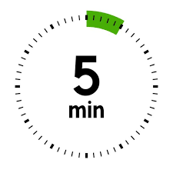
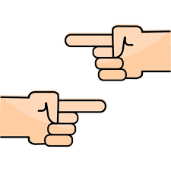
The Buddy System
Buddy
System
You have received an Excel spreadsheet detailing your buddy system.
You are expected to touch base with your buddies once a week.
This helps increase mutual support and accountability.
Notes:
Jena:
Now let's talk about the buddy system.
You have received an Excel spreadsheet detailing your buddy system. MCLD_2025_Buddy_System.xlsx ()
https://wiki.gccollab.ca/images/4/46/MCLD_2025_Buddy_System.xlsx
We expect you to communicate once a week with your buddy.
During the conversation, you will:
discuss what you found interesting and challenging, and what you enjoyed most during the week;
hold conversations for a few minutes, with 5 minutes recommended for each buddy.
This helps increase mutual support and accountability.

Slide 14
Throughout the program
Sub-group
Sub-group
Sub-group
Debriefs
Debriefs
Debriefs
Debriefs
Debriefs
Debriefs
Debriefs
Debriefs
Week
1
Week
8
Buddy System
Notes:
Jena:
(click on every main bullet)
Throughout the program:
Sometimes there will be sub-group activities
There are also debriefs every day, typically towards the end of the sessions,
These are likely to occur with different colleagues every time, as they are randomly assigned
And you also have the Buddy System, which remains the same
You will meet every week with your buddies throughout the 8 weeks
(share the link to the buddy system file)

Slide 15
Gratitude journaling
Take a notebook that will serve you as your journaling reflection or diary – this is personal
Let’s take 2 minutes to write down what you are grateful for
http://greatergood.berkeley.edu/article/item/how_to_upgrade_your_gratitude_paractice
Notes:
Jena:
We're going to take some time now to write down our gratitude for the world we live in. Grab a notebook or use your smartphone to write down your thoughts or keep a journal. This is a personal journal.
We're going to take two minutes to write down something you're grateful for.
This could be in bullet form
Even 2 or 3 things per day will do
They can be simple things you did or noticed during the day
(after reading from the slide)
Some examples of what I write are:
I’m grateful for being able to feel the sun in my skin
I’m grateful for a night of sleep
If you seem to be stuck, start writing whatever is in your mind, even something like "I’m supposed to write something, and my mind is blank. Not sure what to write. What am I grateful for? What is the littlest of the things I’m grateful for?" and something will come any time. When that happens, feel free to leave your sentence interrupted as you are capturing what you’re grateful for.
I’ll start the timer now… (2 minutes)
During the debrief in a couple of minutes, you’ll have the opportunity to share what you noticed, what you found challenging, what amazed you, any other thing you’d like to share.
[[ Note for Translators: Not to be translated nor referenced during the presentation Some additional references:
The benefits of Gratitude Journaling: https://wanderersway.com/blogs/wanderers-way/what-are-the-benefits-of-gratitude-journaling
https://mindfulambition.net/gratitude-journal/
https://www.mindful.org/a-simple-weekly-mindfulness-practice-keep-a-gratitude-journal/
https://ggia.berkeley.edu/practice/gratitude_journalIf
]]

Slide 16
Practice – The basics (1/2)
The intention of being (as opposed to doing)
  Posture
  Slightly tuck your chin
  Mindset
  Focus on the breathing
  Notice
It is about feeling the way you feel, about noticing without judging
Notes:
Dani:
Daily mindfulness exercises greatly benefit your health. They reduce stress, increase concentration, and improve mental clarity.
Don't hesitate to do them every day. You can do them in your chair at work or at home. You can also lie down.
The goal is to get comfortable, to have the intention of being (rather than doing).
So here are some basics:
The intention of being (as opposed to doing)
Posture: sit with a straight back, as comfortable as possible, as if your head is pending from the top
in the chair that you are sited, or cross legged if you feel comfortable
slightly tuck your chin
Mindset: keep an open mind, feel the experience
You experience may vary each day, all is good
Focus on the breathing
Notice
It is about feeling the way you feel, about noticing without judging
have no expectations
have no judgement
have a beginner's mind
be an observer... the mind may be busy and noisy, just observe it

Slide 17
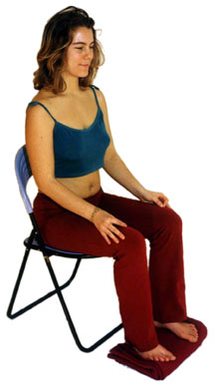
Exercise – Exploring Mindfulness – Body Scan
Time required: 5 minutes
Take advantage of the opportunity and
experience this exercise
Sit comfortable with a straight position
Feel free to close your eyes
Follow my voice as I lead you through the exercise
Notes:
Dani:
To start, let’s experience a mindful exercise…
If you haven’t, take advantage of the opportunity to experience this exercise
Sit as comfortable as possible in a way that allows you to stay awake and attentive
Put your feet flat on the ground, your palms on you lap, upside or downside as it feels more comfortable
Feel free to close your eyes, or semi close them
Follow my voice as I lead you through the exercise
Gently bring attention to your breath, no need to change the way you’re breathing, just notice it
Now, direct your breath and attention and focus on…
Your head, particularly on your mouth, your teeth, your jaw, your lips,
breath in, noticing
your face, your eyes, nose, chicks, eyebrows, front head
As we breath out
Now focus on the top of your head, your scalp, your hair, your ears,
As we continue breathing,
Now focus your attention to your shoulders, breath in, breath out, and notice
Your arms, your hands and fingers, in and out
Every time your attention wanders away, just bring it back gently
Back to your shoulders, and neck, noticing
Your upper back, chest
Your lower back, your abdomen
Direct your breath towards your waist, in and out
Your lower leg, in and out and your upper leg, and notice what you feel
Your feet, in and out, notice what you feel
Your toes, breath in, breath out
Stay there for a few seconds, breathing in and out
When you feel like, open your eyes and come back
(next slide: Debrief)

Slide 18
Debrief – Plenary & Small Groups
Share how the experience went for you
  What insight did you get?
  What did you notice?
  What was challenging or surprisingly easy?
You’ll be joining a small group of 4 to 6 people, randomly assigned
Be conscious of your airtime.
A message will be sent to let you know how much time there is left
Notes:
Dani:
Before debriefing the exercise in small groups, we'll allow a few people (let's say three or four, depending on the time) to speak in plenary. Now, I'd like to open the floor to two or three people who would like to provide feedback in plenary. If you're the first, simply unmute your microphone and speak; if you're the second or third, please raise your hand.
(Give the microphone to two or three people.)
You could share what caught your attention the most.
Talk about how the experience went for you.
What did you learn?
What did you notice?
What was difficult or excessively easy?
((Prepare for breakout rooms))
(Click)
We’ll have about 10-15 minutes, and then come back to continue the session.
For now you'll have the opportunity to provide feedback, in small groups of four to six people who will be randomly assigned. Just be mindful and share the time available among yourselves.
Use your preferred language, introduce yourself briefly, and you'll be able to answer the same questions as those asked.

Slide 19
Your turn for week 1
Connecting – once a week with you buddies
Gratitude Journaling – daily
Practice 5 mins body scan – daily
  https://archive.org/details/BodyScan6minsB
  https://www.youtube.com/watch?v=TRnq8u-3JWU
  https://www.youtube.com/watch?v=6aysZYNGse0
  (aimed at kids, but still really good
  https://www.youtube.com/watch?v=xLoK5rOl8Qk
Questions or comments during the week?
please ask and share via the Cohort
Notes:
Dani:
Connecting – once a week with you buddies
Recommended 30 minutes call: 5 mins for each, you can discuss what you found interested, what was challenging, what you like the most
Gratitude Journaling – daily
This could be in bullet form,
even 2 or 3 things per day will do,
They can be simple things you did or noticed during the day
Practice 5 mins body scan – daily
https://archive.org/details/BodyScan6minsB
https://www.youtube.com/watch?v=TRnq8u-3JWU
https://www.youtube.com/watch?v=6aysZYNGse0
(aimed at kids, but still really good) https://www.youtube.com/watch?v=xLoK5rOl8Qk
Questions or comments during the week?
please ask and share via the Cohort

Slide 20
Meeting Your Buddy System
Take note of your buddies; you can find them via DLCP_2025_Buddy_System.xlsx
One person from your Buddy System must match the meeting invitation (outside of this session).
  It may take a bit of effort to communicate the meetings via email.
  If time permits, you can use the reminder minutes of this session to
    meet with your buddies.
    Agree on a date and time.
During your Buddy System meetings, on another day starting this week, you have the opportunity to share:
How was your experience this week?
What insight did you gain?
What did you notice?
What was difficult or surprisingly easy?
Notes:
Dani:
Take note of who your buddies are, you’ll find them via the DLCP_2025_Buddy_System.xlsx (https://wiki.gccollab.ca/images/d/d5/MCLD_S1_2025_-_Intro_Structure_BuddySystem_SnailUnaware_5Mins_BodyScan_Journaling.pptx)
One person in your Buddy System needs to coordinate the meeting invite (outside of this session)
This may take a bit of email effort to coordinate the meetings
If time allows, you may take advantage of the reminding minutes of this session to
meet your buddies
Agree on the day and time to meet
(cilck)
In your Buddy System meetings, another day starting this week, you have the opportunity to share:
How did this week’s experience go for you
What insight did you get?
What did you notice?
What was challenging or surprisingly easy?

Slide 21
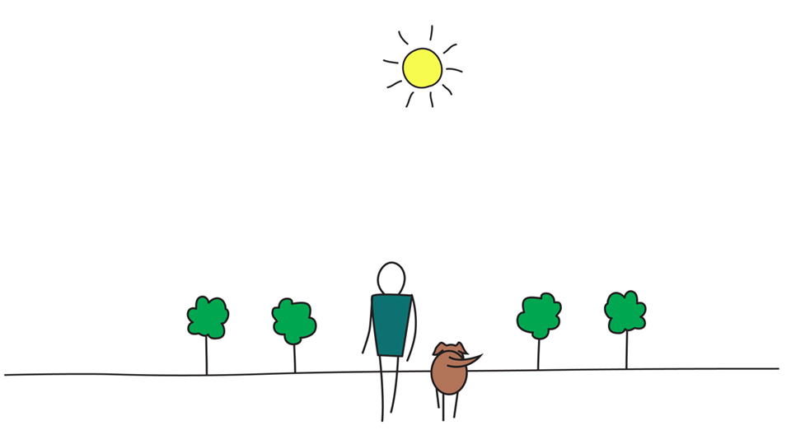

Be Mindful, Be Happy
Notes:
Dani:
Are there any questions?
Otherwise, I wish you happiness

Slide 22
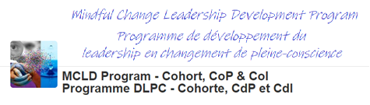
The Cohort
We have many people registered for this program, thus it is considered to be a MOOC (Massive open online course - Wikipedia)
To support your learning experience, we will be using the “MCLD Cohort”, a GCCollab group that is also a Community of Practice:
To leverage the collective knowledge of the group
To access the recording and slides of all sessions
To ask questions
To share experiences
Notes:
Alison:
Addition: you’ll need to create a user and « join » the group
Gccollab reminder to join you need a user profile created and join :
https://account-compte.gccollab.ca/
https://gccollab.ca/groups/profile/7978973/mcld-program-cohort-cop-coi-program-dlpc-cohorte-cdp-et-cdi
[[Massive open online course – Wikipedia - https://fr.wikipedia.org/wiki/Massive_Open_Online_Course
* The link has been changed to reflect French. The title in French is still « Massive open online course MOOC »
]]
(click to show bullets, commenting on the end)
And we’ll do our best to treat it as one
And we use it…

