Slide 1
Usability testing – How to get your proof of vaccination
November 3-5, 2021

Slide 2
Method
Remote testing via MS teams
Participants
7 total participants - Canadian Citizens and permanent residents
- 3 English
- 4 French
Devices
- 4 smartphone
- 3 desktop
*All 7 participants already had a proof of vaccination document

Slide 3
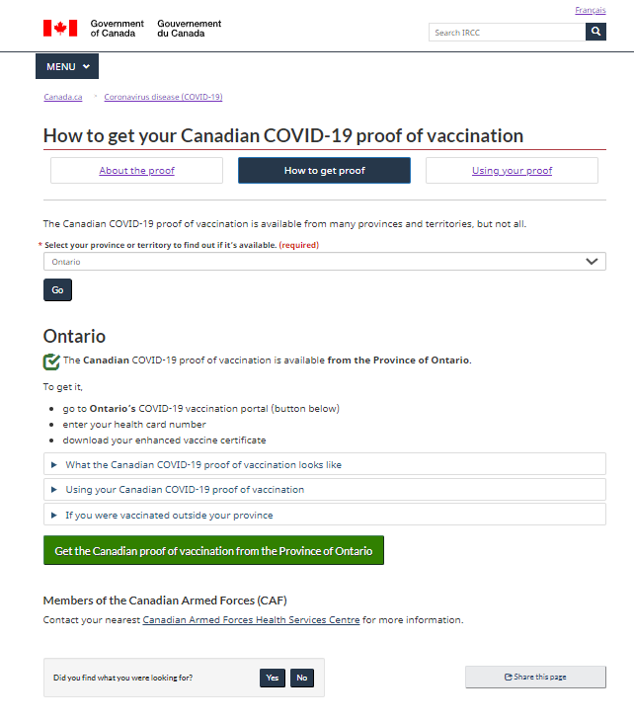
Focal point of usability testing
PAGE:
How to get your COVID-19
proof of vaccination
Scenario 1 – International travel
“Let’s pretend that you are vaccinated, you live in [province or territory] and you plan to travel internationally next month. Your friend sends you this link”
https://www.canada.ca/en/immigration-refugees-citizenship/services/canadian-covid-19-proof-vaccination/get-proof.html
Scenario 2 - Travel within Canada
“Let’s pretend that you are vaccinated, you live in [province or territory] and you plan to travel to Alberta next month. Your friend sends you this link”
https://www.canada.ca/en/immigration-refugees-citizenship/services/canadian-covid-19-proof-vaccination/get-proof.html

Slide 4
Key finding
Participants were able to successfully navigate the ‘How to get proof’ page to get to the button

Slide 5
Other findings of note
Where would they start to get info about proof of vaccination
Most participants said they would go to Google and search for
How their province was providing proof of vaccination
What the government where they were traveling to would accept as proof
No participants said they would check the Government of Canada website

Slide 6
Other findings of note
The “Get Canadian proof” button
On mobile, most participants did not recognize this was a button at first.
On desktop, most people jumped immediately to the button and clicked it before reading any of the content or the button label itself.
Of those who did read the button label, some found it to be unclear.
Most participants expected the button to take them straight to a form to obtain proof and were surprised to have to continue to navigate to find a form.

Slide 7
Next steps
Continue to look at feedback and align with results of usability test
More testing
Continue to clarify areas of confusion from testing results

