Slide 1


The Re-Emergence of GSRM
Governments of Canada Strategic Reference Model
Gary Doucet
VP Practices and Chief Architect
D4iS Solutions
Neil Kemp
Independent Consultant &
D4iS Associate Partner

Slide 2

Lets build a house
Yes we should
Sometimes there is a weakness in words.
But there is a power in models.
EA in the GC: Government of Canada
Notes:
This is an example of confusion when we use just words. Models are a mixture of words with strict meaning and supporting pictures. There is a weakness in words and a power in models.

Slide 3
Summary
The public sector reference model work done in Canada, starting in the early 1990’s, was and still is considered by some to be best in class.
The GSRM (Governments of Canada Strategic Reference Model) was the GC version and it seemed to drop from sight (as well as pan-Canadian efforts) around 2009.
Support did fade but it was more accidental than intentional.
There are still pockets of interest, use and enhancements.
The governments of Canada are wondering what to do next.
Is it time for Open Group involvement?

Slide 4
Context: Timeline
1990s
MRM: Municipal Reference Model developed (Winnipeg)
A standard way to describe services and enable “Service Based Costing”
1995-2000
PSRM: Public Service Reference Model (Ontario)
2002-2004
GSRM: Governments of Canada Strategic Reference Model (GC)
2004-2006
BTEP V2.0 Released (with GSRM).
2006-2007
GSRM Meta Model Created
Presented to UN/CEFACT for consideration as a standard.
BTEP – Business Transformation Enablement Program
Notes:
1990s
MRM: Municipal Reference Model developed
Started in Winnipeg
Chartwell creates the primary IP of the reference models.
A standard way to describe services (Comparable between cities)
Specifically focused on public sector.
Enabled Service Based Costing
Supported by MISA
1995-2000
Provincial Service Reference Model (PSRM)
Started in Province of Ontario
Added services of a provincial nature
2002-4
Governments of Canada Strategic Reference Model (GSRM) Developed
GC adds services types and expands MRM/PSRM beyond services
GSRM is key of BTEP (Business Transformation Enablement Program)
Sponsored and developed by team within Treasury Board Secretariat (TBS)
BTEP “V1” – early adopter projects
Creation of SMSC
2004-2006
BTEP V2.0, Release and promotional campaign
Published set of five documents with templates
Better Outcomes conferences initiated (by GOL Communications)
“Common Language is Common Sense”
2006-7
GSRM Meta Model Created
Presented to UN/CEFACT for inclusion in their standard
UK, Australia, US and Canada agree to look for collaborative project
Gartner publishes review of BTEP and GC EA Program
GSRM Used to inform Internal Services Profile which then becomes part of annual budget process.
Dozens of projects using BTEP and/or GSRM
2007-2008
Decision at SMSC and Joint Council results in creation of CGRM (Canadian Governments Reference Model)
A unified model for all orders of government.
Decision to leverage ICCS for BTEP and GSRM
Concept of Maximum Middle introduced
Upon Joint Council Approval, GC begins legal work to deal with accumulated IP to allow move to ICCS
Takes one year and delays progress
Meantime: MRM project to have a shared repository for Municipalities (led by Region of Peel) (IBM wins contract)
TBS EA Program moves to embedded model.
Internet assets for GSRM and BTEP archived
2009 - Present
Dozens of projects using GSRM, PSRM, MRM and BTEP but steady decline in activity/support.
Continuation of SMSC but steadily declining activity.
Issues
Lengthy legal research surrounding IP with GSRM/BTEP stole time from operationalization agenda.
EA team at GC moved to embedded model and BTEP/GSRM leadership discontinued.
CGRM and BTEP “business lines” at ICCS not operationalized.

Slide 5
Context: Timeline
2007-2008
Decision to create CGRM (Canadian Governments Reference Model)
Will start by offering GSRM content but need to do IP review first
To be managed ICCS (Institute for Citizen Centered Service)
A unified model for all orders of government
Issues
Lengthy legal research surrounding IP with GSRM/BTEP stole time from operationalization agenda
EA team at GC moved to embedded model and Reference Model leadership discontinued
ICCS – Institute for Citizen Centered Service – An NGO serving federal, provincial and municipal governments of Canada
Notes:
It is the hand-off from Federal government to ICCS that seems not to have been executed properly.
The closure of the GC EA program left no organization to steward or speak for CGRM, GSRM nor BTEP.

Slide 6
Why a Reference Model?
To answer questions correctly, consistently, and efficiently:
How many programs and services do we have?
What services do governments provide to a target group (i.e., seniors, youth, indigenous)?
How much do we spend to deliver those services?
Are the services achieving the intended outcomes?
How do we best deliver seamless client-centred services from multiple governments?
How much are we investing in internal services … per external service?
These seem like simple questions but they are hard to answer, especially in aggregation.

Slide 7
Why a Reference Model?
And to design well …
  Ensure solution accomplishes outcome.
  Align execution to strategy
  To align projects to each other.
  To align business units to each other.
  To deliver unified, seamless, accurate and proactive service to clients.

Slide 8
Why a Reference Model?
Improving Business Change Planning
Fosters a common government-wide approach to design:
Provides a common reference point for business “program/service” design.
Helps express and understand the “whole business system” as a strategic design.
Supports the evaluation of alternate strategies and designs.
Requires formal ongoing design governance i.e. aligning investments for business and/or IT change.
Advances goals for seamless and interoperable client centric services.
Please note use of “or”.
Notes:
Why do we need reference models for Business Planning?
Provides a common enterprise-wide approach to see “big picture”
Gains unambiguous stakeholder consensus on all aspects
Reduces risk with stronger evidence based decisions on strategy and implementation
Supports the ongoing alignment and governance of changes
Supports portrayal of interdependencies and linkages within and between departments, agencies across jurisdictions
Provides a rigorous foundation for business and IT alignment
Improves overall business analysis and planning capability

Slide 9
xRM Intro: GSRM
Government of Canada Strategic Reference Model (GSRM)
A consistent model for describing public-sector business designs
A common multi-government public sector vocabulary
Common tools and common language for GC business architecture designs
Supports stakeholder communication, collaboration and consensus
Reusable program/service design patterns
Facilitates business designs to be scalable, integrated and aligned
Supports rigorous, high level analysis and design across diverse portfolios
Notes:
Since GSRM would be the start of CGRM, it is good to know some facts about GSRM:
GSRM: Governments of Canada Strategic Reference Model
Federal Government’s Adaptation of MRM and PSRM
From “Service” to “ Strategic”
GSRM “v1”: 1998-2002
GSRM “v2”: 2003-2004
Business Concepts and Language
Reference Patterns and Metrics
Multi-jurisdictional
Note change of Jurisdiction to Policies.

Slide 10
xRM Intro: GSRM
Provider Programs
Public Programs
Provider program fields are identified by the needs of public programs & other provider programs
Public program fields are identified by the public needs recognized by the government
Public
Target Group(s)
Public Policy,
Planning and Management
Corporate Policy,
Planning and Management, Integrated Delivery,
Communications Management,
Human Resources Management,
Financial Management,
Information Management
Information Technology,
Supply Chain Management,
Administrative Services
Facilities, Fleet and Equipment,
Professional Services
(Socio-) Economic Development
Science and Knowledge Development
Natural Resources
Environment Protection
Public Health
Legal, Collective, Democratic & Human Rights Protection
Social Development
Cultural Development
Educational Development
Public Safety
National Security & Defence
Justice
Notes:
Explain by moving from right to left
Programs that deliver services directly to external target groups are called public programs.
Examples of these include (Socio-) Economic; Environment Protection;…
Those that deliver primarily to other government programs are called provider programs
Provider programs can also be seen as the “internal programs and services” required by the Government to enable it to deliver public programs and services.
Examples of these “internal” programs include: Human Resources; Financial Management; Information Management & Technology Services …
The Information Management fall under the Information Management & Technology Services and is thus an example of a provider program.
Similarly Enterprise Architecture is a provider program. For organizations that still consider EA a technical thing, it too might be considered a part of Information Management & Technology Services.
Today most organizations however regard EA in a broader context and use EA disciplines to support their Corporate Planning.
More in IM & EA in a few slides

Slide 11
xRM Intro - Types of Service Outputs
Service Output Type
Service Type
Supply capacity to act
Funds
Acquiring and providing financial resources
(Units of) Resource
Providing resources such as goods, equipment, accommodations (apart from funds and human resources)
New Knowledge
Conducting research
Enhance capability to act
Care & Rehabilitation Encounters
Providing care & rehabilitation to people and things
Educational & Training Encounters
Providing education and training experiences
Recreational & Cultural Encounters
Providing recreational & cultural experiences
Movements
Moving people and things
Facilitate & influence action
Advisory Encounters
Providing information & advice
Matches, Referrals & Linkages
Brokering, referring, connecting, matching
Advocacy and Promotional Encounters
Influencing, advocating, persuading, promoting awareness
Periods of Agreement
Creating collaborations, negotiating agreements, settling disputes
Regulation
action
Periods of Permission
Regulating, licensing, permitting, certifying, identifying, authorizing
Findings
Inspecting & investigating
Rulings & Judgements
Applying rules & dispensing justice
Penalties & Periods of Sanction
Enforcing compliance, meting out punishment, penalizing
Periods of Protection
Monitoring, warning, guarding, storing, eliminating threats, reducing risks
Interventions
Intervening, responding to threats & emergencies, giving aid, restoring order
Core
Rules (laws, regulations, policies, strategies, plans, designs, standards)
Creating and changing rules
Implemented changes
Changing existing organization, practices, systems

Slide 12
xRM – Patterns
GSRM:
Over 100 patterns
Patterns for:
  Service (Value) Measure
  Service Measures (~25)
  Process Patterns (~ 100)
Supports the 19 Output Types
Complex enough for all government services
Tailorable for Private Sector?

Slide 13
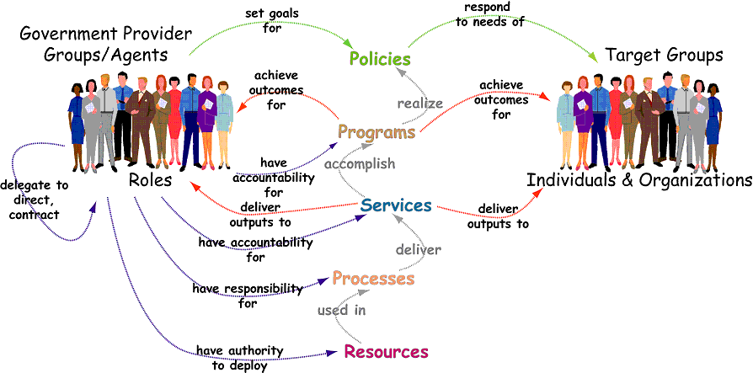
xRM Intro: GSRM Model
Common Language and Structure
Includes:
Standard Set of Business Components & Definitions
Standard Set of Integrated Business Models & Methods
Reusable Business Design Patterns
From GSRM
Notes:
Program – an accountable mandate to address recognized needs of eligible target groups and to achieve specified outcomes by producing service outputs using resources
Service – a means, administered by a program, of producing a final valued output (i.e. service output) to address one or more target group needs, a set of service processes that produces and delivers one service output.
(Service) Process – This refers to the work required to transform inputs to an output. When inputs are supplied and the service process is performed, an output is produced and delivered. Many service processes produce intermediate outputs (e.g. an application form or inspection) on the way to the service output.
Resource – the inputs required to complete a service process (e.g., manpower, money, materials, equipment, space)

Slide 14
xRM: Can they keep up with today?
Time from “service intention” to “operational business” can be greatly reduced with fully developed Reference Models. More on that later.
What if you wanted to hack a life event (retirement, birth of child, moving)?
You would want to bring together every public and private sector service related to that event.
Imagine if the reference model categorization of need and/or target group had been applied to service catalogs, application pages, published budget information, or existing on-line services?
Improves the speed and accuracy of finding services to invoke (or at least identify).

Slide 15
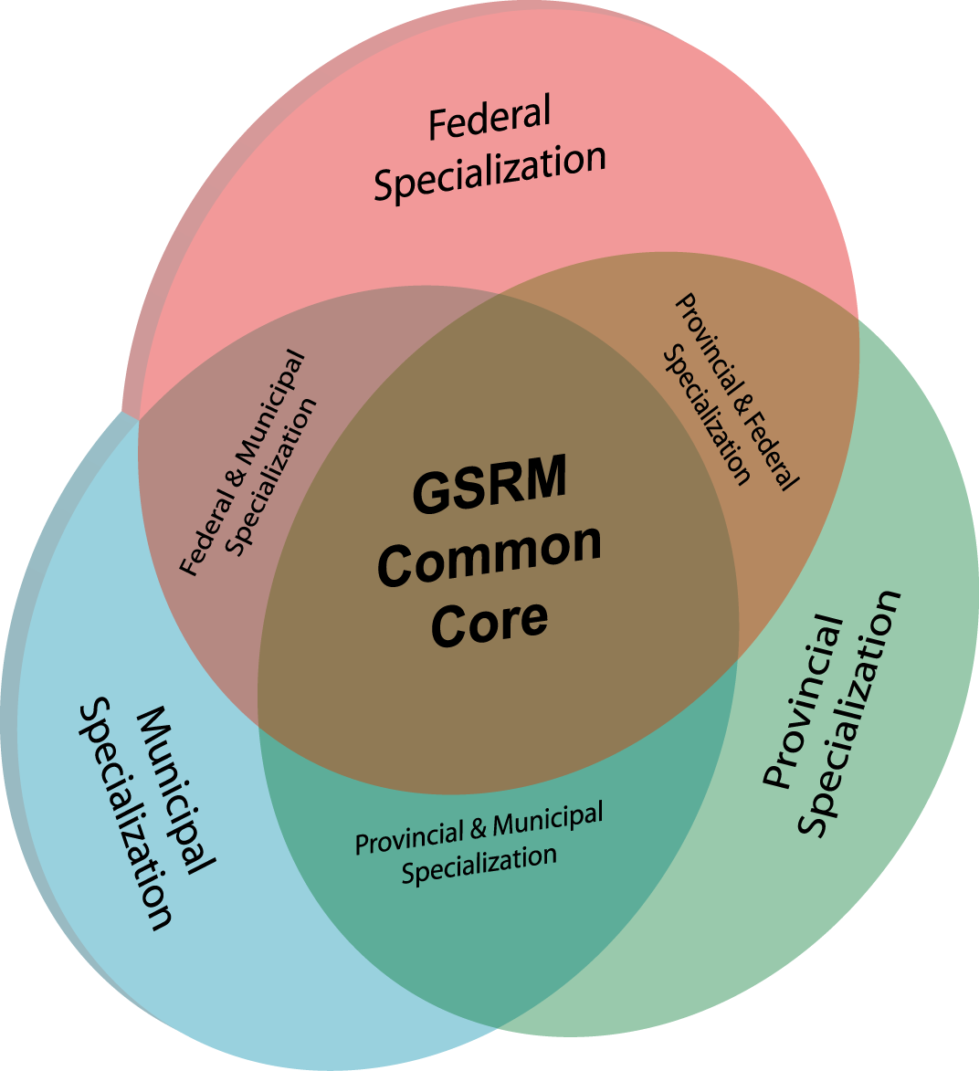
CGRM Governance
GSRM
Aligning Alignment Models
CGRM was started with the intention loading it with material from GSRM, MRM, and PSRM. This image reflects the concept of aligning the public sector reference models.
The central concept around CGRM is the attempt to create a single core which all jurisdictions could agree but allowing for some local differentiation.
CGRM
PSRM
MRM
Maximum Middle
By default, all models start as CGRM assets (i.e. for all to use). If an asset in the middle cannot be agreed then the part(s) which cannot be agreed becomes part of the localization.
Notes:
This slide represents the relationship we must put in place between the federal, provincial (e.g. Public Service Reference Model) and municipal (Municipal Reference Model) realms and the core GSRM between them.
In this core component are three things – firstly, core concepts such as service or program; secondly constructs such as the definition, usage, and business rules for SIAM (Service Integration Accountability Model) ; and thirdly there must be federated repository – a repository which represents shared and unique instances among the models. Within each of the models variances or developments are possible. Naturally a rigourous, but flexible configuration management and change control regime will be required to maintain cohesion.

Slide 16
BTEP
Business Transformation Enablement Program
Not the focus of today but it was the home for GSRM.
Started as part of Federal Government GOL Program
Follow on to GC Federated Architecture Program (FAP)
Business focussed: Visions, Designs and Transformations
Approach to Strategic Planning & Design, service transformation and business architecture.
Currently unsupported but parts still get referenced/used
TOGAF 9 references BTEP (Transformation Readiness Assessment)

Slide 17
Current Status
GSRM: Not actively being maintained by GC. Web assets archived in 2007.
MRM: Still active but quiet on the development front
http://www.misa-asim.ca/members/group.aspx?id=135372
PSRM: Still very active in the province of Ontario
GO-ITS 56 - OPS Information Modeling Handbook
CGRM : Technically “managed” by ICCS but not actively
Link http://www.iccs-isac.org/research/cgrm/?lang=en
Despite lack of formal activity and governance, there are still regular inquiries as to status of work and location of assets for MRM and GSRM.

Slide 18
Current Status – Re-Emerging?
ICCS:
  Has asked for a report defining and evaluating different xRM support models ranging from none to full.
  Is self-supporting and looking for new subscription services to offer its government members
  Already stewards other government-owned intellectual property
  Is a natural home for something like CGRM, especially given their service improvement orientation.
Authors are: Skip Lumley, Roy Wiseman, and Gary Doucet
  Collective experience covering all the models
Is there a role for an existing standards organization here?

Slide 19
A Practitioner's Story
GSRM Applied
Experience with Strategic Business Design
Neil Kemp

Slide 20
Experience
Consulting services for 15 years full time, as a business architect, using the GSRM
Providing advice on questions of interest to executives
Much more business than technical questions
Increase in questions of transformation of the business to exploit digitally enabled channels

Slide 21
GSRM “Likes”
Allows the creation of a repeatable, implementation independent and strategic views of the business to explore issues of purpose, value, accountability.
Focuses on things of great interest to executives
Exposes gaps and overlaps of a fundamental nature in what the business needs to achieve its mission
Provides a tool to explore questions about insourcing/sourcing, merger and divestiture and other strategic questions
Sets an important context for investments in capability by first understanding the nature of value to the enterprise

Slide 22
Principles for working with the GSRM
Maintain a single, integrated view of the business independent of any technology
Start with the principle elements of the GSRM; purpose, and value, augmenting the model as necessary to solve client problems
Always apply basic data modelling standards to document the reference framework
Be evidence based
Make the methods repeatable
  Rules
  Patterns
  Principles
Gradually use a tool to hold and automate the work
Observation: Existing standards do not connect with each other – adopting any one advances your maturity. Adopting any other(s) reduces it

Slide 23
Reference: Winnipeg Fleet Services
(Aug/2006 - Sep/2009)
Problem
Transform an internal vehicle maintenance organization into a public leasing business
Key Results
  Identified missing features in the business
  Produced an organization design and job descriptions
Extensions to Methods and Tools
  Developed an evidence based method for designing organization that align to the strategy (Concepts added and integrated – Function, Authority)
  Generated job descriptions from the model

Slide 24
Reference: British Columbia Student Loan
(Dec/2008 - Jun/2009)
Problem
Provide an integrated loan application processing and award program
Key results
  A repeatable design for integrated service delivery for a complex set of government programs
Extensions to Methods and Tools
  Development and method and to for describing a Logical Solution Architecture to support a business design
  Begin rigorously applying the GSRM service process patterns (from the GSRM Pattern Book) as a repeatable tool in the business design process
  Identified key process patterns that reside below those in the Pattern Book

Slide 25
Reference: City of Ottawa
(Aug/2009 – Sept/2011)
Problem
Downsize, outsource, insource, and optimize a fleet management service
Key Results
  Guidance on reorganization of operations with insourcing and outsourcing decision built into the design
Extensions to Methods and Tools
  Introduced a process hierarchy to normalize the end to end and top to bottom description of work
  Extended the GSRM service process patterns/leveraging earlier patterns

Slide 26
Reference: Department of Fisheries and Oceans
(Sep/2011 – Mar/2012)
Problem
Provide advice on a COTS solution for real property based on a transformed
organization
Key Results
  Created a strategic design for real property management
Extensions
  Extended the GSRM service process pattern/leveraging earlier patterns
  Refined the service, process, and resource performance patterns

Slide 27
Reference: HRSDC/ESDC
(Oct/2011 – Jan/2013)
Problem
How to integrate the internal operations of the department to provide a shared
set of internal services within the department
Key Results
  Integration of SAP and PeopleSoft
  A recognition that the business problem could be addressed only on a GC wide basis
Extensions to methods and tools
  Extended the reference framework to include Channel, Competency (From Foresight Strategic Planning Method)
HRSDC – Human Resources and Skills Development Canada
ESDC – Employment and Social Development Canada

Slide 28
Reference: Treasury Board Secretariat
(Feb/ 2013 – Mar/2017)
Problem
Define the end to end financial processes for the government of Canada
Key Results
  Using the repeatable patterns created the core models in three months
  Identified gaps and scoping issues within the software configuration and implementation project
Extensions
  Extended the GSRM service process pattern /leveraging earlier patterns
  Linked the extended service process pattern to APSC, ITIL, OCEG, COBIT – looking for gaps based on these best practices
  Added risk, controls, and capability as design features within the business architecture

Slide 29
Current work to extend the GSRM
Stabilize the extended model and patterns
Working to develop prototype software tool to automate the full extended model, patterns, and reference framework
Still outstanding
  A repeatable method of finding logical roles independent of the implementation of the business
Research Results
  Design work that took man years at the start of the process can now produce credible designs in a small number of months with higher quality results
Align to APQC, COBIT, OCEG, ITIL, and to IT4IT to gain insight on the impact of size and deployment strategies on the IT value chain

Slide 30
Reusable Patterns
(under continuous improvement)
19 Service Output Types
23 Program Types
60 Functions
900 High Level Processes
5 detailed process types (with 20 detailed processes)
21 Process Exception Conditions
57 logical Solution Types
12 Channel Types
40 Service (Value) Measure Patterns (across the 19 service types)
60 Process Measure Patterns
10 Resource Measures Patterns (a work in progress)
1500 Business Capability Types
(under development)
Service and Process Roles
Control Types
Risk Types

Slide 31
What I would like to see
Ability to gain the insight about applying the GSRM business architecture with other practitioners.
See the GSRM adopted as a standard that will take in the experience of practitioners
The GSRM used to provide a mechanism to align and integrate the full architecture stack. Connecting all parts of the design to the achievement of purpose and the delivery of value

Slide 32
Architecture Accelerator
Using the patterns and appropriate automation we are now shortening the architecture cycle
  Previous time to create a viable and credible strategic architecture 1-5 person years
  Use of patterns has reduced the time to 2-10 months
  Indications that automation will cut the high end in half (still need time to think ☺ )

Slide 33
Take Away
A logical design that focuses on purpose, value, of a business can be quickly produced using patterns to aide in an informed discussion of the business and to inform decisions about implementation, investment, and technology
Notice how few the references there are to technology in the example projects and the strategic nature of the questions asked and answered

Slide 34
Summary
The reference models are still in use
ICCS is looking at how to restart governance
Many practitioners (like Neil) have adopted and adapted, it is time to bring the work together
If you have comments, suggestions, questions or use case material that you think would be useful for ICCS and the joint council, send them in
ICCS – Institute for Citizen Centered Service – An NGO serving federal, provincial and municipal governments of Canada

Slide 35

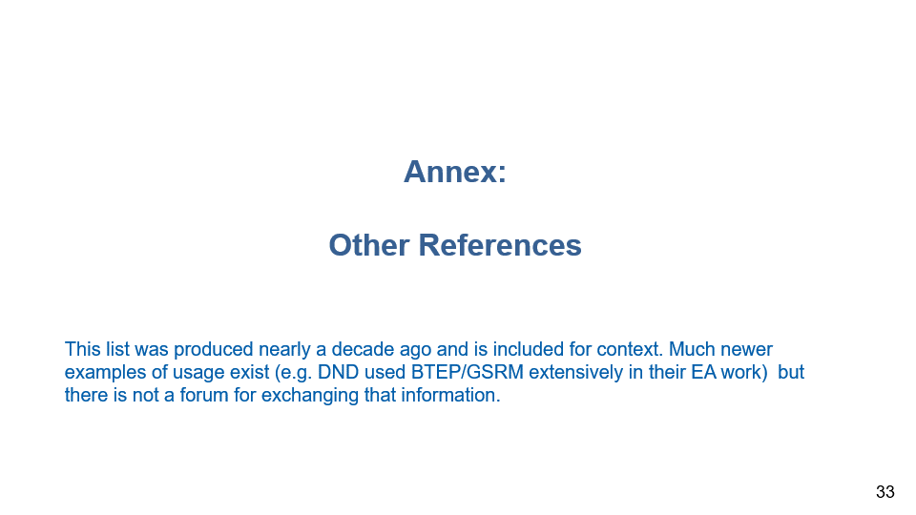
?
Everyone loves standards … that’s why everybody has one.
Contact Information
Gary Doucet
VP Practices and Chief Architect
D4iS Solutions
Gary.Doucet@d4is.com
Neil Kemp
Independent Consultant &
D4iS Associate Partner
Neil.Kemp@d4is.com

Slide 36
Gary Doucet
VP Practices and Chief Architect
D4iS Solutions
Annex:
Other References
This list was produced nearly a decade ago and is included for context. Much newer examples of usage exist (e.g. DND used BTEP/GSRM extensively in their EA work) but there is not a forum for exchanging that information.

Slide 37
Public Sector Reference Models in Action
Federal Government
  Transportation Safety Board – Investigations and Information Management
  Department of Fisheries and Oceans – Process and Information Improvement
  Government of Canada Information Management Transformation
  Federal Government IT Security Program design
  Internal Services Transformation
  GC Services Inventory
  IT Services Profile – Enterprise view of managing IT
  Public Safety and Emergency Preparedness Canada Interoperability Project
  Horizontal Files Analysis – Starting with climate change.
  Alignment of the annual budget process (PAA) and the GSRM to extend the use of the structure beyond budgeting / reporting to program design, analysis and transformation.
Multi-jurisdictional
  Seniors’ Services Mapping Initiative Services for youth.
  Youth Segment, Service Vision for Canadians Initiative
  Improving Services to Businesses in the Restaurant Sector Initiative
  BizPal – Multi-jurisdictional permits and license services.
Case Study
Summary Case Study

Slide 38
Public Sector Reference Models in Action
Information Management (IM) – advantage in planning and design
  TBS able to forge agreement on what IM is and what an IM program should do, and identify the services necessary to achieve the stated outcomes of the government’s IM policy
PSEPC – advantage in alignment
  In less than a year, rigorous analysis of Canada’s public safety and security community completed, interoperability gaps and problems identified, and iteration #1 of vision to achieve interoperability and enhance information sharing completed
Service Canada – advantage in realization projects
  Service mapping for seniors and service vision for youth completed, positioning Service Canada to fast track opportunities for integrated service for two key client groups
BizPal – advantage in day to day operations
  Designs and implementation plans for innovations to integrate permits and license services for businesses across jurisdictions are being developed that will not interrupt ongoing service delivery
Notes:
BTEP has produced some impressive results in all four paths of activity for a number of specific projects.
In IM, Treasury Board, PWGSC and Libraries and Archives Canada have been able to achieve clarity for the first time on where their respective services begin and end. They know where they overlap and should streamline, and where they offer discreet services that need to stay that way. They have the design they need to distribute responsibility for different parts of the work involved in information management across the Government of Canada, while still being able to come together when they need to.
(More to come)

Slide 39
Public Sector Reference Models in Action
Labour Market Delivery Agreement
Background
The LMDA commits both governments to the following goals:
  The creation of an integrated labour market system designed to achieve a more efficient and effective matching of a skilled labour force with current and emerging needs of employers;
  The reduction, to the extent possible, of unnecessary overlap and duplication in their labour market development programs and services and the harmonization of their respective programs and services; and
  The modernization of government services that build a client-centered service culture that offers a seamless, integrated, multi-channel approach to the delivery of government services.
  (from Recitals of LMDA, signed November 2005)
The implementation of the two agreements requires Ontario Government to articulate both what it will deliver to its clients (the business model) and how it will deliver (the service model)

Slide 40
Public Sector Reference Models in Action
Labour Market Delivery Agreement
Scope of Business Model - Existing Programs
Provincial (20)
Federal (7)
  Apprenticeship (Classroom) Training
  Ontario Youth Apprenticeship Program
  Pre-Apprenticeship
  Apprenticeship Client Services
  Modular Training
  Co-op Diploma
  Adjustment Advisory Program
  Apprenticeship Innovation Fund
  Sectoral Initiatives Fund
  Ontario Works
  Job Connect
  Literacy and Basic Skills
  Summer Jobs Program
  Academic Upgrading
  Apprenticeship Scholarships / Signing Bonus
  Access to Professions and Trades
  Local Boards
  Job Grow Hotline
  Apprenticeship Tax Credit
  Ontario Disability Support Program
Employment Assistance
Job Creation Partnerships
Local Labour Market Partnerships
Self-Employment
Skills Development
Targeted Wage Subsidies
Federal Job Bank/Labour Exchange
Notes:
This might be updated

Slide 41
Public Sector Reference Models in Action
Labour Market Delivery Agreement
Opportunities for Service Improvements
The Service Mapping process is the methodology that will identify potential improvements of services to Ontario’s Training & Employment clients. Through this process, there may emerge some opportunities that fit the vision. For example, opportunities that align with ServiceOntario’s vision could include:
  Integration of Job Grow Hotline and Loans for Tools Call Centres
  Journeyperson certificate renewal at ServiceOntario kiosks
  Exam invigilation for apprenticeship certification exams

Slide 42
Public Sector Reference Models in Action
Labour Market Delivery Agreement
Applying BTEP/ Service Output Types to Apprenticeship
(BTEP Service Output Types)
ASSESSMENT
(Matches, Referrals & Linkages)
REGISTER
(Matches, Referrals & Linkages)
FEE FOR REGISTRATION
(Funds, Revenue)
ANNUAL SCHOOL FEES
[Note: External transaction]
IN SCHOOL & ON THE JOB TRAINING
(Education & Training Encounter)
RECORD RESULTS
(Findings)
FEE FOR EXAM
(Funds, Revenue)
SCHEDULE EXAM
(Rulings & Judgements)
WRITE EXAM UNDER VIGILATION
(Findings)
CERTIFICATION
(Periods of Permission)

Slide 43
Public Sector Reference Models in Action
Restaurant Start Up
Grouping Services to identify opportunities for common business processes
Defines “bundles” by identifying services that detect, help or prevent transitions of a target group.
Shows services by type or jurisdiction that must “fit together” to make a difference for the target group.
Identifies opportunities for common or standardized processes to “join up” services in the bundle.
Advisory services are required
in each bundle;
Is there an opportunity here?
20+ permissions
Is there an opportunity here?
Notes:
Two opportunities were selected as the most promising: The Diagram in the Slide shows the 2nd opportunity
1) Enhancing the Canada-Ontario Business Service Centres to improve the client experience by providing one-stop integrated referral to all applicable federal, provincial, regional and municipal services.
2) “Inter-Jurisdictional Service Initiation” – a new service to enable service delivery collaboration across jurisdictions that would automatically initiate access to all services in all jurisdictions where some form of registration (e.g., for permits or licenses) is required.
It is being built to provide and collect information enabling clients to initiate and conduct transactions for services provided by any jurisdiction via any channel from a single contact point.
The diagram – the “Transition Output Bundle Model” – illustrates
the common service types across all jurisdictions (indicated by colour) that align with a client moving from thinking about opening a restaurant (far left) to either doing it or not (far right).
At every stage, advisory services are required (indicated in pale green), and are provided by multiple jurisdictions. This suggests enormous potential for confusion given the fact that most first time restaurant start-ups won’t know what questions to ask or where to look when they need a service, and at present there is no central point to go to that can provide answers that crosses all the jurisdictions involved.
In order to set the stage for problem analysis and developing a target business vision, the current business must be understood. If the current business is already documented using GSRM models, the appropriate pieces can simply be extracted. Where the current business is not documented, or is not documented in GSRM models, some “bootstrap” work is required to populate these models.
Transition Output Bundle Model
By identifying specific service outputs that are offered we were able to:
understand the mix and range of services associated with each transition
identify opportunities for simplification, joining-up and alignment.
distinguish states of importance to target group members from states of importance to providers.
When many providers/jurisdictions are involved, they may identify many different “internal” states that add unnecessary complexity to service delivery and customer experience.
Identify opportunities for simplification, joining-up and alignment.
Are all the states necessary i.e. does each state provide value to the target group member or to the program?
Does it appear that the program states have shifted the burden of government complexity to the target group member?
For each bundle, ask:
Are all the service outputs needed?
Do the service outputs in the bundle ‘belong’ together?
c Are there interdependencies that could be simplified?
d Are multiple jurisdictions providing the same output type in the same bundle?
e Does the target group member have to apply for each service in the bundle?
f Does the target group member have to supply much of the same information to each service in the bundle?
BC One Stop Service is another example of an opportunity to create a single licence for a particular Sector ???? What sector, Debbie?

Slide 44
Public Sector Reference Models in Action
Service Inventory
What is it?
  Initiative to explore requirements, define an information model and formulate implementation recommendations for developing an inventory of services provided by Government of Canada
Why is it needed?
  Provide authoritative list of services offered by the GC
  Improve citizen access to federal government services
  Identify the target groups and the needs that specific services are designed to address
  Provide an information base for evaluating the range of services being offered, identifying overlaps and gaps in service offerings, considering candidates for service transformation
Reimagine this in the context of Government as a Platform. i.e. The app store for services.

Slide 45
Public Sector Reference Models in Action
Service Inventory
GC-TBS-CIOB Project
  Initiated in participation by a number of departments
  Project deliverables being reviewed
  Leveraged earlier work on e-Contact, Seniors Portal, CBSC
Implications
  Creating the initial inventory will require collaborative effort and on-going commitment
  Inventory must have near-term benefit for its stakeholders
  Need to explore interest from multi-jurisdictional partners
  Potential exists for outsourcing operations to registry service providers
Reimagine this in the context of Government as a Platform. i.e. The app store for services.

Slide 46
Public Sector Reference Models in Action
Service Inventory
Service Inventory Information part of a larger picture …
Common
Program Sector
External Service
Internal Service
Reporting to Parliament
Dept
…
Service Output (Type)
Service Delivery Channels
Service Name
Service Recipient
…
Planned Performance
Actual Expenditure
Planned Expenditure
…
Actual Performance
Service Cost
Contact Coordinates
MAF Indicator
…
Service Owner
Cost Allocation
…
All Services
Reimagine this in the context of Government as a Platform. i.e. The app store for services.

Slide 47
Public Sector Reference Models in Action
Budget and Planning
Government of Canada Initiative
Annual planning based on PAA – Program Activity Architecture (Now called Program Alignment Architecture)
GSRM used to inform internal services.
Intent was to move to public services after piloting provider services.
Implication: A service listed on the Canada Site would be traceable to annual plan and budget of depts. We’d know the cost, the intended result and what it takes to change our services to attain …

Slide 48
Public Sector Reference Models in Action
Transportation Safety Board (TSB)
Independent federal agency responsible for identifying safety deficiencies within the federally regulated areas of the Air, Marine, Pipeline and Rail industries by investigating:
  individual occurrences (accidents or incidents)
  re-occurring safety issues across multiple occurrences
4000 occurrences and 120 investigations/year
Approximately 235 employees
10 locations across Canada
No authority to direct changes

Slide 49
Public Sector Reference Models in Action
Transportation Safety Board (TSB)
TSB: Potential Cycles Triggered by a Single Transportation Occurrence
Response Cycles
Investigation Cycles
Litigation Cycles
Change Cycles
Wrap-Up
Safety
Investigation
Criminal
Investigation
Transportation
Occurrence
Media
Coverage
Regulatory
Changes
*
Regulatory
Investigation
Emergency
Response
Operator
Changes
*
Operator
Investigation
Criminal Suits
Wreckage
Disposal
Site
Management
Manufacturer
Investigation
Civil Suits
Industry
Changes
*
Next of Kin
Support
Manufacturer
Changes
*
Coroner
Inquest
Autopsy
Research
Studies
*
*multiple occurrence

Slide 50
Public Sector Reference Models in Action
Transportation Safety Board (TSB)
TSB: Imperatives for Change
Paper-based records management practices could not contend with the volume of electronic information being accumulated on a daily basis
Each mode (air, marine, rail and pipeline) and the regional offices employed varied approaches and tools for collecting, analysing, storing, sharing and disseminating information
Approved investigation methodology not automated resulting in non-standard application of investigation and analysis techniques
Current mode-based IT systems outdated, not standardized, costly to support and not integrated with the investigation process
Corporate and legal obligations with respect to federal legislation at risk because of one or more of the above.

Slide 51
Public Sector Reference Models in Action
Transportation Safety Board
TSB: The Approach
Three year project initiated in April 2003
Build solutions on Business Design/Architecture (GSRM – BTEP)
Strong involvement of eventual users, including use of pilots for actual investigations, to ensure optimal design and ease of use
Acquire software tools – don’t develop them
Phased implementation employing a modular construction approach
Notes:
Build solutions on Business Design/Architecture (GSRM – BTEP )
Strong involvement of eventual users, including use of pilots for actual investigations, to ensure optimal design and ease of use
Active Transition and Ongoing Change Management
Acquire software tools – don’t develop them
A strong service-oriented architecture and collaboration/case focus (Microsoft Sharepoint Portal and Services)
Phased implementation employing a modular construction approach
initially focused on investigation process and report production
environment will eventually support all TSB activities, particularly document control and records management

Slide 52
Public Sector Reference Models in Action
Transportation Safety Board
TSB: Project Objectives
More credible products
More efficient, effective, and defensible processes
Better utilization of knowledge across the TSB
An ability to retrieve quickly information and records in response to any query
Less expenditure at local levels on non-standard software
More consistent and less cumbersome information management practices throughout TSB
Resulted in:
TSB Investigation and Information Management System (TIIMS)

Slide 53
Public Sector Reference Models in Action
Transportation Safety Board
TSB: Reference Models
A structured way to describe TSB’s business providing the context for managing the scope of the project
Reference models were built emphasizing a multi-modal view of the business
Models were developed concurrently via cross-modal workshops
Reference models built in a just in time phased approach
  Version 1 assisted in the scoping and planning (focus was on services, target group & needs, business processes & work products)
  Version 2 defined the data structures, roles and workflow requirements
  Version 3 used to map the Systems Components to the business elements

Slide 54
Public Sector Reference Models in Action
Transportation Safety Board
TSB: Used to Identify and Manage Project Scope
Identified services that were no longer supported but were being maintained
Identified services that were out of scope
Assisted in clarifying designs for controversial services
Identified opportunities for common support services
Facilitated in documenting inter-dependencies and duplication across the organization

Slide 55
Public Sector Reference Models in Action
Transportation Safety Board
Used to Develop Consistent Semantics & Data Structures
Common concepts and vocabulary for use by all four modes
Resolved difficult semantic and data structure issues across modes
Helped to simplify practices and enable stronger data models and database designs
Common taxonomies developed for the development of specific plans

Slide 56
Public Sector Reference Models in Action
Transportation Safety Board
TSB: Used to Examine External Context
Identified other cycles initiated on a Transportation Occurrence
Defined service inter-dependencies and impact
Led to agreement on a common target group taxonomy
Validated additional public facing services and external provider service accountabilities
Permitted shift in focus to the “why” (needs) from the “what” (products)

Slide 57
Public Sector Reference Models in Action
Transportation Safety Board
Used to Build Common Set of Business Processes
Started with GSRM “Findings” pattern which accelerated results
Identified and resolved many process inconsistencies across modes and regions
Validated and/or enhanced previously identified services
Developed process model for “Safety Issues Investigations” which was subsequently trialed and implemented

Slide 58
Public Sector Reference Models in Action
Transportation Safety Board
Used to Assess the Technology
Mapping current technologies to a reference model enabled identification of gaps and interdependencies
Mapping specific products to a reference model enabled an objective assessment of functionality and fit
Provided means to organize and inter-relate categories of functionality
Provided the structure to assess and defend procurement approach

Slide 59
Public Sector Reference Models in Action
Transportation Safety Board
Lessons Learned
Difficult to Find the Right Facilitator/Analyst
Significant Effort to Maintain and Evolve Models
Struggled with defining level of documentation that would be easy to develop and maintain
The Science vs. the Art of GSRM
BTEP Modeling provided a common context with cross functional focus group (approx 12 staff) over a 8 month period meeting 2 hours per week
Notes:
The Science vs. the Art of GSRM
The “Science” (knowledge)
standard definitions, structures and patterns
The “Art” (experience)
knowing where to start modeling, how much modeling is enough, bridging the different perspectives, building in organizational ownership and governance
BTEP Modeling provided a common context with cross functional focus group (approx 12 staff) over a 8 month period meeting 2 hours per week
Facilitated the resolution of long-standing process and data structure inconsistencies
Enabled creation of common vocabulary and understanding of processes and information
Ensured a comprehensive portrayal of interrelationships within the organization
Allowed everyone to see where their work fits into the big picture
Contributed to accelerated consensus building
A strong change management tool

Slide 60
Public Sector Reference Models in Action
Service to Seniors
Seniors needs:
  The average income of Seniors is lower than other age groups
  Health care and support in communities
  Ability to participate in society
How are these needs being met?
  What are the programs and services and who is providing them?
  Where are there overlaps and gaps?
  Where are there opportunities for shared services, consolidated services, elimination of services?
  Are services being effectively delivered?
Participants: Four orders of government (15 Organizations)
Time: 3.5 months elapsed

Slide 61
Public Sector Reference Models in Action
Service to Seniors
Value to Senior’s Portfolio
  Distilled complexity – focus on what is common rather than what is different
  Identified who delivers service to seniors – focus on “what” is delivered rather than “how” it is delivered
  Facilitated inter-jurisdictional discussions on collaboration
Value to Central Agencies
  Improved vertical and horizontal program evaluation and impact analysis
  Clearer horizontal picture to enable improved GC-wide stewardship, decision-making and reporting
  Focus on planning to achieve results as well as managing costs

Slide 62
Public Sector Reference Models in Action
Fisheries Monitoring and Catch Reporting
Business-driven two year initiative to improve fishery monitoring and catch reporting in Pacific Region of department of Fisheries and Oceans
  Catch data essential to manage fisheries and conserve fish stocks
  Regional proof of concept within national framework
Results – common fishery business model :
  Services now integrated / aligned to deliver mandated outcomes
  Identified Gaps and duplication in the value chain
  Implementing new service delivery model, i.e. organization supports business
  Legitimized role of Enterprise Business Architecture (EBA)
Key Success Factors:
  Focus on results that achieved improvements in business outcomes
  Business Champion – Regional Director General

Slide 63

Email
gary.doucet@d4is.com
info@d4is.com
www.d4is.com

