Slide 1
Improving Research Tools - Update
March 6, 2024
Presented to GCWP by CDS
numerique.canada.ca ▪︎ @SNC_GC | digital.canada.ca ▪︎ @CDS_GC

Slide 2
Agenda
Feedback Viewer (FV)
Why improve the FV? Why now?
Improvements so far
Next steps
Search Assessment Tool (SAT)
Why is findability important?
Current state of search performance
Quick poll - Help us understand your search performance needs
Improvements to guidance and Search Assessment Tool (SAT)
Next steps
Give us feedback! Here’s how.
Team
Lana Stewart
Jessica Fan
Hamza Aburaneh
Khalid AlHomoud (CRA)
Jennifer Mealing
Lisa Fast, Jane Stewart (consulting)

Slide 3
Feedback Viewer (FV)

Slide 4
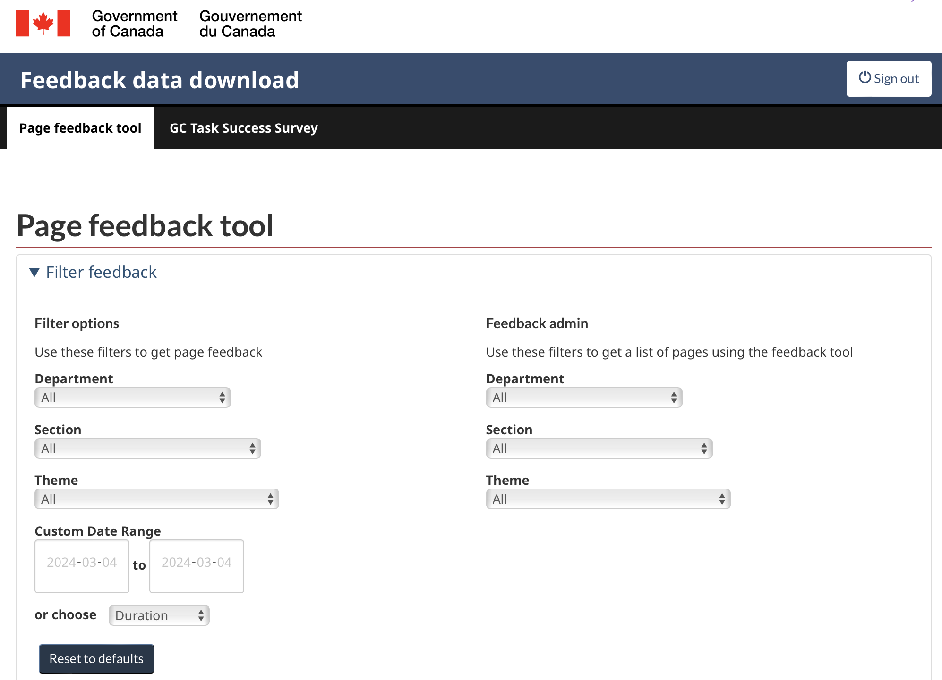
Feedback Viewer - Why improve it? Why now?
V1 - launched 2021
Growing backlog of improvements we’ve wanted to make, but not enough capacity to address them.
Recently, DTO joined CDS and now has additional capacity to do it (for now)!

Slide 5
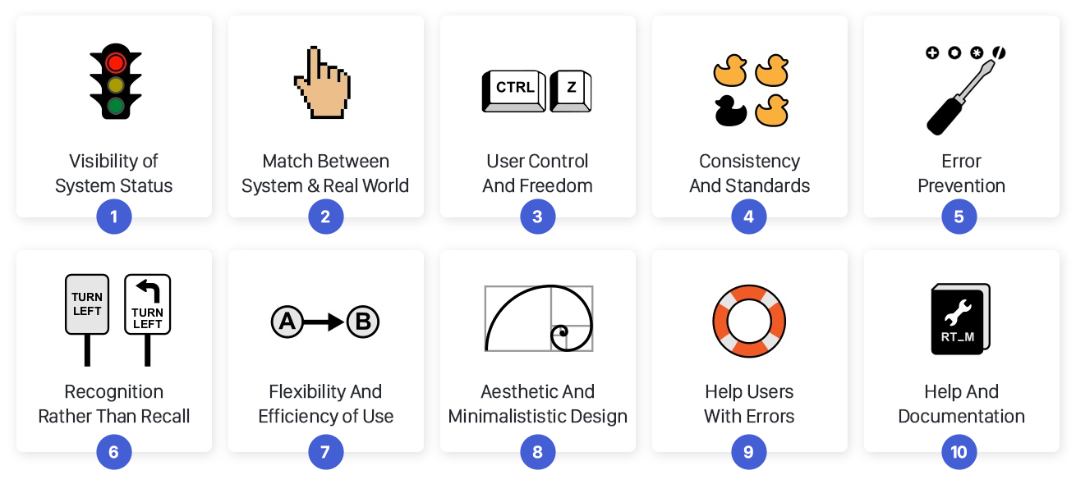
UX Review
A UX review assesses user interfaces according to usability standards. It highlights where these standards are not met and proposes recommendations.
Jakob Nielsen’s 10 Usability Heuristics:

Slide 6
Opportunities for improvement
Key insights from UX Review + 4 user interviews (IRCC, PSPC, ECCC, DFO):
Workflow
Users want to select multiple pages at once (especially english and french page pairs)
Web advisors are busy - they need summaries to make sense of the data.
E-mailed alerts or feedback summaries could be useful
Opportunities for usability improvements
Inconsistent layout between PFT and GC TSS filters
Users don’t understand what the “feedback admin” panel is for
Filter selections get unexpectedly reset if selected out of order
Filters take up too much space, pushing the table out of view
“Reset filter” button too easy to mistakenly press
Missing relevant table columns
File naming conventions for download files could be more detailed

Slide 7
Recommendations
Simplify and optimize the filters
Improve feedback table design
Move “feedback admin” to its own tab and apply a more useful dashboard design
Add links to guidance in navigation and in tooltips where needed
Apply consistent look & feel

Slide 8
Improvements so far
Version 1 (current live site)
Feedback Viewer
Version 2
Updated design: Mockups (Figma)
Rapid iteration on based on 4 user feedback sessions
Development - in-progress (Hamza + Jennifer)

Slide 9
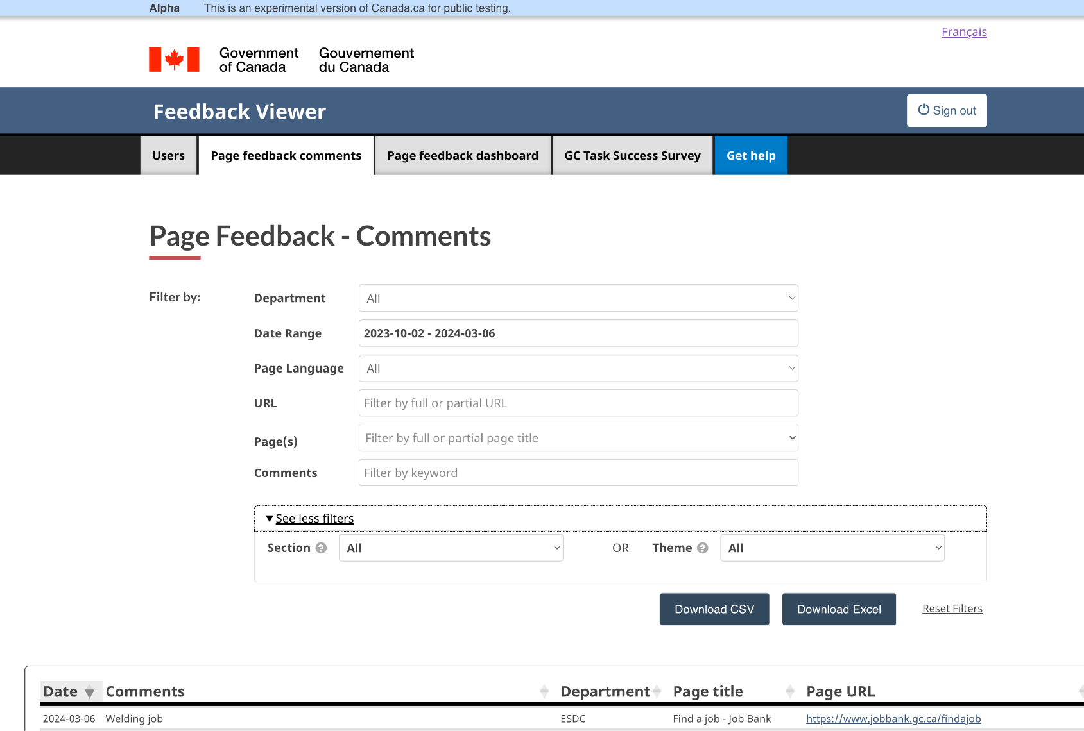
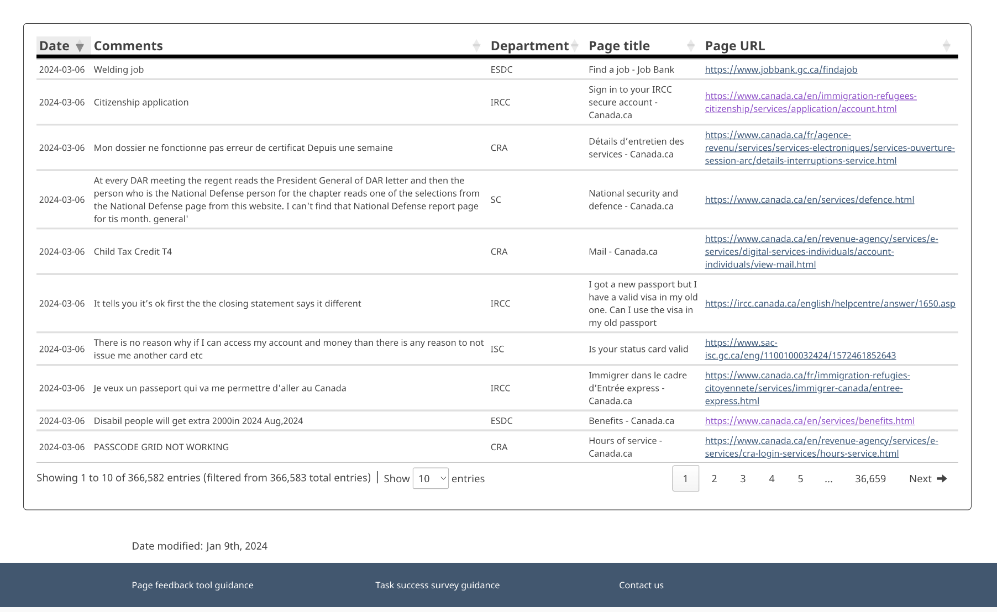
Improvements so far

Slide 10
Next steps
Timeline
Live by March 31st, 2024 for these improvements, but some parts may go live as completed

Slide 11
Search Assessment Tool (SAT)

Slide 12
First, why is findability of your content important?
Help users get to your front door.
Search engines (External)
Search engines (Internal)
Navigation
Chatbots
Live assistants
Notes:
“Findability” includes how easily your content is found through search engines.
External search
And also supported by:
Internal search engine
Information architecture (top level pages)
Navigation (megamenu, breadcrumb, footer)
Live assistants
Chatbots

Slide 13
First, why is findability of your content important?
Help users get to your front door.
Search engines (External)
Search engines (Internal)
Navigation
Chatbots
Live assistants
Notes:
“Findability” includes how easily your content is found through search engines.
External search
And also supported by:
Internal search engine
Information architecture (top level pages)
Navigation (megamenu, breadcrumb, footer)
Live assistants
Chatbots

Slide 14
Why is search important for findability?
47% of visitors to Canada.ca come from external search.
For some institutions, it is even higher
Public Safety 64.1%
Health Canada 63.8%
Internal search is the 2nd most used link on the Canada.ca homepage.
Total internal searches across all of Canada.ca (Feb 2022-2023): 50,953,895
External search is the portal to Canada.ca for a significant proportion of users.
On Canada.ca homepage, internal search is used by a significant number of users to find content.
Notes:
Date range (one year): February 26, 2023 - February 24, 2024
51M internal searches last year

Slide 15
Current state of search performance
External search:
Performing well on average
Top 300 queries in Google rank within the top 3 results (reference)
Internal search:
Significant room for improvement
88 of the top 300 internal queries are outside of the top 3 results (reference)
Page feedback from users
“Your search engine is so bad, will not even find answers to the simplest questions. Instead supplying irrelevant info.” (Feb 16, 2024)
“extremely hard to find anything. Search engine zeros in on every thing under the sun expect what you are looking for.” (December 12, 2023)
“got an answer for everything but what I needed. You really need to upgrade your search engine” (January 30, 2024)
(Google Search Console Canada.ca)
Notes:
Internal search - a new internal search has been procured but will not be ready for about a year. Will take a year to configure.

Slide 16
How might we improve internal and external search performance?
Barriers for web advisors and web managers (our hunch)
No easy way to measure findability of your content (currently you need multiple tools)
Lack / incomplete guidance and tools for improving findability
Lack of capacity for continuous improvement and maintenance

Slide 17
Quick poll - Help us understand your search performance needs
Link to slido:
https://app.sli.do/event/24PYsxEYBiwV8fHCzFozrj

Slide 18
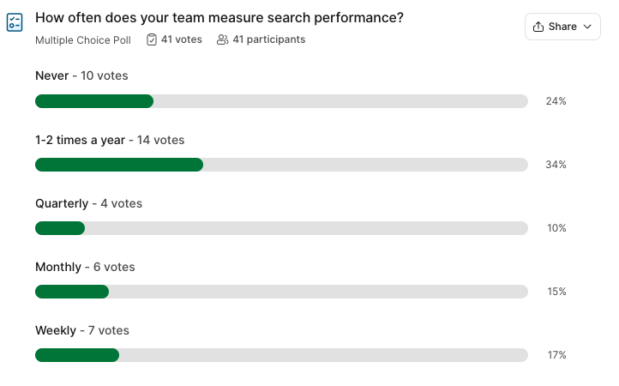

Slide 19
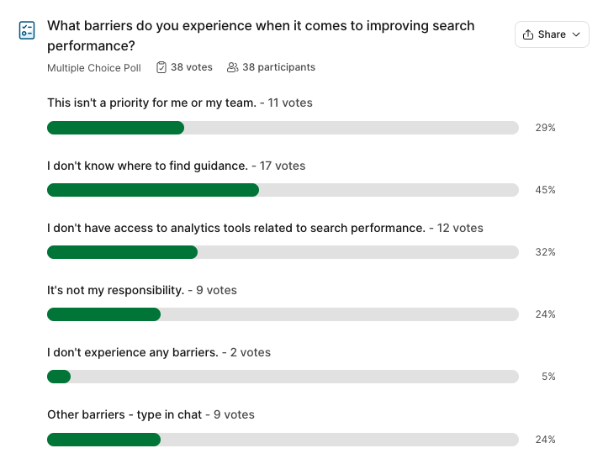

Slide 20
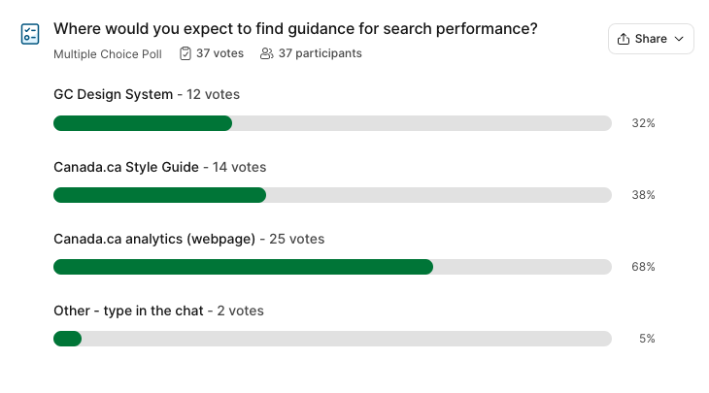

Slide 21
Supporting web teams to improve search performance
LEARN FINDABILITY / SEARCH BEST PRACTICES
RESEARCH SEARCH TERMS
MEASURE SEARCH PERFORMANCE
APPLY SEO TO CONTENT
IMPROVE INTERNAL SEARCH / BOOSTING
Notes:
How we think workflow goes

Slide 22
Supporting web teams to improve search performance
Search performance awareness-building, tools, and guidance
LEARN FINDABILITY / SEARCH BEST PRACTICES
Write, update, and consolidate guidance
Raise awareness for search through GCWP / Web Analytics Community
RESEARCH SEARCH TERMS
Create and share templates to manage search term research
MEASURE SEARCH PERFORMANCE
Build a search assessment tool to save common search terms and their target pages, assess search performance, and easily rerun search scores.
APPLY SEO TO CONTENT
Write, update, and consolidate guidance
IMPROVE INTERNAL SEARCH / BOOSTING
Write, update, and consolidate guidance
Raise awareness for search through GCWP / Web Analytics Community

Slide 23
Supporting web teams to improve search performance
Search performance awareness-building, tools, and guidance
LEARN FINDABILITY / SEARCH BEST PRACTICES
Write, update, and consolidate guidance
Raise awareness for search through GCWP / Web Analytics Community
RESEARCH SEARCH TERMS
Create and share templates to manage search term research
MEASURE SEARCH PERFORMANCE
Build a search assessment tool to save common search terms and their target pages, assess search performance, and easily rerun search scores.
APPLY SEO TO CONTENT
Write, update, and consolidate guidance
IMPROVE INTERNAL SEARCH / BOOSTING
Write, update, and consolidate guidance
Raise awareness for search through GCWP / Web Analytics Community

Slide 24
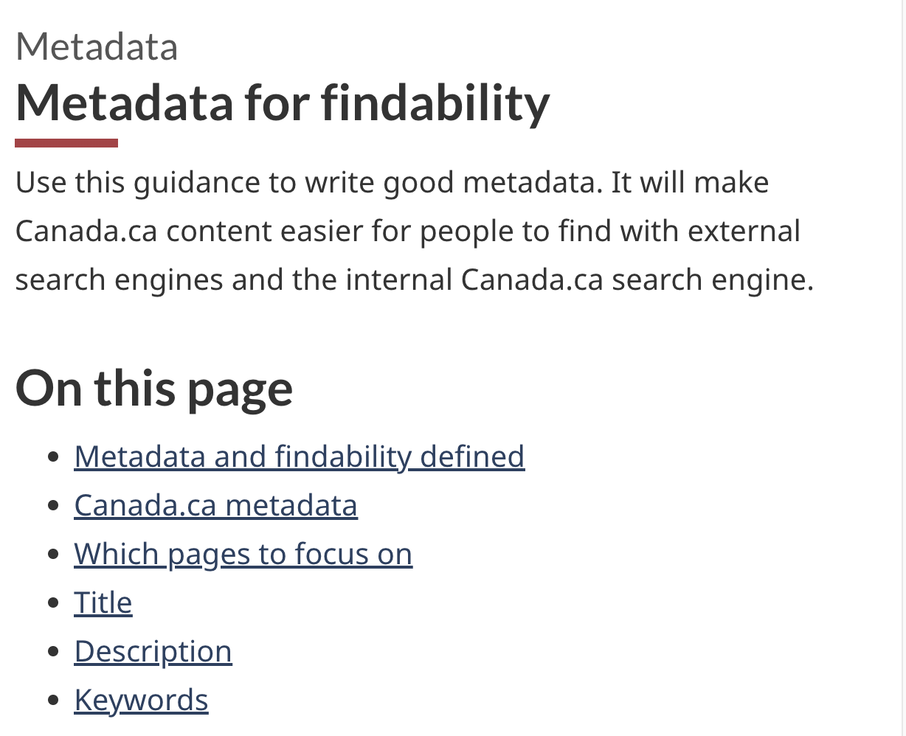
State of search and findability guidance
Top guidance issues:
No single source to start learning about findability
Hard to find and scattered across documents and sites
Incomplete or no guidance
LEARNING ABOUT FINDABILITY & SEARCH
Some guidance exists in the Canada.ca Style Guide
Some guidance exists on GCPedia (ie: How to access Google Search Console)
Lack of guidance on how to research search terms
Need to write documentation to support the Search Assessment Tool
APPLYING SEO TO CONTENT
Guidance exists about adding structured data to pages in the design system
New guidance on how to write good metadata is in development
Potential need for more detailed SEO guidance
IMPROVING INTERNAL SEARCH RESULTS
Lack of guidance (but can request help via Service Desk) about:
How internal search works
When and how to request that a result gets boosted

Slide 25
Supporting web advisors to improve search performance
LEARN FINDABILITY / SEARCH BEST PRACTICES
Write, update, and consolidate guidance
Raise awareness for search through GCWP / Web Analytics Community
RESEARCH SEARCH TERMS
Create and share templates to manage search term research
MEASURE SEARCH PERFORMANCE
Build a search assessment tool to save common search terms and their target pages, assess search performance, and easily rerun search scores.
APPLY SEO TO CONTENT
Write, update, and consolidate guidance
IMPROVE INTERNAL SEARCH / BOOSTING
Write, update, and consolidate guidance
Raise awareness for search through GCWP / Web Analytics Community

Slide 26
Supporting web advisors to improve search performance
LEARN FINDABILITY / SEARCH BEST PRACTICES
Write, update, and consolidate guidance
Raise awareness for search through GCWP / Web Analytics Community
RESEARCH SEARCH TERMS
Create and share templates to manage search term research
MEASURE SEARCH PERFORMANCE
Build a search assessment tool to save common search terms and their target pages, assess search performance, and easily rerun search scores.
APPLY SEO TO CONTENT
Write, update, and consolidate guidance
IMPROVE INTERNAL SEARCH / BOOSTING
Write, update, and consolidate guidance
Raise awareness for search through GCWP / Web Analytics Community

Slide 27
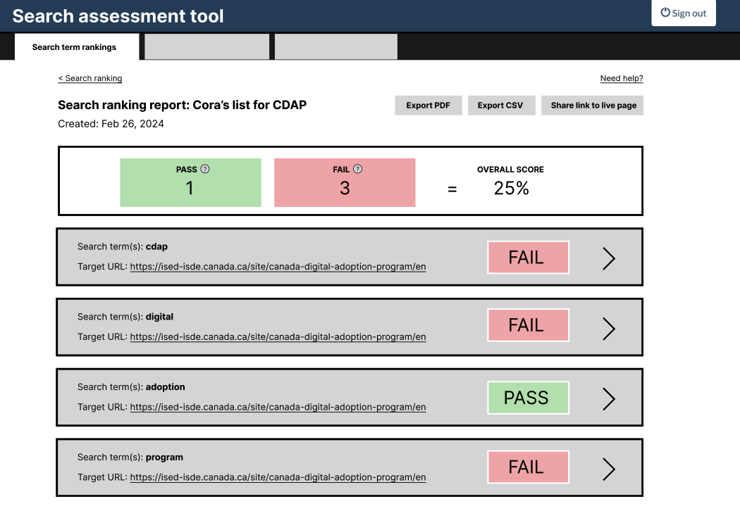
Search Assessment Tool
What it is:
A tool that helps web teams assess how target URLs rank across search engines for top search terms.
Progress so far:
Idea and first iteration of the tool came from CRA.
This was extended to explore scaling to other departments (link)
CDS currently iterating on the design
IRCC feedback and UX review of v1
CDS is currently designing v2 (link to Figma)

Slide 28
Next steps
Timeline
Review with IRCC & prioritize features to code in V2 of the tool
Expand pilot to 4-5 departments when ready (early spring)
Metadata guidance to go live when ready (spring 2024)
Use pilots to build case studies about search improvement & inform internal search engine configuration team on persistent findability issues
Share pilot insights with GCWP. Continue to iterate the tool.
Thinking about how make data analysis easier across multiple data points

Slide 29
Tell us what you think
Comments and questions!
Please share your feedback or suggested improvements on what you’ve seen today
Feedback Viewer
GC Comms Slack channel: #feedback-tool-outil-rétroaction
Search Assessment Tool and search guidance
GC Comms Slack search channel: #search-recherche
Email: lana.stewart@cds-snc.ca

