Slide 1
Indigenous Services Canada Guiding Office Principles Framework
Workplace Change Management Community of Practice
May 2024
Notes:
LT

Slide 2
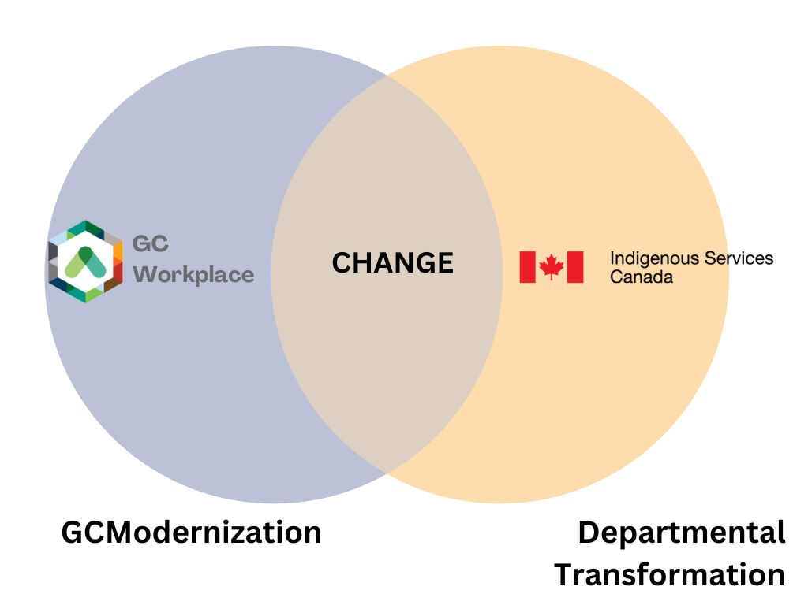
Background and Context
Notes:
LT
Context and Background
In fiscal year 2020/2021, Indigenous Services Canada – Alberta Region (ISC-AB) formally launched its GCworkplace modernization project titled “Space Force”.
Pre-pandemic, over 500 ISC-Alberta Edmonton employees worked on four different floors at the Canada Place office in Edmonton, Alberta.
Something that is notable about the experience of ISC employees going through modernization, is that concurrent to the GCModernization, staff are navigating departmental changes as a result of the dissolution of Indigenous and Northern Affairs Canada (INAC) and being replaced by two departments, Crown Indigenous Relations and Northern Affairs Canada and Indigenous Services Canada (ISC)
After the renovation is complete, the ISC Alberta team will be consolidated to have all work points on one floor.
This move represents not only a transition to GCModernization, but also the integration of two entities into a cohesive ISC-Alberta.

Slide 3
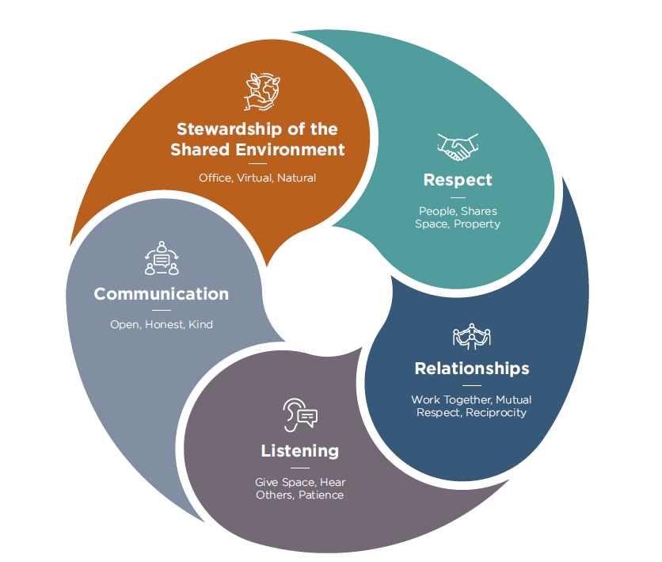
Navigating Change
A tool was needed to anchor staff to guiding office principles during significant changes in the Region.
There was a need to transition from creating specific rules for addressing every office change to implementing a comprehensive and supportive principle-based organizational culture.
A flexible framework was seen as a solution to promote autonomy, empowerment, positive culture, and simplifies communication to support workplace interactions.
Notes:
LT
In light of the significant changes in the Alberta Region, it became apparent that a tool was necessary to align staff with guiding office principles.
There was a decision to move towards a more holistic and supportive framework instead of creating strict rules for navigating office changes.
The framework was designed as a flexible tool to promote autonomy, empowerment, positive culture, streamlined communication, and supportive workplace interactions.

Slide 4
How Did We Get Here?
Workplace Etiquette Working Group
Space Force Team Review
Indigenous Advisory Group Working Session
Environmental Scan
Senior Management Committee Review
Executive Committee Review & Approval
Notes:
Workplace Etiquette Working Group
Convened in April 2023
Composed of the ISC-AB Wellness Coordinator, Indigenous Coordinator, Diversity & Inclusion Lead and Space Force Change Manager
Environmental scan focused on HR companies, post-secondary institutions, government, consulting firms, coworking spaces, IT support companies for coworking/hoteling spaces and reviewed the following:
Common themes for coworking/hotdesking/hoteling spaces
Guiding principles
Best practices for making and enforcing rules
Rules and etiquette for coworking spaces
Indigenous Advisory Group Working Session
Met on November 8th for a 2-hour session focused on reviewing the work completed to date by the “three amigos & Space Force change management rep”
Based on the conversation and guidance from the IAG updates/adjustments were made
Senior Management Committee Review on January 2, 2024

Slide 5
Guiding Office Principles Framework
A framework grounded in ᒥᔪ ᐑᒉᐦᑐᐏᐣ miyo-wîcihtowin -
encouraging good relationships with one another
Notes:
LT
The Framework promotes the Cree principle of miyo-wîcihtowin, encouraging good relationships with one another.
It encourages self-reflection and constructive action as we work together to build a safe, healthy, collaborative and productive work environment and culture.
The Framework is intended to empower staff to navigate new and challenging scenarios.
It serves as a transition away from a rules-based approach, encouraging a reflective approach to interpersonal decision-making in a dynamic work environment.
The Framework applies to everyone, it is a foundational approach to help us think about best practices that create a healthy work environment and culture.

Slide 6
How can Framework be used?
Respect of person, shared space and personal property.
Relationships grounded in reciprocity, mutual respect and a desire to work together.
Listening by giving space, hearing other and practicing patience.
Communication grounded in openness, kindness and honesty.
Stewardship of the Shared Environment including the office, virtual and natural environments.
Notes:
MS
The Framework is designed to encourage self-reflection and support staff to determine the best course of action through:
Respect of person, shared space and personal property.
Relationships grounded in reciprocity, mutual respect and a desire to work together.
Listening by giving space, hearing others and practicing patience.
Communication grounded in openness, kindness and honesty.
Stewardship of the Shared Environment including the office, virtual and natural environments

Slide 7
Framework in Action Boardroom Edition
Communication: Be kind and polite with colleagues using shared spaces
Listening: Be patient and hear one another when using shared boardrooms
Respect: Be mindful of others when using shared boardrooms
Relationships: boardrooms are a shared office resource
Stewardship of the Shared Environment: Apply the campsite rule and leave this space better than how you found it
Notes:
MS
Communication: Be kind and polite with colleagues using shared spaces
Communicate kindly with colleagues when navigating challenging scenarios like double bookings, boardroom confusion, meetings running late
Listening: Be patient and hear one another when using this shared space
Meetings can run over; do your best to end your meetings on time and be polite when you need the space.
Not all boardrooms are soundproofed; remember that others can hear you.
Respect: Be mindful of others when using shared spaces
• In bookable spaces adhere to scheduled bookings.
• Consider booking meetings to start/end with a 5-minute grace period to provide time to transition in and out of the boardroom.
• Boardrooms are limited, before using ask yourself “can this work be done at a workstation with an appropriate headset?”
Relationships: boardrooms are a shared office resource
• Be patient and mutually respectful with colleagues.
• Make sure you receive a confirmation of reservation email for bookable meeting rooms.
• Think ahead, and book a boardroom to ensure you have a space.
• If you no longer require a bookable boardroom be sure to cancel the reservation so others can use the space.
Stewardship of the Shared Environment: Apply the campsite rule and leave this space better than how you found it
• Do not remove the chairs and IT equipment from the space.
• Wipe down shared surfaces with provided wipes.
• Remove all personal items when finished.
• Dispose of garbage and recycling.
• Leave the door open as you leave so it is clear the space is available

Slide 8
Framework in Action Lunchtime Edition
Communication: Check in with co-workers to see if eating at your workstation is okay.
Listening: If someone expresses an issue with you eating at your workstation, be open to moving to a common space.
Respect: What are other people doing around you?
Relationships: are there colleagues sitting in your area?
Stewardship of the Shared Environment: Apply the campsite after you’ve finished eating to ensure your workstation is better than you found it.
Notes:
MS
Communication: Check in with co-workers to see if eating at your workstation is okay.
- Prior to eating at your workstation, it is advised to communicate with your colleagues to ensure it is okay to do so.
Listening: If someone expresses an issue with you eating at your workstation, be open to moving to a common space.
- Practice active listening and be receptive to any concerns raised by others regarding eating at your workstation, and be willing to relocate to a designated common area if necessary.
Respect: What are other people doing around you?
- Consider the activities of those around you and whether eating at your workstation may be disruptive to them.
Relationships: are there colleagues sitting in your area?
- Take into account the preferences of your colleagues who share the workspace and avoid causing any annoyance with your eating habits.
Stewardship of the Shared Environment: Apply the campsite after you’ve finished eating to ensure your workstation is better than you found it.
- After finishing your meal, make sure to clean up your workstation thoroughly to leave it in better condition than you found it, removing any crumbs or mess.

Slide 9
Framework Implementation
The implementation of the framework has been a continuous initiative.
We have utilized various communication channels to underscore the significance of the framework and align it with tangible actions.
These channels include:
Featuring the framework prominently on our GCPedia project website
Emails by both the project team and executive leadership
Internal ISC-Alberta Newsletter
Presentations
Mini-video series
Notes:
MS

Slide 10
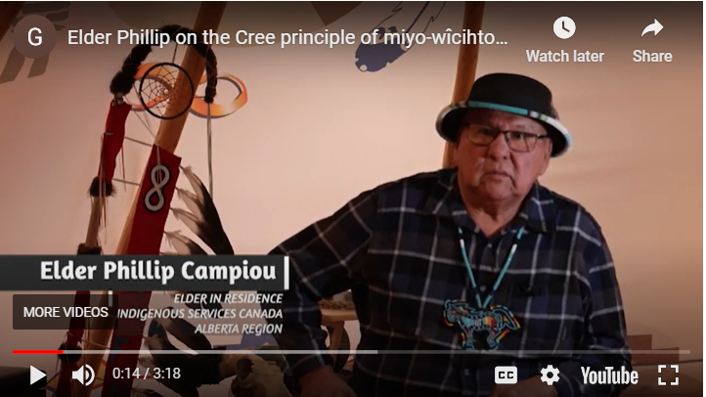
Elder Phillip Video Series
Notes:
LT
One example of how we have tried to re-enforce the principles of the framework is through an interview series with elder Phillip Campiou.
In the interview series, ISC-AB Elder in Residence, Elder Philip Campiou shares the Cree principle of miyo-wîcihtowin, provides guidance on how to navigate periods of change, and teaches about the importance of relationships during times of transition.

Slide 11
Introductory Tent Cards
Notes:
LT
Another opportunity to emphasize the importance of relationships and good relationships was through the introduction of the tent card initiative.
Feedback indicated that with the adoption of a flexible work model, employees were experiencing discomfort in managing interpersonal conversations and conflicts, as they were not always aware of their co-workers' identities and what teams they were apart of.
In response, we developed a name card guide and template for staff to use.
Employees are encouraged to print out a reusable name tent card and display it on their desks during in-office days.

Slide 12
Framework Impact
Notes:
MS
We still in early days of implementing the framework.
So far, it has proven to be a valuable guiding tool for the ISC Alberta Region as we navigate through periods of change.
The framework has helped us address challenging situations by providing a reference point instead of creating arbitrary rules.
Additionally, there has been an increase in communication and utilization of the framework beyond the Space Force project team.
It has become a valuable resource for individuals, teams and leadership.

Slide 13
Notes:
MS/TS

