Slide 1
Design Update Contact AAFC web page
Digital Communications Planning Team
May 2024

Slide 2
Purpose
To present how the "Contact AAFC" web page was optimized based on the User Experience (UX) method.
Conducted by the Digital Communications Planning (DCP) team using the project approach centered on data, knowledge and strategic thinking.
Executed in close collaboration with the Web Communications Advisor in charge of the request
And supported by the technical expertise of ISB for the automation part.
To demonstrate how a client’s web request could trigger a project that would deliver a high quality product based on evidence and usability expertise.
To share and learn from the added value of considering the big picture instead of simply executing a client’s request, while still achieving their targeted goals.

Slide 3
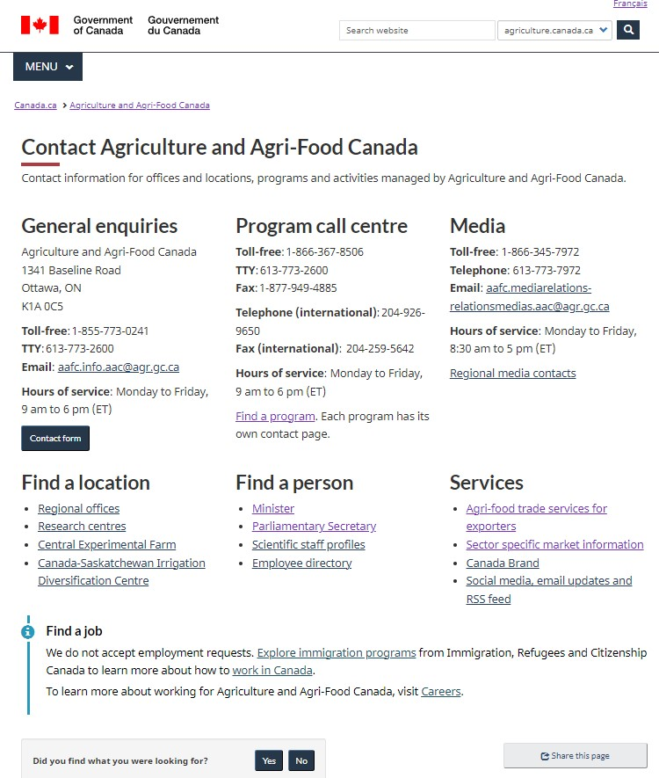
2019 versus 2024
Old New
Notes:
Main changes
1-Header: Revised the page description and removed the Photo
2-General enquiries: Task button and automation of the Contact form (as well as adding automation to the email box for faster triage)
3-Core: Redesign the second half of the page with the creation of 3 sub-headings to regroup all the contacts beside the 3 most requested at the top: Location; Person; Services
4-Info Alert: Inserted an alert to direct users looking to find a job.

Slide 4
Context
The Contact AAFC page previous version was developed in 2019, during the Adoption of the Canada.ca design system by AAFC, using the mandatory template.
To better align our site to the new Canada.ca requirements, we conducted a major restructuring of the Information Architecture.
We have been aiming to optimize this page design in the future, but time had passed… and other priorities pushed it down the “To Do List”.
The outcome for the Contact us page was a patch work of contact information from across the site gathered into one spot. At the time, it included all the info provided or requested by clients without further questioning.

Slide 5
Client’s request
Web request submitted by the client responsible for managing the general enquiries for AAFC Online, in the Ministerial Correspondance and Briefing Division.
The client asked to
1- Add a FAQ section and
2- Remove the general email address from the Contact us page
(or move it down a level in the structure)
They were receiving too many unrelated emails and contact form submissions and wanted to decrease the volume of enquiries received.
Numerous and repetitive emails and contact form submissions were mostly from people looking for jobs in Canada (TFW) or for information managed by other departments (traveling with pets, food labelling, pesticides).
In 2022, there were approximately 909 contact form entries and 772 (85%) were from people outside of Canada looking for a job.
Notes:
2 red flags:
1- FAQs are not a web best practice, it signals that key information is missing in your content.
(The client thought that having a FAQ would encourage users to read through the information instead of submitting an enquiry.)
2- You should not remove a contact information (an email address) to avoid receiving enquiries. We serve Canadians.

Slide 6
Considerations
Multiple audiences/web users of the page and multiple clients with contact info on the page.
Some information was even for internal contacts (such as official languages) or was already listed on other pages (such as ATIP)
Measurement: The page always ranked in the top 10 most visited pages for the last 3 to 4 years, with an average of 30,000 visits per year.
Inconsistency in the publishing process
Page ownership and responsibility challenges, different clients, and turnover of WCA responsible for it.
The page was edited with changes requested by different clients.
There was a lack of consistency and overall strategic view on this page.
Ensure the requested changes would not impact the overall performance the rest of the page.

Slide 7
The approach taken
Decided not to implement the request as is before digging deeper.
The Web Communications Advisor contacted the DCP team to seek support.
Discussion with the client to better understand the end goal, what problem they were trying to fix.
Collaborative work (branch client, web communications, ISB and digital planning team) and Project management approach to address the problem and find usable solutions.
Measurement, testing and data gathering.
Prototype and decision making based on findings.
Notes:
Data gathering and analysis to better understand the client issue.
We went outside of the web role as well, trying to improve the service delivery, but it was definitely beneficial for the end user/end result of the project:
-We reviewed and analyzed their contact form enquiries to suggest drop down categories
-We suggested improvements to their response text for plain language and to make it more user-friendly (some advice was accepted)

Slide 8
Template Analysis
Old page
The page is too busy
Content is not organized by task/user interest
Page description, and Agri-Info description is outdated
Too many contact listings
Overuse of “Agriculture and Agri-Food” in naming conventions
Included unnecessary/internal contact info
Not following latest Canada.ca template
Guidelines from Canada.ca design system
Contact us page template:
Use the contact us page template to present contact info for (a person, an office, an organization, an emergency).
Use to get feedback, complaints or questions from people.
The contact us template page is meant to improve a person’s experience.
Do not use it to trigger business process changes.
Notes:
Clients were reminded that: From a web and service delivery perspective, we are required to make things easier for users/improve their experience. This is an integral component of the Canada.ca design system which all Departments are required to follow - TBS

Slide 9
Measurement
Web analytics with Adobe Analytics tool
Number of visits
Link overlay report
Time spent per visit
Geolocalisation (Regions, Canada, international)
Capturing information using the “Did you find what you were looking for” page functionality.
Video recording of user’s behavior and heatmaps with the Crazy egg software.
Considered A/B testing, but it was not necessary for this exercise.
We tested different layout and design features, the placement of information as well as mobile presentation. Different prototypes design were developed to explore options.
Notes:
We used different tools to measure and better understand the challenges faced by users on the page.
We present the findings in more details at the end of the presentation, in annexe

Slide 10
Findings
Confirmed that Canadian users were finding the information they were looking for.
Majority of visits coming from international visitors, including a large number of international job seekers. (60.3% of visits were from outside of Canada)
Other Findings:
40% of visitors selected the contact form link;
Regional offices and research centres link were also high-level tasks;
From the 44 videos watched, only 2 visitors struggled;
Sector specific contacts were not used/clicked on in the video captures.
Identified service delivery issues and content gaps
Notes:
No major web issues were identified.

Slide 11
Actions
1- Recommended automation of the contact form and general mailbox to improve workflow
The branch client worked directly with ISB, in collaboration with PAB
2- Page re-design
Simplified page description, removed image
Used headings to improve findability
Removed unnecessary information and consolidated like contacts where possible
Organized doormats by user interest/task
Optimized for mobile
Added info alert for job seekers
Task button for online form use
3- To re-assess following 6 months monitoring and measure if the situation improved with the new design.

Slide 12
Automation of the contact form
Integrate dropdowns for major enquiry topics
Analyze "other" enquiries for potential additional categories in the following 6 months measurement period.
Final drop down categories:
Working or studying in Canada (including the Temporary Foreign Workers Program)
Central Experimental Farm (buildings, attractions and maintenance)
Food safety and food labelling
Grants, funding, and programs (excluding the Temporary Foreign Workers Program)
Importing and exporting
International assistance for agriculture
Travelling with pets
Accounts payable (National Capital Region)
Accounts receivable (National Capital Region)
Other
General Mailbox
Automation was also added to the general mailbox to:
Filter out spam, junk and suspicious emails
Generate automatic replies
Automate specific triage actions, For example, forward to other internal teams (programs)
Filter emails to specific folders for better management

Slide 13
Content and Page Design Review
Update Contact us page design for better user engagement, for example:
consider removing decorative image to avoid distractions
reposition social media banner to adhere to the template
update page description from what types of contact information can be found to what type of information AAFC is responsible for and can provide information on (Canada.ca template requirement)
consider adding “task button” for the Contact form to improve task completion
Reposition elements and streamline content for clarity and by task order
Remove unnecessary information, improve crosslinks to anchor information on other pages
Implement a "Did you find what you were looking for" button for user feedback
Determine if the general email is necessary if the online form is available
Notes:
Note: This exercise resulted in other clients to update their respective contact information. For example, the regional contacts listings.

Slide 14
To get findings in more details See slides 17 to 21
ANNEXE- Data gathered from different tools and methods

Slide 15
Conclusion
Using a collaborative and evidence-based approach,
we fixed an issue without impacting the already successful performance of the page,
while enhancing the user experience.
By having the user experience centered and focused in mind, we optimized the Contact us page
While addressing the client’s issues without implementing the original changes requested and without impacting what was already working well.
Additional benefits:
We discovered an unknown visitor geolocation issue: « International versus Canadian users ».
We identified service delivery issues and content gaps.
We shared findings related to “Find a job” with other clients and colleagues from the Canada service page to help future enhancement.
Notes:
*We still get a lot of spam and job requests in different categories, but the number of emails are more manageable. ISB also helped set up Power Automate to further filter out job requests.
Other Findings: -We identified service delivery issues: users receive different information depending on if they go through the general contact versus the regional contacts or International “single window” contact.
-We identified content gaps in terms of labour/workforce, information for new farmers/starting a farming business
-We provided information we collected from the Step Up to the plate campaign to service Canada, in addition to the information we found regarding international versus Canadian visitors. The timing was optimal as they are planning to optimize the Find a job page, and may consider adding more information, crosslinks etc for international job seekers.

Slide 16
ANNEXE
Data gathered from different tools and methods

Slide 17
Analytics
Adobe analytics data (based off the last 12 months) - Most visitors find the contact page from a Google/Bing search (52.3%) and jobbank.gc.ca (10%); - Only (4.1%) of visitors follow the contact page link from the AAFC Online main page; - Most visitors (58.9%) spend less than 15 seconds on the page.
Crazy egg overlay data (based off last 30 days) - On desktop (42.3%) of the clicks are concentrated in the General Enquires Section while (4%) is on the employee directory links. - On mobile (55.1%) of the clicks are concentrated in the General Enquires Section while (4.7%) is on the employee directory links
44% Canadian / 56% international (based off Adobe Analytics data from the past 12 months)
The Contact us page is a high traffic page for AAFC Online. It is the 8 most visited link from the home page. The high traffic to this type of content is not typical web user behaviour.
From November 2022 to November 2023, the Contact us page received 32,259 visits. Of these visits 19,469 (60.3%) were from outside of Canada.
In 2022, there were approximately 909 contact form entries and 772 (85%) were from people outside of Canada looking for a job.
This confirms that one of the main tasks is to look for agriculture jobs in Canada (Temporary Foreign Workers). The task of contacting AAFC Online is so high because these users cannot find this information as it is not on our website (under our mandate).

Slide 18
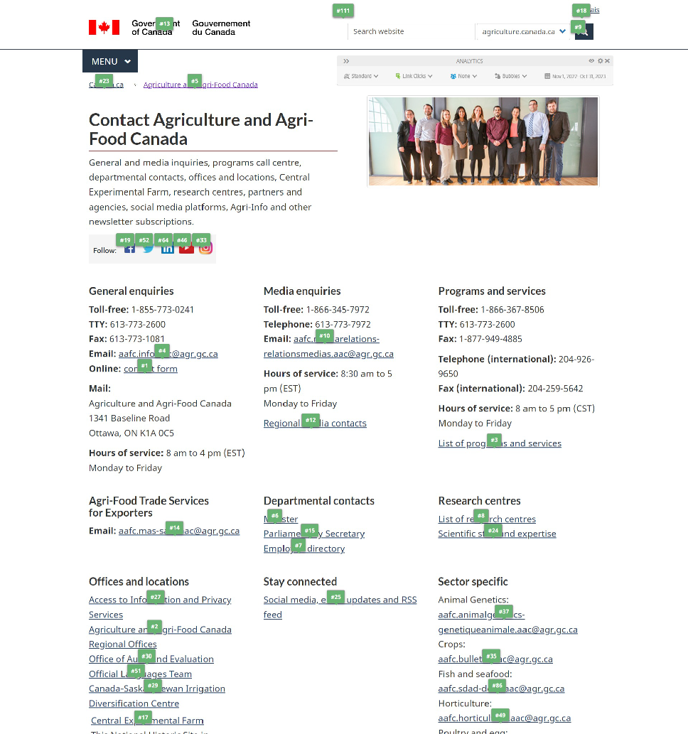
Link Overlay Report
Top 10 most clicked
1- Contact Form-General Enquiries
2- AAFC Regional Offices
3- List of Programs and services
4- Email - General Enquiries
5- AAFC website Home page
6- Minister
7- Employee Directory
8- List of Research Centers
9- Search box
10- Email – Media enquiries

Slide 19
Video analysis (Crazy egg software) December 27, 2023 to January 23, 2024
Total of 91 English videos (4 in French)
44 Canadian visitors (International was excluded from analysis)
Overall, visitors seem to be finding what they are looking for
40% of visitors selected the contact form link
A lot of visitors quickly scroll the page and leave it idle for 3-7 minutes
Regional offices and research centres link were also high-level tasks
Some visitors selected the programs and services link
From the 44 videos watched, only 2 visitors struggled
Sector specific contacts were not used in the video captures
Notes:
The French videos were not analyzed as 4 video’s is too small of a sampling to make observations
The average time per visit is between 30 seconds and 1.5 minutes. This is a good amount of time for a destination page. Users are finding what they are looking for
40% is somewhat expected, For visitors without a dedicated email software (like Outlook) the e-mail address link will not function. They may need to copy and paste the e-mail into a web-based email service.
3-7 minutes idle page: This is most likely from a visitor searching for and finding a contact phone number, and leaving the page open while they are making the call
We simplified the link text for Regional offices from “Agriculture and Agri-Food regional offices” – e-mailed those contacts and updated their page as well.
We may look at creating a programs specific contact page to make the task easier for users (but they are issues with program naming)
The 2 visitors who struggled spent over 30 active minutes on the page, scrolling up and down and continuously moving their mouse on the page
Sector specific not used often – Many years ago, we removed some pages but had to keep a contact for their service.

Slide 20
Page Feedback Tool – Did you find what you were looking?
269 TOTAL January 5, 2024 to March 20, 2024
251 English | 18 French
93% Yes 7% No
Top Comments for “No”
List of food not allowed in Canada
Import information
Contact info for manufacturing plants
Market Access newsletter information
Too much info, I can’t find what I want
Employment
Loans and grants (for livestock)
Comment box only appears when you select “No”
Notes:
To note that the top 3 items are not covered by AAFC mandate but rather by the CFIA.

Slide 21
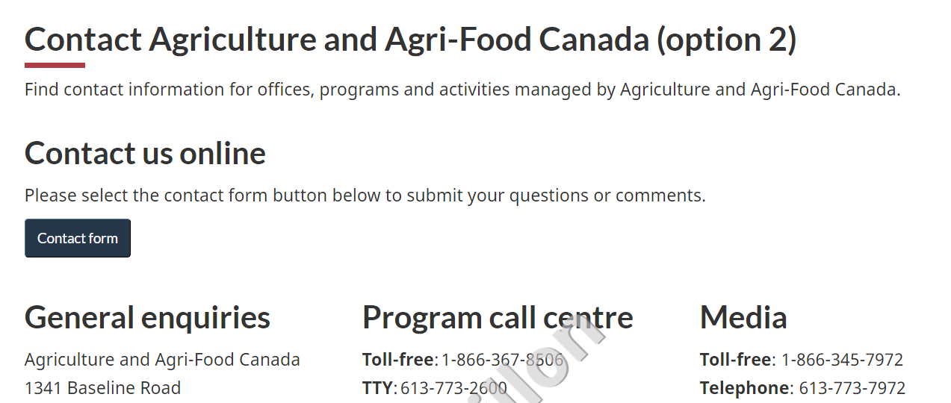
Design Prototypes – What did not work
Job seeker notice first on page
When the Job seeker notice was first on page, it was unexpected information for the page title and page description. This was amplified on mobile, when users would not see any additional information.
Super task button for contact form
The “task” button, although clean in design and straightforward, does not work in our case as the drop-down categories do not include all information on page. For example, a user would not be able to select regional contacts or media. This once again was amplified on mobile because a user would likely automatically select the button without reviewing any other on page information.
Notes:
The “task” button, could be something we work towards, if all contact information is included within the form. However, this could also be overwhelming to users as we have such a wide range of services/categories.

