Slide 1
Information session: Mindful Change Leadership Development program
April 2024
Notes:
Prep:
Update the Sli.do https://www.slido.com/ # mcld - https://app.sli.do/event/vef8EJftsZ6S9NWLoiHdbq
https://wiki.gccollab.ca/MCLD-DLCP , scroll down to the commitment section
MCLD - 8 Week Program Details (https://wiki.gccollab.ca/Mindful_Change_Leadership_Development_Program_Details)
MCLD – FAQ (https://wiki.gccollab.ca/Mindful_Change_Leadership_Development_Program_-_FAQ)
Ginette:
Good morning good afternoon everyone, First, I invite you to reflect on the land you are connecting from, and I would like to acknowledge that I am transmitting to you from the traditional Territory of the Anishnaabe Algonquin People; in Gatineau QC.
Please note that this session is being recorded. By remaining as a participant, we will interpret that as your consent to being recorded and we thank you for staying with us. // Cette session est enregistrée. Nous interprétons le fait que vous demeurez en tant que participant comme votre consentement à faire partie de l’enregistrement. Nous vous remercions de votre collaboration
As today’s session is delivered in English, feel free to express yourself in the official language of your choice // La session d'aujourd'hui étant dispensée en anglais, n'hésitez pas à vous exprimer dans la langue officielle de votre choix.
Please note there is French offering usually deliver during the Fall // Veuillez noter qu'il existe une offre française habituellement livrée à l'automne
(Show the CC slide and stop sharing)

Slide 2
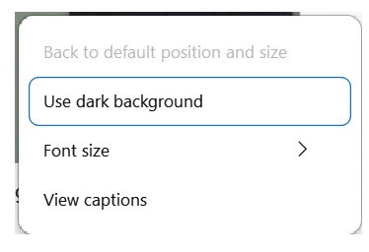
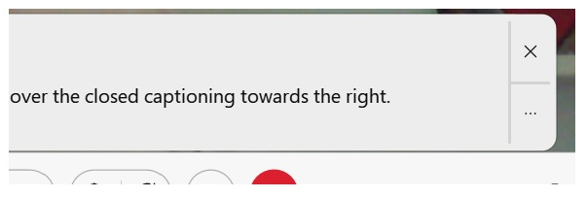
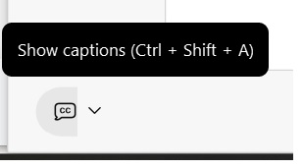
English Automatic Closed Captions Available
Notes:
Ginette:
Prep:
You can use the automatic closed captions option available at the bottom left or your screen
(Stop sharing)
Today’s information session will be led by Alejandro Gonzalez, Senior Advisor, Organizational Development and Change Management, IRCC, and my self, Ginette Bailey, Manager, Human Resources Governance & Administration, Office of the Secretary to the Governor General. We are thankful for the collaboration among all of the IOCN members who are involved in the delivery of this program, specially to the facilitators from various government Departments/Agencies, including:
Service Canada
Governor General
Indigenous Services Canada
Public Services and Procurement Canada
Financial Transactions and Reports Analysis Centre of Canada
Canada Border Services Agency
Treasury Board of Canada Secretariat
(Monday, April 15, 2024)
Now, I’d like to ask Stacey, co-chair of the Interdepartmental Organizational Change Network, IOCN for short, to introduce herself and share a few words with us.
(Stacey quickly introduces herself and share very nice words about the program)
(Ginette continues)
Thanks you Stacey for those kind words
Today, I’m also very happy to present a special guest and Sponsor to the program: Bradley Harkness (he/il), Chief HR Officer and Director General, Corporate Services Sector, Impact Assessment Agency of Canada
Brad, over to you
(Brad introduces himself and shares good words about the program)
Ginette Continues
Many thanks Brad, those are very inspiring messages about the program
(Thursday, April 11, 2024)
we had special guest: Aaron Feniak, Executive Director, Human Resources Council

Slide 3
“Leadership is not a rank or a position, it is a choice - a choice to look after the person to the left of us & the person to the right of us.”
- S. Sinek
Notes:
Ginette:
(after Brad finished, share screen)
A quote from Simon Sinek, (read from the slide)
Strong leadership is one of the drivers of successful change, and leaders who support the people-side of change are essential to success.
This program delivers and promotes mindfulness practices to increase participants’ self-awareness and resilience, equipping leaders that can nurture mindfulness in their teams, with their colleagues and contribute to employee wellness and well-being.
This presentation will provide an overview of the program, share the highlights of the program

Slide 4
Objective
Offer participants an overview of the Mindful Change Leadership Development (MCLD) program 2024, English offering
Notes:
Ginette:

Slide 5
Agenda (In no particular order)
Words from a Sponsor
Share results of previous MCLD program
Share a definition of Mindfulness and Mindful Change Leadership
Experience quick mindful exercises
Overview of the MCLD program
Q&A
Notes:
Ginette:
(paraphrase from slide)
Please write down your questions, at the end there will be time for Q&A
Raising hand
Comments via the chat
Ask questions anonymously via slido (details in next slide)

Slide 6
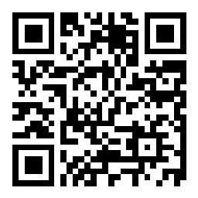
Sli.do
Anonymous questions?
https://www.slido.com/ # mcld https://app.sli.do/event/vef8EJftsZ6S9NWLoiHdbq
Notes:
Ginette:
For those who prefer to ask questions anonymously, you can do so via sli.do
You can access the sli.do link via the chat

Slide 7
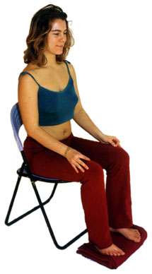
Exercise – Exploring Mindfulness – Body Scan
Time required: 5 minutes
If you haven’t, take advantage of the opportunity to experience this exercise
Sit as comfortable as possible in a straight position
Feel free to close your eyes
Follow my voice as I lead you through the exercise
Then, we will do a short debrief of what you noticed.
Notes:
Ginette:
To start, let’s experience a mindful exercise…
If you haven’t, take advantage of the opportunity to experience this exercise
Sit as comfortable as possible in a way that allows you to stay awake and attentive
Put your feet flat on the ground, your palms on you lap, upside or downside as it feels more comfortable
Feel free to close your eyes, or semi close them
Follow my voice as I lead you through the exercise
Gently bring attention to your breath, no need to change the way you’re breathing, just notice it
Now, direct your breath and attention and focus on…
Your face, your eyes, nose and mouth. Your jaw, noticing
Your head, your scalf, breath in and out
Now direct your breath and attention to your shoulders, breath in, breath out, and notice
Your arms, your hands and fingers, in and out
Every time your attention wanders away, just bring it back gently
Back to your shoulders, and neck, noticing
Your upper back, chest
Your lower back, your abdoment
Direct your breath towards your waist, in and out
Your lower leg, in and out and your upper leg, and notice what you feel
Your feet, in and out, notice what you feel
Your toes, breath in, breath out
Stay there for a few seconds, breathing in and out
When you feel like, open your eyes and come back
Debrief: What did you notice? Let’s take 2 or 3 people who’d like to share how the exercise went for you

Slide 8
Mindful Change Leadership Development Program (MCLD) Goal
To increase self-awareness by developing key skills:
Focus
Clarity
Creativity
Compassion in the service of others
… with a positive impact on well-being and resiliency.
“Individuals with higher mindfulness have greater resilience, thereby increasing their life satisfaction.” - ScienceDirect
Notes:
Alejandro:
When you think about your work and try to find a balance between work priorities, your relationships with colleagues and clients, along with home life responsibility, what strikes you as the key skills needed for this balance? Where would you like to improve?
Is it better presence, or more compassion? Is it increased self-awareness or tools for self-reflection?
We believe that this program helps to answer some of these questions and to improve the key skills of presence, self-compassion, relationality, life-work balance, self-awareness and more.
(click)
There are studies showing that individuals with higher levels of mindfulness tend to be more resilient. And also note that both mindfulness and resilience are important skills for improved well-being
By partaking in the program, you will likely increase the level of honesty and trust within yourself, and therefore with others, allowing for an authentic connection with the work that we do at across the Government of Canada.

Slide 9
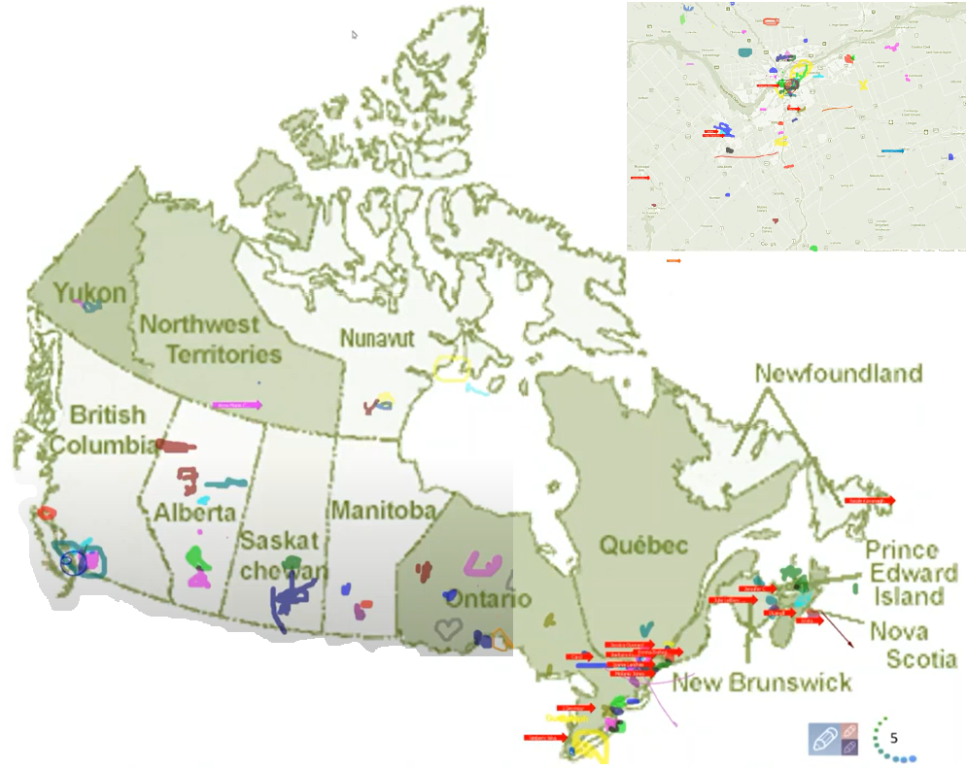
Map of Participation, 2022 English Offering
From across Canada:
From NCR:
Notes:
Alejandro:
The program had participants from across Government and across Canada, as you can see per the slide, the image was co-created at the beginning of the 2022 English offering

Slide 10
Key Findings - MCLD English Program 2022
20.8%
23.0%
14.0%
20.5%
12.6%
, 3 months after
* People who answered "Almost Always", "Very Frequently", and "Somewhat Frequently"
Notes:
Ginette:
Participants completed self-assessment questionnaires at program registration and again three months after the eight-week program, and we have compiled the data to evaluate the results and impacts of the Mindful Change Leadership Development program.
(click)
The blue columns represent the results of the self-assessment questionnaires completed at registration.
(click)
The green columns represent the final assessment, and the differences between them indicate behavioural changes.
A total of 130 participants completed the program, we received 99 final assessments (76% return on self-assessments), and the key findings per category are:
(click on each bullet)
An increase of 12.6% Increase in Employee Engagement – respondents show a sense of clarity of mind.
(Q2. I have difficulty distinguishing what day it is.)
A 23.0% Increase in Promoting Sounder Decision Making - people reported taking time to optimize their productivity.
(Q7. I take time each day to optimize my personal productivity)
Slightly over 20% decrease in Behavioural Risks - participants indicated being more aware of the task at hand.
(Q13. It seems I am running on automatic, without much awareness of what I am doing.)
Close to 21% Increase in Well-Being – respondents feel they are more present while at work and at home.
(Q1. I notice that I am distracted by thoughts about work after working hours or about home related things when I'm working.)
And 14.0% Increase in Resiliency - people reported an improvement in their ability to be present.
(Q21. I find myself listening to someone with one ear, doing something else at the same time.)
What we heard from participants was that the program was a life changing experience, it helped them increased their own sense of well-being; and gave them the tools and practices to use with their teams to support employee wellness and well-being.

Slide 11
MCLD Program Testimonials
"…in a way, your investment in becoming medicine... is a very important investment…" - Elder Malcom Saulis
"I found this course to be extremely powerful and grounding... this really helps to shape how I look at my relationships with my staff… it was excellent. "
"it was very powerful, very interesting, lots of insights. I learned a lot about myself. I found the exercises appropriate in me being more productive, more present in my relationships with my colleagues and also with my family.”
“This series is life changing. I hope to participate more in the future”
"These 8 weeks have been profound… in my view, I think this should be mandatory for everyone. it's that powerful"
"Thank you for this valuable opportunity to grow personally and professionally. It has been an important adjunct to the transformational work we are doing…“
“I wanted to also share some specific gratitude... I found the sessions incredibly helpful, useful and well structured… it's already had a wonderful effect on my life”
Notes:
Ginette:
From this set of testimonials, I’ll allow myself to read the first one in full… from Elder Malcom Saulis: "... in a way, your investment in becoming medicine for yourself and for the rest of the world is something that I'm grateful to be witness to as an occasional participant in this program... any kind of investment like this in order to open your mind, your heart and your spirit to the presence of a larger world, which is either spiritual or physical, is a very important investment, and I applaud you for the investment that you've made." - Elder Malcom Saulis, session 8, 5456

Slide 12
Mindfulness Exercise – Hand
Time required: 3 minutes
Invitation to experience this exercise
Sit as comfortable as possible in a straight position
Feel free to close or semi-close your eyes
Follow my voice as I lead you through the exercise
Then, we will do a short debrief of what you noticed.
Notes:
Alejandro:
With your back straight, sit as comfortable as possible
Gently bring attention to your breath, no need to change the way you’re breathing, just notice it
Stay there for a few seconds
Now, direct your breath and attention to
Now, with the index finger of one of your hands, start at the bottom of your thumb on the opposite hand
Breath in, move your finger towards the top of your thumb
Breath out, move your finger towards the bottom on the other side of your thumb
Breath in, move your finger towards the top of your index, 4, 3, 2, 1
Pause at the top, 4, 3, 2, 1
Breath out, move your finger towards the bottom on the other side of your index, 4, 3, 2, 1
Pause, 4, 3, 2, 1
Next finger Breath in, 4, 3, 2, 1
Pause, 4, 3, 2, 1
Breath out, 4, 3, 2, 1
Pause, 4, 3, 2, 1
Next finger Breath in, 4, 3, 2, 1
Pause, 4, 3, 2, 1
Breath out, 4, 3, 2, 1
Pause, 4, 3, 2, 1
Last finger Breath in, 4, 3, 2, 1
Pause, 4, 3, 2, 1
Breath out, 4, 3, 2, 1
Pause
Stay there for a few seconds, breathing in and out
Now, come back… and open your eyes.
Debrief: What did you notice? Let’s take 2 or 3 people who’d like to share how the exercise went for you

Slide 13
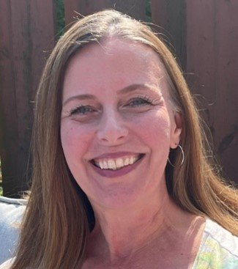
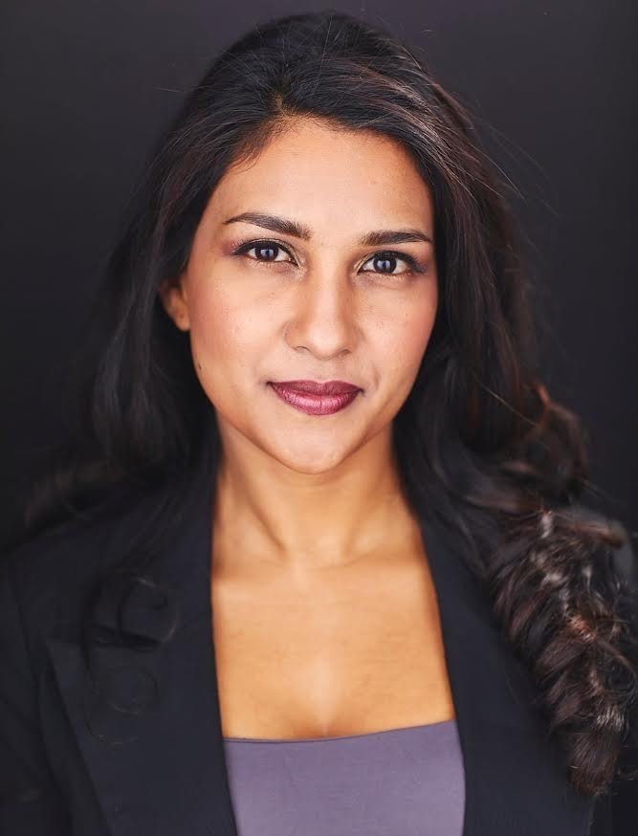
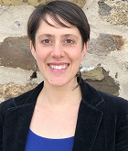
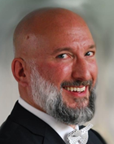
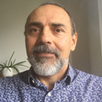
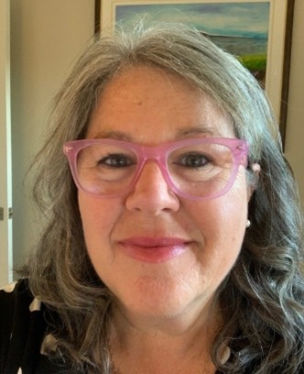
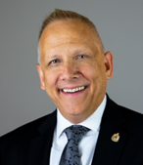
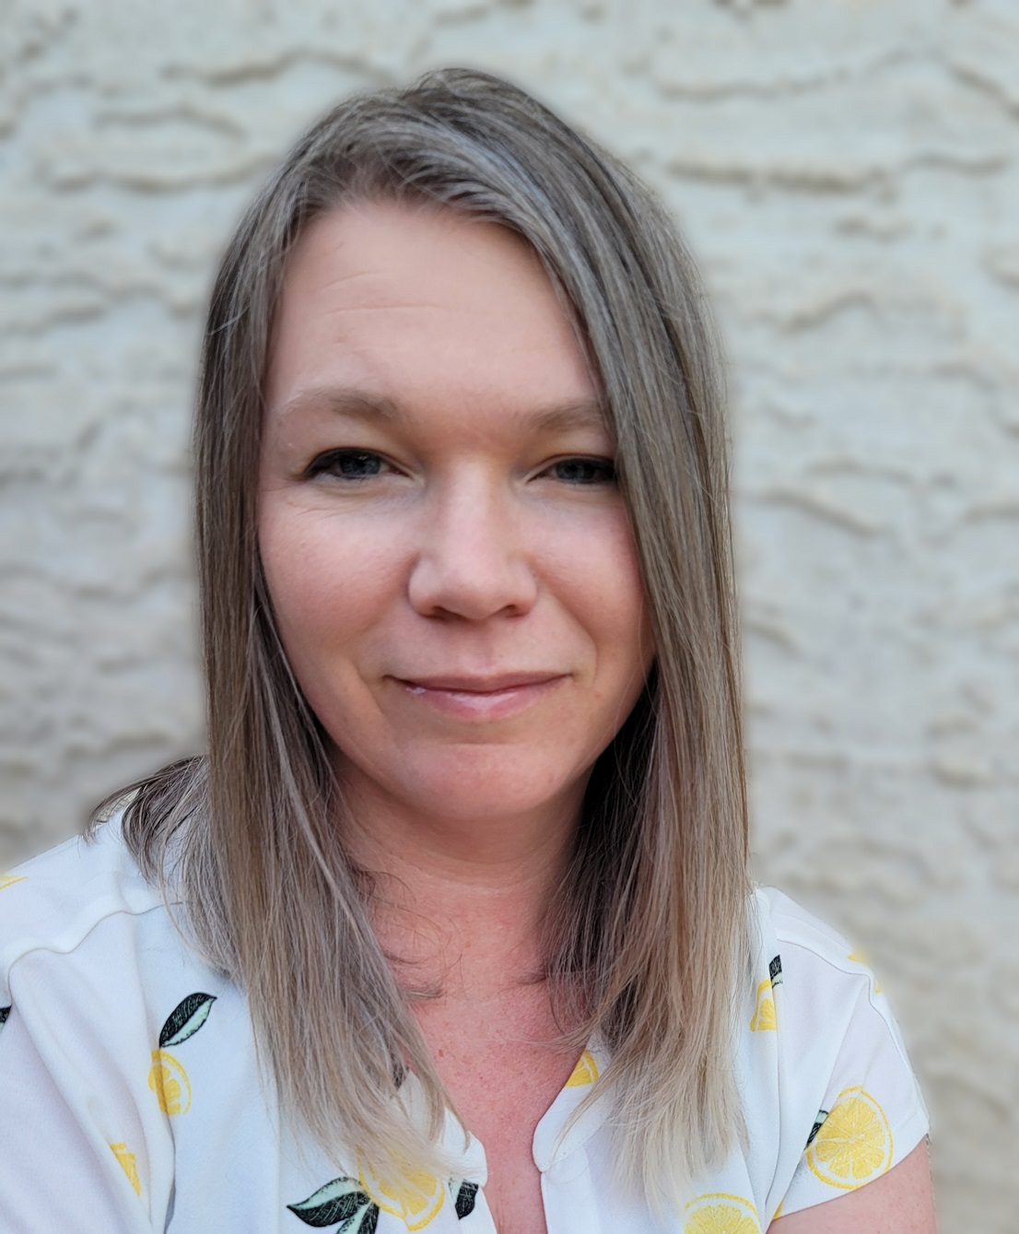
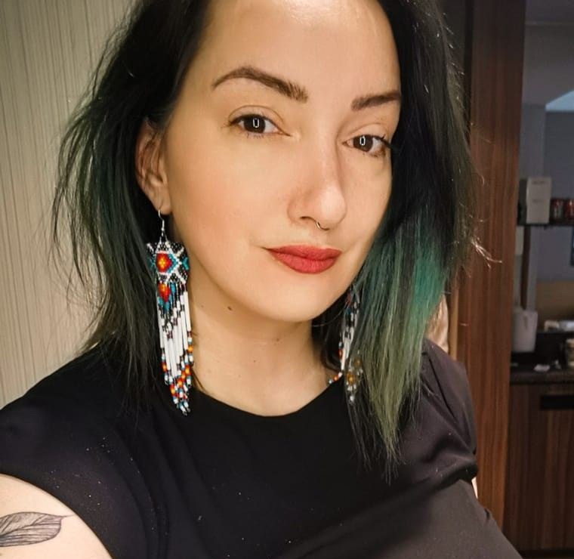
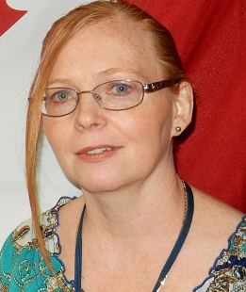
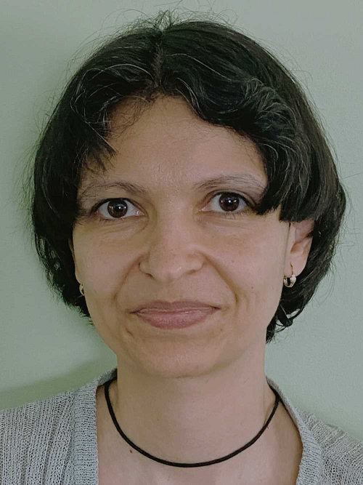
Delivered by a team of volunteering facilitators
Ginette
Casey-Marie
Annie-Claude
Carmen
Alejandro
Marie-Lyne
Robert
Michelle
Dani
Leanne
Galina
… and others…
Notes:
Ginette:
Here a partial list of facilitators from various government Departments/Agencies, including:
Service Canada
Governor General
Indigenous Services Canada
Public Services and Procurement Canada
Financial Transactions and Reports Analysis Centre of Canada
Canada Border Services Agency
Treasury Board of Canada Secretariat
Canada Revenue Agency
Immigration, Refugees and Citizenship Canada
))

Slide 14
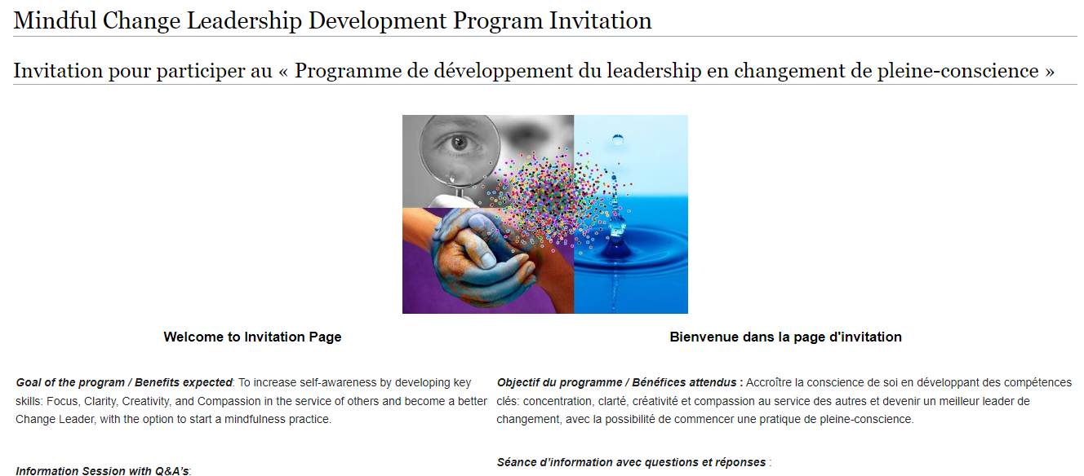
Commitment, Program Overview & FAQ
https://wiki.gccollab.ca/MCLD-DLCP
MCLD - 8 Week Program Details
MCLD - FAQ
Notes:
Alejandro:
“This program is aimed at someone who wants it” (not necessary for one who needs it)
Pages to open and explore:
https://wiki.gccollab.ca/MCLD-DLCP , scroll down to the commitment section
MCLD - 8 Week Program Details (https://wiki.gccollab.ca/Mindful_Change_Leadership_Development_Program_Details)
MCLD – FAQ (https://wiki.gccollab.ca/Mindful_Change_Leadership_Development_Program_-_FAQ)

Slide 15
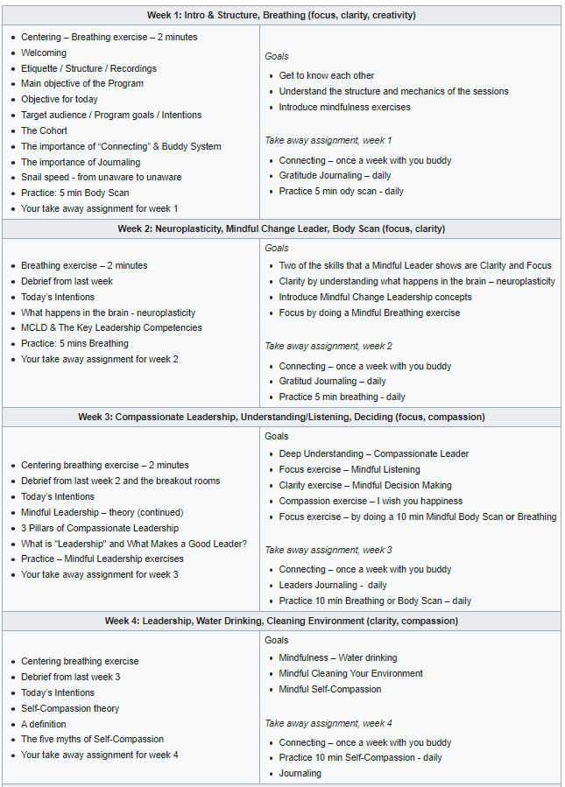
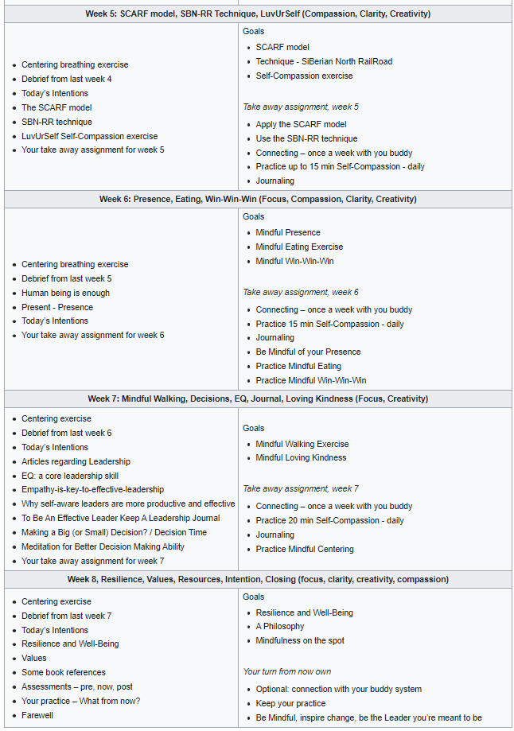
https://wiki.gccollab.ca/MCLD-DLCP
MCLD - 8 Week Program Details.
MCLD - FAQ
Notes:
Alejandro:
The program goes for 8 weeks, with a weekly session of 1.5 hours, plus additional homework for up to an estimate of 2 to 3 hours a week
https://wiki.gccollab.ca/MCLD-DLCP
MCLD - 8 Week Program Details.
MCLD - FAQ
https://gccollab.ca/groups/profile/7978973/mcld-program-cohort-cop-coi-programme-dlcp-cohorte-cdp-et-cdi

Slide 16
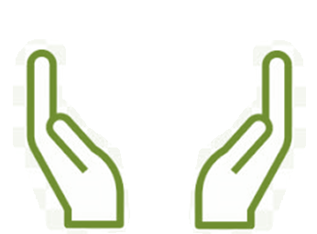
What’s Needed For Success?
Voluntary Participation
Support from Management
Could be added to your Performance Management Agreement or Learning Plan
Notes:
Alejandro:
The sessions and take-home activities require a fairly significant investment by participants, and two components which are key for ensuring your successful participation on this program are maintaining voluntary participation and support from management.
And as a bonus, it could be added to your Performance Management Agreement or Learning Plan
(These 2 success factors are emphasized during the promotion of the program, and employees are encouraged to discuss with their managers to get their support)

Slide 17
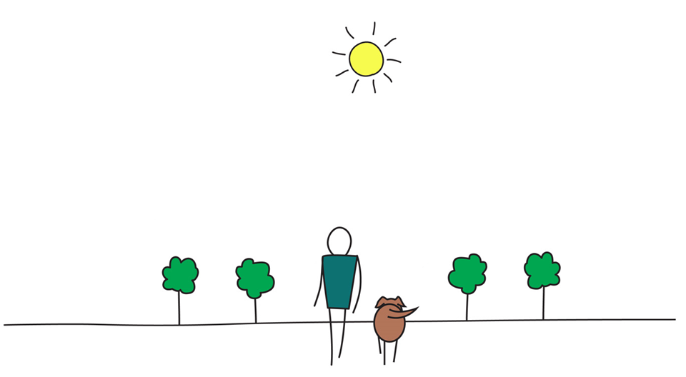
Be Mindful,
Be Happy
Open floor for questions
Please use the “raise hand” functionality
Observe:
One question, per participant, per turn
Alternating with the chat and with anonymous
Notes:
Alejandro:
In the meantime that people raise their hand to ask questions), we’ll reflect back on some of the comments put on the chat…. (mention some of the comments for both exercises)
And now, we open the floor for questions, please observe:
One question, per participant, per turn
Alternating with the chat
And Menti OR Sli.do #mcld - https://app.sli.do/event/ndecSyr9sCAK8nCTSHMcjb, for those who prefer anonymity (provide the Sli.do link and code)

