Slide 1
Emergency Geomatics Service
Situational Awareness to Assist Disaster Relief
Simon Tolszczuk, Nicolas Svacina
Canada Center for Mapping and Earth Observation

Slide 2
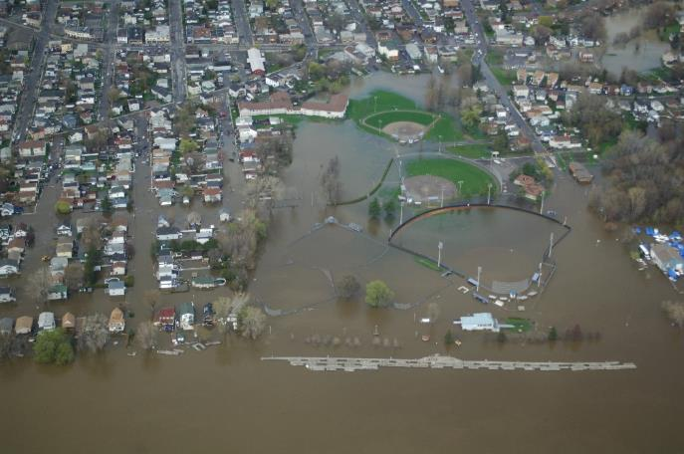
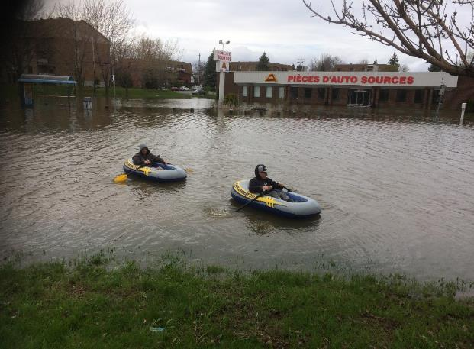
Emergency Geomatics Service (EGS)
Since 2004 the EGS team has provided emergency response mapping across Canada and for International requests covering a wide range of natural disasters.
Notes:
RADARSAT-2 is the main sensor
NRT- response

Slide 3
EGS Activations: 2004 to Present
2019
Jan 12
Today
2004
2006
2008
2010
2012
2014
2016
2018
2020
Apr 10 - May 1
Red River
Mar 1 - Apr 1
NB
Apr 15 - May 15
Red River
Jan 1
EGS Becomes a Critical Function
RCM Launch
Mar 15 - Apr 15
Red River
Mar 15 - Apr 15
Hurricane Igor, NL
Flood
Red River + BC, QC
AB, MB, SK
Apr 15 - Jun 30
MB
May 6 - Jul 1
MB, NB, ON
Jun 1 - Jun 30
MB, ON, QC
Mar 30 - May 4
BC, NB, ON
Nov 28 - Dec 4
NB, ON, QC
Apr 16 - May 21
Oct 15 - Oct 25
MB
MB, ON, SK
Feb 21 - May 23
NB, ON
Apr 18 - May 28
River Ice
May 2 - May 4
ON
Sep 2 - Sep 15
MB, NB
Sep 21
ON
Oct 4
MB, NB
Damage Assessment
Oct 27
Haida Gwaii Earthquake
Apr 15 - May 15
Yellowknife Wildfire
Apr 8 - May 16
Mount Polley Tailings Breach
Feb 4 - May 31
Fort McMurray Wildfire
Apr 10 - Apr 30
Ottawa Tornado
May 7 - May 14
Indian Ocean Earthquake and Tsunami (DND)
Afghanistan Snow Water Assessment (DND)
Aug 4
Myanmar Cyclone Nargis (DND)
International
Haiti Hurricane Hanna
Sep 21
Haiti Earthquake (DND)
Japan Earthquake and Tsunami
Dec 26
Sep 5 - Sep 15
Senegal Flood
International Charter Space and
Major Disasters Activation
Mar 3
Haiti Hurricane Matthew
Jun 1 - Sep 30
Costa Rica Hurricane Otto
2004
2006
2008
2010
2012
2014
May 1 - May 30
2016
2018
2020

Slide 4
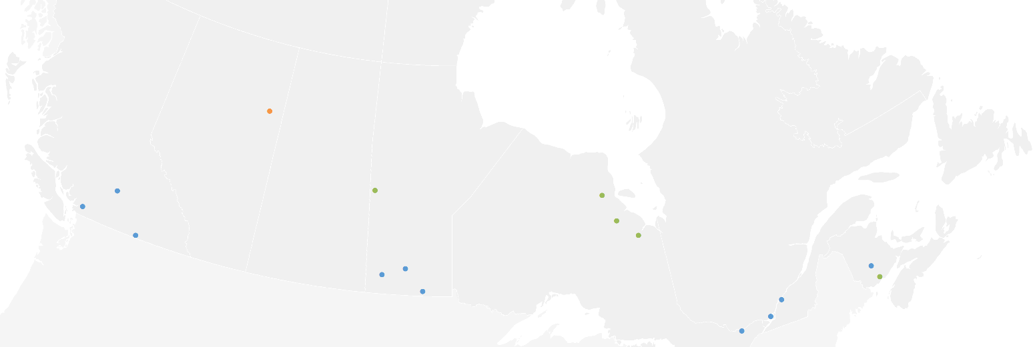
EGS Activations Since Becoming a Critical Service
Fort McMurray
2019
Today
Thompson River
The Pas
Attawapiskat River
Lower Fraser River
Jan 1
Albany River
Central BC Rivers
Moose River
Saint John River
Assiniboine River
Red River
May 7 - May 14
Lac Saint-Pierre
Mar 30 - May 4
Montreal
RCM Launch
Nov 28 - Dec 4
Ottawa River
Mar 20 - Apr 23
2015
2016
2017
2018
Apr 16 - May 21
2019
Feb 21 - May 23
Fredericton, NB
Apr 18 - May 28
Saint John River, NB
Ottawa River ON/QC
Lac Saint Pierre, QC
Lac des Deux Montagnes, QC
Assiniboine River, MB
Ottawa River, ON/QC
Lac Saint-Pierre, QC
Montreal, QC
Flood
BC Rivers
Saint John River, NB
James Bay Rivers, ON
Oct 4
Prairie
Rivers,
MB
Apr 8 - May 16
Oct 15 - Oct 25
Saint John River, NB
James Bay Rivers, ON
Feb 4 - May 31
River Ice
James Bay Rivers, ON
Apr 10 - Apr 30
Prairie Rivers, MB
James Bay Rivers, ON
Red River, MB
All Major Rivers, NB
Damage Assessment
Fort McMurray Wildfire
Sep 21
Ottawa Tornado
International
International Charter Space and Major Disasters Activation
Haiti Hurricane Matthew
Costa Rica Hurricane Otto
May 1 - May 30
2015
2016
2017
2018
2019

Slide 5
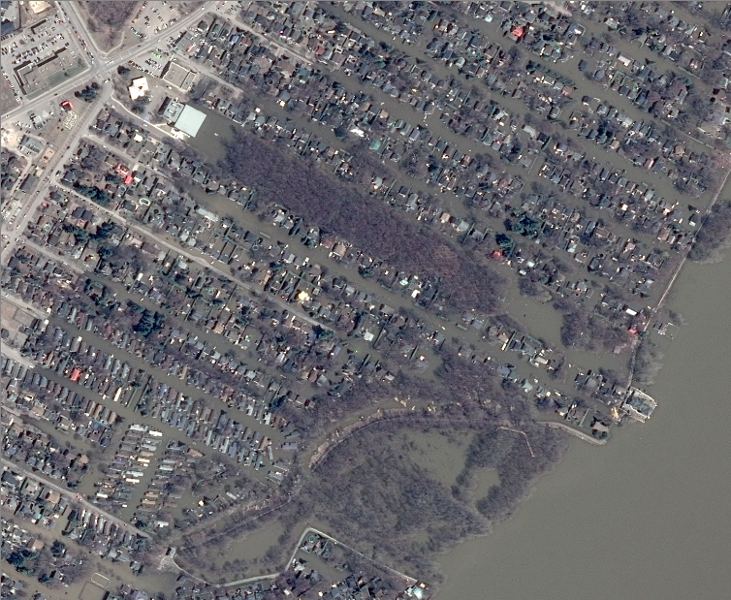
EGS Flood Response
Municipal Emergency Responders
Provincial Government Operations Center
Federal Government Operations Center
Disaster
Other Federal Departments
- Natural Resources Canada
Canada Center for Mapping and Earth Observation
  Satellite Imagery acquisition
  Situational Awareness
Pleiades-1A
Sainte-Marthe-Sur-Le-Lac, QC
2019-04-29

Slide 6

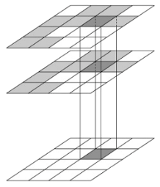
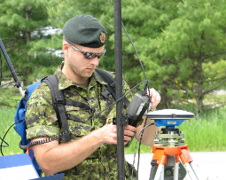




6:00 AM
6:30 AM
7:00 AM
11:00 AM
ACQUISITION
GROUND STATION
EMERGENCY GEOMATICS SERVICE
PRODUCT DELIVERY
PRECISE AREA OF INTEREST COVERAGE
FAST DATA TRANSFER
VALUE ADDED PRODUCT EXTRACTION
DATA DISSEMINATION
Icon made by Freepik from www.flaticon.com
Icon made by Smashicons from www.flaticon.com
Icon made by srip from www.flaticon.com
Icon made by Eucalyp from www.flaticon.com
Style source: PowerPoint School YouTube Channel

Slide 7
6:00 AM
6:30 AM
7:00 AM
11:00 AM
ACQUISITION
GROUND STATION
EMERGENCY GEOMATICS SERVICE
PRODUCT DELIVERY
PRECISE AREA OF INTEREST COVERAGE
FAST DATA TRANSFER
VALUE ADDED PRODUCT EXTRACTION
DATA DISSEMINATION
Icon made by Freepik from www.flaticon.com
Icon made by Smashicons from www.flaticon.com
Icon made by srip from www.flaticon.com
Icon made by Eucalyp from www.flaticon.com
Style source: PowerPoint School YouTube Channel

Slide 8
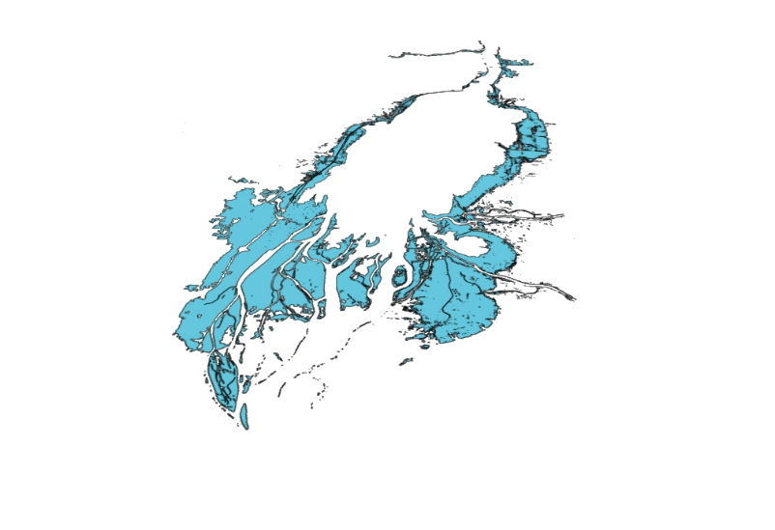
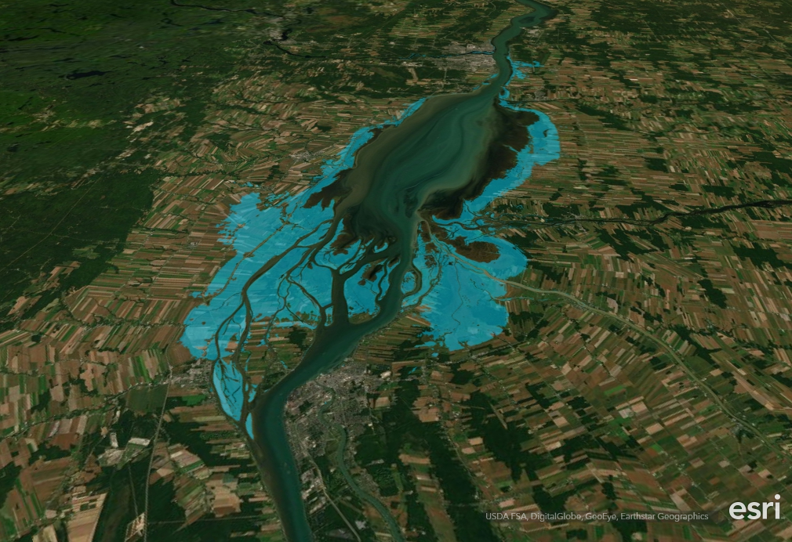
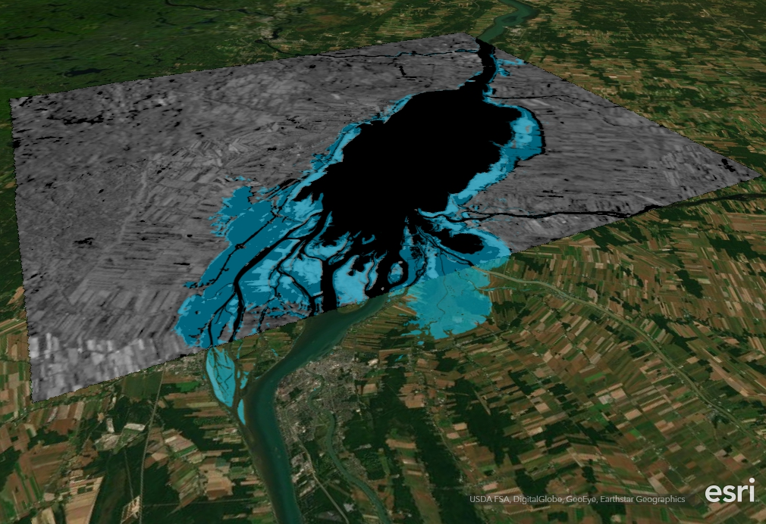
DISSEMINATION
11:00 AM
DISSEMINATION
PRODUCT DISSEMINATION
Icon made by Freepik from www.flaticon.com
Icon made by Smashicons from www.flaticon.com
Icon made by srip from www.flaticon.com
Icon made by Eucalyp from www.flaticon.com
Style source: PowerPoint School YouTube Channel

Slide 9
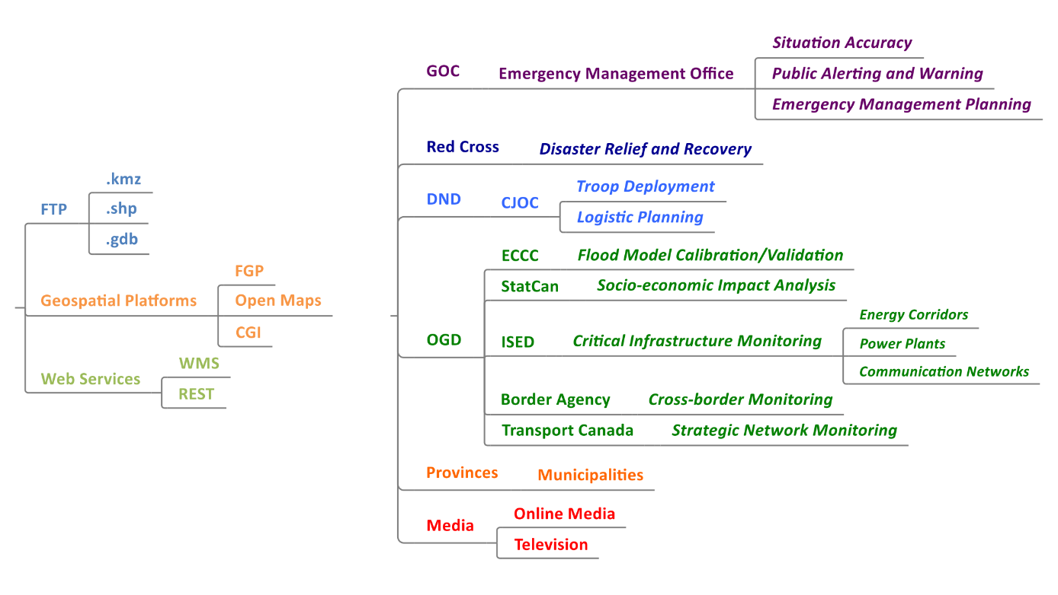
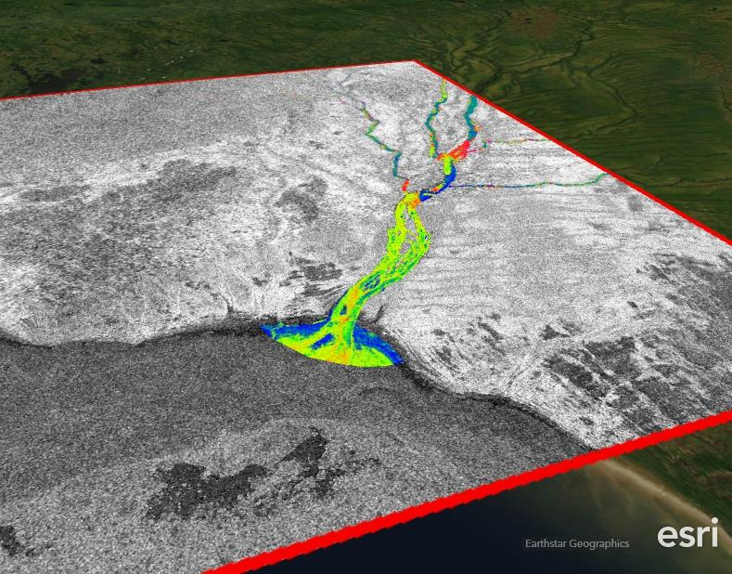
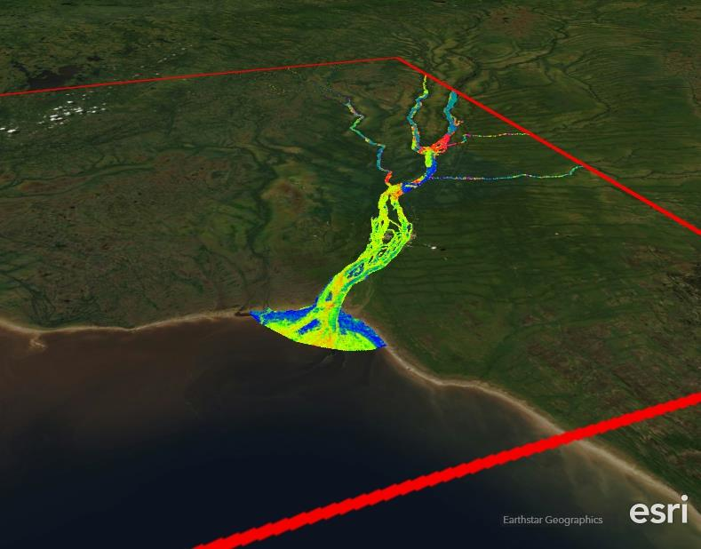
DISSEMINATION
Icon made by Freepik from www.flaticon.com
Icon made by Smashicons from www.flaticon.com
Icon made by srip from www.flaticon.com
Icon made by Eucalyp from www.flaticon.com
Style source: PowerPoint School YouTube Channel

Slide 11
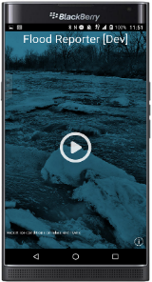
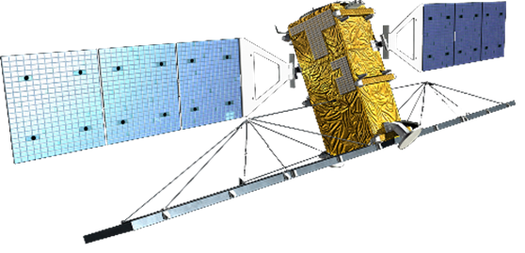

NRCan Observer Crowdsourcing project
River Ice
Satellite Imagery
Improved river ice state maps
End user field observations
Notes:
EGS is developing a crowdsourced geographic information (CGI) mobile/desktop application to enable the gathering of field data in near real time.
The app will help EGS better understand field conditions to assess the quality and accuracy of remotely sensed cartographic products.
The app is available to public safety professionals and collaborators
Allows the users to gather real time observation with geographic location by filling out a survey based on a predefined set of variables.

Slide 12
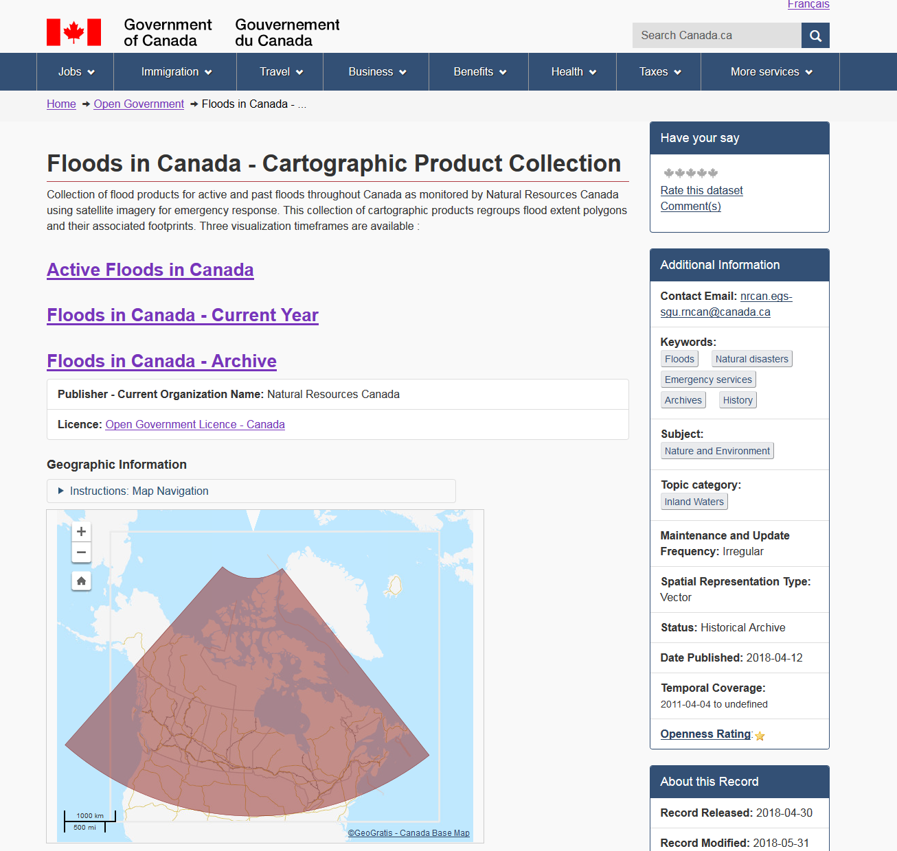
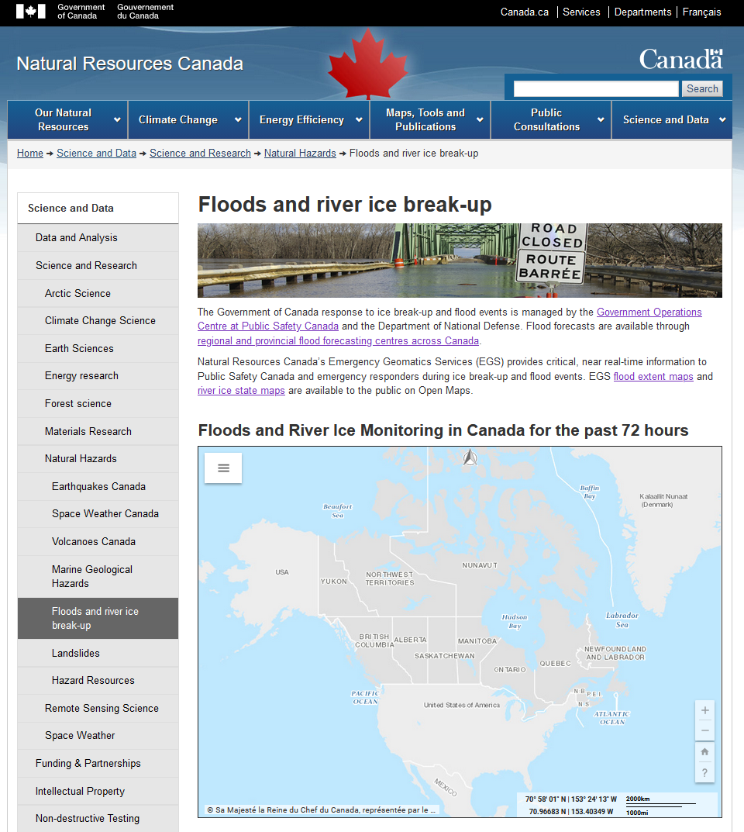
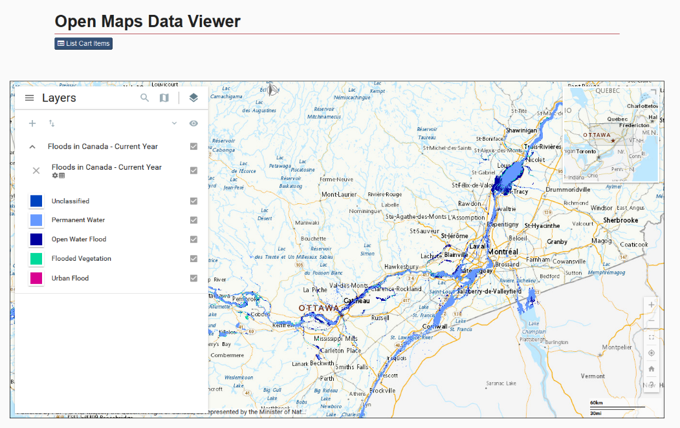
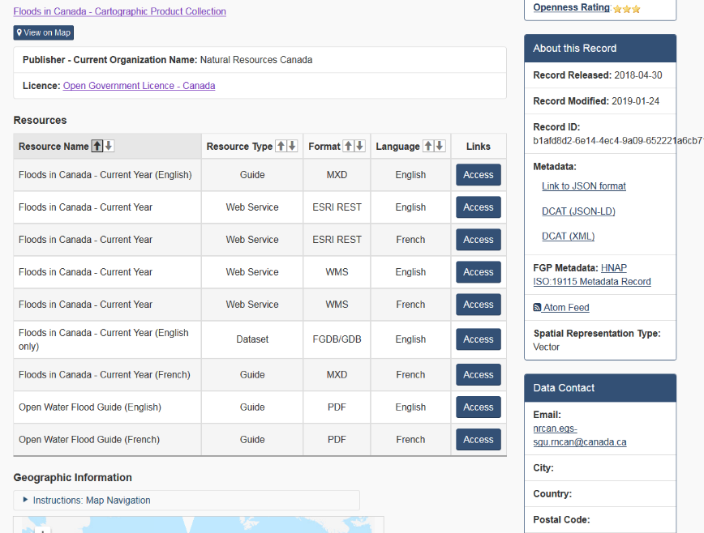
Google us!
NRCan Floods
http://nrcan.gc.ca/hazards/floods
https://open.canada.ca

Slide 13
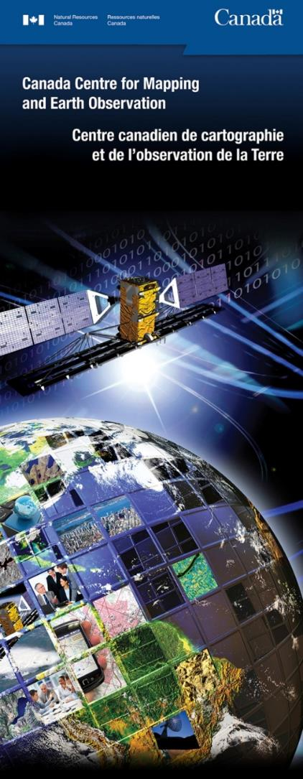
Thank You! Questions?
CCRS-EGS@NRCan.gc.ca
Manager : Vincent Decker
EGS Team: Brad Lehrbass, Victor Neufeld, Tom Rainville, Phil Muise, Nicolas Svacina,
Kieran Moynihan, Élise Bergeron, Diane Drolet, Brigitte Belzil, François Paquette
Senior Scientists: Ian Olthof, Joost Van der Sanden, Torsten Geldzetser, Brian Brisco,
Sergey Samsonov, François Charbonneau
Extended Team:
Hugo Drouin, Benoit Chagnon, Bruno Avard, Geoffroy Houle, Ken Francis, Jean-François Bourgon, Josée- Anne Langlois, Sylvain Plante, David Bélanger, Nicolas Gariépy, Charles Papasadouros, Jean-Claude Lapointe, Alexandre Beaulieu, Robert Gould, Kristian Desjardins, Yannick Blain
CIOSB , Shared Services Canada, CSA order desk

