Slide 1
EOSD Welcoming Event 2024
Employment Opportunity for Students with Disabilities (EOSD)
June 11, 2024

Slide 2
Land Acknowledgement
Take time to develop our own personal approach and understanding of what these territorial acknowledgements mean to us and be intentional about connecting them to our own participation in systemic change.
We encourage you to use this time to do some personal reflection on your own relationship with the traditional indigenous territory where you work and live.

Slide 3
Housekeeping Guidelines
Ensure you’re on mute for the duration of the presentation
If you would like to ask a question or provide a comment, there are two options:
  Raise your hand and wait for the moderator to ask you to unmute
  Write in the chat function of MS Teams
This session is being held in both official languages. American Sign Language (ASL) is available during the English parts and LSQ is available for the French parts.
The MS Teams Live Captioning feature has been enabled

Slide 4


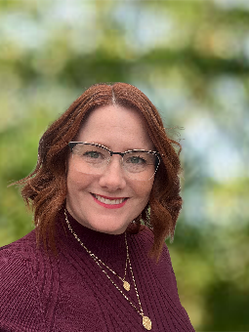
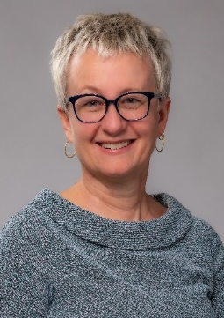
Topics and Guest Speakers
Indigenous Student Employment Opportunity (ISEO)
Véronic Mageau-Gachignac (she/her)
Human Resources Advisor
Indigenous Centre of Expertise (ICoE)
Public Service Commission of Canada
Employment Opportunity for Students with Disabilities (EOSD)
Camila Das Gupta (she/her) and Sylvie Laliberté (she/her)
Centre of Expertise for Diversity and Inclusion (DICoE)
Public Service Commission of Canada
EOSD Student Testiomonial
Leah Plomp (elle)
EOSD Participant
Junior Policy Analyst
Global Affairs Canada
Keynote Speech - Video
Tina Namiesniowski (she/her)
Deputy Minister Champion for Federal Employees with Disabilities
Senior Associate Deputy Minister, Employment and Social Development Canada

Slide 5
2024 Summer Events
Information Session – June 19
GC Workplace Accessibility Passport
Lending Library Service
11:00 am to 12:30 pm (EST) | English and French
Mentorship Session: Speed Matching – July 4
(registration required – more info will be emailed)
1:30 pm to 3:00 pm (EST) | English and French
Participant Limit: 40 Students
Information Session – August 13
Infinity Network
11:00 am to 12:30 pm (EST) | English and French
EOSD Summer Closing Event – August 21
1:00 pm to 2:30 pm (EST) | English and French

Slide 6
Mentorship Program
Mentoring plays an important role in career development
Helpful to see yourself in your mentor and have similar values
Over 100 mentors who are part of the disability community
New this year: matching!
Participants are encouraged to have more than one mentor

Slide 7
After Graduation Job Opportunities
Graduates who previously participated in the EOSD program can be hired through bridging.
Those who sign up for the Virtual Door to Talent with Disabilities – Graduate Inventory will be able to include their CV in our inventory, which is accessible to hiring managers across the public service.
EOSD participants will receive an e-mail with information about the intake and application process at the end of the summer.

Slide 8
Contact Us!
Have questions, comments, or ideas to share?
Contact us at the email below:
cfp.psh-prog-pwd.psc@cfp-psc.gc.ca

Slide 9
Thank you / Merci / Ekosani / Miigwech / Meegwetch / Niá:wen / Mahseecho / Mutna / Wopida / Hei Hei / Marci Cho / ᖁᐊᓇᖅᑯᑎᑦ / Quanaqqutit / ᓇᑯᕐᒦᒃ (Nakurmik) / Qujannamiik / Qujanaq / Kukwstsétsemc / Woliwon / Woliwun / Wela’lin

