Slide 1
GC Task Success Survey:
23-24 Annual Results
May 2024 | GCWP, Web Executive Board

Slide 2
Q4 Results
Overview of the GC’s results for Q4 of 2023-24 FY
140,507 visitors completed the survey.
71.8% of respondents said that they were able to complete their task
We received a total of 80,685 comments from survey respondents.

Slide 3
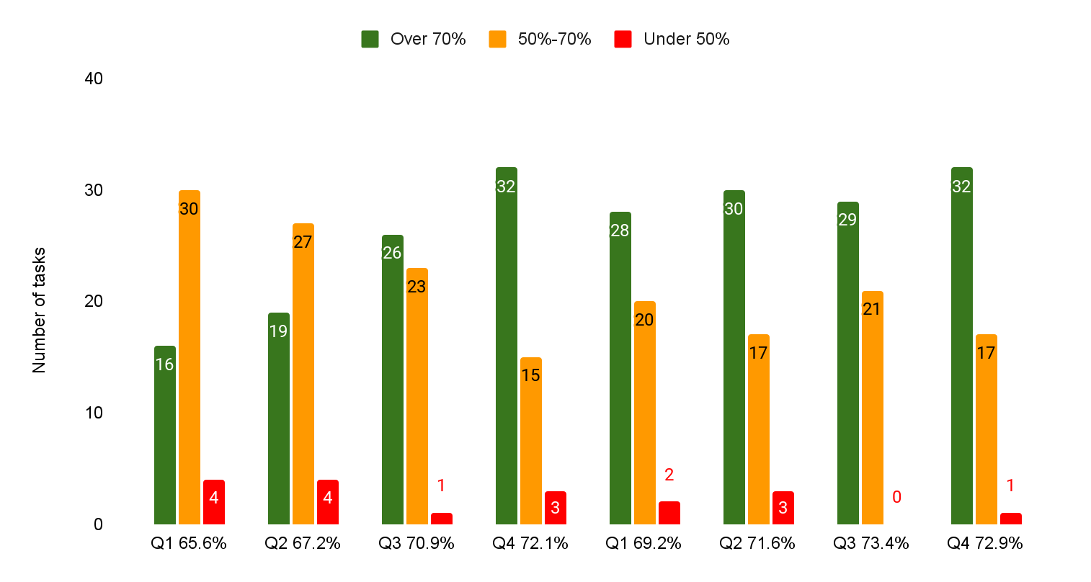
Distribution of top 50 tasks by completion scores
The distribution of “successful” tasks had more stability this year.
Last FY 22-23 was very influenced by pandemic response tasks.
Many tasks remain the same each quarter - but there is variation due to seasonality of tasks. In Q4 we see more tax tasks.
Going forward it may be useful to also report on a common set of tasks each quarter.
FY 22-23
FY 23-24

Slide 4
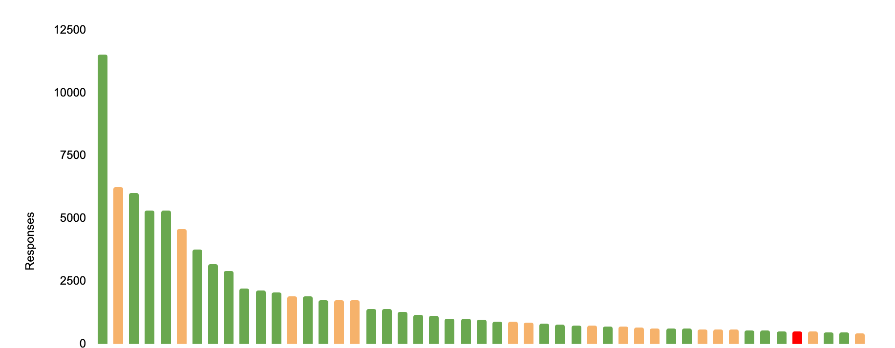
Top 50 tasks: Q4 (23-24) - By number of responses
Apply for a work permit
Most of the top 25 tasks had a 70%+ score suggesting that we should increase our success metric to 75%
Access My Account
> 2000 responses: 12 tasks
1000-2000 responses: 11 tasks
< 1000 responses: 26 tasks

Slide 5
Tasks that entered and exited the top 50 in Q4
11 of the top 50 tasks are different compared to Q3
(22% of tasks)
11 tasks entered the top 50
9 were tax related
Bumped 11 tasks related to benefits, travel, health and immigration out of the top 50
Tasks that dropped out of top 50 in Q4 | Tasks that entered top 50 in Q4
Canada Pension Plan (CPP) - Check payment information | View or download T4 and other tax slips
Travel advice and advisories | Find out when I can expect my tax refund
My Service Canada Account (MSCA) - Check your estimated monthly Canada Pension Plan (CPP) benefits | Find out which tax deductions, credits, or expenses I can claim
My Service Canada Account (MSCA) - Register for an account | Dental insurance (eligibility, apply)
How to extend your stay in Canada | Find my Registered Retirement Savings Plan (RRSP) contribution limit
Apply for the Canada Child Benefit (CCB) | File an employer information return (T4 Summary)
Symptoms or risks for a disease or condition | Check the status of a passport application
Access your pay (MyGCPay, CWA, Phoenix) | Get an income tax form and guide
My Service Canada Account (MSCA) - Check your CPP/OAS application status | Open a My Account
Find a designated learning institution | Disability tax credit
Vaccines and treatment | Access My Business Account

Slide 6
Q4 - Highest completion scores in the top 50 tasks * Where the Q4 response rate was reliable
Takeaways
Even the most successful tasks can receive important page feedback that can improve the user experience.
The benefits payments dates calendar page still includes feedback with pension questions.
Weather performs well overall but still has important feedback about the new radar map.
Pension payment dates | ESDC | 95.80%
Get current and forecasted weather for your location | ECCC | 90.30%
Employment Insurance (EI) - Submit an Employment Insurance Report | ESDC | 89.60%
Calculate payroll deductions | CRA | 86.10%
Check processing times | IRCC | 84.40%
My Service Canada Account (MSCA) - View payment information | ESDC | 82.20%
Apply for a work permit | IRCC | 81.80%
Employment Insurance (EI) - Apply for Employment Insurance | ESDC | 81.30%
Apply for an Electronic Travel Authorization (eTA) | IRCC | 81.00%
Study in Canada – for non-Canadians | IRCC | 80.00%

Slide 7
Q4 - Lowest completion scores in the top 50 tasks * Where the Q4 response rate was reliable
Almost all tasks are directly related to accounts or require sign in to complete.
We consistently see account tasks with lower completion scores.
Open a My Account | CRA | 46.90%
Get, renew or replace a permanent resident card | IRCC | 54.20%
Access My Business Account | CRA | 57.60%
Access My Account | CRA | 59.60%
Benefits for people with disabilities | ESDC | 63.00%
Find an IRCC application package or form | IRCC | 63.10%
Check the status of a passport application | IRCC | 63.70%
Sponsor your family members to immigrate to Canada | IRCC | 64.30%
My Service Canada Account (MSCA) - Sign in | ESDC | 65.40%
Contact Immigration, Refugees and Citizenship Canada | IRCC | 65.60%

Slide 8
Biggest improvements in the top 50: Q3 v Q4
* Where Q3 and Q4 response rates were reliable (** add min # responses)
✅ = Significant change | Dept | Q3 | Q4 | Change
File a Personal tax return | CRA | 62.30% | 70.80% | 8.50% ✅
Apply for a new Canadian passport | IRCC | 70.90% | 78.50% | 7.60% ✅
Check online mail (CRA) | CRA | 70.90% | 75.10% | 4.20% ✅
My Service Canada Account (MSCA) - Check your Employment Insurance (EI) claim status and correspondence | ESDC | 72.50% | 75.20% | 2.70%
Immigrate through Express Entry | IRCC | 69.70% | 72.30% | 2.60%
Contact Immigration, Refugees and Citizenship Canada | IRCC | 63.00% | 65.60% | 2.60%
Get a copy of a notice of assessment or reassessment | CRA | 66.60% | 68.60% | 2.00%
Find an IRCC application package or form | IRCC | 61.20% | 63.10% | 1.90%
Calculate payroll deductions | CRA | 84.50% | 86.10% | 1.60%
Pension payment dates | ESDC | 94.40% | 95.80% | 1.40%
Notes:
File a Personal tax return
This task was added June 2023 so FY 22-23 Q4 data doesn't exist.
Q1 from this year was 58.3%
Context for this task. Need to review the same Q4 data or Q4 vs. Q1

Slide 9
Biggest decreases in the top 50: Q3 v Q4
* Where Q3 and Q4 response rates were reliable
✅ = Significant change | None were significant this quarter | Dept | Q3 | Q4 | Change
Old Age Security (OAS) - View payment amounts | ESDC | 77.90% | 70.40% | -7.50% ✅
Find a visa application centre | IRCC | 77.30% | 72.60% | -4.70% ✅
Find my Tax-free savings Account (TFSA) contribution limit | CRA | 74.20% | 71.30% | -2.90%
Apply for an Electronic Travel Authorization (eTA) | IRCC | 83.40% | 81.00% | -2.40%
My Service Canada Account (MSCA) - Sign in | ESDC | 67.50% | 65.40% | -2.10%
Get, renew or replace a permanent resident card | IRCC | 56.00% | 54.20% | -1.80%
Immigrate as a provincial nominee | IRCC | 71.70% | 70.10% | -1.60%
Benefits for people with disabilities | ESDC | 64.50% | 63.00% | -1.50%
Employment Insurance (EI) - Submit an Employment Insurance Report | ESDC | 90.90% | 89.60% | -1.30%
Check if you need a visa or electronic travel authorization (eTA) to travel to Canada | IRCC | 79.90% | 78.70% | -1.20%

Slide 10
Annual results 23-24
Overview of the GC’s results for 2023-24 FY
501,923 visitors completed the survey.
71.2% of respondents said that they were able to complete their task
We received a total of 283,449 comments from survey respondents.

Slide 11
FY 23-24 - Highest completion scores in the top 50 tasks * Where the response rate was reliable
 | Dept | FY 23-24
Pension payment dates | CRA | 95.20%
Employment Insurance (EI) - Submit an Employment Insurance Report | ESDC | 90.60%
Find language information | PSPC | 89.60%
Calculate payroll deductions | CRA | 86.80%
Travel advice and advisories | GAC | 85.90%
Get current and forecasted weather for your location | ECCC | 85.50%
Find out the symptoms or risks for a disease or condition | PHAC | 85.30%
Find your National Occupational Classification (NOC) | IRCC | 84.80%
Find the next benefit payment date | ESDC | 84.50%
My Service Canada Account (MSCA) - View payment information | ESDC | 82.80%

Slide 12
FY 23-24 - Lowest completion scores in the top 50 tasks * Where the response rate was reliable
 | Dept | FY 23-24
Open a My Account | CRA | 43.40%
My Service Canada Account (MSCA) - Register for an account | ESDC | 48.30%
My Service Canada Account (MSCA) - Check your CPP/OAS application status | ESDC | 50.10%
Change my address with the Canada Revenue Agency | CRA | 51.70%
Canada Pension Plan (CPP) - Apply for Canada Pension Plan | CRA | 52.20%
Old Age Security (OAS) - Apply for Old Age Security | ESDC | 53.00%
Get, renew or replace a permanent resident card | IRCC | 55.10%
Access My Account (CRA) | CRA | 59.20%
IRCC secure account - register, sign in, help | IRCC | 59.90%
Access My Business Account | CRA | 60.80%
All of these tasks are account related

Slide 13
Biggest annual improvements
* Where FY 22-23 and FY 23-24 response rates were reliable
✅ = Significant change | Dept | FY 22-23 | FY 23-24 | Change
Renew a Canadian passport | IRCC | 55.10% | 75.50% | 20% ✅
Apply for a new Canadian passport | IRCC | 55.80% | 75.00% | 19% ✅
IRCC secure account - register, sign in, help New sign-in page pattern launched Dec 7/23 | IRCC | 42.70% | 59.90% | 17% ✅
How to extend your stay in Canada | IRCC | 55.00% | 69.30% | 14% ✅
ArriveCAN - Make a customs and immigration declaration before flying into Canada | CBSA | 61.60% | 75.70% | 14% ✅
Canada Pension Plan (CPP) - Apply for Canada Pension Plan | ESDC | 41.30% | 52.20% | 11% ✅
Check your application status | IRCC | 65.80% | 76.50% | 11% ✅
Apply for a work permit | IRCC | 70.30% | 80.50% | 10% ✅
Apply for the Canada Child Benefit (CCB) | CRA | 56.90% | 66.10% | 9% ✅
Pay your fees online (IRCC) | IRCC | 55.30% | 63.90% | 9% ✅
My Service Canada Account (MSCA) - Check your estimated monthly Canada Pension Plan (CPP) benefits | ESDC | 58.80% | 67.30% | 9% ✅

Slide 14
Biggest annual decreases in success
* Where FY 22-23 and FY 23-24 response rates were reliable
✅ = Significant change | None were significant | Dept | FY 22-23 | FY 23-24 | Change
Find a term or abbreviation in another language | PSPC | 91.60% | 77.90% | -14% ✅
Make a payment to the Canada Revenue Agency (Improvements went live in March) | CRA | 70.20% | 64.00% | -6% ✅
Check the balance owing on a corporate income tax account (Improvements went live in March) | CRA | 75.00% | 69.80% | -5% ✅
Access your pay (MyGCPay, CWA, Phoenix) | PSPC | 72.10% | 67.30% | -5% ✅
Get current and forecasted weather for your location | ECCC | 89.10% | 85.50% | -4% ✅
Check online mail (CRA) | CRA | 78.50% | 75.50% | -3% ✅
Find my Tax-free savings Account (TFSA) contribution limit | CRA | 76.80% | 73.80% | -3% ✅
Jobs in the military (Canadian Armed Forces) | DND | 81.40% | 78.50% | -3%
Get a copy of a notice of assessment or reassessment | CRA | 73.10% | 70.70% | -2% ✅
Access My Account (CRA) | CRA | 61.30% | 59.20% | -2% ✅

Slide 15
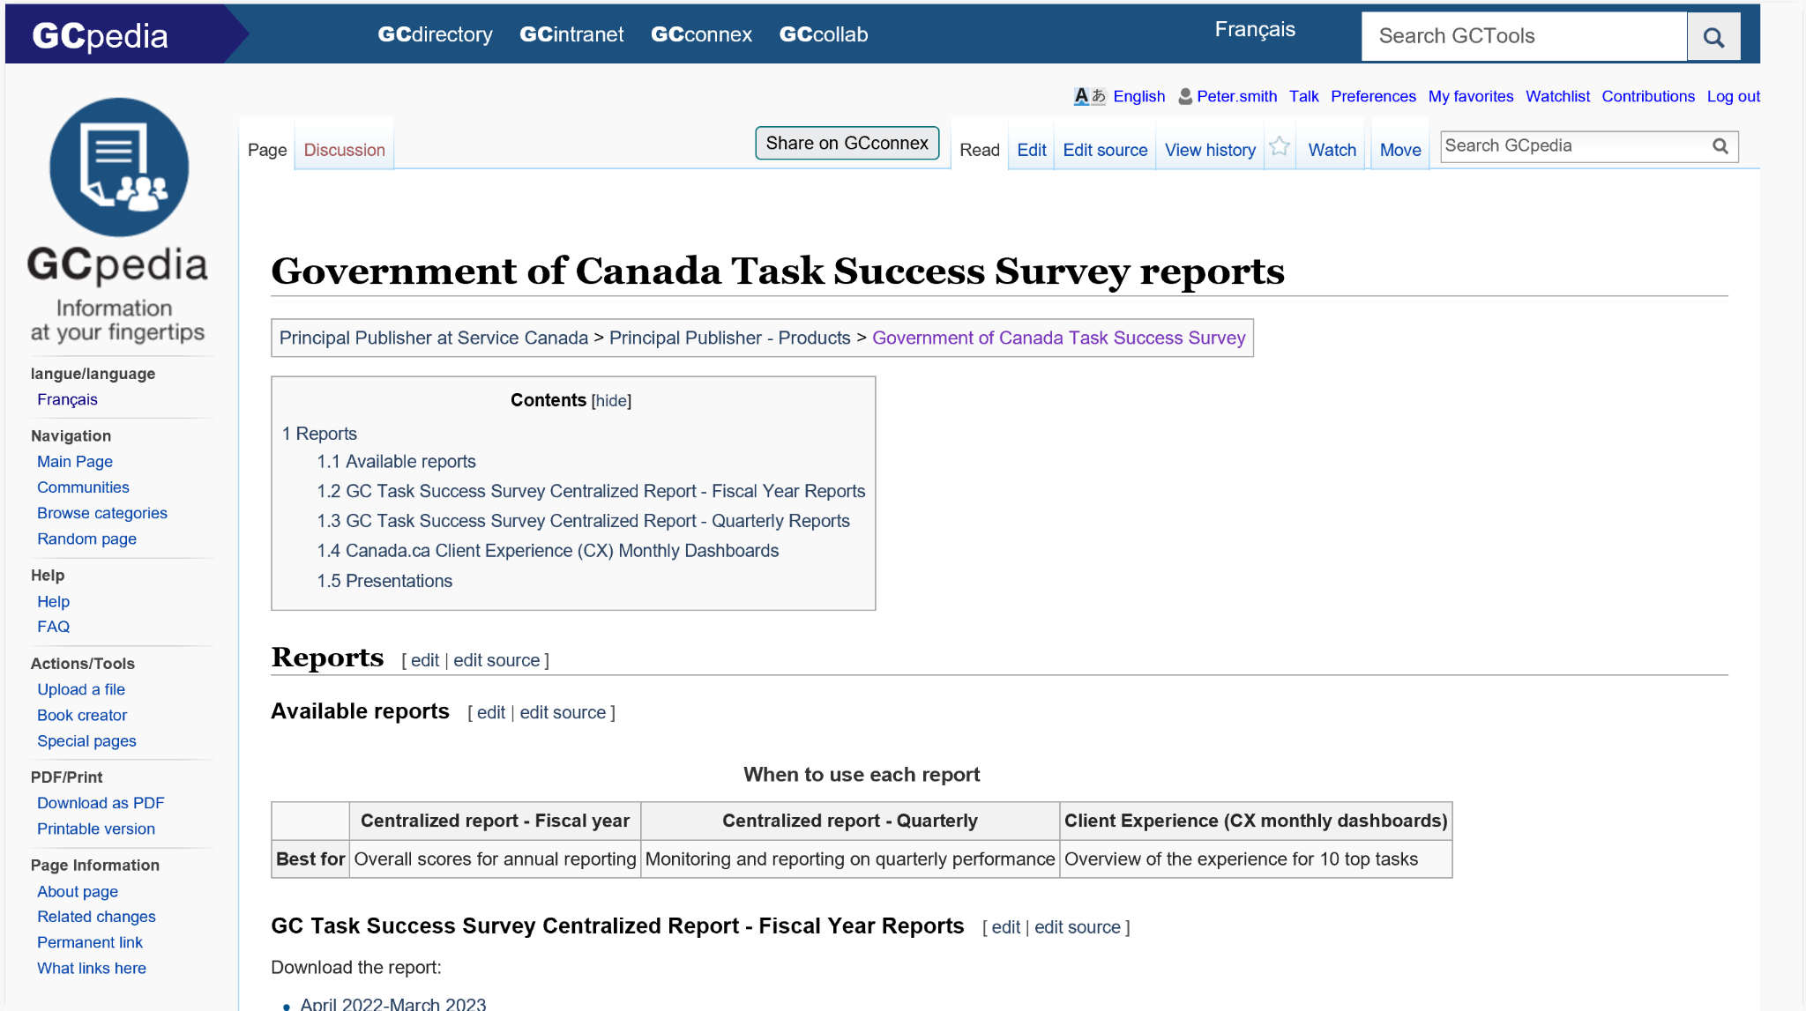
Full annual and quarterly reports
Download the spreadsheet from
GC Task Success Survey reports on GCpedia

Slide 16
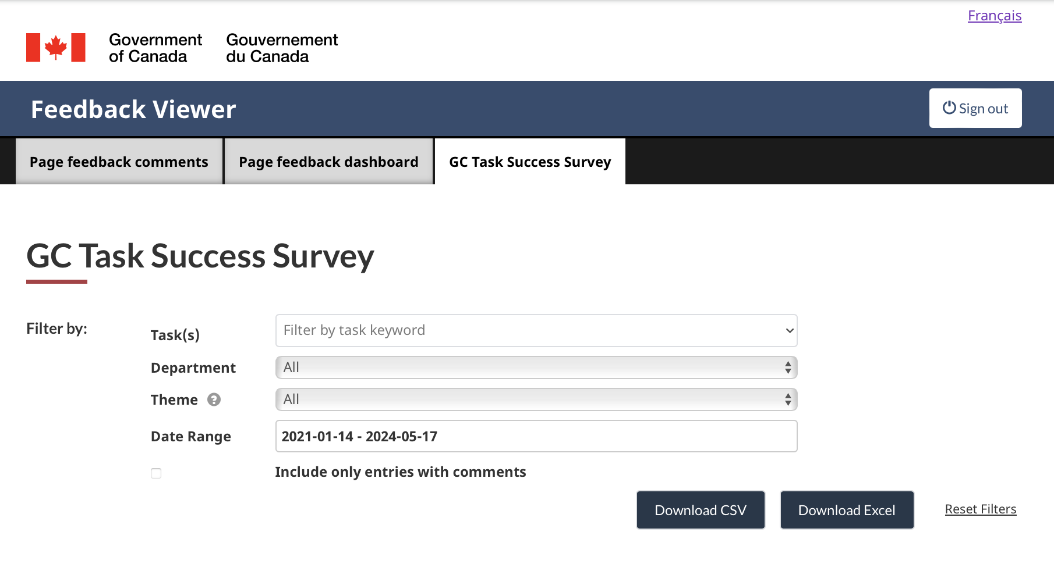
Raw qualitative responses and feedback are available
Download raw survey responses and comments
from the Feedback Viewer

Slide 17
Qualitative data also available in the TSS Results Navigator
The TSS Results Navigator is a new online tool that combines qualitative and quantitative quarterly data.
The tool pre-analyzes feedback into clusters to assist with open text analysis.
It is launching this month.

Slide 18
What’s next for analysis and reporting?
These reports would benefit from integrating more feedback and insights.
Figuring out how to rapidly analyze feedback from large datasets & document the process
Select a set of core common tasks to report on each quarter.
Plus tailoring reports based seasonal or smaller tasks when needed
Methodology: Reviewing the impacts of increasing our success metrics.
Current | Proposed
Green: 70% + | Green: 75% +
Yellow: 50 - 70% | Yellow: 55 - 75%
Red: Under 50% | Red: Under 55%

Slide 19
How is the TSS working for you?
Case studies! If you’ve used the TSS to help prioritize or understand a task better, let us know. We’d like to highlight how people have been using data each quarter.
What insights led to changes on your website?
How are you triangulating TSS data with other datapoints?
What works well when sharing data within your organization?

Slide 20
Thank you for your time
Lana Stewart
A/Supervisor Data and Performance
Digital Transformation Office
Canada Digital Service
lana.stewart@cds-snc.ca
343-551-5967
Lindsay Beaudoin-Rach
A/Manager, Analytics Services
Principal Publisher Service Canada
lindsay.beaudoin@servicecanada.gc.ca
GC Task Success Survey

