Slide 1
Q2 TSS results
2023-24
Digital Transformation Office • #CanadaDotCa • October 2023
Notes:
Opening slide

Slide 2
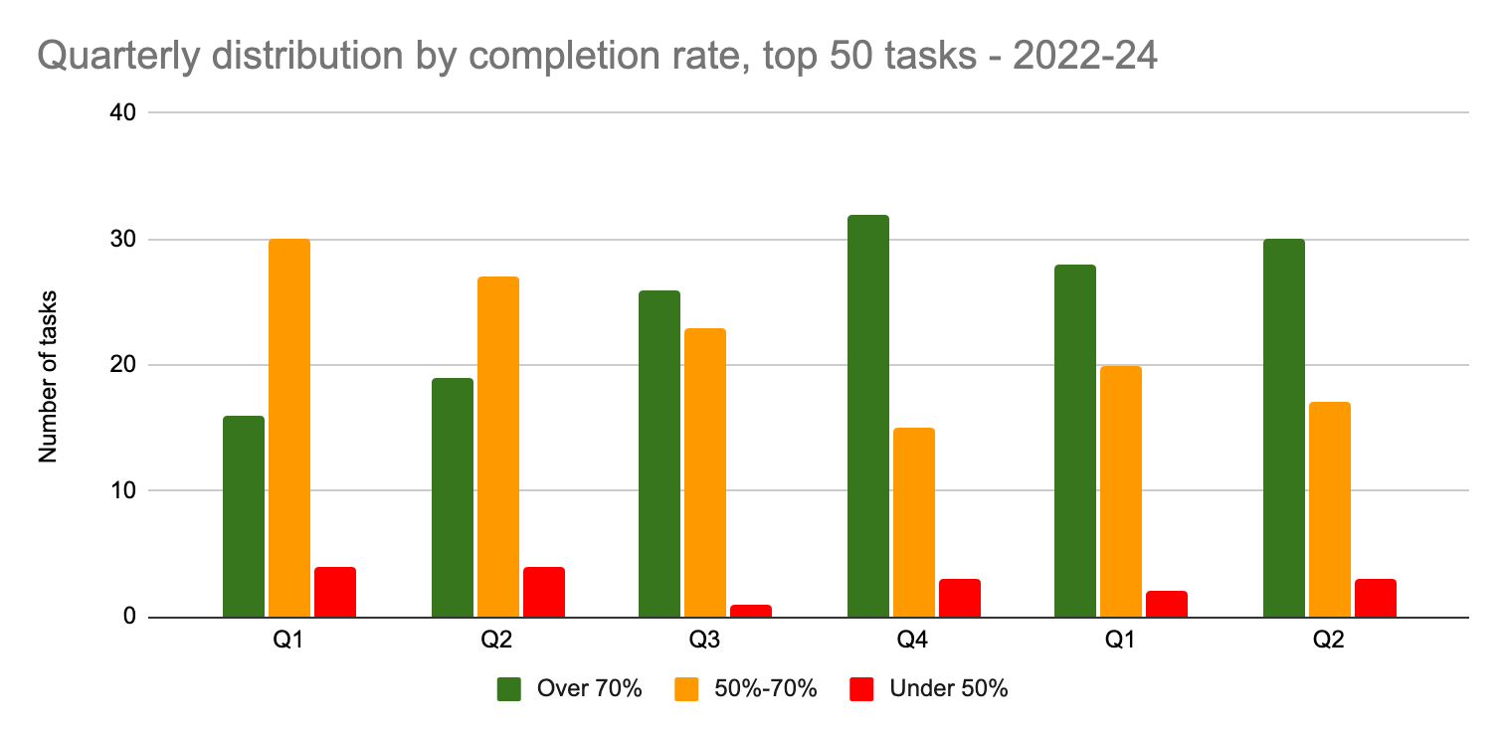
Quarterly comparison
Top 50 tasks: Small increase in green tasks last quarter
The tasks in the top 50 shift between quarters.
This is why we see slight shifts in tasks by completion rate.
For example: Q1 included more tax-related tasks in the top 50 that are not present in Q2’s top 50.
Notes:
Apply for a work permit
0
0.73
3.20%
Check your application status
0
0.7
4.30%
Employment Insurance (EI) - Submit an Employment Insurance Report
0.02309
0.87
2.70%
My Service Canada Account (MSCA) - Check your Employment Insurance (EI) claim status and correspondence
0.0092
0.67
4.90%

Slide 3
Top 50 tasks
Q4 (22-23) : Q1 (23-24) : Q2 (23-24)
 | Q4 | Q1 | Q2
Top 50 task completion average | 72.1% | 69.2% | 71.58%
Top 50 tasks in the green (over 70%) | 32 | 28 | 30
Top 50 tasks in the orange (50%-70%) | 15 | 20 | 17
Top 50 tasks in the red (below 50%) | 3 | 2 | 3
Notes:
What changed? 9 tasks dropped out of top 50 including 5 tax-related tasks that were in the top 50 in Q1 were not present in Q2 including:
Change my address with the Canada Revenue Agency
File an employer information return, such as a T4 Summary
Find out which tax deductions, credits, or expenses I can claim
Get an income tax form and guide
See my T4 information
9 tasks entered the top 50 (plus one new task was added for eTA that was missing in the Travel theme):
Access your pay (MyGCPay, CWA, Phoenix)
Apply for an Electronic Travel Authorization (eTA)
Apply for the Canada Child Benefit (CCB)
Benefits for people with disabilities
Canada Pension Plan (CPP) - Check payment information
File a Personal tax return
Find a designated learning institution
Old Age Security (OAS) - View payment amounts
Pension payment dates
Sign up for direct deposit or update your banking information

Slide 4
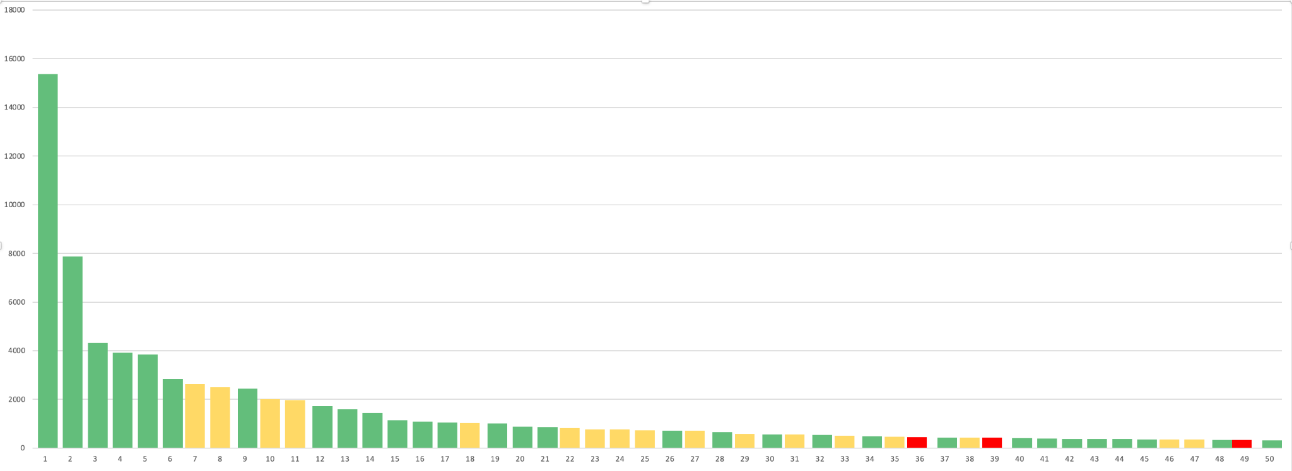
Top 50 tasks
Q2 (23-24) - By number of responses
Notes:
Lots of green in the first part of the chart - 15 of the top 20 tasks
Red tasks relegated to the lower reaches of the top 50

Slide 5
Top performers
Pension payment dates | 96.40%
Calculate payroll deductions | 92.80%
Employment Insurance (EI) - Submit an Employment Insurance Report | 92.00%
Get current and forecasted weather for your location | 85.60%
Travel advice and advisories | 85.10%
My Service Canada Account (MSCA) - View payment information | 83.90%
Canada Pension Plan (CPP) - Check payment information | 83.80%
Check processing times (IRCC) | 82.70%
Apply for a work permit | 81.70%
Find a job in the private sector | 81.20%
Of the top 50 tasks - these tasks had the highest completion percentage in Q2.
Notes:
Top 50 tasks are calculated based on number of responses.
6 of these tasks that have seen consistent increases each quarter since January 2023 (I didn’t look back before this date)
Pension payment dates from 92.3% to 96.4%
Submit and EI report 87.4% to 92%
MSCA View payment information from 79.8% to 83.9%
CPP Check payment information from 81.1% to 83.8%
IRCC Check processing times from 80.6% to 82.7%
Apply for a work permit from 73.4% to 81.7%
Pension payment dates was high in Q1 just not in the top 50 tasks by responses (checking with Maria)
Apply for a work permit was #12 in Q1
Find a job in the private sector was #11 in Q1

Slide 6
Biggest improvements in the top 50
Apply for a new Canadian passport | +9.7 % pts
Benefits for people with disabilities | +9.3 % pts
How to extend your stay in Canada | +8.5 % pts
Calculate payroll deductions | +7.7 % pts
Get current and forecasted weather for your location | +6.8 % pts
Find a visa application centre | +6.7 % pts
Check if you need a visa or electronic travel authorization (eTA) to travel to Canada | +5.1 % pts
Apply for a visitor visa | +5.0 % pts
Top 50 tasks in Q2 (23-24) with the greatest improvement in completion percentage compared to Q1 (23-24)

Slide 7
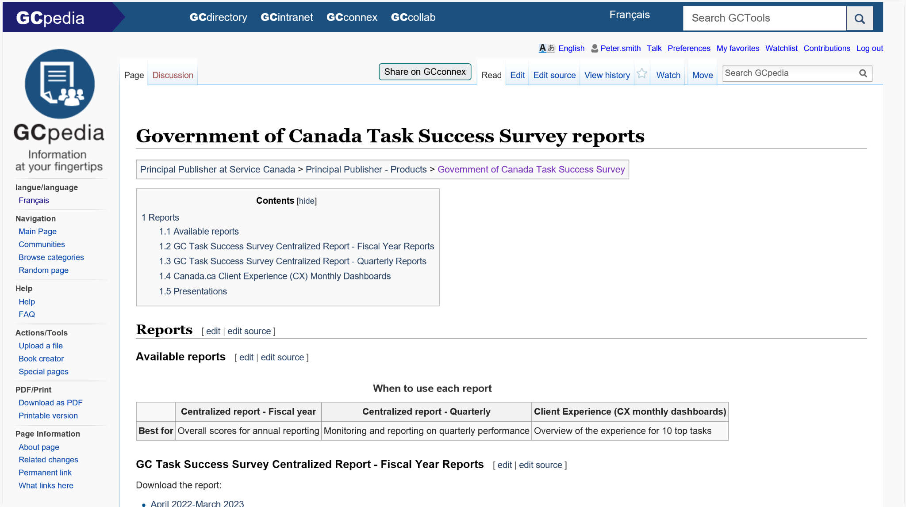
Full report
Download the spreadsheet from GC Task Success Survey reports on GCpedia
Notes:
Next steps - departments should look at their tasks to identify if there was service improvements (on the web or other channels) that contributed to these increases. Q1 saw labour disruptions for two weeks between April 19 and May 3, 2023 - this may have negatively affected Q1 results.

Slide 8
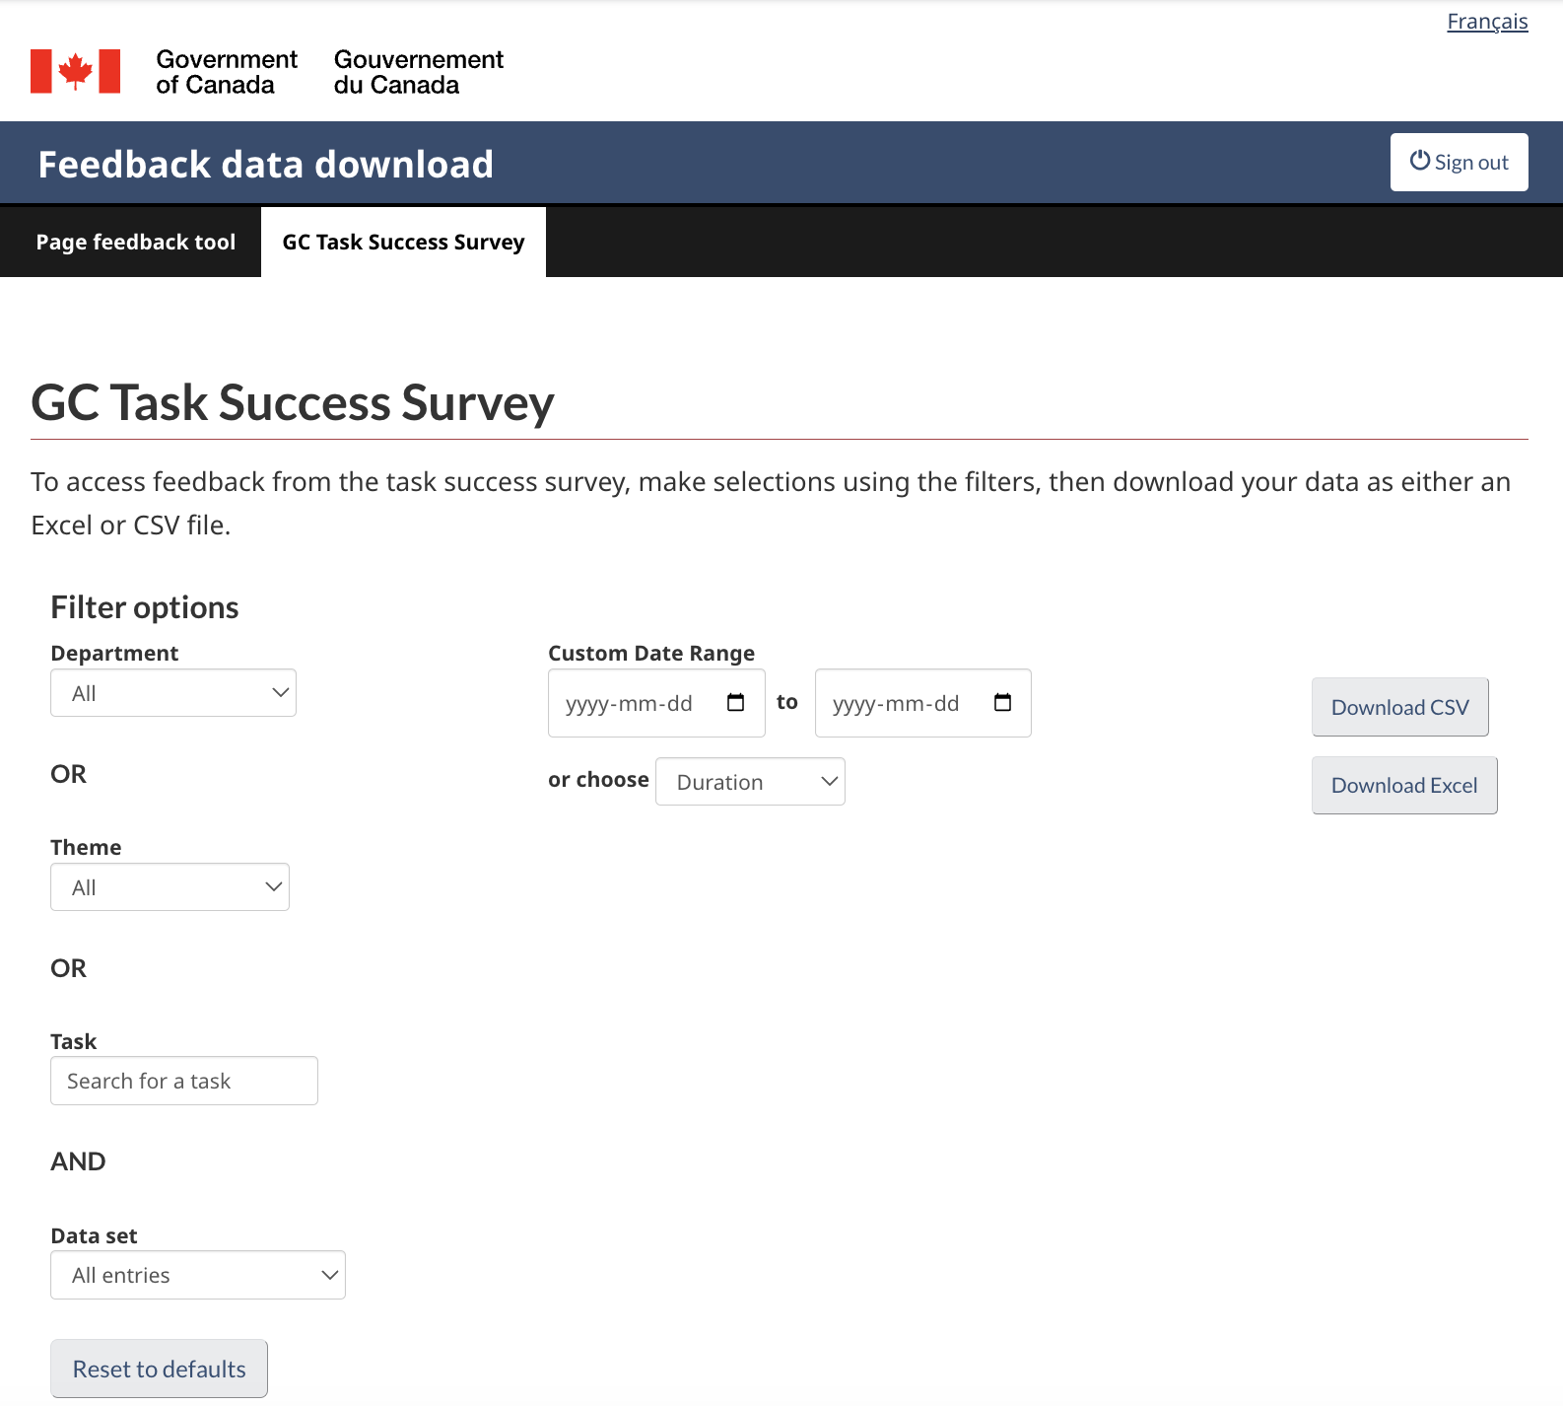
Qualitative data also available
Download comments from the feedback viewer

Slide 9
Thank you for your time
Peter Smith
Chief, Canada.ca Product Design
Digital Transformation Office
Peter.Smith@tbs-sct.gc.ca
613-979-0525
Nicolas Pjontek
Manager, Analytics Services
Principal Publisher Service Canada
Nicolas.Pjontek@servicecanada.gc.ca
GC Task Success Survey

