Slide 1
Results and recommendations from the consultative engagement on the visible minority concept
Spring 2024
Diversity and Sociocultural Statistics
Statistics Canada

Slide 2
Presentation outline
Early findings and recommendations from the consultative engagement on the visible minority concept
The testing approach for Census 2026
Proposed derived variable to replace “visible minorities”
Next steps

Slide 3
Ethnocultural questions in the Canadian census over time
5

Slide 4
Key concepts in immigration and ethnocultural diversity in Canada: 2021 Census
Place of birth
Place of birth of person
Immigration
Year of immigration
Non-permanent residents
Citizenship
Canadian citizenship by birth or naturalization; Country of citizenship
Religion
Religious affiliation
Place of birth of parents
Admission category
Landed immigrants / permanent residents
Generation status
Ethnic or cultural origins
Indigenous peoples (First Nations, Métis and Inuit)
Indigenous ancestry
Population group / visible minorities
Language
Mother tongue
Language spoken at home, language used at work
Indigenous identity
Member of a First Nation or Indian band
First official language spoken
Registered or Treaty Indian Status
Knowledge of official languages and non-official languages
Language Education Rights-Holders
For more information, please refer to the 2016 Census dictionary.

Slide 5
Various data sources are used to measure and take into account the cultural, ethnic, linguistic and religious diversity and pluralism in Canada
Census
Administrative databases
Longitudinal Immigration Database
Uniform Crime Reporting Survey
Thematic surveys (non-exhaustive list)
Canadian Social Survey
Canadian Community Health Survey
Labour Force Survey
Program for the International Assessment of Adult Competencies
Longitudinal and International Study of Adults
Surveys of specific populations
Survey on the Vitality of Official-Language Minorities
Aboriginal Peoples Survey
Ethnic Diversity Survey
Longitudinal Survey of Immigrants to Canada
Survey Series on People and their Communities

Slide 6
Recommendations of the Employment Equity Act Review Task Force related to the “visible minority” concept
Replacing "visible minority" with "racialized worker.“
One element of justification was that StatCan currently uses the term “racialized.”
Creation of a separate employment equity group for Black workers considering the historical legacies of slavery and segregation in Canada.
Creation of an Employment Equity Data Steering Committee under the Employment Equity Act framework, consisting of senior government officials.

Slide 7
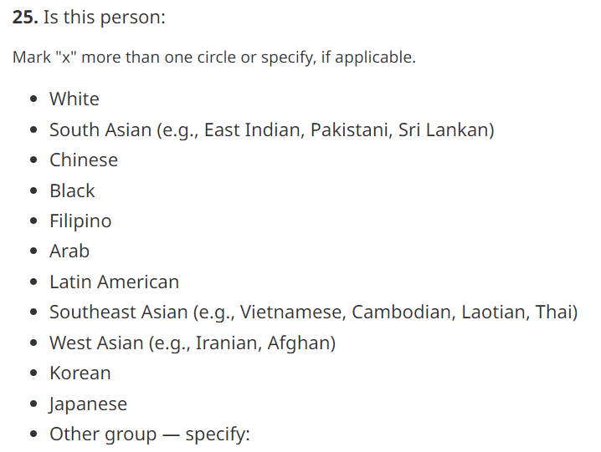
Measuring population group/visible minorities for employment equity purposes Harmonized question on population groups – Census and most surveys
Benefits
Meets the requirements of the Employment Equity Act
Enables the identification of groups that are otherwise difficult to identify
Used to derive standard variables: Visible minority / Population group
Comparability over time and with different data sources (Census, LFS, GSS, etc.) in Canada
Neutral question (no reference to sensitive terms: "visible minority,” "race,” "racial group,” “racialized group,” etc.)

Slide 8
The consultative engagement on the visible minority concept: activities and timeline
November - December 2022: Discussion groups with key stakeholders, including academics and government data users
May 2023: Meetings with federal departments
June 2023: Discussion groups with community-based organizations
October-November 2023: Early findings and validation among the general public
Over 450 participants
Over 230 responses

Slide 9
Topics of the consultative engagement | Topics of the consultative engagement
Terminology | Categories | Purpose of data | Presenting the data
How do data users and the general population feel about the term visible minority, as well as their possible alternatives (racialized groups/minorities, people of colour, population groups, BIPOC, etc.)? | Should the list of groups be modified? What is the implication for measuring the Indigenous population? | What are the data used for? Is the data relevant for employment equity, anti-racism programs, justice, health? Is the data necessary for anti-racism purposes? | Should categories be further aggregated (data reporting and choice of aggregation/ disaggregation at the stage of dissemination)? Should certain variables be crossed to provide more disaggregated data?

Slide 10
Terminology
A number of participants preferred the term “racialized groups” to replace “visible minorities.”
The term “racialized” was also the most controversial option.
The term population group (or another neutral term, such as diverse groups) was the second most preferred.
No clear consensus on a term to replace “visible minority.”
What we heard
Proposed recommendation: Change “visible minorities” for “racialized groups” to align with the recommendations of the Employment Equity Act Review Task Force

Slide 11
Categories
The categories are incoherent because they straddle race, ethnicity, nationality, and geographical descent.
Some categories (in particular, the “Black” category) are too broad and should be more granular.
Comparability between census cycles is important.
Various participants believed that Indigenous peoples should be able to answer this question.
What we heard
Proposed recommendation: Modify the categories to ensure relevance while retaining comparability and data quality
Add a First Nations, Métis, or Inuk (Inuit) category and remove the skip pattern with previous question on Indigenous identity
Develop a testing strategy to evaluate the impact of modifying certain categories, notably “West Asian,” “Arab,” and “Latin American”

Slide 12
Purpose of data
Participants expressed a wide range of applications for the data collected on “visible minorities,” which is not reflected in the current emphasis on the Employment Equity Act.
Some data users called for Statistics Canada to develop a “race” data standard with explicit reference to this concept in the question.
Data on religious groups are crucial to understand the various dimensions of racialization in Canada.
Data on racialization and experience of racism is needed but is not fulfilled with the current question available in the Census.
What we heard
Proposed recommendation: Expand statistical programs to measure racism and discrimination by developing new questions to our current social surveys and through the advancement of a conceptual framework for operationalizing a measure of racism and discrimination with relevant indicators to better understand equity, diversity and inclusion.

Slide 13
Presenting data
Desire for more flexibility in terms of data use and obtain more disaggregated data for certain groups.
The approach of crossing “visible minorities” by region of birth of parents was well received.
The option to present a multiple responses variable was also well received.
What we heard
Proposed recommendation: Provide flexibility to meet various data needs by deriving more than one variable with the data collected through the Census question (racialized groups, populations groups, multiple responses variable, and crosstabulations).

Slide 14
Harmonized question on population groups – Census and most surveys
Currently, an individual identifying as First Nations, Métis, or Inuk (Inuit) to the previous question on Indigenous identity skips this question.

Slide 15
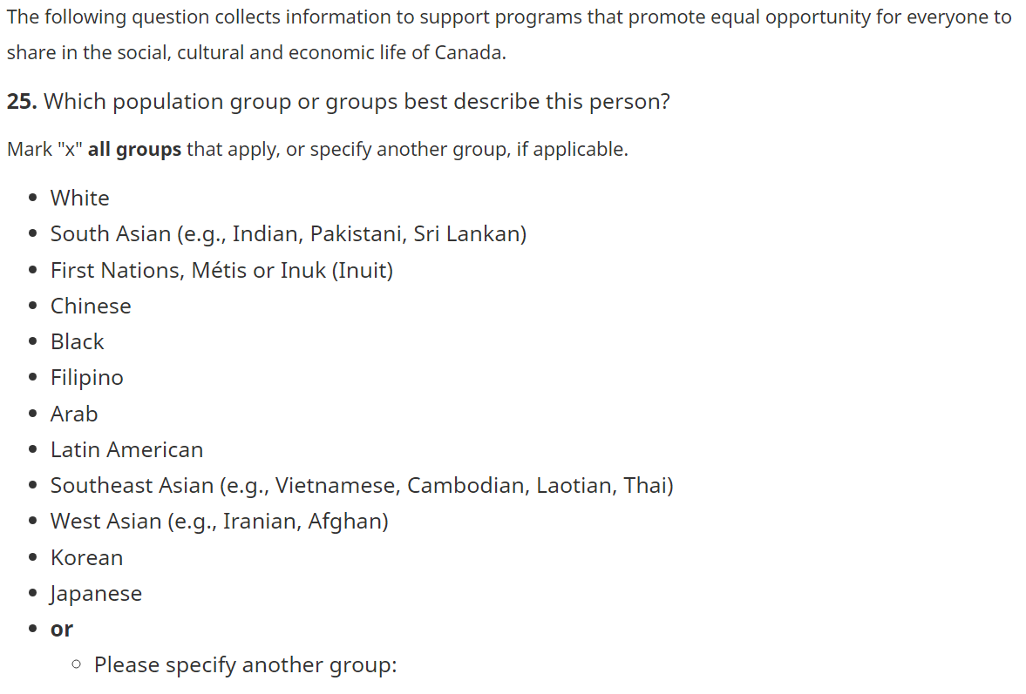
Question for the 2024 Census test
Continuity:
The question remains neutral (no mention of sensitive terminology
Categories remain for historical comparability and in accordance to Employment Equity Act operational definitions
Changes:
Inclusion of a First Nations, Métis or Inuk (Inuit) category and removal of the skip pattern with previous question on Indigenous identity
Wider preamble (beyond Employment Equity Act)
More specific question

Slide 16
For dissemination: the proposed “racialized groups” variable
Racialized groups
South Asian
Chinese
Black
Filipino
Arab
Latin American
Southeast Asian
West Asian
Korean
Japanese
Multiple racialized groups
Racialized groups n.i.e.
First Nations, Métis or Inuk (Inuit)
White
Other groups n.i.e.
Mostly comparable with the current “Visible minorities” variable
“Not a visible minority” broken in separate categories for “First Nations, Métis, or Inuk (Inuit),” “white,” and “Other groups, n.i.e.”
Two other variables will present detail for multiple responses (Population group variable, and a multiple responses variable) and data tables will cross with place of birth of parents.

Slide 17
The pathway to revisiting the visible minority standard for Census 2026
Qualitative testing (2023)
Final standard available for Census 2026 (2025*)
*A departmental standard might be available for dissemination by 2025
Quantitative testing (2024)
The final report for the Consultative Engagement on the Visible Minority Concept will be published in June 2024

Slide 18
Thank you for your attention! Your comments are precious.

