Slide 1
Branch Operation Plan (BOP)
BOP Co-ordinator
LFZ
CCDIC
Sent to 5 DGOs of IDPCB
NML
CIRID
IDPCB
PPMGD

Slide 2
Performance Monitoring Report (PMR)
CCDIC PMR Co-ordinator
Initial & Quarterly Updates
AMR
PPD
Sent to 22 PMR Respondents in CCDIC
PGPHPD
SED
PPMGD

Slide 3
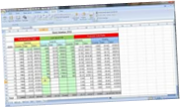
Performance Measurement Tool (PMT)
CCDIC PMT Co-ordinator
Pre-population info listed by Respondent provided for PMT survey
AMR
1
Survey sent to 22 PMR Respondents in CCDIC
PPD
2
PGPHPD
SED
PPMGD
5
Report Sent to CCDIC Co-ordinator
Respondents in CCDIC
Complete Survey
.CSV file Retrieved by VoxCo for Report processing
3
4
Server

Slide 4
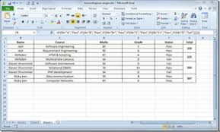
Financial Reporting
OBIP
CCDIC
DGO
Budget Allocation
OCFO
Sent to DGO
OBIP
Directors Inform DGO
PHAC
AMR
PPD
PGPHPD
SED
Managers & Staff
Inform Director
PPMGD

Slide 5
Management Variance Reporting (MVR) Process
3
CCA
OBIP
CCDIC
DGO
CCDIC MVR
2
Cost Center MVR
Anticipated Report
Committed Report
Actual Report
Salary Report
1
Q1, Q3, Q6 Q9
Received day 10-15 of the month
Send back errors
Received day 10-15 Send back errors
Day 15-25 Meetings
Day 20-30 Update anticipated and commitments
AMR
PPD
PGPHPD
SED
PPMGD

