Slide 1
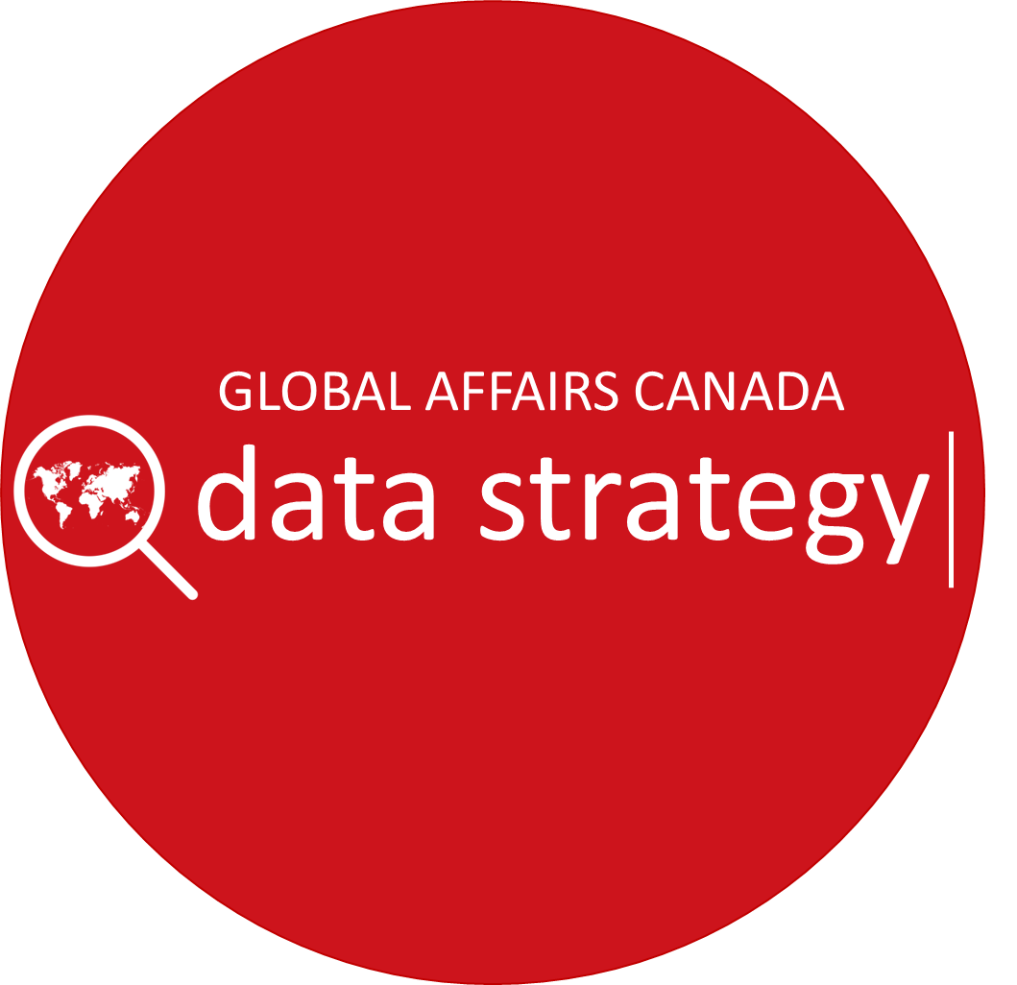
Approved
September 14, 2018

Slide 2
DATA STRATEGY HIGHLIGHTS
The GAC Data Strategy framework now expanded into a 5 year GAC Data Strategy based on 5 pillars (Culture, Access & Analytics, People, Performance & Results, Management & Governance).
Detailed action plans completed for each of the 5 pillars:
Work already underway with several “early wins” including the roll-out of Spectrum (modern, self-service business intelligence and analytics portal).
Focus now on implementing phase 1 (crawl), with following strategic objectives:
Increase employee awareness of and engagement with data.
Advance key foundational work across all pillars and progress on data systems improvement.
Undertake specific data-related projects to demonstrate the value of data for employees.
Branch plans (80% completed) are being aligned with and reflected in the departmental strategy, and efforts to support their implementation are underway.
3-phase implementation approach (crawl, walk, run) and a DG-level Data Strategy Working Group both in place to monitor and report on execution and results.
Ongoing engagement with broader Government of Canada data strategy work, and links with other related departmental processes, cooperation and action with outside partners.

Slide 3
DATA STRATEGY OBSERVATIONS
We are making good progress:
From a basic assessment of our data situation to a GAC data strategy this year.
Among the first departments to develop a data strategy, a positive observation in this year’s MAF rating.
Some early wins, notably launch of Spectrum, demonstrating benefits of data to colleagues.
High quality, positive team effort across business lines to develop strategy.
With a GAC Data Strategy now in place, two top horizontal challenges to focus on this year:
Culture – increasing interest, awareness, use of data by our employees; showing how data helps colleagues in their work is fundamental, needs to drive everything.
Coordination – very good branch plans developed, great pockets of excellence, but time and work needed to ensure we all row in the same direction.
Three areas for particular attention:
Data collection – especially performance and results information.
Data systems – improvements to main content and contact systems.
Data management – including governance, stewardship, and quality all critical foundation activities.

Slide 4
DATA STRATEGY 5-YEAR TIMELINE
YEAR 1 (2018-2019) YEARS 2-3 (2019-2021) YEARS 4-5 (2021-2023)
Timeline
DEVELOPMENT CRAWL WALK RUN
1
2
3
4
5
Data Maturity
GAC is here
FALL 2017
Data strategy framework developed with key GAC stakeholders, integrated best practices from leading OGDs
WINTER 2018 – SUMMER 2018
Framework is expanded into a full data strategy
(integrating USS/DMA/ExBo views).
MAF rates GAC data governance as “notable practice”. Branch data plans integrated into the data strategy.
FEBRUARY 2018
ExBo endorsed approach, including a “five pillar” structure
DECEMBER 2017
USS validated overall vision

Slide 5
DATA STRATEGY YEAR 1
2018-19
PILLAR 1: CULTURE
WALK
RUN
CRAWL
GAC is here
EXPECTED HEADLINE OUTCOMES
Employees’ data awareness, engagement, use is increased.
Implementation of data plans across the department is coordinated.
PRIORITY ACTIONS
Undertake robust communications activities, including access to basic data training modules.
Establish mechanism to align branch data plans with GAC data strategy.
Include data-related commitments in PMA/PSPA plans and training.
Launch data and policy development support unit to encourage use of data for policy and to join up data and policy activities across the department.

Slide 6
DATA STRATEGY YEAR 1
2018-19
PILLAR 2: ACCESS & ANALYTICS
WALK
GAC is here
RUN
CRAWL
EXPECTED HEADLINE OUTCOMES
Employees can access and explore data more easily; create and use dynamic dashboards, reports and data stories; use modern tools for analytics.
PRIORITY ACTIONS
Launch Spectrum (modern, self-service analytics portal) and provide related support and training at HQ and missions.
Expand the business intelligence and analytics community of practice to increase analytics expertise, share best practices across the department.
Produce analytics products that support decision-making (e.g. Trade, Consular, HR, Finance).
Undertake experimentation projects with data science.

Slide 7
DATA STRATEGY YEAR 1
2018-19
PILLAR 3: PEOPLE
WALK
RUN
CRAWL
GAC is here
EXPECTED HEADLINE OUTCOMES
Competency and Assignment Management System (CAMS) is launched, including tracking of competencies.
Basic HRMS position data (CBS & LES) is improved & linked to budgets
Data training needs and gaps are better understood.
Data competency and staffing needs are better understood.
PRIORITY ACTIONS
Roll-out CAMS to help match pool-managed employees’ competencies with relevant assignments (start with 2019 HQ rotational process).
Continue to clean up HRMS (CBS and LES) and ensure the integrity of the foundational HR data in support of managers and workforce planning across the department.
Define data competencies for all data literacy positions, including data scientists (data specialists).
Integrate data literacy into the CFSI curriculum according to community of practice, especially FPDS.

Slide 8
DATA STRATEGY YEAR 1
2018-19
PILLAR 4: PERFORMANCE & RESULTS
WALK
RUN
CRAWL
GAC is here
EXPECTED HEADLINE OUTCOMES
PIPs process is better understood and used, number of performance indicators is rationalized, performance data collection is monitored, overlapping reporting requirements are examined.
Employee performance measurement training needs and gaps are assessed.
Performance measurement roles and responsibilities are clarified.
PRIORITY ACTIONS
Review, streamline PIP and DRF indicators and continue communication efforts on the PIP process.
Create central warehouse for PIP indicators.
Advance improvements to main performance and results data systems including international assistance, consular, trade, FPDS.
Launch Departmental evaluation-based learning strategy.

Slide 9
DATA STRATEGY YEAR 1
2018-19
PILLAR 5: MANAGEMENT & GOVERNANCE
WALK
RUN
CRAWL
GAC is here
CRAWL
EXPECTED HEADLINE OUTCOMES
Priorities and issues relating to data management and governance are better understood.
A roadmap to improve data management in priority areas is developed.
Data stewardship responsibilities are defined and communicated.
PRIORITY ACTIONS
Assess GAC data management (quality, stewardship, governance) landscape, needs and priorities.
Develop a roadmap that outlines initiatives and accountability to mature data management at GAC.
Begin to strengthen foundational data management capabilities, services, and skillsets.
Develop a data stewardship structure.

Slide 10
DATA STRATEGY: THE FUTURE & RESOURCES
PHASES 2 AND 3
Phases 2/3 will largely build on activities and projects initiated in Phase 1.
New actions are foreseen under all areas.
General outcomes have been defined but will be adjusted based on progress in Phase 1.
RESOURCES
Phase 1 – All priority actions currently underway or planned are being funded from existing resources or through the Departmental management reserve.
Phase 2 and 3 – Will require new resources; needs are being assessed and costed; will be consolidated and presented later in FY 2018-19.

Slide 11
GAC DATA STRATEGY FRAMEWORK
Vision
Position GAC as one of the best-in-class among federal departments and other foreign ministries, in strategically harnessing data to serve citizens and make a difference in the world.
Mission
For GAC employees to be able to collect, have access to, analyze, and use high quality data to inform decision-making and better communicate results to Canadians
Drivers
Results and Delivery Agenda GAC Mandate Client Service Employee Empowerment
Maximize value: get the best data we can and make the most of the data we have to develop policy and deliver programming
Strengthen Capacity: make sure our people have the knowledge and skills to be able to use data most efficiently
Improve Performance: use and manage data better to improve planning, implementing monitoring and evaluation, and communicating results
Goals
CULTURE
Data-enabled Policy and Program Development
ACCESS AND ANALYTICS
Business Intelligence (BI) and Analytics
PEOPLE
Data Talent Development
PERFORMANCE AND
RESULTS
Integrated Performance Measurement and Reporting
MANAGEMENT AND GOVERNANCE
Data Governance and Management
Action Pillars
Ultimate Outcomes
People think about and understand what data they need and the form they need it to do their work.
People generate, collect, analyze, and use data to make policy, program, and client service proposals, advice and improvements.
Ultimate Outcomes
People from business lines and IT work together in an integrated manner to identify and implement data analytics and reporting solutions that enable departmental outcomes.
A modern data analytics capability is developed that gives department-wide access to integrated data and self-service tools.
A community of expertise connects departmental business and IT resources, skills and knowledge.
Ultimate Outcomes
The department understands the data skills and capabilities it needs
People have the data skills. they need to do their jobs and data literacy standards are developed, reflected in training programmes, performance management and recruitment.
Data analytics profiles are integrated into the profile of more jobs, data scientists are recruited and retained to do data specific work.
Ultimate Outcomes
Meaningful, measurable data based performance indicators are developed, implemented, and standardized across the department.
Capacity to aggregate data and results from different departmental (and external) performance tracking systems is increased.
Data is collected and used to support resource allocation decisions and to report and communicate departmental results.
Ultimate Outcomes
Data oversight is strengthened.
Data quality is improved.
Data sources are consolidated and data sharing is increased.

