Slide 1
Engagement Week
Digital Comptrollership Program
Business Authority & Design Authority session
November 17, 2020

Slide 2
MS Teams Meeting Protocols
Please mute your audio when you are not speaking
When you have a question, please use the raise hand button or add a comment
When asking a question, please say your name, role and agency or department
2

Slide 3
Digital Comptrollership Program (DCP) Vision
DCP is creating a future in which “digital controllership” can harness innovation and technology to reimagine capabilities, business processes and policies, fundamentally transform its role, and provide more and more insightful and strategic support to the organization.
DCP Program will modernize the Business Model across the Government of Canada. Key objectives:
Provide more timely access to reliable, consistent GC-wide information
Ensure that FM services better enable the delivery of programs for Canadians and remain cost effective and sustainable
Design and deliver standard, streamlined processes and common data structures
Build modernized common systems to replace departmental platforms
3

Slide 4
DCP - Strategic Priorities
Strategic priorities and relevance to GC’s Digital Comptrollership Program (DCP)
Strategic priority
Description
Suggested evolution
Build engaging experiences: Radically simplify complicated processes for citizens and provide personalized, self-managed online services for guiding them, thus enabling governments to be more responsive, efficient and accountable to their citizens. Citizen- centric governments will catalyze civic participation, public innovation and social inclusion.
Put the citizen at the center
Primary FMT focus
Become a data-driven government: Integrate real time financial and operational data and other knowledge source across departments to turn data into actionable insights for analytics-based, transparent and timely decisions. Data-driven governments will anticipate needs and become more pro-active in allocating funds and resources cost-effectively for higher performance levels.
Leverage data as an asset
Reimagine work, processes and operating models
Improve efficiency and focus on higher-value outcomes : Reimagine core processes (tax, social, security, HR, finance, procurement, services) and operating models through a modern, government-wide digital core connected to networks. Governments’ workforce will benefit from embedded analytics, standard tasks automation and intelligent technologies to focus their work on exceptions and specific cases that require their expertise.
Source: SAP Best Run – Public Sector 2019
4

Slide 5
DCP - Execution Focus
The Digital Comptrollership Program will deliver a modern business model to bring Digital Transformation across the GC built on SAP’s next generation SAP S/4HANA achieving digitalization, improving operational effectiveness and efficiency and increasing transparency and accountability.
Digitalize
Operate more efficiently and effectively
Increase transparency and accountability
Establish a GC digital core as the foundation to run real-time transactions and analytics
Deliver the template for Government Digital Transformation
Digitalize and transform operational models and processes
Develop common data structures and processes
Ensure business outcomes are the key focus for success
Continually analyze program performance through a new coordinated model
5

Slide 6
DCP - Background & Approach
In 2019 to support the DCP roadmap, the Program conducted a series of collaborative workshops to engage the GC departments over eight key focus areas
The key activities of the engagement were as follows:
Understand GC departments’ pain points, priorities and pre-requisites
Create a heatmap of current state capabilities
Identify gaps and potential opportunities to support the DCP vision
Prioritize the gaps to identify early wins and benefits for the departments
Develop an instance strategy and deployment roadmap
Develop an optimal target solution architecture and development roadmap for the GC Digital Core
Identify program risks, recommend an operational model to position the program for success
Primary focus of GCfm *
Extended areas of focus
To support the DCP Strategy and target architecture, the Program and SAP conducted additional workshops and meetings with key line of business stakeholders.
Financial Management Transformation Roadmap – Final Report 2019
https://www.gcpedia.gc.ca/wiki/File:FinancialManagementTransformation_Roadmap_FinalReport_25082019.pdf
6

Slide 7
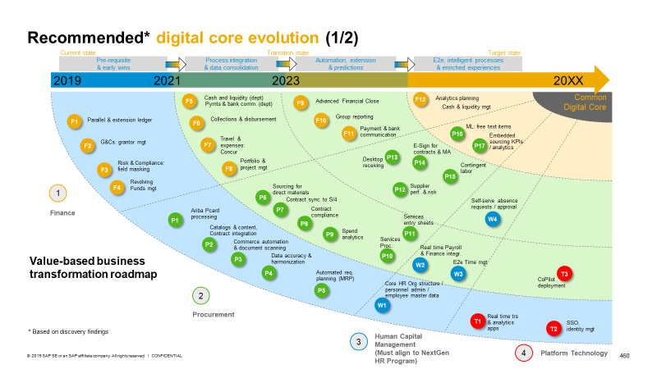
DCP - Prioritize Transformation
Departments depends on applications to run and support their Business. The GC will maximize and leverage the latest developments in technology to unlock new capabilities and innovation. Tackle common pain points across the departments and improve operational efficiency and effectiveness.
Prioritize the transformation Roadmap to drive transformation toward a data driven and digital Government.
Designing and implementing the value realization dashboard(s), defining and baselining the key performance indicators.
Increase operational efficiency
Enable real time decision making
Leverage data as a strategic tool across the entirety of the GC
Digital Government
Change operational models connecting across traditional silos in real time
Use insight to identify, predict, and address issues to improve effectiveness and efficiency for all
7

Slide 8
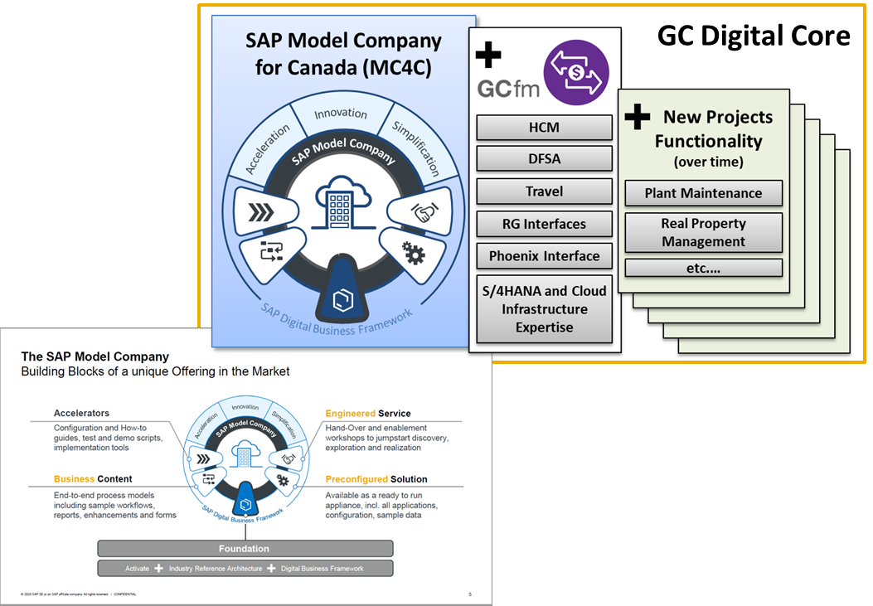
DCP - GC Digital Core (Accelerator)
Establish a GC Digital Core template as the foundation and accelerator to run real time transactions and analytics, increase business process standardizing and common data structures and increase Innovation to support Digital transformation.
To accelerate the Digital Transformation and lower the overall cost of ownership, the GC will implement a Coordinated Model that will support a collaborative model for maintenance and change management across the GC.
Faster time to value
A centralised program for transformation allows for the reuse of key resources and skills to increase implementation efficiency
Increase implementation time using the template with preconfigured, end-to-end business processes fully documented and tested.
Lower total cost of ownership
Deliver a template to accelerate the transition to S/4HANA and simplify maintenance and operations
Transition to less instances through coordinated support and maintenance
8

Slide 9
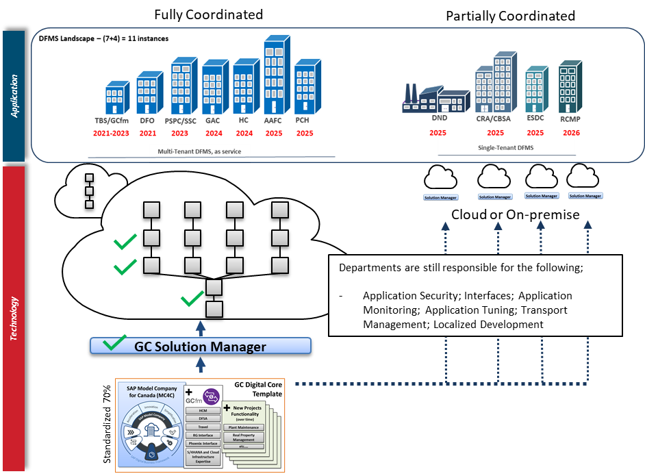
Departmental Financial Management Systems Landscape
9

Slide 10
Overview of the Business Authority & Design Authority within the DCP Coordinated Model
10

Slide 11
DCP’s Coordinated Model Structure
Business Authority
Overall structure to support the Transition to S/4HANA and Deliver Transformation across the GC
Central Design Authority, reports to the Business Authority
Steering Committee
Design Authority
Program Leadership
Enterprise Architecture Review Board
Business Process Authority Board
CoE Review Board
ARCHITECTURE REVIEW BOARD
BUSINESS PROCESS AUTHORITY BOARD
CENTER OF EXCELLENCE
PROGRAM MANAGEMENT OFFICE
Team of Architects who will define and maintain the target architecture and overall roadmap
Team of business and functional experts per line of business with Business Process Owners as Co-Leads, endorsing decisions DCFOs
Team of Application Lifecycle Management Experts who will define and maintain the co-ordinated operating model
Focused on managing the schedules, costing and plans for the program
The group will manage the global release plan across the clusters for major releases
Project managers to support cluster onboarding and aligning deployments with the program
Review board with 2 representatives from each cluster to finalise all proposals from the arb and COE to the business authority
Business Process Owners’ role is to maintain process integrity, review and validate business requirements and master data per line of business
11

Slide 12
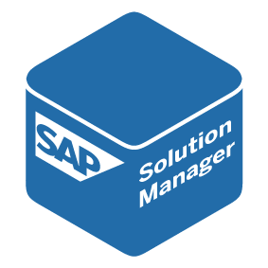
DCP Governance
GC Digital Core Template
The GC Digital Core template management approach allows multi-site SAP installations to efficiently manage the GC’s business processes across deployments – from initial template definition to template implementation and template optimization.
For the GC, the template, built iteratively is the optimal solution to deliver the Program goals and also allows for the best return on investments; as new functionality is delivered, all departments linked to the template can deploy the new functionality without the requirement to design and build.
Business Authority
Requirements
Budget
GC Template
GC Digital Core
TBS (GCfm)
DFO
PSPC
GAC
AAFC
DND
CRA/CBSA
DCP ARB
Design
Tools
Materials
DCP BPOB
Fixtures
Fittings
Furniture
DCP CoE
Maintenance
Architecture and Design
GC Digital Core
12

Slide 13
DCP Business Authority - Terms of Reference
Purpose
The Digital Comptrollership Program Business Authority, as per the coordinated governance and support model, and sets direction for transformation of financial and materiel management (FM) across government, represents the FM business, and sets the business agenda.
Objective
The main function of the governance will be to oversee the incremental development of the Government of Canada (GC) Digital Core. The Digital Core’s concept is based on a common understanding that “some” activities or functions are, or should be, standardized across the GC. The first version of the GC Digital Core will address basic financial management activities (e.g., accounting, procurement, budgeting and forecasting), however, it will rely on other government departments (OGD’s) and the functional community to assist in the development of any additional functionality (e.g., extended asset management, real property), moving forward.
Responsibilities
The FMT Program Steering Committee provides leadership and advice on:
Vision for FM across government
Prioritizing business requirements regarding functionality to be included in future releases
Oversight of projects that make up the DCP Program
Transformation strategies, implementation roadmap and priorities
Desired outcomes and benefits
Implementation resourcing and funding
The Business Authority directs and empowers the Design Authority.
13

Slide 14
The Role of the Business Authority - Process
The Business Authority sets the business agenda
It provides the vision and strategy for business transformation and directly empowers the design authority
The Business Authority is ultimately responsible for the planning of new solutions, functionality and changes across the DCP Program
Design Authority
Business Requirements
Prioritization
Feasibility
Release Planning
Project/ Change Approved
Once the Business Authority has set the vision and agreed the agenda for the transformation, it begins to gather and validate business requests and requirements
The Business Authority will then prioritize the business requirements based on alignment to the vision or the mandate for change and then pass the requirements to the Design Authority
The Design Authority will validate the feasibility of the business requirement/request – Architecture, Business Process Owners/Working Groups – and pass to the ALM team for release planning to determine when the functional or technical change can be adopted, what options are available and then pass to PMO for costing and timing.
Once validated that it is feasible and the correct solution is identified with the correct release and costed, the series updated release plan is presented back to the Business Authority
Depending on the release approach, the Business Authority will approve projects/major changes at regular intervals – Quarterly, Annually
14

Slide 15
DCP – Business Capability Model
15

Slide 16
Understanding what a business capability model delivers
A Business Capability Model facilitates strategic discussion on identifying key capabilities required by a business or an organization
The key value of a Business Capability Model (BCM) is aligning in a language that everyone can understand
The BCM decomposes the functional areas of an enterprise and describes the primary business functions. It helps to describe, discuss, understand and optimize WHAT an enterprise does
Business capabilities are different from business processes, business capabilities are required to executive business process – for example: Sales vs Selling (ability v activity)
The key reason we need to utilize a BCM are:
To provide us with a model to quickly identify the business areas where SAP can deliver the capabilities with the most value
To bring together the business and IT discussion to quickly achieve a joint level of understanding
Aid with a coherent and comprehensive view of business motivation, capabilities, processes, data and resources
16

Slide 17
FM Business Capability Model (BCM)
Finance and Budget
Procurement
Sales
Human Resources
Asset Management
Materials Management
Supply Chain Management
Analytics and Reporting
Accounting and Financial Close
Supplier Data Management
Customer Data Management
Organisational Management
Asset Master Record
Material Master Record
Business Planning
Business Intelligence
Accounts Payable
Operational Procurement
Revenue Management
Personnel Administration
Asset Operations and Maintenance
Core Inventory Management
Warehouse Management
Planning and Analysis
Accounts Receivable
Sourcing
Order Management
Payroll
Asset Insights
Transportation Management
Operational Reporting
Asset Accounting
Catalog Management
Billing
Talent Management
Environment, Health, and Safety
Yard Logistics
Predictive Analytics
Financial Planning and Analysis
Contract Management
Credit Management
Time and Attendance
Defense Maintenance & Configuration
Defense Supply & Replenishment
Machine Learning Services
Funds Management
Invoice Management
People Analytics
Application Platform
Enterprise Data Warehouse
Defense Operational Readiness
Portfolio and Project Management
Application Platform
Robotic Process Automation
Spend Analysis
Delegated Signatories
Manufacturing
Treasury Management
Bill of Materials
Content, Collaboration and Output Management
Collaborative Networking
Defense Organizational Management
IT Management
Database and Data Management
Travel Expense Management
Production Planning
Interface Management
Application Lifecycle Management
Information Governance
Grants Management
Production Execution
Process Management and Integration
IT Infrastructure Management
Data Quality
Real Estate Management
Quality Management
User Experience
Security
Master Data Management
Salary Forecasting
Enterprise Risk and Compliance
Access and Identity Management
Data Migration and Replication
Note: Some working groups mapped to Level 1, some to Level 2 BCM
Legend
Level 1
Level 2

Slide 18
Digital Transformational Leadership Partners
Leadership starting to take shape
Working Groups | Co-Lead | Co-Lead
Finance and Budget | Monique Arnold, PSPC | Sophie Bainbridge, GAC
Financial Planning and Analysis | Michelle Baron, ISED | Shirley Carruthers, GAC
Project and Portfolio Management | Johanne Diotte, NRC | TBC - Dwayne Ross, RCMP
Travel and Expense Management | Hongchao Wang, HC | Nathalie Proulx, IRCC
Real Estate Management | Denis Lemieux, PSPC | Elizabeth Tough, GAC
Grants Management | Paula Hadden-Jokiel, ISC
Procurement, Materials Management | Karine Paré, ISED | Jimmy Fecteau, CBSA
Sales | Johanne Diotte, NRC
Asset Management
Human Resources
Receiver General | Jeffrey Lay, PSPC RG Treasury
18

Slide 19
DCP - Data Strategy and Governance Update
19

Slide 20
FM Data Strategy
In 2017, FMT contracted Gartner to develop a maturity benchmark assessment and identify the key FM master data domains
During this engagement, they conducted 17 interviews with over 40 representatives across departments, agencies, and central agencies
This engagement produced:
Master Data Management (MDM) Program Vision
MDM Strategic Goals
Executive Recommendations
Refine and Socialize MDM Vision, Strategy and Metrics
Establish authority, mandate and project
Establish MDM Data Domain priorities
Define business requirements for MDM
Establish an Information Governance for MDM
Establish a MDM Program for Financial Management
Define data quality, data integration and master data life cycle
Support FMT MDM planning and blueprint for the GCFM solution
20

Slide 21
FM Data Strategy cont’d…
In 2019, SAP delivered its “Point of View” document, identifying the development of a program-wide Master Data Management Strategy as one of the key recommendations.
Workshops with departments identified inconsistent and poor quality of master data as a key pain point
Currently, DCP is advancing SAP’s and Gartner’s initial recommendations, while also aligning to OCIO’s existing data and digital mandate
Current focus:
Defining a Master Data Management and Governance strategy and actionable roadmap for SAP master data, supporting the SAP-driven business transformation projects, EPS and S/4HANA; as well as, Real Property and G&Cs
Defining Data Ownership & Stewardship including a data governance operating model, organizational structure, roles and responsibilities
Explore and assess if policy changes would be required
Next steps: Finalize contracting; and determine whether policy changes are required to support new governance/operating model
CEDI
GARTNER
SAP
Digital Comptrollership
21

Slide 22
Our Approach to Deliver Value
22

Slide 23
GC’s Digital Transformation Approach
23

Slide 24
Enterprise Solution Back Office City Map
Draft for Discussion Only
Real Property
Next Gen HR-PAY
TA#1
Travel Next Gen
Projects
EPS
Phase I
Phase II
EPS
SAP S/4 HANA
Less than 7 years to move dep’ts to S/4 HANA
Pay Premium
NextGen HR and Pay
Pilot
Next Gen Travel
4 years to move dep’ts off HRG

Slide 25
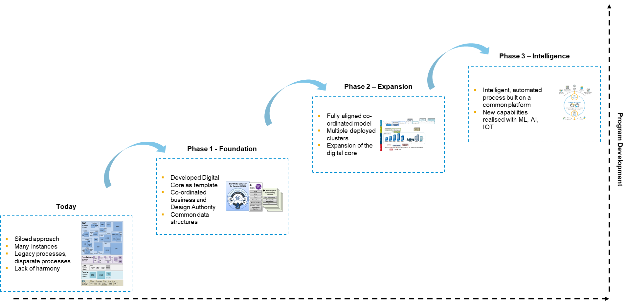
Focus and Evolution Path
Template delivered GC Digital Core
Common platforms
Common data structures
Common principles
Real-time reporting for improved decision making
Improved data quality
Better access to data and information
Digital Comptrollership
25

Slide 26
Any Questions?
26
Notes:
Plug email again

