Slide 1
Enterprise Solutions
Updates and progress from Dec. 15, 2020.
DRAFT
Presentation to DM CEPP
May 7, 2021 Version
For Discussion
Last updated: May 19, 2021

Slide 2

Overview of the December 15, 2020 Presentation
The various facets for Enterprise solutions success
  Governance, solutions, and culture framework for Enterprise solutions
Benefit to operate as one, to better serve all
  A more cohesive digital experience for clients, users and other stakeholders
  Increased interoperability and collaboration between government services and programs
  Reduced total cost of ownership for provision external and internal services
  Ability to leverage modern skill sets across the Government of Canada
The role of DM CEPP
  Govern the direction and priorities for modern GC enterprise solutions
Business Capabilities
  Standard to define enterprise solutions
Not one size fits all
  Centralized to federated enterprise solutions
GOVERNANCE
SOLUTIONS
CULTURE
________________________________________
NOTE: Snapshot of the December deck can be found in the Annex

Slide 3
To Provide updates and progress against Dec. 15, 2020
Next Steps
Purpose
Establish priority business capabilities with potential for high-value enterprise solutions (e.g., identity management, audit management)
Define business owner role and designate departments to lead discovery-phase for select enterprise solutions under oversight of DM CEPP and GC EARB.
Build a roadmap for DM CEPP enterprise solutions to establish prioritization of enterprise-wide IT investments and procurements
1
2
3

Slide 4
Recap…
What is Enterprise?
Why focus on enterprise solutions?
Enterprise is generally defined as “an organization” or “organizational unit”
In the GC, ‘enterprise’ refers to a whole-of-government holistic approach.
An enterprise approach can be applied various facets, like governance, solutions, standards and culture
Enterprise solutions are internal and external Government of Canada assets that can be re-used in and across multiple parts of the organization.
Business capabilities are an expression of what a business does and can do.
Business processes support business capabilities and express how the capability is delivered.
To “operate as one” we propose to focus on enterprise solutions linked to business capabilities

Slide 5
DOSP¹ Strategic Pillars
Vision, Pillars and Priorities for 2021-2024
The Government of Canada is an open and service-oriented organization that operates and delivers programs and services to people and businesses in simple, modern and effective ways that are optimized for digital and available anytime, anywhere and from any device.
Digitally, the Government of Canada must operate as one to benefit all Canadians.
VISION
PILLARS
Modernize Legacy IT Systems
Improve Services
Implement Enterprise
Transform the Institution
Strengthen the overall health of the government’s application portfolio
Provide modern, reliable and secure networks and infrastructure
Improve the service experience of all clients
Maximize public value of data and information
Build and use secure common solutions for digital service delivery
Manage and use data and information as strategic assets
Plan and govern for the sustainable and integrated management of service, information, data, IT, and cyber security
Deploy modern and accessible workplace tools and devices
Support fully digital delivery by managing a government-wide culture shift
Build a workforce for digital-first delivery
PRIORITIES
GC DIGITAL STANDARDS
Design with users / Iterate and improve frequently / Work in the open by default / Use open standards and solutions / Address security and privacy risks / Build in accessibility from the start / Empower staff to deliver better services / Be good data stewards / Design ethical services / Collaborate widely
________________________________________
¹ DOSP - The Government of Canada Digital Operations Strategic Plan for 2021–2024

Slide 6
DOSP Pillars, Priorities, Actions
IMPLEMENT ENTERPRISE
3.1 Manage and use data and information as strategic assets
  creating effective governance structures, roles and responsibilities
  building and using a common data reference model and an inventory of government data assets
  defining a government data quality framework
3.2 Plan and govern for the sustainable and integrated management of service, information, data, IT, and cyber security
  better coordinate our transformation efforts
  focus on users and service delivery when considering new IT solutions or modernizing old ones
  make sure our IT investments align with business services
3.3 Deploy modern and accessible workplace tools and devices
  providing a suite of accessible, modern and secure, cloud‑based tools for enhanced productivity, collaboration, video conferencing and email
  equipping the GC workforce with modern workspaces and secure workplace devices
  establishing enterprise standards for back-office tools and solutions
3
Pillar

Slide 7
1. Establish Priority Business Capabilities
An assessment of 4 opportunities was conducted to validate aspects of the governance, solutions, and culture framework for Enterprise Solutions.
Opportunities
Specific key findings
TeamMate, Internal Audit Management (BCM 9.6.2) OCG Moving from 35 instances to a single central instance will facilitate frictionless reporting
Learning, Training & Development Management System (BCM 8.3.4) CSPS Provide employees with a single window to general and department specific training
Sign In Canada, Identity and Access Management (BCM 9.1.2) TBS A secure, modern, and efficient credential management solution to access GC services and address technical debt
GCdocs Modernization, Information Management (BCM 7.0 ) TBS and PSPC To consider lessons learned from an existing enterprise solution and facilitate Program reforms to improve value to users and remain responsive in the current operating environment
  Governance: SSC to reviewing opportunity to become the service provider but it is not currently within the SSC current mandate
  Governance: Need initial capital funding for technical owner to configure enterprise solution platform
  Culture: CSPS is not mandated or resourced to provide departmental enterprise solutions
  Governance: Funding, CSPS cannot cost recover from departments
  Governance: Sign-in Canada was not funded in budget proposal
  Culture: CRA and ESDC proceeding with modernization efforts
  Governance: formalize roles and responsibilities beyond existing MOUs; adopt product-based governance; review the appropriateness of the funding model given the evolving policy environment
  Solutions: current configuration of Content Server deployments (technical solution) have a poor user experience resulting in ineffective IM outcomes and departments seeking alternate solutions; deployment of new collaboration tools (M365 and gcxchange) presents new opportunities to manage IM in a more integrated way

Slide 8



1. Framework Assessment Key Findings
Governance
Culture
Solutions
  Pilots have been able to describe their solutions using the BCM, identify the business problem, and value proposition to address user needs
  Enterprise solution opportunities lack a defined path to advance and as a result tend to fizzle out
  Operational enterprise solutions governance and support is at a low maturity level
  Departments are not mandated and lack incentives to provide services to other departments, need a dedicated organization for enterprise solutions.
  Cost recovery and appropriation models are adequate for operational costs, but up-front funding is required for initial development and evolution of enterprise solutions.
  Departments are ready to buy into Enterprise solutions once they exist, but lack of available ready to use solutions result in departments developing their own.
  Need dedicated teams of “enterprise” business owners and service providers to develop, operate and evolve enterprise solutions, do we need a Shared Services organization to act as the service provider? Do expand SSC mandate to include applications?
  Mandate use and appropriate departmental funds. Define a clear role and responsibility for users to determine needs and for the Business Owners and Service Provider to be accountable.
  Identifying and developing enterprise solutions is not a problem, focus needs to be on governance and culture
  Pilots have been able to define the business problem and processes like the concept case and GCEARB are existing tools that can be used
  Cloud base solutions from public cloud service providers are enabling business owners to envision enterprise solutions but they need technical partnerships from dedicated solution providers to provision IT
Need a culture shift + different ‘operating model’ (Product Mgt.)
8

Slide 9
2. Define Governance, Roles and Responsibilities
Stakeholders
Stakeholders in the form of a ‘product board’ determine and validate user needs, prioritize the delivery roadmap and manage the related expenditures.
Business Owner:
The Business Owner has overall accountability for delivering on the business outcomes and achieving the benefits that a solution is meant to enable or facilitate.
Service Provider:
The Service Provider operates and manages IT solutions and/or services and provides them to end users.
Defines … ‘WHO’
Defines … ‘WHAT’
Defines … ‘HOW’
business/program representatives from across departments
Sponsors enterprise solution
identify users
determine user needs
consumes
contributes funds
Defines the required capabilities and intended business outcomes and benefits
Serves as sponsor and is accountable for the achievement of the business outcomes and benefits following implementation
Establishes and maintains governance
Secures funding and resources and provides oversight
Consults with and engages stakeholders and other implicated parties to ensure alignment towards delivery
Reviews and signs-off on key strategic risks
Authorizes the IT service
Oversees data stewardship practices at the production solution-level
Creates roadmap for service or product improvements
Responsible on behalf of an organization for requirements definitions, service delivery, security and reliability
Implement the requirements
Signs off on platform scope
Collect data to measure service levels and key performance indicators
Ensure compliance with standards
Monitor, test and adjust as required
Support innovative products and services
Conduct security assessments
DM CEPP
Enterprise Business Direction
GC EARB
Alignment with Enterprise Architecture, B I A T S

Slide 10
3. Build A Roadmap For DM CEPP Enterprise Solutions
Enhance existing governance for digital solutions to improve “Enterprise” realization
-- Form a DM CEPP working group to sponsor and assist Enterprise solutions --
EARLY ENGAGEMENT
SOLUTION ALIGNMENT
PROJECT AUTHORITY
ASSURANCE
Budget Proposal & M.C.
Solution Architecture
TB Sub (TB)
Project Execution
Concept Case
GC EARB
TB Submission
Project Oversight
Identifies and defines strategic needs by the business
Alignment to Enterprise Architectures (B I A T S)
Mandatory Procedure
Directive
OPMCA Requirements
Ongoing Project Monitoring
Has the problem or opportunity been well defined with clear objectives and measures for success?
Does this address business capabilities common across the GC?
Does the solution align to the EA Framework?
Is the solution able to scale to Enterprise?
Does the project comply to TB policies?
Is the solution funded for the Enterprise?
Is the project positioned for Enterprise success?
Has appropriate and effective governance been put in place to help ensure success?
DM CEPP Enterprise Solutions Working Group
TBS, SSC and Departmental representation
10

Slide 11



Proposed Governance…
The ‘HOW TO’
DM CEPP
Governs Enterprise Direction
Ensures funding
DM CEPP
= Enterprise Authority
GC EARB
Governs architecture direction
Ensures alignment (policy, standards & strategy)
GC EARB
= Technical Authority
NOTE:
Each Enterprise solution will have unique:
Solutions teams
Product Mangers
Product Board
Product Board
Business/program representatives from across departments, collaborators and decision makers
= Technical + Business SMEs (Subject matter experts)
(1:n)
Product Manager
Define capabilities, data, funding, service levels, roadmaps
(1:n)
= Business Owner
Solutions Team
Procures, operates & evolves
Some cases develops and maintains
= Service Provider
(1:n)
____________________________
Source: Interpretation of Gartner: ‘The Importance of a Product Management Mindset in Canadian Government’
Notes:
Recommendations
Government CIOs tasked with the optimization of IT management and operations should consider
the following recommendations:
-CIOs asked to help create an IT shared services organization should help educate decision makers that shared services must have a board of directors that includes at least a significant representation of decision makers from customer organizations.
-When advising on the governance arrangement, CIOs should ensure members of the board of directors recognize not only individual accountability for the departments and agencies they represent, but also accept primacy of their fiduciary responsibility. This is required for the success of the shared services organization.

Slide 12
3. Build A Roadmap For DM CEPP Enterprise Solutions
Concept Endorsement
DM CEPP
Architecture Endorsement
GC EARB
Proof of solution
Business owner and Service Provider
Development
Business owner and Service Provider
Operate and Evolve
Business owner and Service Provider
Present summary of concept case including
Business problem
Business Capabilities
Users
Stakeholders
Benefits
Governance
Business Owner
Service Provider
Funding
GC EARB review for alignment to:
  Business
  Information
  Application
  Technology
  Security
Validate business benefits and solution for stakeholders
Plan for development, operations, implementation and operations
Roadmap to evolve
Develop solution using integrated team
Release solution to users and stakeholders
Operate the solution
Roadmap continuous improvements of capabilities
Keep technology current
Report back to DM CEPP on progression

Slide 13
Next steps
Fix the systemic issues with enterprise solutions as identified in the Framework Assessment Key Findings
Specifically:
  Enterprise solution opportunities lack a defined path to advance and as a result tend to fizzle out
  Cost recovery and appropriation models are adequate for operational costs, but up-front funding is required for initial development and evolution of enterprise solutions.
  Need dedicated cross-departmental members to form committees to support “enterprise” business owners, as well as dedicated teams of service provider to develop, operate and evolve enterprise solutions.
  (Do we need a Shared Services organization to act as the service provider? Do expand SSC mandate to include applications?)
❶
❷
❸

Slide 14
DM CEPP
(DEC 15, 2020)
14

Slide 15
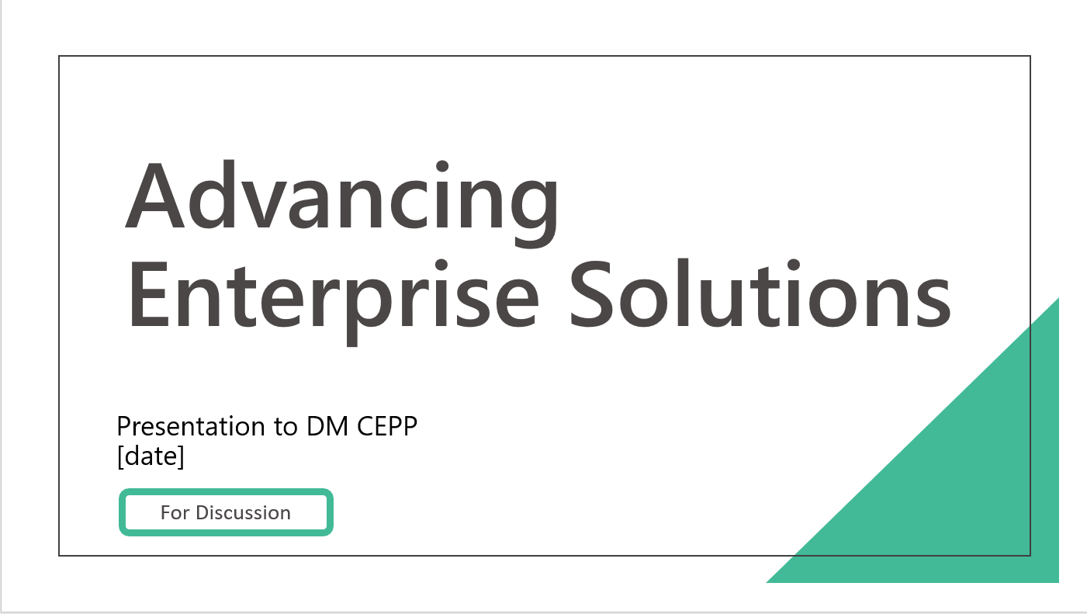
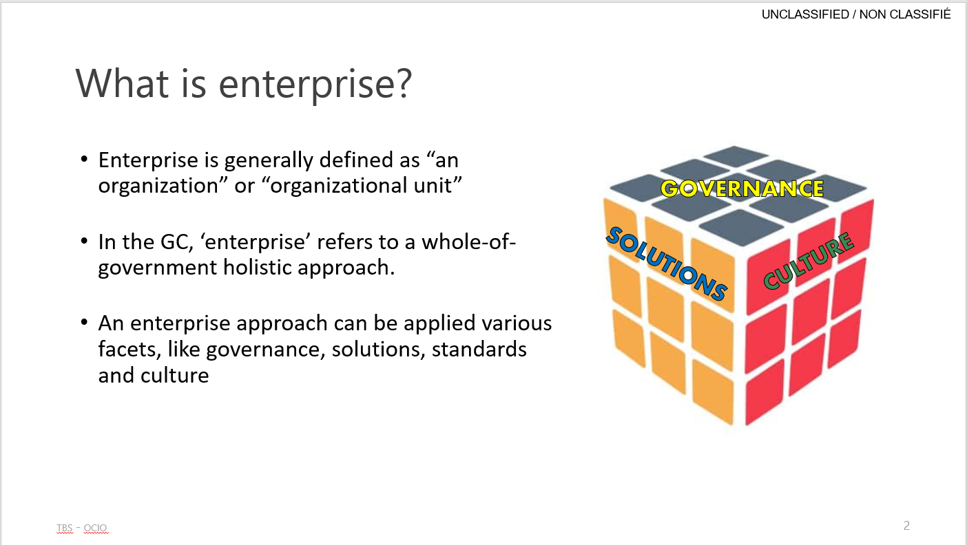
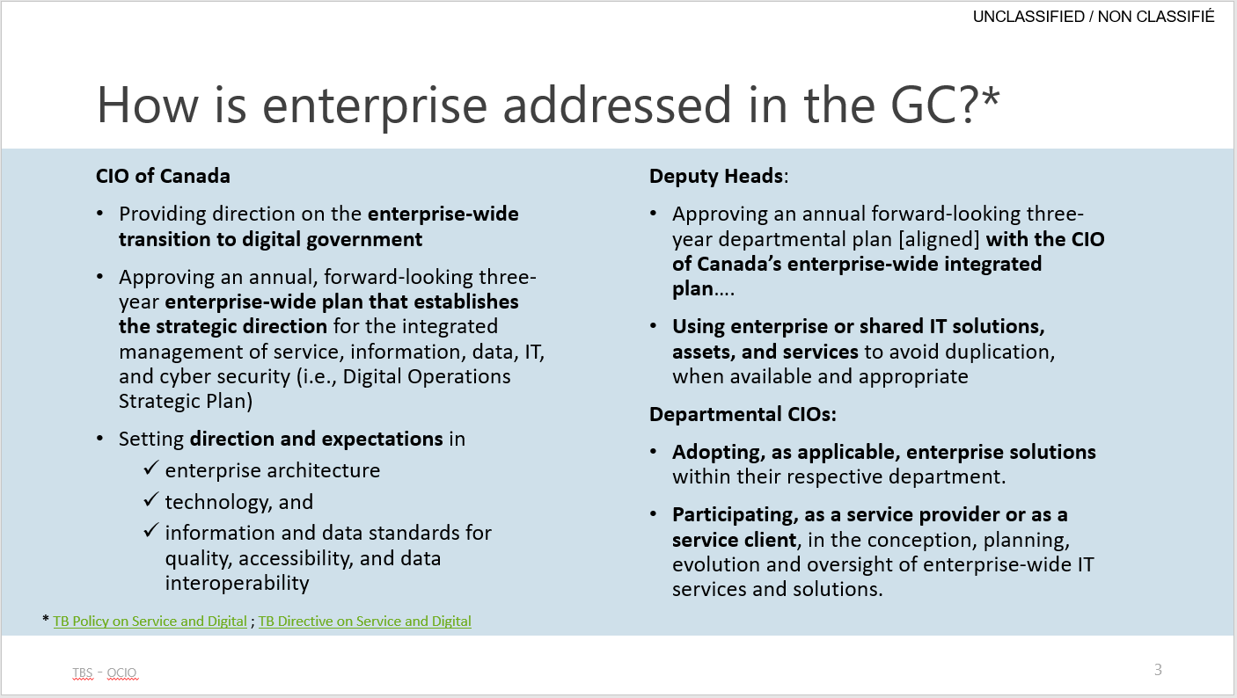
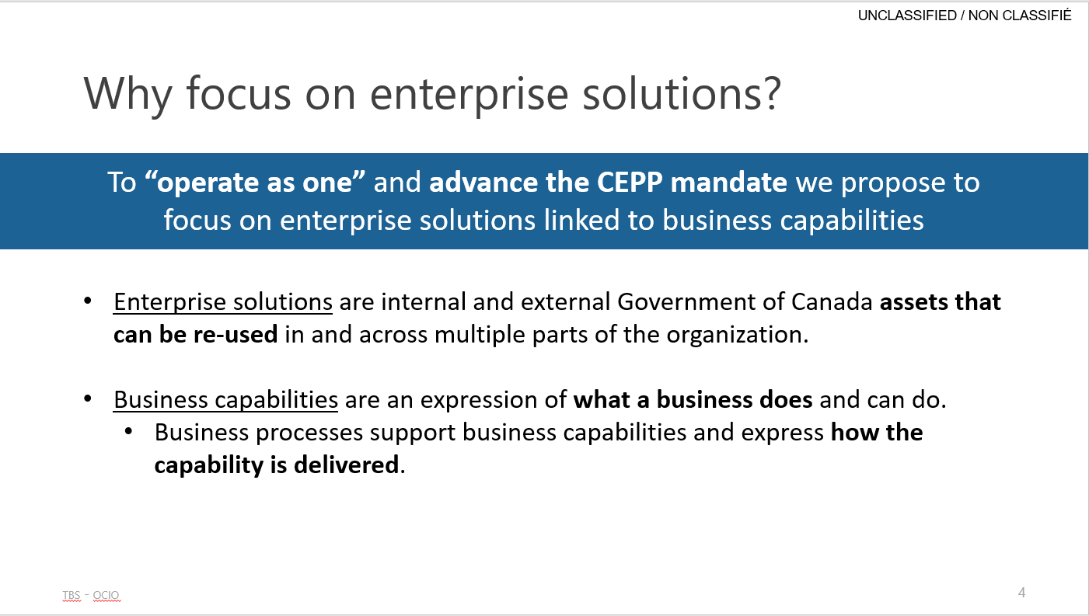
15

Slide 16
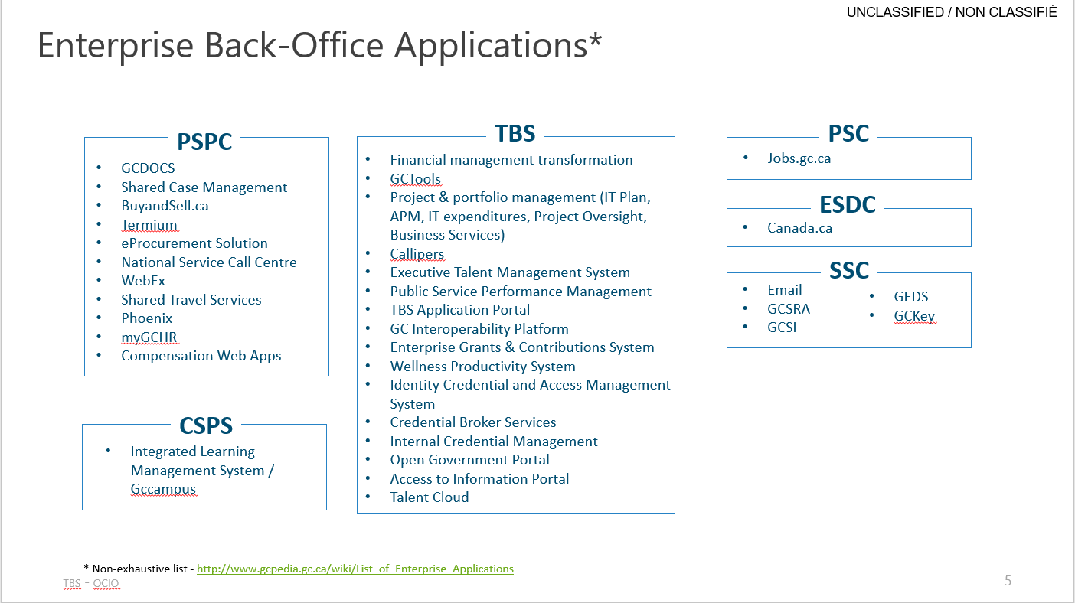
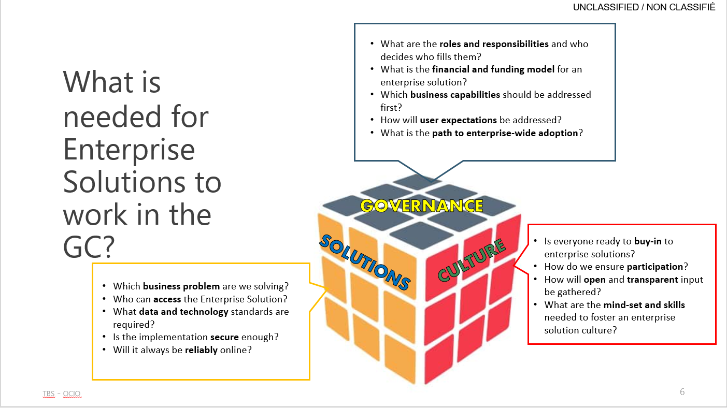
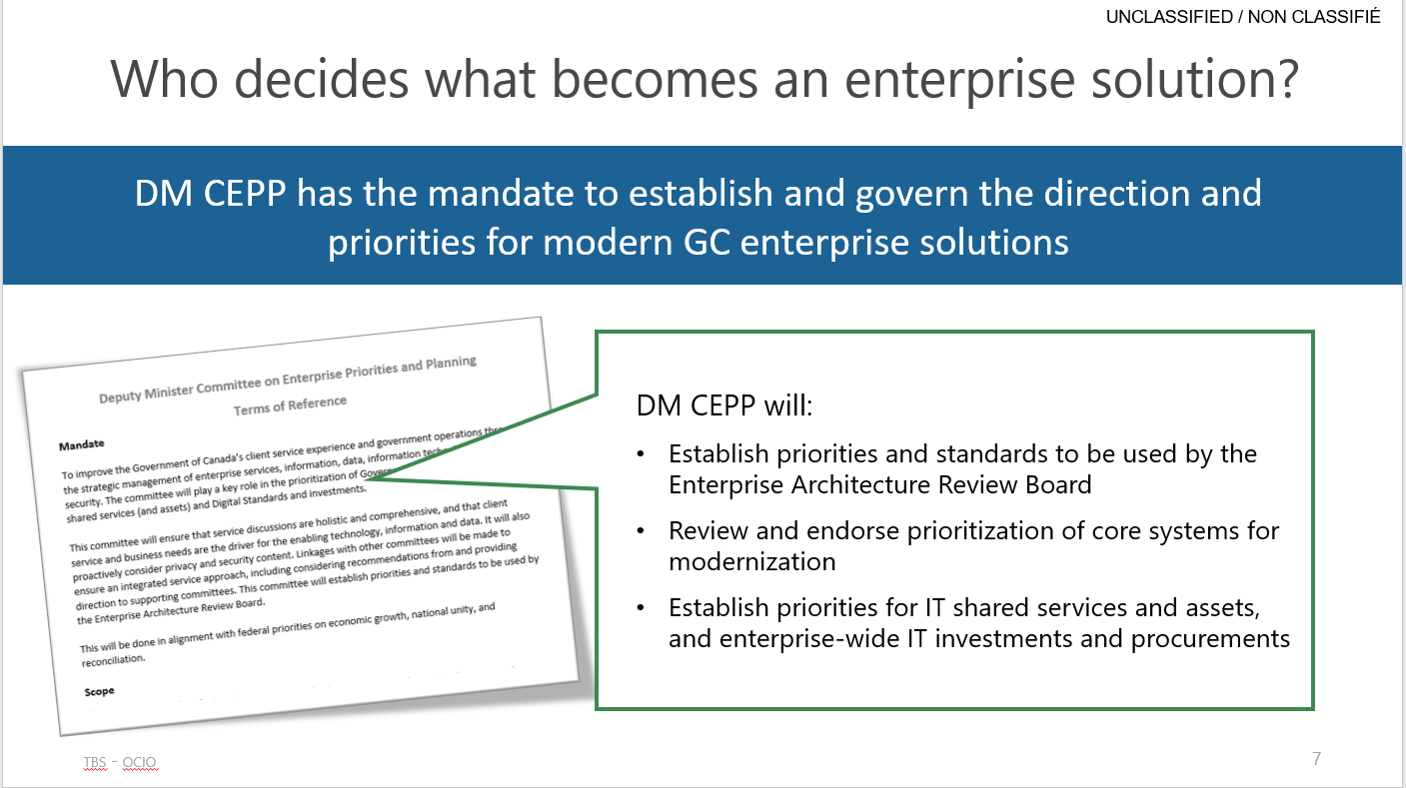
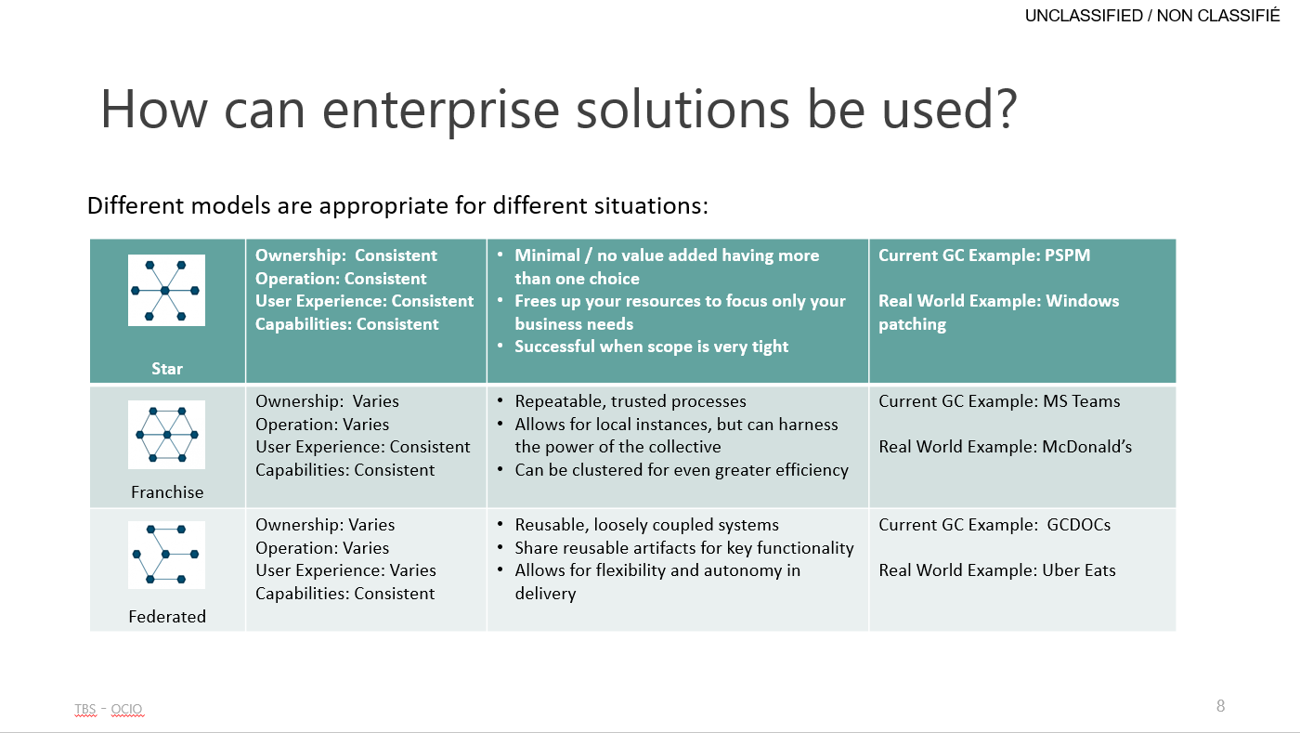
16

Slide 17
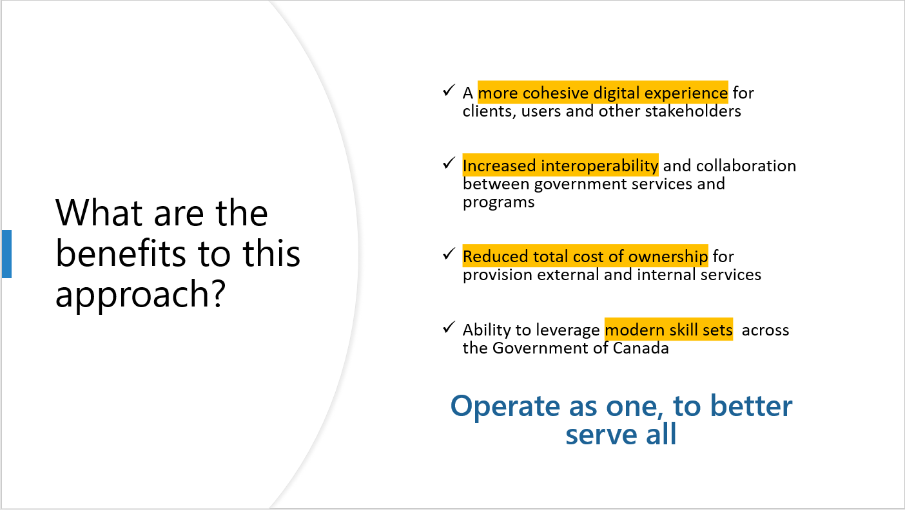
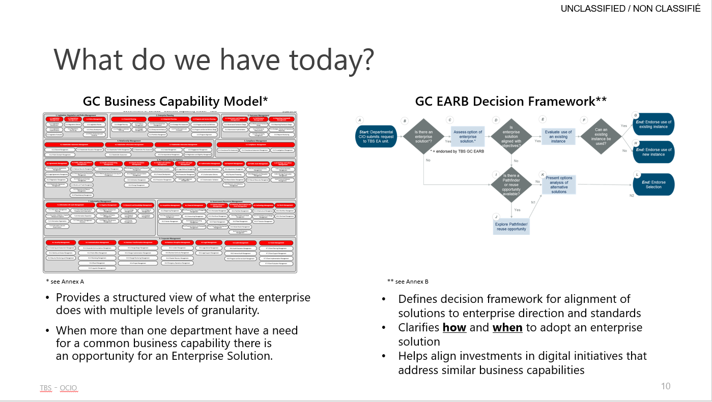
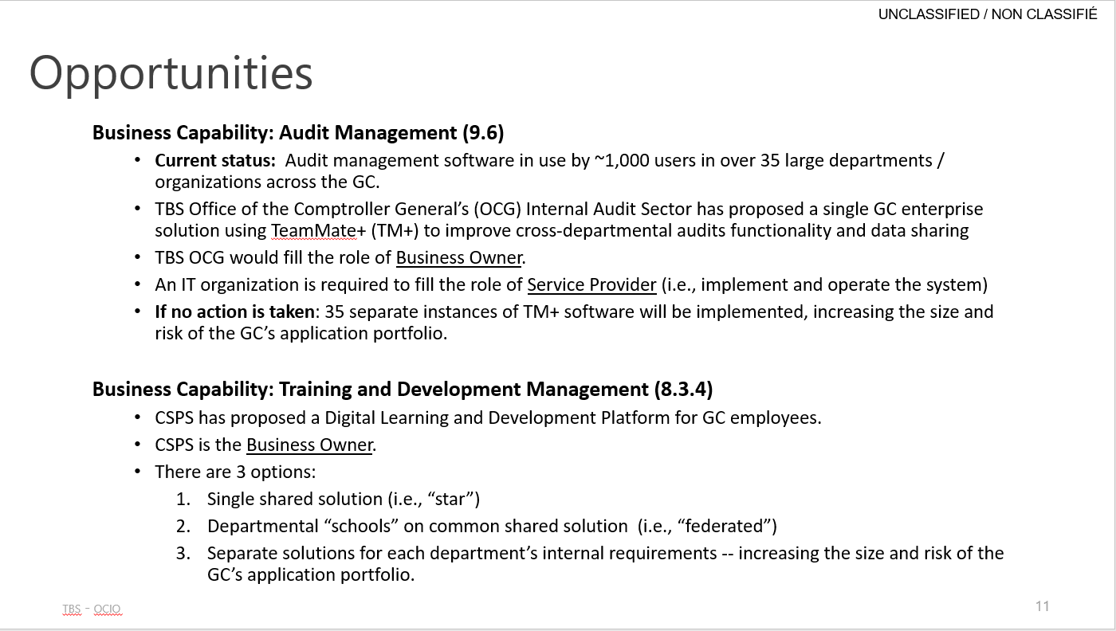
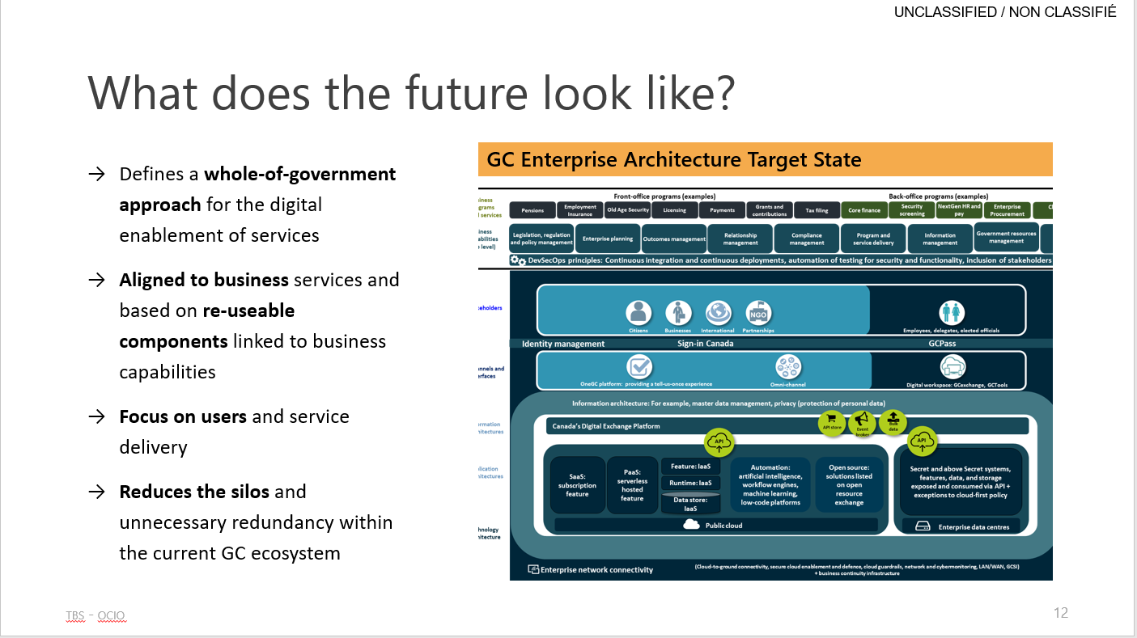
17

Slide 18
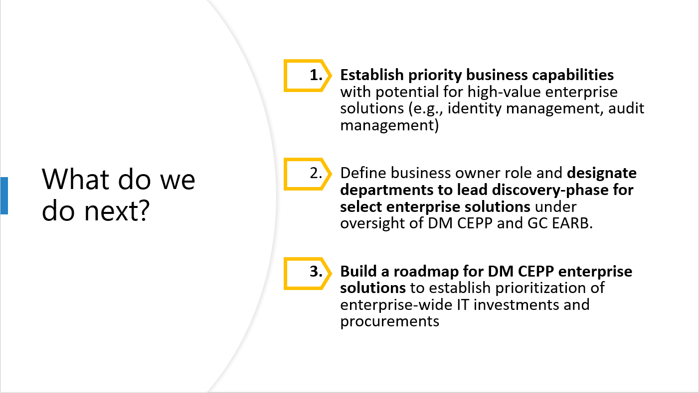
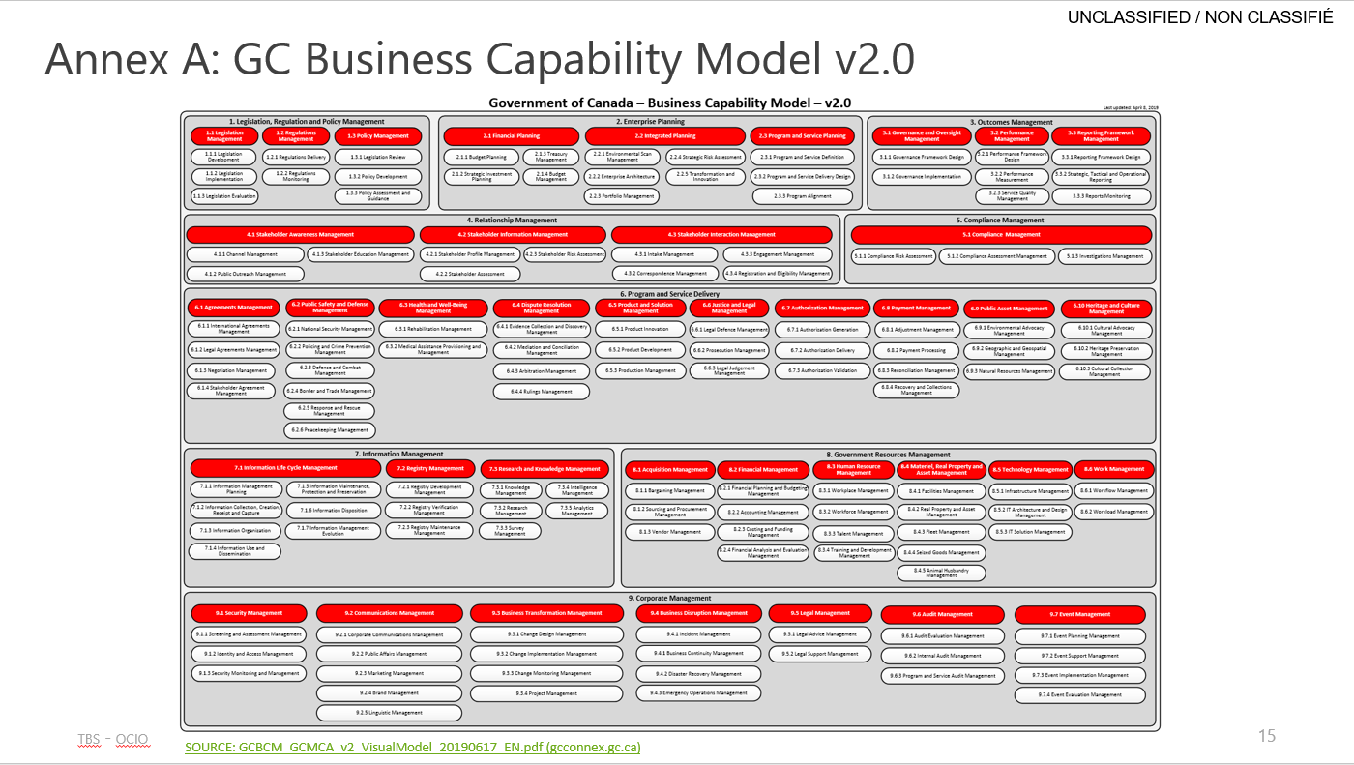
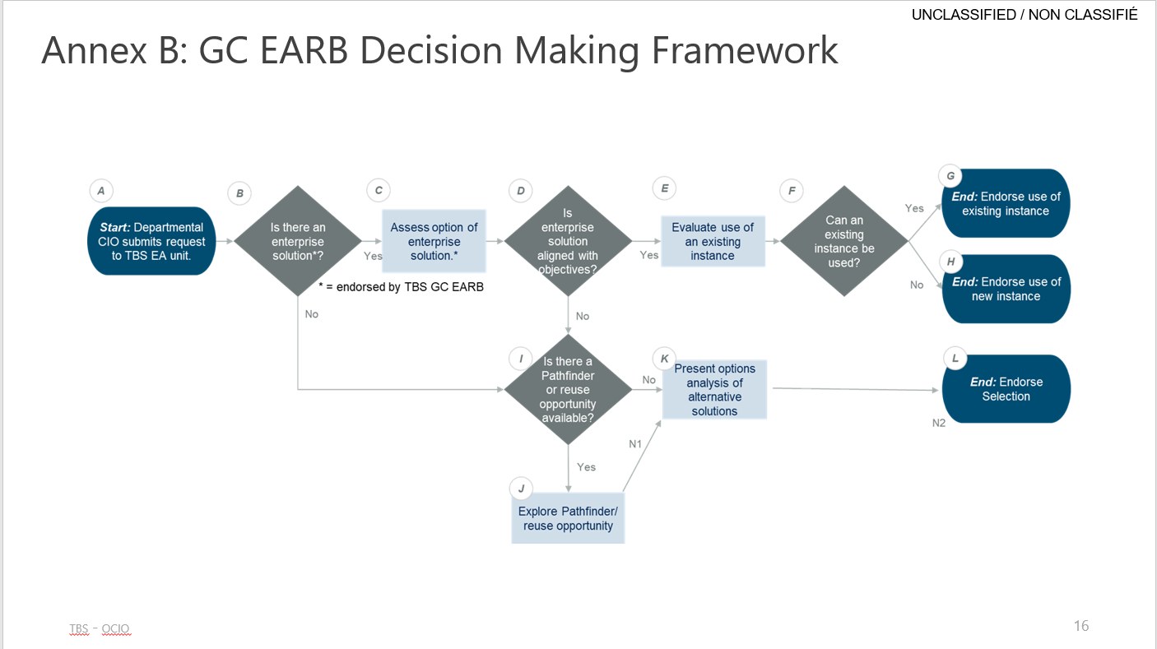
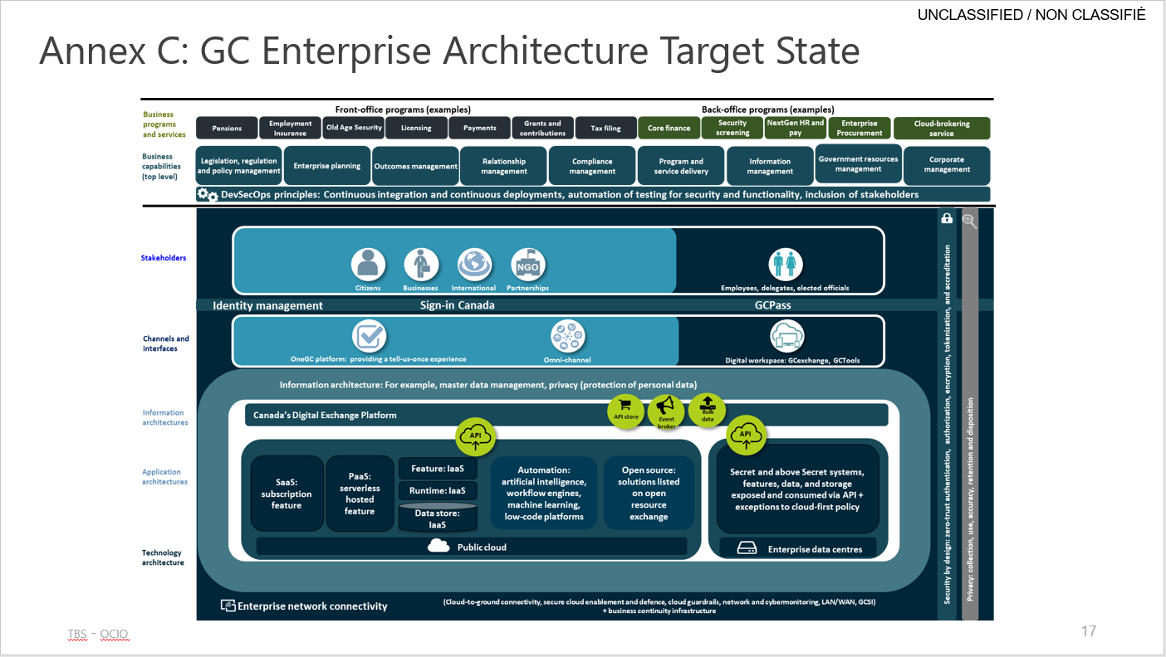
18

