Slide 1
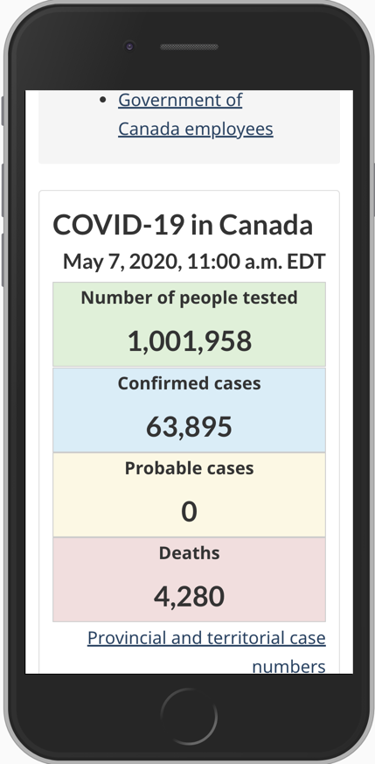
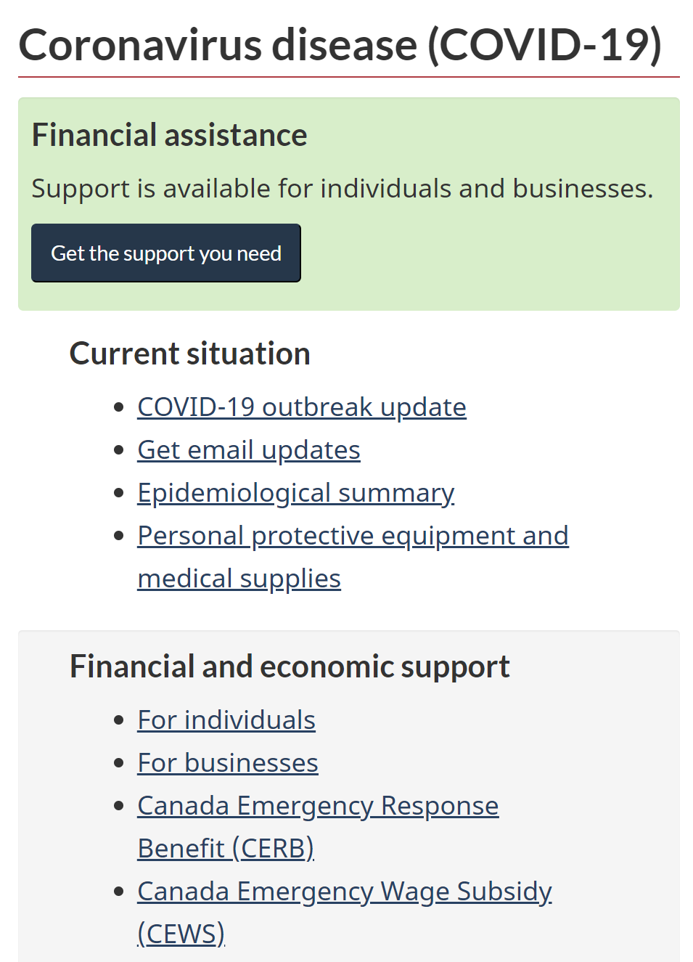
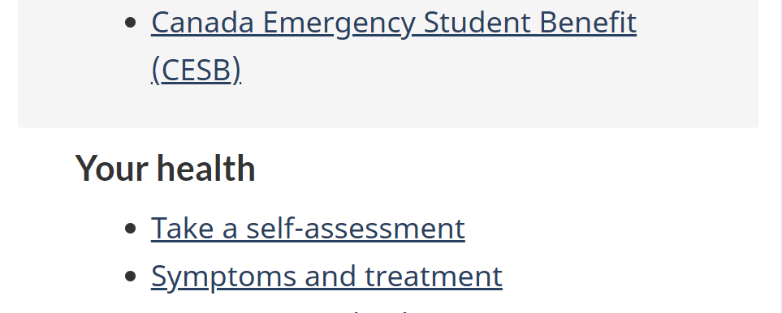
Canada.ca COVID-19 Top Task Identification
with Gerry McGovern
and the World Health Organization
Canada.ca digital transformation office (TBS)
and Health Canada
May 25, 2020

Slide 2
About the COVID-19 top-task study
A World Health Organization web-based study conducted with Gerry McGovern (international usability expert).
Purpose: Identify the top tasks and resources that people visiting the website are looking for.
The GC digital team contributed to the work. The study was run for the WHO, Norway, Canada & Ireland.
The results help better understand the content and resource needs of Canadians at present time.
These, combined with ongoing analytics and page success testing, will help to further plan and prioritize information and resources to meet evolving needs.

Slide 3
How input was captured
Study invitation appeared on
Canada.ca pages (randomly
generated) from May 14 to 19.
6,441 responses
90% in English
10% in French
How respondents reached the study
55% via Canada.ca/coronavirus pages
44% via other Canada.ca pages
1% via direct invites (GC employees)

Slide 4
Insight into top task / resource needs
Top-task identification study asked website visitors to:
Select up to 5 tasks / resources that are most important to you when interacting with the Government of Canada
Answers selected from randomized list of 78 topics, created based on WHO study categories and Canada.ca-specific data
Results sorted by number & percentage of votes for top tasks / resources
Top results (25% of votes) were for these seven top tasks and resources:
1) Financial support, benefits 5)Vaccine
2) Money issues 6) Latest updates
3) Outbreak cases data 7) GC strategy
4) New outbreak, second wave

Slide 5
Results: Top 20 most important tasks
 | Tasks and resources | Votes (29,343) | % of voters (6,441)*
1 | Financial support, benefits for individuals and families (eligibility, availability, training) | 1,453 | 23%
2 | Money issues, personal finances, savings, pensions | 1,073 | 17%
3 | Confirmed cases, deaths, recoveries (daily, total) | 1,064 | 17%
4 | New outbreak, second wave (response, containment) | 959 | 15%
5 | Vaccine (development, availability, safety) | 953 | 15%
6 | Latest news, latest research (alerts, directives, updates) | 943 | 15%
7 | Government strategy (long-term control, lockdown exit, transition, economy reboot) | 874 | 14%
8 | Government of Canada guidelines, standards, decisions | 827 | 13%
9 | Travel restrictions (national, international, borders, quarantine) | 820 | 13%
10 | Workplaces (preventing spread, rights, reopening criteria, guidance) | 775 | 12%
11 | End date, new normal, safe again | 752 | 12%
12 | Infection hotspots, clusters, exposures (near me, identifying, tracking) | 720 | 11%
13 | Government guidance, regulations (national, local) | 715 | 11%
14 | Compare statistics (national, local, tests, cases, recoveries, deaths, demographics) | 708 | 11%
15 | Mental health, wellbeing | 570 | 9%
16 | Transmission, spread, epidemiology | 569 | 9%
17 | Immunity, antibody testing (criteria, availability, accuracy) | 551 | 9%
18 | Avoiding physical contact (social / physical distancing, self isolation) | 527 | 8%
19 | Personal protective equipment (PPE: masks, shields, gowns) | 521 | 8%
20 | Cleaning, disinfecting, waste disposal (hands, deliveries, home, workplace) | 439 | 7%
*People vote for up to 5 tasks - so percentages do not add up to 100

Slide 6
Results: 3rd quartile tasks
 | Tasks and resources | Votes (29,343) | % of voters (6,441)*
19 | Personal protective equipment (PPE: masks, shields, gowns) | 521 | 8%
20 | Cleaning, disinfecting, waste disposal (hands, deliveries, home, workplace) | 439 | 7%
21 | Modelling, forecasting, trends (flattening curve, economic impact) | 437 | 7%
22 | Number of tests (tests performed, individuals tested) | 434 | 7%
23 | Myths, fake news, misinformation, out of date information | 424 | 7%
24 | Symptoms, signs | 408 | 7%
25 | Government of Canada's position, opinion, response to | 407 | 7%
26 | At-risk, vulnerable (age, pre-existing conditions, disabilities, ethnic minorities) | 399 | 7%
27 | Testing for live / active virus infection (eligibility criteria, availability, accuracy) | 398 | 7%
28 | High risk transmission environments, (care homes, restaurants, supermarkets) | 386 | 7%
29 | Relationships (family, friends, colleagues) | 380 | 6%
30 | Food, medicines, essential products (stocks, hoarding, availability, disruptions) | 374 | 6%
31 | Virus survival / viability / persistence on surfaces, in air | 370 | 6%
32 | Essential services, key / critical workers | 367 | 6%
33 | Virus mutation, new strains | 340 | 6%
34 | Movements, interactions of infected people (tracking, contact tracing) | 338 | 6%
35 | Financial support for businesses and organizations | 336 | 6%
36 | Health services unrelated to pandemic (appointments, prescriptions) | 314 | 5%
*People vote for up to 5 tasks - so percentages do not add up to 100

Slide 7
Results: 4th quartile tasks
37 | Infectiousness (when infectious, super spreader, asymptomatic)
38 | Drugs (preventative, treatment, development, approved)
39 | Government roles, responsibilities, who's in charge of what?
40 | Likely course of illness, outcomes, prognosis
41 | Caring for a vulnerable, at risk person
42 | Scams, cybersecurity threats
43 | Raw data, open data, datasets, metadata
44 | Compare symptoms with cold, flu, allergies
45 | Home schooling, remote teaching, learning (tips, how-to, advice)
46 | Physical wellbeing, exercise, breathing exercises
47 | Treatment lessons learned, emerging best practice, failures
48 | How you can help (volunteering, donating)
49 | Confined living, dealing with being inside (activities)
50 | Diet, food, nutrition, supplements
51 | Privacy rights, data protection, anonymity (apps, personal data)
52 | Incubation period, time from infection to symptoms
53 | Immigration (foreign workers, students)
54 | No longer infectious (criteria, time required in self isolation)
55 | Technology/internet support for less experience, vulnerable, poor
56 | Working from home (guidelines, tips, advice)
57 | Research papers, studies
58 | Deliveries, online shopping, mail
59 | Post recovery complications (neurological, cardiac, respiratory)
60 | Emergency contacts (ambulance, medical)
61 | Industry specific advice (airlines, funeral homes, supermarkets)
62 | Contact the Government of Canada (media, experts)
63 | Diagnosis
64 | Public health campaign material, posters, communications
65 | Research ideas, submissions, funding, grants
66 | Original outbreak source, patient zero (global, national)
67 | Caring for someone with virus at home, yourself with virus
68 | Dying alone, funeral rites, mourning, grief
69 | Domestic, sexual abuse, violence
70 | Community-based support groups, local networks
71 | Explaining pandemic to children (guides, resources, advice)
72 | Animals and virus (get it from, give it to, walking)
73 | Explaining pandemic to those with learning difficulties (guides)
74 | Virus family, definition, names, acronyms
75 | Professional medical training, courses
76 | Business participation, new products, ideas
77 | Ventilators (availability, approved, impact, decision to use)
78 | Pregnancy, birth, infants (precautions, advice, breast feeding)

Slide 8
Top audience votes vary only slightly
 | Task selections by audience group | Academic / researcher / student | Business | Gov emp | Individual / family | Job seeker | PHO or health care … | Total
 | Number of respondents | 172 | 191 | 107 | 5,498 | 251 | 130
1 | Financial support, benefits for individuals and families (eligibility, availability, training) | 23% | 21% | 15% | 23% | 31% | 15% | 23%
2 | Money issues, personal finances, savings, pensions | 16% | 14% | 16% | 17% | 22% | 9% | 17%
3 | Confirmed cases, deaths, recoveries (daily, total) | 10% | 6% | 12% | 18% | 4% | 18% | 17%
4 | New outbreak, second wave (response, containment) | 9% | 7% | 10% | 16% | 10% | 9% | 15%
5 | Vaccine (development, availability, safety) | 15% | 8% | 10% | 15% | 14% | 8% | 15%
6 | Latest news, latest research (alerts, directives) | 7% | 12% | 18% | 15% | 8% | 14% | 15%
7 | Government strategy (long-term control, lockdown exit, transition, economy reboot) | 10% | 16% | 21% | 14% | 13% | 12% | 14%
8 | Government of Canada guidelines, standards, | 8% | 22% | 19% | 13% | 10% | 19% | 13%
9 | Travel restrictions (natl, intl, borders, quarantine) | 10% | 10% | 8% | 13% | 6% | 9% | 13%
10 | Workplaces (preventing spread, rights, reopening, | 7% | 31% | 18% | 11% | 14% | 12% | 12%
11 | End date, new normal, safe again | 9% | 8% | 11% | 12% | 12% | 8% | 12%
12 | Infection hotspots, clusters, exposures (near me, identifying, tracking) | 6% | 3% | 6% | 12% | 9% | 5% | 11%
13 | Government guidance, regs (national, local) | 10% | 18% | 19% | 11% | 8% | 9% | 11%
14 | Compare statistics (national, local, tests, cases…) | 12% | 4% | 12% | 12% | 2% | 14% | 11%
15 | Mental health, wellbeing | 6% | 7% | 4% | 9% | 12% | 7% | 9%
For business, the top task is missing from this list – 34% voted for ‘Financial support for businesses and organizations (eligibility, availability, training) – lists by audience in annex

Slide 9
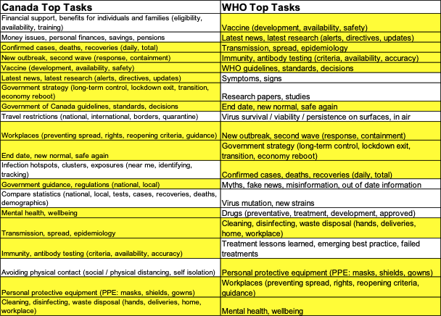
Canada – WHO comparison
70% overlap between Canada and WHO top tasks
(highlighted in yellow)
*The divergences in top tasks are not surprising, as people have different needs from their Government than from the WHO, such as financial assistance.
Notes:
75% overlap with Norway’s results

Slide 10
Top-task alignment with Canada.ca
Results compared with existing Canada.ca COVID-19 content and resources
(in violet).
Also, identifies new and future content areas that will need attention, e.g. containment and reopening
(in orange).
 | Tasks and resources
1 | Financial support, benefits for individuals and families (eligibility, availability, training)
2 | Money issues, personal finances, savings, pensions
3 | Confirmed cases, deaths, recoveries (daily, total)
4 | New outbreak, second wave (response, containment)
5 | Vaccine (development, availability, safety)
6 | Latest news, latest research (alerts, directives, updates)
7 | Government strategy (long-term control, lockdown exit, transition, economy reboot)
8 | Government of Canada guidelines, standards, decisions
9 | Travel restrictions (national, international, borders, quarantine)
10 | Workplaces (preventing spread, rights, reopening criteria, guidance)
11 | End date, new normal, safe again
12 | Infection hotspots, clusters, exposures (near me, identifying, tracking)
13 | Government guidance, regulations (national, local)
14 | Compare statistics (national, local, tests, cases, recoveries, deaths, demographics)
15 | Mental health, wellbeing
16 | Transmission, spread, epidemiology
17 | Immunity, antibody testing (criteria, availability, accuracy)
18 | Avoiding physical contact (social / physical distancing, self isolation)
19 | Personal protective equipment (PPE: masks, shields, gowns)
20 | Cleaning, disinfecting, waste disposal (hands, deliveries, home, workplace)
Notes:
There may be work underway on these containment and reopening topics

Slide 11
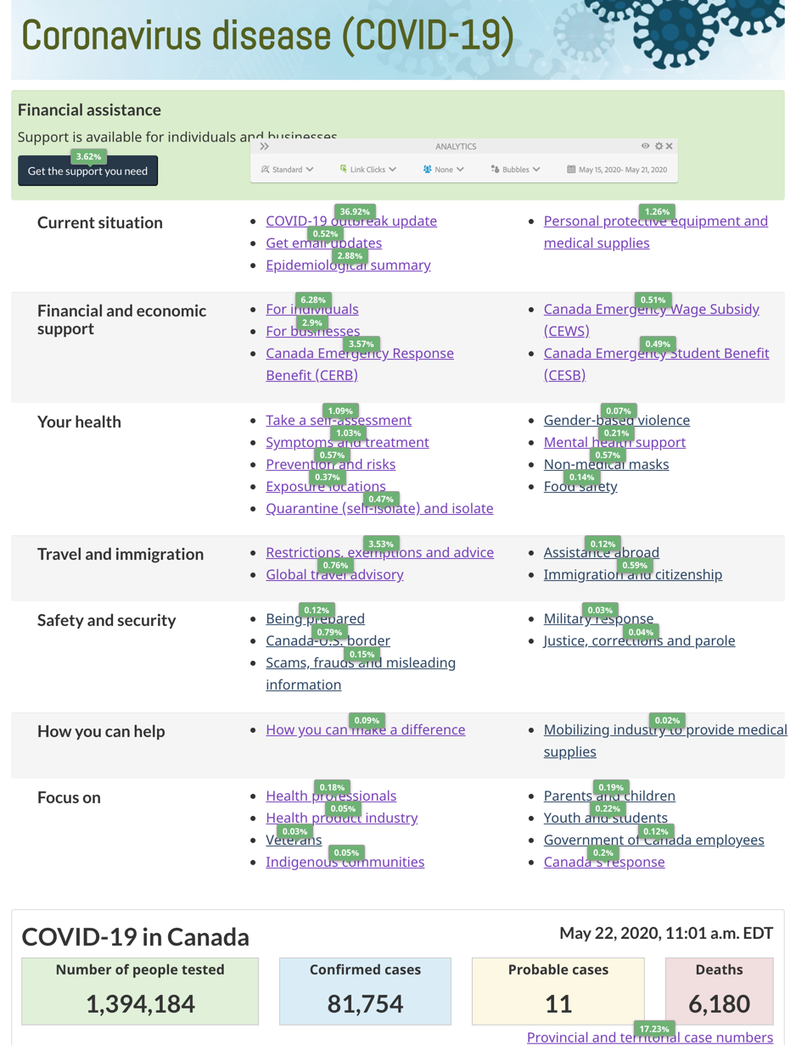
Current site
Canada.ca/coronavirus
Results matched with Canada.ca/coronavirus webpage & click map.
Top tasks / resources identified in study:
Financial support
Outbreak data (confirmed cases, deaths, recoveries)

Slide 12
Next steps
Share results with GC teams, and compare with other data.
Identify missing content for top tasks.
Determine content in policy and planning stages within GC/HC
Prioritize & deprioritize top tasks and ‘tiny tasks’
Create new content and resource categories
Rationalize with existing structure and analytics
Test, develop and launch content as it is available
Keep testing and improving
Canada.ca/coronavirus (COVID-19)
Notes:
Prototype https://test.canada.ca/covid-19-guidance/proto/landing-recovery.html

Slide 13
Annex - Top-task study respondents
Identification
Locations
 | Percent | Count
Individual / family | 86% | 5,498
Job seeker | 4% | 251
Business | 3% | 191
Academic/ researcher/ student | 3% | 172
Health officer / provider | 2% | 130
Government employee | 2% | 107
NGO | 0% | 19
Media | 0% | 16
 | Total | 6384
 | Percent | Count
Alberta | 12% | 762
British Columbia | 15% | 972
Manitoba | 4% | 258
New Brunswick | 3% | 162
Newfoundland & Labrador | 1% | 95
Northwest Territories | 0% | 7
Nova Scotia | 4% | 249
Nunavut | 0% | 3
Ontario | 42% | 2,712
Prince Edward Island | 0% | 32
Quebec | 15% | 991
Saskatchewan | 3% | 185
Yukon | 0% | 13
 | Total | 6,441

Slide 14
Annex - Top-task study respondents
Ages
Use of Canada.ca
 | Percent | Count
17 or younger | 1% | 88
18 – 24 | 6% | 392
25 – 34 | 11% | 722
35 – 44 | 14% | 901
45 – 54 | 21% | 1,334
55 – 64 | 26% | 1,697
65 – 74 | 15% | 996
75 or over | 4% | 237
I'd rather not say | 1% | 70
 | Total | 6,437
 | Percent | Count
Daily | 33% | 2,146
Weekly | 29% | 1,882
Monthly | 7% | 427
Infrequently | 15% | 937
First time | 12% | 781
Never | 4% | 260
 | Total | 6,433

Slide 15
Individuals and families Top votes for 5,498 respondents
 | Tasks | Academic / researcher / student | Business | Gov employee | Individual / family | Job seeker | PHO or health car… | Total
1 | Financial support, benefits for individuals and families (eligibility, availability, training) | 23% | 21% | 15% | 23% | 31% | 15% | 23%
2 | Confirmed cases, deaths, recoveries (daily, total) | 10% | 6% | 12% | 18% | 4% | 18% | 17%
3 | Money issues, personal finances, savings, pensions | 16% | 14% | 16% | 17% | 22% | 9% | 17%
4 | New outbreak, second wave (response, containment) | 9% | 7% | 10% | 16% | 10% | 9% | 15%
5 | Vaccine (development, availability, safety) | 15% | 8% | 10% | 15% | 14% | 8% | 15%
6 | Latest news, latest research (alerts, directives, updates) | 7% | 12% | 18% | 15% | 8% | 14% | 15%
7 | Government strategy (long-term control, lockdown exit, transition, economy reboot) | 10% | 16% | 21% | 14% | 13% | 12% | 14%
8 | Travel restrictions (national, international, borders, quarantine) | 10% | 10% | 8% | 13% | 6% | 9% | 13%
9 | Government of Canada guidelines, standards, decisions | 8% | 22% | 19% | 13% | 10% | 19% | 13%
10 | Infection hotspots, clusters, exposures (near me, identifying, tracking) | 6% | 3% | 6% | 12% | 9% | 5% | 11%
11 | End date, new normal, safe again | 9% | 8% | 11% | 12% | 12% | 8% | 12%
12 | Compare statistics (national, local, tests, cases, recoveries, deaths, demographics) | 12% | 4% | 12% | 12% | 2% | 14% | 11%
13 | Workplaces (preventing spread, rights, reopening criteria, guidance) | 7% | 31% | 18% | 11% | 14% | 12% | 12%
14 | Government guidance, regulations (national, local) | 10% | 18% | 19% | 11% | 8% | 9% | 11%
15 | Immunity, antibody testing (criteria, availability, accuracy) | 5% | 3% | 7% | 9% | 6% | 10% | 9%
16 | Mental health, wellbeing | 6% | 7% | 4% | 9% | 12% | 7% | 9%
17 | Transmission, spread, epidemiology | 8% | 6% | 12% | 9% | 5% | 13% | 9%
18 | Avoiding physical contact (social / physical distancing, self isolation) | 8% | 7% | 9% | 8% | 11% | 6% | 8%
19 | Personal protective equipment (PPE: masks, shields, gowns) | 6% | 20% | 10% | 8% | 5% | 13% | 8%
20 | Number of tests (tests performed, individuals tested) | 5% | 1% | 4% | 7% | 5% | 5% | 7%

Slide 16
Business: Top votes -191 respondents
 | Tasks | Academic / researcher / student | Business | Gov employee | Individual / family | Job seeker | Public health officer or health car… | Total
1 | Financial support for businesses and organizations (eligibility availability, training) | 5% | 34% | 7% | 4% | 6% | 5% | 5%
2 | Workplaces (preventing spread, rights, reopening criteria, guidance) | 7% | 31% | 18% | 11% | 14% | 12% | 12%
3 | Government of Canada guidelines, standards, decisions | 8% | 22% | 19% | 13% | 10% | 19% | 13%
4 | Financial support, benefits for individuals and families (eligibility, availability, training) | 23% | 21% | 15% | 23% | 31% | 15% | 23%
5 | Personal protective equipment (PPE: masks, shields, gowns) | 6% | 20% | 10% | 8% | 5% | 13% | 8%
6 | Government guidance, regulations (national, local) | 10% | 18% | 19% | 11% | 8% | 9% | 11%
7 | Government strategy (long-term control, lockdown exit, transition, economy reboot) | 10% | 16% | 21% | 14% | 13% | 12% | 14%
8 | Cleaning, disinfecting, waste disposal (hands, deliveries, home, workplace) | 5% | 16% | 8% | 7% | 2% | 8% | 7%
9 | Money issues, personal finances, savings, pensions | 16% | 14% | 16% | 17% | 22% | 9% | 17%
10 | Latest news, latest research (alerts, directives, updates) | 7% | 12% | 18% | 15% | 8% | 14% | 15%
11 | Travel restrictions (national, international, borders, quarantine) | 10% | 10% | 8% | 13% | 6% | 9% | 13%
12 | Industry / sector specific advice (airlines, funeral homes, supermarkets) | 2% | 9% | 3% | 2% | 4% | 3% | 2%
13 | Business participation, new products, ideas | 1% | 8% | 2% | 1% | 2% | 2% | 1%
14 | End date, new normal, safe again | 9% | 8% | 11% | 12% | 12% | 8% | 12%
15 | Vaccine (development, availability, safety) | 15% | 8% | 10% | 15% | 14% | 8% | 15%
16 | New outbreak, second wave (response, containment) | 9% | 7% | 10% | 16% | 10% | 9% | 15%
17 | Avoiding physical contact (social / physical distancing, self isolation) | 8% | 7% | 9% | 8% | 11% | 6% | 8%
18 | Mental health, wellbeing | 6% | 7% | 4% | 9% | 12% | 7% | 9%
19 | Transmission, spread, epidemiology | 8% | 6% | 12% | 9% | 5% | 13% | 9%
20 | Symptoms, signs | 4% | 6% | 5% | 7% | 5% | 2% | 6%

Slide 17
Academics,researchers and students Top votes – 172 respondents
 | Tasks | Academic / researcher / student | Business | Gov employee | Individual / family | Job seeker | Public health officer or health car… | Total
1 | Financial support, benefits for individuals and families (eligibility, availability, training) | 23% | 21% | 15% | 23% | 31% | 15% | 23%
2 | Money issues, personal finances, savings, pensions | 16% | 14% | 16% | 17% | 22% | 9% | 17%
3 | Immigration (foreign workers, students) | 15% | 3% | 1% | 2% | 8% | 3% | 3%
4 | Vaccine (development, availability, safety) | 15% | 8% | 10% | 15% | 14% | 8% | 15%
5 | Compare statistics (national, local, tests, cases, recoveries, deaths, demographics) | 12% | 4% | 12% | 12% | 2% | 14% | 11%
6 | Government strategy (long-term control, lockdown exit, transition, economy reboot) | 10% | 16% | 21% | 14% | 13% | 12% | 14%
7 | Travel restrictions (national, international, borders, quarantine) | 10% | 10% | 8% | 13% | 6% | 9% | 13%
8 | Confirmed cases, deaths, recoveries (daily, total) | 10% | 6% | 12% | 18% | 4% | 18% | 17%
9 | Home schooling, remote teaching, learning (tips, how-to, advice) | 10% | 2% | 5% | 4% | 8% | 0% | 4%
10 | Government guidance, regulations (national, local) | 10% | 18% | 19% | 11% | 8% | 9% | 11%
11 | Research papers, studies | 10% | 2% | 3% | 2% | 2% | 5% | 3%
12 | End date, new normal, safe again | 9% | 8% | 11% | 12% | 12% | 8% | 12%
13 | New outbreak, second wave (response, containment) | 9% | 7% | 10% | 16% | 10% | 9% | 15%
14 | Modelling, forecasting, trends (flattening curve, economic impact) | 8% | 5% | 7% | 7% | 4% | 5% | 7%
15 | Government of Canada guidelines, standards, decisions | 8% | 22% | 19% | 13% | 10% | 19% | 13%
16 | Avoiding physical contact (social / physical distancing, self isolation) | 8% | 7% | 9% | 8% | 11% | 6% | 8%
17 | Transmission, spread, epidemiology | 8% | 6% | 12% | 9% | 5% | 13% | 9%
18 | Government of Canada's position, opinion, response to | 8% | 5% | 10% | 6% | 9% | 5% | 6%
19 | Virus survival / viability / persistence on surfaces, in air | 8% | 5% | 4% | 6% | 3% | 7% | 6%
20 | Research ideas, submissions, funding, grants | 8% | 5% | 3% | 2% | 3% | 2% | 2%

Slide 18
Government employees Top votes – 107 respondents
 | Tasks | Academic | Business | Government employee | Individual / family | Job seeker | PHO or health care | Total
1 | Government strategy (long-term control, lockdown exit, transition, economy reboot) | 10% | 16% | 21% | 14% | 13% | 12% | 14%
2 | Government of Canada guidelines, standards, decisions | 8% | 22% | 19% | 13% | 10% | 19% | 13%
3 | Government guidance, regulations (national, local) | 10% | 18% | 19% | 11% | 8% | 9% | 11%
4 | Latest news, latest research (alerts, directives, updates) | 7% | 12% | 18% | 15% | 8% | 14% | 15%
5 | Workplaces (preventing spread, rights, reopening criteria, guidance) | 7% | 31% | 18% | 11% | 14% | 12% | 12%
6 | Money issues, personal finances, savings, pensions | 16% | 14% | 16% | 17% | 22% | 9% | 17%
7 | Financial support, benefits for individuals and families (eligibility, availability, training) | 23% | 21% | 15% | 23% | 31% | 15% | 23%
8 | Confirmed cases, deaths, recoveries (daily, total) | 10% | 6% | 12% | 18% | 4% | 18% | 17%
9 | Compare statistics (national, local, tests, cases, recoveries, deaths, demographics) | 12% | 4% | 12% | 12% | 2% | 14% | 11%
10 | Transmission, spread, epidemiology | 8% | 6% | 12% | 9% | 5% | 13% | 9%
11 | End date, new normal, safe again | 9% | 8% | 11% | 12% | 12% | 8% | 12%
12 | Essential services, key / critical workers | 6% | 6% | 11% | 5% | 6% | 8% | 6%
13 | New outbreak, second wave (response, containment) | 9% | 7% | 10% | 16% | 10% | 9% | 15%
14 | Vaccine (development, availability, safety) | 15% | 8% | 10% | 15% | 14% | 8% | 15%
15 | Personal protective equipment (PPE: masks, shields, gowns) | 6% | 20% | 10% | 8% | 5% | 13% | 8%
16 | Government of Canada's position, opinion, response to | 8% | 5% | 10% | 6% | 9% | 5% | 6%
17 | Avoiding physical contact (social / physical distancing, self isolation) | 8% | 7% | 9% | 8% | 11% | 6% | 8%
18 | Working from home (guidelines, tips, advice) | 3% | 4% | 9% | 2% | 7% | 2% | 3%
19 | Travel restrictions (national, international, borders, quarantine) | 10% | 10% | 8% | 13% | 6% | 9% | 13%
20 | Cleaning, disinfecting, waste disposal (hands, deliveries, home, workplace) | 5% | 16% | 8% | 7% | 2% | 8% | 7%

Slide 19
Public health officers & health care providers: Top votes for 130 people
 | Tasks | Academic / researcher / student | Business | Gov employee | Individual / family | Job seeker | Public health officer or health care prov | Total
1 | Government of Canada guidelines, standards, decisions | 8% | 22% | 19% | 13% | 10% | 19% | 13%
2 | Confirmed cases, deaths, recoveries (daily, total) | 10% | 6% | 12% | 18% | 4% | 18% | 17%
3 | Financial support, benefits for individuals and families (eligibility, availability, training) | 23% | 21% | 15% | 23% | 31% | 15% | 23%
4 | Latest news, latest research (alerts, directives, updates) | 7% | 12% | 18% | 15% | 8% | 14% | 15%
5 | Compare statistics (national, local, tests, cases, recoveries, deaths, demographics) | 12% | 4% | 12% | 12% | 2% | 14% | 11%
6 | Transmission, spread, epidemiology | 8% | 6% | 12% | 9% | 5% | 13% | 9%
7 | Personal protective equipment (PPE: masks, shields, gowns) | 6% | 20% | 10% | 8% | 5% | 13% | 8%
8 | Government strategy (long-term control, lockdown exit, transition, economy reboot) | 10% | 16% | 21% | 14% | 13% | 12% | 14%
9 | Workplaces (preventing spread, rights, reopening criteria, guidance) | 7% | 31% | 18% | 11% | 14% | 12% | 12%
10 | Immunity, antibody testing (criteria, availability, accuracy) | 5% | 3% | 7% | 9% | 6% | 10% | 9%
11 | Virus mutation, new strains | 6% | 3% | 6% | 5% | 5% | 10% | 5%
12 | Money issues, personal finances, savings, pensions | 16% | 14% | 16% | 17% | 22% | 9% | 17%
13 | New outbreak, second wave (response, containment) | 9% | 7% | 10% | 16% | 10% | 9% | 15%
14 | Travel restrictions (national, international, borders, quarantine) | 10% | 10% | 8% | 13% | 6% | 9% | 13%
15 | Government guidance, regulations (national, local) | 10% | 18% | 19% | 11% | 8% | 9% | 11%
16 | Food, medicines, essential products (stocks, hoarding, availability, disruptions) | 6% | 3% | 5% | 6% | 9% | 9% | 6%
17 | Infectiousness (when most infectious, super spreader, symptom-free but infectious) | 4% | 2% | 4% | 5% | 6% | 9% | 5%
18 | Vaccine (development, availability, safety) | 15% | 8% | 10% | 15% | 14% | 8% | 15%
19 | End date, new normal, safe again | 9% | 8% | 11% | 12% | 12% | 8% | 12%
20 | Essential services, key / critical workers | 6% | 6% | 11% | 5% | 6% | 8% | 6%

